Slide 1
Piloting an International Clinical and Public Health Training Site in Ecuador: Initial Steps and Lessons Learned
Peter Baum, DO – PGY3
October 6, 2017
AAFP Global Health Workshop
Scripps Mercy Hospital Chula Vista
Family Medicine Residency Program

Slide 2
AN INTERNATIONAL PUBLIC HEALTH AND CLINICAL TRAINING PROGRAM IN AFFILIATION WITH:
Fundación CIMAS
University of California San Diego (UCSD) – School of Medicine, Division of Global Health
Scripps Mercy Hospital Graduate Medical Education
Ecuadorian Ministry of Public Health

Slide 3
AKNOWLEDGEMENTS:
Dr. Marianne McKennett, MD
Program Director, Scripps Mercy Hospital Chula Vista Family Medicine Residency
Clinical Professor, UC San Diego School of Medicine, Department of Family Medicine and Public Health
Dr. Regina Wang, MD
Assistant Professor of Family Medicine and Public Health, UC San Diego School of Medicine.
Dr. Jose Ricardo Suárez, MD, PhD
Assistant Professor, UC San Diego School of Medicine - Division of Global Health, Department of Family Medicine and Public Health
Dr. Akbar Rahman, MD, MPH
Assistant Clinical Professor,
UC San Diego School of Medicine

Slide 5
WORKSHOP OBJECTIVES:
Highlight the importance of providing international clinical and public health training opportunities in medical education.
Share initial steps and lessons learned in planning and piloting an international clinical and public health training initiative.
Describe the development of strategic long-term partnerships between medical institutions, governmental, and non-governmental organizations.
Discuss the development and pilot testing of a clinical rotation curriculum in the context of Ecuadorian society and health systems.
Share experiences in support of public health and clinical work being done in a local Ecuadorian community.

Slide 6
Growing Interest in Global Health & Medicine
According to recent studies, 25-33% of medical students participate in international global health experiences.
“International rotations broaden a resident’s medical knowledge, reinforce physical examination skills, and encourage practicing medicine among underserved and multicultural populations.”
“The newly trained global-health-competent physicians will not only have improved clinical skills and knowledge but also will be better equipped to serve the populations of our country and, indeed, of the world.”
(Acad Med. 2009; 84:320–325.)

Slide 7
Growing Interest in Global Health & Medicine
1998: ~45% of family medicine (FM) residencies offered international rotations.
2016: ~75% of FM residencies offer international and/or domestic global health (GH) experiences.
50% of FM residency applicants inquire about GH opportunities.
33% of residents who made the decision to join programs were influenced by available GH opportunities.
(Fam Med 2016;48(7):532-7.)

Slide 8
Percent of Family Medicine Residency Programs Reporting Participation in at least One GH Activity
Percentage of Residents Participating
(Fam Med 2016;48(7):532-7.)

Slide 9
Percent of Family Medicine Residency Programs Reporting Primary Barriers to GH Activity
Primary Barriers to GH Activity
(Fam Med 2016;48(7):532-7.)

Slide 10
PRE-ROTATION PLANNING:
Connection with Fundación CIMAS via UCSD-SOM, Global Health Division Professor – Dr. Jose Ricardo Suarez.
Team of residency & medical school faculty conducted site visits ~1 year prior to initial pilot rotation.
Ecuadorian Ministry of Public Health Clinics & Hospitals in three rural communities.
Two small inpatient hospitals
Outpatient clinic with basic emergency medical services, labor & delivery ward

Slide 11
PRE-ROTATION PLANNING:
Panel at the Ministry of Public Health:
Public Health representatives
President of Universidad Central del Ecuador
Dean of Local Medical School
Community leaders of Pedro Moncayo County
Representatives of UNICEF, FAO

Slide 12
PILOT ROTATION: TABACUNDO

Slide 13
“Health is born where people live, work, love, and have fun.”
Laguna Mojanda – 45 mins from Tabacundo

Slide 14
HOMESTAY
Cecilia Mantilla and German Castro = lawyers
Provide legal services to locals, many indigenous, most w/ very limited resources
Cecillia = previous mayor of Tabacundo (~2004-2008)
Now community organizer and president of the “Mancomunidad”
“La Mancomunidad” is a group of local governments (juntas parroquiales) that collaborate together to achieve common goals for those they serve.
Cecilia is closely affiliated with Fundación CIMAS

Slide 15
Clinical Rotation: Centro de Salud Tabacundo – Tipo C
My Rotation Format (can be customized to resident interests):
Week 1: Orientation 2-3 days in Quito
Week 2: Family Medicine Outpatient
Week 3: ½ Family Medicine + ½ OB/GYN
Week 4: OB/GYN
Every Friday: CECUIDAS (Centro del Cuidado del Adulto Mayor)
Screenings: Vitals, BP, BMI, HTN, Glucose, Depression, Smoking, Physical
Weekends: family and travel time

Slide 16
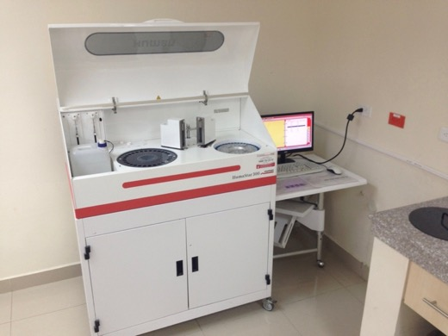
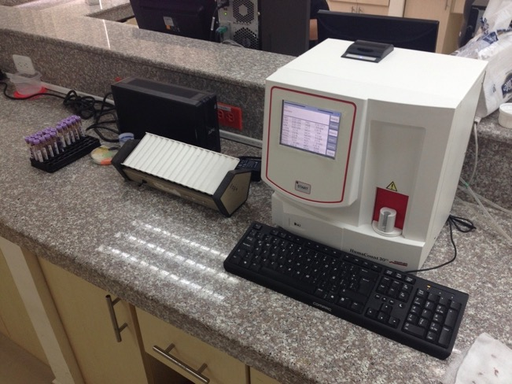
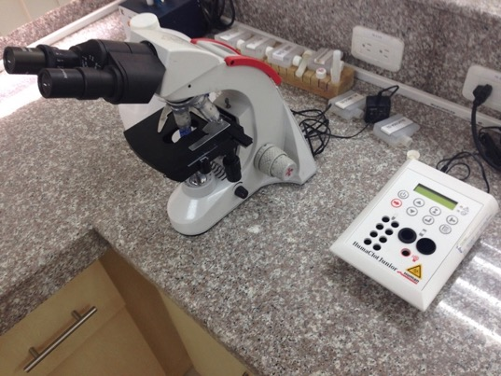

Slide 17
LABS AND IMAGING:
CBC
Na+, K+, BUN, Cr
Basic Lipid Panel (T. Chol, LDL)
Stool Ova & Parasites
LFTs
X-Ray (no radiologist = you read it!)
OB Ultrasound
SEND OFF LABS: ALL OTHERS

Slide 18
COMMON PRESENTATIONS
Well Child Visits
HTN
DM2
Diarrhea / Malnutrition
URI
CAP
Joint / Back Pain

Slide 19
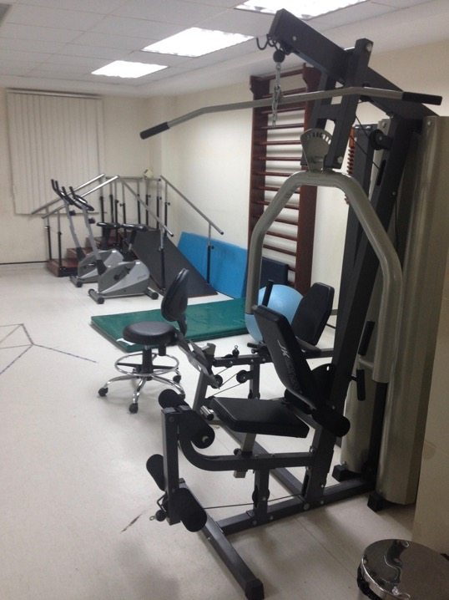
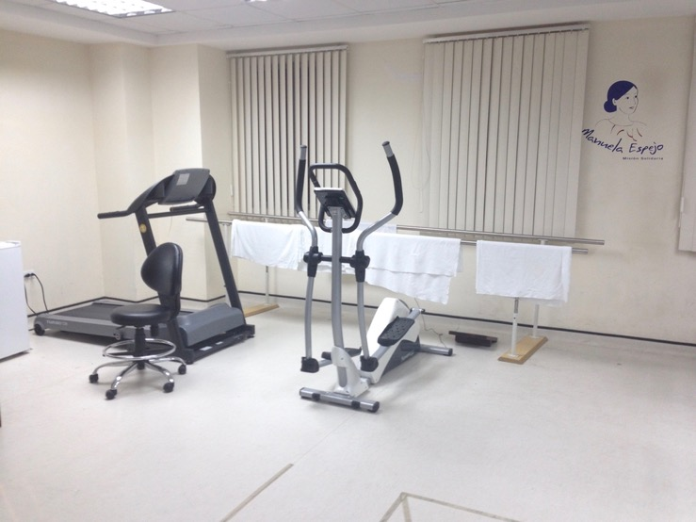
PHYSICAL THERAPY

Slide 20
OB/GYN Opportunities

Slide 21
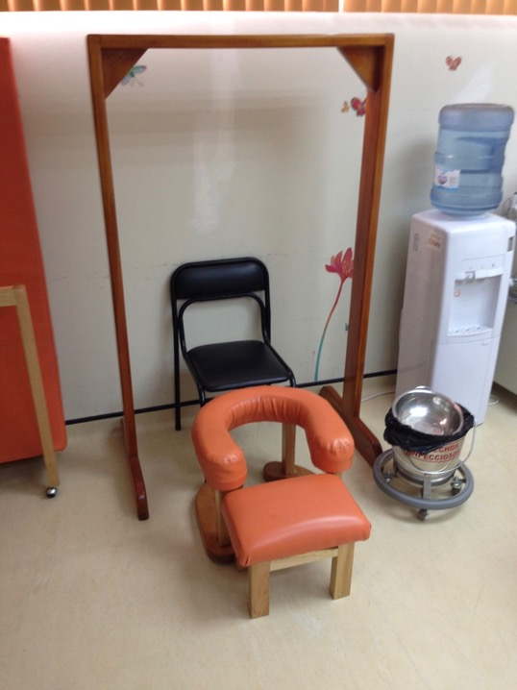

Slide 22
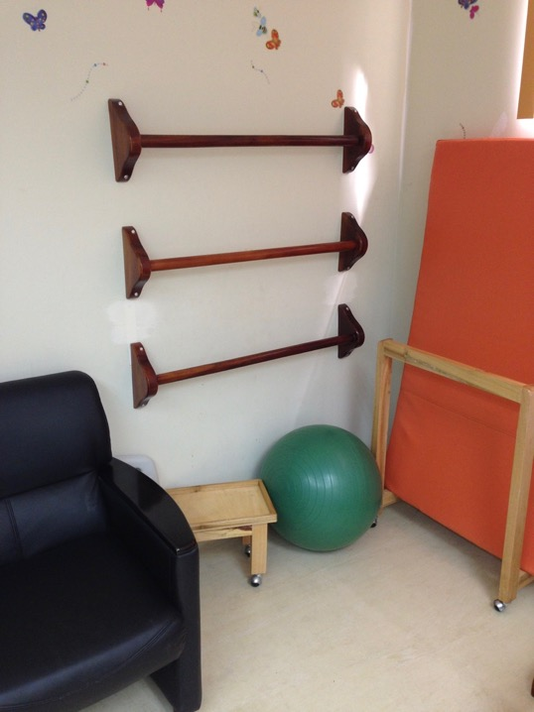
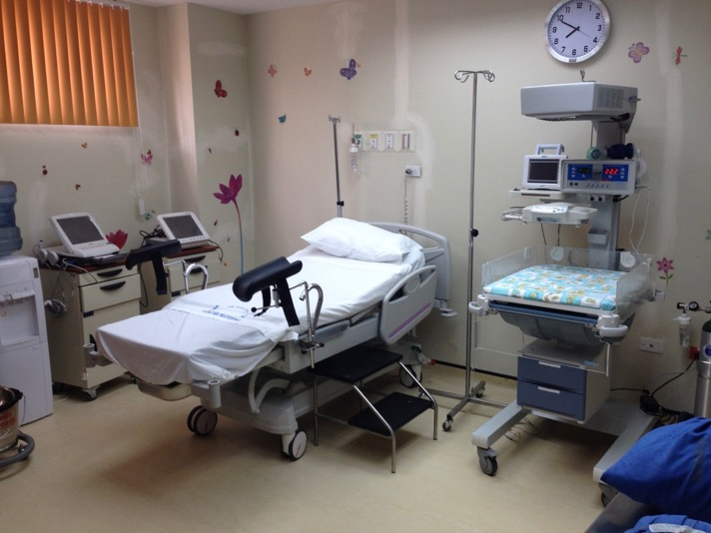

Slide 23
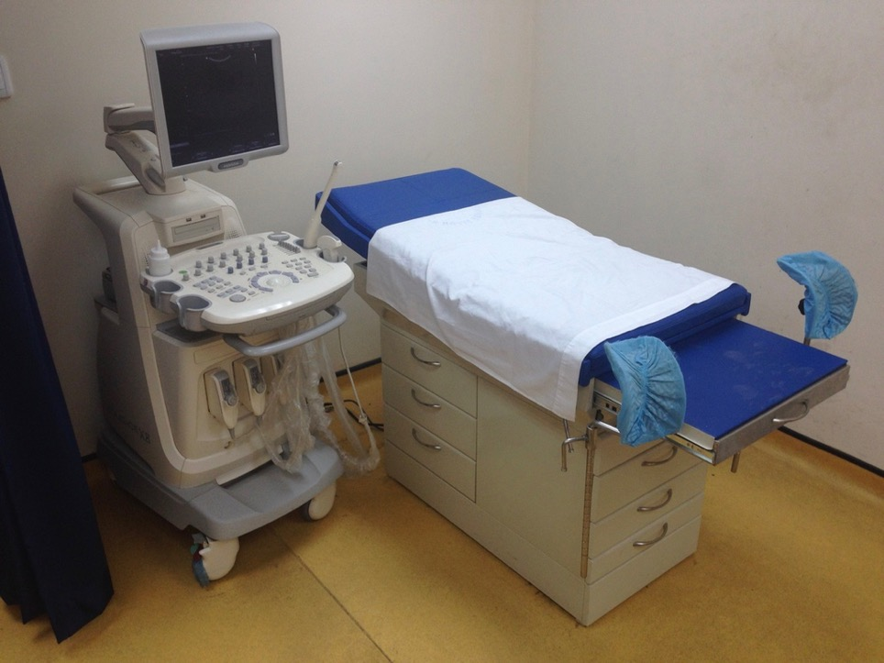

Slide 24
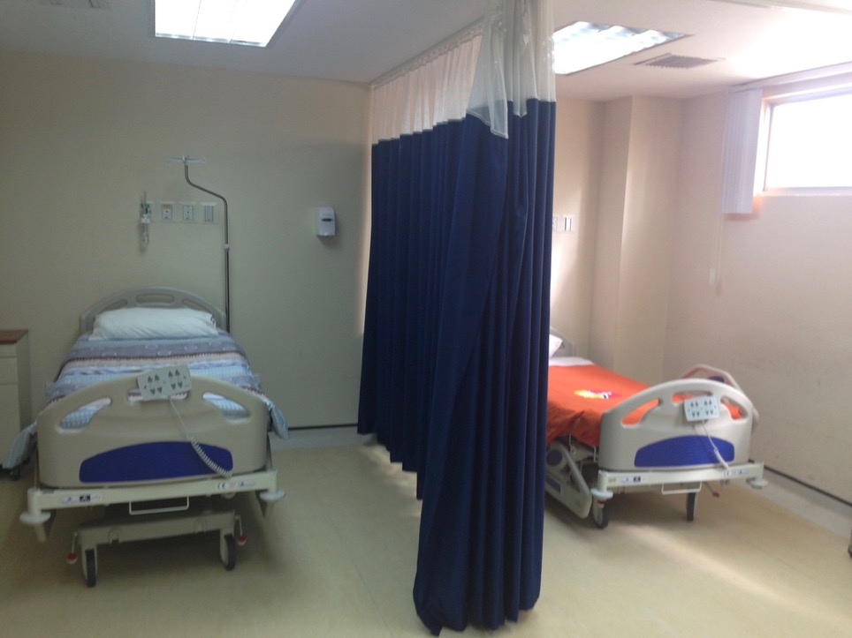

Slide 25
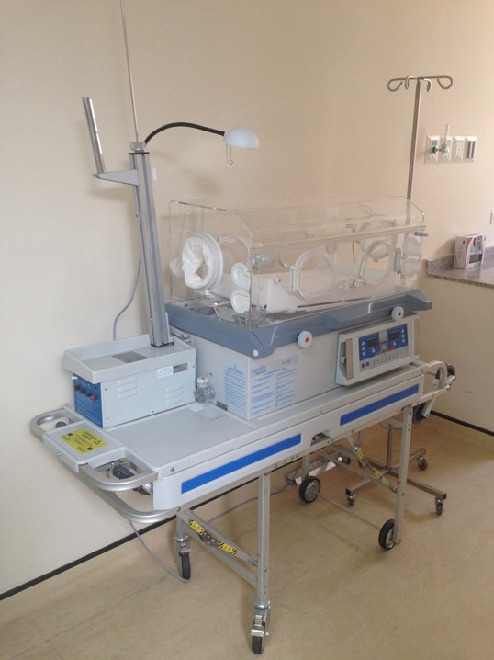

Slide 26
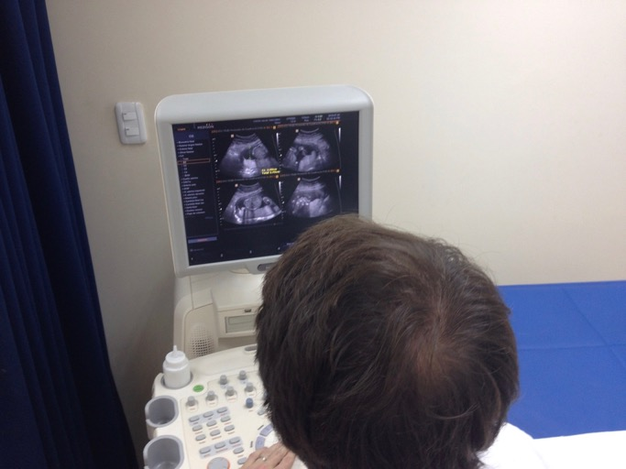
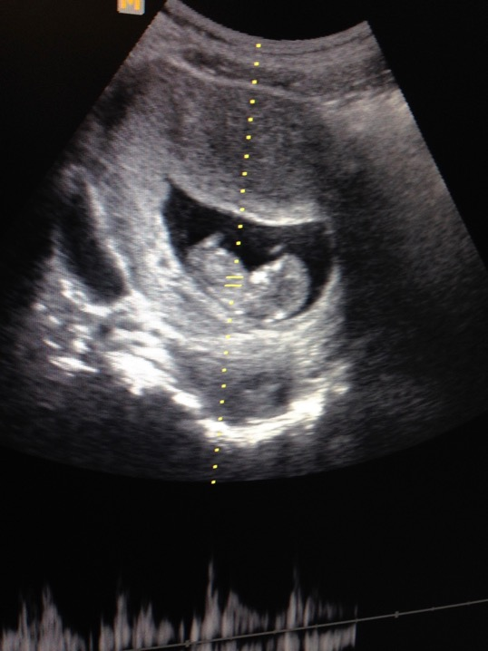
OB/GYN Ultrasounds: 10-20 per day

Slide 27
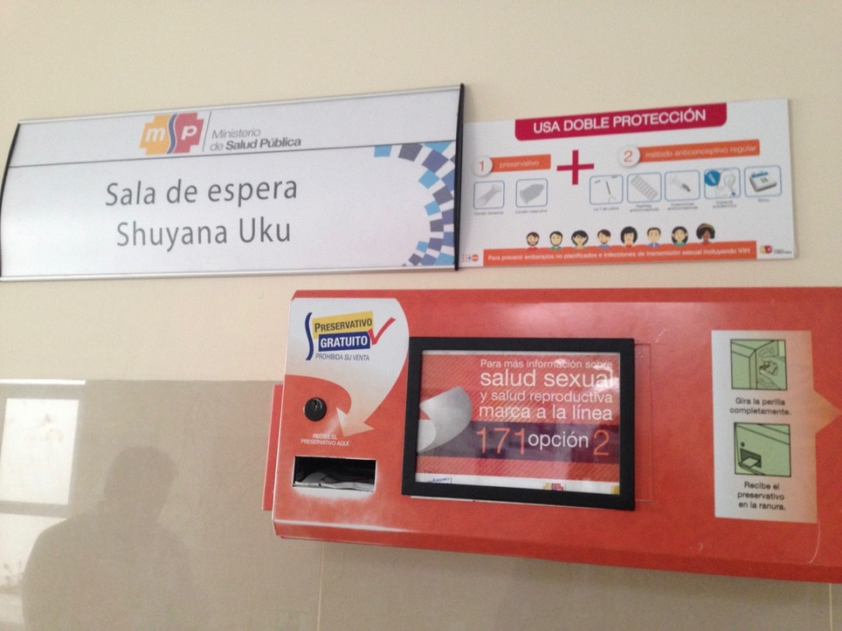

Slide 28
Psicoprofilaxis del Parto “Labor Psycho-prophylaxis”
Group Pregnancy Educational Visits
Similar to CenteringPregnancy® educational curriculum, w/o physical exam
Run by Nurse Mid-Wife

Slide 29
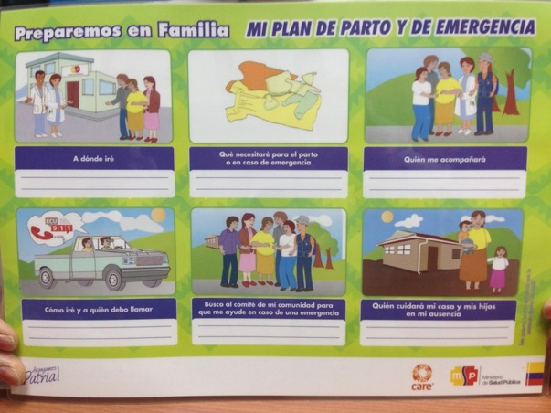
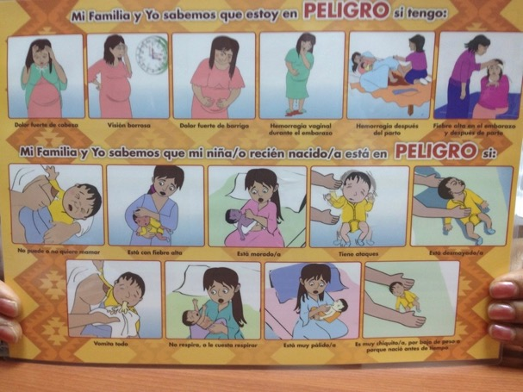

Slide 30
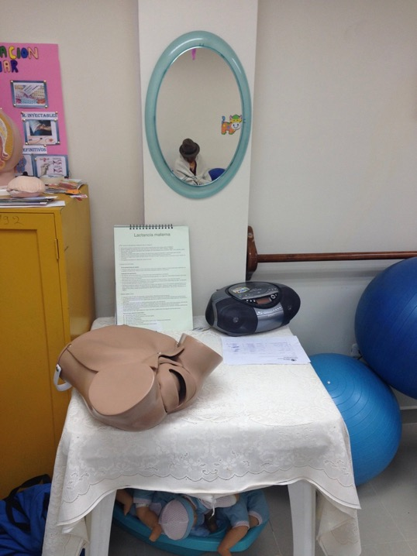

Slide 31
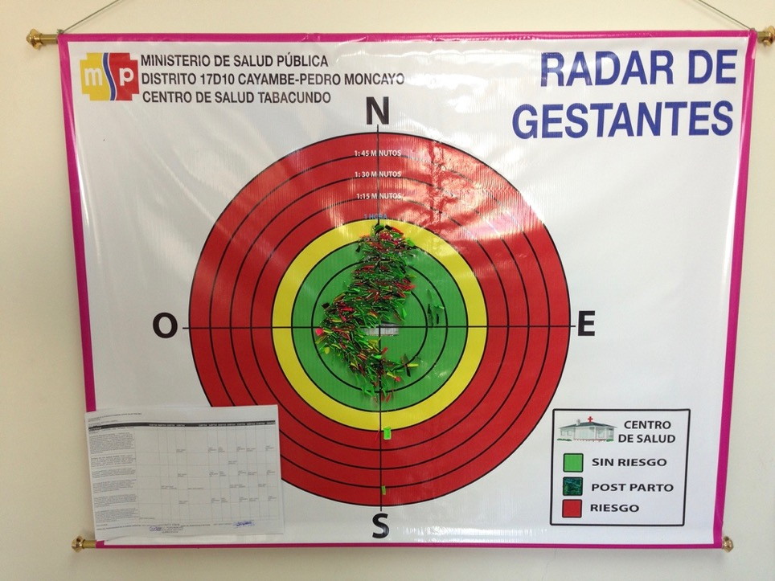

Slide 32
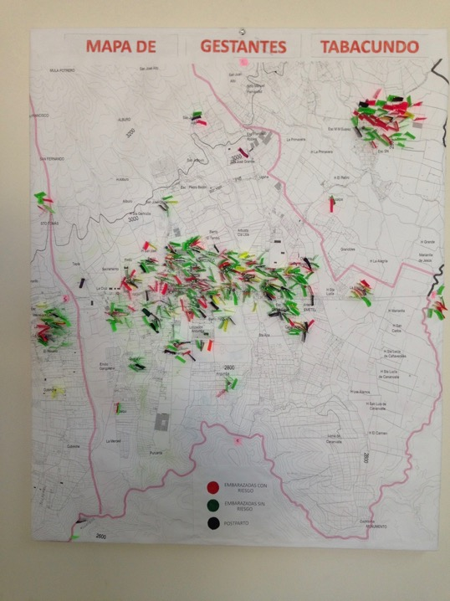

Slide 33
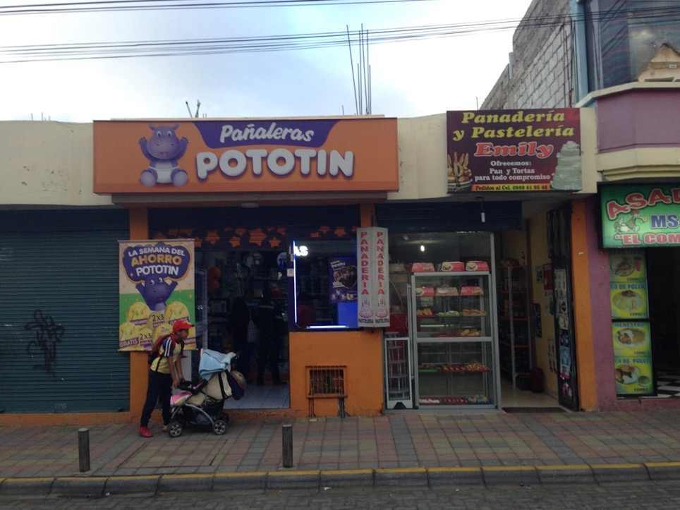
Lucrative
Diaper Store
A sign of opportunity for family planning activities

Slide 34
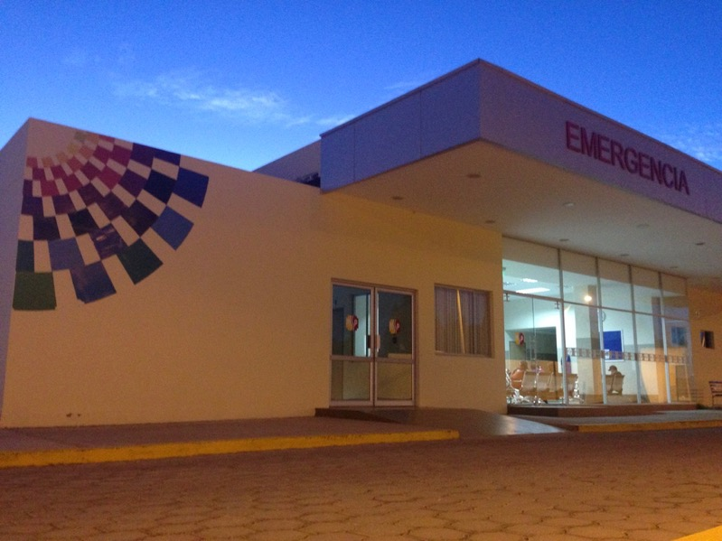
Basic Emergency
&
Urgent Care

Slide 35
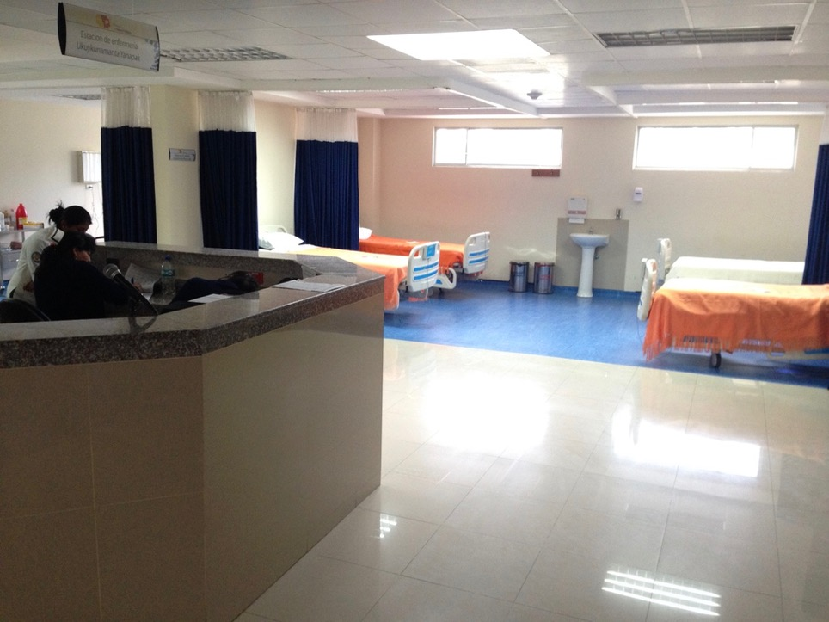

Slide 36
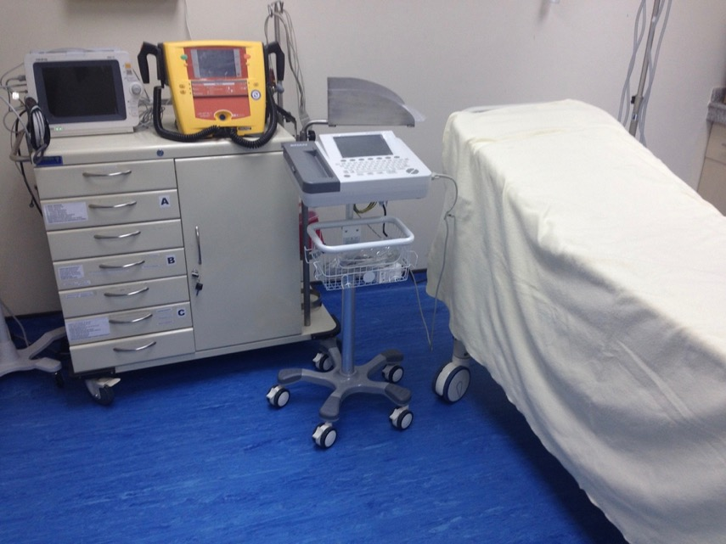

Slide 37
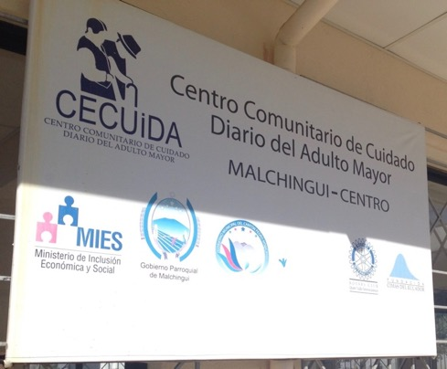
CECUIDA: Centro Comunitario de Cuidado Diario del Adulto Mayor
Adult day health centers in rural townships within 45 mins of Tabacundo
Elderly Adult Daily Care Centers (CECUIDA) = community space where comprehensive care focuses on:
Periodic health maintenance visits
Nutrition: daily hot meal
Socialization
Physical and Occupational Therapy
Art Therapy

Slide 38
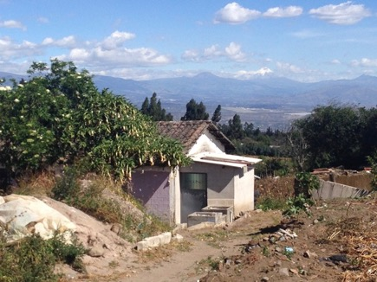
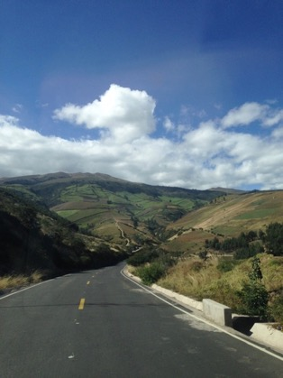
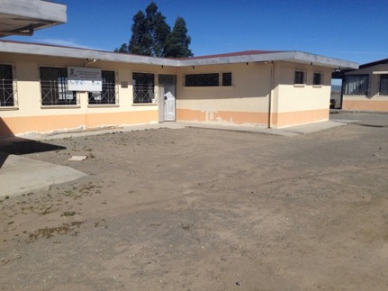
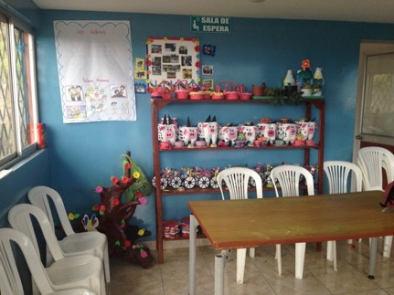

Slide 39
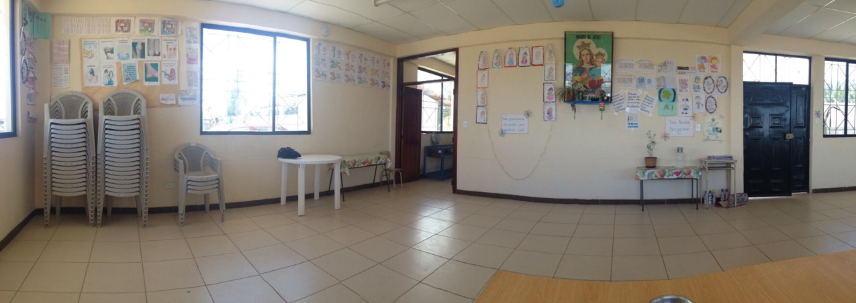

Slide 40
STRENGTHS | WEAKNESSES
Modern healthcare facility w/ ultrasound & x-rays Vaccines, basic lab, pharmacy stocked w/ common meds Some clinicians evidence-based: OB/GYN, PEDS, FM CECUIDAS – Adult Day Health Centers Patient volume, common conditions | Occasional shortages of medications Dwindling government funding (low oil prices) Some clinicians not-so-evidence-based Lack of some lab capabilities on-site Paper charts Clinicians w/ limited access to evidence-based resources Lack of autonomy
OPPORTUNITIES | CHALLENGES
Psicofrofilaxis del Parto ~ akin to CenteringPregnancy® Sex education and Family Planning classes Bridging care at CECUIDAS w/ MSP more formally Linking in w/ UCSD local research project ESPINA Community home health visits (motorcycle = limiting factor) Hospital rotation (Cayambe or Otavalo) Implementing weekly EBM lecture series Further development of orientation lecture series MSK clinic? | Dwindling Ecuadorian government funding Clinician staffing may change every few years (Cuban physicians sign 2-3 year contracts) Malpractice insurance need?

Slide 41
LESSONS LEARNED:
Level of orientation needed will vary depending on resident baseline host country & cultural knowledge.
Weekly EBM series was & could easily be implemented on site.
Changes in ministry leadership could jeopardize potential future collaboration & participation at site.
Resident autonomy could be promoted w/ continued longitudinal resident participation & establishment of longitudinal on-site faculty.
Avenues for reciprocal training of Ecuadorian health professionals at our local U.S. institutions could be explored.

Slide 42
FUTURE DIRECTIONS:
Consideration of development of Global Health Track or Global Health Area of Concentration:
↑ longitudinal participation at Tabacundo site
Further resident involvement in community oriented primary care projects & existing public health educational initiatives.
Eg. Maternal/Child Health, Adolescent Med
Development of more formalized resident GH curriculum: online modules / relevant readings.

Slide 43
FUTURE DIRECTIONS:
Further collaboration w/ Fundación CIMAS on public health research and initiatives.
Eg. Clinician involvement in ESPINA and future public health research.
Bridging CECUIDAs care with referrals to Ministry of Public Health sites more formally.

Slide 44
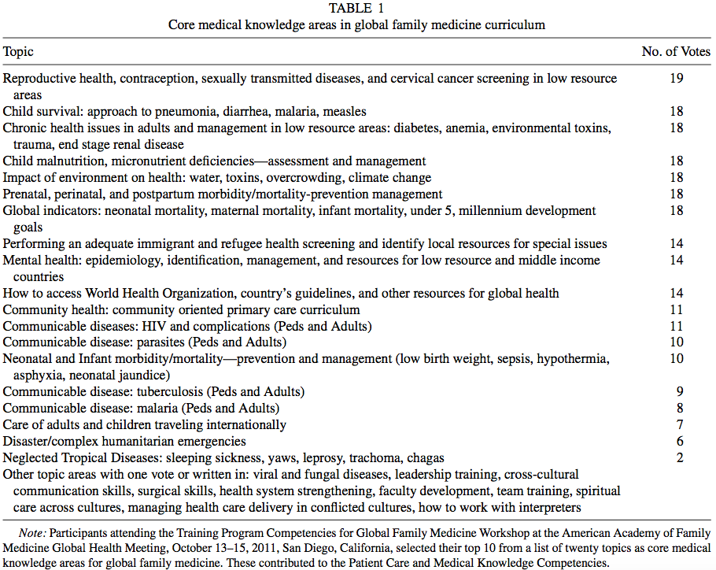
(Teach Learn Med. 2014;26(2):174-83)

Slide 45
CURRICULAR RESOURCES:
http://www.aafp.org/patient-care/global-health/fellowships.html
http://www.cugh.org/resources/educational-modules
http://www.uniteforsight.org/global-health-course/module1
http://globalhealth.northwestern.edu/education/online-curriculum/index.html

Slide 46
GROUP ACTIVITY: 20-30 MINS
Using the provided worksheet:
Please brainstorm and write down how you and your colleagues would plan to implement a new international rotation site in your residency/medical school.
OR
Plan to strengthen upon an existing international rotation site.
Notes:
WORKSHEET TO BE DEVELOPED

Slide 47
REFERENCES:
American Academy of Family Physicians: Fellowships and Courses in Global Health. Available at: http://www.aafp.org/patient-care/global-health/fellowships.html. Accessed August 14, 2017.
Anandaraja N; Hahn S; Hennig N; Murphy R; Ripp J. The design and implementation of a multidisciplinary global health residency track at the Mount Sinai School of Medicine. Academic Medicine. 2008;83(10):924-8.
Arora G; Ripp J; Evert J; Rabin T; Tupesis JP; Hudspeth J. Taking it Global: Structuring Global Health Education in Residency Training. Journal of General Internal Medicine. 2017;32(5):559-562.
Asgary R; Smith CL; Sckell B; Paccione G. Teaching immigrant and refugee health to residents: domestic global health. Teaching & Learning in Medicine. 2013;25(3):258-65, 2013.
Consortium of Universities for Global Health. Available at: http://www.cugh.org/resources/educational-modules. Accessed August 14, 2017.
Coupet S, Del Valle J (2013) A case for an international health elective training program during residency: a four-points call for action. Teach Learn Med 25: 266-271.
Drain PK, Holmes KK, Skeff KM, Hall TL, Gardner P. Global Health Training and International Clinical Rotations during Residency: Current Status, Needs, and Opportunities. Academic medicine : Journal of the Association of American Medical Colleges. 2009;84(3):320-325. doi:10.1097/ACM.0b013e3181970a37.
Grissom MO; Iroku-Malize T; Peila R; Perez M; Philippe N. Mapping Residency Global Health Experiences to the ACGME Family Medicine Milestones. Family Medicine. 2017;49(7):553-557.
Hau DK; Smart LR; DiPace JI; Peck RN. Global health training among U.S. residency specialties: a systematic literature review. Medical Education Online. 2017;22(1):1270020.

Slide 48
REFERENCES:
Hernandez R, Martir JFS, Durme DJV, Faller J, Yong-Yow S, MSEd MKD, Achkar MA. Global Health in Family Medicine Residency Programs: A Nationwide Survey of US Residency Directors: A CERA Study. Fam Med 2016;48(7):532-537.
Loignon C, Gottin T, Valois C, Couturier F, Williams R, Roy PM. Reflective practice and social responsibility in family medicine. Canadian Family Physician. Nov 2016, 62 (11) e699-e704.
Melby MK; Loh LC; Evert J; Prater C; Lin H; Khan OA. Beyond Medical "Missions" to Impact-Driven Short-Term Experiences in Global Health (STEGHs): Ethical Principles to Optimize Community Benefit and Learner Experience. Academic Medicine. 2016;91(5):633-8.
Northwestern Medicine, Feinberg School of Medicine: Center for Global Health, Global Health Online Curriculum. Available at: http://globalhealth.northwestern.edu/education/online-curriculum/index.html. Accessed August 14, 2017
Porter M; Mims L; Garven C; Gavin J; Carek P; Diaz V. International Health Experiences in Family Medicine Residency Training. Family Medicine. 2016;48(2):114-20.
Puvvula J; Granados G. Developing an international health area of concentration in a family medicine residency. Family Medicine. 2007;39(9):666-70.
Schultz SH; Rousseau S. International health training in family practice residency programs. Family Medicine. 30(1):29-33, 1998 Jan.
Uejima, T. Medical missions and medical malpractice: the current state of medical malpractice overseas. American Society of Anesthesiologists. 2011;75(2): 22-24.
Unite for Site, GHU/Innovate Free Webinars. Available at: http://www.uniteforsight.org/webinars. Accessed August 14 2017.
University of Minnesota/Centers for Disease Control On-line Global Health Course. Available at: http://www.globalhealth.umn.edu/online trainingglobalhealth/index.html. Accessed August 14, 2017
Zink T, Solberg E. Development of a Global Health Curriculum for Family Medicine Based on ACGME Competencies. Teaching and Learning in Medicine. 2014, 26:2, 174-183, DOI: 10.1080/10401334.2014.883987.

Slide 49
QUESTIONS? THANK YOU!
Peter Baum, DO – PGY3
Scripps Chula Vista Family Medicine Residency
Chula Vista, CA
baum.peter@scrippshealth.org
peter.m.baum@gmail.com

