Slide 1
The Family Physician as Global Health Clinical Trialist: Challenges and Rewards
Steve Manock, MD, MS
Director, Global Health
John Peter Smith Family Medicine Residency Program
Consulting Research Physician
Sanaria, Inc.

Slide 2
Objectives
Consider how involvement in clinical trials can make a valuable contribution to improving global health.
Understand some of the challenges of conducting clinical trials in the developing world.
Examine the potential rewards of doing clinical research in global health.

Slide 3
How can family physicians have a positive impact on global health?
Direct patient care: mission organizations and other NGOs

Slide 4
How can family physicians have a positive impact on global health?
Direct patient care: mission organizations and other NGOs
Teaching health care providers in developing countries

Slide 5
How can family physicians have a positive impact on global health?
Direct patient care: mission organizations and other NGOs
Teaching health care providers in developing countries
Promoting family medicine overseas

Slide 6
How can family physicians have a positive impact on global health?
Direct patient care: mission organizations and other NGOs
Teaching health care providers in developing countries
Promoting family medicine overseas
Public health

Slide 7
How can family physicians have a positive impact on global health?
Direct patient care: mission organizations and other NGOs
Teaching health care providers in developing countries
Promoting family medicine overseas
Public health
Teaching residents/students in the U.S. who will serve overseas

Slide 8
How can family physicians have a positive impact on global health?
Direct patient care: mission organizations and other NGOs
Teaching health care providers in developing countries
Promoting family medicine overseas
Public health
Teaching residents/students in the U.S. who will serve overseas
Research

Slide 9
Types of Global Health Research
Published case reports/series

Slide 10
Types of Global Health Research
Published case reports/series
Prevalence studies

Slide 11
Types of Global Health Research
Published case reports/series
Prevalence studies
Active epidemiologic surveillance

Slide 12
Types of Global Health Research
Published case reports/series
Prevalence studies
Active epidemiologic surveillance
Health systems research

Slide 13
Types of Global Health Research
Published case reports/series
Prevalence studies
Epidemiologic surveillance
Health systems research
Clinical trials

Slide 14
Clinical Trial
Highly structured and regulated research study designed to assess the safety and effectiveness of an experimental treatment or device

Slide 15
Helpful Professional Attributes of a Global Health Clinical Trialist
Breadth and depth of clinical expertise

Slide 16
Helpful Professional Attributes of a Global Health Clinical Trialist
Breadth and depth of clinical expertise
Extended experience in health care in the developing world

Slide 17
Helpful Professional Attributes of a Global Health Clinical Trialist
Breadth and depth of clinical expertise
Extended experience in health care in the developing world
Cultural literacy/aptitude

Slide 18
Helpful Professional Attributes of a Global Health Clinical Trialist
Breadth and depth of clinical expertise
Extended experience in health care in the developing world
Cultural literacy/aptitude
Language abilities

Slide 19
Helpful Professional Attributes of a Global Health Clinical Trialist
Breadth and depth of clinical expertise
Extended experience in health care in the developing world
Cultural literacy/aptitude
Language abilities
Research experience

Slide 20
Helpful Professional Attributes of a Global Health Clinical Trialist
Breadth and depth of clinical expertise
Extended experience in health care in the developing world
Cultural literacy/aptitude
Language abilities
Research experience
Teaching ability

Slide 21
Helpful Professional Attributes of a Global Health Clinical Trialist
Breadth and depth of clinical expertise
Extended experience in health care in the developing world
Cultural literacy/aptitude
Language abilities
Research experience
Teaching ability
Organizational skills

Slide 22
Helpful Professional Attributes of a Global Health Clinical Trialist
Breadth and depth of clinical expertise
Extended experience in health care in the developing world
Cultural literacy/aptitude
Language abilities
Research experience
Teaching ability
Organizational skills
Desire to have an impact beyond direct patient care

Slide 23
Clinical Trial Alphabet Soup
PI
IP
IB
IRB
MRO
CRO
SOP
ICF
CRF
AE
SAE

Slide 24
Clinical Trial Alphabet Soup
PI: Principal Investigator
IP: Investigational Product
IB: Investigator’s Brochure
IRB: Institutional Review Board
MRO: Medical Research Organization
CRO: Contract/Clinical Research Organization
SOP: Standard Operating Procedure
ICF: Informed Consent Form
CRF: Clinical Report Form
AE: Adverse Event
SAE: Serious Adverse Event

Slide 25
Other Helpful Terms
Sponsor
Funder
Protocol
Deviation
Monitor
Query
Clinical Hold

Slide 26
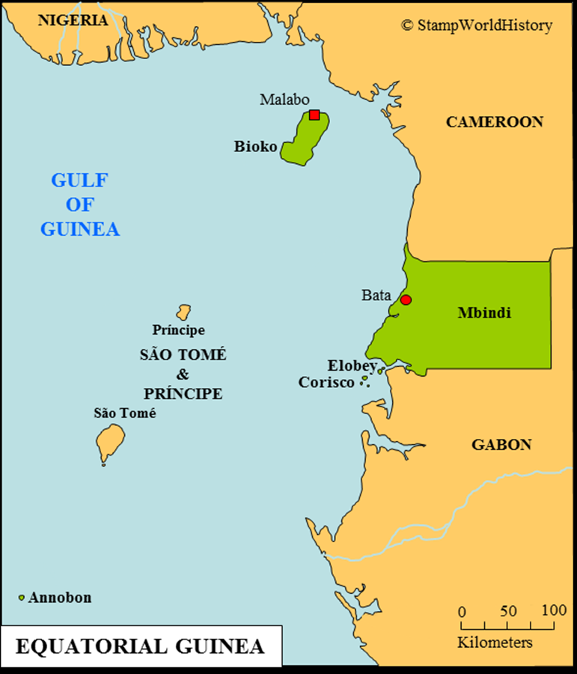
Equatorial Guinea
Former Spanish colony on the west coast of Central Africa
Population: 909,000 (190,000 on Bioko Island)
Major oil revenues since the mid-1990s
Highest per capita income of any African nation (USD 38,000/yr) – ineligible for foreign aid
Stark socioeconomic disparities

Slide 27
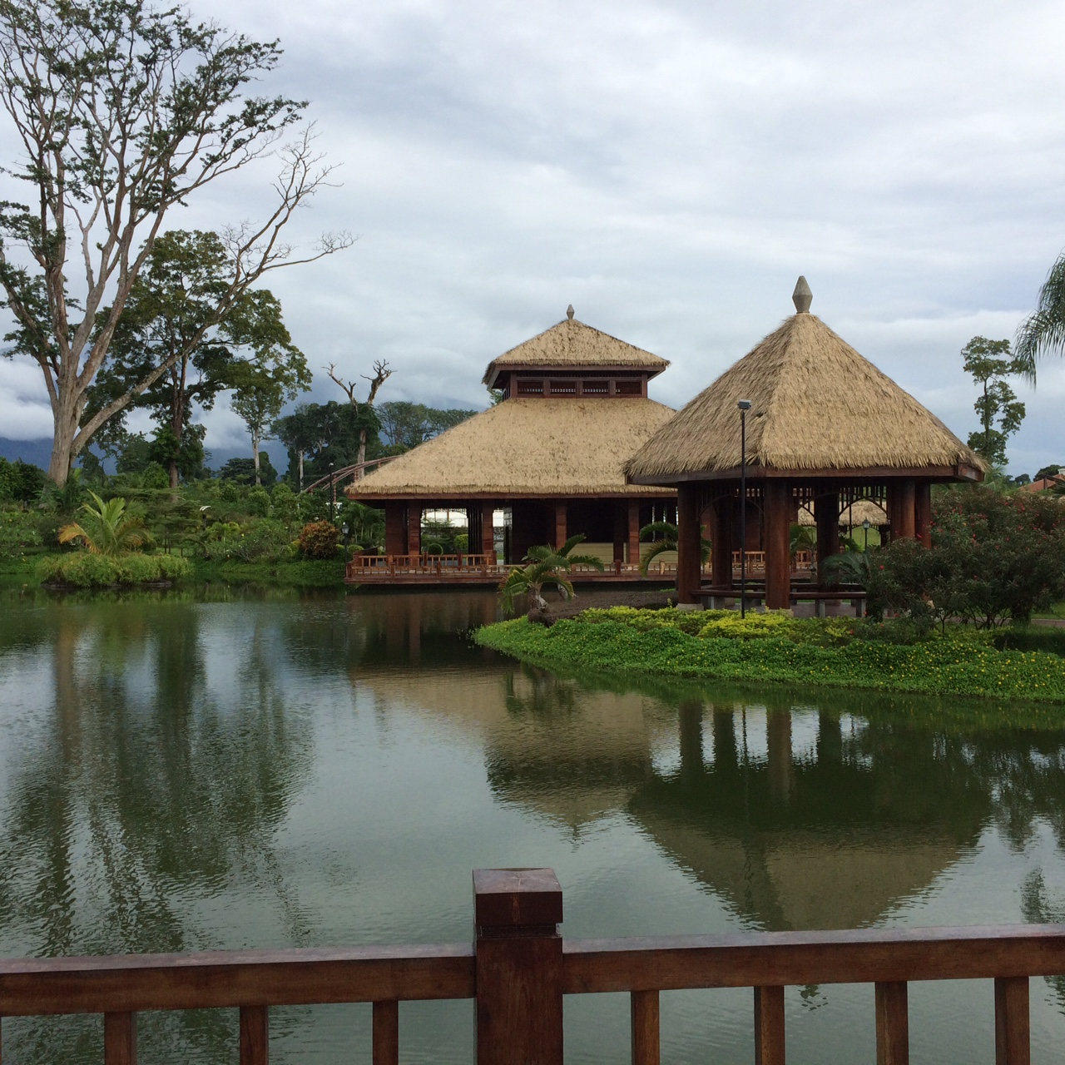
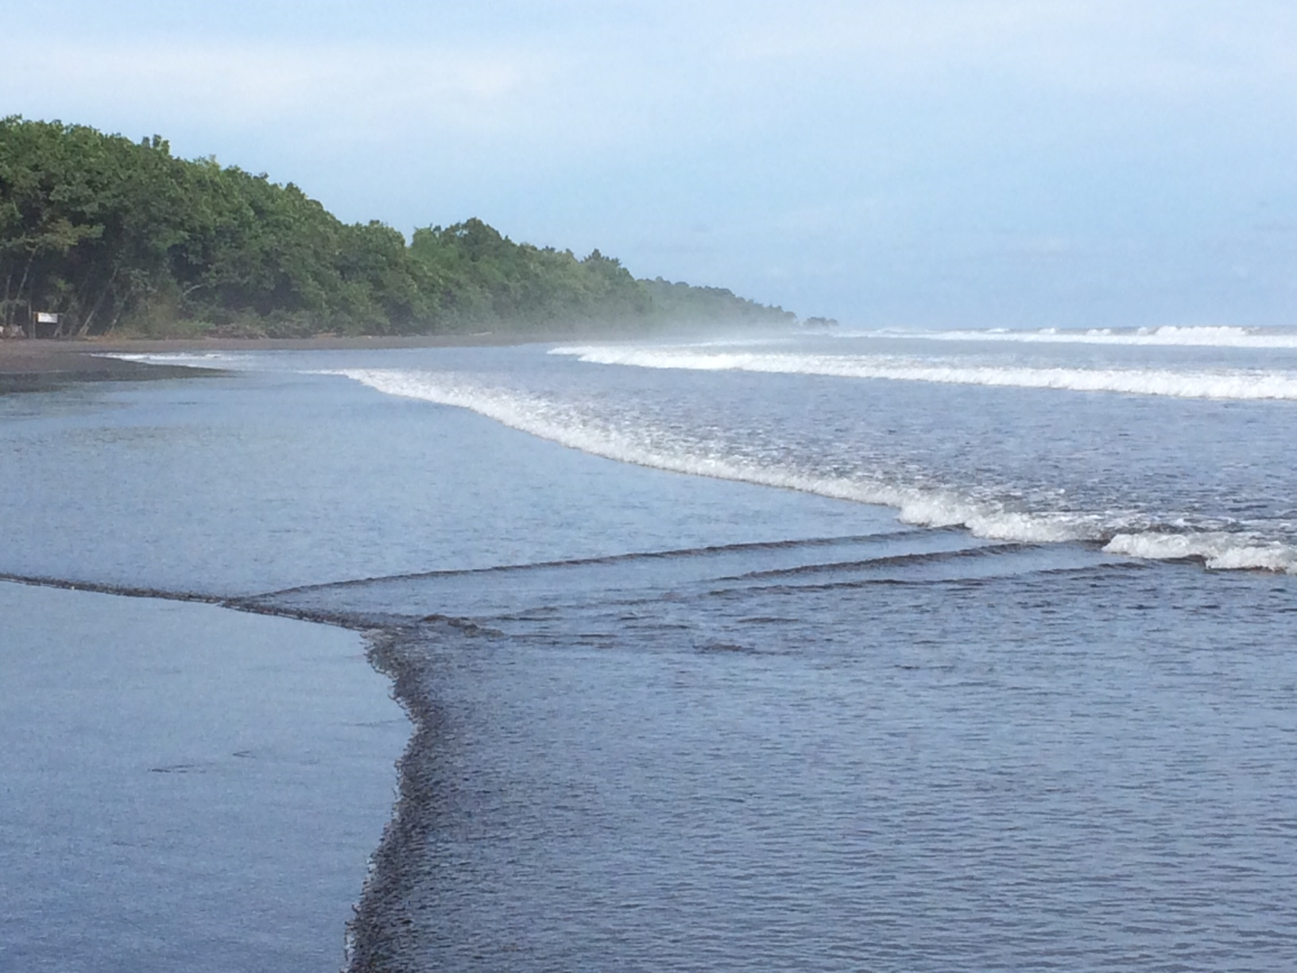
Equatorial Guinea
Tropical island with beautiful areas

Slide 28
Clinical Research in Equatorial Guinea
Variety of epidemiologic surveillance studies done by a Spanish NGO in recent decades – some local capacity building
First phase I (safety) trial of vaccine in 2015 – 33 young men, new international team
Phase II (safety/efficacy) trial in late 2016-early 2018: 135 subjects age 6 mos to 65 years, compared two different vaccines
Controlled human infection

Slide 29
Challenges
Politics
IRBs
Funder
MRO staff
Complex trial
Local personnel
Communication
Logistics
Research center
Healthcare infrastructure
Transition from patient care
Living conditions
Family issues

Slide 30
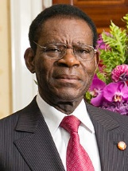
Challenges: Politics
President Obiang came to power in a coup in 1979
Political culture of infighting, one-upmanship, distrust and fear
Direct impact on relationships with local IRB and Ministry of Health

Slide 31
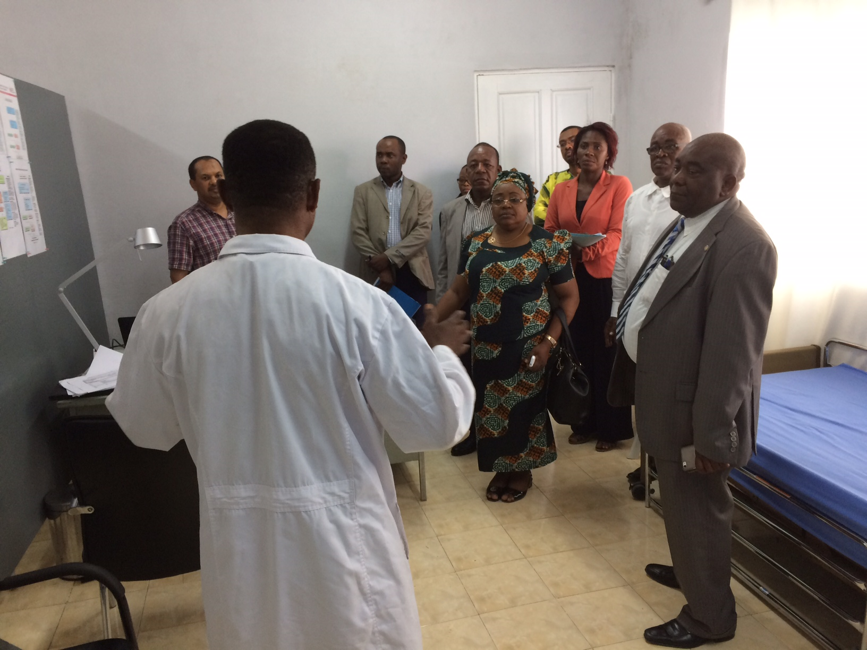
Challenges: IRBs
Newly formed IRB in country with limited research history
IRB members were presidential appointees, many of whom feared scapegoating
Four IRBs: Equatorial Guinea, U.S., Switzerland, Tanzania

Slide 32
Challenges: Funder
80% of $58 million provided by government, remaining 20% from U.S. oil companies that work in EG
Government funding comes from deferred oil revenue, passes directly to research partners: stymies corruption (potential resentment)
Oil company funding comes through corporate social responsibility division: unrealistic timelines/overly American approach

Slide 33
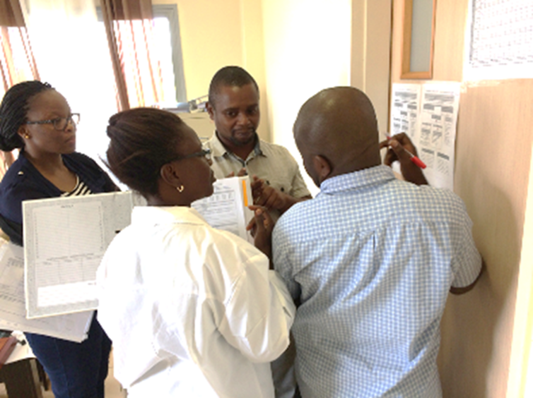
Challenges: MRO staff
Experienced Tanzanian research institute
Less experienced junior staff
New to Equatorial Guinea, not Spanish speakers
Sensitive to issues of “control” by sponsor

Slide 34
Challenges: Complex Trial
Double-blind randomized controlled trial with 135 healthy subjects age 6 mos to 65 years

Slide 35
Challenges: Complex Trial
Double-blind randomized controlled trial with 135 healthy subjects age 6 mos to 65 years
Screening/vaccinating infants & children: blood draws, ECGs, incomplete routine vaccinations, consenting + assenting

Slide 36
Challenges: Complex Trial
Double-blind randomized controlled trial with 135 healthy subjects age 6 mos to 65 years
Screening/vaccinating infants & children: blood draws, ECGs, incomplete routine vaccinations, consenting + assenting
Screening older adults: about 50% excluded due to previously undiagnosed chronic illness (HTN, DM, obesity)

Slide 37
Challenges: Complex Trial
Double-blind randomized controlled trial with 135 healthy subjects age 6 mos to 65 years
Screening/vaccinating infants & children: blood draws, ECGs, incomplete routine vaccinations, consenting + assenting
Screening older adults: about 50% excluded due to previously undiagnosed chronic illness (HTN, DM, obesity)
Controlled human infection

Slide 38
Challenges: Complex Trial
Double-blind randomized controlled trial with 135 healthy subjects age 6 mos to 65 years
Screening/vaccinating infants & children: blood draws, ECGs, incomplete routine vaccinations, consenting + assenting
Screening older adults: about 50% excluded due to previously undiagnosed chronic illness (HTN, DM, obesity)
Controlled human infection
Multiple home and clinic visits to assess AE’s

Slide 39
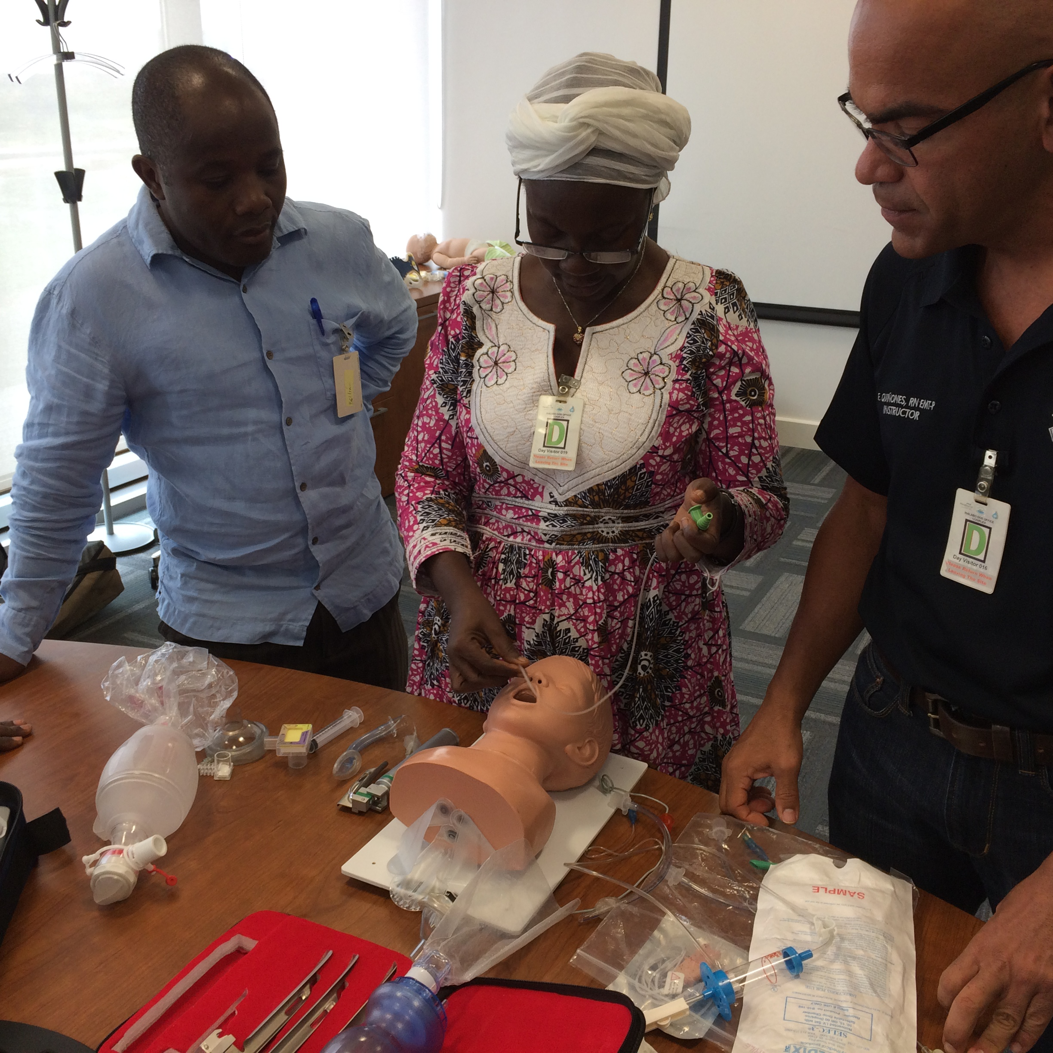
Challenges: Local Personnel
Most had had no experience with clinical trials
Physicians and nurses with basic training, experience in very resource-limited settings, differing views of quality/documentation/ professional status/work ethic
Limited motivation to learn
Lots of protocol deviations (incomplete consenting/assenting)

Slide 40
Challenges: Communication
Language: Spanish, English, Swahili, French, Bubi, Fang
Culture: Equatoguinean/Tanzanian/American/Latin American/European
Trust issues: “You can’t believe 80% of what these people say.”

Slide 41
Challenges: Logistics
Unreliable internet
Unreliable electricity/water
Shipping involves many hurdles: permission/delays/corruption

Slide 42
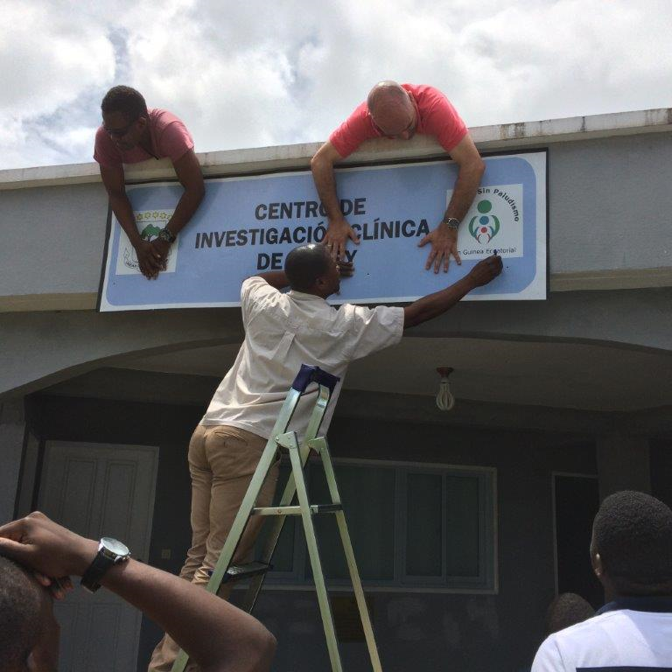
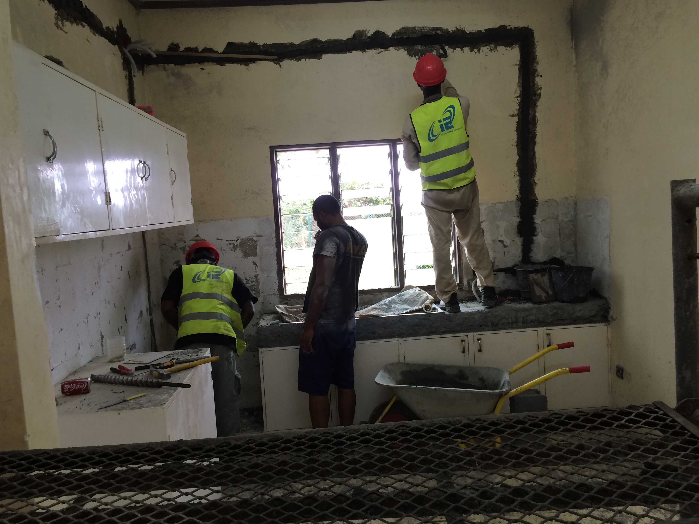
Challenges: Research Center

Slide 43
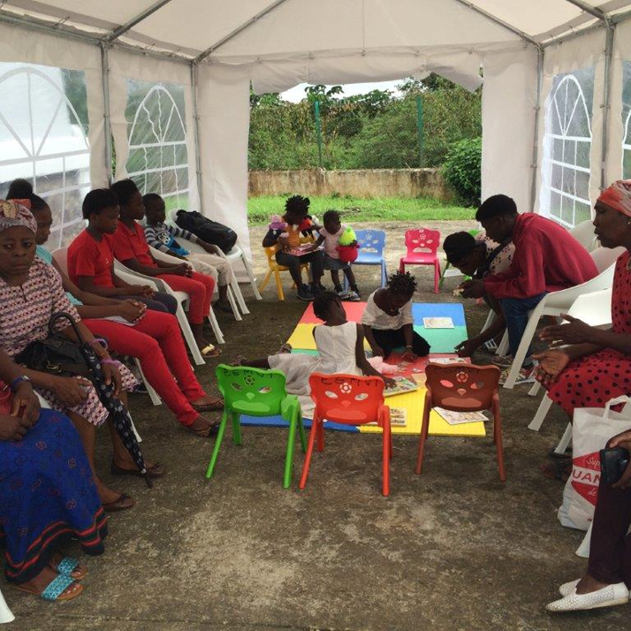
Challenges: Research Center

Slide 44
Challenges: Healthcare Infrastructure
Ministry of Health facilities: some basic labs, x-ray and medicines; rudimentary records

Slide 45
Challenges: Healthcare Infrastructure
Ministry of Health facilities: some basic labs, x-ray and medicines; rudimentary records
Tertiary care (private Israeli hospital): some specialties, more labs (frequent shortage of reagents), CT (no MRI)

Slide 46
Challenges: Healthcare Infrastructure
Ministry of Health facilities: some basic labs, x-ray and medicines; rudimentary records
Tertiary care (private Israeli hospital): some specialties, more labs (frequent shortage of reagents), CT (no MRI)
Provided primary care at research center

Slide 47
Challenges: Transition from Direct Patient Care
“New specialty” as clinical trialist

Slide 48
Challenges: Transition from Direct Patient Care
“New specialty” as clinical trialist
All decisions by committee

Slide 49
Challenges: Transition from Direct Patient Care
“New specialty” as clinical trialist
All decisions by committee
Limited application of personal clinical knowledge/skills

Slide 50
Challenges: Transition from Direct Patient Care
“New specialty” as clinical trialist
All decisions by committee
Limited application of personal clinical knowledge/skills
Local medical staff had little interest in learning

Slide 51
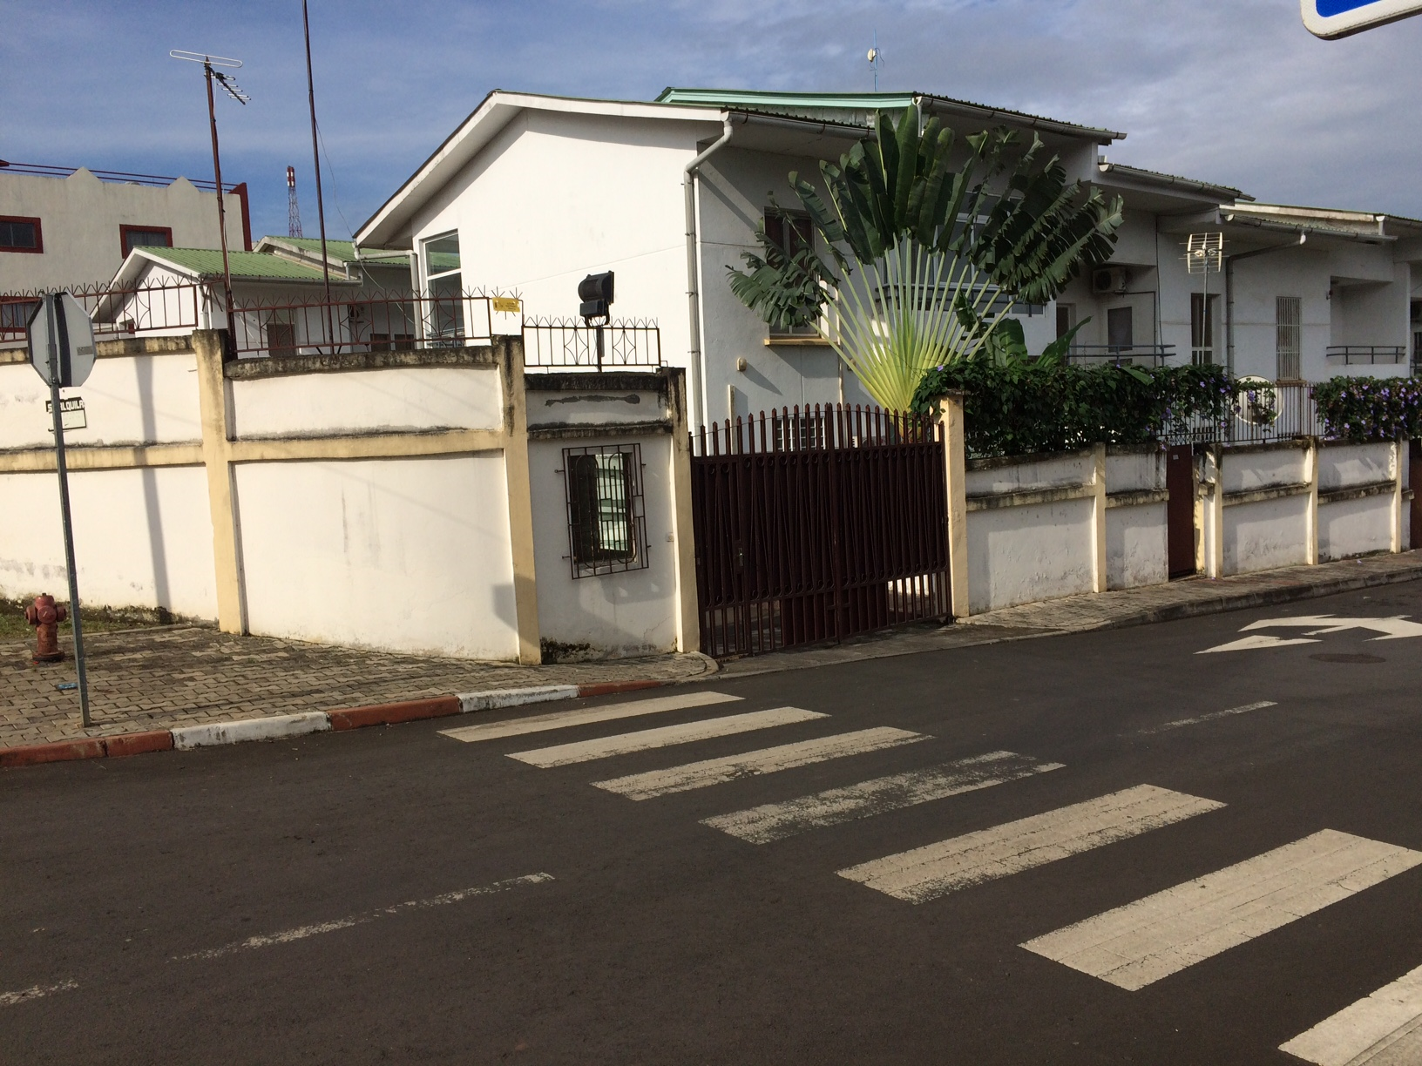
Challenges: Living Conditions/Family Issues
Stark socioeconomic differences

Slide 52
Challenges: Living Conditions/Family Issues
Stark socioeconomic differences
Police/military harassment: document checks, traffic “violations”, requests for money, detention

Slide 53
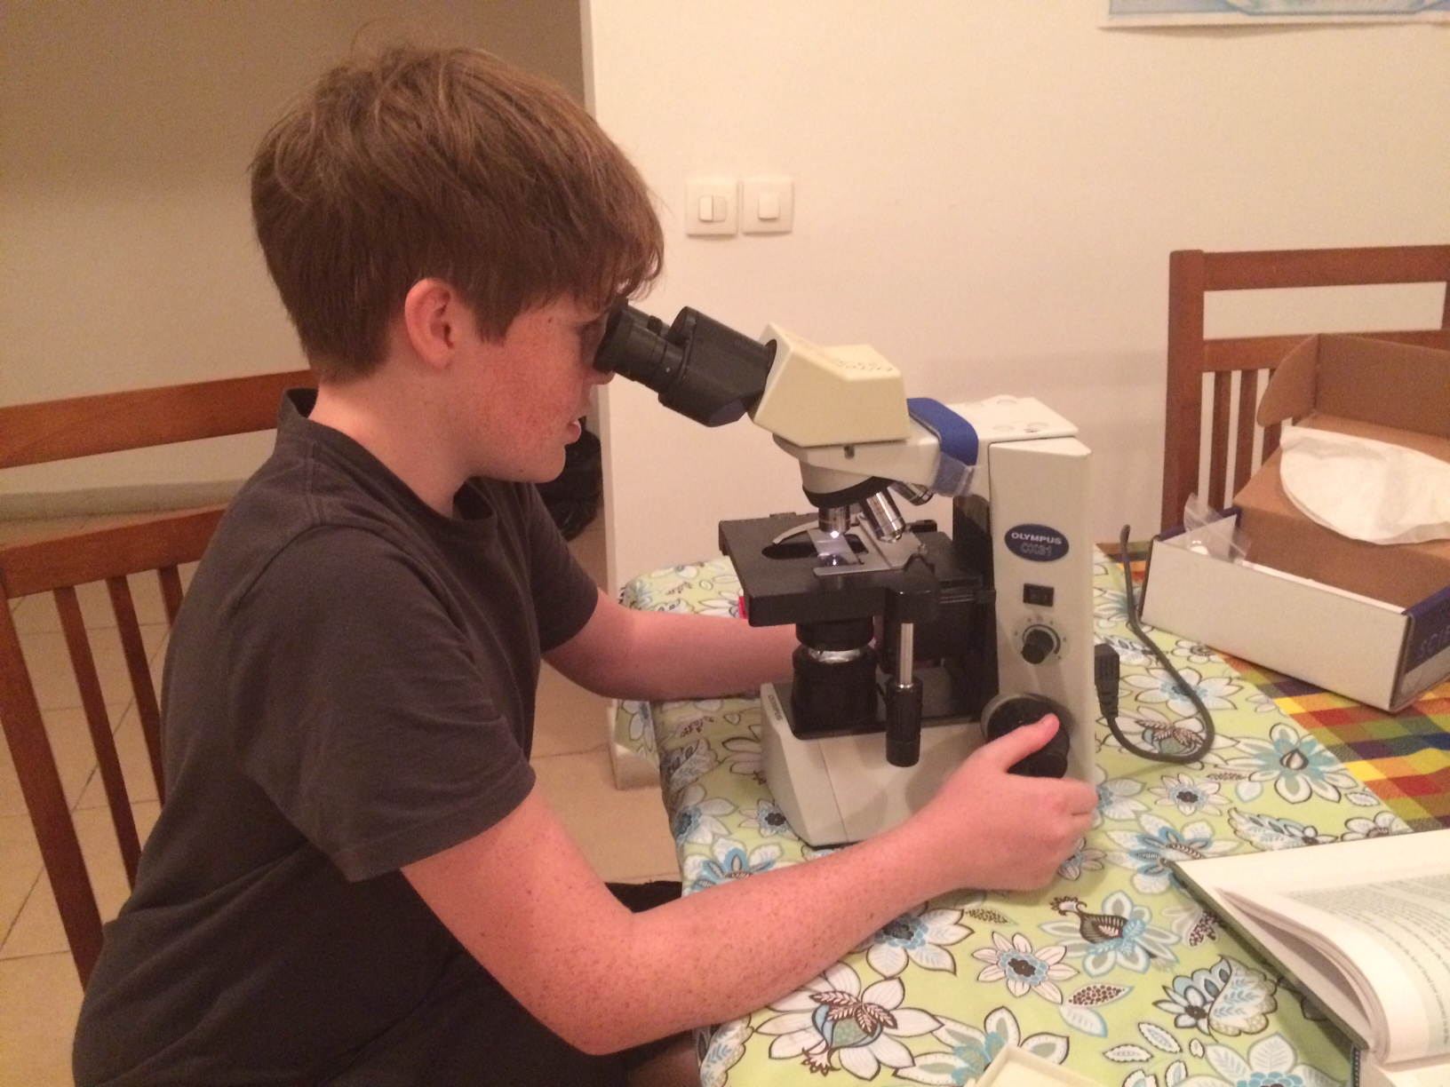
Challenges: Living Conditions/Family Issues
Stark socioeconomic differences
Police/military harassment: document checks, traffic “violations”, requests for money, detention
Family isolation: limited movement around the island, lack of suitable school, very limited social interactions: “prison”

Slide 54
Rewards
Friendships
Learning
Developing new skills
Innovation/Successes
Cultural exposure
Accomplishments

Slide 55
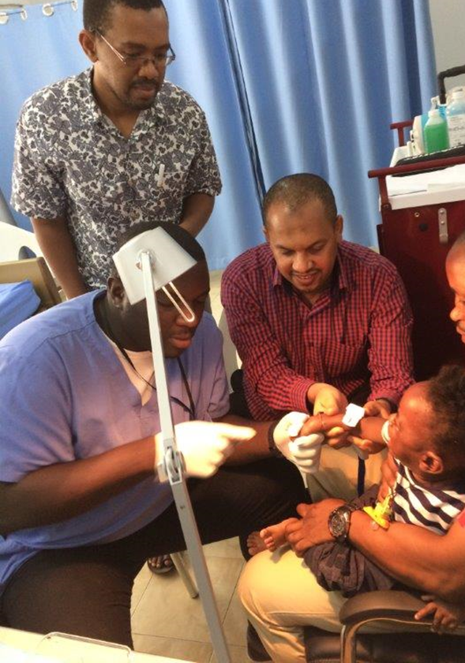
Rewards: Friendships
Comraderie borne of mutual struggle
Facilitating communication/understanding
Earning trust

Slide 56
Rewards: Learning
Design and execution of clinical trials
Tropical disease control and treatment
Vaccinology

Slide 57
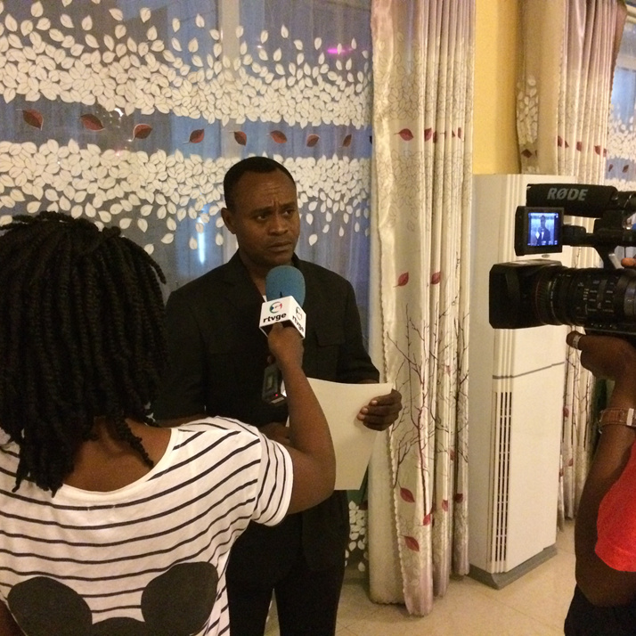
Rewards: developing new skills
Organization/management
Public relations
Liaison to government and corporate entities
Dealing with diverse partners
Global communication (email, Skype, visits)

Slide 58
Rewards: Innovation/Successes
Developed trust with Ministry of Health and local IRB members (projecting optimism, warmth, sincerity, continuity)

Slide 59
Rewards: Innovation/Successes
Usefulness of role-playing for learning and team-building (fixed professional and gender hierarchy – MDs over nurses, data entry staff)

Slide 60
Rewards: Innovation/Successes
Constant availability to capitalize on teachable moments (overcoming pride, lack of initiative, outdated practices)

Slide 61
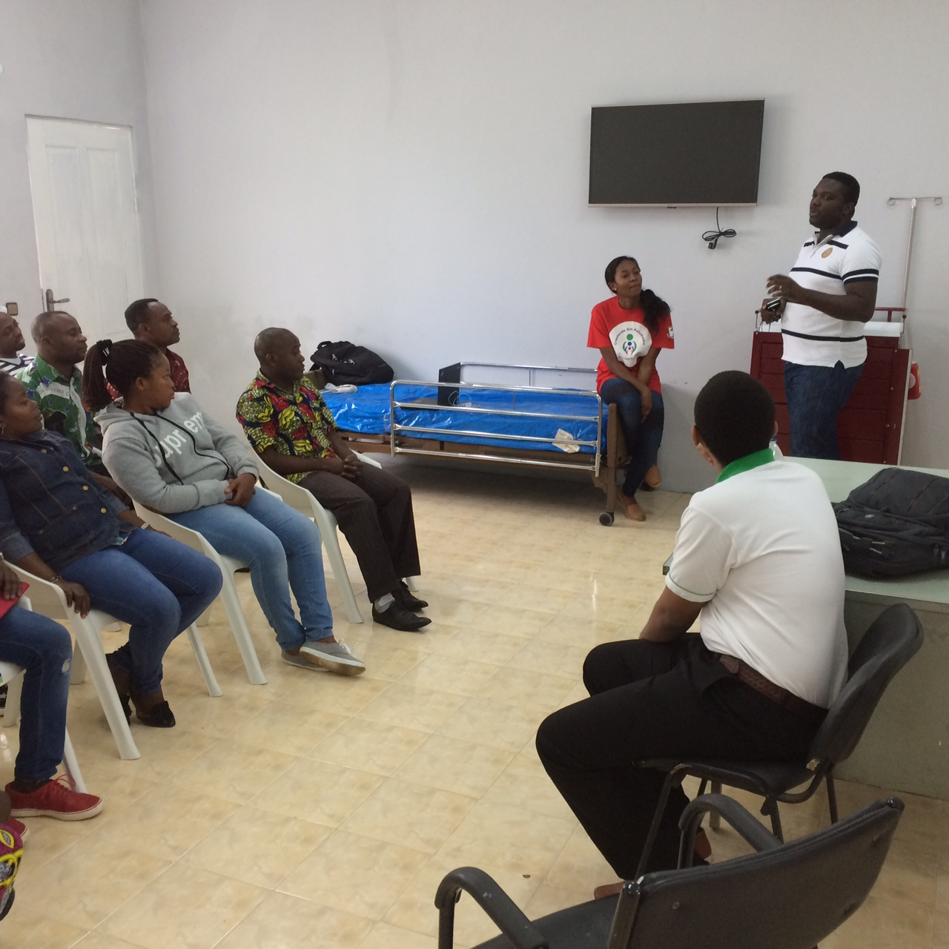
Rewards: Innovation/Successes
Staff feedback/processing meetings (giving a voice to “subordinates”)

Slide 62
Rewards: Innovation/Successes
Coordination of specialty/international health care:
- 15-year-old boy with generalized seizure

Slide 63
Rewards: Innovation/Successes
Coordination of specialty/international health care:
- 15-year-old boy with generalized seizure:
Sleep-derived EEG

Slide 64
Rewards: Innovation/Successes
Coordination of specialty/international health care:
- 15-year-old boy with generalized seizure:
Sleep-derived EEG
MRI on mainland

Slide 65
Rewards: Innovation/Successes
Coordination of specialty/international health care:
- 15-year-old boy with generalized seizure:
Sleep-derived EEG
MRI on mainland
meetings in high school, local hospital, research center

Slide 66
Rewards: Innovation/Successes
Coordination of specialty/international health care:
- 15-year-old boy with generalized seizure:
Sleep-derived EEG
MRI on mainland
meetings in high school, local hospital, research center
international consultants

Slide 67
Rewards: Innovation/Successes
Coordination of specialty/international health care:
- 27-year-old man with cervical lymphadenopathy:
Failed empiric treatment with amoxicillin

Slide 68
Rewards: Innovation/Successes
Coordination of specialty/international health care:
- 27-year-old man with cervical lymphadenopathy:
Failed empiric treatment with amoxicillin
Failed empiric treatment for TB

Slide 69
Rewards: Innovation/Successes
Coordination of specialty/international health care:
- 27-year-old man with cervical lymphadenopathy:
Failed empiric treatment with amoxicillin
Failed empiric treatment for TB
Biopsy showed non-Hodgkin lymphoma

Slide 70
Rewards: Innovation/Successes
Coordination of specialty/international health care:
- 27-year-old man with cervical lymphadenopathy:
Failed empiric treatment with amoxicillin
Failed empiric treatment for TB
Biopsy showed non-Hodgkin lymphoma
Chemotherapy in India

Slide 71
Rewards: Innovation/Successes
Coordination of specialty/international health care:
- 18-month-old girl with persistent pneumonia

Slide 72
Rewards: Innovation/Successes
Coordination of specialty/international health care:
- 18-month-old girl with persistent pneumonia:
multiple rounds of broad spectrum antibiotics

Slide 73
Rewards: Innovation/Successes
Coordination of specialty/international health care:
- 18-month-old girl with persistent pneumonia:
multiple rounds of broad spectrum antibiotics
serial CT scans

Slide 74
Rewards: Innovation/Successes
Coordination of specialty/international health care:
- 18-month-old girl with persistent pneumonia:
multiple rounds of broad spectrum antibiotics
serial CT scans
bronchoscopy in Gabon

Slide 75
Rewards: Cultural exposure
West African exuberance

Slide 76
Rewards: Cultural exposure
West African exuberance
Muslim faith, traditional values

Slide 77
Rewards: Cultural exposure
West African exuberance
Muslim faith, traditional values
Life under a repressive regime

Slide 78
Rewards: Cultural exposure
West African exuberance
Muslim faith, traditional values
Life under a repressive regime
Family trips to Tanzania, the Netherlands, London

Slide 79
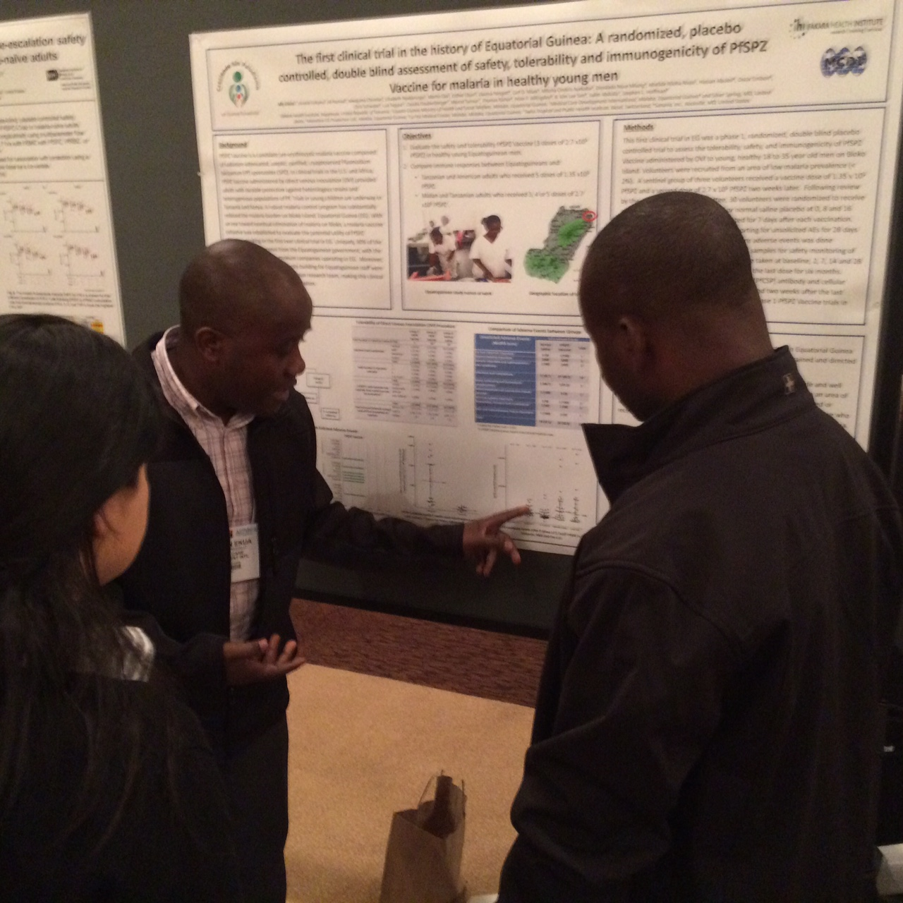
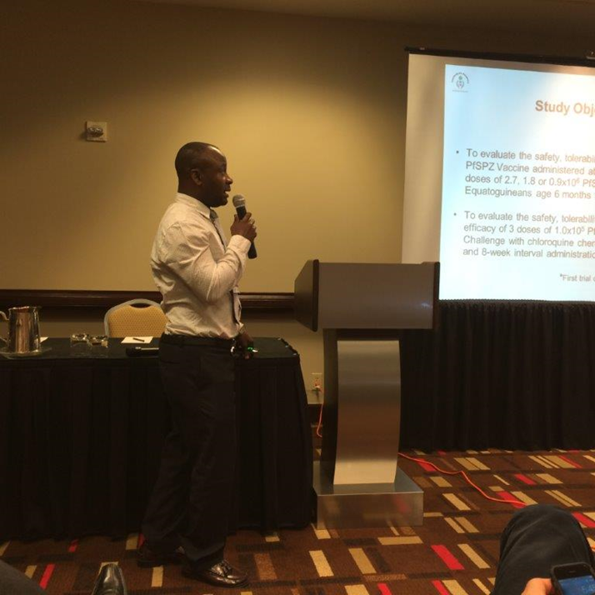
Rewards: Accomplishments
Developed research team/center

Slide 80
Rewards: Accomplishments
Developed research team/center
Completion of a clinical trial with 135 subjects age 6 mos to 65 years

Slide 81
Rewards: Accomplishments
Developed research team/center
Completion of a clinical trial with 135 subjects age 6 mos to 65 years
One of the first trials to use controlled human infection in the developing world

Slide 82
Conclusions
Involvement in clinical research in a resource-limited setting can have a positive impact on global health
Multiple professional and personal challenges
Do the potential rewards outweigh the challenges?

Slide 83
Advice for Potential Clinical Trialists
Work with an established research center/team
Be realistic about any “red flags”
American Society of Tropical Medicine & Hygiene job listings
Don’t burn professional bridges

Slide 84
Acknowledgements
Jennie & Nate Manock:
For their longsuffering and unconditional support during 18 months in Equatorial Guinea

Slide 85
Questions?

