Slide 1
2021 Global Health Summit
Online Tutorial to Address Inadequate Clinical Supervision
for Family Medicine Residents In Palestine

Slide 2
The Team
Dr. Lubna Al-Saudi, FMS, Nablus Palestine
Head of Family + Community Medicine Department and Director of FM residency at An-Najah National University in Nablus, Palestine
Dr. Benjamin Colton, FM, UC Irvine FM residency
Moved family to teach at Hashemite Univ in Jordan in 2014
Dr. Ann Smalldridge, GP, UK, Trainer
36 years practice in Manchester, retired, trains refugee doctors in the UK
Dr. Nicki Spicer, GP, UK, Trainer
35 years practice in Devon, retired
Dr. Therese Zink, FM, (MN, Ohio, RI)
US Fulbright Scholar 2019-2021

Slide 3
ACTIVITY DISCLAIMER
The material presented here is being made available by the American Academy of Family Physicians for educational purposes only. Please note that medical information is constantly changing; the information contained in this activity was accurate at the time of publication. This material is not intended to represent the only, nor necessarily best, methods or procedures appropriate for the medical situations discussed. Rather, it is intended to present an approach, view, statement, or opinion of the faculty, which may be helpful to others who face similar situations.
The AAFP disclaims any and all liability for injury or other damages resulting to any individual using this material and for all claims that might arise out of the use of the techniques demonstrated therein by such individuals, whether these claims shall be asserted by a physician or any other person. Physicians may care to check specific details such as drug doses and contraindications, etc., in standard sources prior to clinical application. This material might contain recommendations/guidelines developed by other organizations. Please note that although these guidelines might be included, this does not necessarily imply the endorsement by the AAFP.

Slide 4
DISCLOSURE
It is the policy of the AAFP that all individuals in a position to control content disclose any relationships with commercial interests upon nomination/invitation of participation. Disclosure documents are reviewed for potential conflict of interest (COI), and if identified, conflicts are resolved prior to confirmation of participation. Only those participants who had no conflict of interest or who agreed to an identified resolution process prior to their participation were involved in this CME activity.
All individuals in a position to control content for this session have indicated they have no relevant financial relationships to disclose.

Slide 5
Learning Objectives

Slide 6
Learning Objectives
Describe challenges of training residents cross-culturally with a focus on training in Arab culture
Outline the challenges of online training in low and middle income countries regarding bandwidth and competing demands
Articulate the value of co-teaching with Family Physicians from another country

Slide 7
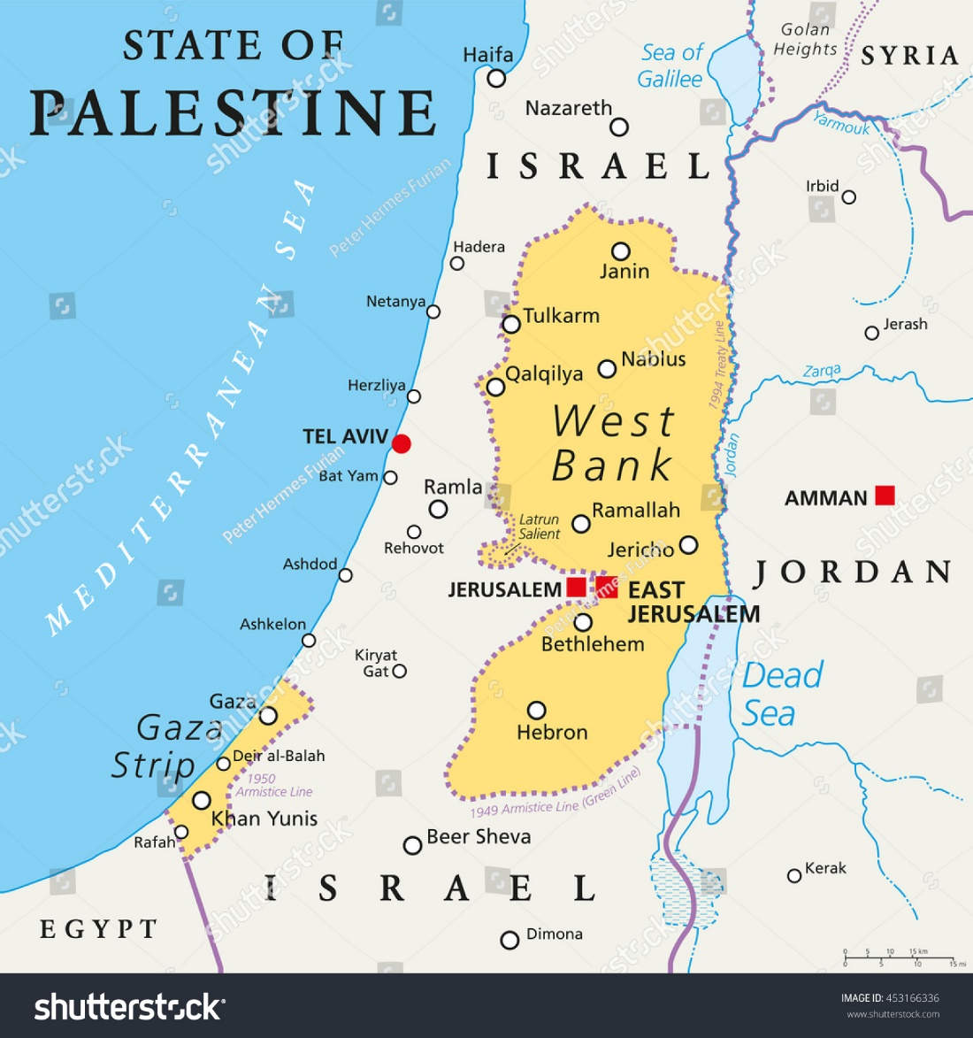
Workshop Plan
Introduction – Therese (3 min)
Brief History of Family Medicine in Palestine—Dr. Lubna (5 min)
The problem that needed to be addressed: Limited Clinical Supervision raise competence as clinicians & concern about passing their Palestine Board exams –Dr. Ann (5 min)
What was done (25 min w/ Drs. Ben and Nicki, role play)
Questions and Answers -- Facilitate (10 min)
–use chat or raise hand

Slide 8
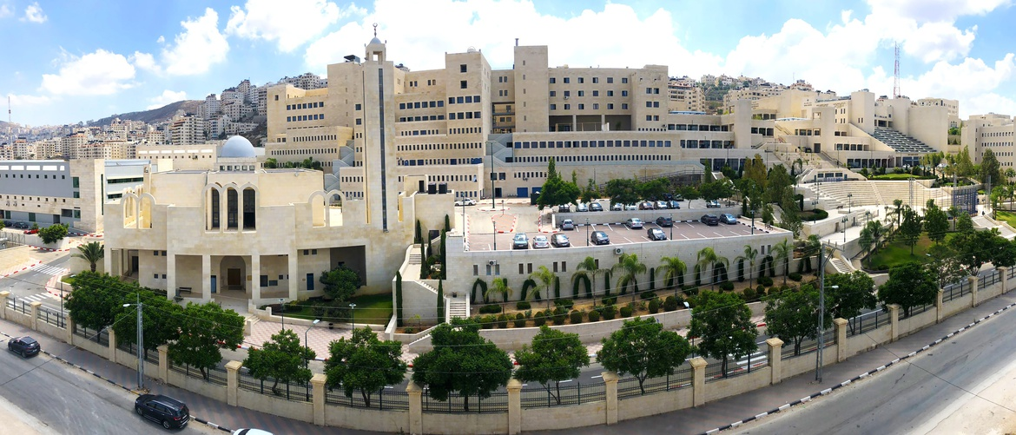
An-Najah National University, Palestine

Slide 9
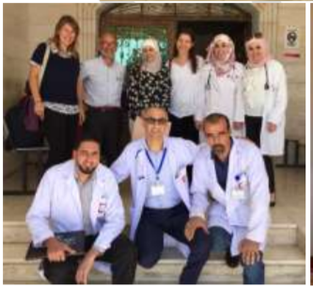
Family Medicine Residency Program
4-Year Program
2 Components
The first 30 months includes rotatation at hospitals accredited by PMC through different specialties
Academic – 1 day/week
Clinical
The last 18 months at PHCC
NGO funded workshops
Lectures
Research project
Prerequisites for the HSFM (High Specialty Family Medicine) degree and practice
Complete successfully academics + research project
Pass the Palestinian board exam
Notes:
TOT ,ECG , BLS , ACLS , Radiology , Communication Skills , Leadership, Mental Health, Clinical Research …etc

Slide 10
Evolution of the Family Medicine Program
51 doctors in total enrolled in the FM residency program since 2010
Pre 2010
2010
2011
2015
2016
2018
2019
1997 – 1998
Unsuccessful attempts
First FM Residency Program in Palestine
Recognised by the PMC
FM Residency Program
FM Residency Program
FM Residency Program
FM Residency Program
FM Residency Program
14 residents
4 residents
5 residents
13 residents
5 residents
10 residents
Notes:
The program was established by Dr Samar Musmar
Was the first and the only FM program in Palestine
22 have been accepted for

Slide 11
Evolution of the Family Medicine Program
40 FM residents in total
2016
2018
2019
2021
FM Residency Program
FM Residency Program
FM Residency Program
FM Residency Program
13 residents
5 residents
10 residents
26 residents
Notes:
The program was established by Dr Samar Musmar
Was the first and the only FM program in Palestine
22 have been accepted for

Slide 12
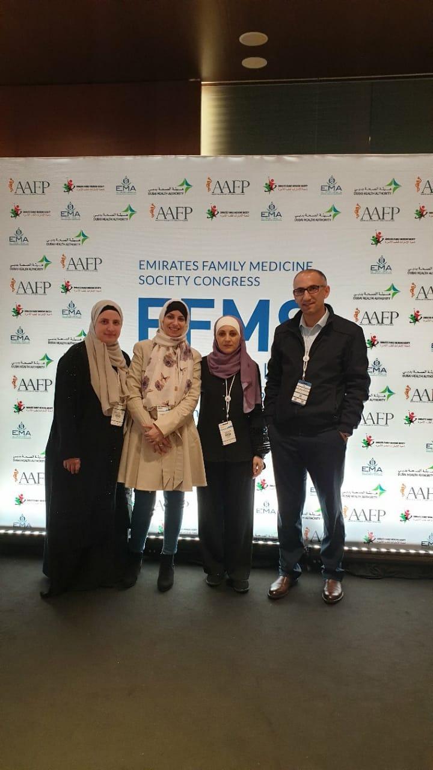
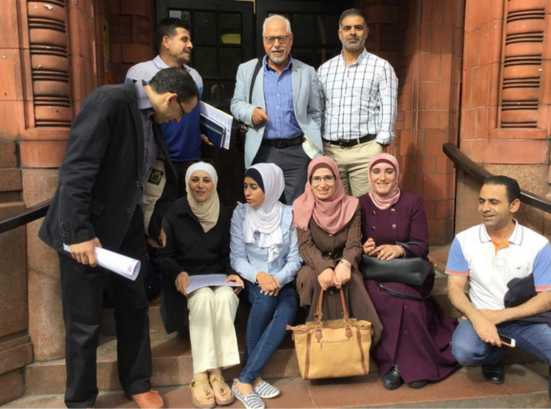
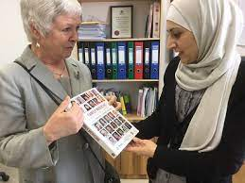
Capacity Building Activities
Study tour in Amman, Jordan (2019)
FM Conference in Dubai, UAE (2019)
Study Tour
in London, UK (2018)
Visit by Amanda Howe/President of WONCA (2017)

Slide 13
The problem that needed to be addressed
For a number of reasons the 2016 4th year residents had not had the opportunity to have work based supervision from a trainer/preceptor during their Family medicine placements
By spring 2020 opportunities diminished further due to COVID
There was concern that the residents were not ready for their Palestinian Board exams in October or for independent practice
There were considerable obstacles to putting in place any face to face teaching

Slide 14
What was done: The tutorial
9 experienced volunteer GP trainers recruited – 9 in UK, 1 in Jordan
3 teams including an Arabic speaker if possible
Zoom accounts set up
13 Residents divided into 3 groups- selected by faculty in ANNU
Resident lead for each group
Tutors briefed on learning needs, cultural issues and best use of zoom platform
Zoom tutorials run for 1 hour every week from June to September - total of 37 tutorials
WhatsApp groups in between
Tutors had regular debriefs
Feedback from tutors, residents and faculty

Slide 15
Training the Final Year Family Medicine Residents in Palestine on Zoom
What Was The Aim ?
To Create a Team of Self - Directed Adult Learners from five Final Year Family Medicine Residents in Palestine
Using:
Guidelines
Evidence Based Medical Resources
Personal Experience as Family Medicine Doctors and Trainers in UK, US and Jordan

Slide 16
Training the Final Year Family Medicine Residents in Palestine on Zoom
Some Similarities to Training FM Residents in Palestine compared with the UK :
The Residents were, bright, competent and very keen to learn.
They had a very good foundation of core medical knowledge.
They always came prepared with cases to discuss.
Their patients present similar dilemmas to our own.
For example, requesting:
Vit B12 injection ‘for energy’,
Investigations when they may not be appropriate,
Antibiotics for viral upper respiratory tract infections.

Slide 17
Training the Final Year Family Medicine Residents in Palestine on Zoom
Some of the Challenges to Training FM Residents in Palestine on Zoom compared to the UK:
Limitations in their FM clinics
Limitations of equipment
Competing demands
Language Barriers
Cultural issues
Notes:
Cultural issues – not used to saying they don’t know
Very doctor centered consulting

Slide 18
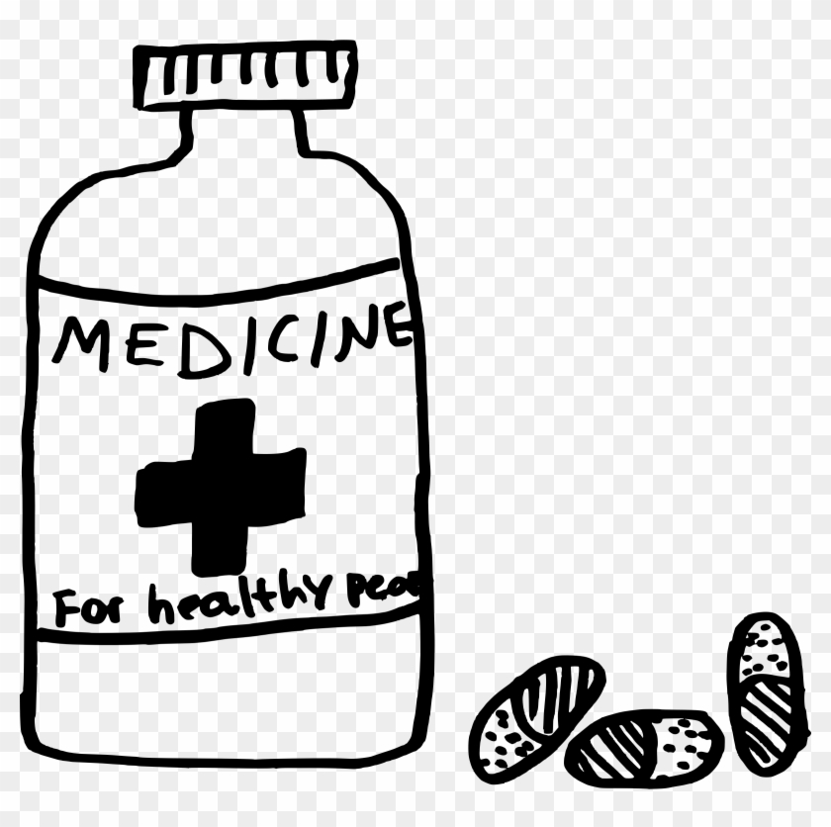
Training the Final Year Family Medicine Residents in Palestine on Zoom
Some of the Challenges to Training FM Residents in Palestine on Zoom compared to the UK:
1/ Limitations in their FM clinics
Limited experience using international guidelines in managing chronic disease,
Only 5 minutes per patient (if they were lucky!)
No appointment system,
No Electronic Medical Record system,
No formal Continuity of Care
No prescribing formulary with in-depth prescribing advice on interactions, contra-indications etc,
The availability of expensive medicines was very limited

Slide 19
Training the Final Year Family Medicine Residents in Palestine on Zoom
Some Differences between Training FM Residents in Palestine compared to the UK:
2/ Limitations of equipment
Variable quality of phones to access internet
Very unreliable internet
Bandwidth was limited so some residents could only use audio
Electricity was unreliable.
3/ Competing demands
They tended to do the tutorials in their own time
For example, at home with young children
Covid clinics
4/ Language Barriers
Notes:
It was difficult running interactive tutorials without being able to see the residents. Sometimes we would have to cancel the tutorials at the last minute because of internet connectivity or electricity blackouts.
Sometimes residents had to share phones and so were in public spaces like noisy resident cafes. If they were at home they would also be doing childcare. Some would have to cancel tutorials because of last minute covid clinics. We ran the tutorials in English and sometimes they had difficulty understanding more difficult concepts. That’s when we called on Ben with his fluency in arabic

Slide 20
Training the Final Year Family Medicine Residents in Palestine on Zoom
Overcoming Challenges
Resistance to sharing difficulties
The residents preferred to present a case where things had gone well
We added our own cases where things had not gone well to encourage them to share their own cases
We explored “What ifs”
Not enough time
We suggested choosing one case a week to do a detailed consultation and bringing back the patient for a
15-minute slot
either at the beginning or the end of a session when there is less time pressure
Empathy with the context
No continuity of care,
Tests too expensive for the patient to afford
We put forward practical suggestions, for example keeping a notebook
Support for the vision of how it could be
Small steps. Motivation - Improve doctor and patient satisfaction

Slide 21
Training the Final Year Family Medicine Residents in Palestine on Zoom
What did we Do?
We set up a WhatsApp Group for the residents.
We used Case Discussions to develop:
Stage 1 – Core Principles of Family Medicine
Stage 2 - Resident Directed Learning
Stage 3 – The Residents as Facilitators
Stage 4 - Consolidating the learning
Clinical skills practice for the exam.

Slide 22
Training the Final Year Family Medicine Residents in Palestine on Zoom
We Set up a WhatsApp Group for the Year 4 Residents
It enabled us to build a close and supportive relationship with the residents. They had easy access to us, for support in their clinics, 7 days a week.
We encouraged the residents to use it to ask us about any clinical issues they had encountered in their clinics and to tell us about cases that they planned to bring to the next session. This allowed us to prepare in advance.
We aimed to respond to any questions they had from their clinics within 48 hours – often directing them to an evidence-based guideline.
We downloaded all teaching materials, links to clinical papers and relevant Guidelines onto the Group WhatsApp

Slide 23
Training the Final Year Family Medicine Residents in Palestine on Zoom Stage 1 - We used clinical cases to introduce:
Structured pathway through a FM Consultation
A structured way of thinking through Differential Diagnoses
Red flags, Surgical sieves, Aide memoires …. And What else could it be ?
Safety netting to protect the doctor and the patient
We encouraged the use of international Guidelines to encourage best practice e.g. NICE, JNC etc
We encouraged the use of Reflection for Improving
We introduced a structured way of looking at polypharmacy in the elderly

Slide 24
Training the Final Year Family Medicine Residents in Palestine on Zoom
Example Case Presentations 1
A Young Child with Diarrhoea and no energy
The FM Resident took a history and checked the child. All observations were within normal limits so she reassured the mum that the diarrhoea would likely get better on its own.
Several weeks later, the mum happened to see the resident in clinic and was angry with her. She said the diarrhoea and low energy did not improve on its own and that she had had to bring her child back to the clinic. The second doctor she saw took a stool sample which confirmed the child had amoeba.
We searched out some papers on the prevalence of GI parasitic infections in children in Palestine and soon found a journal report by Dr Hussein (2011) from An-Najah University suggesting the prevalence to be as high as 22%
Another paper suggested that Intestinal parasitic infections in children in Palestine can be as high as 48% (37% giardia, 9% tapeworm)
https://pubmed.ncbi.nlm.nih.gov/1296273/ 1992 Pubmed The living and health conditions of Palestinian children
https://bmcpublichealth.biomedcentral.com/articles/10.1186/s12889-019-8024-2; Prevalence of selected intestinal protozoan infections in marginalized rural communities in Palestine 2019
https://onlinelibrary.wiley.com/doi/pdf/10.1111/j.1365-3156.2010.02674.x 2011 prevalence of intestinal parasites among school children in northern districts of the West Bank, Palestine Ayman S. Hussein Faculty of Medicine An-Najah University, Nablus

Slide 25
Training the Final Year Family Medicine Residents in Palestine on Zoom
Take Home lessons:
We concluded that children presenting with diarrhoea in Palestine probably need a stool microscopy and culture, whereas in more developed countries, diarrhoea is more likely to have a viral cause and so be self limiting.
We also agreed that mums bringing in children should always be listened to carefully and taken seriously. Mum had afterall, said that the child had no energy.
As Tutors we introduced the Core Principles of Family Medicine
Creating a Non-judgmental environment for open and honest shared learning.
Introducing structure to Clinical Decision Making.
How to use and apply Evidence-based Medicine and Guidelines in a consultation
Learning from sharing personal experiences from their clinics.
The value of Reflection.
Resident-led learning - Identifying their own learning needs
Using available Tools to meet the learning needs

Slide 26
Training the Final Year Family Medicine Residents in Palestine on Zoom
Example Case Presentation 2
The Father of one of the FM Residents with Hypertension and Poorly Controlled Diabetes Feeling Light-headed.
This allowed an opportunity to discuss polypharmacy, medication side effects, interactions and falls risk.
We evaluated each medication he was taking; looking at the risk-benefit analysis for an elderly man with diabetes and hypertension
We discussed anticholinergic burden
We looked at the blood biochemistry and kidney functioning in relation to his medications
We used this case to look at guidelines on polypharmacy in the elderly
References:
https://awmsg.nhs.wales/files/guidelines-and-pils/polypharmacy-guidance-for-prescribing-pdf/
https://www.cgakit.com/m-2-stopp-start
Notes:
STOPP-START
Screening Tool Of Older People's Prescriptions (STOPP)
Screening Tool to Alert to Right Treatment (START)
All Wales Medicines Strategy Group guidance for Polypharmacy: Guidance for prescribing

Slide 27
All Wales Medicines Strategy Group Polypharmacy: Guidance for Prescribing

Slide 28
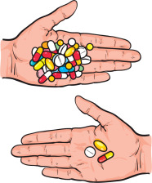
STOPP START Toolkit Supporting Medication Review
STOPP START Toolkit
Supporting
Medication Review
STOPP:
Screening Tool of Older People’s potentially inappropriate Prescriptions.
For example, choosing to stop doxazosin in preference to one of the other antihypertensives (all of which had more evidence for benefit behind them) in the above gentleman with postural hypotension.
START:
Screening Tool to Alert doctors to Right i.e. appropriate, indicated Treatments.
For example, starting a patient on long term, high dose corticosteroids on a bisphosphonate to protect them from osteoporosis.

Slide 29
Training the Final Year Family Medicine Residents in Palestine on Zoom
The Group then reviewed his medication and how best to follow him up
One FM Resident who specializes in diabetes made recommendations on how to improve his diabetic care and arranged to see him in the clinic
Tutors used this case to develop:
Resident-Directed Learning from a “problem case“
The Value of Teamwork - the whole is bigger than the sum of its parts.
The Power of Reflection
Shared Learning from personal experiences from their clinics.
Encouraging the group members to support each other.
Sharing skills within the group e.g. a member with a special interest in diabetes.

Slide 30
Training the Final Year Family Medicine Residents in Palestine on Zoom
Example Case Presentation 3: The Feverish Child
Nadia presented a case where her cousin had bought in her 2-year-old who had a fever and coryza.
Nadia took a good history and examined the child.
Apart from the fever she was otherwise well.
Nadia reassured her cousin and said to bring the child back if she got worse.
After 2 days the child was no better so mum bought her back to another doctor and not to Nadia.
That doctor gave the child antibiotics and she recovered.
Nadia’s cousin felt Nadia should have given her child antibiotics.
Nadia was upset that her cousin had not brought the child back to her for review.

Slide 31
Training the Final Year Family Medicine Residents in Palestine on Zoom
Examples of Case Presentations: The Feverish Child
This case gave us the opportunity to look at:
Sharing a difficult experience and learning from it
NICE (National Institute for Health and Care Excellence) for guidance on a feverish child
Role Play of consultation skills
https://www.nice.org.uk/guidance/ng143/resources/support-for-education-and-learning-educational-resource-traffic-light-table-pdf-6960664333

Slide 32
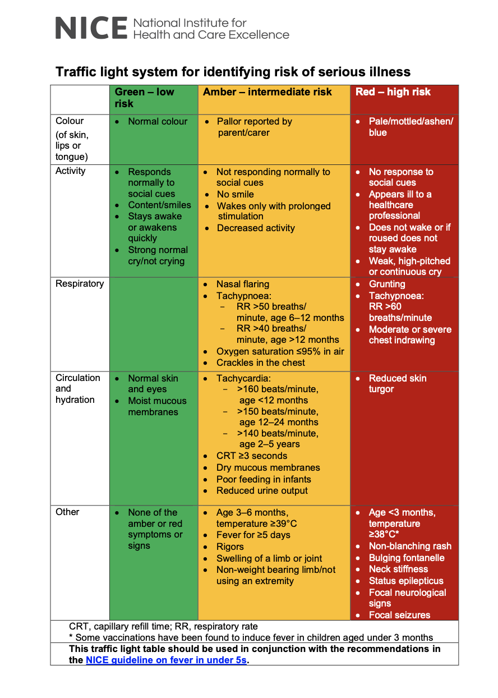
Training the Final Year Family Medicine Residents in Palestine on Zoom

Slide 33
Training the Final Year Family Medicine Residents in Palestine on Zoom
Example Case Presentation 3: The Feverish Child
The group reviewed Nadia’s history and examination and discussed how she had ‘closed’ the consultation with her cousin.
They discussed how Nadia could have managed the consultation differently, in order for Nadia’s cousin to feel more confident in her findings.
We also asked them to prepare a role play of how they may have done things differently.

Slide 34
Role Play: the Feverish Child

Slide 35
Training the Final Year Family Medicine Residents in Palestine on Zoom
Personal Professional Development
Other case presentations repeatedly identified the challenges of managing anxiety and depression
The group asked for training to help them manage these cases in their clinics
We found a clinical psychologist from the Maudsley Hospital in London to run a short course on Brief CBT in Primary care
This modelled the learning cycle

Slide 36
Training the Final Year Family Medicine Residents in Palestine on Zoom
Stage 4 - Consolidating the Learning.
Practicing for the examination
using the OSCEs (observed
clinical skills exam) and CSA
(clinical skills analysis).

Slide 37
Training the Final Year Family Medicine Residents in Palestine on Zoom
Some Feedback from the Residents:
‘These Sessions helped me to organize my ideas in a systematic way’
‘They gave me the courage to take decisions with confidence’
‘They helped simplify cases that I thought were hard’
‘I learned how to deal with polypharmacy’

Slide 38
Participant Participation, Please . . .
Share your experiences on the chat
Speak up and share your experiences

Slide 39
Training the Final Year Family Medicine Residents in Palestine on Zoom
Lessons Learned by working with UK Colleagues
More centralized guidelines
Slight differences between US and UK guidelines
Medication names in Palestine are more similar to UK than US
Focus on teaching (rather than just modeling) consultation skills
Focus on Reflection
Peer-review
Recertification Process (mentorship)
Notes:
Guidelines- less freedom to practice how you want but more standardization across practices,
Differences – statin therapy, ASA as primary prevention, etc – forces you to the evidence

Slide 40
Training the Final Year Family Medicine Residents in Palestine on Zoom
References
Some of the Guidelines we used:
https://www.nice.org.uk
https://awmsg.nhs.wales/files/guidelines-and-pils/polypharmacy-guidance-for-prescribing-pdf/
https://www.cgakit.com/m-2-stopp-start
https://gpnotebook.com/en-gb/
https://www.bash.org.uk/guidelines/

Slide 41
Wrap up and Questions

Slide 42
Acknowledge Foundation for Family Medicine in Palestine
+
Medical Aid for Palestinians for their support and contributions

Slide 43
How to contact us:
Dr. Benjamin Colton, FM, Jordan
bencolton5@gmail.com
Dr. Ann Smalldridge, GP, UK,
annsmalldridge@gmail.com
Dr. Nicki Spicer, GP, UK, Trainer
nickispicer@me.com
Dr. Lubna Al-Saudi, HSFM, Nablus Palestine
lubna_saudi@najah.edu
Dr. Therese Zink, FM, (MN, Ohio, RI), US Fulbright
theresezink@gmail.com

Slide 44
44

