Slide 1
What every Family Physician needs to know about Medicare Risk Adjustment? Valerie Green-Amos, M.D., FAAFP President, J. Mario Molina M.D., P.C.

Slide 2
RISK ADJUSTMENT
Risk adjustment for Medicare advantage beneficiaries helps identify individuals who can benefit from enhanced care coordination, thus improving quality.
Due to an enhanced emphasis on caring for the chronically ill in primary care, knowledgeable provider groups have increased their skills in accurate coding and documentation thus helping health plans and medical groups alike understand their population better.
Success in Risk Adjustment capture is due to appropriate diagnosis identification, capture, and documentation of patients consistent with CMS guidelines.

Slide 3
Why is RAF/ HCC capture important?
Documentation and tracking of certain disease states enhances the quality of care provided to patients.
Proper documentation can ensure additional revenue from CMS is available to assist in the care of your most difficult Medicare patients.
Recapture annually of these diagnoses provides enhanced resources that will help providers and patients stay vigilant about chronic diseases needing monitoring.

Slide 4
RAF Scores
Each Medicare patient is assigned a portion of the Risk Adjustment Factor (RAF) composed of only demographic information (age, sex, disabled or has disabled variables)
For many providers, the average RAF score is 0.6 which is consistent with a minimal margin above this demographic contribution
RAF = demographic contribution and HCC

Slide 5
Risk Score Calculations
Example of Risk Adjustment Factor (RAF) calculation
Male, age 77, with HCCs: Right Heart failure , Diabetes with Complications, and Chronic Obstructive Pulmonary Disease
Risk adjustment model coefficients:
Male age 77 = $5,100
CHF = $3,900
Diabetes w/ comp = $3,300
COPD = $3,700
Predicted expenditures are $16,000
Average expenditures for all Medicare beneficiaries are $10,000 Thus the risk adjustment factor (RAF) for this patient is= 1.6
$16,000/$10,000= 1.6

Slide 6
Why are HCC codes so important?
CMS developed a number of HCCs (Hierarchical Condition Categories): medical conditions that map to a group of ICD10 diagnosis codes.
Most of these codes are for chronic conditions but some are for acute states like pneumococcal pneumonia, or Myocardial Infarction
These acute HCC codes may not carry over year to year due to the nature of the disease or event.

Slide 7
HCC
A payment model for reimbursement exists based on the complexity of disease by virtue of the risk adjustment factor (RAF)
Value is associated with the individual HCCs
CMS has quantified an expense risk for each HCC group
The sicker the patient, the higher the RAF score if conditions are properly identified and documented through charting and encounter submission

Slide 8
Documentation Standard
New Condition – Diagnosis / Logic / Plan
Ex: COPD, long history of smoking and many admissions for shortness of breath reported by patient, order PFTs for baseline and start ipratropium and antibiotic.
Continuing Condition – Diagnosis / Evaluative Statement / Plan
Ex: Diabetic neuropathy, worsening because stocking-glove distribution ascending to knee, start gabapentin.

Slide 9
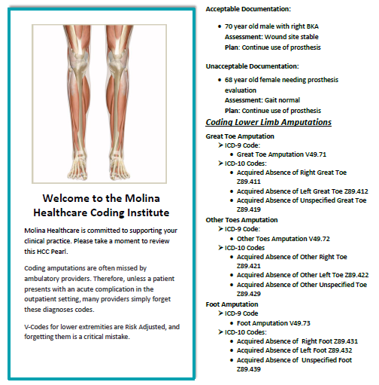
Molina Healthcare Coding Tips Amputation

Slide 10
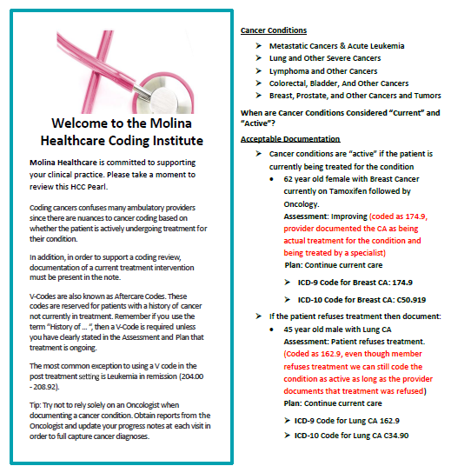
Molina Healthcare Coding Tips Cancer

Slide 11
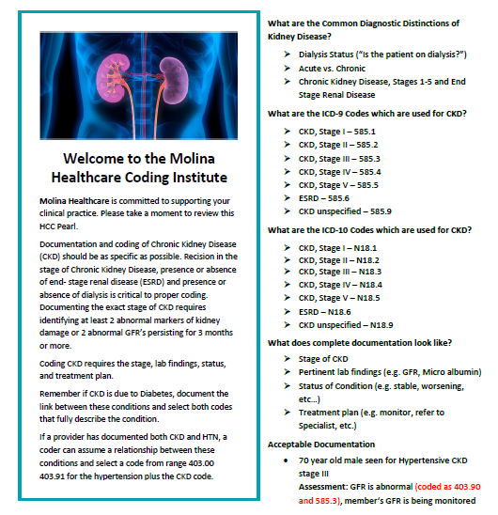
Molina Healthcare Coding Tips Chronic Kidney Disease

Slide 12
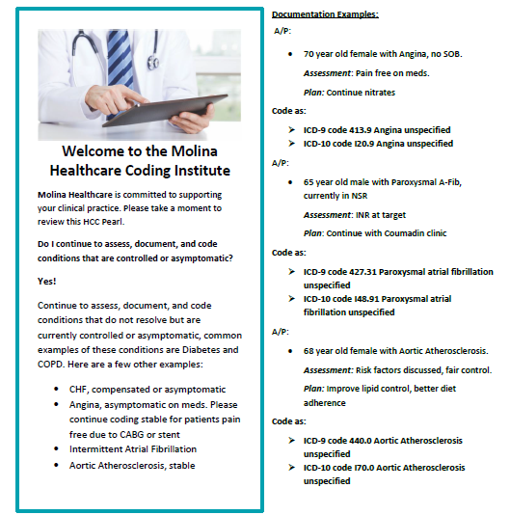
Molina Healthcare Coding Tips
Coding Conditions That Are Controlled or Asymptomatic

Slide 13
Molina Healthcare Coding Tips
COPD vs. Emphysema Coding and Documentation

Slide 14
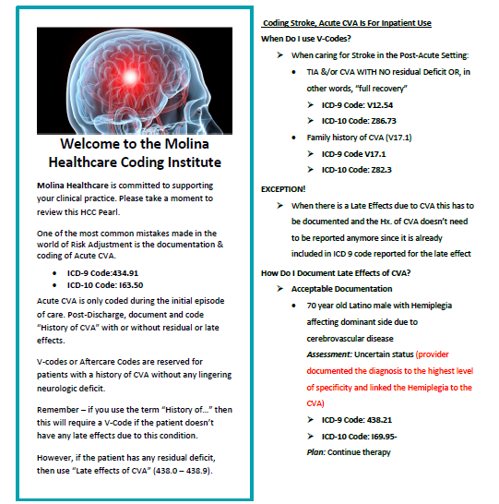
Molina Healthcare Coding Tips
Cerebrovascular Accident (CVA)

Slide 15
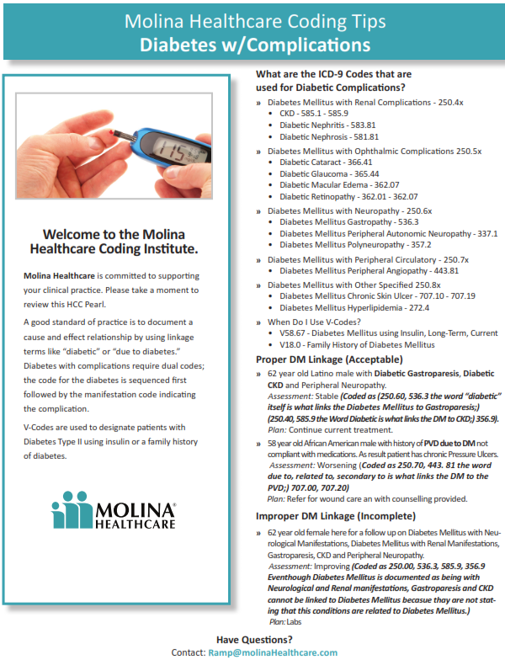
Molina Healthcare Coding Tips
Diabetes w/ Complications

Slide 16
HCC Tips
Concentrate on your sickest patients
Use analytical resources to focus your attention on the identification and management of the sickest patients
Ultimately these patients will get better care

Slide 17
HCC Trivia
85 year old white female, symptoms of UTI.
Patient is tired, less energy and poor appetite and had a heart attack (MI) 1 year ago. The patient appears frail and has lost 30 lbs. in the past 6 months. Urinalysis shows white cells, leukocyte esterase, and micro albuminuria. Serum creatinine is 1.3 and GFR is 48. Patient has been complaining of urinary discomfort, weakness, and has had dry and itchy skin for the past 6 months.

Slide 18
Case Study #1
PMH: Stable diabetes mellitus (DM), chronic kidney disease (CKD) exacerbated by diabetes, stable BKA, stable history of MI, UTI w/ serum creatinine 1.3 6 months ago. Lab findings revealed CKD stage 3.
Plan: Repeat labs, Glucophage 500 mg bid. for DM. Cipro for UTI. Ensure supplements for malnutrition. RTC in 3 months.

Slide 19
Case Study #2
Provider Initial Assessment
MI | No
HTN | Yes
Afib | No
PVD | Yes
CHF | Yes
High Cholesterol | No
CKD-CrCl | No
COPD/Asthma | No
Cancer | No
CVA | No
Depression | Yes
Which of these diagnoses are risk adjustable?
Not initially evaluated at first visit.
Notes:
Answers: PVD, CHF, depression if major; HTN is not risk adjustable

Slide 20
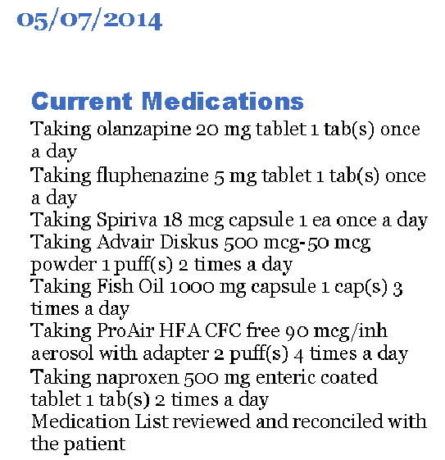
Case Study #3
What diseases does this member likely have?
Based on this chart alone, what diagnoses can be coded?
Are there any opportunities for additional risk score enhancement? Discuss.
Notes:
Answers:
Schizophrenia and COPD
COPD only – hx of schizophrenia is not a risk adjustable diagnosis
If the type of schizophrenia and co-morbidity symptoms were also documented, we would get additional value for this diagnosis.

Slide 21
Questions

