Slide 1
Best Foot Forward : Preparing Your Students for Residency Interviews
Enrique Fernandez, MD, MSEd
Ross University School of Medicine
Keith Foster, Ph.D
University of Maryland Prince Georges Hospital FMRP
Sean Gnecco, MD
Ross University School of Medicine
Vijay Rajput, MD
Ross University School of Medicine

Slide 2
Objectives
Understand factors affecting an applicants invitation to a residency interview from the Residency perspective
Identify verbal, non-verbal and written elements that affect Applicants outcome in the NRMP Match process
Strengthen Applicants’ skills needed to maximize interview success, including telephone, Skype, and the AAMC SVI.

Slide 3
Disclosures
Not
Ours

Slide 4
We apologize !
We only have 1 (one) giveaway – but it’s really nice.

Slide 5
Getting the foot and shoe matched is the goal !

Slide 6
2018 Match Results

Slide 7
Trends in the 2018 Match
48.5% USMG matched in first choice. 73.3% matched in top three choices
31.6% (USIMG and IMG) matched in first choice and 51.5% top three choices
37% US seniors matched into primary care (FM, IM, Peds)
The ratio of PGY1 positions per active US seniors was 1.6, the highest on record
OB/GYN highest matched with 2,768 students
EM offered 2,278 positions with 99.4% filled
Diagnostic Radiology: 125 categorical positions offered and 944 advanced positions. 100% of the categorical positions were filled and 99.5% of the advanced positions were filled, both among the highest on record

Slide 8
Family Medicine Positions - 2018 Match
Total number of programs – 557
Positions – 3,654 (96.7% fill rate)
USMG – 1,648 (9.3% of US Seniors applying)
USIMG – 735
DO – 701 (18.6% of US DO Seniors applying )
Filled by non-US IMG – 330
Unfilled positions - 119

Slide 9
2018 PD Survey – Interview selection factors
Criterion/Factor |  | Percent Citing Factor | Average Rating
PERCEIVED COMMITMENT TO THE SPECIALTY |  | 92 | 4.6
USMLE STEP 1 SCORE |  | 89 | 3.8
PERSONAL STATEMENT |  | 87 | 4.1
USMLE STEP 2 CK SCORE |  | 87 | 3.9
LETTERS OF RECOMMENDATION IN THE SPECIALTY |  | 85 | 4.1
Passing USMLE Step 2 CS |  | 82 | 4.3
Any Failed Attempt in USMLE |  | 80 | 4.2
MSPE |  | 75 | 3.8

Slide 10
2018 PD Survey – Ranking factors
Criterion/Factor |  | Percent Citing Factor | Average Rating
INTERACTIONS WITH FACULTY DURING INTERVIEW |  | 96 | 4.9
INTERPERSONAL SKILLS |  | 96 | 4.9
INTERACTION WITH RESIDENTS (HOUSESTAFF) |  | 89 | 4.8
FEEDBACK FROM CURRENT RESIDENTS |  | 89 | 4.8
PERCEIVED COMMITMENT TO THE SPECIALTY |  | 86 | 4.6
USMLE STEP 2 CK SCORE |  | 76 | 3.9
PERCEIVED INTEREST IN PROGRAM |  | 73 | 4.3
EVIDENCE OF PROFESSIONALISM AND ETHICS |  | 73 | 4.2
Passing USMLE STEP 2 CS |  | 72 | 4.3

Slide 11
Family Medicine Interview Statistics

Slide 12
Number of interviews and ranked programs

Slide 13
One Program’s Experience:
Number of Ranked Applicants by Choice of Specialty 2016 - 2018*
Specialties:
Internal Medicine
Pediatrics
Psychiatry
Emergency Medicine
Anesthesiology
Dermatology
Surgery
Neurology
OB/Gyn

Slide 14
Breakout Group

Slide 15
General Considerations
Preparation, preparation, preparation !
Most programs have informational web pages.
It’s good to learn about what a program considers as its strengths. These are good topics of conversation during your interview.
You should also learn a little bit about the program’s Leadership.
Doing your research about a program prior to the interview will allow you to formulate well thought out questions to ask during the interview.
Understand the match process, evaluate participation in ERAS and its consequences
You can monitor your application status through ADTS (Applicant Document Tracking System)
Check you emails frequently during the interview season
Check junk mail (Thalamus, etc)
Communicate with emails and do not “text” the program’s leadership
Understand all parts of the application, be prepared to address what’s in it – transcript, MSPE, personal statement, LoRs
Understand residency programs have unique methods of interviewing; be ready for anything; research social media for sample interviews, practice
Understand that evaluation begins before you arrive and continues throughout the visit – no matter how social it feels
Understand the value of researching information about the programs you visit
Understand that there is a lot of competition; be realistic about the specialty and program applied to; standing out has value, but only if its in a positive way

Slide 16
Interview Formats
Most include facility tour, resident meeting, and/or educational activity
One and done - meet with the PD or faculty member
Multiple – meet with several faculty and residentsd
Applicant group – one interviewer, several applicants
Faculty group – many interviewers, one applicant
Hybrid – a blend of any of these
2-Day – extended visit usually with faculty dinner/social
Preinterview – phone, skype,
Coming soon? Standardized Video Interview (AAMC SVI)

Slide 17
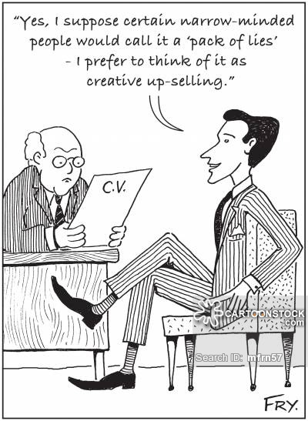
Individual Coaching
Interview
Anxiety
Behavioral Questions
Less than stellar
Applicant

Slide 18
Wrap- Up
Questions/Discussion
Thank You !

Slide 19
Please evaluate this presentation using the conference mobile app! Simply click on the "clipboard" icon on the presentation page.

