Slide 1
A Commitment to Health Equity
The 37th Forum for Behavioral Science in Family Medicine
Reflections on Why
One Journey Toward How
Jennifer Edgoose, MD, MPH
September 24,2016

Slide 2
I have no disclosures

Slide 3
Objectives
Reflect upon the wicked problem
Consider what is necessary to exert change
Present a strategic journey of intentional transformation
Share your commitment to change
Photo by N.kimy The Path

Slide 4
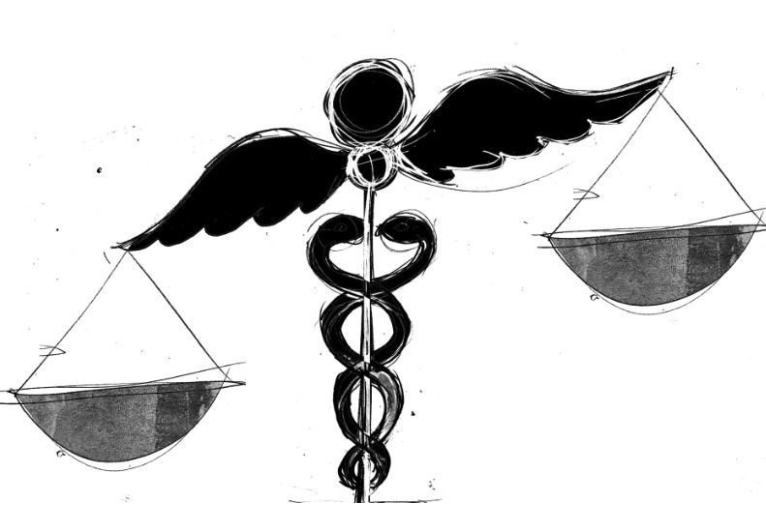
The Wicked Problem
A wicked problem is a problem that is difficult or impossible to solve because of incomplete, contradictory, and changing requirements that are often difficult to recognize. The use of the term "wicked" here has come to denote resistance to resolution, rather than evil. Moreover, because of complex interdependencies, the effort to solve an aspect of a wicked problem may reveal or create other problems.
Notes:
1967 around social policy planning by C. West Chruchman

Slide 5
Smedley, BD, Stith AY, Nelson AR (editors). Unequal Treatment: Confronting Racial and Ethnic Disparities in Health Care. Washington, DC: The National Academies Press,2002.
African Americans are 4 times as likely to develop end stage renal disease yet only 70% as likely to be referred for renal transplantation than non-Hispanic (NH) whites.
Hispanics with fractures are 2 times less likely to receive pain meds in the ED than non-Hispanic whites.
Asian Americans have lower rates of colorectal and breast cancer screening than NH whites.
Racial and ethnic minorities receive lower quality health care than non-minorities
...even when income, insurance status and medical conditions are similar.
Notes:
562 page literature review of 100 studies mandated by Congress in 1999
1. Kandula NR, Wen M, Jacobs EA, Lauderdale DS. Low rates of colorectal, cervical, and breast cancer screening in Asian Americans compared with non-Hispanic whites: Cultural influences or access to care? Cancer 2006; 107;184.
2. Todd KH, Samaroo N, Hoffman JR. Ethnicity as a risk factor for inadequate emergency department analgesia. JAMA. 1993;269;1537.
3. Pletcher MJ, Kertesz SG, Kohn MA, Gonzales R. Trends in opiod prescribing by race/ethnicity for patients seeking care in US emergency departments. JAMA. 2008;343:1537.
4. Morrison RS, Wallenstein S et al. “We don’t carry that”--Failure of pharmacies in predominantly nonwhite neighborhoods to stock opioid analgesics. N Engl J Med. 342(14):1023-1026.

Slide 6
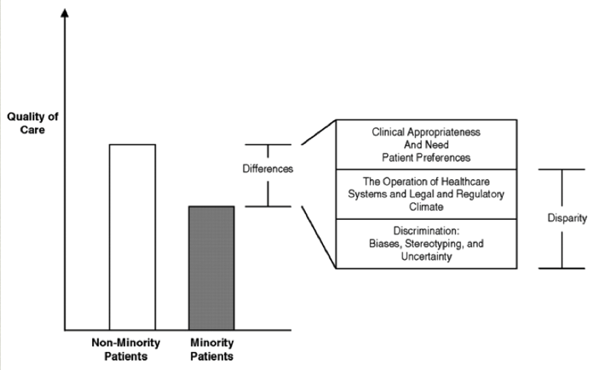
Refusal rates are small and don’t fully account for disparities
Hannan EL, van Ryn M, Burke J, et al. Access to coronary artery bypass surgery by race/ethnicity and gender among patients who are appropriate for surgery. Med Care.1999 Jan;37(1):68-77.
Notes:
refusal rates are small and do not fully account for disparities
(Hannan et al, 1999, Ayanian et al, 1999)
Med Care. 1999 Jan;37(1):68-77.
Access to coronary artery bypass surgery by race/ethnicity and gender among
patients who are appropriate for surgery.
Hannan EL, van Ryn M, Burke J, Stone D, Kumar D, Arani D, Pierce W, Rafii S,
Sanborn TA, Sharma S, Slater J, DeBuono BA

Slide 7
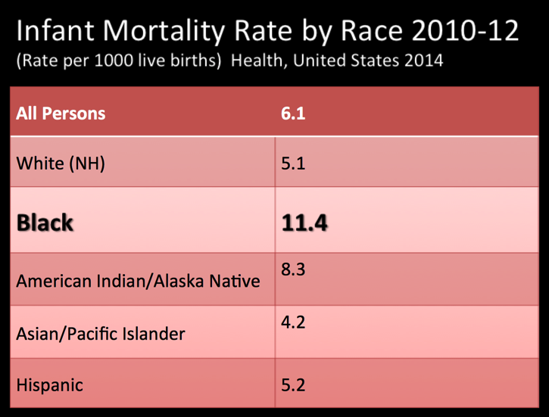
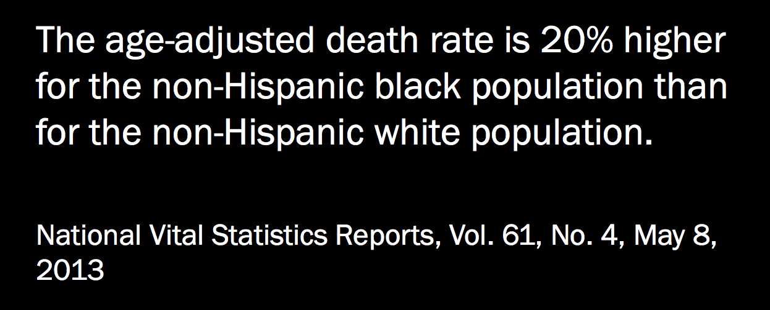
U.S. Department of Health and Human Services
November 2000

Slide 8
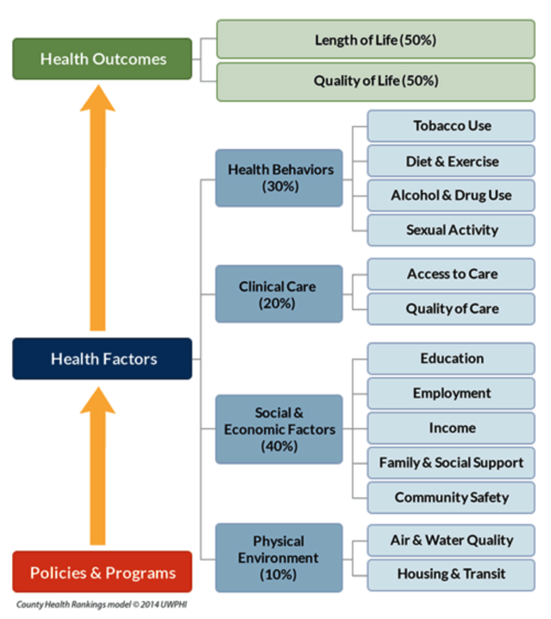

Slide 9
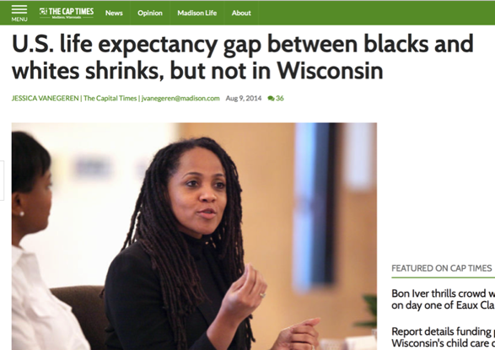
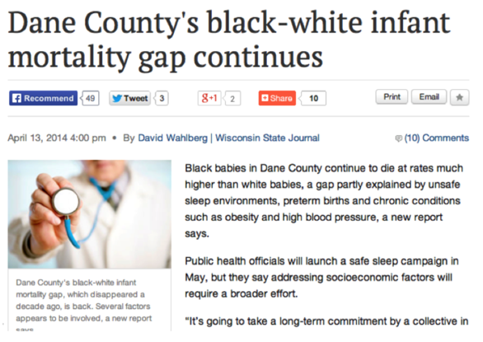
Social determinants are strong predictors for health outcomes trumping even other intermediary health access issues.
In Dane County in 2012, AA were more likely to have health insurance and to receive adequate prenatal care than their black peers nationally.
The journal Health Affairs published a report about life expectancy and the gap between black and white Americans. Wisconsin was the only state to see and the gap widen [for women] between 1990-2009.
Notes:
Harper S, MacLehose RF, Kaufman JS. Life Expectancy Gap Among US States, 1990–2009. Health Aff. August 2014;33(8):1375-82.

Slide 10
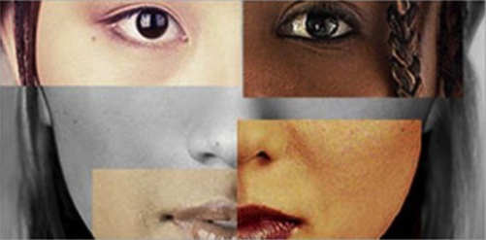
Addressing inequities in health care is an absolute imperative.

Slide 11
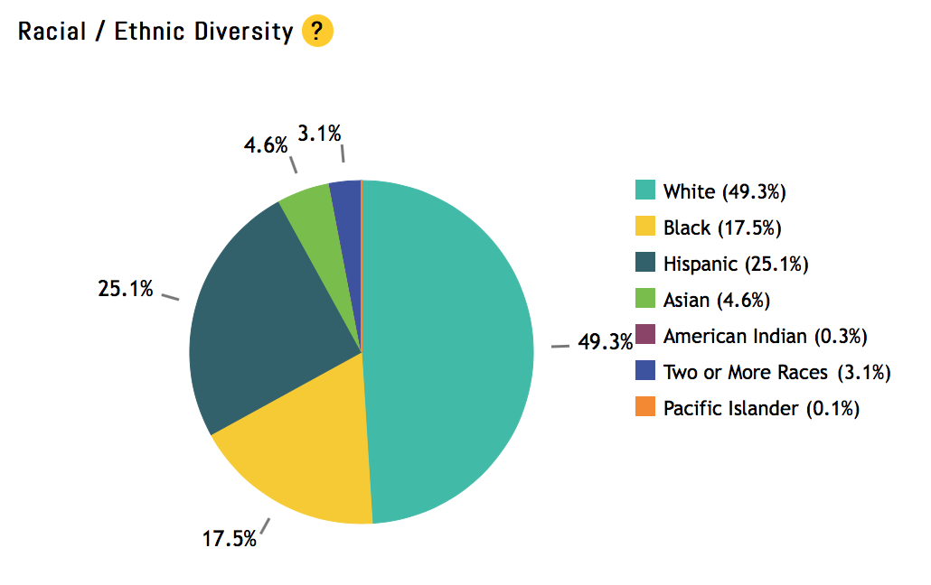
The U.S. population will be minority white by 2044.
% WHITE
2011 51%
49%

Slide 12
“Of all the forms of inequality, injustice in health care is the most shocking and inhumane.”
- Reverend Martin Luther King, Jr. Medical Committee for Human Rights, 1966
Notes:
April 16, 1966

Slide 13
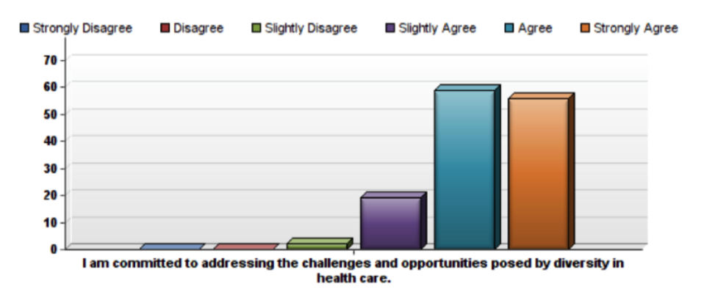
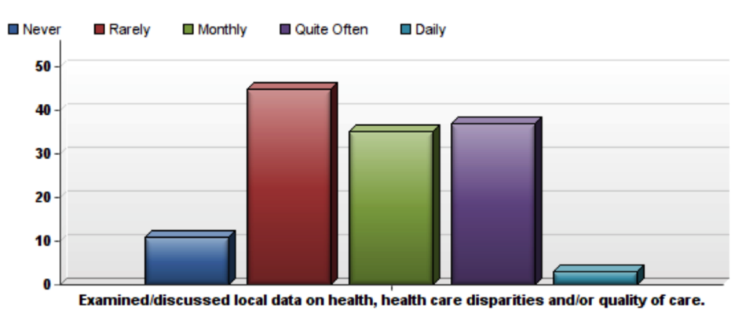
A climate survey (August 2014)
Notes:
DFM in 2014

Slide 14
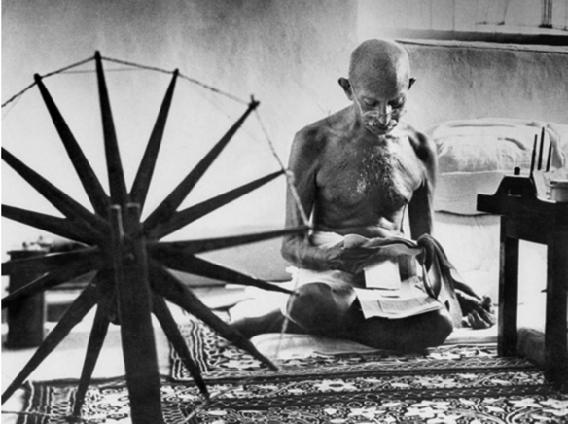
“Be the change that you wish to see in the world.”
MARGARET BOURKE WHITE, 1946. TIME LIFE PICTURES/GETTY IMAGES
Dandi Salt March
Mahatma Gandhi
Notes:
First photo the Salt March to Dandi April1930: he illegally collected dalt as a symbolic act against the British Raj

Slide 15
Intentionality

Slide 16
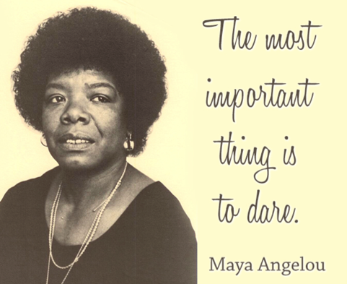
Courage
Notes:
Picture of confronting the dragon

Slide 17
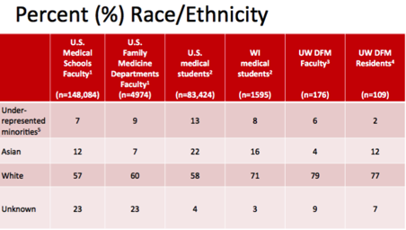
Community and Population Health (Health Disparities)
Diversity and Inclusion

Slide 18
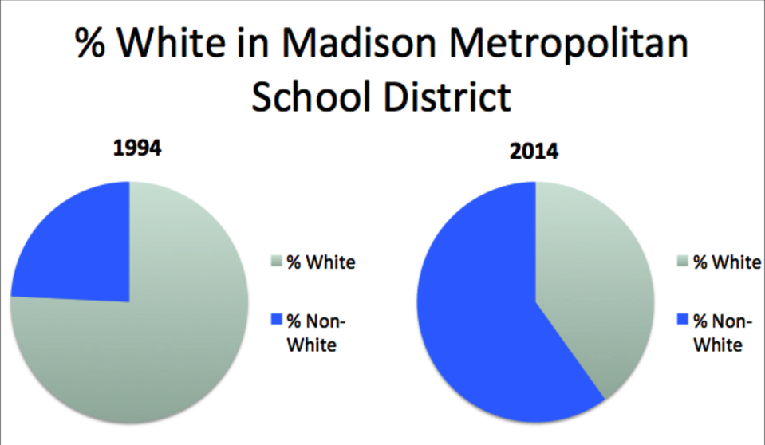
Finding your why:
An email Friday, March 21, 2014 12:01pm …
From: Vincent Amy J [mailto:Amy.Vincent@fammed.wisc.edu] Sent: Friday, March 21, 2014 12:01 PM To: all.alumnihall; mad.fac; mad.res Subject: [mad.fac] Madison and Baraboo Class of 2017
Greetings,
We now have names of the Madison and Baraboo class of 2017 finalized (listed below)! Please see the attached poster for their pictures and medical schools.

Slide 19
White Privilege Conference
WHITE ANTI-RACIST CAUCUS
PEOPLE OF COLOR/ INDIGENOUS CAUCUS
BI-RACIAL/MIXED HERITAGE CAUCUS
Notes:
1) People of Color/Indigenous Caucus (Madison Ballroom C) 2) Bi-Racial/Mixed Heritage Caucus (Hall of Fame) 3) White/Anti-Racist Caucus (Madison Ballroom A)

Slide 21
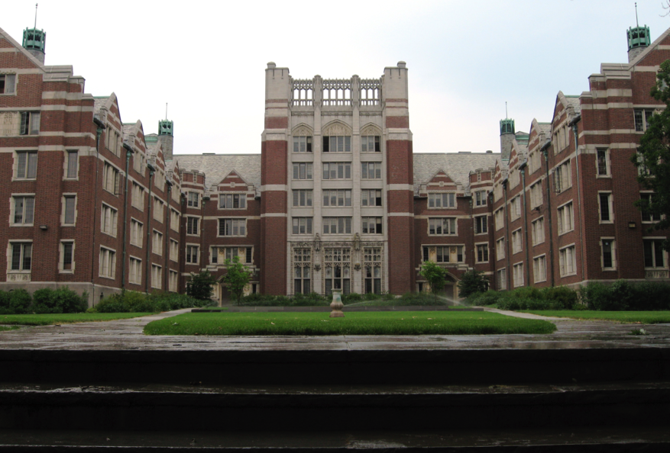
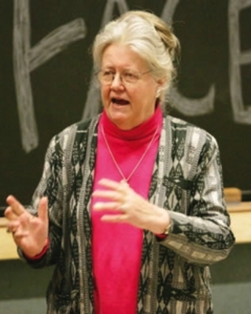
Notes:
the associate director of the Wellesley Centers for Women,^{[1]} and a speaker and the founder and co-director of the National S.E.E.D. Project on Inclusive Curriculum (Seeking Educational Equity and Diversity)
authoring the 1988 opinion article "White Privilege and Male Privilege: A Personal Account of Coming to See Correspondences through Work in Women's Studies"

Slide 22
Bringing it all together
Community and Population Health (Health Disparities)
Diversity and Inclusion
2020 Initiative
Diversity
Equity &
Inclusion

Slide 23
A path toward equity

Slide 24
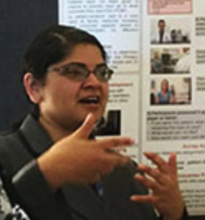
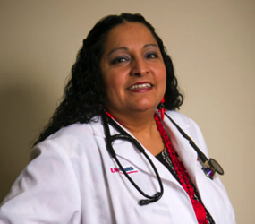
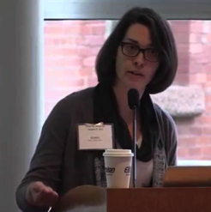
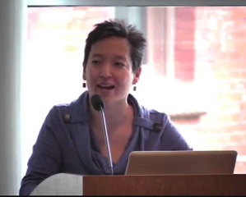
Transforming a statewide department
The 2020 Initiative

Slide 25
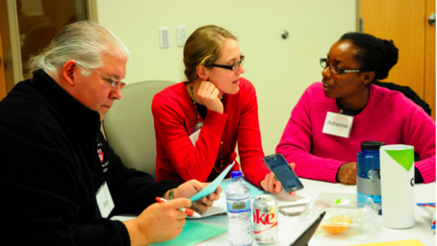
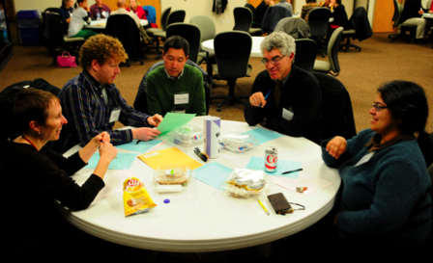
Strategic components
Find partners: Two heads are better than one
Garner financial support from leadership
Promote inclusivity
Establish ground rules
Encourage collaboration
and shared learning
experiences
Notes:
Core planning group
Jennifer Edgoose, MD, MPH
Robin Lankton, MPH
Patricia Tellez-Giron, MDNancy Pandhi, MD, PhD
Included faculty [clinical and research]; residents; administrators; educational and clinical staff
50-125 participants generally attended organized events
Videoconferencing was available
Podcasts were produced
-To increase awareness of diversity issues in our geographical community, patient populations, and Department
To identify and prioritize potential interventions that can increase Department responsiveness to diversity issues
To develop a strategy that assures a Departmental commitment to health equity, diversity and inclusion

Slide 26
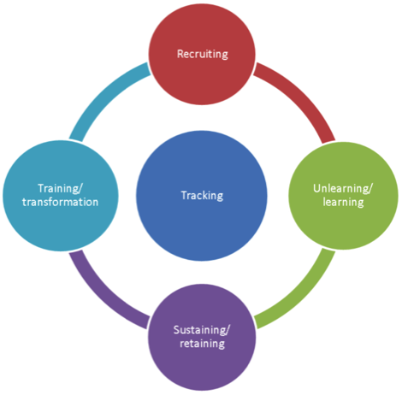
Action Phase
Tracking
Recruiting
Unlearning and Learning
Sustaining and Retaining
Training/Transformation

Slide 27
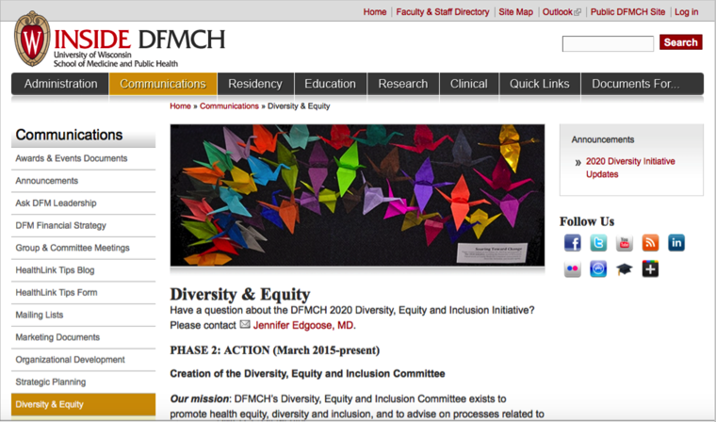
Diversity, Equity and Inclusion Committee
https://inside.fammed.wisc.edu/2020-diversity-initiative

Slide 28
A theoretical framework
And what we’ve learned along the way

Slide 29
Consider health “inequities” instead of “disparities”
“When disparities are strongly and systematically associated with certain social group characteristics such as level of wealth or education, whether one lives in a city or rural area, they are termed inequities.”
Wirth ME, Delamonica E, Sacks E, Balk D, Storeygard A, Minujin A. (2006b). Monitoring Health Equity in the MDGs: a Practical Guide. New York: CIESIN and UNICEF
Notes:
Wirth ME, Delamonica E, Sacks E, Balk D, Storeygard A, Minujin A. (2006b). Monitoring Health Equity in the MDGs: a Practical Guide. New York: CIESIN and UNICEF.
Available from: http://sedac.ciesin.org/povmap/downloads/analysis/Health_equity_Guidelines.pdf

Slide 30
What causes inequities?
Differences in the quality of care within the health care system
Differences in access to curative and preventive health care services
Differences in life opportunities, exposures, and stresses that result in differences in underlying health status
Phelan JC, Link BG, Tehranifar P. Social conditions as fundamental causes of health inequalities. J Health Soc Behav.2010;51(S):S28-S40.
Byrd WM, Clayton LA. An American Health Dilemma: Race, Medicine, and health Care in the United States, 1900-2000.New York, NY: Routledge,2002.
Smedley, BD, Stith AY, Nelson AR (editors). Unequal Treatment: Confronting Racial and Ethnic Disparities in Health Care. Washington, DC: The National Academies Press,2002.

Slide 31
Equality versus Equity
EQUALITY = SAMENESS | EQUITY = FAIRNESS
Give everyone the same thing | Giver everyone access to the same opportunities
Only works if everyone starts from the same place | We must first ensure equity before we can enjoy equality

Slide 32
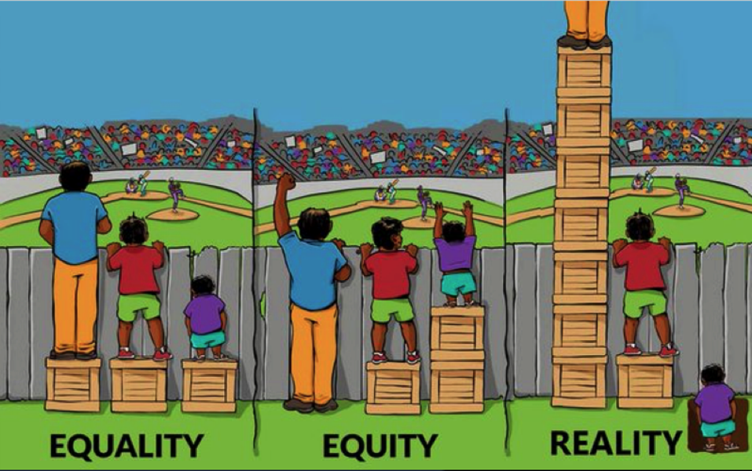

Slide 33
Framing equity through the lens of racism
Taboo
Pervasive
Un-measurable
Inescapable
Private and Public

Slide 34
Defining racism
A system of structuring opportunity and assigning value based on the social interpretation of how one looks (which is what we call “race”), that
Unfairly disadvantages some individuals and communities
Unfairly advantages other individuals and communities
Saps the strength of the whole society through the waste of human resources
Jones CP. Confronting Institutional Racism. Phylon 2003;50(1-2):7-22

Slide 35
Types of racism
Personally-mediated racism — prejudice (differential assumptions) and discrimination (differential action/treatment) by individuals towards others; and
Institutionalized racism — differential access to the goods, services, and opportunities of society by race;
Internalized racism — acceptance by members of the stigmatized races of negative messages about their own abilities and intrinsic worth.
Jones CP. Levels of racism: A theoretic framework and a gardener's tale Am J Public Health; 2000; Aug; 90 (8):1212-5.
Notes:
Gardener’s tale

Slide 36
ADDRESSING INTERNALIZED RACISM
Critical for educators to consider

Slide 37
Wisconsin Council on Children and Families Race to Equity, 2013
“Conscious racism and color prejudice may not have been the primary cause of this extreme racialization of disadvantage, but allowing such a close link between color and disadvantage to persist can only serve to nurture stereotypes, foster profiling, and produce differential expectations for achievement within the community at large, while at the same time undermining motivation, aspiration, self-esteem, confidence, and hope among African American children and their families.”

Slide 38
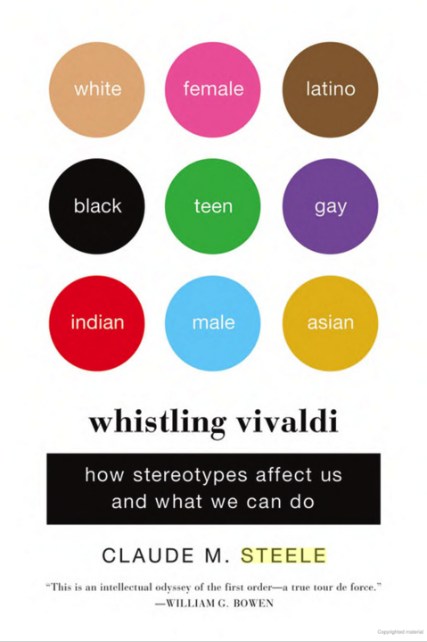
Stereotype threat
Stereotype threat refers to being at risk of confirming, as self-characteristic, a negative stereotype about one's group
Steele CM, Aronson J. Sterotype threat and the intellectual test performance of African Americans. J Pers Soc Psychol 1995;69(5):797-811.
Notes:
Black college freshmen and sophomores performed more poorly on standardized tests than White students when their race was emphasized.
consistent exposure to stereotype threat (e.g., faced by some ethnic minorities in academic environments and women in math) can reduce the degree that individuals value the domain in question
stereotype threat can harm the academic performance of any individual for whom the situation invokes a stereotype-based expectation of poor performance.
the conditions that produce stereotype threat are ones in which a highlighted stereotype implicates the self though association with a relevant social category
Gen Intern Med. 2010 May; 25(Suppl 2): 169–177.
Published online 2010 Mar 30. doi: 10.1007/s11606-009-1221-4
PMCID: PMC2847106
Stereotype Threat and Health Disparities: What Medical Educators and Future Physicians Need to Know
Diana J. Burgess, PhD,1,2 Jennifer Warren, PhD,3 Sean Phelan, MPH,4 John Dovidio, PhD,5 and Michelle van Ryn, PhD, MPH6
http://www.ncbi.nlm.nih.gov/pmc/articles/PMC2847106/

Slide 39
Reduce stereotype threat
Acknowledge the complex systemic and systematic challenges that patients of color experience – acknowledge that race matters
Make diversity visible and recruit and retain racial and ethnic minority providers and staff
Don’t talk only about health disparities
Notes:
Modified from
Tillman Farley lecture Fall 2014
Race and Racism in Health Care.
http://www.fammed.wisc.edu/our-department/media/1278/role-race-and-racism-health-disparities

Slide 40
Teach race is a social construct not a biological construct
Tsai J, Ucik L, Baldwin N et al. Race matters? Examining the rethinking race portrayal in preclinical medical education. Acad Med.2016;91(7):1-5.
Dorothy Roberts, sociologist and law professor
https://www.ted.com/talks/dorothy_roberts_the_problem_with_race_based_medicine?language=en

Slide 41
Teach the life-course effects of the social construct of race
https://www.youtube.com/watch?v=sdFzwPEfRhs
Lu MC, Halfon N. Racial and ethnic disparities in birth outcomes: A life-course perspective. Maternal and Child Health Journal.2003;7(1):13-30.
David R, Collins J. Disparities in Infant Mortality: What’s Genetics Got to Do With It? American Journal of Public Health. 2007;97(7):1191-1197.
…An argument for the cumulative effects of racism
Notes:
YouTube 6 min 8 seconds

Slide 42
CONFRONTING PERSONALLY-MEDIATED RACISM

Slide 43
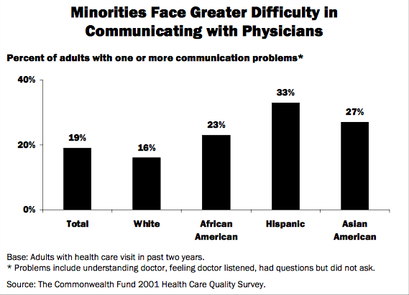
Work on active listening and intentional communication
A large survey asked patients if they experienced
difficulty understanding their provider
felt their provider didn‘t listen to them
had medical questions they felt they could not ask their provider
Source: The Commonwealth Fund 2001 Health Care Quality Survey.
Notes:
large telephone survey
Source: The Commonwealth Fund 2001 Health Care Quality Survey. www.cmwf.org/surveys

Slide 44
“Although myriad sources contribute to these inequities, some evidence suggests that bias, prejudice, and stereotyping on the part of healthcare providers may contribute to the differences in care...often despite providers' best intensions."
Smedley BD, Stith AY, Nelson AR. Unequal Treatment: Confronting racial and ethnic disparities in health care. Washington, DC: The National Academies Press, 2003
Notes:
- male physicians referred black females less than white people or black men for cardiac cath with the same symptoms. Schulman et al (1999)
- male physicians prescribed twice the level of analgesics for white patients than black; female physicians prescribed high doses of analgesics for black than white patients (Weisse et al 2001)
doctors rated black patients as less intelligent, less educated and more likely to abuse drugs and ETOH and less likely to comply with medical advice (van Ryn and Burke 2000)
ANTaR has been working with Aboriginal and Torres Strait Islander organizations and leaders on rights and reconciliation issues since 1997.

Slide 45
Cultural-competency is not enough
Generalizations
awareness of cultural norms
Stereotyping
the assumption that everyone in a given culture is alike
Cultural competency
possessing knowledge, awareness, respect and sensitivity for other cultures and applying it
Cultural humility
lifelong learning about oneself and those “other” to us
Stone J, Moskowitz GB. Non-conscious bias in medical decision making: what can be done to reduce it? Medical Education 2011: 45: 768–776.
Notes:
A system of beliefs, values, rules, and customs shared by a group and used to interpret experiences and direct patterns of behavior

Slide 46
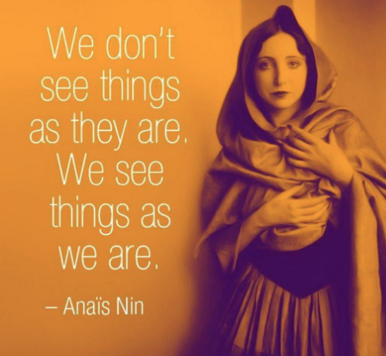
Edgoose JY, Regner CJ, Zakletskaia LI. BREATHE OUT: a randomized controlled trial of a structured intervention to improve clinician satisfaction with "difficult" visits. J Am Board Fam Med. 2015 Jan-Feb;28(1):13-20.

Slide 47
Types of bias
EXPLICIT BIAS
IMPLICIT BIAS
Expressed directly
Aware of bias
Operates consciously
Example: “I like whites more than Latinos”
Expressed indirectly
Unaware of bias
Operates sub-consciously
Example: One sits further away from a Latino than a white individual.
Notes:
Blair IV, Havranek EP, Price DW, et al. An Assessment of Biases Against Latinos and African Americans Among Primary Care Providers and Community Members. American journal of public health. 2013;103(1):10.2105

Slide 48
The effect of implicit bias
Black patients had less positive reactions to medical interactions with physicians [who are] relatively low in explicit but relatively high in implicit bias.
Penner LA, Dovidio JF, West TV et al. Aversive racism and medical interactions with Black patients: A field study. J Experimental Social Psychology.2009;46(2):436-440.
Notes:
Tillman Farley lecture Fall 2014
Race and Racism in Health Care.
http://www.fammed.wisc.edu/our-department/media/1278/role-race-and-racism-health-disparities
Green et al 2007 JGIM
implicit bias (not explicit) significantly causes treatment bias

Slide 49
Explore our implicit bias
https://implicit.harvard.edu/implicit/

Slide 50
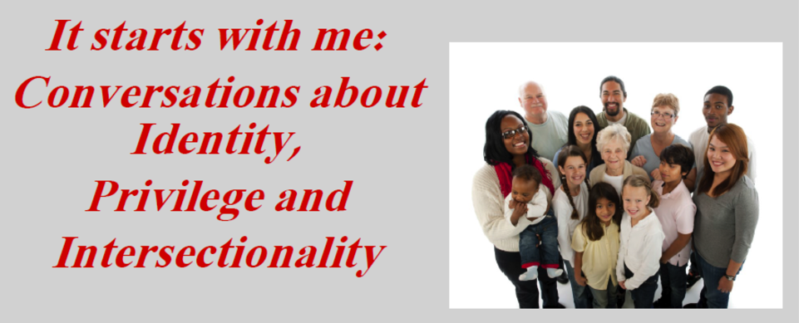

Slide 51
COMBATTING INSTITUTIONALIZED RACISM

Slide 52
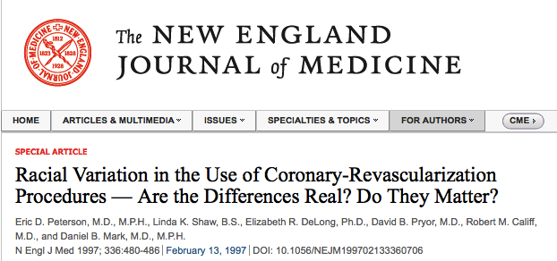
But hope for change exists…
African Americans are 32% less likely to undergo bypass surgery and 13% less likely to undergo angioplasty than non-Hispanic whites for coronary artery disease.

Slide 53
Institutional racism can be overcome with intentional, non-racist institutional practices and policies and attending to disparities in the data.
Notes:
“Our analysis suggests that racial disparities in D2B [door to balloon] times have significantly narrowed over time and that improving national quality of care appears to have not only improved overall performance but also diminished disparities.”
Curtis JP, Herrin J, Bratzler DW, Bradley EH, Krumholz HM. Trends in Race-Based Differences in Door-to-Balloon Times. Arch Intern Med. 2010;170(11):992-993.

Slide 54
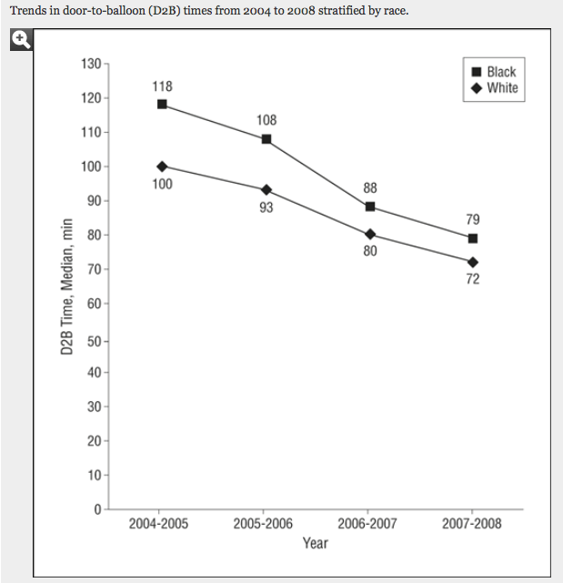
Curtis JP, Herrin J, Bratzler DW, Bradley EH, Krumholz HM. Trends in Race-Based Differences in Door-to-Balloon Times. Arch Intern Med. 2010;170(11):992-993.
Notes:
http://archinte.jamanetwork.com/article.aspx?articleid=416011
Curtis JP, Herrin J, Bratzler DW, Bradley EH, Krumholz HM. Trends in Race-Based Differences in Door-to-Balloon Times. Arch Intern Med. 2010;170(11):992-993.
Over 4 years, national performance on D2B times improved dramatically, and these improvements were accompanied by a marked narrowing of racial disparities in D2B times. Improvements may be due to a number of factors, including public reporting of D2B data,4 the cumulative experience of hospitals performing primary percutaneous coronary intervention,5 and the dissemination of effective strategies to reduce delays through the D2B Alliance and Mission Lifeline.
Previously, we noted that a large proportion of race-related disparities in D2B times was attributable to differences in the care delivered at hospitals that treated a higher proportion of black patients.1 The current data are consistent with that observation. If overall improvements in D2B times have reduced variation across hospitals, one would expect differences by race to narrow. As such, continued efforts are necessary to eliminate the remaining race-based differences in D2B times and continue to improve overall times. Alternatively, the analysis could be confounded by changes in case mix as well as changes in measure exclusion criteria over time. However, there is no evidence to suggest that these exclusion criteria would disproportionately affect patients based on race.
Our analysis suggests that racial disparities in D2B times have significantly narrowed over time and that improving national quality of care appears to have not only improved overall performance but also diminished disparities.
Over 4 years, national performance on D2B times improved dramatically, and these improvements were accompanied by a marked narrowing of racial disparities in D2B times. Improvements may be due to a number of factors, including public reporting of D2B data,4 the cumulative experience of hospitals performing primary percutaneous coronary intervention,5 and the dissemination of effective strategies to reduce delays through the D2B Alliance and Mission Lifeline

Slide 55
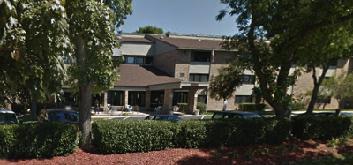
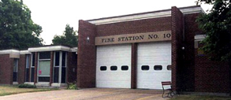
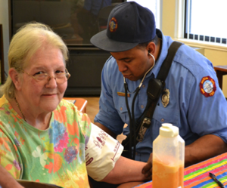
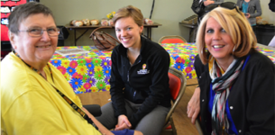
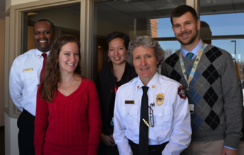
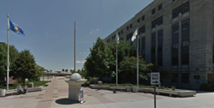
Engage with communities
Other partners:
Aging and Disability Resource Center
Care Wisconsin
River Food Pantry
UW Geriatric Medicine
Madison Police Department
Notes:
CARE summary: An outreach pilot
Goal largely to foster communication/relationships
A result of “hot spotting” in Madison
Based on previous experiences with similar
Community Action Resource and Education (CARE) is a recent pilot program initiated by the Madison Fire Department to foster communication between MFD and the residents of several housing communities in Dane County identified as "hot spots" of first responder resource utilization. The Department of Family Medicine and Community Health was invited to participate in this pilot because of the close proximity of one of the housing units, Dryden Terrace, to the Northeast Family Medicine Center on Northport Drive. As part of this community project, residents, faculty, nurses and other staff from the Northeast Clinic are attending community half days at Dryden Terrace with the Madison Fire Department Station 10, developing a needs assessment of Dryden Terrace residents with regard to healthcare utilization and first responder needs, and working in partnership with MFD to explore new avenues for data sharing and collaboration.
Objectives of CARE:
Expand (medical and fire prevention) services
Develop rapport with citizens served
Distribute fire prevention information
Consultation on fire hazards
Checking basic vitals
Develop interaction with community service providers during non-emergencies
Reduce number of calls to building
Within the over-arching context of the MFD’s strategic plan, there are three proposed “Community Paramedicine” pilot programs. CARE is one of these pilots and it involves fostering communication between local fire stations and several “hot spots” of resource utilization in Madison, one of which is Northeast Family Medicine Center’s next-door-neighbor.
Mobile Integrated Health Pilot Program: The Division Chief of Medical Affairs and EMS staff members have identified members of the community who have conditions which often result in calls for Emergency Medical Services, and to proactively care for these individuals so as to reduce the number of emergent 9-1-1 calls. This is a classic community paramedicine program, in which EMTs or paramedics are given additional training to address non-urgent healthcare needs in order to divert unnecessary resource utilization.
The goals of the Mobile Integrated Health Pilot are:
- Direct and assist residents on how to utilize existing services within the community. By collaborating with other agencies within the community and providing training to MFD first responders and medics, we will be able to assist residents on accessing the proper service providers.
- Determine underlying causes of heavy users of the EMS system and work with available resources to match the right resources to the address the issues of the user.
UW Hospital Community Paramedicine program: The MFD has been asked to participate in an developed by a National Institutes of Health (NIH) grant that will support older adults that have been discharged from Emergency Departments in an effort to decrease hospital readmission rates. The Principal Investigator is by Dr. Manish Shah from the UW Hospital. This is also a classic community paramedicine program.
The goals of the Community Paramedicine pilot are to:
- Provide follow-up visits to patients after discharge. The MFD will collaborate with the UW Hospital to provide follow-up visits to patients discharged by the Emergency Department (ED). (An amendment to this grant is pending – anticipate final approval in the fall).
A Community Outreach Program for field personnel to work with members of the community that reside in buildings and neighborhoods that have high 9-1-1 utilization rates.

Slide 56
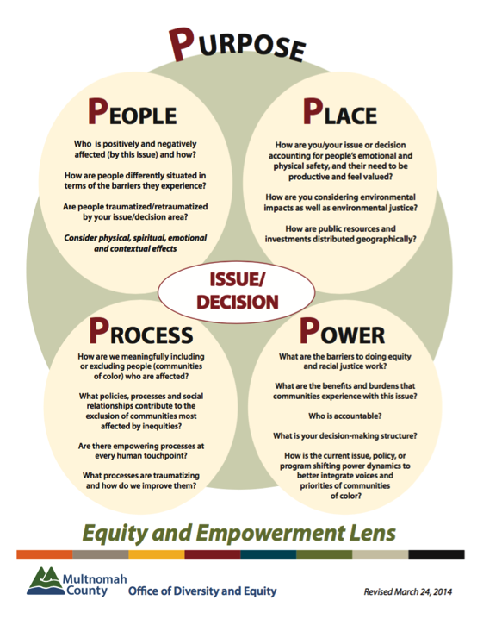

Slide 57
Concluding Foundational Principles
Institutional racism is not our fault but it is our responsibility to eradicate.
Challenging racism and white privilege is everyone’s work.
Diversity is a benefit to everyone, not just minorities.
Implicit bias and racism were taught to all of us without consent.
Implicit bias can be unlearned but requires continual and intentional self work.
Institutional racism can be addressed through continual and intentional community work.
It takes sustained effort to change systems. We will not naturally evolve toward greater equity.
Building relationships across difference is not the same as confronting systems of oppression.
Race means a lot and a little all at the same time.
Adapted from Hollins and Govan by Jess Guh

Slide 58
Health Equity Summit -
Expanding Primary Care’s Role in
Decreasing Health Disparities and
Achieving Health Equity
PORTLAND, OREGON
APRIL 22-25, 2017

Slide 59
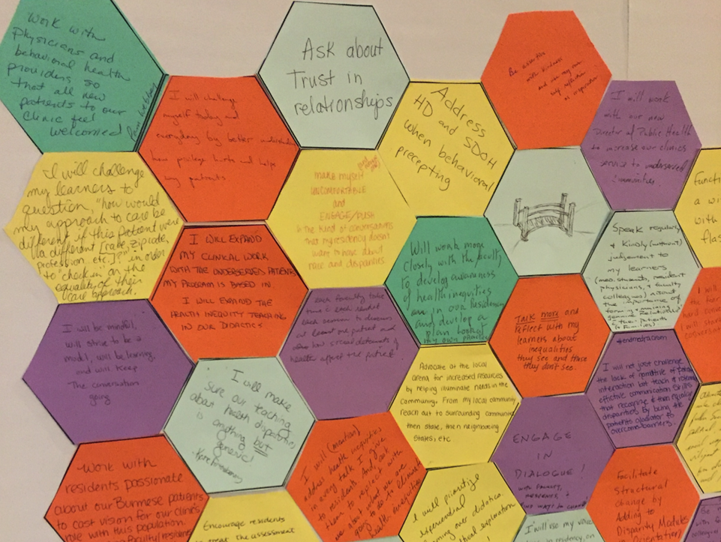

Slide 60
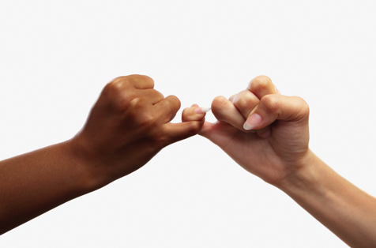
Your commitment
What’s your why?
What do you commit to do?

Slide 61
