Slide 1
Teaching Family Oriented Care in Family Medicine Residency: Several approaches & techniques to incorporate in your training program
Amy Romain, LMSW, ACSW
Sparrow/MSU Family Medicine Residency
Lansing, Michigan
Colleen T. Fogarty, MD, M.Sc.
University of Rochester/Highland Hospital Residency in Family Medicine
Rochester, New York

Slide 2
Objectives
State the key concepts underpinning the Family Life Cycle.
List the steps to develop an ecomap and genogram with an individual patient or a family.
Implement a family meeting feedback process with trainees, using a provided teaching module and behaviorally anchored feedback tool.

Slide 3
Agenda
Background – Teaching Family Oriented Care
Family Life Cycle Curriculum
Graphic Models for Systems Informed Care (Genogram and Ecomap)
Family Conference Module
Discussion

Slide 4
Background
Notes:
Like you, we have collected many stories about why teaching our learners and our systems about how to care for families is important. I’d like to share one with you…
During one of our small group sessions with the interns an intern shared a story that started off sounding like the many stories I have heard interns tell.
On night float, taking care of a pt in the ICU who she had never spoken to in an alert moment, and the patient dies. The resident was called by the nurse to do the death pronouncement and manage the paperwork associated with it. It was the middle of the night and no family was in the room. The resident did her tasks left the room and sat at the nurses station to do her charting. While there she heard the commotion of people and looked up to see several family members filter into the room she had just left. Feeling unprepared and scared she lowered her head and vowed to not make eye contact with any of them. When I asked her about this decision she acknowledged that she did not want to talk to the family because she would not know what to say. She had no medical advice for them and she did not want them to ask her questions she could not answer. Here a competent, confident physician who knew how to do life saving medical procedures like run a code, adjust a vent setting, felt unprepared to talk to a family. No one had ever equipped her with those tools… it was as if she didn’t speak the language!

Slide 5
Myth or Magic?
Family
Osmosis

Slide 6
We have chosen as our careers to teach our learners how to be Family Physicians What do you do to honor this? Are you intentionally teaching family?

Slide 7
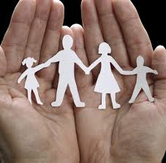
Notes:
As teachers of family physicians we have the awesome responsibility of helping learners understand that caring for families is a golden thread that runs through our speciality. And that as we teach them to think about and care for families and people in the context of their families we must also acknowledge and help the learners see how their own experiences within their own context influences their work as a physician.

Slide 8
Family in Family Medicine Residency Programs: Results of a National Survey
Korin EC, Odom AJ, Newman NK, Fletcher J, Lechuga C, McKee MD. J Fam Med 2014;46(3):209-214
2011 Survey of all ACGME FMRPs (454)
PD 142 (29%), BSF 178 (36%), CR 169 (34%)
272 programs with at least 1 respondent
Teaching about the family is highly valued by most respondents, yet same respondents do not see this being valued by their programs.
Teaching of family topics is less emphasized, compared to other behavioral science topics.
While a family focus may be integrated into behavioral topics (e.g. communication and interpersonal skills or behavior change), family concepts are not emphasized as central curriculum themes.

Slide 9
Finding Family in the Milestones
“Family” as part of a system of care and a systems paradigm is found in skills and levels in all of the 6 competency areas
Prevalent in the patient care, professionalism, & communication milestones
See handout on STFM Resource Library for “Finding Family in the Milestones”
Notes:
PC : Clarifies the goals of care for the patient across the course of the chronic condition and for his or her family and community
MK: Recognizes the effect of an individual’s condition on families and populations
PROF: Identifies own cultural framework that may impact patient interactions and decision-making
SPB: Understands the roles and responsibilities of oneself, patients, families, consultants, and interprofessional team members needed to optimize care, and accepts responsibility for coordination of care
Comm: Educates and counsels patients and families in disease management and health promotion skills

Slide 10
What we teach…
Contextual Care
Family Life Cycle
Family Conferences
Gathering Important Family History
Family Oriented Interviewing
Family Health Beliefs
Communicating with patients and family at end of life
Personal family experiences
Managing difficult family behaviors
Parenting Skills
Caring for Caregivers
Supporting material for many of these topics can be found on fmdrl.org

Slide 11
Variety of settings…
The Basics - Intern Behavioral Med Month
Family Focus Days - Didactics
One on One Observation & Feedback
Small Group Sessions
Reflective Reading and Writing
Family Systems Consultation in Precepting
Comprehensive Family Curriculum

Slide 12
Continuum of Natural Systems
Engel GL: The clinical application of the biopsychosocial model. Am J Psychiatry 1980; 137:535-544.
Notes:
Reinforcing the bio-psycho-social model. Physicians are Systems Thinkers… help them extend beyond biology to include the psychosocial context of the patient.

Slide 13
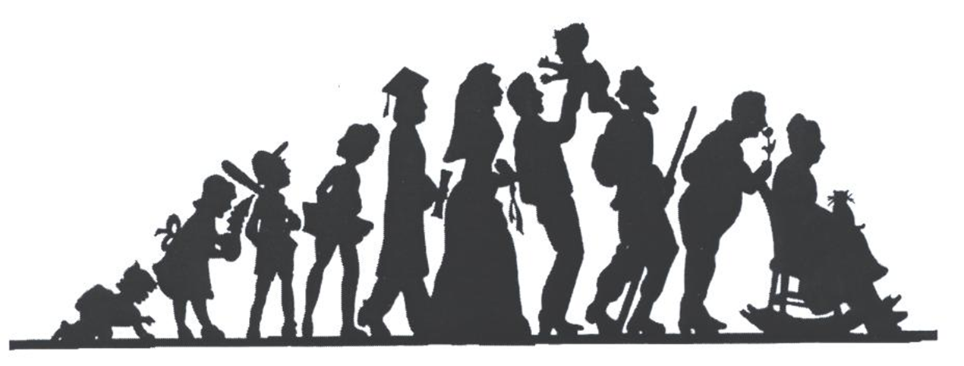
Family Life Cycle

Slide 14
Teaching: Family Life Cycle
Objective: Recognize families go through predictable change precipitated by life events
Content: 6 Stages of Family Life Cycle
(Carter & McGoldrick, 1989)
Goal: Learners will be able identify FLC stages of patients and families and be able to offer anticipatory guidance associated with each stage

Slide 15
Family Life Cycle Curriculum

Slide 16
Fundamentals of Family Life Cycle
Family Physicians should know:
Basic principles of family lifecycle
Impact of lifecycle on family and individual health
How to identify possible family lifecycle stressors

Slide 17
Integrating FLC Concepts in BM Curricula
Topic seminars, based on lifecycle stages
Case presentations
Formal
Precepting encounters
Direct observation of encounters
Video review of clinical work

Slide 18
FLC Seminar Activity
Use photos of team to illustrate stages
Small groups assigned a FLC stage and answers
What are the tasks the individual and the family must do in order to move through this stage?
What challenges might the individual encounter in this stage
And additional questions like…
What do you call your in-laws?
How often did you see your grandparents and under what circumstances?
How do you negotiate the holiday schedule?
Develop anticipatory guidance for assigned stage

Slide 19
Other Methods
Use film clips, poetry, book excerpts, etc. to illustrate stages of the family life cycle (examples on STFM Resource Library)
OR, assign residents to search for an example of stage and share with the group
Discuss developmental tasks, threats, and generate anticipatory guidance
Notes:
Example: FLC Stage 3 Families with Young Children
Video Clip: Dinner Scene From the Incredibles http://movieclips.com/xVjEM-the-incredibles-movie-rowdy-dinner

Slide 20
Teaching Tips: Family Life Cycle
Consider overlap of individual stages of psychosocial development and the family life cycle
Overlay of Erickson’s Stages of Psychosocial Development
Changes in relational, reproductive and intergenerational behaviors and its impact on the FLC

Slide 21
Graphic Models for Contextual Care
Genograms
Ecomaps

Slide 22
Genograms
Method of diagramming family and other important relationships
Process of constructing is as important as outcome
Helps people see and recognize the important people in their life
Helps clinician see patterns that may affect patient in the “here and now”

Slide 23
Genograms

Slide 24
Teaching, Learning, and Using Genograms
Readings and discussion
Practice!
Presenting own genogram with focus on:
Health & illness
Immigration
Influences to pursue medicine
Influences on leadership traits
Preparing brief genograms of patients
Constructing genogram with families

Slide 25
What is an Ecomap?
25
Hartman, A. (1978, reprinted 1995). Diagrammatic assessment of family relationships. Families in Society: the Journal of Contemporary Human Services, 76(2), 111-122
Notes:
25

Slide 26
Why use an Ecomap to elicit context?
Provides structure for discovering patient’s context
Gives window to person’s environment; goes beyond family
Social determinants of health, ACEs, protective factors
Efficient, easy to read
Strengthens provider-patient relationship
26
Notes:
26

Slide 27
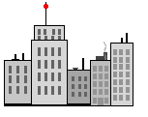
Ecomap Domains
Significant Relationships
Neighborhood
Social Groups
Employment
Education
Community Services
Other
$ Rx
27
Notes:
27

Slide 28
Ecomap Construction
Social
Groups
Other
Community
Services
Patient
Education
Employment
Neighborhood
Significant
Relationships
______ _______ - - - - - - - /\/\/\/\/\/\/\/\/\/\
_______
Connected Strong Weak Stressed/Conflict
Arrows should aim in the direction of the flow of energy
28
Notes:
28

Slide 29
Ecomap Demonstration

Slide 30
Context Informs Assessment & Intervention
Understand stressors & potential barriers
Identify supports
Reinforce strengths
Patient education (health literacy, family health beliefs)
Readjust goals
Opportunities

Slide 31
Teaching Ecomaps
PGY1
Workshop – Introduction to Ecomaps
pop-culture example
practice on each other
practice on a case in workshop
Practice on patients
Interview patient, construct Ecomap
Present Ecomap - tell the story and discuss
Ecomap patients during video review

Slide 32
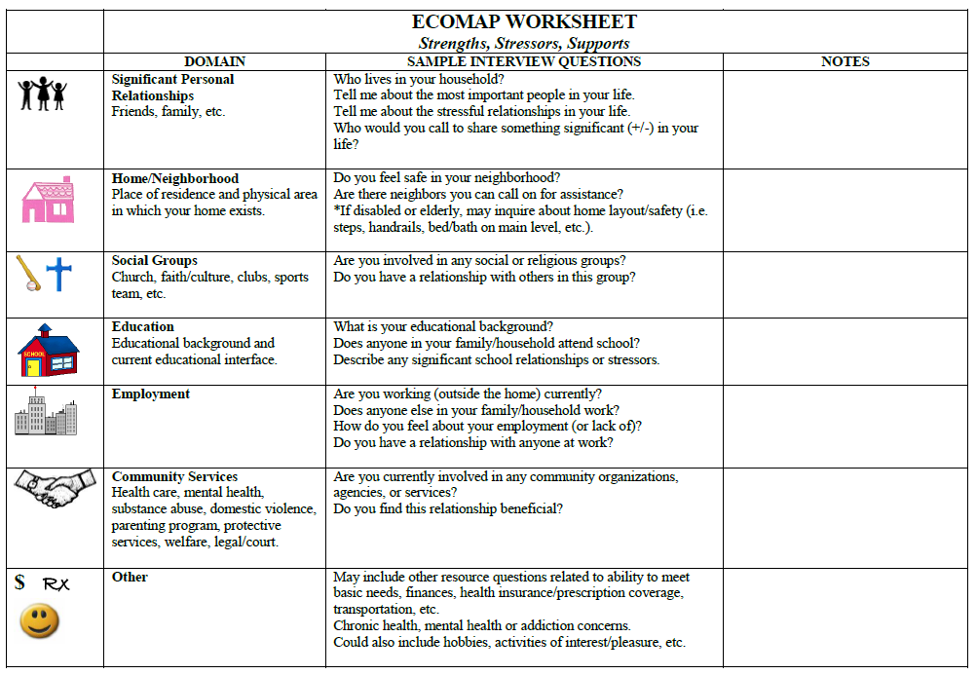

Slide 33
Using Ecomaps
PGY2 & 3
Mental Health Clinic (create while listening)
Patients with complexity
PGY1-3
Home visits
Family conferences
Case presentations
BM didactics
Notes:
Also done by BHC’s for patients seen ongoing and by MSW interns

Slide 34
Other Applications of Ecomaps
“Get to know you” exercise for interns (team building)
Medical student education
Systems-based practice
Health system mgmt.

Slide 35
Family Conferences
Formally taught during psychosocial rotation, “Family Practicum” course
14, 3-hour sessions
Physician and Psychosocial faculty team
Each resident has 2 opportunities
Videotaped + observation team

Slide 36
Family Conferences
Pre-family meeting preparation
Identifying suitable family
Background
Genogram
Hypothesis
Goals
Observer roles

Slide 37
Family Conferences
In session:
Joining
Developing Agenda
Identifying the “problem”
Setting goals

Slide 38
Family Conferences
In session
Adapts his/her behavior to style and affect of family
Recognition and respect for family hierarchy
Avoids coalitions

Slide 39
Family Conferences
In session
Family organization: genogram
Individual and family functioning
Individual and family resources
Summarizes problem
Uses family strengths in developing shared plan

Slide 40
Family Conference Video

Slide 41
How to Integrate This?
Identify and invite champions
Find opportunities to insert or highlight concepts across curricular domains
Family Systems consultation in precepting and co-visits (“listen for”)
Case review/presentations
Didactic modules
Comprehensive Family Oriented Care curriculum
Curiosity and honor for residents’ family lives

Slide 42
Discussion

Slide 43
Resources
STFM Resource Library resourcelibrary.stfm.org
Reflective Material (PULSE, Family Systems & Health, creative writing from peers & learners)
CFHA Webinars cfha.net
ETSU Cancer Stories Project
Emotional Survival Guide for Caregivers (Barry Jacobs, PsyD)
Ted Talks

Slide 44
Contact Us
Colleen_Fogarty@UMRC.Rochester.edu
amy.romain@sparrow.org

Slide 45
Please evaluate this presentation using the conference mobile app! Simply click on the "clipboard" icon on the presentation page.

