Slide 1
Impact of Group Medical Visits on Patient Engagement and Quality of Life
5/3/2022, STFM Indianapolis, IN​
Charlotte Talley Boyd, MA • Carmen Strickland, MD, MPH • Jennifer Roper, MD
Julienne Kirk, PharmD, BCPS • John Spangler, MD, MPH

Slide 2
Disclosures
We have no disclosures to discuss

Slide 3
Objectives
1. Discuss use of the group medical visit (GMV) model for chronic disease conditions in a family medicine residency program​
2. Relate the features of group care models that support enhanced levels of patient activation and the impact this might have on overall health outcomes.​
3. Describe a project assessing impact of GMV on patient activation and quality of life.

Slide 4
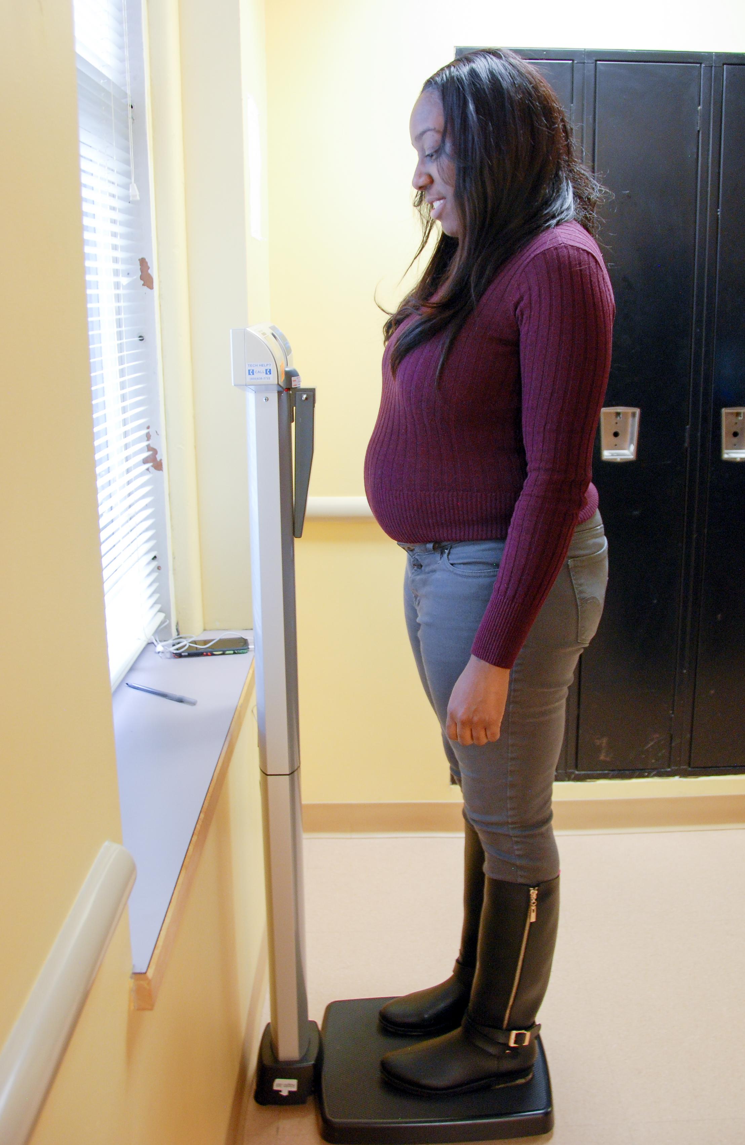
Group Medical Visits at ​ Atrium Health Wake Forest Baptist​ Family Medicine Residency
History​
Team​
Patients/recruiting​
Programs​
Diabetes​
Weight management- Lighten-Up​
Sessions​
Key Elements​
Notes:
SMART goals​
Nutrition/Exercise focus/Behavior Change​
Personalized/Tailored Care plan​
- Accountability​
- Goal Formation​
- Self-discovery​

Slide 5
Why use GMV in residency practice?
Patient Benefits
Resident Benefits
Provider Benefits
Improved health outcomes
Self-management skills
Self-efficacy
Benefit from intensive weight management intervention in primary care practice
Patient satisfaction
Exposure to new care model
Practice with motivational interviewing and lifestyle counseling
Coaching in SMART goals
Resident satisfaction​
Increased time with patients
Deeper view into lifestyle factors of health
Opportunity to assess patient recall
Opportunities for scholarship, QI, and research
Provider satisfaction
Notes:
Patients: Improved outcomes, self-management skills and self-efficacy, e ffective means of integrating multicomponent, intensive, behavioral intervention for obesity management into primary care practice​
Satisfaction/positive feedback​
​
Residents​
Opportunity for exposure to an innovative care model​
Practice motivational interviewing and lifestyle counseling​
Training in SMART goal formation with patients​
Resident satisfactions​
​
Providers​
More time with patients and deeper knowledge of lifestyle factors​
Opportunity to assess patient recall​
Satisfaction in teaching skills that can be applied to multiple health conditions​
Opportunities for scholarship; quality improvement; research​

Slide 6
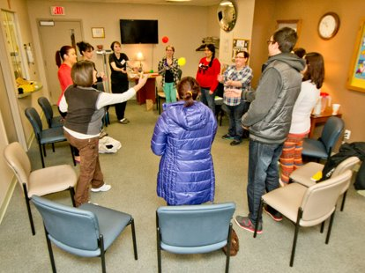
Hypothesis
Group Medical Visits increase patient activation and quality of life (QOL) as measured by PAM and SF-12.

Slide 7
How could GMV enhance patient activation and QOL?
Improved self-efficacy​ in health
More involved in self-care activities (weight and blood pressure) and supervised practice in analyzing these numbers ​
More time with provider in session as provider/facilitators ​
Accountability
Practice use of timely feedback to inform choices
Social support

Slide 8
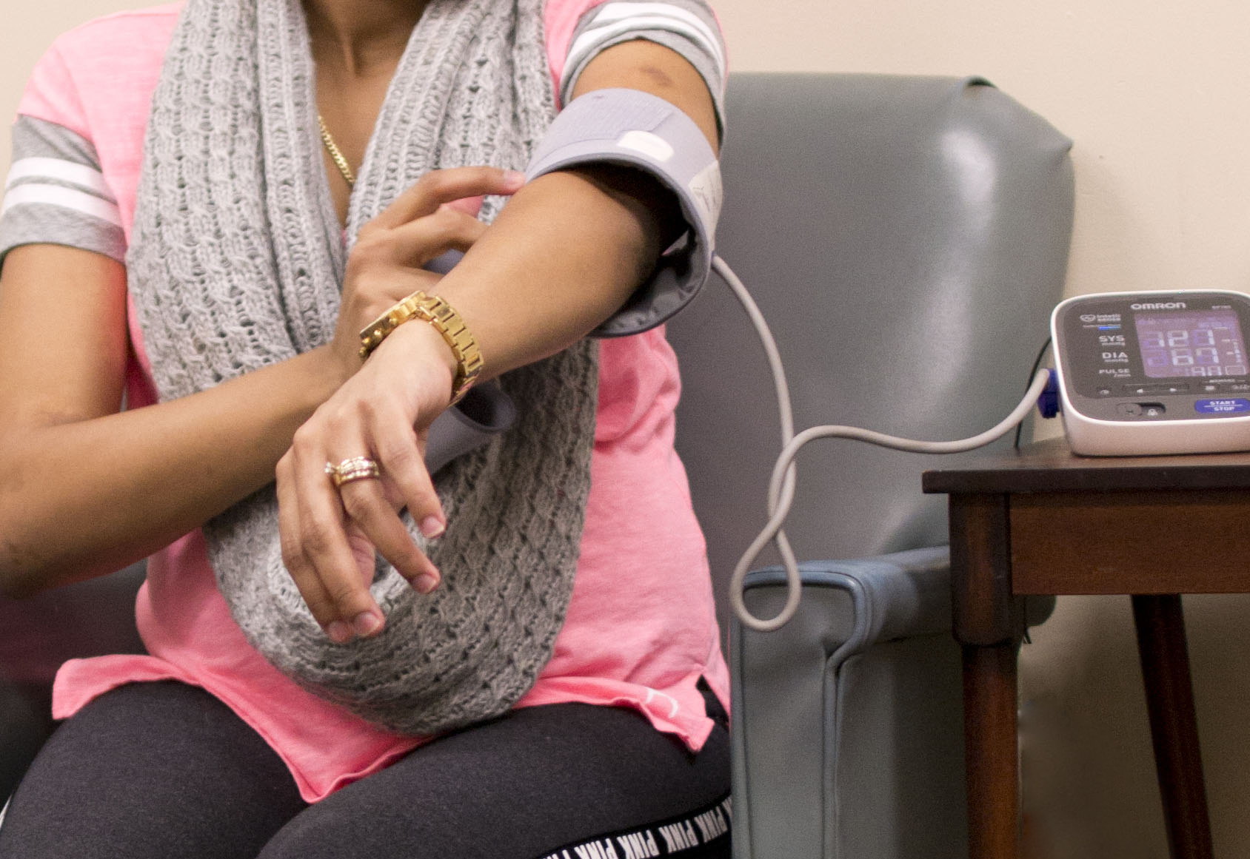
What was the project?
IRB​
Funding ​
Selection/exclusion​
Inclusion criteria
Enrolled in GMV at our practice
Attendance to half of sessions
Outcomes (pre-post)​
PAM​
SF-12 (PCS and MCS) ​
Blood pressure​
Weight​
Hemoglobin A1c (in GMV Diabetes)
Notes:
No funding for project except to purchase PAM and SF-12 (minimal from department, most from provider CME fund)
PAM: $75 as a research license (usually $4500/year)
SF-12: $450/year

Slide 9
Why use PAM and SF-12 with GMV patients?
Objective measure of impact
Role of Patient Engagement (PAM)
Role of Quality of Life (SF-12)
Correlation to medication adherence, hospitalization, appropriate use of healthcare system, healthcare expenditure, etc.
Provides insight into multiple areas that comprise patient health (emotional, social, mental, physical functioning and pain).
There are several measures of SF-12 that can be summarized by physical component score (PCS) and mental component score (MCS).
Notes:
Each point increase in PAM score correlates to a 2% decrease in hospitalization and a 2% increase in medication adherence , tailor education and educational materials​
PCS = physical component score of SF-12
MCS = mental component score of SF-12

Slide 10
Challenges and changes during the project
Maternity Leave​
Pandemic​
Challenging enrollment, particularly for Diabetes​
Compliance with mandates- masks, spacing & group size​
Difficult cohort enrollment (Lighten Up)​
Shifted to rolling sessions​
Every 1st/3rd Thursday evening​
Added Telehealth appointment for Intake visits

Slide 11
Descriptive characteristics
 | Lighten Up | Diabetes
N | 12 | 38
Age, median, years | 56 | 62
Weight, mean (SD), lbs | 266.7 (47.0) | 219.4 (44.4)
Gender Female | 9 (75%) | 26 (66.7%)
Male | 3 (25%) | 13 (33.3%)
Race Black | 6 (50.0%) | 20 (51.3%)
White | 6 (50.0%) | 18 (46.1%)
Hispanic | --- | 1 (2.6%)
HbA1c, mean (SD), % | --- | 8.2 (1.9)
Duration of T2DM, median, months | --- | 89.5
Notes:
Just leave as LU and DM columns or add "All" column as well?
Does there need to be a caption to describe LU and DM? Should headings be different?

Slide 12
Results
 | Time 1 | Time 2 | Mean Difference | SD of Difference | Paired t-test p value
Weight, lbs (SD) Lighten Up Diabetes | 266.7 216.9 | 257.9 213.5 | -8.8 -3.4 | 9.6 5.9 | .006 .002
HbA1c, mean (SD), % Diabetes | 8.1 | 7.2 | -0.9 | 1.2 | .000
PAM Score Lighten Up Diabetes | 60.4 65.7 | 66.8 69.4 | 6.4 3.6 | 12.7 11.2 | .095 .060
SF-12 PCS Lighten Up Diabetes | 44.5 44.3 | 47.7 44.7 | 3.2 0.4 | 6.6 7.1 | .106 .748
SF-12 MCS Lighten Up Diabetes | 48.2 51.6 | 50.3 52.6 | 2.1 0.9 | 7.3 7.8 | .323 .474
Notes:
Weight loss statistically significant in both groups
Statistically significant decrease in A1c
PAM changes borderline statistically significant
Explain that increased access to pharm d and med changes improves a1c outcome along with lifestyle learning

Slide 13
Lessons Learned
Improving weight and blood sugars
PAM/SF12 assessment was challenging​
Timing of A1C
Rolling admission benefits​
Intake visit benefits​
Telehealth
Individual plan
Medication option
Notes:
Surveys took more time than anticipated and took away from the first session
Motivated patients can join at any time, making recruitment easier
Lower patient commitment needed (can drop in and out)

Slide 14
GMV Next Steps
1. Ready for larger groups ​
Co-facilitation​
Light documentation/1:1 interaction time​
Patient teaching and support
2. Adding new providers – onboarding process needed​
Facilitation guide​
Facilitation training​
3. New projects​
Successful CGM project – what's next?
Notes:
Patient teaching and support = older patients teaching newer patients

Slide 15
Photographs used in this presentation used with permission from CHI
Kirk, J et al. (2018). Educational strategies of diabetes group medical visits: a review. Current Diabetes Reviews, 14 (3): 227-236.
Loosman, W, et al. (2015). Short-form 12 or short-form 36 to measure quality-of-life changes in dialysis patients? Nephrology Dialysis Transplant, 30 (7): 1170-1176.
Hibbard, J, et al. (2005). Development and testing of a short form of the Patient Activation Measure. Health Research and Educational Trust.
Wan, W, et a. A. (2018). Economic evaluation of group medical visits for adults with diabetes in community health centers. Diabetes, 67(1).
Thompson-Lastad, A, et al. (2019). Integrative group medical visits: a national scoping survey of safety-net clinics. Health Equity, 3(1).
Kirk JK, Boyd CT, Spangler JG, Strickland CG (2020). Group Medical Visits (GMV): experiences with patient and resident implementation. Expert Rev Endocrin Metab Jan;15(1) 51-57. doi: 10.1080/17446651.2020.1717946, Epub 2020 Jan 28. PMID: 31990589.

Slide 16
Notes:
Final slide?

