Slide 2
Teaching Telehealth for Reproductive Health Care
Mayra Hernandez-Schulte MD, Chelsea Faso, MD
Notes:
Thank you for joining in for our seminar. We will be discussing teaching telehealth for reproductive health care.
This seminar is presented by Mayra Hernandez Schulte and Chelsea Faso.
We are Family Physicians and current Fellows with the Reproductive Health Access Project at the Institute for Family Health in NYC.

Slide 3
Disclosures
None

Slide 4
Learning Objectives
Explore what sexual & reproductive health services (SRH) really require in person care and what can be done via video or phone based on best evidence
Examine the technology and regulations that can be minimized in order to enhance patient safety
Discuss where our advocacy and teaching can be focused in order to provide innovative and safe care
Notes:
(Chelsea)
We’d also like to mention at times we are showing data or quoting studies they may describe their patient population as “women” – what they are referring to is cisgender women. We know that people of all genders get abortions, use contraception, and experience early pregnancy loss.

Slide 5
Assure confidentiality
Notes:
(Chelsea)
A main principle to teach for telehealth is confidentiality. Remember to check with your patient right up front about whether or not they can talk freely and safely. In NYC we have many young people calling us from bathrooms. We have heard that in other cities, people go sit in their cars.

Slide 6
4 Rs of Trauma-Informed Care
1. Realizing the widespread impact of trauma
2. Recognizing signs and symptoms of trauma in people, including patients, their families, staff and clinical team members
3. Responding by fully integrating knowledge about trauma into policies, procedures, and practices, and
4. Seeking to actively resist Re-traumatization
^{Source:}
Trauma-Informed Approach and Trauma-Specific Interventions. http://www.samhsa.gov/nctic/trauma-interventions
Notes:
(Chelsea)
It is important to acknowledge that gyn care can be very triggering for people who have experienced trauma within the healthcare system or in their personal lives. SRH and GYN care can place people in very vulnerable positions (ex. on the exam table). It is important to teach a trauma-informed care approach. Approach care assuming everyone may have a history of trauma. Ask for permission during conversation and during examination, explaining every step of the way. NO unnecessary touching, being extremely gentle. The principles for trauma informed care are listed here.
The upside of telemedicine and doing everything remotely, is that many patients are re-establishing care who many have been avoiding it in person. We can see it as an opportunity to create a comfortable space and build trust so that when in person visits return, we may be able to do the screening tests again. Even there, we can get creative with self-paps and self-swabs.

Slide 7
Contraceptive Counseling

Slide 8
Contraceptive Counseling
What contraceptive options could you offer via telehealth?
What history would you need to know when starting a new contraceptive method?
Notes:
(Chelsea)
We’d first like review one area of SRH: contraceptive counseling
Options for remote contraception prescriptions may include CHCs (Pill, Patch, Ring), POPs, EC, self-administered Depo-SC, and contraceptive gel
As far as history, we are mainly screening for contraindications to estrogen therapy. These include: migraines with aura, uncontrolled HTN, history of or current VTE, history of bariatric surgery for pills, smoking > 15 cigarettes/day and over age 35. These are items that can be reviewed using the CDC Medical Eligibility Criteria
Telehealth protocols suggest if no documented history of HTN in the medical record, or if normal blood pressure documented in the past year, send Rx to pharmacy
You can also ask the patient to check blood pressure on a family member’s home cuff or in the pharmacy
Lastly, we should also determine risk of a person currently being pregnant at the time of starting a method. The US CDC SPR (Selected Practice Recommendations) has criteria that are highly accurate at ruling out a current pregnancy. There are also quick-start algorithms online.

Slide 9
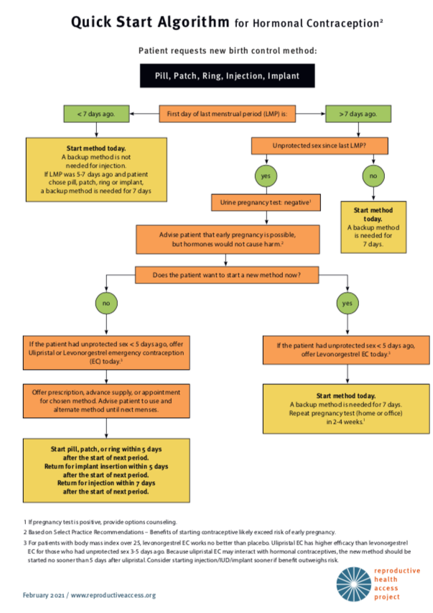
Contraception: Quick Start
LMP
Last Unprotected Sex
Notes:
(Mayra)
In clinic, we can offer a pregnancy test and ask about LMP and last sexual encounter
Over a telemedicine visit we can still ask patient about LMP and last sexual encounter. We may also ask them if they have access to a home pregnancy test. If they did not have intercourse since their last period, they are unlikely to be pregnant, and we can confidently prescribe a birth control method. If someone has had sex since their LMP, we can use the quick start algorithm to see if a patient should be offered emergency contraception, or if there is risk of an early pregnancy. We can reassure patients that hormones would not cause harm in an early pregnancy.

Slide 10
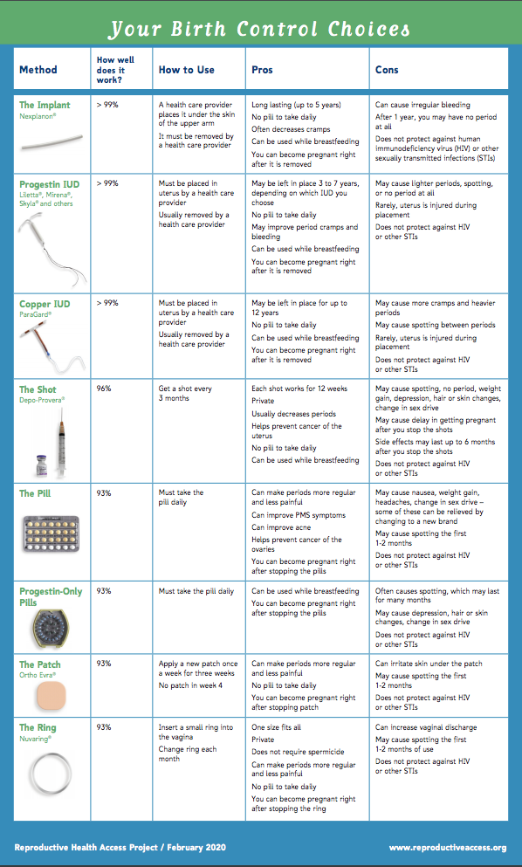
Contraception: Undecided about method
Schedule telemedicine visit
Send information sheet first prior to visit so patient is ready
If patient decides on IUD or implant, discuss timing, risks/benefits of travel, bridge method pros and cons
Notes:
(Chelsea)
When planning a telehealth visit for contraceptive counseling, consider sending written materials about contraceptive options prior to the visit.
Use patient centered counseling and review medical eligibility to decide on a contraceptive method.
For Pills/Patches/Rings/Gels: send Rx to pharmacy with refills for one year
Depo-Provera: offer subcutaneous injectable kit of 104 mg that patient can fill at pharmacy, offer a visit for injection teaching
Some patients may call for EC and it should be dispensed or prescribed liberally
LARC: offer bridge method until a visit is scheduled in-person
Written materials can be found on the RHAP website in multiple languages. Bedsider is another great resource: https://www.bedsider.org/

Slide 11
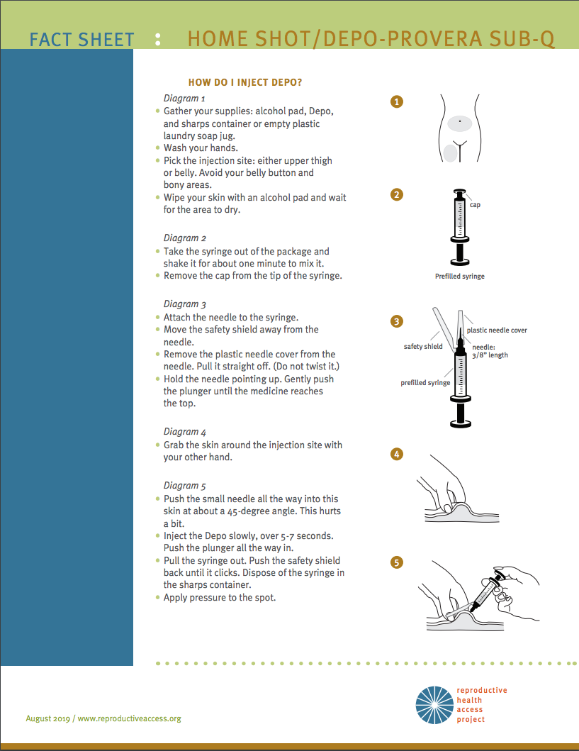
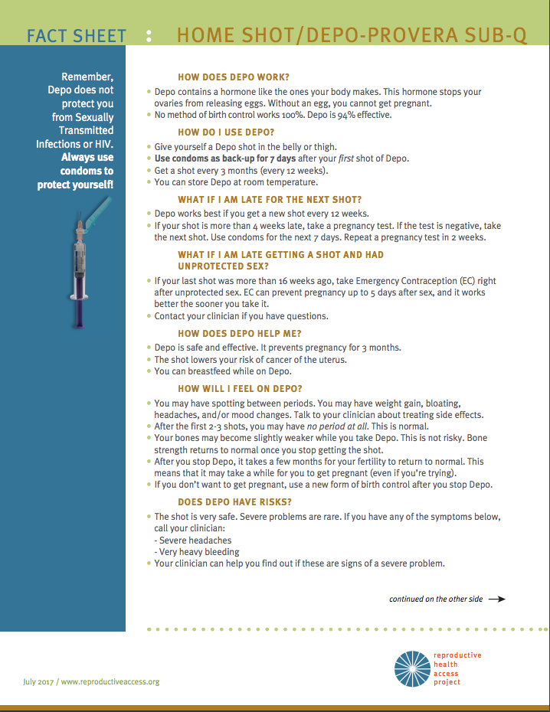
For medroxyprogesterone users: Consider SUB-Q DEPO
Notes:
(Mayra)
There are online patient education materials for self-injection of medroxyprogesterone (Depo)
Again the prescribed dose is 104 mg subq every 12 weeks/3 months,
This compares with the in clinic IM dose of 150 mg with 15 week
SUB-Q medroxyprogesterone was added to NYS Medicaid formulary without a prior authorization, so should be covered by other insurance providers.
Do you offer Sub-Q depo over telehealth?

Slide 12
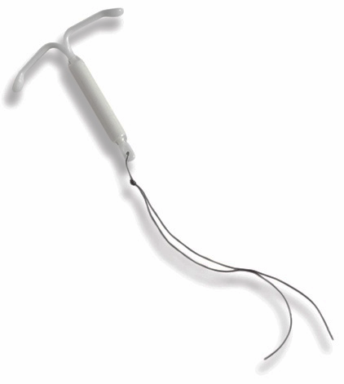
CONTRACEPTION
IUDS & IMPLANTS: PLACEMENTS
Counsel on risks/benefits prior to office visit, via telehealth
IUD/Implant Placement: Proceed with in-person visit if patient does not want a bridge method for now
Notes:
(Mayra)
For LARC devices, we can minimize the number of visits for contraceptive planning, using a telemedicine visit to counsel on risk/benefits prior to an in-office visit. Remaining patient-centered during decisions about logistics, is just as important as when choosing a method. It is important to continue advocacy around sexual and reproductive health: we must resist considering this care as “elective,” even during a pandemic.

Slide 13
CONTRACEPTION
IUDS & IMPLANTS: REMOVALS
Paragard is good for 12 years, Nexplanon for 5, Mirena for 7, Liletta for 8, and Skyla for 3
For IUD removals: offer to teach patient IUD self-removal via telemedicine
Notes:
(Mayra)
For removal of IUD/Implants, we follow evidence based recommendations for length of effectiveness. Counsel that paraguard is effective for 12 years, Nexplanon for 5, mirena for 7, liletta for 8, and Skyla for 3 years. Note that these evidence based intervals may vary from FDA guides (FDA: Paraguard: 10 years, Nexplanon 3 years, Skyla 3, Mirena 7 years).
If past expiration date, can be left in with another method added

Slide 14
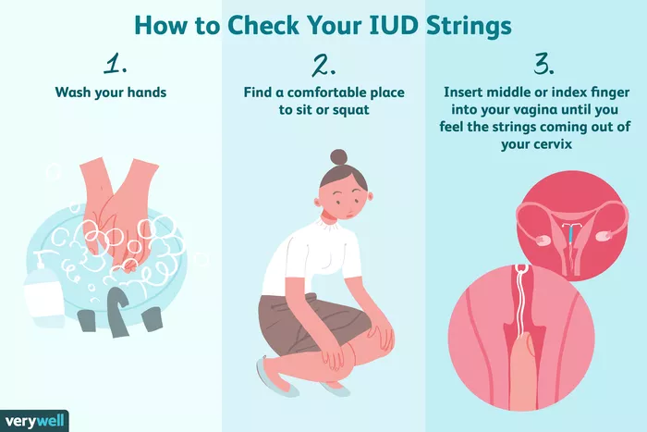
CONTRACEPTION
IUD SELF-REMOVAL: Position and string length are important
Notes:
(Mayra)
For those interested in self removal: sitting with one foot up on chair to push cervix down. Reach into vagina and try to twirl strings around one finger and then grasp strings with that finger and thumb to pull. Works best when strings have been left long
It is important to counsel about self-removal at time of device placement, as this may guide how long we should leave the strings. Longer string lengths (~7 cm) were associated with higher success of IUD self-removal.
If patient does not want to wait or try self removal and has urgent concern, proceed with an in-person visit (or really if patient just wants it out)
Image source: https://www.verywellhealth.com/how-to-check-your-iud-strings-906659

Slide 15
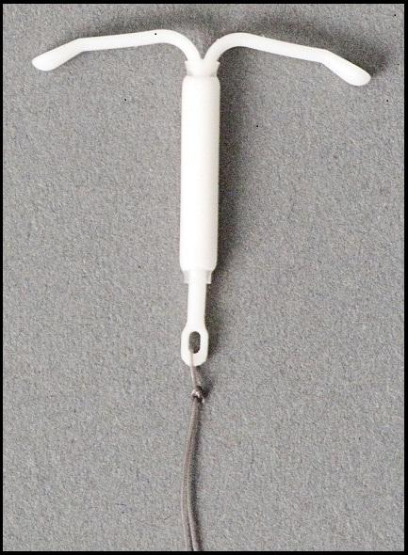
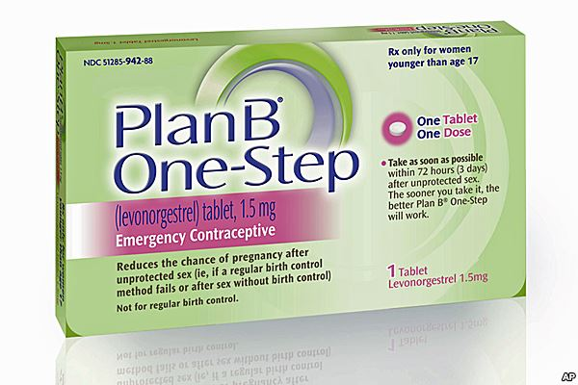
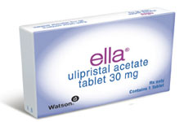
CONTRACEPTION
Emergency Contraception
Factors that will affect the efficacy of the emergency contraception (EC) pill:
LMP
Timing of last unprotected sex
BMI
Notes:
(Mayra)
Plan B (Levonorgestrel) – effective up to 3 days after unprotected sex, loses efficacy in patients with BMI over 26 and efficacy decreases with time from unprotected sex.
Ella (ulipristal acetate) – more effective than Plan B, maintains nearly full efficacy on 4th and 5th day. Used up to 5 days after unprotected sex. Loses efficacy in patients with BMI over 35.
Copper/Progestin IUD- most effective, can be placed up to 5 days post-unprotected sex.

Slide 16
CONTRACEPTION
Starting hormonal contraception after Ella
Ella is a progesterone receptor modulator
A hormonal contraceptive method will theoretically compete with Ella and may render it useless
Notes:
(Mayra)
When counseling a patient on when to initiate hormonal contraception after using Ella for EC, it is recommended to advise starting (or resuming) hormonal contraception no sooner than 5 days after use of UPA.
This is because Ella/UPA is a progesterone receptor modulator, and there is a theoretical risk of decreased effectiveness if used with other progestins. Since this interaction is purely theoretical, we can used shared decision making, and balance the weighted risk of decreased Ella effectiveness vs risk of not starting another contraceptive method. You can always recommend your patient to take a pregnancy test in 2-3 weeks if opting to start hormonal method immediately after taking ella.
If EC copper IUD, no need
If EC ulipristal, wait 5 days to start any method – ACOG rec based on one study and theoretical interaction – often not practical
Use shared decision making, and if Casey wants to start a method the same day, counsel on risks of early pregnancy and recommend taking a pregnancy test in 2 weeks
If EC levonorgestrel, start ASAP– can put in progesterone IUD same day as EC
Over 90% of women who use EC do not get pregnant and remain at risk of conception from further acts of sexual intercourse unless they use another contraceptive method.
Ella (Ulipristal acetate, UPA) is a selective progesterone receptor modulator, and in theory Ella could alter the effectiveness of progestogen-containing contraception started immediately after EC. The results of a recently published pharmacodynamic study of the effect of UPA or placebo followed by quick-starting a combined OC pill were reassuring in that there was no difference in the timing of the onset of ovarian quiescence associated with starting the COC.
Though there is a very real possibility that quick-starting a POP may jeopardize the contraceptive effectiveness of UPA itself, significantly reducing the chance of the emergency contraceptive preventing a pregnancy resulting from the act of intercourse for which it was taken in the first place.
Thus would be important to discuss benefits/risks/alternatives.
Glasier A, Starting hormonal contraception after using emergency contraception: what should we recommend?, Human Reproduction, Volume 30, Issue 12, December 2015, Pages 2708–2710, https://doi.org/10.1093/humrep/dev242

Slide 17
CONTRACEPTION
Options for transgender patients:
Items to consider:
desire for menses
feelings about pelvic exam
whether estrogen may counter some effects of testosterone
Notes:
(Mayra)
When counseling our transgender male patients, all contraceptive methods remain eligible options. We can prescribe the method that is medically safe and conducive to personal goals. Some things to consider include desire for menses, feelings about a pelvic exam (for IUDs), and interactions between estrogen components countering effects of gender-affirming therapy.
We must also consider the multiple barriers that exist for patients on the gender spectrum (including physical discomfort, emotional and gender dysphoria related discomfort, insurance difficulties, stigmatization and discrimination by other patients, staff, pharmacies, and medical providers).
Special issues to keep in mind regarding contraception options:
Interactions with cross-gender hormonal therapy, ie- if on testosterone may not want estrogenic effects of birth control
Desire to have or not have monthly menses
Apprehension about pelvic exam, history of trauma
History of uterine or pelvic reconstructive surgery
Reference: Potter, J., Peitzmeier, S. M., Bernstein, I., Reisner, S. L., Alizaga, N. M., Agénor, M., & Pardee, D. J. (2015). Cervical cancer screening for patients on the female-to-male spectrum: a narrative review and guide for clinicians. Journal of general internal medicine, 30(12), 1857-1864.
May prefer methods that diminish menses and have less estrogenic effects

Slide 18
Pregnancy Options Counseling

Slide 19
Pregnancy Options Counseling
How would you approach a telehealth visit for a positive home pregnancy test or missed/late menstrual period?
Notes:
(Chelsea)
We’d now like to introduce another topic in SRH: options counseling.
After a pregnancy diagnosis, our options are mainly continue or terminate. From there we can counsel on abortion options: medication vs procedure.
Sources:
Abortion Access in the United States, 2014, https://www.guttmacher.org/infographic/2017/abortion-access-united-states-2014
Abortion Incidence and Service Availability in the United States, 2014, https://www.guttmacher.org/journals/psrh/2017/01/abortion-incidence-and-service-availability-united-states-2014

Slide 20
MEDICATION ABORTION
NO-TOUCH, NO TEST PROTOCOLS
Need sure LMP under 11 weeks
No labs except patient reported positive urine test
No Rhogam under 10 weeks
No ultrasound if sure LMP
Remote counseling and consent (RHAP website)
Still offer procedural abortion as option – remain patient centered
Follow up done with telehealth visit
Notes:
(Chelsea)
Providing medication abortion is safe and can be done remotely based on evidence based protocols (like the no touch-telehealth based protocol seen here). The pandemic has accelerated reliance on these protocols, and has enabled us to expanded abortion access.
If planning for a pill/medication abortion, what history should we gather over telemedicine?
We should gather an estimation of gestational age. MAB has proven efficacy for up to 11 weeks GA, and likely farther.
We would assess for contraindications to MAB - IUD in place (can be self-removed and then proceed with MAB) - allergy to prostaglandins or mifepristone - chronic renal failure - long-term systemic corticosteroid therapy - hemorrhagic disorders - concurrent anticoagulant therapy - no access to a telephone
Some highlights from the no-touch, no-test protocol include the following:
Rhogam is a medication that stops your blood from making antibodies to Rh+ blood cells. Evidence suggests that under 8 weeks GA, and probably further, exposure to fetal red blood cells is below the threshold for maternal Rh sensitization (only a risk for future pregnancies)
RHAP has protocols and consent templates that can be exchanged over virtual platforms and bypass need for in-person signatures
Follow up is guided by clinical assessment based on history
Pills can be mailed to certified pharmacies or patients can drop by an office to pick up the pills. Pills do NOT have to be ingested in the presence of a provider/prescriber. This is regulated by the FDA REMS, which I will elaborate on later.
SOME STATES MAY PERMIT MAILING (19 states block clinicians from mailing medication abortion remotely as of Jan 2022)
It is important to reassure patients that first trimester abortions do not increase risk of:
Infertility, Ectopic pregnancy, Miscarriage, Birth defect, Preterm or low-birthweight delivery
https://www.reproductiveaccess.org/wp-content/uploads/2020/03/03-2020-No-touch-MAB-workflow-final.pdf

Slide 21
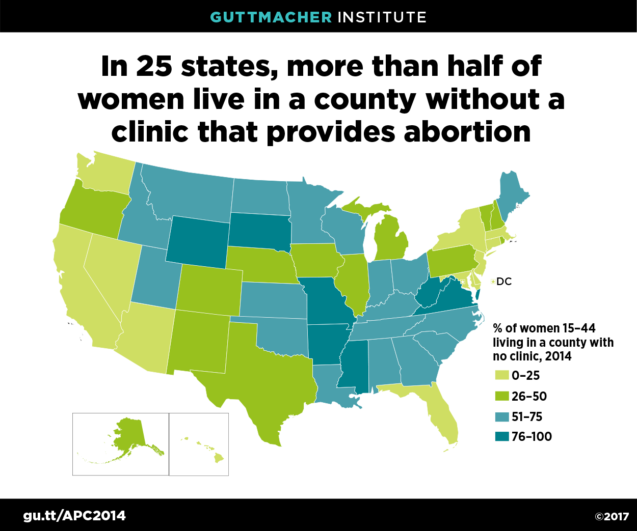
Abortion access
Notes:
(Chelsea)
A note on abortion access:
In 2014, about 90% of US counties had no abortion provider. Numbers are essentially stable from 2011.
The number of clinics providing abortions declined 6% between 2011 and 2014, and declines were steepest in the Midwest (22%) and the South (13%).
25% of pregnant persons travel greater than 50 miles to access abortion services
If most primary care clinicians offered medication abortion, the US would no longer have a shortage of abortion providers.
NAF highlights that sub-specialty training/accredidation is not necessary to provide safe abortion care
Sources:
Abortion Access in the United States, 2014, https://www.guttmacher.org/infographic/2017/abortion-access-united-states-2014
Abortion Incidence and Service Availability in the United States, 2014, https://www.guttmacher.org/journals/psrh/2017/01/abortion-incidence-and-service-availability-united-states-2014

Slide 22
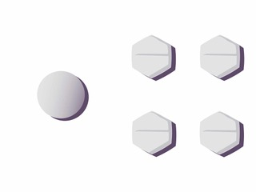
THE MOST COMMON REGIMEN IN THE U.S Mifepristone + Misoprostol
Notes:
(Chelsea)
Protocol:
Gestational age limit
77 days off label (70 days by FDA)
Mifepristone dose
200 mg oral Taken in office or at home
Misoprostol dose and route can vary based on GA and clinic protocol
Office or Phone/Telehealth follow-up visit
7-14 days after mifepristone
Minimum office visits
1-2
Cost of medications
$60-90 for mifepristone; $4 for miso

Slide 23
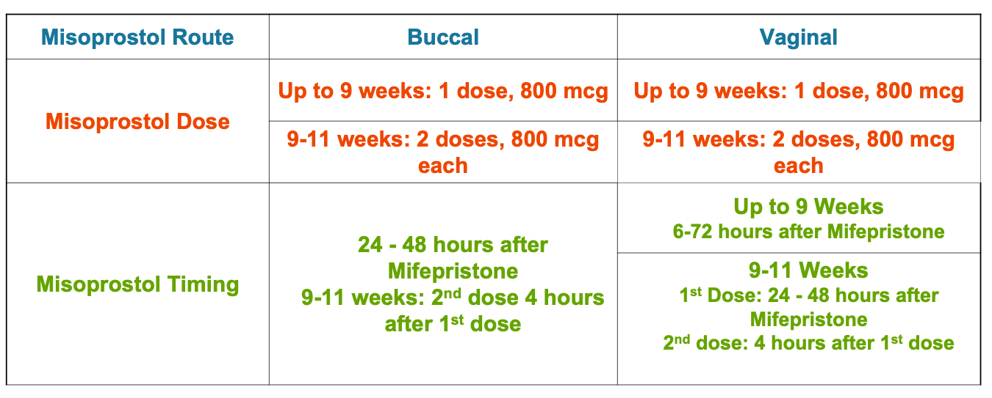
Misoprostol Route and Timing
Notes:
(Chelsea)
Misoprostol dose can vary based on GA
Routes of administration vary based on clinic protocols, and include buccal (between cheeks and gums) and vaginal
Misoprostol comes in 200 mcg tablets, a full dose is 4 tablets buccally or vaginally
For GA above 9 weeks (63 days) a second dosing of misoprostol improves the success of the medication abortion
References for extended gestational limit
Beverly W, Dzuba IG, Chong E, et al. Extending Outpatient Medical Abortion Services Through 70 Days of Gestational Age. Obstetrics & Gynecology. 2012;120(5):1070-1076. doi:10.1097/AOG.0b013e31826c315f.
Bracken, H., N.T.N. Ngoc, E. Schaff, K. Coyaji, S. Ambardekar, E. Westheimer, B. Winikoff. Mifepristone Followed in 24 Hours to 48 Hours by Misoprostol for Late First-Trimester Abortion. Obstetrics and Gynecology (Apr 2007), 109 pp.895-901.
Kapp N, Eckersberger E, Lavelanet A, Rodriguez MI. Medical abortion in the late first trimester: a systematic review. Contraception. 2019;99(2):77-86. doi: 10.1016/j.contraception.2018.11.002.
Schaff EA, Fielding SL, Eisinger SH, Stadalius LS, Fuller L. Low-dose mifepristone followed by vaginal misoprostol at 48 hours for abortion up to 63 days. Contraception. Jan 2000;61(1):41-46.
Schaff EA, Fielding SL, Westhoff C. Randomized trial of oral versus vaginal misoprostol 2 days after mifepristone 200 mg for abortion up to 63 days of pregnancy. Contraception. Oct 2002;66(4):247-250.
References for lower mifepristone dose
Li C-L, Chen D-J, Song L-P, et al. Effectiveness and Safety of Lower Doses of Mifepristone Combined With Misoprostol of the Termination of Ultra-Early Pregnancy: A Dose-Ranging Randomized Controlled Trial. Reproductive Sciences. 2014;22(6):706-711.
Weeks AD and Stewart P. The use of low dose mifepristone and vaginal misoprostol for first trimester termination of pregnancy. Br J Fam Planning 1995;21:85-86.
World Health Organization Task Force on Post-Ovulatory Methods of Fertility Regulation. Comparison of two doses of mifepristone in combination with misoprostol for early medical abortion: a randomized trial. BJOG 2000 107(4): 524-530
Schaff EA, Eisinger SH, Stadalius LS, Franks P, Gore BZ, Poppema S. Low-dose mifepristone 200 mg and vaginal misoprostol for abortion. Contraception. Jan 1999;59(1):1-6.
References for higher misoprostol dose
Coyaji,K., U. Krishna, S. Ambardekar, H. Bracken, V. Raote, A. Mandlekar, B. Winikoff. Are two doses of misoprostol after mifepristone for early abortion better than one? British Journal of Obstetrics and Gynaecology, (Mar 2007), 114 (3), pp. 271–278.
Castillo P, Sanhueza P, Hernandez EML, Bousieguez M, Dzuba I. Does a repeat dose of 800mcg misoprostol following mifepristone improve outcomes in the later first trimester? A retrospective chart review in Mexico City. Paper presented at: National Abortion Federation Annual Meeting; April 22, 2017; Montreal, Quebec.
References for non-oral misoprostol route
Schaff EA, et al. Vaginal misoprostol administered at home after mifepristone (RU486) for abortion. J Fam Pract 1997;44:353-60.
Schaff EA, Fielding SL, Westhoff C. Randomized trial of oral versus vaginal misoprostol at one day after mifepristone for early medical abortion. Contraception. Aug 2001;64(2):81-85.
Schaff EA, Fielding SL, Westhoff C. Randomized trial of oral versus vaginal misoprostol 2 days after mifepristone 200 mg for abortion up to 63 days of pregnancy. Contraception. Oct 2002;66(4):247-250.
Winikoff B. Oral vs buccal administration of misoprostol after mifepristone for medication abortion up to 63 days. Obstetrics and Gynecology 2008, accepted for publication.
References for misoprostol timing
Guest J, Chien P, Thomson M, Kosseim ML. Randomised controlled trial comparing efficacy of same day administration of mifepristone and misoprostol for termination of pregnancy with the standard 36- to 48-hour protocol. Bjog. Oct 2005;112(10):1457.
Schaff EA, Fielding SL, Westhoff C, et al. Vaginal misoprostol administered 1, 2, or 3 days after mifepristone for early medical abortion: A randomized trial. Jama. Oct 18 2000;284(15):1948-1953.
Shannon C., E. Wiebe, F. Jacot, E. Guilbert, S. Dunn, W.R. Sheldon, B. Winikoff. Regimens of misoprostol with mifepristone for early medical abortion: a randomised trial. British Journal of Obstetrics and Gynaecology (Jun 2006), 113(6), pp 62-628.
Creinin MD, Fox MC, Teal S, Chen A, Schaff EA, Meyn LA: MOD Study Trial Group: A randomized comparison of misoprostol 6 to 8 hours versus 24 hours after mifepristone for abortion. Obstet. Gynecol. 2004 103(5 Pt. 1): 851-859

Slide 24
Mifepristone REMS
Prescribers must be certified: complete a form attesting that they can:
- Accurately date pregnancies
- Diagnose ectopic pregnancies
- Provide care or refer for incomplete AB or bleeding
Patients must sign a Patient Agreement Form
FDA updates - restrictions continue without evidence
Notes:
(Chelsea)
The FDA REMS (Risk Evaluation and Mitigation Strategy) is drug safety program, required for medications with serious safety concerns to help ensure that benefits of the medication outweigh the risks. Examples of medications under REMS include clozapine and chemotherapy agents
The Mifepristone REMS involves prescribers completing a certification attesting their capability to date a pregnancy, diagnose ectopic pregnancy, and provide care for incomplete MAB. It also requires patients to sign an agreement form.
The Mifepristone REMS requires that a certified provider dispense the medication. It is NOT required for a patient to consume the medication at a clinic or with a provider.
The FDA has lifted the in person dispending requirement for Mifepristone as of Dec 2021. Arguments continue that Mifepristone/MAB is safe and, effective, and that the REMS poses an undue burden on patients and providers.
Regulations may also vary by state
19 states still require the clinician providing a MAB to be physically present when the medication is administered, thereby prohibiting the use of telemedicine to prescribe MAB
In 13 states, Mifepristone is available by mail (Hawaii, Washington, Oregon, New Mexico, Colorado, Georgia, New York, Maine, Iowa, Minnesota, Illinois, Maryland and Montana)

Slide 25
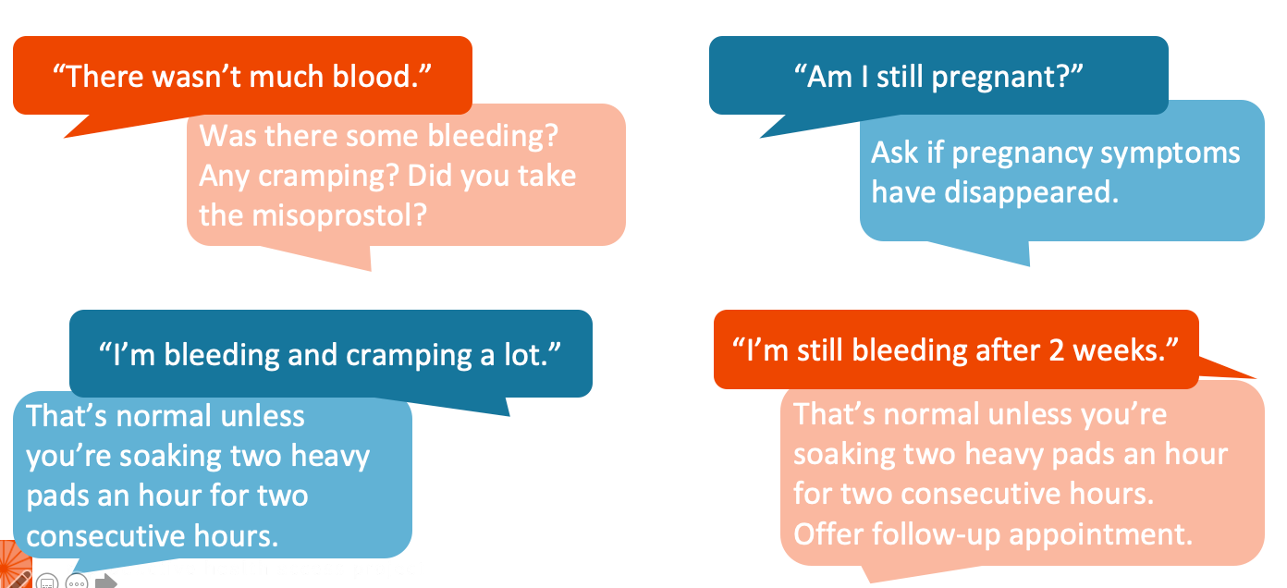
Phone calls after medication abortion
Notes:
(Mayra)
Follow up for medication abortion can be completed over telemedicine. Confirming completion of a MAB involves a clinical history, and can be narrowed down to 4 questions: 1) Did you take the pills, 2) Did you have bleeding after taking the pills, 3) Did you have cramping after taking the pills, and 4) Do you still feel pregnant
Patients may call with symptoms that worry them. For the vast majority, the only necessary interventions are listening and reassuring.

Slide 26
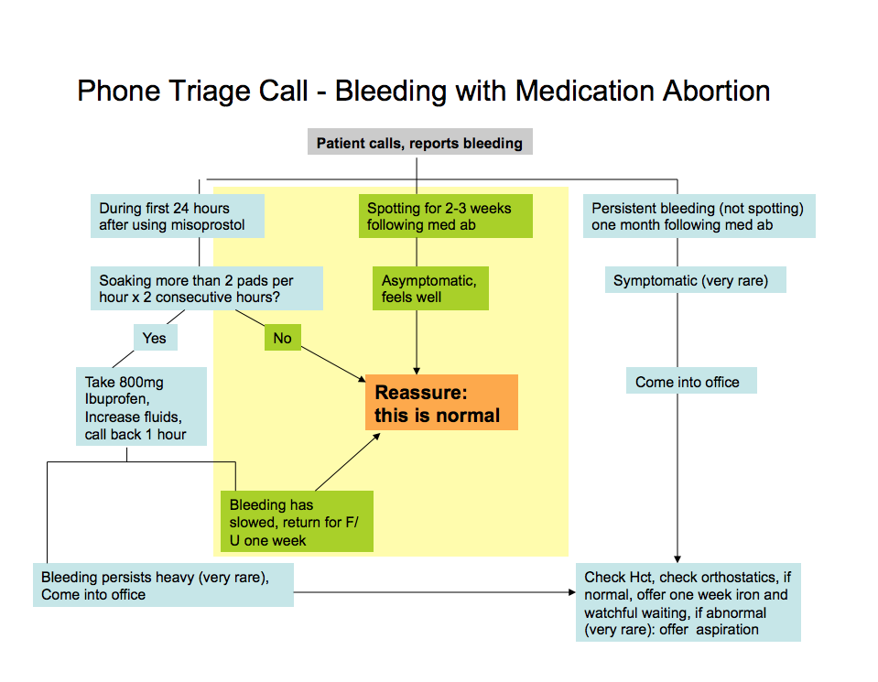
CALLS ABOUT MEDICATION ABORTION
Notes:
(Mayra)
RHAP provides algorithms for triaging phone calls about bleeding with medication abortion using mifepristone and misoprostol.
This triage sheet applies to medication abortion with Mife and misoprostol

Slide 27
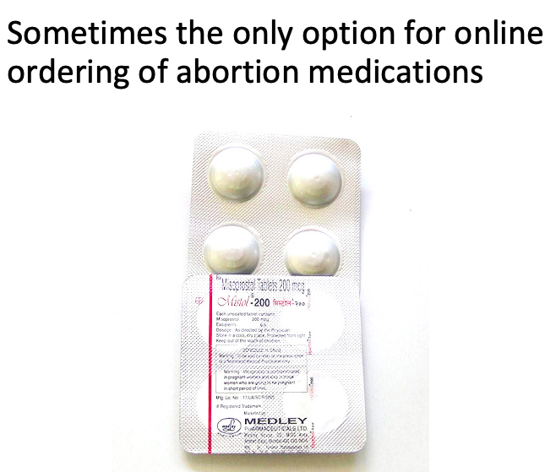
Misoprostol alone medication abortion
Notes:
(Mayra)
Misoprostol-only MAB protocols have been used more globally. Misoprostol is inexpensive and readily available in most countries.
Usual dosage is 800mcg sublingual or buccal every 3-4 hours x 3 or until it works.
Availability of this method has decreased maternal morbidity and mortality in countries where abortion remains illegal.
The phone calls after a misoprostol only abortion may be different, and more studies need to be done on what the optimal dosage is.
Studies of Misoprostol Alone Regimens
Ho PC, Blumenthal PD, Gemzell-Danielsson K, Gómez Ponce de León R, Mittal S, Tang OS. Misoprostol for the termination of pregnancy with a live fetus at 13 to 26 weeks. Int J Gynaecol Obstet. 2007 Dec;99 Suppl 2:S178-81
Moreno-Ruiz NL, Borgatta L, Yanow S, Kapp N, Wiebe ER, Winikoff B. Alternatives to mifepristone for early medical abortion. Int J Gynaecol Obstet. 2007 Mar;96(3):212-8
van Bogaert LJ, Sedibe TM. Efficacy of a single misoprostol regimen in the first and second trimester termination of pregnancy. J Obstet Gynaecol. 2007 Jul;27(5):510-2
Wiebe ER, Trouton KJ, Lima R. Misoprostol alone vs. methotrexate followed by misoprostol for early abortion. Int J Gynaecol Obstet. 2006 Dec;95(3):286-7
Blanchard K, Shochet T, Coyaji K, Thi Nhu Ngoc N, Winikoff B. Misoprostol alone for early abortion: an evaluation of seven potential regimens. Contraception. Aug 2005;72(2):91-97. Blanchard K, Winikoff B, Ellertson C. Misoprostol used alone for the termination of early pregnancy. A review of the evidence. Contraception. Apr 1999;59(4):209-217.
Jain JK, Dutton C, Harwood B, Meckstroth KR, Mishell DR, Jr. A prospective randomized, double-blinded, placebo-controlled trial comparing mifepristone and vaginal misoprostol to vaginal misoprostol alone for elective termination of early pregnancy. Hum Reprod. Jun 2002;17(6):1477-1482.

Slide 28
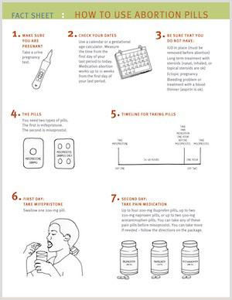
MEDICATION ABORTION
PROTOCOLS & RESOURCES
Protocol using mifepristone & misoprostol
Medication abortion FAQs
Sam’s Medication Abortion zine
How to use medication abortion pills fact sheet
Notes:
(Chelsea)
RHAP is one of many great online resources for reproductive and sexual health information for providers and patients, including protocols, FAQs, and patient ed materials
https://www.reproductiveaccess.org/resources/?rsearch=&rtopic%5B%5D=42
www.reproductiveaccess.org

Slide 29
Mifepristone ordered online or via telehealth
Notes:
(Mayra)
Like we reviewed, MAB using Mifepristone and Misoprostol can be provided in some states using telehealth. This regimen is also available online, through self-sourced means (not involving a health care provider).
Family medicine clinics and academic centers that already dispensed are now working on mailing
Access Delivered/Plan C is developing a tool kit on how to do mife remotely in collaboration with UW
Hotlines to support people who are self managing: ReproCare and M&A Hotline

Slide 30
SELF SOURCED/SELF MANAGED
Notes:
(Mayra)
Online startups: Hey Jane and Top Drawer/Choix, Also Plan C, AID Access, can help pregnant people in the community access this regimen without a prescriber.
There are also hotlines to support people who are self-sourcing and self-managing their abortions, including Plan C and M+A Hotline
Plan C: a website dedicated to up to date information on medication abortions and where to get the pills online plus phone and text support.
MAhotline.org: Phone or text support for self managed miscarriage or abortion with resources for more indepth support.

Slide 31
Reproductive Legal Helpline
Notes:
As our talk does not focus on legal questions about medication abortions. IF/When/How is an organization that can assist with questions about legal rights and self managed abortion. They may also be able to assist in finding lawyer if needed.

Slide 32
Miscarriage Management

Slide 33
MISCARRIAGE
PREGNANT AND BLEEDING
Send patient for remote ultrasound diagnosis
Send patient to lab only for serial quants
Treatments that may not need in person care: expectant and medication (with the exception of medication pickup)
Still offer all three forms of treatment for patient to decide what’s best for them
Notes:
(Chelsea)
Components of miscarriage managment can be conducted via telehealth as well
If a miscarriage is confirmed by ultrasound criteria, counseling about options (expectant management, medication, and procedural management) can be done via telehealth
We can schedule needed ultrasounds and lab visits

Slide 34
Conclusions
Telemedicine is a tool that can expand access to sexual & reproductive health services, including contraception, abortion, and miscarriage management
Future considerations:
Health Equity
Advocacy
Notes:
Telehealth overall can be a method for expanding access.
With any new innovation in medical care, we must examine its implication with a health equity lens, understanding that the design of our health system in inequitable
We must be cautious to not assume remote care is the preferred method of care for some. Some studies have found that younger folks and some communities prefer in-person care over telehealth. We must also consider telehealth could possibly worsen disparities in care for folks with poor internet/wireless access, digital literacy, or limited device availability (ex children using phone/computer for school), just to name a few.
Inequitable care determined by zip code/state. Providing care across state lines.

Slide 35
REFERENCES
Foster DG, Karasek D, Grossman D, Darney P, Schwarz EB. Interest in using intrauterine contraception when the option of self-removal is provided. Contraception. 2012;85(3):257-262. doi: 10.1016/j.contraception.2011.07.003.
Hendriks E, MacNaughton H, MacKenzie MC. First Trimester Bleeding: Evaluation and Management. Am Fam Physician. 2019;99(3):166-174.
Hendricks E, Rosenberg R, Prine L. Ectopic Pregnancy: Diagnosis and Management. Am Fam Physician. 2020 May 15;101(10):599-606.
Raymond EG, Grossman D, Mark A, et al. Commentary: No-test medication abortion: A sample protocol for increasing access during a pandemic and beyond. Contraception. 2020;101(6):361-366. doi: 10.1016/j.contraception.2020.04.005.
US CDC Medical Eligibility for Contraceptive Use, 2016.
Wu JP, Pickle S. Extended use of the intrauterine device: a literature review and recommendations for clinical practice. Contraception. 2014;89(6):495-503. doi: 10.1016/j.contraception.2014.02.011.

