Slide 1
Towards More Sustainable Programming for Global Health Missions
Laban Tsuma MD MPH
10/05/2017

Slide 2
Global Health Missions
Medical outreach to disadvantaged or hard-to-reach areas is the focus for global health missions.
How is population health momentum sustained after the missions?
Where they exist, community health programs run by community health workers play are key role to fill the existing gap between the public health system and households. This helps to foster benefits after missions and prevents erosion of coping skills.

Slide 3
Kenya
The local environment is complex-made up of community, aspirations, institutions, partners
Projects (read global health missions) are time limited investments/initiatives (that deliver a set of activities) that produce outcomes within a community
Projects that deliver desired community outcomes are more likely to be sustained in some form by other community resources long after the initial project has come to an end

Slide 4
What we know about Global Health Missions
Short-term experiences and activities should be designed and planned to lay the foundation for long-term, collaborative, equitable relationships that address the true needs of international communities and health systems and contribute to their further development and sustainability
As regards sustainability: The program should show a commitment to an ongoing relationship, contributing to sustained improvement in health outcomes of the community, not self-serving to the participants, and consistent with the community’s cultural standards. Through long-term relationships, collaboration, and cooperation with in-country organizations and entities strive to augment, enhance, or develop local services for long-term impact.
As regards service: Collaboration with a government agency, a non-government agency, or a community organization is essential.
As regards education: Enhance and develop the skills, abilities, competence, and stature of our international colleagues, local caregivers, members of the health care system of the country, as well as volunteers/participants
Notes:
What we do not know well enough (or know how to do)
How do we maximize long term impacts through our global health projects?

Slide 5
Tenwek Hospital
Tenwek Community Development uses the local church institution to mobilize community for health through volunteers called CRPs (community resource persons). Enablers and barriers exist and these keep on changing with time.
Tenwek’s strategy: A community health department seeking to strengthening Community Volunteers as part of the global health mission project
What do we know about scaling up and sustainability of CHW programs?

Slide 6
Scaling up and sustainability of CHW programs
A Systematic review of Determinants of success in scaling up and sustaining CHW programs in LMICs identified 23 enablers and 15 barriers which were grouped in 3 thematic categories:-
-program design and management,
-community fit,
-integration with the broader environment
A CHW performance tool was applied at Tenwek (an established CHW program located at the site of ongoing health mission). Enablers and Barriers were identified and discussed.

Slide 7
Testing out these results in a live setting
-program design and management
CRPs are married women, available and not too old, respectable and trustworthy, willing to serve and must successfully complete the 1st training.
CRPs are motivated via community recognition by having local pastors commission them for service after training, increasing their network or net worth in the community, receiving training, replacing home based water filters provided by program for a fee, transitioning to be local elected leaders or chiefs.
TCD have employed field staff who supervise the CRPs weekly
Notes:
Tenwek Community Development uses the local church institution to mobilize community for health through volunteers called CRPs (community resource persons)

Slide 8
Testing out these results in a live setting
-community fit
CRPs work on community priorities by engaging communities in identifying needed interventions, establishing goals and targets, helping to install social sanctions re violators of community interest
-integration with the broader environment
Integration is fostered by having government personnel and other stakeholders involved in CRP training and CRPs “do not belong to Tenwek but to everybody”

Slide 9
Where do we go from here?
For example, can training (and empowerment) of health workers and community resource persons be built into the Global Health Mission Project?
How do we prioritize what key areas of empowerment make the most sense specific to our location?
The Center for Design and Research for Sustainability program has developed a sustainability framework that identifies 5 characteristics that define sustainability at the community setting.

Slide 10
Sustainability Assessment
These 5 characteristics include
health outcomes (reduction in morbidity and mortality),
health services quality and organization (performance of local health institutions),
local organizations capacity and viability (functionality and connectedness of community institutions like schools, churches etc),
community involvement (empowerment of community volunteers) and
external factors (political landscape)

Slide 11
The Future
Global Health Missions are projects targeting a community and are time-limited. They usually employ in areas of unmet health need which is hard to reach and poorly connected to the local health system
A project needs to adapt to make its cause sustain within a community after it comes to an end
Is it possible to identify and measure sustainability factors within the project and using project resources to strengthen them?

Slide 12
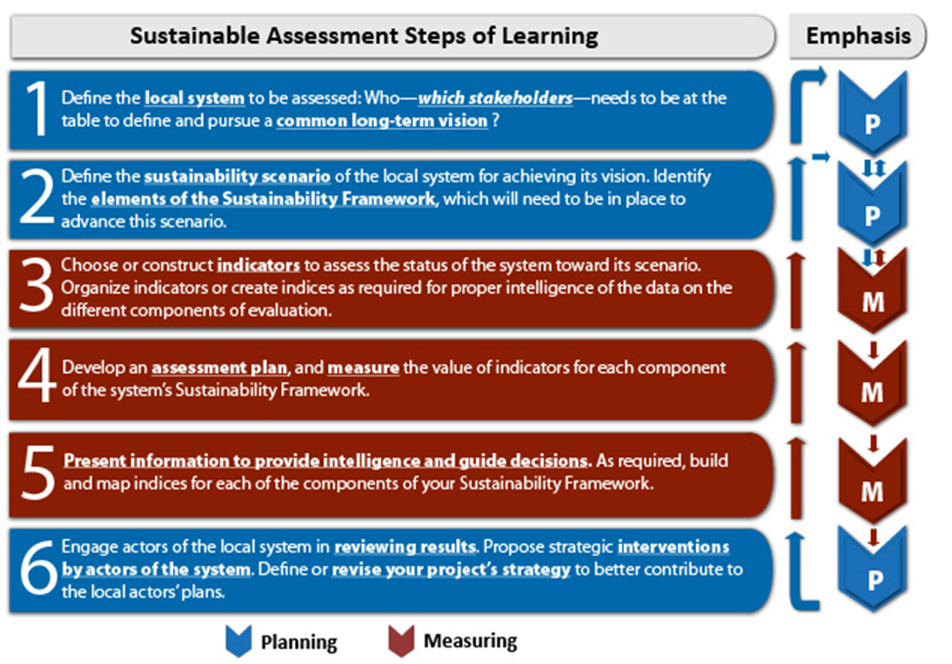

Slide 13
Lessons Learned
Global Health Missions have the potential of causing harm
Short term programs can encourage lasting health and social impact by inclusive planning
Projects need to guide situational assessment with project stakeholders at the beginning of any project to ensure that enablers are maximized and barriers avoided. They should maintain a dashboard for sustainability that stakeholders can benchmark during the Life Of Project.

Slide 14
References
Community Health Workers in Low- and Middle-Income Countries: What Do We Know About Scaling Up and Sustainability?
AAFP Guiding Principles for Global Health Service Learning Programs
Friends of Tenwek
CEDARS (Center for Design and Research for Sustainability)

