Slide 1
Evaluating What Matters in a Wellness Curriculum
Julie M. Schirmer, LCSW
Lindsay Fazio, PhD
Aaron Grace, PhD
Mary Talen, PhD

Slide 2
Disclosures
The presenters have nothing to disclose

Slide 3
Goals and Objectives
Increased clarity about key components to consider when designing and evaluating Wellness curriculum for medical learners.
Design a plan to move forward in measuring what matters for their programs' Wellness curriculum.
Collaborate with others on an evaluation design that compares and contrasts Wellness Curricula within and between Family Medicine programs.

Slide 4
How do you define wellness?
A dynamic and ongoing process involving self-awareness and healthy choices resulting in a successful, balanced lifestyle. It:
incorporates balance between the physical, emotional, intellectual, social, and spiritual realms
results in a sense of accomplishment, satisfaction, and belonging
provides protection from the unique demands of medical training and beyond
encourages a community of openness and support
From Waukesha Family Medicine Residency Program, Waukesha, WI and adapted from Eckleberry-Hunt J, Van Dyke A, Lick D, Tucciarone J. Changing the conversation from burnout to wellness: Physician well-being in residency training programs. J Grad Med Educ. 2009;1:225-30

Slide 5
How do you define wellness?
Balance or health in multiple domains. Physician Wellness Inventory
Being challenged, finding meaning, and achieving success in various aspects of personal and professional life. Shanafelt TD, Sloan JA, Habermann TM. The well-being of physicians. Am J Med. 2003;114:513-519
Healthy existence through balance and integration across multiple life dimensions. Goss HB, Cuddihy TF, Tomson ML. Wellness in higher education: a transformative framework for health-related disciplines. Asia-Pac J Heal Phys Educ Rec. 2010;1:19-36
The extent to which an individual finds meaning, and is authentically expressive of their self, in their life and work (Suchman & Zeldin, 2001), which may be indicated by an overall sense of satisfaction and balance in one’s life.
J.E. Wallace, J. Lemaire. Social Science & Medicine 64 (2007) 2565–2577

Slide 6
Essential Elements of Wellness Curriculum
Many wellness curricula components
mindfulness groups
access to MH care
flexible administrative time, etc
Which are most essential?
Study of residency wellness experts using Delphi method to identify most essential elements
Penwell-Waines L, Runyan C, Kolobova I, Grace A, Brennan J, Buck K, Ross V, Schneiderhan J. (2019). Making Sense of Family Medicine Resident Wellness Curricula: A Delphi Study of Content Experts. Family Medicine, 51(8):670-676.

Slide 7
Essential Elements of Wellness Curriculum
Twenty seven participants across 3 rounds
14 items rated essential by 80% of participants
5 items rated most essential:
Make wellness part of vocabulary early and often
Create a culture for safe disclosure of burnout and depression
Provide access to confidential, affordable MH services
Wellness curriculum should be longitudinal
Identify one or more wellness champion
Perhaps content matters less than structure
Penwell-Waines L, Runyan C, Kolobova I, Grace A, Brennan J, Buck K, Ross V, Schneiderhan J. (2019). Making Sense of Family Medicine Resident Wellness Curricula: A Delphi Study of Content Experts. Family Medicine, 51(8):670-676.
Notes:
14 items rated essential by 80% include:
Make wellness part of the residency vocabulary and culture by beginning wellness conversations in orientation and regularly thereafter*
Create a culture of safe, confidential disclosure for burnout, depression, suicidal ideation, and impairment
Make wellness part of the residency vocabulary and culture by integrating resident wellness into mentoring and advising system
Provide (directly or referral) accessible, confidential, affordable mental health services
Measure resident wellness through qualitative methods (e.g., one-to-one check-ins, advisor/mentor meetings, reflection activities, informal feedback) at least annually
Optimize work schedules to promote wellness, such as mechanisms to attend medical visits and a non-punitive back-up system for work absences
Faculty model wellness behaviors
Develop and maintain a regular recurring or longitudinal wellness curriculum (e.g., building skills such as mindfulness, resilience, empathy)*
Identify and implement solutions to improve the learning and work environment, flow, and efficiency
Publish residents’ schedules in a timely manner to allow for non-work activities to be scheduled
Identify one or more wellness champions (faculty or resident) with explicit leadership support*
Schedule and support time to connect with colleagues and mentors (enhancing professional relationships)
Create a culture that fosters self-reflection
Incorporate elements of fun into the culture

Slide 8
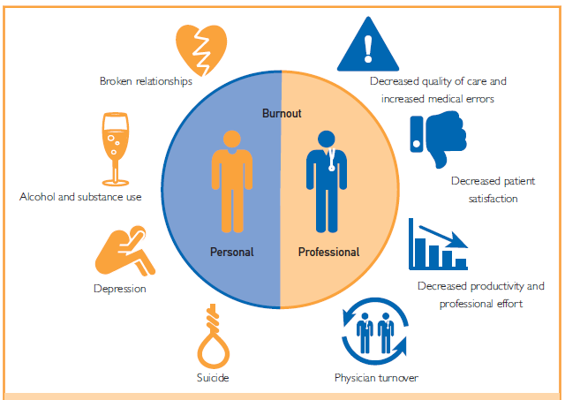
Is well-being the same as lack of burnout?
Shanafelt, TD and Noseworth, J. (2017). Executive Leadership and Physician Well-being: Nine Organizational Strategies to Promote Engagement and Reduce Burnout. Mayo Clin Proc. 2017;92(1):129-146.

Slide 9
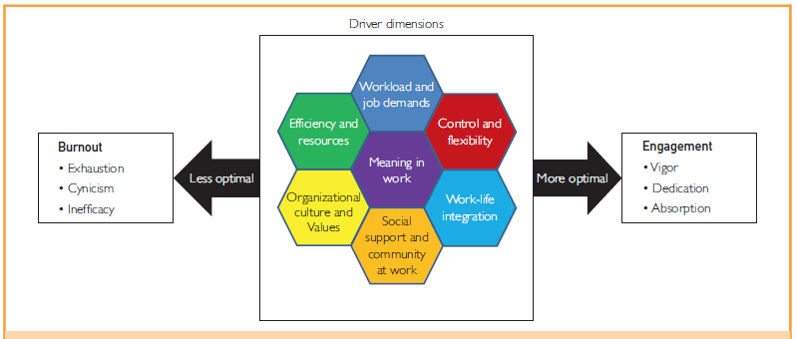
Key drivers to burnout and engagement (Shanafelt, 2017)

Slide 10
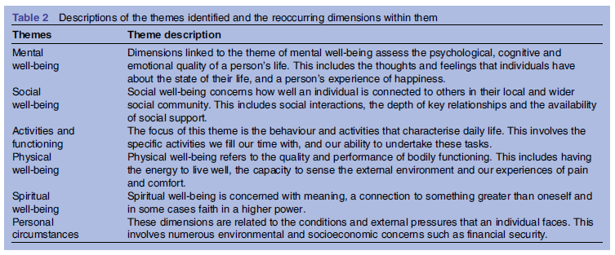
Well-Being Dimensions
Linton M-J, et al. (2016). Review of 99 self-report measures of well-being in adults; exploring dimensions of well-being and developments over time. BMJ Open 2016;1-16.

Slide 11
Wellness Systems Dimensions
Individual
Team
Health Care System
National Level
Shanafelt, TD and Noseworth, J. (2017). Executive Leadership and Physician Well-being: Nine Organizational Strategies to Promote Engagement and Reduce Burnout. Mayo Clin Proc. 2017;92(1):129-146.

Slide 12
Timeline for Optimal Success
Get stakeholders together to define Wellness
Identify suitable measure
Review confidentiality and managing personal data
Think about who to survey, frequency and how data will be used
IRB, depending on institution
Implement

Slide 13
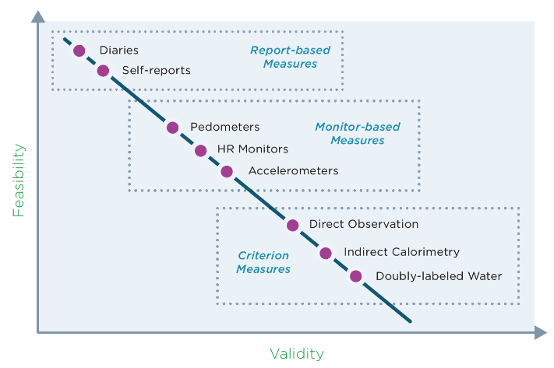
Feasibility and validity graph
Notes:
Multiple factors impacting wellness
Lack of psychometric data on many measures
Cost
Adherence
Survey fatigue
Managing personal data
Relevance to one’s own program
Other?

Slide 14
For residents or team, consider not screening
Depression
Suicidality
Substance Use

Slide 16
Individual Worksheets:
definition
current measurement lens and process
preferred measurement lens and process

Slide 17
Small Groups
Consult and share

Slide 18
Reports Out
Notes:
How does your program define Wellness?

Slide 19
Collective next steps?
Develop a consensus statement defining Wellness
Evaluate key components and recommendations for Wellness Measures for FM Community
Participate in collective measurement bank
Other?

Slide 20
Wrap Up
Explicit, agreed upon definitions
Measures to follow
? Measurement task force
STFM Well-Being Collaborative

