Slide 1
Perinatal Substance Abuse: Educating the Next Generation of Physicians in the Midst of an Epidemic
Hannah Watson, MD,
Erin Lund, MD, MPH, Joe Matel, MD
Kate McCalmont, MD
Lara Crystal-Ornelas, MD, Martín Escandón, MD, Eric Wilson, MD
Nicole Yonke, MD, MPH

Slide 2
At the end of this session you should be able to…
Describe the epidemiology of perinatal substance abuse in the United States
Apply principles of public health program planning to describe the landscape of perinatal substance abuse in their community, identify key stakeholders and community partners, and brainstorm potential clinical interventions to address the crisis
Identify pearls and pitfalls of integrating residents into perinatal substance abuse treatment programs

Slide 3
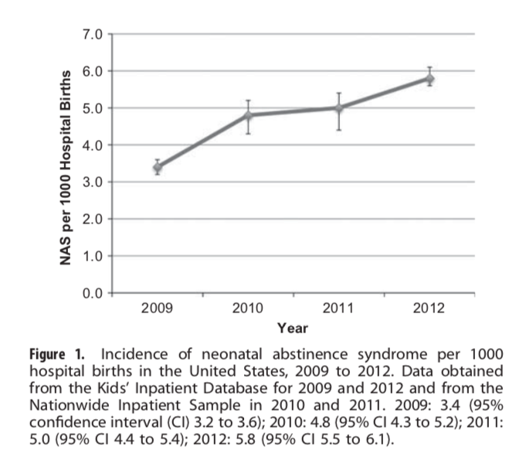
Opioid Use Disorder (OUD) in pregnancy is prevalent and expensive
Notes:
It bears repeating that the opioid epidemic is prevalent and expensive:
5.3% pregnant women self-report illicit drug use
One in five women fill an opioid prescription during pregnancy
Largest increase in heroin use in past 9 years is in women
Between 1999-2014 there was 333% increase in the prevalence of OUD in pregnancy, with 6.5 cases per 1,000
Hospital charges associated with NOWS exceed $1.5 billion per year

Slide 4
Family physicians are well suited for treating OUD in pregnancy because we provide continuity of care for the the whole family, chronic disease, and are in rural communities
Notes:
Clearly there is a need for committed providers to provide compassionate and evidence-based care to pregnant women with OUD and their children.
Can family docs do it? Absolutely, and here’s why:
We are chronic disease experts
We are committed to continuity
We provide maternity care, well child care, well adult care, and substance abuse treatment
We provide dyad care
We are rural health providers

Slide 5
Caring for women with OUD requires collaboration and continuity
Saia, K.A. et al, 2016
Notes:
Caring for women with OUD requires collaboration and continuity, and encompasses a few key domains:
1. Medication Assisted Therapy for OUD with buprenorphine or methadone
2. Obstetric care
-Prenatal care should be recovery-affirming and trauma-informed
-High risk consultation as needed for IUGR, hypertensive disorders, history of preterm birth, seizure disorders
3. Mental health care for high prevalence of co-occurring mood disorders, complex PTSD
-Psychiatry consultation when indicated
-Behavioral health counseling
4. Community-based services
-collaboration with treatment facilities
-referrals for social needs including housing, food, childcare, transportation
5. Enhanced postpartum care:
-Close follow-up
-Lactation support
-Screening/treatment for postpartum depression
-Transition to PCP

Slide 6
Milagro is an integrated perinatal care and SUD treatment program in the family medicine department at UNM Hospital
Notes:
Our clinic provides pharmacotherapy, prenatal care, counseling, community support worker, delivery with a continuity provider, couplet care treatment for Neonatal Opioid Withdrawal Syndrome and postnatal care. Families transition to the FOCUS clinic for well child care.

Slide 7
There was initial resistance with growing the Milagro clinic, but 8 years later almost all of our faculty feel comfortable caring for these families.
Notes:
The clinic started as small group in 2011 and was initially reliant on our Maternal Child Health fellows and a few core faculty. After the promising results of the MOTHER trial, we felt expanded access to MAT with buprenorphine was a critical aspect of treatment for the growing patient population with OUD in pregnancy. Family medicine was already caring for these families after birth, so the Milagro clinic came to be housed in our department. UNM is a large academic system and key stakeholders also include the Ob residency and the MFM fellowship. Training everyone is important, and collaboration is key. Despite some initial apprehension of faculty, we have found success after 8 years. Most of our faculty enjoy this work and want to do it.

Slide 8
FOCUS is a medical home that integrates home-based Early Intervention with primary medical care for families impacted by substance abuse
Notes:
FOCUS is a multidisciplinary program that addresses the complex needs of families with children age 0-3 years who are at risk for developmental delay
Most of the families in FOCUS are addressing substance use disorders and are additionally affected by mental health disorders, domestic violence, social instability, and poverty
All second year residents receive buprenorphine training
EI team includes Developmental Specialists, Family Service Coordinators, Occupational Therapists, Speech-Language Therapists, and Infant Mental Health Specialists
EI Services are funded through a contract with the NM DOH Family, Infants & Toddlers Program
Department of Family Medicine supports faculty time for clinics

Slide 9
Residents collaborate in multi-disciplinary teams and provide continuity of care for the whole family
Notes:
FOCUS clinics occur at two of the resident continuity clinics
Residents are scheduled into FOCUS clinic in place of their own continuity clinic

Slide 10
The New Beginnings Clinic provides prenatal care and dyad care through age 1 for high risk families
Notes:
New Beginnings serves women with substance use disorder in pregnancy, including opioid use disorder, but also women with complex mental health needs and high social needs including homelessness and incarceration. Since founding, we have shown:
Improved attendance in prenatal visits achieved through active case management
We have active relationships with outpatient treatment programs and growing relationship with the jail
We have improved access to mental health and perinatal education
We are the county referral site for other FQHCs and Ob-Gyn colleagues

Slide 11
Co-following high risk patients with a multidisciplinary team improves continuity and ensures high quality care
Notes:
1. Team-based care teaches residents about community resources
2. When residents co-manage patients they can be effective advocates for patients in hospital.
3. Safe training environment to learn about medication assisted treatment especially buprenorphine, psychiatric comorbidities and safety profiles of commonly used psychiatric medications in pregnancy.

Slide 12
Plan for your community
PROBLEM How are pregnant patients with SUD managed in your community What is the current state of perinatal SUD training for students/residents? | STAKEHOLDERS Who cares for these patients currently? What community resources are available? Who could be a champion?
BARRIERS What is access to case management services? What funding pools exist to support collaboration? | SUCCESS How would you measure improvement in resident education and patient access/outcomes?

Slide 13
Pearls and Pitfalls
Notes:
The needs and resources of your community should guide program implementation. A few key things to remember:
1. Follow the money: There are lots of grant funding opportunities through SAMSA and HRSA. Even without grant support you can build a model with billable visits. Active case management is critical to ensure patients show up.
2. While we have focused specifically on OUD today I would encourage you to use the resources directed at the current opioid crisis to improve SUD treatment for all patients
3. Practicing team-based care and collaborating with community partners ensures that complex patients receive the support they need.
4. Residents can be a bridge in vulnerable transitions between clinic, triage, delivery and postpartum
5. Caring for women with OUD in pregnancy is challenging and incredibly gratifying work. Find joy in the journey

Slide 14
Questions?
Hannah Watson
hannahw@srhealth.org
Erin Lund
erinl@srhealth.org
Nicole Yonke
nyonke@salud.unm.edu
Kate McCalmont
kmccalmont@salud.unm.edu

Slide 15
References
Substance Abuse and Mental Health Services Administration, Results from the 2013 National Survey on Drug Use and Health: Summary of National Findings. 2014.
Desai RJ, Hernandez-Diaz S, Bateman BT, Huybrechts KF. Increase in Prescription Opioid Use During Pregnancy Among Medicaid-Enrolled Women: Obstet Gynecol. 2014;123(5):997-1002. doi:10.1097/AOG.0000000000000208
Jones, Christopher M. Demographic and Substance Use Trends Among Heroin Users — United States, 2002–2013. MMWR Morb Mortal Wkly Rep. 2015;64:719-725.
Martin CE, Longinaker N, Terplan M. Recent trends in treatment admissions for prescription opioid abuse during pregnancy. J Subst Abuse Treat. 2015;48(1):37-42. doi:10.1016/j.jsat.2014.07.007
Haight SC, Ko JY, Tong VT, Bohm MK, Callaghan WM. Opioid Use Disorder Documented at Delivery Hospitalization—United States, 1999–2014. Morb Mortal Wkly Rep. 2018;67(31):845.
Patrick S, Davis MM, Lehman CU, Cooper WO. Increasing incidence and geographic distribution of neonatal abstinence syndrome: United States 2009 to 2012. J Perinatol. 2015;35:650–655.
Sai K, Schiff D, Elisha M et al. Caring for Pregnant Women with Opioid Use Disorder in the USA: Expanding and Improving Treatment Current Obstetrics and Gynecology Reports 2016; 5:257-263
Gopman S. Prenatal and Postpartum Care of Women with Substance Use Disorders. Obstet Gynecol Clin North Am. 2014;41(2):213-228. doi:10.1016/j.ogc.2014.02.004
Sutter MB, Gopman S, Leeman L. Patient-centered Care to Address Barriers for Pregnant Women with Opioid Dependence Obstet Gynecol Clin North Am. 2017; 1: 95-107
Sutter MB, Watson H, Bauers A, Johnson K, Hatley M, Yonke N, Leeman L. Group Prenatal care for Women Receiving Medication Assisted Teatment for Opioid Use Disorder in Pregnancy: an Interprofessional Approach. J Midwifery Women’s Health. 2019; 64 (2): 217-224

