Slide 1
When "Gripe" is not just a cold: Assessing pediatric asthma in Santo Domingo, Dominican Republic
Presenters: Lipi Gupta M2, Mark Ryan M.D.
Authors (A-Z): Andrew Andreae M2, Allison Borda M2, Kristin Romutis M2, Lipi Gupta M2, Mark Ryan M.D., Priya Sabu M4, Wendy Sun M2.

Slide 2
Activity Disclaimer
ACTIVITY DISCLAIMER
It is the policy of the AAFP that all individuals in a position to control content disclose any relationships with commercial interests upon nomination/invitation of participation. Disclosure documents are reviewed for potential conflicts of interest (COI), and if identified, conflicts are resolved prior to confirmation of participation. Only those participants who had no conflict of interest or who agreed to an identified resolution process prior to their participation were involved in this CME activity.
Dr. Mark Ryan, Andrew Andreae, Allison Borda, Kristin Romutis, Lipi Gupta, Priya Sabu, & Wendy Sun have indicated they have no relevant financial relationships to disclose.

Slide 3
Learning Objectives
Recognize the impact of asthma in the developing world, and identify challenges to diagnosis and treatment of asthma on a short-term medical service trip.
Describe a rapid and accurate approach to screening for asthma among pediatric patients who present to a short-term medical trip in Santo Domingo, and assess the usefulness of this approach in other settings.
Discuss the prevalence of asthma in the community of Paraíso, Santo Domingo, and develop an approach to using this information clinically in terms of diagnosis and treatment.

Slide 4
Do you...
Want to screen for childhood asthma to manage your patients?
Work in an underserved setting?
Work with Spanish-speaking patients?
Want to know more about childhood asthma in Santo Domingo, Dominican Republic (DR)?
Then you’re in the right place!
Notes:
Last bullet animate later

Slide 5
The Problem
high risk of undiagnosed and untreated childhood asthma
Adult asthma in top 3 most prevalent chronic diseases in the DR
Common environmental risk factors
Frequent chief complaint of “gripe”

Slide 6
The Problem
No pediatric asthma prevalence data for the DR
We could not identify Spanish-language screening tools feasible for one-time clinical encounters in medical outreach clinics

Slide 7
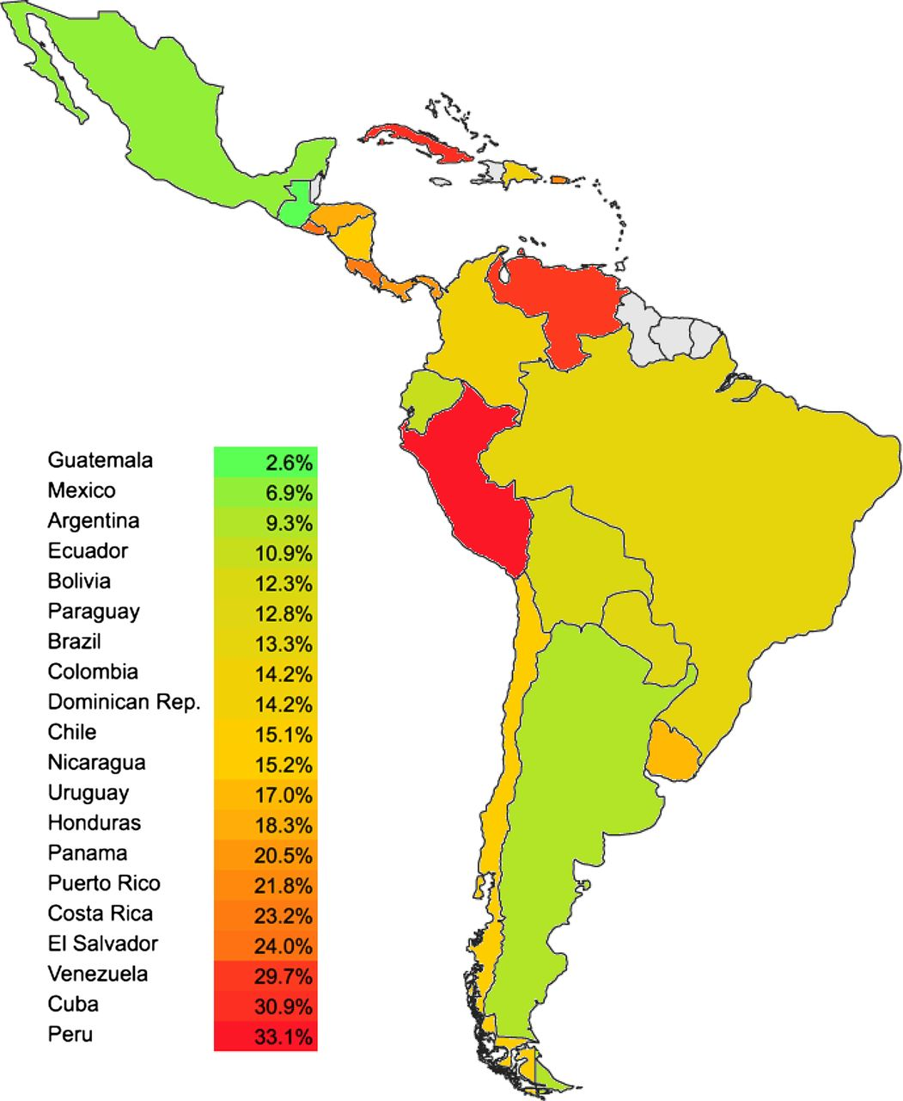
Prevalence
In this map of childhood asthma in Latin America, DR estimate (14.2%) based on adult asthma
Erick Forno et al. Thorax 2015;70:898-905
Copyright © BMJ Publishing Group Ltd & British Thoracic Society. All rights reserved.
Notes:
Prevalence of childhood asthma in Latin America.5 7–9 Prevalence in the Dominican Republic is based on adult asthma.

Slide 8
Pre-existing Screening Tools
 | Items | Symptom Questionnaire | Clinical Diagnostic Tool | Spanish Language Validation | Latin Am. Population Validation | Age Range
International Study of Asthma and Allergies in Childhood (ISAAC) [Fernández et al., 2005] | 8+ | x |  | x | x | 6-7 13-14
Asthma Screening Parent Questionnaire [Busi et al., 2015] | 11 | x |  | x | x | 3-6 9-12
Asthma-Allergy Screening Parent Questionnaire [Redline et al., 2004] | 14 | x |  |  |  | 5-12
The Asthma Predictive Index (API) [Castro-Rodriguez, 2011] | 6 |  | x |  |  | 2-13
PIAMA Asthma Prediction Score [Caudri et al., 2009] | 8 | x | x |  |  | 0-8
Notes:
Consider a brief sentence on each about why they did not fully meet the goal of what we needed
(API first made in 2000. The PIAMA score used API and added variables that were unlikely to confer the same predictive value to our population: Male sex, posterm delivery, low parental education (common here), serious infections (common here), parents use of inhalation meds (not feasible here even if they need it)

Slide 9
Asthma’s Burden of Disease
Preventable with patient education & treatment
Early childhood onset
Sleep disturbances
School absences/poor
performance
Childhood hospitalizations

Slide 10
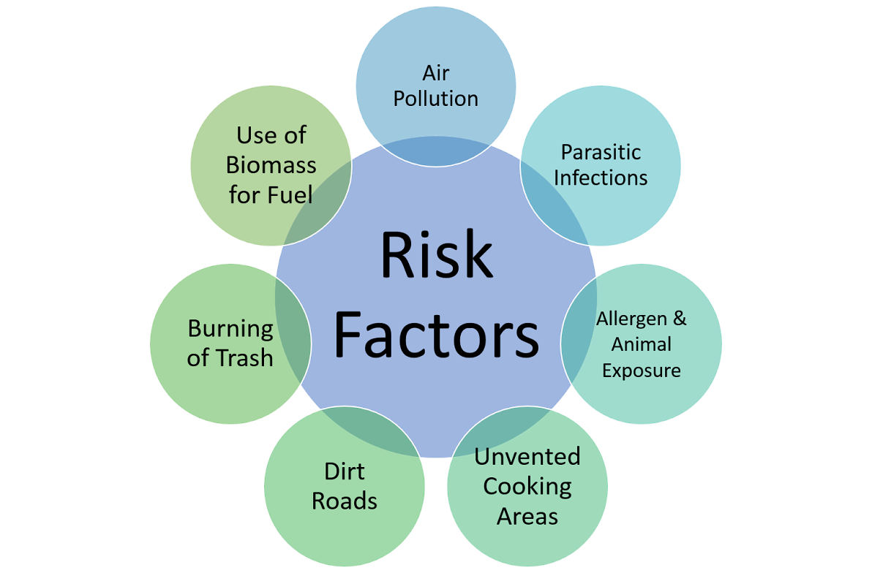
Asthma Risk

Slide 11
Study Goals
Identify the prevalence of children with significant asthma risk
Assess the usefulness of abbreviated, rapid screening tools in a fast-paced, short-term, free clinic with minimal resources
Notes:
But we all face time constraints….
Short term:

Slide 12
Benefits
Patient education
Preventative treatment
Follow-up care
A screening tool which may be used in other similar settings
Improve quality of life for children at risk for asthma

Slide 13
Methods
Subjects:
Patients aged 2-12 who presented with a parent to the short-term medical outreach clinic in Paraíso, Villa Mella, Santo Domingo Norte
Risk Assessment:
An Asthma Questionnaire and Clinical Risk Assessment Tool based on two previously validated tools

Slide 14
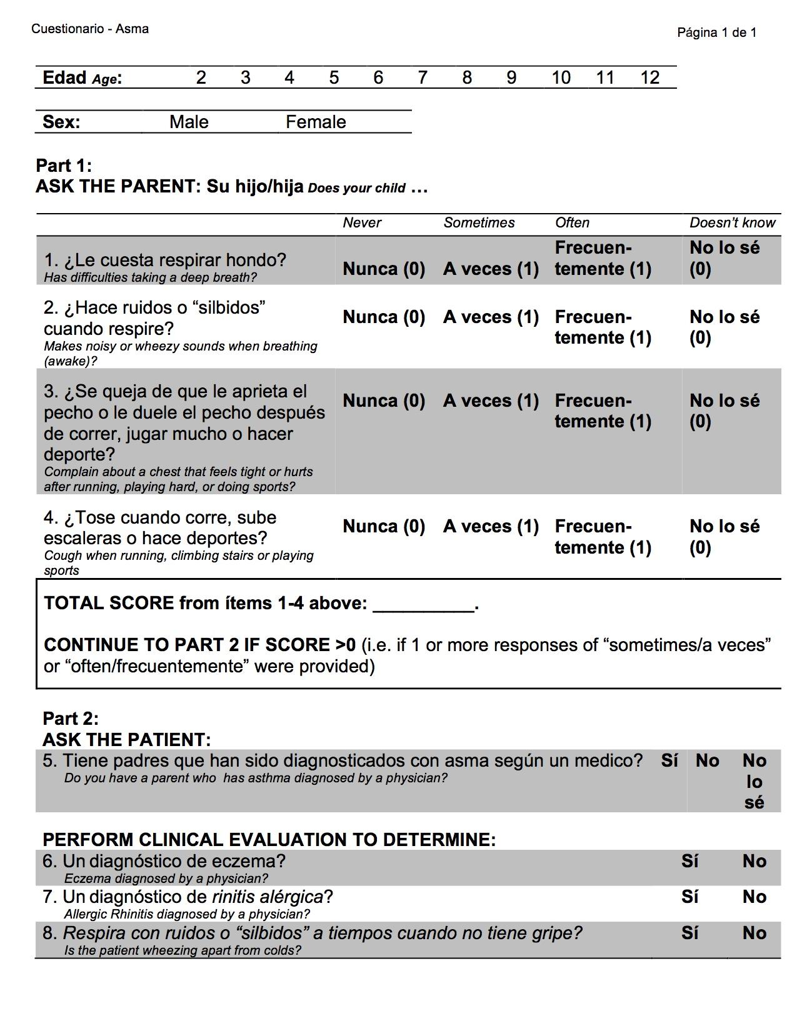
Risk Assessment Design
Part 1: Based on the Asthma Parent Screening Questionnaire developed by Busi et al. (2012), which provided high sensitivity
Four questions for the child’s parent
Sensitivity: 91-95% (Busi et al., 2012; Busi et al., 2015)
Notes:
Combinations questions sensitivities

Slide 16
Risk Assessment Design
Part 2: Based on the Asthma Predictive Index (API) developed by Castro-Rodriguez et al. (2011), which provided high specificity
2 Major risk factors:
Parental asthma
Patient eczema
3 Minor risk factors:
Wheezing (outside of colds)
Allergic rhinitis
Eosinophilia
A positive API screen:
one Major OR two Minor criteria
Specificity: 79-97% (Castro-Rodriguez et al, 2011).
Notes:
Exzema & allergic rhinitis were originally in age 2, 3
Wheezing episode frqu. (3+/yr or less) were originally in age 0-3
Eosinophilia
Wheezing more a survey Q – than MD dx
A positive API screen originally also being an early life wheezer (either 3+ episodes per year for first 3 yrs of life (stringent) or <3 episodes per year for first 3 yrs of life)
The API identifies two major and three minor criteria for development of pediatric asthma in children who exhibited wheezing during the first three years of life
A positive API screen:
one major OR two minor criteria
We only used current eczema, which likely reduced the # responses we would have had.

Slide 17
2 Major risk factors:
Parental asthma
Patient eczema
3 Minor risk factors:
Allergic rhinitis
Wheezing (outside of colds)
Eosinophilia (not assessed due to clinic limitations)

Slide 18
Part 1: Score of > 0 in Part 1 was a positive risk for asthma related respiratory difficulties and qualified the child for Part 2
Part 2: Includes one question directed towards the parent and three questions the physician answered based on clinical examination of the child
Notes:
Part 1: A score of > 0 in Part 1 was a positive risk for asthma related respiratory difficulties and qualified the patient for the second part of the survey.
Part 2: Part 2 of the risk assessment included one question directed towards the parent and three questions the physician answered based on clinical examination of the child.
Practice to make sure I dont confuse ppl wihle restating it

Slide 19
Results - Study Demographics
74 children
35 (47%) males
36 (49%) females
3 (4%) unspecified
Aged 6.3 ± 3.0 SD yrs
Differences among sex (p = 0.222) and ages (p = 0.653) NOT statistically significant in chi-squared tests
Characteristic (100%) | N = 74
Age (yrs)
2 | 5 (6.8%)
3 | 10 (13.5%)
4 | 11 (14.9%)
5 | 6 (8.1%)
6 | 6 (10.8%)
7 | 8 (9.5%)
8 | 7 (8.1%)
9 | 6 (5.4%)
10 | 4 (5.4%)
11 | 5 (6.8%)
12 | 3 (4.1%)
Unspecified | 3 (4.1%)
Sex
Males | 35 (47.3%)
Females | 36 (48.6%)
Notes:
Were seen at the brigade clinic
For diff in asthma risk assessment

Slide 20
Results - Questionnaire
46 of 74 (62%) screened positive via Part 1 of the risk assessment
Of the 46 with positive screenings, 19 (25.7% of the total sample), met criteria for Probable Asthma under Part 2 of the risk assessment
Question | Frequency | n = 74
Has difficulties taking a deep breath? | Never | 42 (56.8%)
 | Sometimes | 25 (33.8%)
 | Often | 7 (9.5%)
 | Doesn't Know | 0 (0.0%)
Makes noisy or wheezy sounds when breathing (awake)? | Never | 44 (59.5%)
 | Sometimes | 18 (24.3%)
 | Often | 11 (14.9%)
 | Doesn't Know | 1 (1.4%)
Complain about a chest that feels tight or hurts after running, playing hard, or doing sports? | Never | 45 (60.8%)
 | Sometimes | 15 (20.3%)
 | Often | 14 (18.9%)
 | Doesn't Know | 0 (0.0%)
Cough when running, climbing stairs, or playing sports? | Never | 46 (62.2%)
 | Sometimes | 13 (17.6%)
 | Often | 15 (20.3%)
 | Doesn't Know | 0 (0.0%)

Slide 21
Results - Risk Categories
N = 74 | Risk Category | Parent Questionnaire | API
28 (37.8%) | ♦Not at Risk | - | NA
11 (14.9%) | ♦Elevated Risk | + | No Criteria Met
16 (21.6%) | ♦High Risk | + | Insufficient Criteria Met
19 (25.7%) | ♦Probable Asthma | + | Sufficient Criteria Met
Notes:
62.2% are at risk
Not at Risk, defined by those who answered "Never" or “I don’t know” to all four initial screening questions
Elevated Risk, defined by those who answered "Sometimes" or “Frequently” to at least one of the four initial screening questions but did not answer "Yes" in any of the API questions for asthma
High Risk, defined by those who answered "Sometimes" or “Frequently” to at least one of the four initial screening questions, and answered "Yes" for some of the API questions but not enough to be "high risk"
Probable Asthma, defined by those who answered "Sometimes" or “Frequently” to at least one of the four initial screening questions, and met criteria (at least one major, or both minor criteria) under the API for asthma.

Slide 22
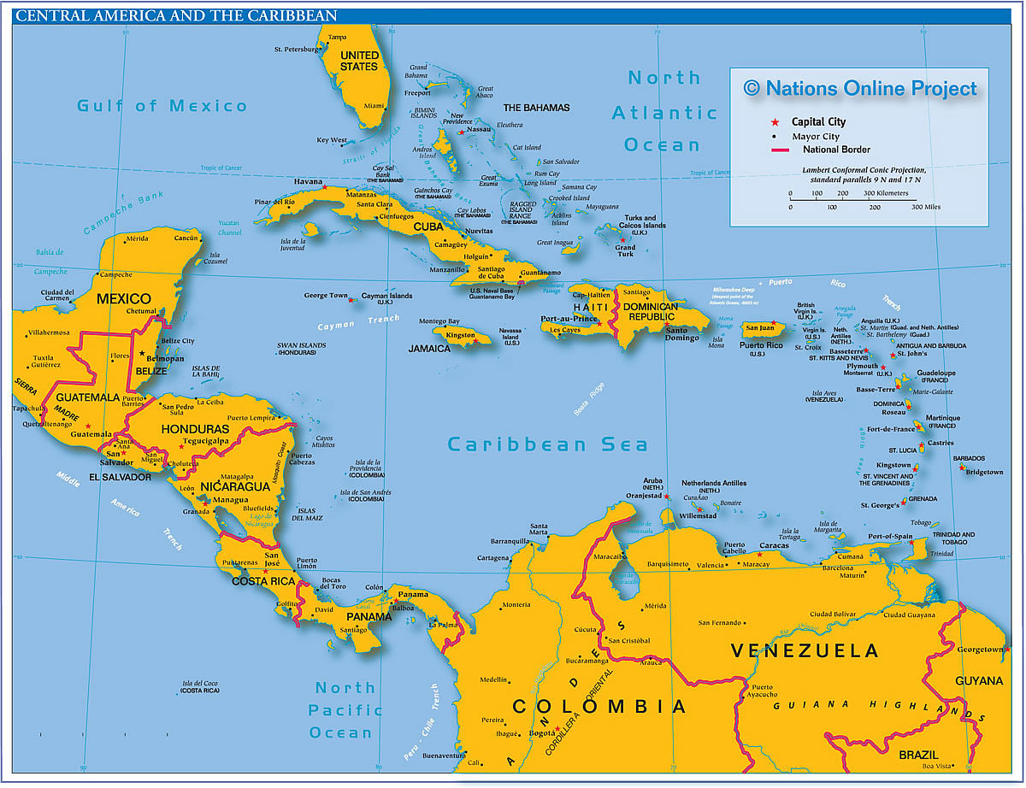
Asthma Prevalence
Probable childhood asthma in the DR
25.7%
Peer Countries:
Cuba (30.9%)
Venezuela (29.7%)
Costa Rica (23.2%)
Puerto Rico (21.8%)
Panama (20.5%)
Honduras (18.3%)
DR
Notes:
Recall--estimate from prior was closer to 14%

Slide 23
Usefulness of this study’s Risk Assessment
Fast and easy to use with minimal training needed
Tool allows physician to both screen, and if necessary assess patient for asthma
No specialized or invasive testing necessary
Translated into Spanish
Items have been validated for both Latin American and North American populations
Useful for toddlers through teenagers
Limited impact of patient health literacy on treatment decisions
Notes:
<5 min use
Though Busi’s questionnaire was not itself validated with North American populations, the same items, in English, have been validated with Americans in Redline et al.’s study

Slide 24
Value of this project
First known study to determine the prevalence of pediatric asthma in the DR
- Team Preparation
- Patient Education
- Medication Purchases
Clinical screening and risk assessment tool could be useful for other fast-paced community clinics
Notes:
Prevalence data could shape clinical decisions such as:

Slide 25
Limitations
Smaller-than-expected N = 74 as child had to present to clinic with a parent
Symptoms of eczema, wheezing, and allergic rhinitis were diagnosed using a one-time clinical encounter
Truncated Asthma Screening Parent Questionnaire and API: might the adaptations impact test characteristics?
Notes:
Patient population screened limited to

Slide 26
Future Research
Asthma risk factors, causal mechanisms, and the role of atopy in the DR
Risk assessment tool should be validated to confirm that Probable Asthma is diagnosed asthma
Assessment of how the tool affects medical trip operations and (?) clinical outcomes
Notes:
To build off of our study, future research can look into
The role of…. allergies

Slide 27
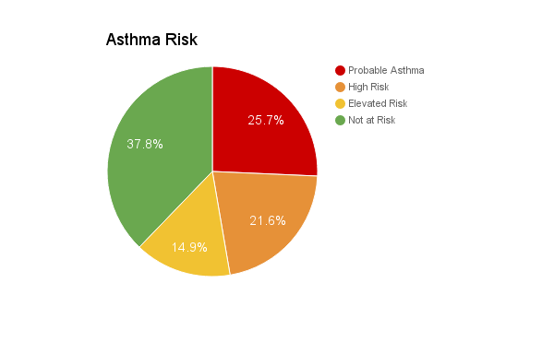
Conclusion
62.2% of patients ages 2-12 are at risk for asthma
Rate of Probable Asthma among children, if representative of the DR, would rank among the highest national rates in Latin America

Slide 28
References
Asher MI, Keil U, Anderson HR, et al. International Study of Asthma and Allergies in Childhood (ISAAC): rationale and methods. European Respiratory Journal 1995, 8:483-491.
Busi, LE, Sly, PD, Restuccia, S, & Llancamán, L. Validation of a school‐based written questionnaire for asthma case identification in Argentina. Pediatric Pulmonology. 2012 Jan; 47(1), 1-7.
Busi, LE, Sly, PD, & Llancamán, L. Validation of a questionnaire for asthma case identification in pre‐schools in Latin America. Respirology. 2015 Jun 24; 20(6), 912-916.
Caban-martinez AJ, Halder GE, Tellechea L, et al. Health status and behaviors among adults residing in rural Dominican Republic. Rural Remote Health. 2012 May 15;12:1956.
Castro-Rodriguez, JA. The Asthma Predictive Index: early diagnosis of asthma. Current Opinion in Allergy and Clinical Immunology. 2011 June; 11(3), 157-161.
Caudri D, Wijga A, Schipper CM, et al. Predicting the long-term prognosis of children with symptoms suggestive of asthma at preschool age. Journal of Allergy and Clinical Immunology. 2009 Nov 30;124(5):903-10.

Slide 29
References
Fernandez CM, Fernandez-Benitez M, Miranda MP, et al. Validation of the Spanish version of the Phase III ISAAC questionnaire on asthma. Journal of Investigational Allergology and Clinical Immunology. 2005 Jan 1;15(3):201.
Forno E, Gogna M, Cepeda A, et al. Asthma in Latin America. Thorax. 2015 Sep;70(9):898-905.
Gerald LB, Sockrider MM, Grad R, et al. An official ATS workshop respot: issues in screenig for asthma in children. Proceedings of the American Thoracic Society. 2007; 4, 133-141.
Lang JE, Blake KV. Role of biomarkers in understanding and treating children with asthma: towards personalized care. Dove Press Journal: Pharmacogenomics and Personalized Medicine. 2013 Aug 20; 6, 73-84.
Neffen H, Fritscher C, Schacht FC, et al. Asthma control in Latin America: the Asthma Insights and Reality in Latin America (AIRLA) survey. Rev Panam Salud Publica. 2005 Mar 17; 191-197.
Redline S, Gruchalla RS, Wolf RL, et al. Development and validation of school-based asthma and allergy screening questionnaires in a 4-city study. Annals of Allergy, Asthma & Immunology. 2004 Jul 31;93(1):36-48.

