Slide 1
Maintaining Family Medicine Foothold in Labor and Delivery:
Developing Obstetric Leaders in Increasingly Specialized Climates
Elise Laflamme MD
Caroline Komanecky MD
Greater Lawrence Family Health Center
Lawrence Family Medicine Residency

Slide 2
Disclosures
None

Slide 3
Objectives
Review potential advantages of a multidisciplinary maternity care setting for a Family Medicine residency training program.
Gain at least one technique to improve interdisciplinary communication on Labor and Delivery.
Identify at least one approach to support the role of Family Medicine in a hospital system.
Share strategies to teach Family Medicine residents within a historically hierarchical maternity care system.

Slide 4
Need for obstetric providers
Despite improving technology and safety practices, maternal and infant mortality and racial disparities in OB care have not improved
Huge need in rural settings
49% of all counties in the US do not have OBGYNs
In-hospital OB care is decreasing in relation to US population
Decreasing OBGYN generalists
Earlier OBGYN retirement
Clustering of OBGYN in metropolitan areas
Notes:
ARHQ data 2000-2009 - OB safety indicators improved, but inpatient maternal and neonatal mortality remained relatively constant, with persistently higher rates of both among black women
American Congress of Obstetricians and Gynecologists. (2011). The obstetrician-gynecologist workforce in the United States. Facts, Figures and Implications. 2011. http://www.acog.org/publications/ obgynWorkforce/obgynWorkforce.pdf. Accessed Aug 17, 2011

Slide 5
FM-OBs can fill this need
FM-OBs are cost effective
FM-OBs more likely to work in rural and underserved areas, where this need is greatest
More FMs entering practice
More than two times annual residency spots in FM as compared to OBGYN
Notes:
4. Magee 2017 “Family Medicine Maternity Care call to action”- cost efficacy documented many places
5. Tong 2013 “Family physicians in the maternity care workforce: factors influencing declining trends”. ABFM data 2000-2010 - Practicing in a rural setting (OR = 2.2; 95 % CL 2.1-2.4), an educational setting (OR = 6.4; 95 % CL 5.7-7.1) and in either the Midwest (OR = 2.6; 95 % CL 2.3-2.9) or West (OR = 2.3; 95 % CL 2.1-2.6) were the strongest predictors of higher likelihood of providing maternity care

Slide 6
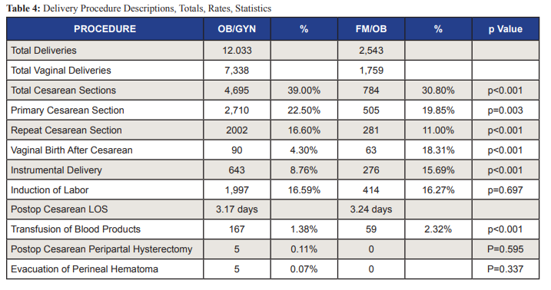
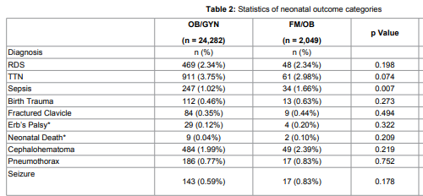
FM-OBs provide high quality perinatal care
FM-OBs and OBGYNs provide comparable maternity care with no differences in neonatal outcomes
FM-OBs have lower CS rates, higher VBAC rates
Avery 2014
Deutchman 1995
FM-OBs and OBGYNs have comparable neonatal outcomes
Avery 2015
Notes:
6) Avery 2014: 14,576 deliveries at regional hospital 2003-2011 - FMOBs do not transfer care for high risk: total CS rate (39 vs 30%), PCS rate, RCS rate lower for FPOB; VBAC rate higher for FPOB (18 vs 4%); instrumental VD higher for FPOBs (15 vs 8%)
7) Deutchman 1995: 1942 deliveries at community hospital 1991-1992; risk score analysis equal among OB/FM patients; FMOBs had lower incidence of CS (15 vs 26%); higher NSVDs, VBAC, vacuum use; no dif in maternal or neonatal m/m
8) Avery 2015: reviewed neonatal outcomes of 26,331 infants 2006-2013; 10 common neonatal outcomes (RDS, TTN, sepsis, birth trauma, clavical fx, erb’s palsy, mortality, cephalohematoma, pneumothorax, neonatal seizures → all comparable

Slide 7
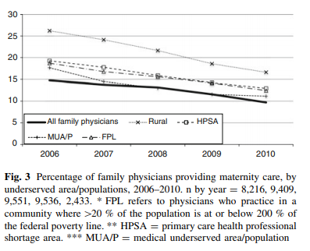
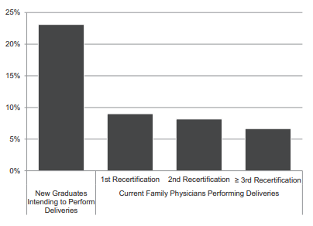
...Yet FM-OBs are still declining
Maternity care by FM physicians declined from 23.3% in 2000 to 9.7% in 2010
Factors associated with increased likelihood to practice maternity care: female, younger, rural setting, educational setting, in the midwest or West
Many FM trainees intend to provide maternity care but few actually do once in practice
Notes:
5) Tong study: cross sectional study using the American Board of Family Medicine survey data collected from every family physician during application for the Maintenance of Certification Examination to determine the percentage of family physicians that provided maternity care from 2000 to 2010
The ABFM demographic data survey includes a mandatory question that asks all candidates for ‘‘percentage of your time by type of practice or professional activity’’ with a number of different possible practice and professional activity choices including ‘‘maternity care.’’ No explanation of the term ‘‘maternity care’’ was provided on the survey and candidates replied to the survey based on their own personal interpretation. Maternity care was used as a binomial variable with any maternity care versus 0 % maternity care. A total of 90,221 ABFM candidates completed the ABFM MOC Examination between 2000 and 2010
Family physicians who were female, younger and US medical graduates were more likely to practice maternity care. Practicing in a rural setting (OR = 2.2; 95 % CL 2.1–2.4), an educational setting (OR = 6.4; 95 % CL 5.7–7.1) and in either the Midwest (OR = 2.6; 95 % CL 2.3–2.9) or West (OR = 2.3; 95 % CL 2.1–2.6) were the strongest predictors of higher likelihood of providing maternity care
9) Berreto 2016: used data from the American Board of Family Medicine’s Family Medicine Certification examination application questionnaire, completed by both graduating residents and practicing physicians, from 2014 to 2016. Although 21% of new family medicine graduates in 2016 reported an intention to include obstetric delivery in their scope of practice, only 7% of family physicians currently do so. (Percentage of third-year family medicine residents intending to perform obstetric delivery (n 9128) and percentage of practicing family physicians performing obstetric deliveries, by testing cohort: first recertification (n 8059), second recertification (n 7186), >third recertification (n 10,589)

Slide 8
Models of Maternity Care Involving Family Medicine Physicians
Notes:
Focus on Hospital systems, Multi-disciplinary systems
Aware that there are home deliveries, and models of FM only in rural areas as well
For time sake and focus of our discussion, want to focus on settings that we can optimize multi-disciplinary systems

Slide 9
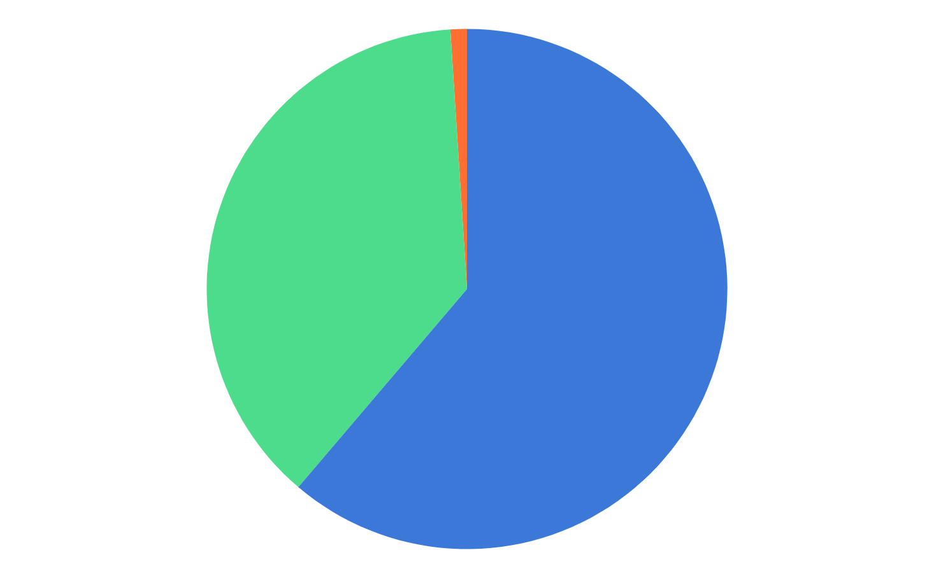
Unofficial Survey of FM Physicians Delivering Maternity Care
105 responses
⅓ Rural, ⅓ Suburban, ⅓ Urban
Inpatient Maternity Care
20% - Training FM residents in surgical obstetrics
17% - Family Medicine OB Fellowship
Spectrum of Maternity Care
94% - Vaginal deliveries
51% - Cesarean sections
63% - Other OB surgical procedures
4% - 1st assist cesarean sections
3% - Vacuum delivery privileges only
94% - Inpatient postpartum care
87% - Inpatient newborn care
83% - Newborn circumcision
Training FM residents under umbrella of OBGYN residency (1%)
Community Hospital,
no FM residency (37%)
FM residency (60%)
Notes:
Unofficial survey to FMOB Moms Facebook group to get a sense of what other maternity care systems in the US look like in general, rather than talking about just our own experience
“Other surgical OB procedures” = D&C, tubal ligation

Slide 10
Varying Models of FM Maternity Care in the U.S.
General Structure of Inpatient Maternity Care Backup System
13% : FM care for low-risk subset / OB cares for high-risk subset
25% : FM care for low-risk subset consult on-call OBGYN for high risk subset
18% : FM care for low-risk subset consult Laborist for high-risk subset
15% : FM staffs all laboring patients MFM consult when necessary
15% : FM staffs all laboring patients transfers to outside hospital if requiring higher level of care
Notes:
Great heterogeneity in the details of multi-disciplinary context of maternity care systems within respondents

Slide 11
Positive Aspects of Involving OBGYNs in FM Resident Training
Breadth and Depth of experiences
Increased volume
Varying styles to learn from
Strengthen surgical training (complications of surgeries, specific GYN surgical techniques)
Confidence in managing high-risk labors/high-risk patients
Demonstrates care of complex patients within a multidisciplinary framework
Demonstrates collaboration, trust, and respect between specialties
Wellness for FM physicians (less call if sharing with OBGYNs)
Rapidly available for emergencies (if in-house)
Notes:
Results from same survey
Last point → there was variety in response and notes that some on-call OBGYN backup systems did not have in-house coverage and were NOT felt to be readily available for emergencies

Slide 12
2015 CERA Study: Use of Laborists in FM Residency Training
44% of FM programs reported a laborist model in their main teaching hospital
Of these….
64.1% viewed laborists as good/excellent educators
54.3% reported no change in L&D teaching required of their faculty despite the laborist service
15% reported that > 30% of graduating residents went on to practice OB within family medicine
Significant Variety of responses in regards to:
Laborist direct supervision of exam skills
Laborist giving formal didactics
Laborist attending morning report with teaching component
Improvement of maternity care training quality with laborists
Improvement of resident supervision with laborist presence
Baldor RA, Pecci CC, Moreno G, Van Duyne V, Potts SE. A National CERA Study of the Use of Laborists in Family Medicine Residency Training. Fam Med. 2017;49(2):114-121.
Notes:
CERA = Council of Academic Family Medicine Education Research Alliance Survey of PROGRAM DIRECTORS at FM Residencies
95% of “laborists” were reported to be Obstetricians (other 5% were FMOB with c-section privileges, without c-section privileges and midwives)
Also of note, 41% of the respondents noted that their main training hospital also housed obstetrical residents in training (not noted what the overlap of these numbers was with the laborist % however)
Unclear what “Improvement of resident supervision” means after reading the full text

Slide 13
Difficulties: OBGYN involvement in FM resident training
Communication
Nursing Laborist/OB
Board Rounds
OB distrust of Family Medicine skillset
Preconceived negative bias
“Hovering”
Consulting without request
Variable teaching skills/interest
Resistant to involving residents in care
Impatient with residents
Use scrub tech/other options for 1st assist
Learning cases may be prioritized to OB residents
Limited use of evidence-based practice
Decrease in volume; Case-load shift
Level of respect varies
Verbal abuse/derogatory comments
Toxic environment can scare residents away from OB in future career
Resident exposure to practices not typical in FM training
Example: early amniotomy
Complex consultation guidelines
Inequity in credentialing requirements (OBvsFM)
Financial issues
RVUs to delivering physician
Notes:
Same unofficial survey
**Note that “Level of Respect” was also variable in the survey → also notes of collegial relationships between physicians (But this slide is focusing on difficulties)
RVUs to delivering physician → if a FM physician labored with patient for 24 hours but the patient ultimately went to C/S - all RVUs to OBGYN in some systems

Slide 14
Tried and Proven: Approaches to Support Family Medicine Roles within a Hospital System
Leadership awareness of Family Medicine training/scope of practice
Seat at the table in hospital leadership/on all committees
Peer Review/Case Review, Quality Improvement, Multidisciplinary projects, Guideline and Protocol development, Privileging
Increasing time that those in leadership roles spend in clinical hospital duties
Regular multi-specialty meetings reviewing high-risk patients
Training residents within the organization
Pecci CC, Mottl-Santiago J, Culpepper L, Heffner L, McMahan T, Lee-Parritz A. The birth of a collaborative model: obstetricians, midwives, and family physicians. Obstet Gynecol Clin North Am. 2012;39(3):323-334. doi:10.1016/j.ogc.2012.05.001

Slide 15
Preparing FM residents OB for successful practice
Cervical dilation models
ALSO
Perineal laceration models
C-section models
Competency focused
Fellowship (or “area of concentration” at LFMR)
Notes:
FMOB discussions continue to happen at STFM and in 2014 Maternity Care summit conducted, with consensus that practice should move toward competency assessment after a minimum number
Pecci, Leeman, Wilkinson 2008 “FMOB Fellowship Graduates: Training and Post-Fellowship Experience”
Survey to 165 fellowship grads 1999-2003 - 88% provide prenatal care, 66% have CS privileges, 44% in rural areas, 88% in community hospitals, 49% faculty at FMRs
Identified fellowship programs using the AAFP Directory of Fellowship Programs. Additional programs not listed in the directory were identified by personal communication and by a request on the Society of Teachers of Family Medicine listserve to the Group on Family-centered Perinatal Care (FAMDEL). We asked directors of identified fellowships to provide a list of their graduates during 1992–2002.

Slide 16
“In most discussions of system failures in healthcare organizations, there are 3 root causes that are common to organizations with a high number of occurrences of medical injury:
The concept and process of the normalization of deviant behavior
Hierarchy between caregivers
Failure of trust, teamwork, and communication within the organization.”
Dawn Collins, RN, JD
2008
Collins, Dawn E. (2008). Multidisciplinary Teamwork Approach in Labor and Delivery and Electronic Fetal Monitoring Education: A Medical-Legal Perspective. The Journal of Perinatal & Neonatal Nursing, 22(2), 125–132.

Slide 17
Improving Interprofessional Communication on L & D
TEAMSTEPPS training (Team Strategies and Tools to Enhance Performance and Patient Safety)
Comprehensive Unit-based Safety Program (CUSP) training - AHRQ
Team Performance Plus training
MORE^{OB}
ALSO (Advanced Life Support in Obstetrics)
Formal safety huddles - organized presentation and comment style
Often involving formal teaching for residents
Timely feedback and leadership buy-in
Frequent and Early communication between specialties/nursing
Multi-disciplinary emergency drills
Team Performance Plus
Notes:
Many of these were discussed in the informal survey, as well as in literature
Most of these trainings are either few-day trainings involving the entire multi-disciplinary team OR trainings that span over a few years
SPECIFICS OF THE TRAININGS:
2) CUSP: Online modules, One-day course, Cohort training
3) Team Performance Plus:
Web-based - improves team development and quality of patient care by measuring 7 characteristics of high-performing healthcare teams
Provides leaders with a process for identifying their teams’ growth opportunities, recognizing strengths
4) MORE^{OB}
Interprofessional training on safety, emergencies, teamwork
Typically 3 year program
Baseline assessments and post-tests
*Collaborative teaching
*Many years of work -- don’t give up!
*Clear guidelines optimizing scope of practice for each medical professional
*Nurses have FM attending direct phone numbers

Slide 18
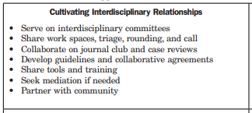
Improving Interprofessional Communication on L & D
2016, 2017 - STFM Annual Conference presentations on similar topics
FM physicians can improve interprofessional relationships by:
Filling clinical areas of need at the hospital
Teaching maternity/team-based trainings
FM physicians can improve maternity care presence by:
FM representation on committees/leadership
FM representation in writing of maternity care privileging requirements
Goldstein JT, Hartman SG, Meunier MR, Panchal B, Pecci CC, Zink NM, Shields SG. Supporting Family Physician Maternity Care Providers. Fam Med. 2018 Oct;50(9):662-671.
Notes:
Not a revolutionary topic – lets keep the discussion going!

Slide 19
Boston Medical Center - Collaborative Model
Family Medicine
High-functioning, collaborative maternity care team with clearly defined practice structure
Systems promoting culture of safety
Interdisciplinary education that integrates skills and expertise of each profession
Mistrust, inconsistent communication, variable skill sets
OBGYN
CNM
Pecci CC, Mottl-Santiago J, Culpepper L, Heffner L, McMahan T, Lee-Parritz A. The birth of a collaborative model: obstetricians, midwives, and family physicians. Obstet Gynecol Clin North Am. 2012;39(3):323-334.

Slide 20
Boston Medical Center - Collaborative Model
Team-Focused
Acceptable Case Load
Good Documentation
Clarity of Responsibility
Maximizing Continuity
High Efficiency
Citizenship
Frequent Communication
Evidence-Based Care
Excellence in Education
Notes:
10 key parts to the collaborative model
Based on 10 principles
Large poster with guiding principles displayed on L&D
For first year of project - working group met weekly

Slide 21
Boston Medical Center - Collaborative Model
24 hour in-house staffing for OB/FM/CMN
Hierarchy de-emphasized; promote skill-set strengths/scope of care
Clarity of supervising attending provider
Multi-disciplinary teaching
Resident assigned to all deliveries/labors, including with CNM
OBs: required leadership workshops
FMs: maintain competence in intrapartum skills
Team trainings:
OB, CNM, FM, anesthesiology, RNs, ED physicians
Clinical guidelines developed by all parties
Notes:
*24 hour in-house staffing: supported by hospital financially; merged billing under one entity
*FM competence in intrapartum skills → monthly faculty seminars, evidence review, hands-on skills; MINIMUM SHIFTS worked/year
*Team Trainings: specifically for BMC -- used TeamSTEPPS, Team Performance Plus, Online educational models on fetal monitoring interpretation and emergency drills

Slide 22
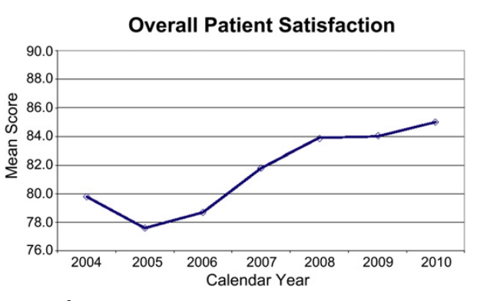
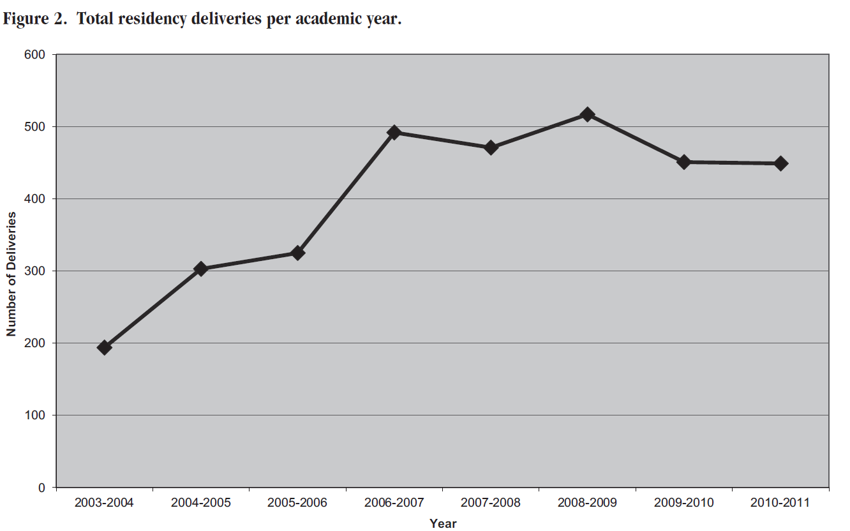
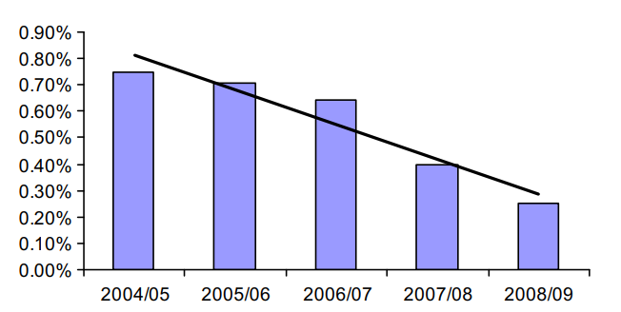
Boston Medical Center - Collaborative Model
Described Outcomes
Model of sustainable maternity care practice in urban environment for FM residents
Increase in residency deliveries
Improved patient satisfaction (Press Ganey)
Decreased malpractice claims
Increased collegiality
Rate of Claims per Policy Year Deliveries
Notes:
Increase in residency deliveries → Possible increase in FM graduates choosing a position practicing maternity care
Increase in collegiality MARKED BY..
OB teaching awards → CNM and FM attendings
FM teaching award → CNM
References for graphs: Total residency deliveries (Pecci JABFM 2012); Rate of Claims & Patient Satisfaction (Pecci Obstet Gynecol Clin N Am 2012)

Slide 23
Dartmouth-Hitchcock Collaborative Care Model
Motivation: patient requests for female providers
Solution: CNM service added to OBGYN service
Public leadership support of CNM/OB collaborative practice
OB Department Chair readily available for brainstorming
Collaborative Practice Agreement AND Clinical Practice Guidelines
Hire individuals interested in working in a collaborative practice; who view differences as potentially beneficial
Bi-directional specialty support and consultation
Interprofessional education
Regular M&M, obstetric case conferences, Grand Rounds
Public demonstration of respect between colleagues
Cordell MN, Foster TC, Baker ER, Fildes B. Collaborative maternity care: three decades of success at Dartmouth-Hitchcock Medical Center. Obstet Gynecol Clin North Am. 2012 Sep;39(3):383-98.
Notes:
*Interprofessional Education
CNMs provide medical education for OBs/medical students
OB residents spend 1 month of training with the CNM service
CNM Director involved in interview process for OB residents
*Collaborative Practice Agreement - separate from Consultation Guidelines, describes provider scope of care and professional responsibilities (including respect of other specialties)

Slide 24
Dartmouth-Hitchcock Collaborative Care Model
Described Learning Points
Good intentions are not enough → need supportive leadership & infrastructure
Absence of a hierarchical approach = communication that shares power
Everyone practices to full extent and not beyond level of training
All providers held equally accountable to high level of standard
Barriers to interprofessional education
Historical hierarchy, belief that physicians are the most powerful medical professionals
Cordell MN, Foster TC, Baker ER, Fildes B. Collaborative maternity care: three decades of success at Dartmouth-Hitchcock Medical Center. Obstet Gynecol Clin North Am. 2012 Sep;39(3):383-98.

Slide 25
Evidence supporting collaborative Maternity Care practice
3 ACOG fellows and 3 CNM
Reviewed 60 papers on successful models of sustained collaborative practices
5 successful themes found
Motivation for Collaboration
Reciprocal Consultation
Mutual Respect and Trust
Care Integration - review of FHT/Care plans at board rounds with respectful communication
Interprofessional Education
Avery MD, Montgomery O, Brandl-Salutz E. Essential components of successful collaborative maternity care models: the ACOG-ACNM project. Obstet Gynecol Clin North Am. 2012 Sep;39(3):423-34.
Notes:
MOTIVATION FOR COLLABORATION:
Care for women in a safe and effective manner
Increase educational opportunities for learners
RECIPROCAL CONSULTATION:
Systematic process for referral of care from one clinician to another
Methods of fostering clear communication
All groups involved in protocol development and QI projects
Ensuring that all groups were using Evidence-Based practice
Developing feasible financial structure
MUTUAL RESPECT AND TRUST
Leadership roles from all specialties
Involvement of all specialties in committees
Overcoming misconceptions of specialties and addressing strengths

Slide 26
References
Howell EA, Zeitlin J, Hebert P, Balbierz A, Egorova N. Paradoxical trends and racial differences in obstetric quality and neonatal and maternal mortality. Obstet Gynecol. 2013;121(6):1201-1208.
Rayburn WF. The Obstetrician-Gynecologist Workforce in the United States: Facts, Figures, and Implications. Washington, DC: American Congress of Obstetricians and Gynecologists. 2011.
Rayburn WF, Tracy EE. Changes in the Practice of Obstetrics and Gynecology. Obstet Gynecol Surv. 2016;71(1):43-50.
Magee, Susanna R. et al. Family Medicine Maternity Care Call to Action: Moving Toward National Standards for Training and Competency Assessment. Family medicine 49 3 (2017): 211-217 .
Tong ST, Makaroff LA, Xierali IM, Puffer JC, Newton WP, Bazemore AW. Family physicians in the maternity care workforce: factors influencing declining trends. Matern Child Health J. 2013;17(9):1576-1581.
Avery, Daniel M. Graettinger, Kristine R. Waits, Shelley. Parton, Jason M. Comparison of Delivery Procedure Rates Among Obstetrician-Gynecologists and Family Physicians Practicing Obstetrics. American Journal of Clinical Medicine 2014; 10(1); 16-20.
Detuchman, Mark E. Sills. Sills, DeAnna. Connor, Pamela D. Perinatal Outcomes: A Comparison Between Family Physicians and Obstetricians. J Am Board Fam Pract 1995; 8(6): 440-447.
Avery, Daniel M. et al. Neonatal Outcomes of 26,331 Infants Delivered by Obstetrics Fellowship Trained Family Physicians and OB/Gyns. Journal of Family Medicine and Disease Prevention 2015; 1(3).
Berreto, Tyler W. et al. Intention Versus Reality: Family Medicine Residency Graduates’ Intention to Practice Obstetrics. J Am Board Fam Med 2016; 30: 405-406.
Baldor RA, Pecci CC, Moreno G, Van Duyne V, Potts SE. A National CERA Study of the Use of Laborists in Family Medicine Residency Training. Fam Med. 2017;49(2):114-121.
Pecci CC, Mottl-Santiago J, Culpepper L, Heffner L, McMahan T, Lee-Parritz A. The birth of a collaborative model: obstetricians, midwives, and family physicians. Obstet Gynecol Clin North Am. 2012;39(3):323-334. doi:10.1016/j.ogc.2012.05.001
Pecci, Christine. Leeman, Lawrence. Wilkinson, Joanne. Family Medicine Obstetrics Fellowship Graduates: Training and Post-Fellowship Experience. Fam Med 2008; 0(5): 326-332.
Collins, Dawn E. (2008). Multidisciplinary Teamwork Approach in Labor and Delivery and Electronic Fetal Monitoring Education: A Medical-Legal Perspective. The Journal of Perinatal & Neonatal Nursing, 22(2), 125–132.
Goldstein JT, Hartman SG, Meunier MR, Panchal B, Pecci CC, Zink NM, Shields SG. Supporting Family Physician Maternity Care Providers. Fam Med. 2018 Oct;50(9):662-671.
Pecci CC, Mottl-Santiago J, Culpepper L, Heffner L, McMahan T, Lee-Parritz A. The birth of a collaborative model: obstetricians, midwives, and family physicians. Obstet Gynecol Clin North Am. 2012;39(3):323-334.
Pecci CC, Hines TC, Williams CT, Culpepper L. How we built our team: collaborating with partners to strengthen skills in pregnancy, delivery, and newborn care. J Am Board Fam Med. 2012 Jul-Aug;25(4):511-21. doi: 10.3122/jabfm.2012.04.110160. PMID: 22773719.
Cordell MN, Foster TC, Baker ER, Fildes B. Collaborative maternity care: three decades of success at Dartmouth-Hitchcock Medical Center. Obstet Gynecol Clin North Am. 2012 Sep;39(3):383-98.
Avery MD, Montgomery O, Brandl-Salutz E. Essential components of successful collaborative maternity care models: the ACOG-ACNM project. Obstet Gynecol Clin North Am. 2012 Sep;39(3):423-34.

Slide 27
Discussion
Please share something from your institution that has been successful in developing positive multi-disciplinary culture on L&D

