Slide 1
Insta-who? TO FOLLOW OR NOT TO FOLLOW RESIDENTS: THAT IS THE ETHICAL QUESTIOn
Limor Gildenblatt, PhD, LCSW & Carlie Nikel, PsyD

Slide 2
INTRODUCTIONS
Limor Gildenblatt, PhD, LCSW – Behavioral Health Faculty
Saints Mary & Elizabeth Family Medicine Residency – July 2020
Resurrection Medical Center Family Medicine Residency – 4 yrs
Masonic Family Medicine Residency Program – 1 year
Carlie Nikel, PsyD – APD & Director of Behavioral Science
University of Missouri Kansas City – 4.5 years

Slide 3
Disclosures

Slide 4
OBJECTIVES
Evaluate the pros and cons of being connected on social media
Compare and contrast ethical differences between various disciplines
Outline educational opportunities and discussion topics to have with faculty and/or residents

Slide 5
Why talk about boundaries & social media?
This topic feels relevant to all of us – inevitable boundary considerations we face
Making decisions based on ethical guidelines may further distance us from residents

Slide 6
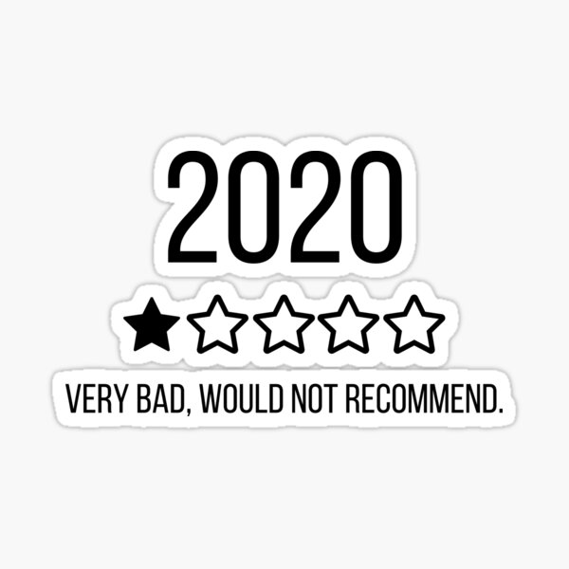
Why talk about boundaries & social media Continued…
No road map in terms of what we should be doing when it comes to social media relationships with our residents
It’s still 2020…so boundaries may feel even more complicated at times, we may be relying more on social media in our residencies

Slide 7
THE Social media DILEMMA - LG

Slide 8
The Social media DILEMMA - CN

Slide 9
fACULTY/resident relationships & BOUNDARIES…

Slide 10
PROS & CONS OF SOCIAL MEDIA CONNECTION
PROS
Deepen connection with residents
May detect residents who are suffering emotionally
Ability to share information
CONS
Residents may learn personal info about us faculty
We may learn things about residents that puts us in diff places with work
Residents may feel like there is favoritism

Slide 11
Social media and Covid
Virtual recruitment
Easy way to share stress management information

Slide 12
Ethics: Psychologists, Social workers, and physicians
Interdisciplinary team members may address ethical dilemmas differently
Need to openly discuss these differences when making decisions

Slide 13
Psychologists
Avoid harm
Do not exploit persons who you supervisor, evaluate, or other authority
*Social Media Guideline – Confidentiality of Data and Information

Slide 14
Social Workers
Avoid harm
Do not exploit others
Conflicts of Interest
Supervision and Consultation

Slide 15
Physicians
Do no harm
*Code of Medical Ethics Opinion

Slide 16
To sum it up…
Similarities
Do no harm
Avoid exploiting people
Differences
Level of guidance within ethics code
Professionalism!

Slide 17
What Dilemmas may arise?
Unprofessional behavior
Privacy violations
Pushing boundaries

Slide 19
Breakout rooms | Questions
How do you/does your residency handle social media relationships with residents? Why?
How do we talk about this as a faculty, especially when we are all likely on many parts of the scale?
Is this a personal choice as a faculty member or should this be a group decision as a faculty?

Slide 20
Breakout rooms REPS

Slide 21
Conclusion & recommendations
Professionalism education
Include social media behaviors
Talk about this amongst your faculty
Decide as a program if this should be an individual vs. group choice
Make a plan to address social media professionalism lapses

Slide 22
CONCLUSIONS & RECOMMENDATIONS
Be transparent with residents
Can talk about what program decides from the get-go
Revisit these conversations and decisions often
Does this work in your residency program?
Is it causing issues?
Is it having a positive impact?

Slide 23
QUESTIONS
Limor Gildenblatt, PhD, LCSW
Limor.Gildenblatt@amitahealth.org
Carlie Nikel, PsyD
Carlie.Nikel@tmcmed.org
STFM Connect
STFM Listserv
Notes:
5 minutes for questions
-continuing the discussion on STFM connect listserv

Slide 24
references
American Medical Association. (2016). AMA principles of medical ethics. Retrieved Sept. 20, 2020, from https://www.ama-assn.org/delivering-care/ama-principles-medical-ethics
American Psychological Association. (2013). Guidelines for the practice of telepsychology. http://www.apa.org/practice/guidelines/telepsychology.aspx
American Psychological Association. (2017). Ethical principles of psychologists and code of conduct Retrieved at https://www.apa.org/ethics/code/ethics-code-2017.pdf
Association of State and Provincial Psychology Boards. (2013). ASPPB social media task force guidelines for the use of social media for psychologists in practice. Retrieved from https://asppb.site-ym.com/resource/resmgr/PSYPACT_Docs/ASPPB_TELEPSYCH_PRINCIPLES.pdf
Barsky, A. E. (2017). Social Work Practice and Technology: Ethical Issues and Policy Responses. Journal of Technology in Human Services, 35(1), 8–19. https://doi-org.proxy.library.umkc.edu/10.1080/15228835.2017.1277906
Federation of State Medical Boards. (2012). Model policy guidelines for the appropriate use of social media and social networking in medical practice. Retrieved at http://www.fsmb.org/siteassets/advocacy/policies/model-guidelines-for-the-appropriate-use-of-social-media-and-social-networking.pdf
Greysen, S. R., Chretien, K. C., Kind, T., Young, A., & Gross, C. P. (2012). Physician violations of online professionalism and disciplinary actions: a national survey of state medical boards. JAMA, 307(11), 1141–1142. https://doi-org.proxy.library.umkc.edu/10.1001/jama.2012.330
Lannin, D. G., & Scott, N. A. (2013). Social networking ethics: Developing best practices for the new small world. Professional Psychology Research and Practice, 44(3), 135-141.
National Association of Social Workers. (2017). NASW code of ethics. Retrieved Sept. 20, 2020, from https://www.socialworkers.org/About/Ethics/Code-of-Ethics/Code-of-Ethics-English
Tutelman, P. R., Dol, J., Tougas, M. E., & Chambers, C. T. (2018). Navigating your social media presence: Opportunities and challenges. Clinical Practice in Pediatric Psychology, 6(3), 289–298. https://doiorg.proxy.library.umkc.edu/10.1037/cpp0000228.supp

