Slide 1
S06: How to Write an Op-Ed
Bich-May Nguyen, MD, MPH, FAAFP @bicmay
Ranit Mishori, MD, MHS, FAAFP @ranitmd
Kenneth W. Lin, MD, MPH, FAAFP @kennylinafp
Sarah Kureshi, MD, MPH

Slide 2
Influence
Common goal: to create political will
Your members of Congress and their aides will pay attention to opinion pieces deemed worthy of publishing because they know that hundreds, perhaps thousands of other readers are seeing your call to action

Slide 3
Ask Yourself
Why am I writing this?
Who am I writing this for?
Who are you?
So what?

Slide 4
Engaging the Media
Follow mainstream and alternative media sources
http://www.usnpl.com/
Research and know your issue the best you can
Have data and stories that make a strong case for your issue
Find a way to connect your issue to something local
Anticipate the other side and prepare for myths and attacks

Slide 5
Tell a story
Stories grab attention
We remember stories, not stats
Worrying about how much you don’t know is the biggest barrier to advocacy

Slide 6
Op-Eds
Guest columns, usually 500 – 700 words
The smaller the paper, the better chance of getting published
You are well-positioned as an “expert”

Slide 7
Basic Structure
Anecdote
Problem
Solution
Call to action
Tie back to anecdote

Slide 8
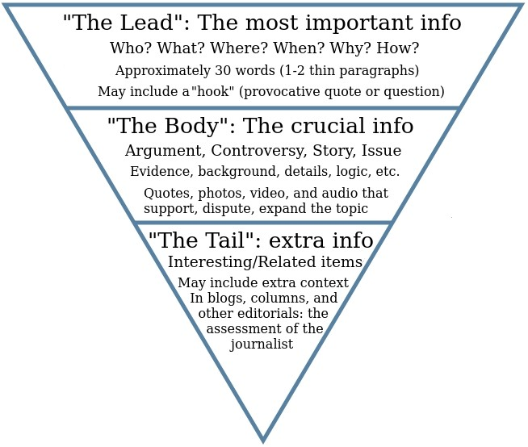

Slide 9
Nut graphs: The 5 W’s
First thing you write
The paragraph is in the beginning
Do not veer off from main topic – if it doesn’t relate to your nut graph, cut it!

Slide 10
Ledes
First paragraph
Draw the reader in
Appeal to the reader’s emotions

Slide 11
How to Write an Op-Ed
Check submission guidelines
Try to tie the issue you want to write about to a recent event
Have a clear point of view
Hook readers with your main point
Tell readers why they should care

Slide 12
How to Write an Op-Ed
Offer specific recommendations
In responding to an article, avoid point-by-point rebuttals
Acknowledge the opposition
Appeal to your authority and expertise
Be the voice of reason

Slide 13
How to Write an Op-Ed
Use short sentences and paragraphs
Avoid jargon
Use the active voice
Don’t ramble
End with a clear call to action

Slide 14
Keys to Getting Op-Eds Published
Can elaborate more, but don’t ramble
Tout those local angles
Be strategic in who submits it
If paper won’t publish as an op-ed, ask if you can edit it down to an LTE

Slide 15
Edit for Maximum Impact
Re-structure: the inverted pyramid
Conclusion/essential info first
Add supporting information
Related info/background
Edit for main idea
Is the message clear?
Did you bury the lede?

Slide 16
Edit for Maximum Impact
Use facts and stats sparingly, and only to support your main topic
Remove redundant phrases and over-explanation
Vary your language choices
Be concise

Slide 17
Edit for Maximum Impact
Edit for spelling, tense, grammar
Announce technical terms
Give up some precision for a “good enough for right now” definition
Paraphrased definition and description

Slide 18
Use $5 words, not $10 words
Expect
Try
Begin, Start
Show, Prove
If
Many, Several
End, Cancel

Slide 19
Use Transitions When Starting Paragraphs
In contrast
However
Similarly
Also
Above all
More importantly
First, Second, Last
Eventually

Slide 20
Finding the Right Venue
Geography: http://wsnpl.com
Topic
Timeliness
Format
Published before?
DO NOT pitch story without first reading publication

Slide 21
How to Pitch to Editor
Email version of a cover letter
Brief, catchy subject heading
Address editor by name
State who referred you
Introduce yourself
Why you’re writing

Slide 22
How to Pitch to Editor
Explain why audience would be interested now
Summarize background, main sources, evidence, key takeaways
OK to use bullets
Be concise
Is your content exclusive? Unique?

Slide 23
How to Pitch to Editor
Acknowledge editor’s busy schedule
Your availability for copy editing, revisions
Suggest follow up dates

Slide 24
Rejected? Resubmit Elsewhere!

Slide 25
After Publication, Share!
Email your legislators’ offices
Send copies to your communications department
Send copies to STFM, AAFP

Slide 26
Work Those Social Media Channels
Set up a promotional schedule across social media networks
Tweet 2-3 times on the day of publication, then 1 day later, 1 week later, 1 month later, 2 months later
Facebook post the day of, 1 week later, 1 month later, etc

Slide 27
Contact
Bich-May Nguyen, MD, MPH, FAAFP Bich-May.Nguyen@memorialhermann.org
Ranit Mishori, MD, MHS, FAAFP mishorir@georgetown.edu
Kenneth W. Lin, MD, MPH, FAAFP Kenneth.Lin@georgetown.edu
Sarah Kureshi, MD, MPH
sk795@georgetown.edu

