Slide 1
Careers in Academics *** straight or winding
Beat Steiner MD MPH
Professor of Family Medicine UNC School of Medicine
Medical Director Primary Care Services – Wakebrook

Slide 2
Preparation

Slide 3
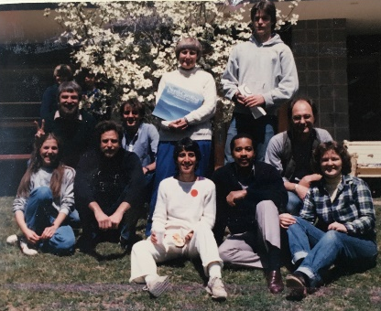
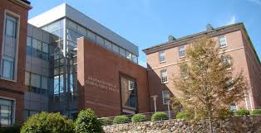
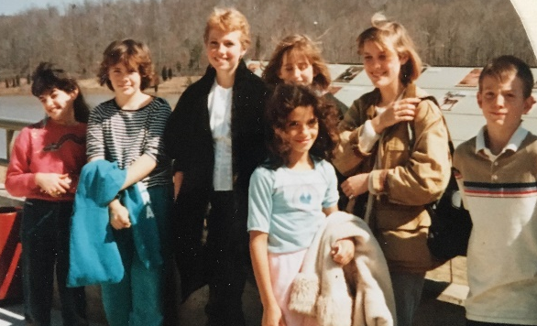
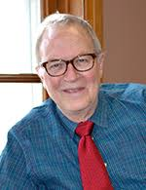
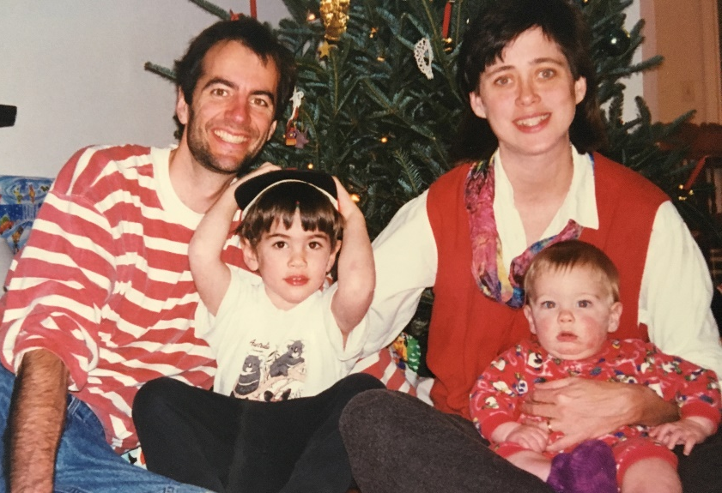
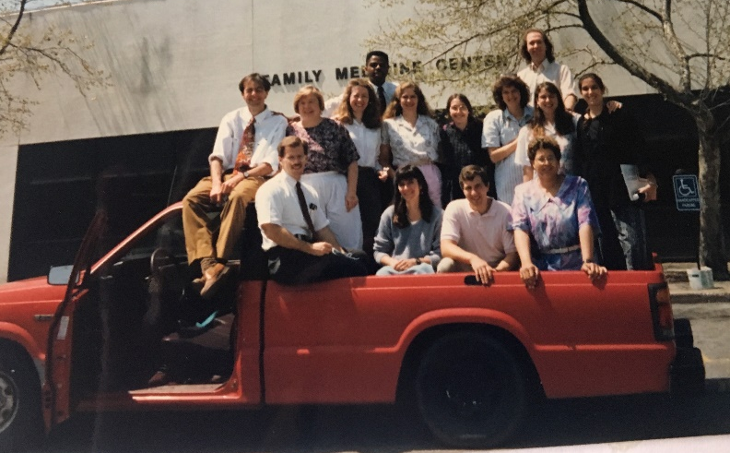

Slide 4
Highlights

Slide 5
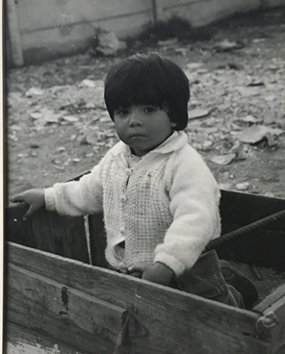
Care for Patients
Inspire students to care
Shape policy outside of SOM
Connect with colleagues nationally

Slide 6
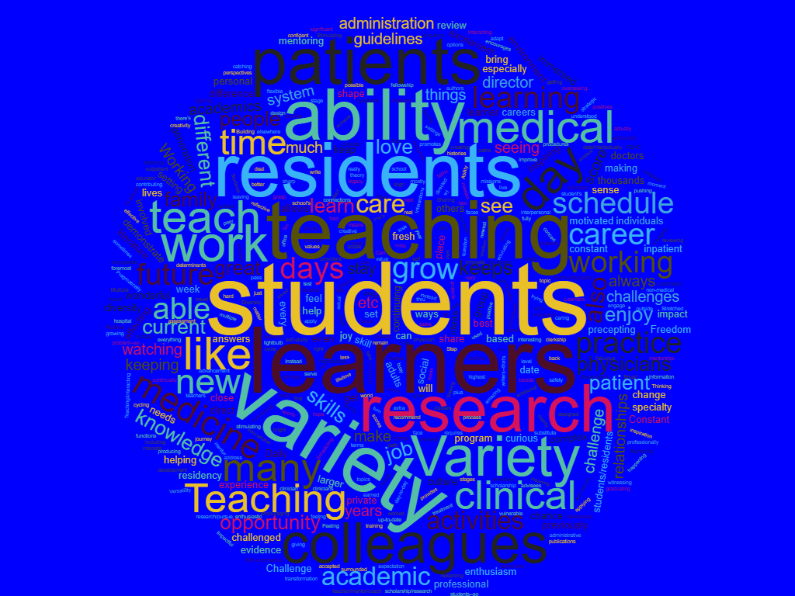

Slide 7
Advice

Slide 8
Define your core and let it guide you
Hone your skills
Plan ahead but not too much
Be open to opportunities but no need to do them all today
Find mentors

Slide 9
Make Your Own Connection Write your advice on the letter on your table and give it to a student after the session

