Slide 1
Neuropathy
DM Newman, May 2021

Slide 2
Lumbar radiculopathy
Cervical radiculopathy
Diabetic neuropathy
OUTLINE
Notes:
Diag > Rx

Slide 3
Lumbar radiculopathy
Vs Sciatica
Notes:
Not talking about back pain.
Sciatica is like UTI in that it involves a lot of specific conditions and I think one needs to be as specific as possible. What is the anatomic cause of the sciatica?

Slide 4
Definitions
Sciatica
Inflammation of the Sciatic Nerve and any of it’s components
Multiple Causes
Lumbar Radiculopathy
Pain originating from one (or occasionally 2) lumbar nerve roots
90% from compression in the intervertebral foramen
Lumbago = Undifferentiated low back pain

Slide 5
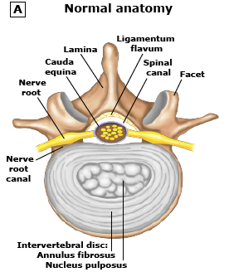
Normal Anatomy
Remember:
Anterior & Posterior Primary Rami

Slide 6
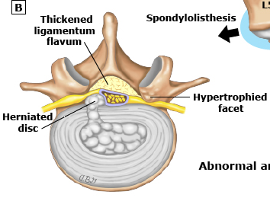
Abnormal Anatomy

Slide 7
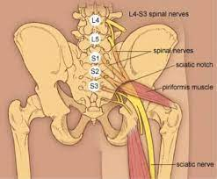
Sciatic Nerve
Notes:
L4-L5 + S1-2-3
Not L3!

Slide 8
L1 – Femoral Nerve
Ileopsoas – Hip flexion
L2 / L3 / L4 - Femoral + Obturator
Ileopsoas – Hip flexion
Quadriceps - Knee extension
Hip adduction
L5 – Peroneal, Tibial + Superior Gluteal
Ankle dorsiflexion, inversion/eversion, EHL
Gluteus medius - Hip abduction
S1 – Inf Gluteal, Tibial
Gluteus - Hip extend, Hamstrings - Knee flex
Ankle plantarflex
Lumbar Myotomes

Slide 9
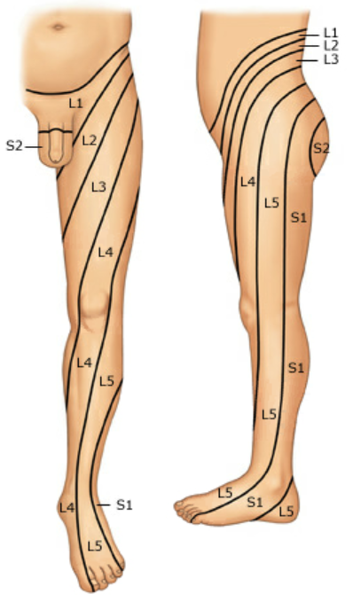
L2+ 3 – Anterior thigh
L4 – Medial ankle and foot. (Can cause aterolateral thigh pain)
L5 – Dorsum of Foot
S1 – Sole and lateral foot.
Dermatomes

Slide 10
L3 (L4) – Patella
S1 – Achilles
No reflex for L5
Reflexes

Slide 11
L3
L4
L5
S1
Where?

Slide 12
L5 or S1 common
L4 or S2 uncommon
Others rare
Where
Notes:
Central disk protrusion does not cause radiculopathy
12

Slide 13
Acute
Ruptured Disk
Trauma
Chronic
Spondylolisthesis
Tarlov cysts
Facet arthropathy
Tumor
(Ligament hypertrophy)
How
Notes:
Central disk protrusion does not cause radiculopathy
13

Slide 14
What does it test?
(Mechanism)
Straight Leg Raising Lasègue’s Test

Slide 15
No pain with Hip IR / ER
Pain in ipsilateral buttock, low back not isolated calf or knee
Pain between 30° and 60° Resistance to further flexion
Increased with Dorsiflexion of foot
Decreased with flexion of knee
Crossed SLR very specific, not sensitive.
Straight Leg Raising
Notes:
Distraction first. Seated. Abduct / adduct for hip pain
Patrick’s (Figure-4) – hip / SI.
Sensitivity 90o
15

Slide 16
Valsalva, cough, sneeze – suggests acute disk
May or may not have back pain
Walks / stands with torso forward flexed
Sitting hurts more than standing
Better first AM
Other Signs, Sx

Slide 17
Plain films not helpful
MRI for “low back pain”
64% of symptomatic showed disk protrusion / extrusions
36% of asymptomatic
If prior surgery or concern for tumor / infection get contrast
CT or CT-myelogram if unable to do MR
Imaging
Notes:
Meta-analysis of 6000 patients
17

Slide 18
Severe or Progressive
Pre-operative Planning
Incontinence / Retention
Suspicion of Cancer / Infection
> 12 weeks of symptoms despite adequate conservative management
Imaging - When
Notes:
18

Slide 19
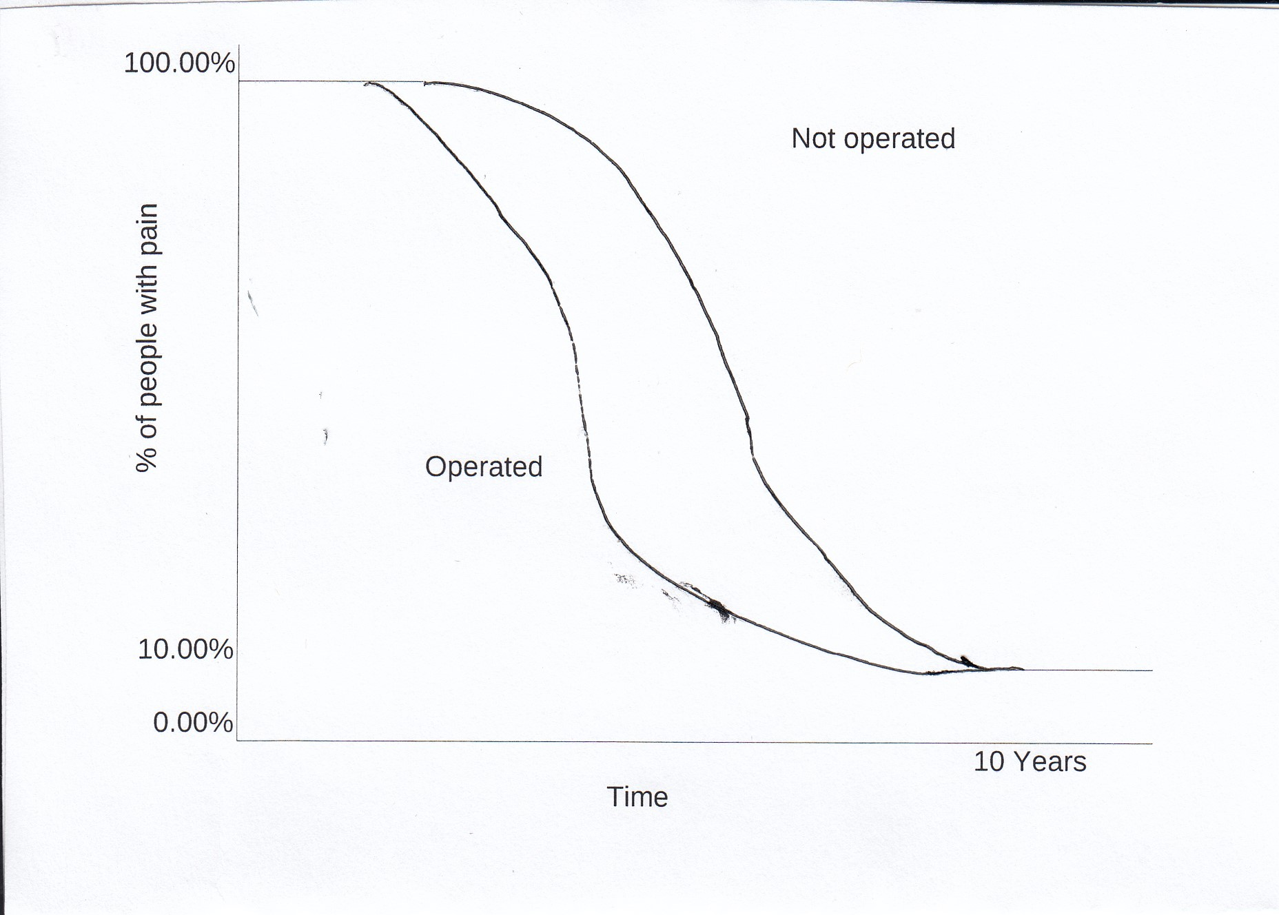
Surgical Results

Slide 20
Sciatica DDx
(Not radic.)

Slide 21
Spinal Stenosis
SI derangements
Meralgia Paresthetica
Zoster
Ischial Bursitis
Referred
Quadratus Lumborum
Gluteus Medius Tendinitis
Injury
Direct blow / Fall
Fx Pelvis
Hip Dislocation
Injection
Wallet Pressure
Piriformis Syndrome
Running, Lunging, Yoga
Pelvic Tumor
Endometriosis
Hamstring Tear
Sciatica – Causes other than Radiculopathy

Slide 22
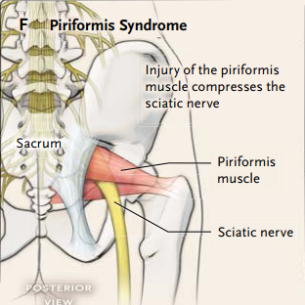
Piriformis Syndrome

Slide 23
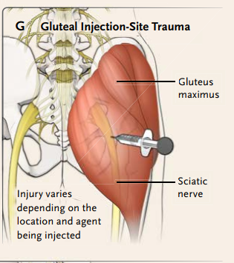
Gluteal Injection Trauma

Slide 24
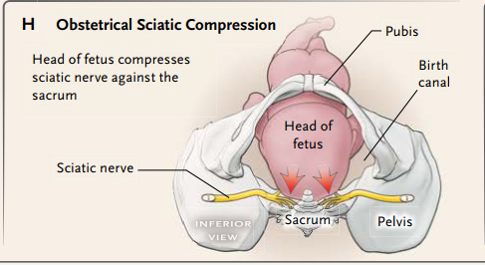
OB Trauma

Slide 25
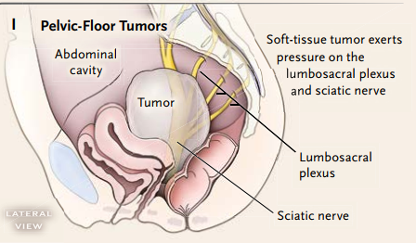
Pelvic Tumor

Slide 26
CervIcal radiculopathy
Notes:
Not talking about back pain.
Sciatica is like UTI in that it involves a lot of specific conditions and I think one needs to be as specific as possible. What is the anatomic cause of the sciatica?

Slide 27
History
“I woke up with it.”
Unilateral pain radiating down arm
Can be just paresthesia
15% have weakness as a symptom

Slide 28
First rib dysfunction
Cervical Myelopathy
Zoster
Tumor
Thoracic Outlet
Shoulder pathology
Differential Dx

Slide 29
C 5
C 6
C 7
C 8
T1
Where?
Notes:
C7, C6

Slide 30
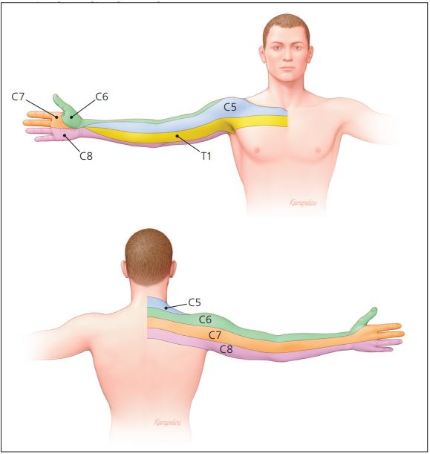
Dermatomes

Slide 31
Muscles / Reflex
C5
Deltoid; Biceps
C6
Biceps, Wrist extension
C7
Triceps, Wrist Flexion
(Triceps reflex)
C8
Finger Flex
C8
Hand intrinsics

Slide 32
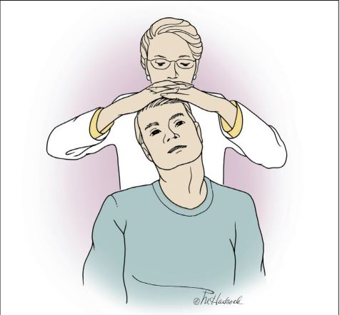
Spurling’s
Notes:
Extend, sidebend toward, axial pressure. Some also do traction.

Slide 33
Treatment
90% resolve in 3 mos w/o surgery
Cervical collar
Hard / Soft
Sleep, Passenger, Pain
Physical therapy
Exercise
Traction
If not much better in 8 – 12 wk→ MRI
OMT not helpful
(? Steroids)

Slide 34
Diabetic Neuropathy
Notes:
Not talking about back pain.
Sciatica is like UTI in that it involves a lot of specific conditions and I think one needs to be as specific as possible. What is the anatomic cause of the sciatica?

Slide 35
Diagnosis
History Variable
Hypesthesia to Allodynia
Often associated with central activation
Burning, stabbing, shocking, ache
Often worse at night and disturb sleep
Can be asymptomatic, even with ulcer
Up to 50% of people with diabetes
Not related to duration or control

Slide 36
Diagnosis - Exam
Loss of Vibratory (128 Hz)
+ LR 35
Interobserver reliability low
Loss of Filament
+ LR 16
Interobserver reliability Moderate
Abn Heel walking
+ LR 11 but confidence interval crosses 1
Loss of Achilles Reflex

Slide 37
Other forms
3rd Nerve Palsy
Gastroparesis
Sciatica
Also femoral and peroneal nerves
CTS
Notes:
CTS 3 x than non-diabetic

Slide 38
Other forms – p 2
Erectile Dysfunction
Bladder Dysfunction
Retention
Hesitancy / Dribbling
Cystitis
Abn Sweating
Notes:
Sweating can be hands / feet or other patterns. Also gustatory

Slide 39
Treatment
Standard
Glucose control, stop smoking, lipid control, BP control
TCA
NNT 1.3; NNH 6 (minor); 28 (major)
SNRI
NNT 3; NNH 10 (minor); 17 (major)
Gabapentinoid
NNT 3; NNH 4 (minor); 11 (major)
Opioid
NNT 3; NNH 4 (minor); 8 (major)
Topical: Lidocaine, Capsaicin

Slide 40
Jensen RK, Kongsted A, Kjaer P, Koes B. Diagnosis and treatment of sciatica. BMJ. 2019 Nov 19;367:l6273. doi: 10.1136/bmj.l6273. PMID: 31744805.
Ropper AH, Zafonte RD. Sciatica. N Engl J Med 2015;372:1240-8.
Kanji JN et al. Does this patient with diabetes have large-fiber peripheral neuropathy? JAMA. 303(15): 1526-1532
Siddiq AB, Clegg D, Al-Hasan S, Rasker JJ. Extra-spinal Sciatica and Sciatica Mimics: A Scoping Review. Korean J Pain. 2020;33(4):305-317.
UpToDate
Childress MA, Becker BA. Non-operative Management of Cervical Radiculopathy. Am Fam Physician. 2016 May 1; 99(9):746-754.
Deli G, Bosnyak E, Pusch G, Komoly S, Feher G: Diabetic Neuropathies: Diagnosis and Management. Neuroendocrinology 2013;98:267-280. doi: 10.1159/000358728
References

