Slide 2
The Papaya Workshop A Model for Virtual Procedure Training During COVID and Beyond
Chelsea Faso, MD, Heather Paladine, MD, MEd, Rithika Mathias, MD, Ian Lague, MS
Notes:
Thank you for joining in for our seminar. We will be discussing the papaya workshop: a model for virtual procedure training during COVID and beyond.
This seminar is presented by Heather Paladine, Rithika Mathias, Chelsea Faso, and Ian Lague (lag-yew).

Slide 3
Disclosures
Heather Paladine, Rithika Mathias, Chelsea Faso, and Ian Lague have no financial relationships to disclose.
Notes:
We have no financial relationships to disclose.

Slide 4
Objectives
After attending this seminar, participants will be able to:
Understand the role of primary care physicians in abortion care and describe the practice of Manual Vacuum Aspiration (MVA) including options counseling, pain management, and use of patient-centered language and trauma-informed care
Model a papaya MVA simulation and become familiar with tools used for the actual MVA procedure
Identify impact of a virtual papaya workshop in medical education and beyond
Use the virtual papaya workshop model to develop new virtual models of procedure training.
Notes:
Objectives: After attending this seminar, participants will be able to…

Slide 5
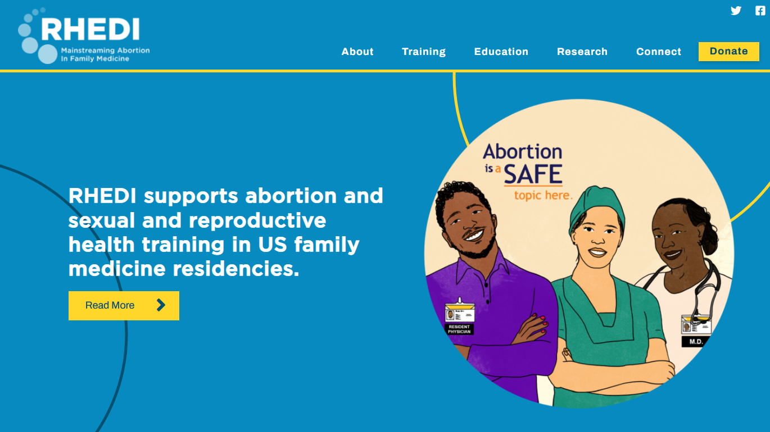
Reproductive Health Education in Family Medicine (RHEDI)
Notes:
We’d first like to introduce some of our affiliated organizations.
RHEDI (or Reproductive Health Education in Family Medicine) is an organization that aims to mainstream and destigmatize abortion care within family medicine.
RHEDI envisions a world where both abortion and contraceptive care are provided within family medicine, and every person can receive patient-centered, full spectrum reproductive health care without barriers.
Family physicians provide comprehensive health care across the lifecycle and are well-positioned to help provide this care.

Slide 6
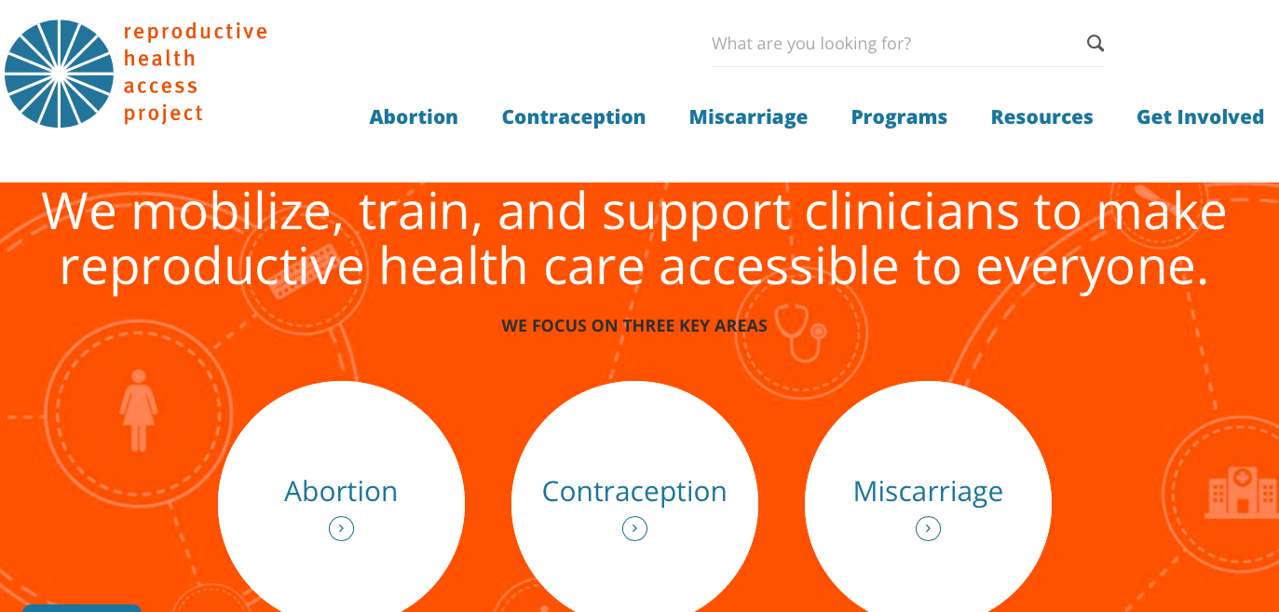
Reproductive Health Access Project (RHAP)
Notes:
The Reproductive Health Access Project (or RHAP for short) is a national nonprofit organization that works directly with primary care providers, helping them integrate abortion, contraception, and miscarriage care into their practices so that everyone can receive this essential health care from their own primary care clinicians.
RHAP is well known for patient education materials and advocacy work through the AAFP and beyond.

Slide 7
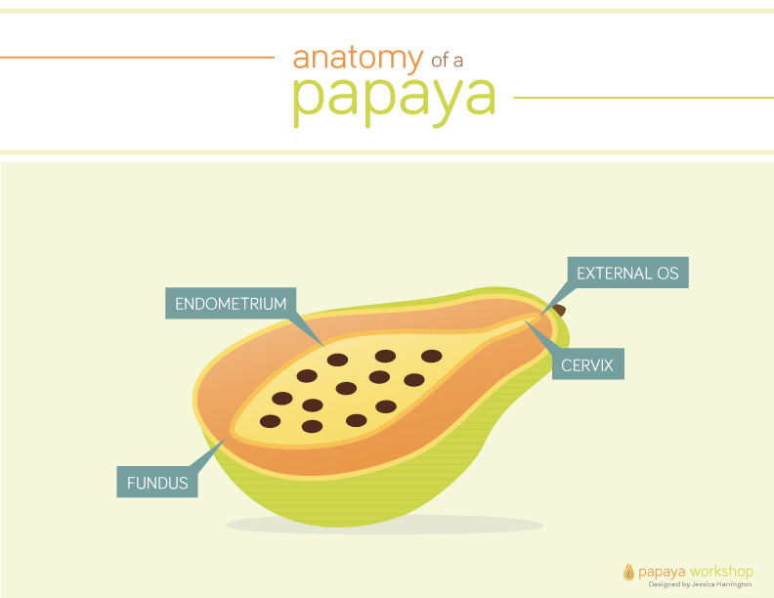
Papaya Workshop History
Medical training tool
Community advocacy and exposure
The Virtual Model
Notes:
The papaya workshop has long been utilized as an innovative interactive instruction model for teaching intrauterine procedures using inexpensive materials.
RHEDI started hosting virtual papaya workshops in the summer of 2020, because there was concern about how many abortion training opportunities had been lost during the pandemic. It was quickly discovered that virtual workshops could be just as powerful as in-person events for dispelling myths and stigma around abortion care and demonstrating just how fast and simple procedural abortion can be--as I think you'll all discover today.
We also found that virtual workshops could really welcome in folks that the traditional workshops weren't necessarily including. That meant students and residents whose programs would never allow them to host an abortion-related workshop, but also patient advocates, RJ activists, community leaders, and patients--and it became clear that the papaya workshop experience could be one of patient empowerment and of reclaiming medical knowledge and control. (Something that is particularly important in the context of pervasive reproductive violence and coercion).

Slide 8
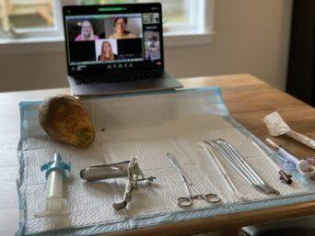
Virtual Papaya Workshop Setup
Facilitators and participants are all virtual
https://rhedi.org/virtual-papaya-workshops/
Notes:
In an effort to support procedural abortion training during the COVID-19 pandemic, RHEDI has developed a model for virtual papaya workshops.
Workshops can be held over any video conferencing applications (ex zoom), and offer expanded access to hands-on experience with procedural abortion care, using papayas as uterine models.
In order to host your own virtual papaya workshop for learners at your institution/organization, RHEDI recommends the following resources (link to resource list on slide):
- an MVA kit (which includes an aspirator, cannula, and dilators).
- Video or Live role play (videos available on RHEDI website)
- Papayas, plum tomatoes, or dragonfruit, to use as uterine models
- Instruction sheets for participants and facilitators
- If your institution cannot provide the MVA tools, MVA kits can be ordered online and mailed to registered participants (See link on slide)

Slide 9
Virtual Patient Centered Options Counseling
Model for patient care via telemedicine
Includes remote patient counseling and precepting
Notes:
RHEDI Virtual Papaya Workshop (12:45): https://www.youtube.com/watch?v=Ha6YYuFu-hg
https://youtu.be/Ha6YYuFu-hg
Virtual workshops for provision of sexual and reproductive health services are extremely relevant given the expansion of telemedicine services over the past 2 years.
This virtual model is a tool to spread relevant knowledge and skills, but also a tool to enhance how we provide remote/virtual care to our patients. As telemedicine is here to stay, it is extremely relevant to introduce remote counseling skills to our learners (students/residents).
We will now walk through a video role play. The video you're about to see was a collaborative effort (and a low budget one) that we made with Columbia's Center for Family and Community Medicine, and the Reproductive Health Access project. In the first part of the video, you'll see a model for a virtual counseling session with a patient, a resident, and a preceptor. And you'll notice that the roleplay depicts the most common kind of 'options counseling' where the patient really knows that they don't want to stay pregnant and the conversation is about the different abortion methods available. The second part of the video identifies the most standard items on the tray for a manual vacuum aspiration abortion. Finally in the third part of the video, our colleagues Payal Patel and Rithi Mathias walk through the steps of the procedure and demonstrate using the papaya as a uterine model. One thing to note here is the way Payal is modeling supportive, open, non-coercive language throughout the procedure and how Rithi's patient responds to that. Last things I'll say is that there are many variations in how people approach the MVA procedure and counseling and we don't mean to present this as the only way or a perfect example of patient-centered care. We hope we'll get a chance to hear about alternate approaches and look really forward to questions and feedback from the survey at the conclusion of this seminar.
(PLAY VIDEO)
As seen in the video, counseling can be completed entirely through remote means. This patient opted for a suction procedure. For those requesting medication abortion, we have evidence based no-test medication abortion protocols. We use these protocols to provide counseling remotely and increase access to essential abortion care, completely eliminating the need for patients to visit in-office for medication abortion.

Slide 10
Manual Vacuum Aspiration (MVA)
MVA Tray Video & Interactive Tray Demo
Notes:
MVA Tray Video (starts at 4:38): https://www.youtube.com/watch?v=Ha6YYuFu-hg
Interactive Tray Website: https://rhedi.org/interactive-tray-for-manual-vacuum-aspiration/
Interactive Tray Video (2:09): https://www.youtube.com/watch?time_continue=1&v=rWKzZreEQfk&feature=emb_logo
The RHEDI video can be used to review tools on an MVA procedure tray.
RHEDI also provides an interactive self-study MVA Tray tool, which allows learners to examine each item on a virtual MVA tray. Use this tool to learn a “no-touch” technique, identify instruments, test your knowledge about each tool, and review the order of steps for an aspiration procedure. We will now show a video demo of the interactive MVA tray.
And the second is a demonstration of RHEDI’s interactive MVA Tray tool, which prompts users to hover over each item on a virtual MVA tray, identify the instrument, and answer some basic questions about it. You’ll see first the learner is identifying the speculum and its use in the procedure, and getting feedback when they get it right. You’ll also see the prompt here when the learner mis-identifies the dilators as sounds, and is prompted to review the background materials and try again. With the MVA, the learner is asked to correctly re-order the steps of the aspiration process, using a drag-and-drop interaction. The tool also makes sure learners understand the ‘no-touch’ technique for the MVA and can demonstrate it by dragging the gloves to the places where each item on the tray can be touched. At the end of the session, the learner gets a score, which can also be automatically emailed to the preceptor.
While the MVA interactive tray is clearly a more detailed and technical learning tool, designed primarily for residents and students, I want to suggest that we should consider sharing resources like this with non-traditional medical learners in community and activism contexts. Even if learners aren’t going to memorize the items on the MVA tray, being transparent about this information can make SRH care much less intimidating and opaque to pts, and it can be part of a restorative process to affirm patient autonomy and start to build trust in communities who have good reasons to mistrust medical institutions and interventions…..

Slide 11
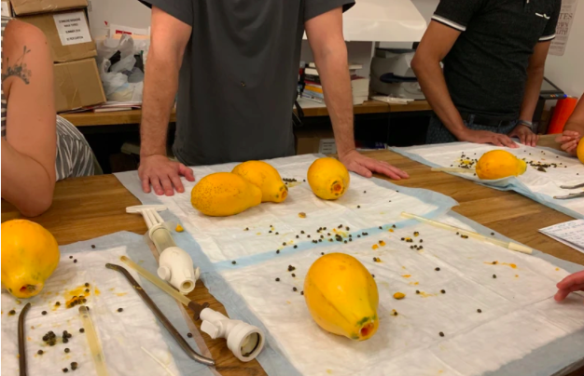
The Virtual Papaya Workshop: Beyond Clinical Training
We can use a virtual papaya MVA workshop for community outreach
Notes:
Beyond clinical training, virtual papaya workshops can be used for community trainings
Members from our group including our presenter Ian Lague (lag-yew), have promoted in-person community papaya workshops prior to Covid as seen in the picture here.
Abortion advocates such as one from NYC for Abortion Rights who participated in the workshop reported how they believe in grassroots strategies to move the abortion rights movement and stated, ““Participating in this workshop makes me feel more confident and prepared to deal with an increasingly frightening reality as our rights continue to be chipped away.”
Hopefully as a community of abortion care advocates and practitioners we can work together to destigmatize the abortion process for patients and their families, advocates and learners and be able to reach more people through the virtually adapted papaya workshop.

Slide 12
The Virtual Procedure Training Model
Beyond the pandemic
Access to expanded network of trainers and learners
Next Steps:
Develop resources and create central library for resources
Develop a system for facilitator and participant evaluation and feedback
Notes:
We can use the virtual papaya workshop as a model for other procedure training in medical education. As demonstrated, we have the ability to create video role-play, interactive online tools, and online resources to continue procedure training. These models prove to not only be effective tools in the setting of a pandemic and social distancing protocols, but can be a valuable tool in expanding access to training in settings where trainers are limited. For example, access to abortion training in medical residency has been severly impacted by sweeping abortion restrictions across the country. Could we use this as a model to maintain procedure training

Slide 13
Conclusions
Virtual papaya workshops:
Expand access to training during the pandemic and beyond
Provide framework for remote teaching in sexual & reproductive health and beyond
Offer communities a chance to reclaim medical knowledge and power
Support patient autonomy and advocacy
Family Physicians are well positioned to train in and provide abortion care, including uterine aspiration
Notes:
Overall, virtual papaya and SRH workshops are beneficial for medical trainees, the community, and our patients. Based on our experiences, they are feasible, they allow for expansion of access to SRH training during the pandemic and beyond, they provide a framework for remote teaching, they allow non-medical community members to reclaim medical knowledge and power, and they ultimately support patient autonomy and advocacy.
We conclude that Family Physicians are well positioned to train in AND provide abortion care, including uterine aspiration.
We’d like to end by encouraging you all to consider hosting a virtual workshop yourselves, not just for potential providers but for anyone in the communities where you live and work. RHEDI would be happy to consult with you about the logistics and supplies.

Slide 14
Notes:
Thank you all so much for listening in to our presentation.
We have a document included in our files that have a list of our resources as well as our contact information. Feel free to reach out with any comments or questions!
Please take a moment to complete our brief post-presentation survey.
Thanks again!

Slide 15
Resources
RHEDI Virtual Papaya Workshops: https://rhedi.org/virtual-papaya-workshops/
RHEDI Interactive MVA Tray: https://rhedi.org/interactive-tray-for-manual-vacuum-aspiration/
Virtual Papaya Workshop Video Role-Play: https://www.youtube.com/watch?v=Ha6YYuFu-hg
RHEDI Uterine Aspiration Simulation: https://rhedi.org/uterine-aspiration-simulation-workshop/
Comparison of Early Abortion Options: https://rhedi.org/comparison-of-early-abortion-options/
Insights: Local Anesthesia for Uterine Aspiration: https://www.reproductiveaccess.org/resource/insights-local-anesthesia-uterine-aspiration/
Aspiration Abortion Training Videos: https://rhedi.org/aspiration-abortion-training-videos/
Options Counseling Presentation: https://www.reproductiveaccess.org/resource/options-counseling/
Teaching Manual Vacuum Aspiration Using Papayas – The Papaya Workshop: https://www.reproductiveaccess.org/resource/teaching-manual-vacuum-aspiration-using-papayas/
Notes:
We will be sure to have these slides shared, or a document to access these resources for independent learning, or for facilitating your own virtual papaya workshop!

Slide 16
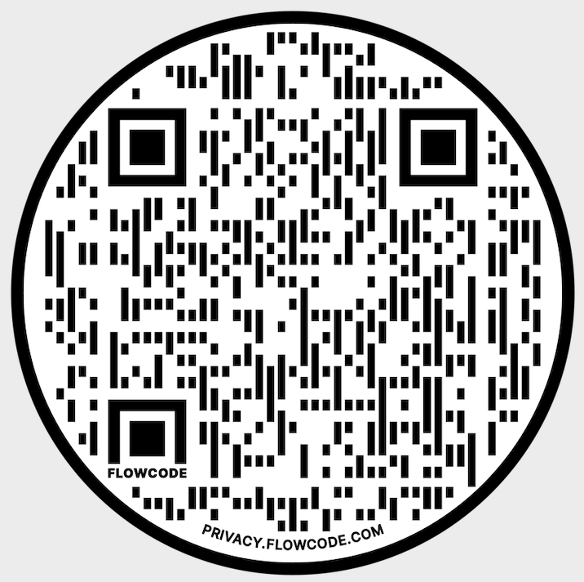
Pre-Seminar Survey
Notes:
We’d like to ask for participants to complete a short survey before viewing the content of this seminar. We will follow up with a post-survey to evaluate the impact of this seminar.

Slide 17
Post-Seminar Survey
Notes:
Thank you all so much for listening in to our presentation.
We have a document included in our files that have a list of our resources as well as our contact information. Feel free to reach out with any comments or questions!
Please take a moment to complete our brief post-presentation survey.
Thanks again!

