Slide 1
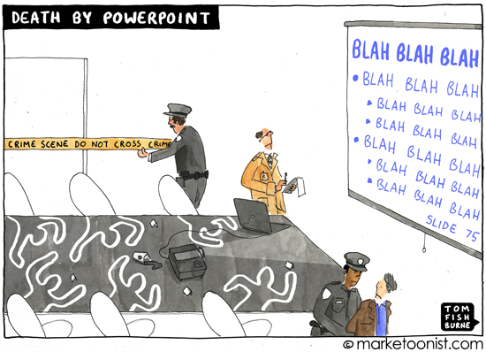
Put Down the Power Point!
Nicole McGuire, DHSc, MS, RRT, CNP
Amber Cadick, PhD, HSPP

Slide 2
Disclosures
We have nothing to disclose

Slide 3
Goals and Objectives
Participants will be able to
Identify key components of adult learning
Conduct interactive learning strategies that will enhance content retention
List multiple strategies to improve learner engagement

Slide 4
Take off the Power Point Water Wings

Slide 5
Balls of Doom
5 strategies for active learning – Jace Hargis
7 mantras for educators to live by – Robert Boyce

Slide 6
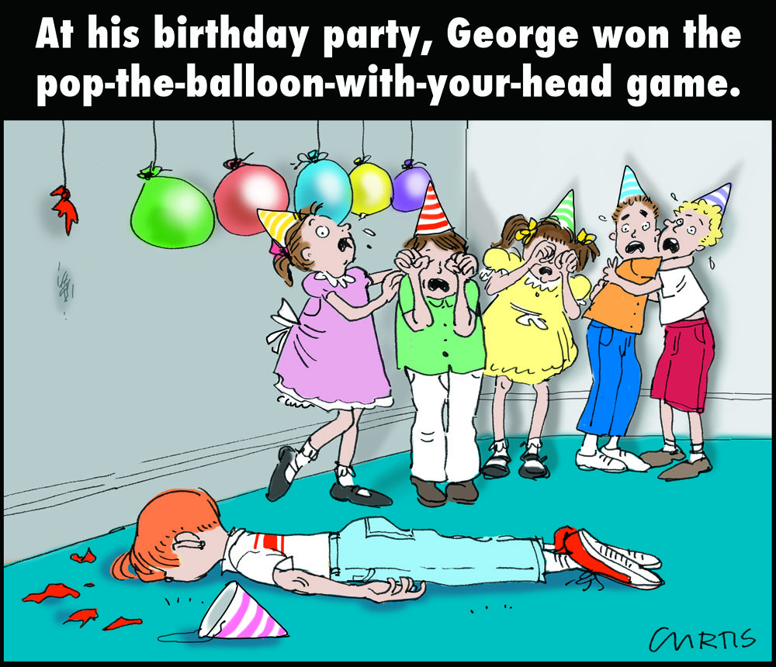
Balloon Pop!
At the cue please pop your balloons to find your task inside

Slide 7
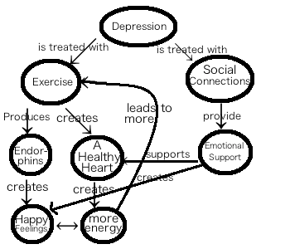
Concept Mapping
Take the drawings and organize them into a flow chart.
Draw the connections you make between concepts

Slide 8
Psychoanalysis
Get into pairs and interview one another about the learning techniques and concepts presented today. The focus, however, is upon analysis of the material rather than rote memorization.
Sample Interview Questions: Can you describe to me the topic that you would like to analyze today?
What were your attitudes/beliefs before this topic?
How did your attitudes/beliefs change after learning about this topic?
How will/have your actions/decisions altered based on your learning of this topic?
How have your perceptions of others/events changed?

Slide 9
Review
Balls of Doom
Balloon Pop!
Drawing for Understanding
Concept Mapping
Psychoanalysis

