Slide 1
Caring for Patients: Tracking Behavioral Health Needs in Clinic Using Patient Registries
Lindsay T. Fazio, PhD
Sara Lampert, BA
Mark Drexler, MD

Slide 2
Disclosures
We have no disclosures

Slide 3
Goals and Objectives
Demonstrate understanding of benefits and limitations of using patient registries.
Learn how to design and set up a patient registry for the population you are managing.
Identify patients that belong in patient registries.
Recognize health identifiers relevant for specific clinic populations.

Slide 4
Glenbrook Family Care Center
Full scope outpatient clinic located in Glenview, Illinois.
Longitudinal Clinic for The University of Chicago Family Medicine Residency Program.
18 Residents, 14 Faculty (including Behavioral Science).
Integrated Behavioral Health Program started 09-2017:
Psychologist
Psychiatrist
Social Work (LCSW)

Slide 5
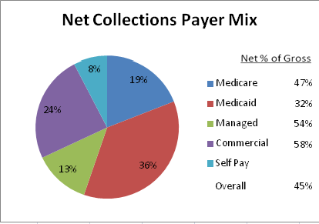
Clinic Background
We care for approximately 8,200 patients.
Payer Mix
We provide approximately 1,300 visits monthly.
837 patients (10%) have an active diagnosis of depression.

Slide 6
Literature on Registries
IMPACT Study
AIMS : Decrease in ER visit
6 chronic diseases correlated with depression
Diabetes - Asthma
CV Disease -Arthritis
Obesity - Cancer
10% reduction in PHQ9 over 12 week progress
Benefit to care coordination
Reference on bottom of slide
Notes:
https://www.ncbi.nlm.nih.gov/pmc/articles/PMC1323317/

Slide 7
Purpose of Registries
Allows clinical teams to identify patients with different needs
Utilized in order to assess patients’ level of need
Predict level of risk
Focused interventions
Shows treatment progress or lack thereof
Data accessible in one place
Track data over time & by provider
Facilitate care coordination
Overall: Aids clinical teams provide better care to patients
Notes:
population health management

Slide 8
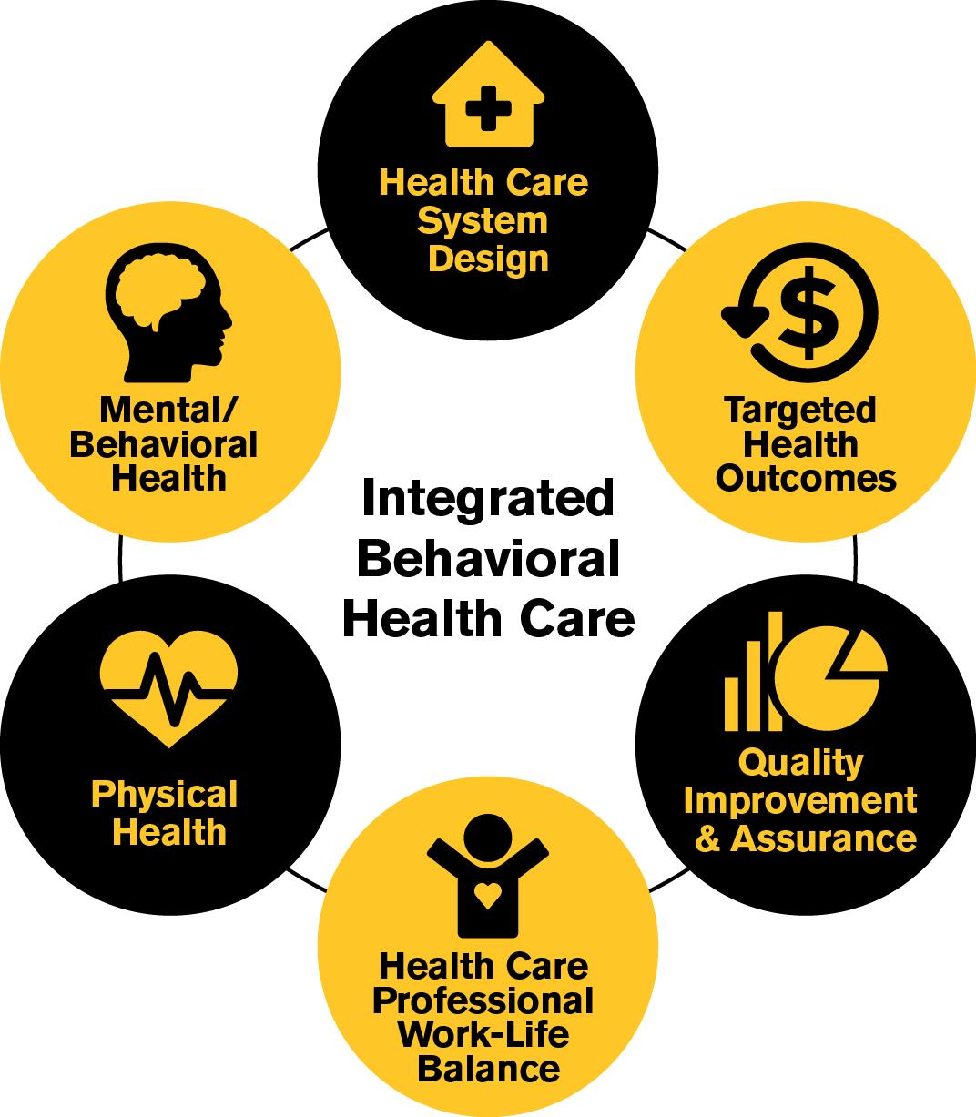
Our Project Design
Implement a behavioral health registry to track the behavioral health needs and outcomes of our patients.
Track utilization of our three behavioral health providers.
Demonstrate improved health outcomes over time.
Analyze progress of Integrated Care Model.
Notes:
Details of the registry info

Slide 9
Our Registry Information
321 patients are currently being tracked
Registry Fields:
Visit dates
Providers seen
Number of visits
PHQ9 scores
Diagnoses (behavioral health & chronic disease)
Notes:
What we track:
Name
MRN
DOB
Date of last visit
Number of visits with each provider
Behavioral health diagnosis including depression, anxiety, ADHD, bipolar, PTSD, psychosis, schizophrenia, adjustment disorder, substance abuse
Chronic disease diagnosis including diabetes (Type I and II), CV disease, arthritis, asthma, obesity, cancer

Slide 10
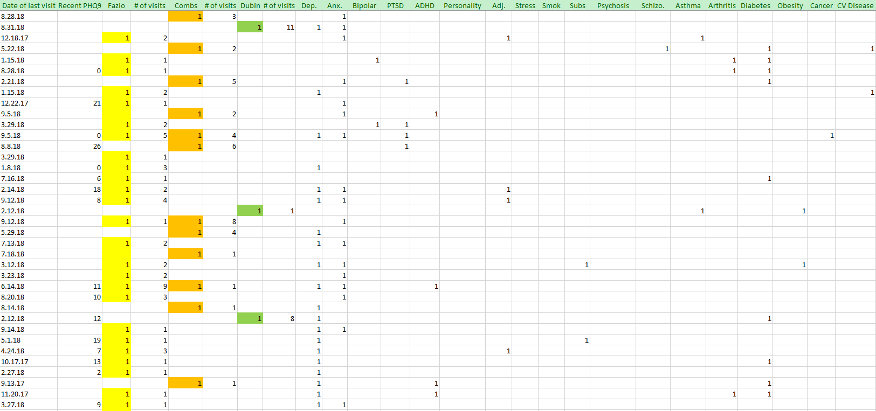

Slide 11
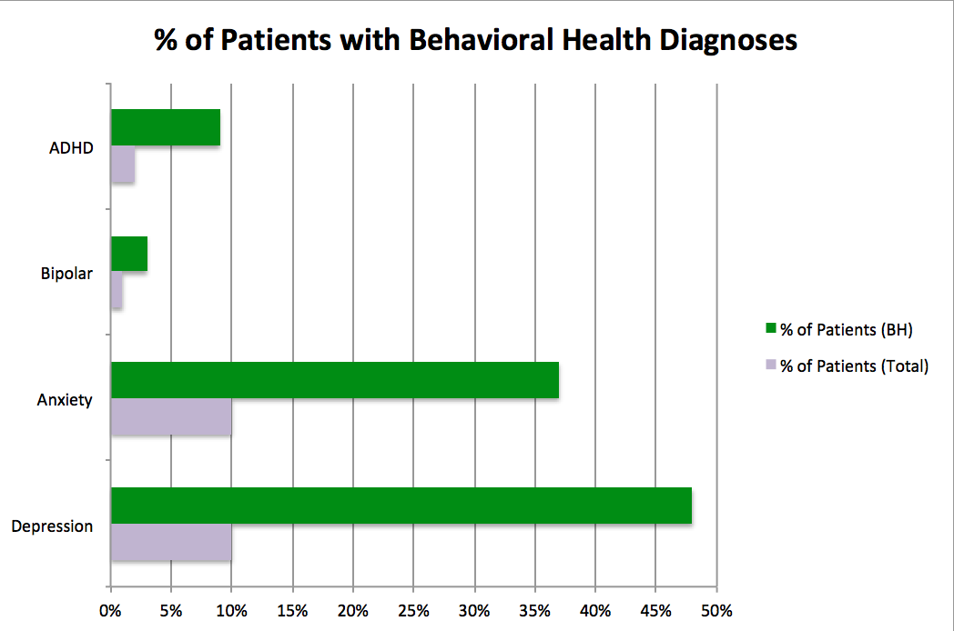
Registry Behavioral Health Conditions

Slide 12
Registry Chronic Disease Details

Slide 13
Steps To Develop a Registry
Identify population to track.
Identify specific patient details you want to track.
Compile patients into a protected and easily. accessible list (we used an Excel Data Base).
Update the registry regularly (daily, weekly) based on volume of data being entered.
Develop reports and tracking lists that will allow targeted oversight and interventions.

Slide 14
Effective Use of Registry Data
Regular collaborative care team treatment meetings.
Assessing treatment progress (i.e. PHQ9 scores for depression).
Tracking patient follow-up and compliance.
Monitoring patient ED visits and Hospitalizations.
Coordinating care with PCP, including treatment updates and reminders to consult BH & planning future visits.

Slide 15
Challenges to Registry Use and Management
Office (Physician / Staff) buy in.
Determining best method to identify and enroll patients into your registry.
Time commitment to act on registry information.
Time commitment required to update patient information.
Lack of protocols and standardized workflows.
Limited literature about population management.

Slide 16
Lessons Learned from our Project
Choose Appropriate Patient Population
Inclusion criteria could include: mental health and medical diagnoses, BH providers seen, or monitor entire population.
Choose Appropriate Registry Measures
Since patients have behavioral health conditions other then depression, additional measures must be tracked.
PHQ9 scores do not capture clinical improvement if patients are being treated for conditions other then depression:
only 9 patients had a 10% increase
12 patients had a 10+% increase
Notes:
9 patients had a 10% decrease
12 had a 10%+ increase
2 patients scores remained the same
All other patients had 1 or 0 PHQ9s on file

Slide 17
Lessons Learned Continued
Need to set up protocols and expectations
Not all behavioral health providers use PHQ9 scores
only 142 of 321 patients have 1 or more PHQ9 scores on record
Dedicated staff and appropriate time are needed to maintain and utilize registries effectively.
Value of registry for care coordination
Registry can be utilized for treatment planning and modification.
BH providers can coordinate appointments with PCPs.
Identification of patients who have not scheduled follow up visits with Behavioral Health
Consultation with psychiatry and social work.
Notes:
9 patients had a 10% decrease
12 had a 10%+ increase
2 patients scores remained the same
All other patients had 1 or 0 PHQ9s on file

Slide 18
Future Directions
Standardize administration of PHQ9 during each visit.
Target follow up assessment based on clinical diagnoses:
GAD 7 for anxiety
Specific measures for ADHD, PTSD, etc.
Automate workflow of registry management.
Obtain objective measures to assess value to patients and providers.
Develop approaches to implement proactive patient outreach.
Notes:
image of a path

Slide 19
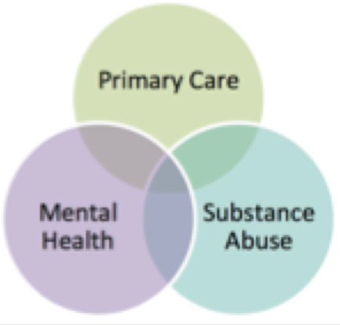
Collaborative Care Project
Goal: To develop and implement a system wide strategy to:
Provide timely mental health services to patients
Increase access to care and efficient diagnosis and treatment of patients
Joint project between Family Medicine and Psychiatry
Primary Care Tools to aid providers in diagnosing and managing behavioral health conditions:
Screening with detailed treatment strategy recommendations
Evidence based treatment algorithms
Behavioral Health Immediate Care Center
Notes:
Drexler: add goals of project

Slide 20
Questions?

Slide 21
AIMS Center. (2018). Collaborative Care. Retrieved from https://aims.uw.edu/collaborative-care.
Behkami, N. A. (2012). Examining Health Information Technology Implementations: Case of the Patient-Centered Home. Retrieved from ProQuest.
Bower, P. Gilbody, S., Richards, D., Fletcher, J., Sutton, A., (2006). Collaborative care for depression in primary care: Making sense of a complex intervention: systematic review and meta-regression. British Journal of Psychiatry, 189. 484-493.
Eckstrom, J., Williams, D., Avery, M., Unutzer, J. (2015). The utility of a caseload registry: perceptions of behavioral health clinicians working in integrated primary care and mental health program. General Hospital Psychiatry, 37(4), 39-334.
Eubanks, C. Avery, M. The Use of Registries to Guide and Improve Care Delivery: What Can Behavioral Health Learn from Primary Care?. [PowerPoint slides]. Retrieved from https://www.cibhs.org/sites/main/files/file-attachments/thurs._11_15_san_diego_b_use_of_registries_eubanks.pdf.
Moran, M. (2015, August 14). Registry Can Help APA Demonstrate Value of Psychiatric Treatment. American Psychiatric Association. Retrieved from https://psychnews.psychiatryonline.org/doi/full/10.1176/appi.pn.2015.8b27.
Tai, B., Hu, L., Ghitza, U. E., Sparenborg, S., VanVeldhuisen, P., Lindblad, R. (2014). Patient registries for substance disorders. Substance Abuse Rehabilitation, 5, 81-86.
Unutzer, J., Katon, W., Callahan, C. (2002). Collaborative Care Management of Late-Life Depression in the Primary Care Setting. JAMA 288(22), 2836-2845.

