Slide 1
MAHEC Intellectual/ Developmental Disability (IDD) Consult Clinic
Rebecca Putnam, MD
MAHEC Family Medicine Residency Program – Asheville
Spring 2021

Slide 2
Objectives
Identify disparities in healthcare facing adults with intellectual/developmental disabilities
Learn about one model to expand care for adults with IDD
Review clinic data and resident satisfaction

Slide 3
What is IDD?
North Carolina State definition of developmental disability
Chronic
Begins at birth or in childhood (before age 21)
Adversely affects an individual’s daily living and functioning
Can be caused by physical impairment, mental impairment, or combination
Notes:
https://www.ncdhhs.gov/assistance/disability-services/intellectual-developmental-disabilities

Slide 5
Why focus on this population?
Seek care more than the general population, but LESS than those with similar chronic diseases.
Underdiagnosis of chronic disease
Less likely to have routine care (immunizations, BP control, oral care, cancer screening, ASCVD prevention)
Seek emergency care 2x more often than general population
More likely to be hospitalized for primary care-preventable diseases
UK study:
13% of deaths of general population preventable with good quality health care
37% of deaths in IDD preventable with good quality health care
Medicaid expenditures at 10x that of non-disabled children for those with disabities
Why? Shortage of qualified, trained healthcare providers in community
Notes:
asthma, otitis media, congestive heart failure and angina pectoris
Felce 2008
Balogh 2010
Heslop 2014
Krahn 2006

Slide 6
Key Milestones
2013 - Piloted IDD curriculum (from NC Council on DD) with interested residents
2013 - MAHEC inquiry into starting IDD clinic with several other providers
2015 - MAHEC IDD Advisory Council launched, expanded in 2017
2016 - MAHEC and Vaya collaborated on consult clinic grant (not awarded)
2017 - MAHEC & Vaya agree to move ahead with clinic, Vaya RN IDD care navigator outstationed
2017- 2018 - Pilot clinic in academic year well-liked by residents and patients
2018 - Hiring of IDD-focused faculty to focus on expanding efforts, more frequent clinic
2019 – started accepting referrals from outside the organization

Slide 7
MAHEC-Vaya Partnership
Biweekly meetings with key representatives from MAHEC and Vaya
MAHEC attendees: clinical staff, clinicians, front office staff, office managers
Vaya attendees: care management director, IDD care management manager, care navigator, population health outcomes director
IDD-specific training (by Vaya) for two medical assistants (gathering background information, IDD, service network, care navigation, etc.)
Information exchange before appointments (care plans, psych evals, etc)
Collaboration on clinic workflow
Presence/consultation with Vaya Healthcare Navigator at or after appointment
Collaboration on outcome measures, program evaluation
Notes:
Your key players may be different.
If you live in a state with START services (California, Colorado, Georgia, Iowa, Maryland, New Hampshire, New York, North Carolina, Rhode Island, Texas, Washington), I bet that they would have TONS of patients who would be ideal

Slide 8
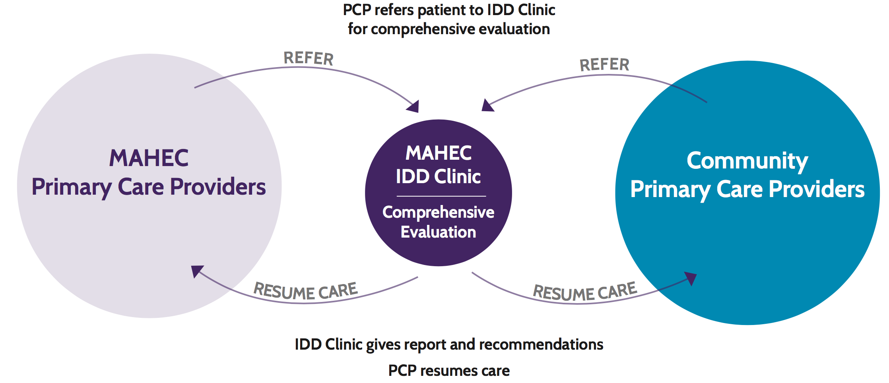
Clinic Process

Slide 9
Services Provided to Patients/Families
Access to support services, including caregiver support
Behavioral Health (depression, anxiety, OCD, etc.)
Menses management/birth control
Co-management of epilepsy, nutrition deficiencies, obesity, other chronic diseases
Advanced Care Planning
Health maintenance (general and disease specific), wellness
Medication management and reconciliation
Coordination with specialists
Referrals for dental care, rehab services (PT/OT/speech)
Transitions (pediatrics to adult care, across care continuum)
Notes:
-DD – dad made wheelchair van, no one maintaining tube feeds.
-planning TD for aging mom (with myeloma) or JC (88yo)
-CD - having sex, no custody of other children, doesn’t want pregnancy, on depo long term.
-SS - ID, perimenopausal, worsening agitation/behaviors, on depo.
-AA with epilepsy/G tube coordinating removal, hypopit

Slide 10
Case 1
48yo woman referred by care manager because her guardian (sister) concerned that “her doctor doesn’t know what to do with her”
Family would like a roadmap/for someone to look at “big picture”
Notes:
-recent change in guardian due to mom’s debility from breast cancer
-genetic disorder: family thinks has both Angelman and Prader-Willi
-epilepsy, intractable/followed by neuro
-stool withholding behavior
-daytime sleepiness
Notes:
-screenings – people with IDD less likely to receive routine cancer screenings
-genetic disorder – clarification is important – there are guidelines for both Angelman and Prader Willi
-epilepsy – puts at high risk for metabolic disease including osteoporosis
-stool withholding – GI issues are chronically undermanaged. Opportunities for counseling on constipation action plan
-daytime sleepiness – high risk for OSA, also ? If anyone is looking at medication list as a whole (zolpidem, lorazepam, clobazam, gabapentin, oxcarbazepine)
At end of visit, called care coordinator, sent her and PCP summary with recommendations

Slide 11
Case 1
Health maintenance
Mom with breast cancer – have they discussed cancer screening?
Genetic disorder
There ARE care guidelines for adults with certain genetic disorders
Epilepsy
Antiepileptics can lead to a number of drug-drug interactions and nutritional deficiencies
Stool withholding behavior
GI issues very common but often undertreated
Daytime sleepiness
OSA frequently underdiagnosed
Potential for drug-drug interactions

Slide 12
Health Maintenance in IDD
Still follow USPSTF guidelines
Canadian Consensus Guidelines (2018) https://www.cfp.ca/content/cfp/64/4/254.full.pdf
HealthWatch Tables https://ddprimarycare.surreyplace.ca/tools-2/health-watch-tables/
Down Syndrome
Fragile X
Prader Willi
Smith Magenis
22q11 deletion syndromes
Fetal Alcohol Spectrum Disorder
Autism Spectrum Disorder
Angelman Syndrome
Sexual history important
Don’t presume abstinence
High rate of LGBTQ
Notes:
Canadian Consensus Guidelines
Smith Magenis - self hugging; affectionate, engaging
Unibrow
Tented upper lip, depressed nasal bridge
https://link.springer.com/article/10.1186/s13023-015-0330-x
AAP:
Autism, CF, Down Syndrome, Fetal Alcohol, Fragile X, Klinefelter, Marfan, Muscular Dystrophy, NF1, Noonan, Prader Willi, Sickle Cell, TS, Turner, Williams

Slide 13
Who are we seeing?
Age: Median 25 (range 13-88)
65% male

Slide 15
Insurance/Service Connection

Slide 16
Common Diagnoses

Slide 17
Resident participation/teaching
1-2 didactic sessions per year on IDD topics
Residents self-select to participate in workgroup or advisory council (usually 1-3 of 12 in each class)
All residents will have at least 1-3 clinic sessions in residency with focused teaching
Pt transferring care are assigned to that day’s resident
Residents fill out yearly survey on competence/comfort in IDD care
Notes:
In actually asking residents to rate satisfaction, evenly split between “somewhat dissatisfied, neither satisfied nor dissatisfied, somewhat satisfied, extremely satisfied” – the most common comment was that they wished they had more opportunities to work in clinic.

Slide 18
Apprehension and Outcomes
Would our clinic become the de-facto PCP for all patients with IDD in the community? ($$$)
Building resident competency has built multiple options in the community
27% ended up transferring care
Would having a separate clinic make PCP feel like they shouldn’t manage?
Many are willing to learn!
If referrals were sent by non-PCP, would PCP be upset?
Most PCP feedback has been excellent!
How to manage reimbursement?
Billing on time, consult codes, extended services
High no-show rate
Telehealth has helped to reduce
Ability to help in clinic and have non-IDD add-ons

Slide 19
Take away/Conclusion
There are ample opportunities to improve healthcare delivery to adults with intellectual/developmental disabilities
Our first few years of the IDD clinic have been helpful for both community engagement, resident education, and workforce development.
Partnership with our Medicaid payor, Vaya Health, was essential for clinic development, information sharing, and care coordination.
Several other adult IDD clinics exist across the country, but most are specialty-driven (psych, neuro, etc.) rather than primary care-driven. We believe our model better addresses the need for a more competent and confident primary care workforce.
Please contact me Rebecca.Putnam@mahec.net with any questions or comments!

Slide 20
References
American Academy of Pediatrics (1999). Sterilization of Minors with Developmental Disabilities. Pediatrics, 104(2), 337-340.
Balogh, R., Brownell, M., Ouellette-Kuntz, H., & Colantonio, A. (2010). Hospitalisation rates for ambulatory care sensitive conditions for persons with and without an intellectual disability-a population perspective: Hospitalisations intellectual disability population. Journal of Intellectual Disability Research, 54(9), 820–832. https://doi.org/10.1111/j.1365-2788.2010.01311.x
Felce, D., Baxter, H., Lowe, K., Dunstan, F., Houston, H., Jones, G., … Kerr, M. (2008). The Impact of Checking the Health of Adults with Intellectual Disabilities on Primary Care Consultation Rates, Health Promotion and Contact with Specialists. Journal of Applied Research in Intellectual Disabilities, 21(6), 597–602. https://doi.org/10.1111/j.1468-3148.2008.00432.x
Heslop, P., Blair, P. S., Fleming, P., Hoghton, M., Marriott, A., & Russ, L. (2014). The Confidential Inquiry into premature deaths of people with intellectual disabilities in the UK: a population-based study. The Lancet, 383(9920), 889–895. https://doi.org/10.1016/S0140-6736(13)62026-7
Krahn, G. L., Hammond, L., & Turner, A. (2006). A cascade of disparities: Health and health care access for people with intellectual disabilities. Mental Retardation and Developmental Disabilities Research Reviews, 12(1), 70–82. https://doi.org/10.1002/mrdd.20098
North Carolina Health and Human Services https://www.ncdhhs.gov/assistance/disability-services/intellectual-developmental-disabilities
Rethinking guardianship http://rethinkingguardianshipnc.org/

