Slide 1
Enhancing Medical Students' Attitudes toward Patients with Disabilities using a Home Visit
Nathan Bradford, MD
Brian Mulroy, DO
Andrew Symons, MD
Michelle Johnson

Slide 2
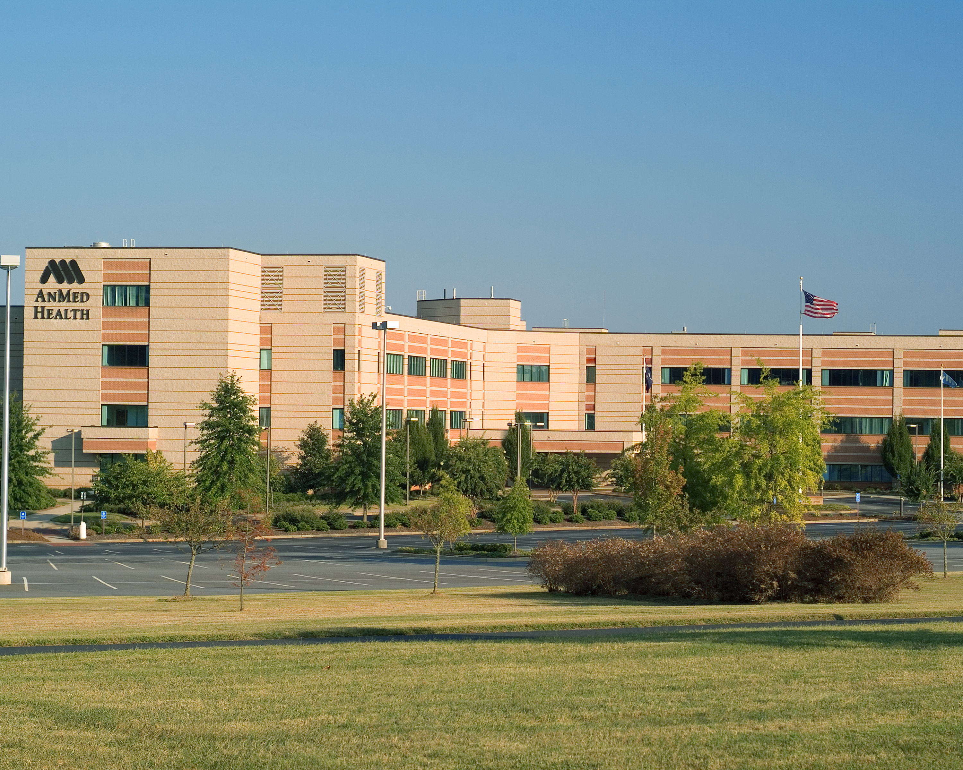
Disclosures
No financial disclosures

Slide 3
Introduction/Background
Medical students have been assisting in the transition process for 3 years
Numerous patients were being lost to follow
Numerous barriers to their care
Wanted to improve students’ comfort in dealing with youth with special healthcare needs (YSHCN)
We have improved transitions in our community
We now have a formalized curriculum on patients with disabilities

Slide 4
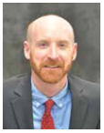
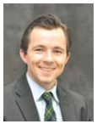
AnMed Health Anderson, SC
12 3rd year medical students (MUSC and VCOM)

Slide 5
Milestones Addressed
Cares for patients with chronic conditions (PC-2)
Advocates for individual and community health (SBP-3)
Demonstrates humanism and cultural proficiency (PROF-3)
Communicates effectively with patients, families, and the public (C2)
Effectively communicates with physicians, other health professionals, and health care teams (C3)

Slide 6
Reflections
“I learned that a disability does not prevent an individual from becoming a functional member of society.” –BK, PC-2
“It was impressive to hear about the amount of time and work the parents put into coordinating the simplest activities that I take for granted every day.” –KG,PROF-3
“I learned which questions I should be asking to understand what disabled patients are capable of and their goals in order to manage their own health.” –TC, PC-2
“This experience stressed the importance of patience, availability, and strong communication not only with the patients but also with their caretakers.” –AG, C-2

Slide 7
Project Objectives
Appreciate how a home visit with a person with a disability can impact medical students
Assess learners' cultural proficiency with disabilities using the validated tool "Medical Student Attitudes Toward Persons with Disabilities”
Interface with local support agencies to teach medical students about disabilities

Slide 8
Goals of the Project
Improve verbal communication skills of our medical students
Interact with local agencies
Improve the health care of a specific group of patients with disabilities

Slide 9
Project Summary
Introduction to students
Survey Completion
Didactic
Video
Transition
Home visit
Survey Completion
Medical Student Attitudes Toward Persons with Disabilities

Slide 10
Introduction to Students
“Medical Care for the Disabled Patient” presentation from Residency Curriculum Resource (RCR)
Video “Patient Voices”

Slide 11
Transition
Each MS-3 was assigned a YSHCN
Attended last visit at children’s clinic (exit visit)
Stayed in contact with their YSHCN
Attended entrance visit at family medicine clinic
Worked on independent living skills using validated checklist (gottransition.org)

Slide 12
Home Visit
Reached out to a local support group Physicians Education Awareness Program (PEAP)
Coordinator met with the medical students and explained the program
The students were then taken to the home of one of their clients (YSHCN) and were allowed to interview the patient and family

Slide 13
Reflections
“I did not realize the many obstacles families and patients with disabilities must go through daily” –AN, PC-2
“Something as simple as going to the grocery store or showering are struggles they face on a daily basis” –AO, PC-2
“It was a great opportunity for students to gain insight on the unique family dynamics that arise when taking care of a disabled patient and how caretaker fatigue may develop.” –BP, PROF-3
“By creating a bridge between pediatric and adult care, we can target a very marginalized population.” –DS, SBP-3

Slide 14
Results
Our hypothesis: Students would become more comfortable working with patients with special needs
Results: Apparently, we were wrong
Did our students become more humble?
Was this the project or simply being a 3rd year coming to the realization they do not know as much as they thought?
Others?

Slide 15
1 Strongly Disagree, 2 Disagree, 3 Agree, 4 Strongly Agree
 | Pre | Post | Difference | Control
3. Most people with disabilities feel sorry for themselves. | 2 | 1.67 | -0.33 | 2
4. I am comfortable being around a person who has an intellectual disability (i.e. mental retardation, autism). | 3.5 | 3.16 | -0.34 | 3.25
5. People with disabilities are as happy as people without disabilities. | 3.16 | 2.83 | -0.33 | 3
6. I would be comfortable interacting with a person with an intellectual disability who was in the community on his or her own (i.e., without staff members or caretakers). | 4 | 3 | -1 | 3.5
7. I would be comfortable being around a person who uses a wheelchair. | 4 | 3.16 | -0.84 | 4
8. Most people with disabilities resent people without disabilities. | 1.67 | 1.83 | 0.16 | 1.75
9. I would be comfortable being around a person who is deaf. | 3.16 | 2.83 | -0.33 | 3.5
10. I am only comfortable around people with intellectual disabilities if they are well behaved. | 2.5 | 2.67 | 0.17 | 1.75
11. Most people with disabilities expect special treatment. | 1.83 | 1.83 | 0 | 2
12. I would be comfortable working with a person with an intellectual disability who had someone assigned to supervise and train her. | 3.83 | 3.33 | -0.5 | 3.25
13. Most people with disabilities are not ashamed of their disability. | 3 | 3 | 0 | 3
14. If I were visited by a person who is blind, I would be comfortable helping him or her navigate the environment. | 3.83 | 3.16 | -0.67 | 3.75
15. I am more comfortable around people with intellectual disabilities when they have someone who is not disabled to help them. | 3.16 | 3.5 | 0.34 | 2.75
16. If I introduced a person with disabilities to my friends, I think they would feel uneasy. | 2.33 | 2 | -0.33 | 1.75
17. People with disabilities should be cared for in any primary care office as opposed to a specialty clinic. | 3.16 | 2.33 | -0.83 | 2.75
18. I would feel comfortable living next door to a person with an intellectual disability that lives by himself. | 3.33 | 3.33 | 0 | 2.75
19. I would be comfortable living in a neighborhood where there is a group home for people with various developmental disabilities (e.g., Down Syndrome, Cerebral Palsy, Mental Retardation, etc.). | 3.5 | 3.33 | -0.17 | 3.5
20. I would feel comfortable being around a person with an intellectual disability in public even though his behavior might be a bit bizarre (e.g., rocking back and forth, talking loud, etc.). | 3.33 | 3.16 | -0.17 | 3.25

Slide 16
Scenario A: | Pre | Post | Difference | Control
You enter the exam room. A middle-aged man and women are there. He tells you he is experiencing chronic abdominal pain.
21. I have had experiences similar to scenario A. | 3.33 | 3.5 | 0.17 | 3.75
22. In scenario A, I would be comfortable determining the role of the man vs. the woman in providing the history of the complaint. | 3.83 | 3.33 | -0.5 | 3.5
23. In scenario A, I would be comfortable performing a physical exam on the patient. | 4 | 3.5 | -0.5 | 4
24. In scenario A, I would be comfortable establishing a differential diagnosis for the abdominal pain. | 4 | 3.5 | -0.5 | 3.75
Scenario B:
You enter the exam room. A middle-aged man is seated in a wheel chair. Standing behind him is a woman of about the same age. The patient in the wheel chair appears to have spasticity in all 4 limbs. He greets you by saying “hello”. His speech is somewhat garbled, though intelligible. The woman tells you that the patient is here because he is experiencing chronic abdominal pain.
25. I have had experiences similar to scenario B. | 2.33 | 2.5 | 0.17 | 3.75
26. In scenario B, I would be comfortable determining the role of the man vs. the woman in providing the history of the complaint. | 3.5 | 3 | -0.5 | 3.5
27. In scenario B, I would be comfortable performing a physical exam on the patient. | 3.83 | 2.83 | -1 | 3.5
28. In scenario B, I would be comfortable establishing a differential diagnosis for the abdominal pain. | 4 | 3 | -1 | 3.5

Slide 17
Limitations
Small sample size
Difficult to eliminate other variables (i.e. progressing through 3rd year)
Limits of self-reporting (i.e. “comfort”)
Does it actually translate into improved care?

Slide 18
References
Jain, Care of Patients with Disabilities: An Important and Often Ignored Aspect of Family Medicine Teaching, Fam Med 2006;38(1):13-5.
D’Agata, Dreyfus, Kripke, Bullock, Martin, Medical Care of the Disabled Patient, Family Medicine Residency Curriculum Resource, STFM
Physician Education Awareness Program, Family Connections SC
Symons, et al., Development of an Instrument to Measure Medical Students’ Attitudes toward People with Disabilities, Intellectual and Developmental Disabilities 2012, Vol. 50, No. 3, 251–260
Kripke, C. C. (2014). "Primary Care for Adolescents with Developmental Disabilities." Prim Care 41(3): 507-518

Slide 19
Please evaluate this presentation using the conference mobile app! Simply click on the "clipboard" icon on the presentation page.

