Slide 1
Not Throwing Away Our Shot: The Evidence for Influencing Vaccine Behavior
Aaron J Grace, PsyD
Director of Behavioral Medicine
Waukesha Family Medicine Residency at ProHealth
Assistant Clinical Professor of Family Medicine
Medical College of Wisconsin
Katherine Buck, PhD, LMFT
Director of Behavioral Medicine
Associate Program Director
JPS Family Medicine Residency
Ft. Worth, Texas
Lauren Thomas, MD
PGY-III
Chief Resident
Waukesha Family Medicine Residency at ProHealth

Slide 2
Objectives
No relevant financial disclosures
Describe the extant literature on the relative ineffectiveness of in-office interventions for modifying vaccine behavior
Describe which interventions are effective at changing vaccination behavior
Identify 2 concrete steps you can take in your local setting to increase likelihood of vaccine acceptance

Slide 3
Let’s get warmed up …
What have you noticed going on with colleagues regarding emotions & vaccine hesitancy?
Tell us in the chat
On a post it:
What is your current approach/your organization’s approach to increasing vaccination?

Slide 4
Acknowledgments
There are many reasons that people are hesitant to get vaccinated
Some people in attendance today are likely unvaccinated
Respect for all
Our position is to advocate for widespread adoption of the vaccine as a public health intervention

Slide 5
Our Strategy
Scientist-clinicians
Evidence-based medicine
Types of data: Harmful vs ineffective vs effective
Anecdata, RCTs, Cochrane reviews
Childhood, adolescent, adult vaccines

Slide 6
Patient Case
A resident is pre-staffing a patient who has not been vaccinated. The resident knows you are an expert in health behavior change and is asking the best approach to increase the likelihood that the patient becomes vaccinated. What do you tell them?
Take 30 seconds and jot down your thoughts on a post-it

Slide 7
Kaiser Family Foundation COVID-19 Vaccine Monitor
An ongoing research project tracking the public’s attitudes and experience with COVID-19 vaccinations
https://www.kff.org/coronavirus-covid-19/dashboard/kff-covid-19-vaccine-monitor-dashboard/
Notes:
Nationally-representative sample of 1,888 adults (including 512 Hispanic and 497 non-Hispanic Black) at least 72 in Spanish, 415 was prepaid cellphone)
Early anti-vaccine movement: 1721 –someone threw primitive grenade through window of Cotton Mather – “I’ll inoculate you with this!”

Slide 8
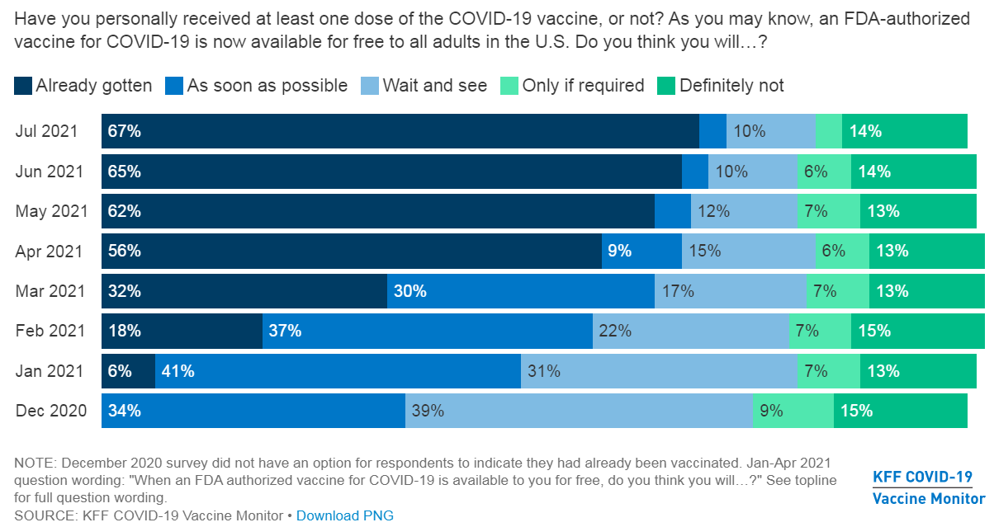
Notes:
https://www.kff.org/coronavirus-covid-19/poll-finding/kff-covid-19-vaccine-monitor-june-2021/
Nationally-representative sample of 1,888 adults (including 512 Hispanic and 497 non-Hispanic Black) at least 72 in Spanish, 415 was prepaid cellphone)

Slide 9
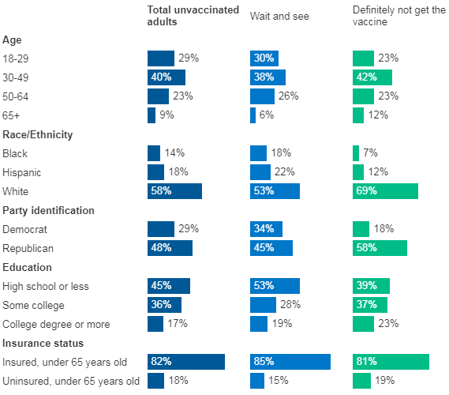
Unvaccinated adults tend to be
Younger
People of color
Republican-leaning
Less educated
Rural
Notes:
Also from KFF.

Slide 10
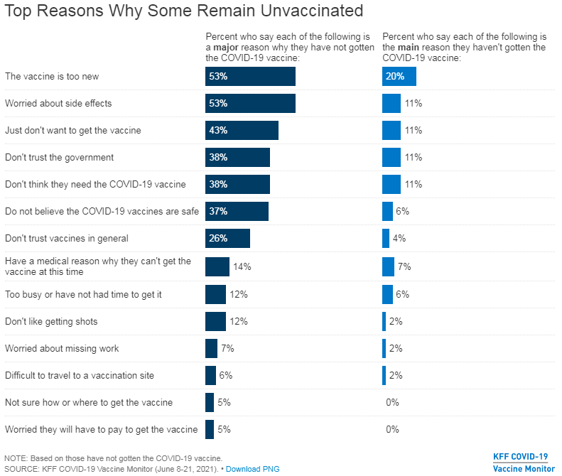
Notes:
https://www.kff.org/coronavirus-covid-19/poll-finding/kff-covid-19-vaccine-monitor-june-2021/
Nationally-representative sample of 1,888 adults (including 512 Hispanic and 497 non-Hispanic Black) at least 72 in Spanish, 415 was prepaid cellphone)

Slide 11
The entire household probably needs convincing
Notes:
https://www.kff.org/coronavirus-covid-19/poll-finding/kff-covid-19-vaccine-monitor-june-2021/
Nationally-representative sample of 1,888 adults (including 512 Hispanic and 497 non-Hispanic Black) at least 72 in Spanish, 415 was prepaid cellphone)

Slide 12
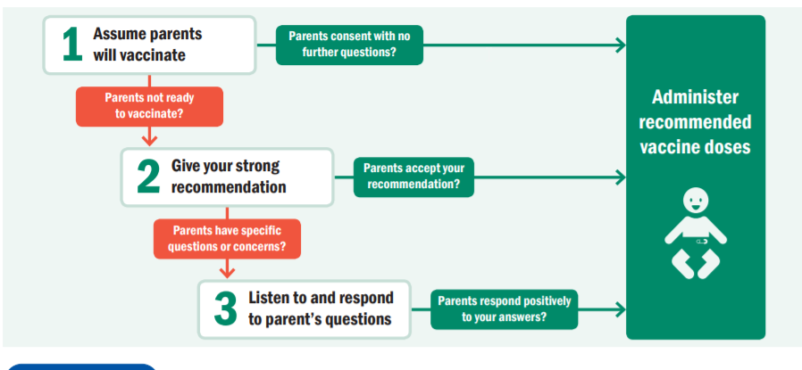
So, what do we do?

Slide 13
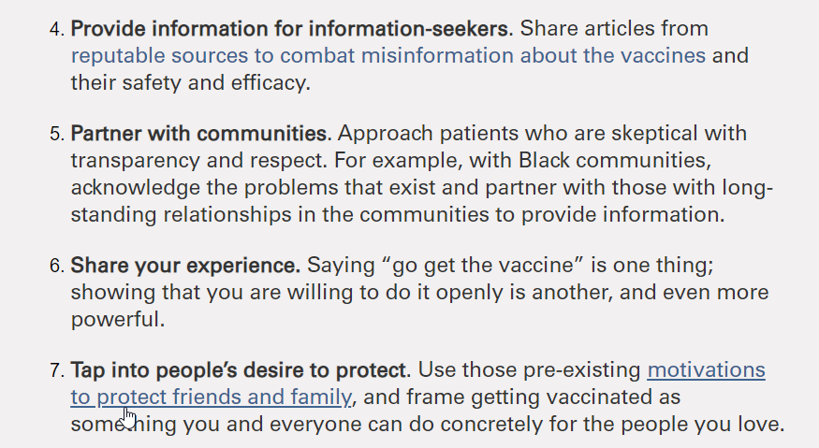
So, what do we do?
Notes:
https://healthblog.uofmhealth.org/wellness-prevention/overcoming-covid-19-vaccine-hesitancy
https://www.doh.wa.gov/Portals/1/Documents/1600/coronavirus/820-130-ProviderMRNAVaccinesDiscussionGuide.pdf

Slide 14
So, what do we do?
Notes:
https://www.cdc.gov/coronavirus/2019-ncov/communication/vaccination-toolkit.html
https://www.ama-assn.org/delivering-care/public-health/covid-19-vaccine-hesitancy-10-tips-talking-patients

Slide 15
Current Recommendations
Many current recommendations are based off of studies that showed an increase in acceptance of vaccinations, but no actual increase in vaccine uptake
Others utilize post-vaccination surveys to indicate what families saw as influencing factors, rather than RCT’s
Notes:
Joseph NP, Bernstein J, Pelton S, Belizaire M, Goff G, Horanieh N, Freund KM. Brief Client-Centered Motivational and Behavioral Intervention to Promote HPV Vaccination in a Hard-to-Reach Population: A Pilot Randomized Controlled Trial. Clin Pediatr (Phila). 2016 Aug;55(9):851-9. doi: 10.1177/0009922815616244. Epub 2016 Mar 10. PMID: 26968631.
Opel DJ, Mangione-Smith R, Robinson JD, et al. The Influence of Provider Communication Behaviors on Parental Vaccine Acceptance and Visit Experience. Am J Public Health. 2015;105(10):1998-2004. doi:10.2105/AJPH.2014.302425

Slide 16
What doesn’t work?
Physician communication training
Trained physicians in “Ask, Acknowledge, Advise”
Had no effect on maternal vaccine hesitancy
8.9% of control group
7.5% of intervention group
(P= 0.78); OR 1.22, 0.47-2.68.
2015 Pediatrics Henrikson et al
Notes:
Henrikson NB, Opel DJ, Grothaus L, Nelson J, Scrol A, Dunn J, Faubion T, Roberts M, Marcuse EK, Grossman DC. Physician Communication Training and Parental Vaccine Hesitancy: A Randomized Trial. Pediatrics. 2015 Jul;136(1):70-9. doi: 10.1542/peds.2014-3199. Epub 2015 Jun 1. PMID: 26034240.

Slide 17
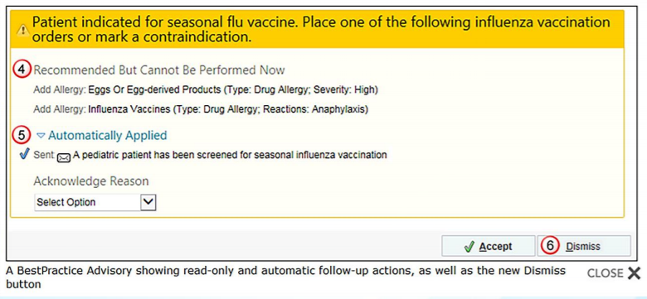
What doesn’t work?
Provider prompts
“Provider prompts make little to no difference compared to usual practice”
HPV: OR 0.99 (0.55-1.81)
Tdap: OR 1.28 (0.59-2.80)
Meningococcal: OR 1.09 (0.67-1.79)
Influenza: OR 0.91 (0.61-1.34)
2018 Cochrane Review
Improving vaccination uptake among adolescents
Notes:
Abdullahi LH, Kagina BM, Ndze V, Hussey GD, Wiysonge CS. Improving vaccination uptake among adolescents. Cochrane Database of Systematic Reviews 2020, Issue 1. Art. No.: CD011895. DOI: 10.1002/14651858.CD011895.pub2

Slide 18
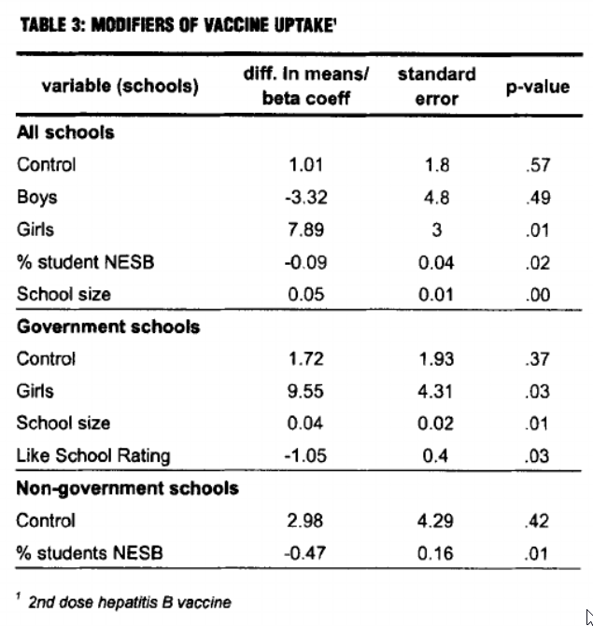
What doesn’t work?
Complex, multi-component health education was no different than simple education
Health education kit for hepatitis B
Resource fact sheet
Informational video
Questions to engage adolescent audience
Small group discussion
Notes:
Abdullahi LH, Kagina BM, Ndze V, Hussey GD, Wiysonge CS. Improving vaccination uptake among adolescents. Cochrane Database of Systematic Reviews 2020, Issue 1. Art. No.: CD011895. DOI: 10.1002/14651858.CD011895.pub2

Slide 19
What doesn’t work?
Videos for patients/families (in isolation)
8 minute video developed by the Vanderbilt Vaccine Research Program
Included debunking myths about vaccines as well as 3 parental accounts of children w/ vaccine preventable illnesses
Showed no difference in vaccination rates
2013 Acad Pediatrics Williams et al
Notes:
Williams SE, Rothman RL, Offit PA, Schaffner W, Sullivan M, Edwards KM. A randomized trial to increase acceptance of childhood vaccines by vaccine-hesitant parents: a pilot study. Acad Pediatr. 2013;13(5):475-480. doi:10.1016/j.acap.2013.03.011

Slide 20
What doesn’t work?
Passive interventions
Interventions with <10% increase in immunization rate included those focused on quality improvement at clinics
Longer clinic hours
Improved data collection
Passive interventions: signs, posters
2015 Vaccine: Jarrett et al
Notes:
Jarrett C, Wilson R, O'Leary M, Eckersberger E, Larson HJ; SAGE Working Group on Vaccine Hesitancy. Strategies for addressing vaccine hesitancy - A systematic review. Vaccine. 2015 Aug 14;33(34):4180-90. doi: 10.1016/j.vaccine.2015.04.040. Epub 2015 Apr 18. PMID: 25896377.

Slide 21
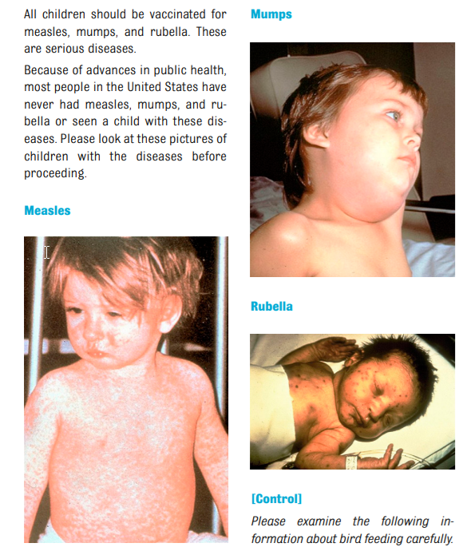
What doesn’t work?
Brochures for patients/families
4 pro-vaccine messages
1) “Autism correction” – presented scientific evidence debunking the vaccine/autism link
2) “Disease risks” – described symptoms and adverse events associated with MMR
3) “Disease narrative” – narrative of a mother recounting her infant son’s hospitalization with measles
4) “Disease images” – presents parents with pictures of a child who has each disease
Control: a text about the costs and benefits of bird feeding
2014 Pediatrics Nyhan et al
Notes:
Nyhan B, Reifler J, Richey S, Freed GL. Effective messages in vaccine promotion: a randomized trial. Pediatrics. 2014 Apr;133(4):e835-42. doi: 10.1542/peds.2013-2365. Epub 2014 Mar 3. PMID: 24590751.

Slide 22
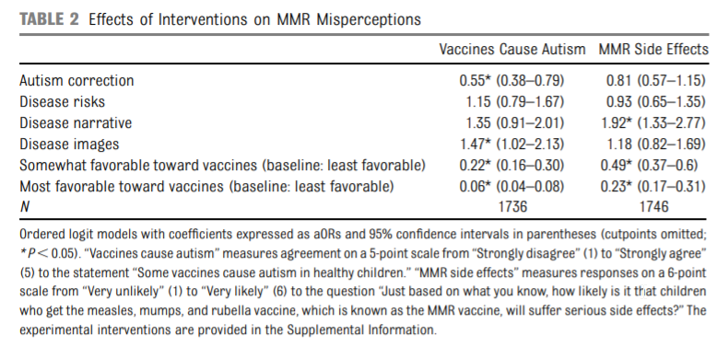
What doesn’t work?
Brochures for patients/families
“We found that a pro-vaccination message was least persuasive among parents who had the most negative attitudes toward vaccines, the group of greatest public health concern. In particular, corrections of misperceptions about controversial issues like vaccines may be counterproductive in some populations. The best response to false beliefs is not necessarily providing correct information. “
2014 Pediatrics Nyhan et al

Slide 23
No need to despair -- Some things work!

Slide 24
What works? Paying people
New York – free lottery ticket (prizes $20 - $5mil)
WV, CT, MI, WA – savings bonds, drinks,
debit cards, joints
Krogers – Five $1 million give away,
50 free groceries for a year
Ohio Vax-A-Million campaign
Five drawings for $1million each; Five drawings for full college tuition

Slide 25
What works? Paying people
Ohio Vax-a-Million
Vaccinations increased 33% in the week after the lottery was announced (89,464 → 119,394)
New vaccinations dropped off after that
“Movable Middle”
Temporary bump phenomenon in California, Oregon, West Virginia, Colorado
Notes:
https://apnews.com/article/ohio-coronavirus-vaccine-coronavirus-pandemic-oddities-health-8728927905ffaed3d462a274524f9e30
https://apnews.com/article/oh-state-wire-ohio-coronavirus-pandemic-health-794fbad03d6fa15d4d96ac8742133624
https://www.nytimes.com/2021/05/04/upshot/vaccine-incentive-experiment.html

Slide 26
What works? Time off work
After controlling for age, race, ethnicity, education, income, party identification
Notes:
https://www.kff.org/coronavirus-covid-19/poll-finding/kff-covid-19-vaccine-monitor-june-2021/
Nationally-representative sample of 1,888 adults (including 512 Hispanic and 497 non-Hispanic Black) at least 72 in Spanish, 415 was prepaid cellphone)

Slide 27
What works? Increased access
“Would a mobile vaccination clinic make you more likely to get vaccinated?”
Total Unvaccinated: 17% yes
Wait and see: 22% yes
Definitely not: 3% yes
Total Black unvaccinated: 22% yes
Total Hispanic unvaccinated: 33% yes
Notes:
https://www.kff.org/coronavirus-covid-19/poll-finding/kff-covid-19-vaccine-monitor-june-2021/
Nationally-representative sample of 1,888 adults (including 512 Hispanic and 497 non-Hispanic Black) at least 72 in Spanish, 415 was prepaid cellphone)

Slide 28
Increasing vaccinations of adolescents – Cochrane Review
Simple health education (in school, social media, postcards) improves HPV vaccination (RR 1.43)
Financial incentives ($60 gift vouchers) improves HPV vaccination (RR 1.45)
Combining financial incentives and health education had no additive effect
Provider education, individualized provider feedback, frequent CME visits, and provider incentives improved HPV vaccination
Targeting providers and parents using education, phone calls, and marketing improved HPV vaccination (RR 1.41)
Notes:
Abdullahi LH, Kagina BM, Ndze V, Hussey GD, Wiysonge CS. Improving vaccination uptake among adolescents. Cochrane Database of Systematic Reviews 2020, Issue 1. Art. No.: CD011895. DOI: 10.1002/14651858.CD011895.pub2

Slide 29
5-component intervention for adolescents
Fact-sheet library for providers
Parent education website that created individually-customized info
Series of disease images associated with HPV
Decision aid for HPV vaccination
Communication training
Self-guided webinar
Two in-person, 1-hr training sessions
Presumptive approach + motivational interviewing
Two 1-hr strategy meetings
Vaccine champion
Results:
16 practices, 12 months
43,132 patients
aOR 1.46 – 1.56
4%-9% absolute increase
Dempsey AF JAMA Pediatr. 2018
Notes:
JAMA Pediatr. 2018 May; 172(5): e180016.
Published online 2018 Mar 5. doi: 10.1001/jamapediatrics.2018.0016
PMCID: PMC5875329
PMID: 29507952
Effect of a Health Care Professional Communication Training Intervention on Adolescent Human Papillomavirus Vaccination
A Cluster Randomized Clinical Trial
Amanda F. Dempsey, MD, PhD, MPH,^{1,2} Jennifer Pyrznawoski, MSPH,¹ Steven Lockhart, MPH,¹ Juliana Barnard, MA,¹ Elizabeth J. Campagna, MS,¹ Kathleen Garrett, MA,³ Allison Fisher, MPH,⁴ L. Miriam Dickinson, PhD,^{1,5} and Sean T. O’Leary, MD, MPH^{1,6}

Slide 30
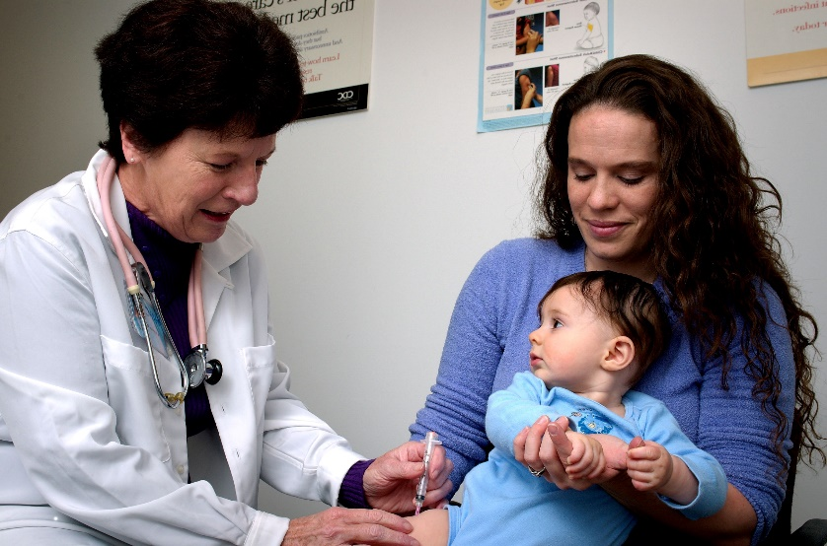
What works? Presumptive communication
“Well, we have to do some shots.”
“I don’t know…” or “where would he catch Hep B?” or “I want to go slow”
“He really needs these shots” or “whooping cough can be a killer in a child under 1” or “it’s less shots than it used to be”
Vaccine resistant parents accepted initial plan 47% of the time
Notes:
Opel et. al. The Architecture of Provider-Parent Vaccine Discussions at Health Supervision Visits. Pediatrics 2013;132:1037–1046. doi:10.1542/peds.2013-2037

Slide 31
What works? Mandatory vaccination
Mandatory vaccination leads to large increase in Hep B vaccination among adolescents (RR 3.92)
Emerging evidence shows robust effect with COVID-19 mandates
Controversial
Fears of mass resignations overblown (<2% of employees actually resign)
~92-97% COVID-19 vaccine adherence in health systems following mandate
Religious and Medical exemptions
1905 US Supreme Court upheld authority of states to enforce compulsory vaccination
Can refuse an unvaccinated student admission – 1922
Notes:
https://theconversation.com/half-of-unvaccinated-workers-say-theyd-rather-quit-than-get-a-shot-but-real-world-data-suggest-few-are-following-through-168447
Abdullahi LH, Kagina BM, Ndze V, Hussey GD, Wiysonge CS. Improving vaccination uptake among adolescents. Cochrane Database of Systematic Reviews 2020, Issue 1. Art. No.: CD011895. DOI: 10.1002/14651858.CD011895.pub2

Slide 32
What works? Reminding people
Reminders: calls, texts, letters, postcards, or combination resulted in higher vaccination rates (overall RR 1.28)
Cochrane Review
55 studies
138,000 participants
Intervention | Risk Ratio
Postcard | 1.18
Text | 1.29
Robocall | 1.17
Personalized phone call | 1.75
Letter | 1.29
Childhood | 1.22
Adolescent | 1.29
Adult | 1.29
Notes:
Patient reminder and recall interventions to improve immunization rates
Julie C Jacobson Vann
Robert M Jacobson
Tamera Coyne‐Beasley
Josephine K Asafu‐Adjei
Peter G Szilagyi
Authors' declarations of interest
Version published: 18 January 2018 Version history
https://doi.org/10.1002/14651858.CD003941.pub3

Slide 33
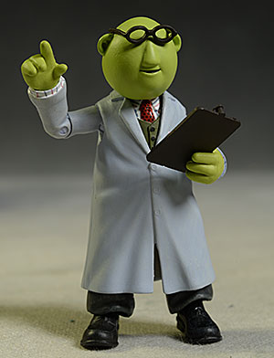
Our Recommendations
Spend your time advocating for structural changes (reminders, increased access)
Most clinicians don’t feel comfortable doing nothing
CFHA approach
Quick to back off and move on
Tailor counseling to patients’ concerns

Slide 34
Taking the message home …
Look back at your post-it from earlier
What is one thing you might change in your own practice?
How is your institution nailing this? How could they do it better?

Slide 35
References
Abdullahi LH, Kagina BM, Ndze V, Hussey GD, Wiysonge CS. Improving vaccination uptake among adolescents. Cochrane Database of Systematic Reviews 2020, Issue 1. Art. No.: CD011895. DOI: 10.1002/14651858.CD011895.pub2
Associated Press. Analysis: Vaccinations jumped 33% after Vax-a-Million news. Accessed 9/21/2021. https://spectrumnews1.com/oh/columbus/coronavirus/2021/05/23/analysis--vaccinations-jumped-33--after-vax-a-million-news
Dempsey AF, Pyrznawoski J, Lockhart S, et al. Effect of a Health Care Professional Communication Training Intervention on Adolescent Human Papillomavirus Vaccination: A Cluster Randomized Clinical Trial. JAMA Pediatr. 2018;172(5):e180016. doi:10.1001/jamapediatrics.2018.0016 Jarrett C, Wilson R, O'Leary M, Eckersberger E, Larson HJ; SAGE Working Group on Vaccine Hesitancy. Strategies for addressing vaccine hesitancy - A systematic review. Vaccine. 2015 Aug 14;33(34):4180-90. doi: 10.1016/j.vaccine.2015.04.040. Epub 2015 Apr 18. PMID: 25896377.
Half of unvaccinated workers say they’d rather quit than get a shot – but real-world data suggest few are following through. The Conversation. Accessed 10/04/2021. https://theconversation.com/half-of-unvaccinated-workers-say-theyd-rather-quit-than-get-a-shot-but-real-world-data-suggest-few-are-following-through-168447
Henrikson NB, Opel DJ, Grothaus L, Nelson J, Scrol A, Dunn J, Faubion T, Roberts M, Marcuse EK, Grossman DC. Physician Communication Training and Parental Vaccine Hesitancy: A Randomized Trial. Pediatrics. 2015 Jul;136(1):70-9. doi: 10.1542/peds.2014-3199. Epub 2015 Jun 1. PMID: 26034240.
Henry TA. COVID-19 vaccine hesitancy: 10 tips for talking with patients. American Medical Association. Accessed 9/21/2021. https://www.ama-assn.org/delivering-care/public-health/covid-19-vaccine-hesitancy-10-tips-talking-patients
Jacobson Vann J, Szilagyi P. Patient reminder and recall systems to improve immunization rates. Cochrane Database of Systematic Reviews. 2005;(3). doi:10.1002/14651858.CD003941.pub2
Joseph NP, Bernstein J, Pelton S, Belizaire M, Goff G, Horanieh N, Freund KM. Brief Client-Centered Motivational and Behavioral Intervention to Promote HPV Vaccination in a Hard-to-Reach Population: A Pilot Randomized Controlled Trial. Clin Pediatr (Phila). 2016 Aug;55(9):851-9. doi: 10.1177/0009922815616244. Epub 2016 Mar 10. PMID: 26968631.

Slide 36
References
Kaiser Family Foundation COVID-19 Vaccine Monitor. Accessed 9/21/2021. https://www.kff.org/coronavirus-covid-19/poll-finding/kff-covid-19-vaccine-monitor-june-2021/
Malcom K. Overcoming COVID-19 Vaccine Hesitancy. Accessed 9/21/2021. https://healthblog.uofmhealth.org/wellness-prevention/overcoming-covid-19-vaccine-hesitancy
Nyhan B, Reifler J, Richey S, Freed GL. Effective messages in vaccine promotion: a randomized trial. Pediatrics. 2014 Apr;133(4):e835-42. doi: 10.1542/peds.2013-2365. Epub 2014 Mar 3. PMID: 24590751.
Opel DJ, Mangione-Smith R, Robinson JD, et al. The Influence of Provider Communication Behaviors on Parental Vaccine Acceptance and Visit Experience. Am J Public Health. 2015;105(10):1998-2004. doi:10.2105/AJPH.2014.302425
Skinner SR, Imberger A, Lester R, Glover S, Bowes G, Nolan T. Randomised controlled trial of an educational strategy to increase school–based adolescent hepatitis B vaccination. Australian and New Zealand Journal of Public Health. 2000;24(3):298-304. doi:10.1111/j.1467-842X.2000.tb01572.x
Social Media Toolkit: COVID-19 Vaccinations. Centers for Disease Control. Accessed 9/21/2021. https://www.cdc.gov/coronavirus/2019-ncov/communication/vaccination-toolkit.html
Staras SAS, Vadaparampil ST, Livingston MD, Thompson LA, Sanders AH, Shenkman EA. Increasing Human Papillomavirus Vaccine Initiation Among Publicly Insured Florida Adolescents. Journal of Adolescent Health. 2015;56(5, Supplement):S40-S46. doi:10.1016/j.jadohealth.2014.11.024
Washington State Department of Health Health Care Provider Discussion Guide: Building Confidence in COVID-19 mRNA Vaccines. Accessed 9/21/2021. https://www.doh.wa.gov/Portals/1/Documents/1600/coronavirus/820-130-ProviderMRNAVaccinesDiscussionGuide.pdf
Williams SE, Rothman RL, Offit PA, Schaffner W, Sullivan M, Edwards KM. A randomized trial to increase acceptance of childhood vaccines by vaccine-hesitant parents: a pilot study. Acad Pediatr. 2013;13(5):475-480. doi:10.1016/j.acap.2013.03.011

Slide 37
Aaron Grace, PsyD Katherine Buck, PhD, LMFT
aaron.grace@phci.org kbuck@jpshealth.org
Lauren Thomas, MD
lauren.thomas@phci.org

