Slide 1
Addressing the challenges of preceptor development and recruitment
A joint venture between STFM and ABFM to offer Performance Improvement Credit
2/1/2019
Notes:
UNC is part of 44 pilot sites working with both the STFM and ABFM

Slide 2
Kelly Lacy Evans, MD
Kelly Fedoriw Bossenbroek, MD
Monecia Thomas, MHA
No disclosures

Slide 3
Objectives
“The rationale for the expansion of MOC Part 4 activities from solely clinical practice improvement to educational practice improvement is based on a belief that improving trainee learning and assessment, will ultimately result in improved education, and ultimately, improved care to patients served by the graduates of accredited programs.”

Slide 4
Objectives
Investigate ways with ABFM and STFM to give preceptors credit for precepting students.
Utilize preceptor self-assessment to identify preceptor learning needs.
Improve precepting skills in specific areas as evaluated by students.
Increase preceptor retention by offering the Performance Improvement Credit.
Provide asynchronous faculty development to busy preceptors.

Slide 5
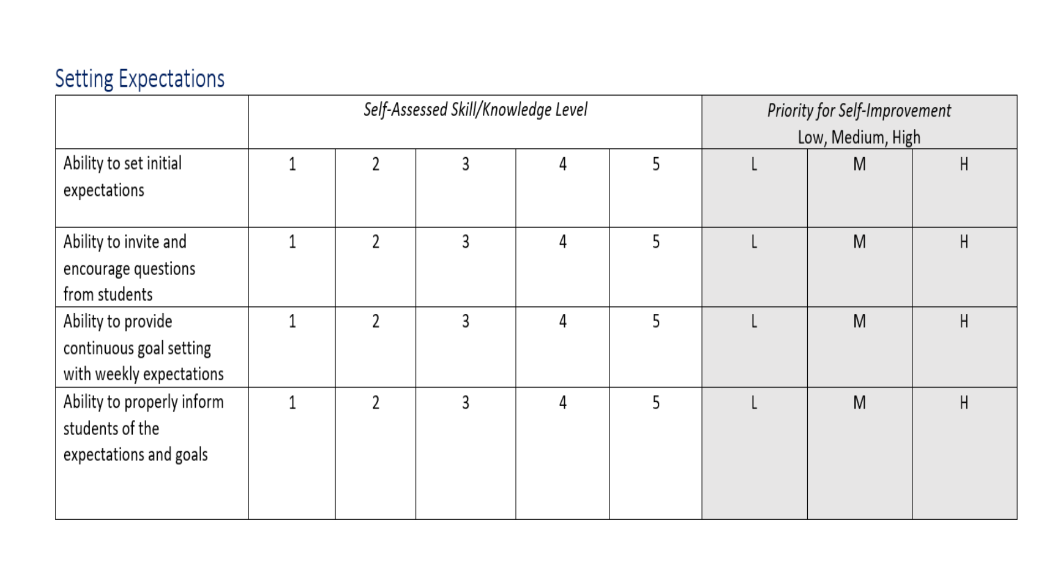
Please take 1 minute to fill out the needs assessment
Not a validated instrument. Developed by the Society of Teachers of Family Medicine Medical Student Education Committee. April 2018.
Adapted from Dankowski, M. Faculty Development Needs Assessment Survey. (Word document). Retrieved from The STFM Resource Library:https://resourcelibrary.stfm.org/viewdocument/faculty‐development‐needs‐assessmen. 3/23/2018.

Slide 6
Faculty Development Videos
Setting Expectations

Slide 7
Preceptor Recruitment
Shortage of preceptors nation-wide for medical student education
Can we increase the number of preceptors by offering certification credit through the ABFM for developing a short-term relationship with learners to improve patient care?
Notes:
-our goal is to recruit and retain more skilled preceptors as participating will help preceptors meet the ABFM Performance Improvement Credit.

Slide 8
Project Design
Complete at least 180 1:1 contact hours with learners
Participate in 2 interventions to improve teaching skills
Review and reflect on the results of the intervention
Complete an attestation
Timeframe: June 1-December 31, 2018
Goal: recruit 25 preceptors

Slide 9
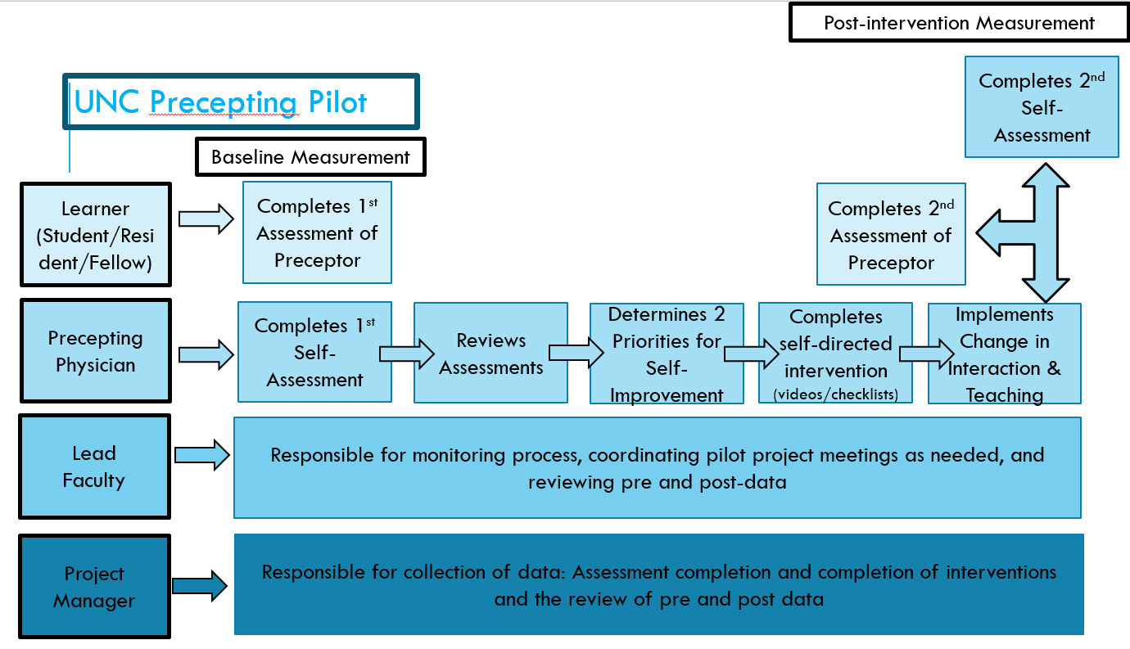
Notes:
preceptors and learners (medical students, residents, fellows, PAs) will perform a needs assessment to evaluate the preceptors
watch a set of educational videos or read 3 page hand-out directed at improving their two most challenging areas
preceptor will implement the suggested changes in their interaction and teaching with learners
repeat the self-assessment to measure improvement.
allows teaching physicians to work on self-identified learning needs.

Slide 10
Preceptor Development
Self-identify learning needs
Asynchronous schedule
Address the following areas:
Clinical teaching
Preparation for learners in the clinical setting
Setting expectations
Providing verbal feedback
Student Evaluation
Notes:
-Preceptor development is challenging due to the demands of teaching physicians’ schedules and individual learning needs.
1) Clinical teaching including assessing the learner’s needs and skills, providing direct observations, and being able to identify a struggling learner.
2) Preparation for learners in the clinical setting including being aware of program expectations, managing one’s time, and providing appropriate staff.
3) Setting expectations including ability to invite and encourage questions as well as provide continuous goal-setting with weekly expectations.
4) Providing verbal feedback including both negative and positive feedback using Situation, Behavior, Impact, Action (SBAI) structure.
5) Student Evaluation including providing constructive and specific comments as well as encouraging open dialogue.

Slide 11
Faculty Development Videos
Teaching Skills
Created by outpatient community medicine Course Directors with funding from North Carolina Area Health Education Centers
Free and easily accessible
Notes:
-Dr. Amy Shaheen and Kelly Fedoriw
-Videos on:
Setting expectations
Providing feedback
Giving feedback and learning response
Student evaluation
Professionalism
-Goal to improve clinical learning experiences of students, faculty precepting experiences, and patient experiences with students in practices across North Carolina
-Developed to provide faculty with needed support while they precept students via brief, engaging, and informative videos

Slide 12
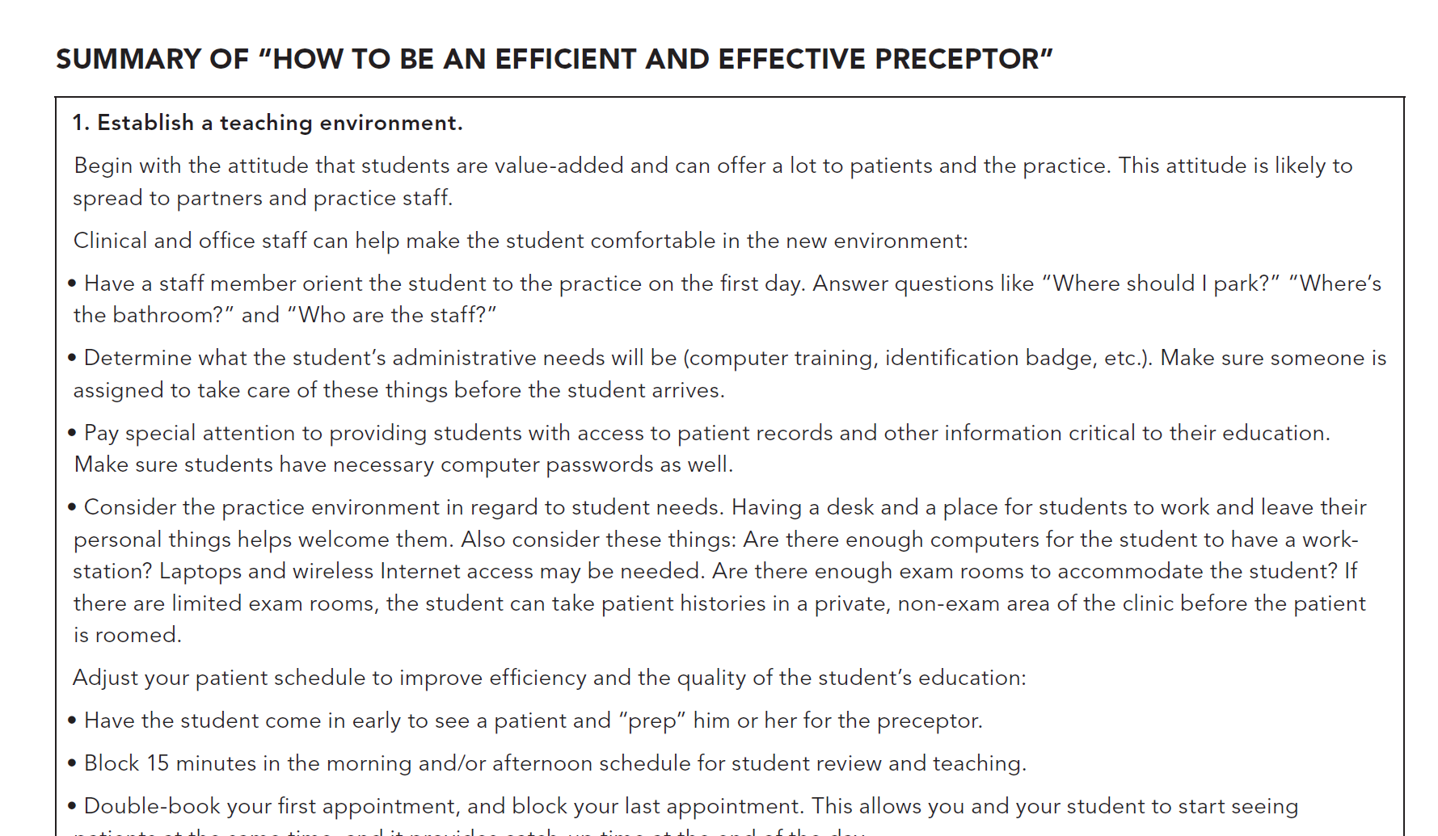
Reproduced with permission from How to Be an Efficient and Effective Preceptor, May/June, 2010, Vol 17, No 2, issue of Family Practice Management Copyright (c) 2010 American Academy of Family Physicians.
All Rights Reserved.

Slide 13
Records maintained by a Qualtrics survey online.
number of precepting hours
assessment tool responses:
Self assessment
Learner assessment of preceptor
Notes:
Preceptors have to log hours

Slide 14
19 preceptors completed the pilot, 14 UNC Faculty
>200 unique learners
Average of 260 precepting hours
1 new preceptor recruited
Notes:
- Average 4.3 years as a preceptor, 5 community preceptors, 14 UNC faculty
- One preceptor marked that this was their 1st year as a preceptor (UNC Faculty Member – Assistant Professor).
* I think it made more aware of how to moderate my approach based on the level of learner and their learning style.

Slide 15
Pre-data
Priorities for Self-Improvement:
Most popular
Clinical Teaching Skills - 12 preceptors
Setting Expectations - 10 preceptors
Least popular
Student Evaluations - 2 preceptors

Slide 16
Post-data
Most improvement
Article
Clinical Teaching Skills
Setting Expectations
Video
Providing feedback
Least improvement
Video
Student Evaluations
Notes:
Most improvement:
the 3 above categories increased because the Preceptors were more aware/cognizant of setting Expectations (included in clinical teaching) as well as providing feedback which could be implemented throughout the rotation
2) Least improvement
scores remained the same. Both Preceptors received all 5s at the beginning and at the end of the pilot. Most likely because students were not sure how to rank their preceptors as this is typically done at the end

Slide 17
Changes to teaching
“Making more time to do direct observation and give concise, balanced, timely feedback”
“More intentional about setting expectations at the beginning of the sessions and giving targeted feedback at the end of the session”
“Identify problem learners and earlier intervention”
“Learned to describe what I saw, the effect it had and what specifically I needed the student to change”
“Clarified expectations on a regular basis”

Slide 18
Challenges
Reminding preceptors to log hours
Where preceptor was at in MOC cycle

Slide 19
Future vision
Introductory video to explain project
More self-improvement tools to choose from – readings, videos, webinar
Make learner feedback anonymous to preceptor
Increase number of learners providing feedback
Differentiate learners – medical students v. residents
Contact between preceptors and “veteran” teachers
Increased marketing
Notes:
We sent out a survey asking for feedback and some of that is included here.
1st, 2nd, 3rd, 4th year medical student v. 1st, 2nd, 3rd year resident

Slide 20
“Thank you so much for your help and always being available during the process. It was definitely the most useful Part IV I have been involved in, and really did help me with areas I needed to work on.”

Slide 21
Questions?

