Slide 1
Designing a Social Determinants of Health Curriculum Through Interprofessional Education and Community Partnership
Alex Kaysin, MD, MPH
Sarah Nickolich, MD
Nancy Denizard-Thompson, MD
Amber Brooks, MD
Gia DiGiacobbe
David Miller, MD, MS
Beat Steiner, MD, MPH

Slide 2
Disclosures
None of the authors have any conflicts of interest
Curriculum design activities are funded by a grant from the Fullerton Foundation

Slide 3
Objectives
On completion of this session, participants should be able to:
Describe a strategic approach to integrate social determinants of health into a population health training curriculum for undergraduate medical students
Describe strategies to engage community partners and enable students to better understand and tackle local health disparities
Describe the components of an interactive teaching method for health professions students learning to incorporate the social determinants of health into practice

Slide 4
Main Objective
Giving students the skills to identify people of diverse backgrounds with barriers to health;
Naming associated social determinants;
and applying appropriate tools and community resources to go beyond clinical care in reducing health disparities
Notes:
We emphasize people rather than patients in order to highlight the need to move our students’ thinking beyond the confines of a health facility and focus on the social networks in which our patients reside. We believe this will maximize the impact of related interventions or initiatives

Slide 5
https://www.who.int/social_determinants/final_report/csdh_finalreport_2008.pdf
Notes:
Global importance of SDOH driven by WHO and its commission on the SDOH, 2005-08
Despite increasing interest in teaching the social determinants of health in undergraduate medical education, few models exist.
The IOM repeatedly has stated that increased clinician leadership is necessary for redesigning our health care system for the twenty-first century. Such a system must address population health, in concert with the public health system.

Slide 6
Factors That Affect Health
Examples
Smallest
Impact
Counseling & education
Clinical Interventions
Long-lasting protective Interventions
Changing individuals’ default decisions to be healthier
Socioeconomic factors
Condoms, “eat less, move more”
Rx for high blood pressure, high cholesterol
Immunizations, brief intervention, cessation treatment, colonoscopy
Fluoridation, 0g trans fat, iodization, smoke-free laws, tobacco tax
Largest
Impact
Poverty, education, housing, inequality
Frieden TR. A framework for public health action. Am J Public Health. 2010;100(4):590–595.
Notes:
Graphic from an article by Thomas Frieden, former Director of CDC. Factors of health pyramid is an idea that underlies the essence of what we’re trying to accomplish.
Socioeconomic Factors are the single largest determinant of health.
Physicians have a necessary and important role, but in order to improve health outcomes, physicians need to better understand the foundation on which people’s health is built.
Counseling & Education, Clinical Interventions, and Long-lasting Protective Interventions are familiar territories for us. Clinicians should also be encouraged to participate in the two bottom tiers: Changing context and Socioeconomic Factors. (Examples from health policy, advocacy and public health measures demonstrate the opportunities for physician and healthcare worker leadership in general).
Clinical interventions play an important role but have a relatively smaller impact on overall health.

Slide 7
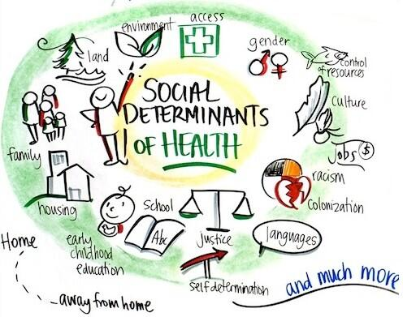
Notes:
SDOH includes a multitude of social, economic, political and cultural factors which have the power to affect the health of people, communities and populations.
In designing a student-focused curriculum, we need to determine specific areas to focus on in order to maximize impact while forming partnerships to ensure coverage of as many domains as possible

Slide 8
Healthy People 2020 Approach to SDOH
Built Environment
Health and Healthcare
Social and Community Context
Education
Economic Stability
SDOH
https://www.healthypeople.gov/2020/topics-objectives/topic/social-determinants-of-health
Notes:
The Healthy People 2020 approach to the SDOH includes this “place-based” organizing framework, reflecting five (5) key areas of social determinants of health (SDOH), which served as a model for our work.
Run by the Department of Health and Human Services, Healthy People 2020 is a comprehensive, national health promotion and disease prevention planning process.

Slide 9
Healthy People 2020 Approach to SDOH
Economic Stability
Employment
Food security
Education
Early childhood education and development
High school graduation
Social & community context
Civic participation
Discrimination
Housing stability
Poverty
Language and literacy
Incarceration
Social cohesion
Health and Healthcare
Access to primary care and other healthcare services
Health literacy
Built Environment
Access to nutritious food
Crime and violence
Environmental conditions
Housing quality
https://www.healthypeople.gov/2020/topics-objectives/topic/social-determinants-of-health

Slide 10
Designing Web Modules
Grant funded by Fullerton Foundation, 2016-2019
Partnership between Wake Forest and UNC Schools of Medicine
Primary care faculty and education specialists of UNC-Chapel Hill and Wake Forest SOM

Slide 11
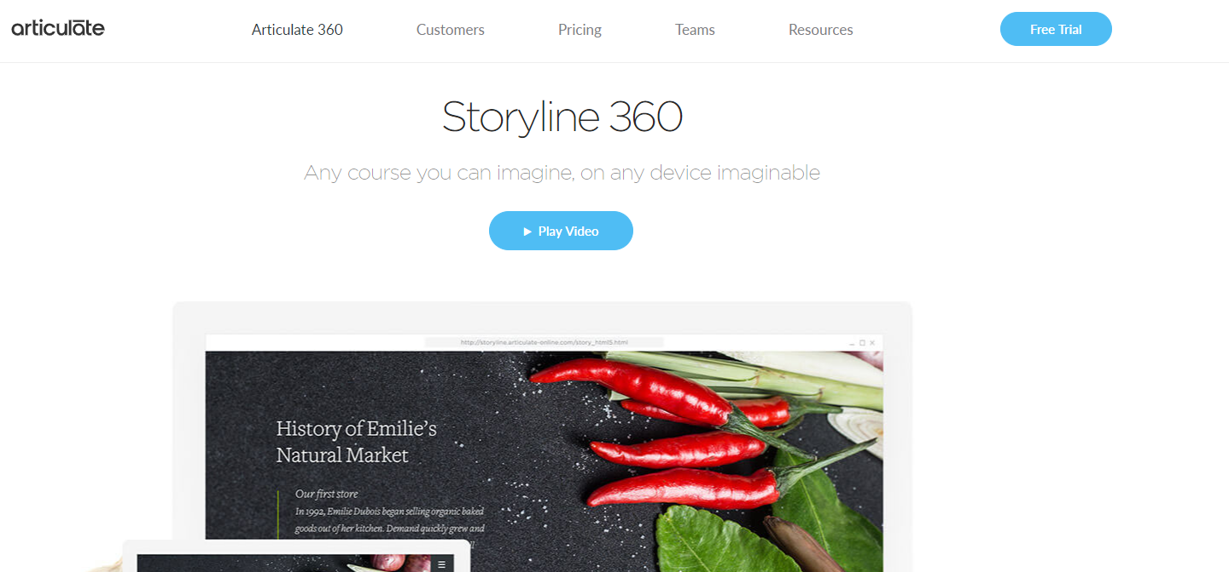
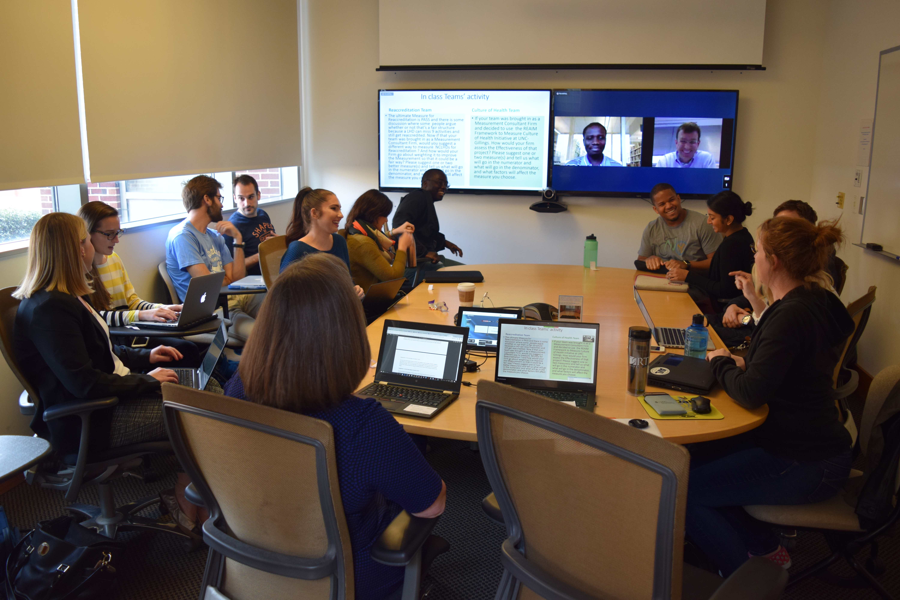
Designing Web Modules: student-driven process
Focus groups with medical students in the UNC primary care and population health leadership track (MS1 and MS2)
Module design in PowerPoint and enhanced in Storyline software from Articulate 360

Slide 12
Digital Module Content
Introduction: Population health to reduce health disparities
Education and Health Disparities
Housing and Built Environment as Social Determinants
Environmental Health
Access to care
Food Insecurity
Transportation as a Social Determinant
Maternal and Infant Health Disparities
Implicit Bias
Social Networks and Health Equity
Notes:
Module topics were split between both campuses followed by a process to harmonize the final content and structure to suit the needs of each campus

Slide 13
Designing Web Modules: student-driven process
Contextually relevant, concise and evidence-based modules on Social Determinants of Health and health disparities. 30-60 min run-time (podcast experience)
Integrated case studies emphasizing interprofessional and community-based projects
Visually-appealing content including short videos, links to external content and interactive digital exercises to better engage Millennial learners
Suggested exercises involving short field work assignments in students’ communities to draw on real-world examples and experiential learning
Content from CDC, AAFP, DHHS, county health departments, NIH, peer-reviewed primary research, non-profit organizations working on health and social disparities, and general media content from NPR, ProPublica, TED, etc.
Notes:
Case studies specifically chosen to depict community engagement opportunities for healthcare workers to address health disparities through a social determinants lens

Slide 14
Digital Module Content
Notes:
Examples of modules-
-Population Health Management – factors of health analysis, drivers of population health, understanding health system financing and cost distribution
-Housing – including micro-environments and analysis of homelessness, its root causes, health impact and possible solutions driven by real-world case studies
-Environmental health – effect of water, soil and air quality on communities with in depth case studies based on Flint, MI (lead contamination of drinking water) and Tooleville, CA (arsenic contamination of community water sources). Students are introduced to the drinking water disparities framework to understand the factors, actors and impacts of environmental pollutants and how this plays out over existing socioeconomic and racial disparities. Encourages students to strongly consider the environmental exposures when addressing people’s health concerns.
-Childhood education and development – Reviews the ecologic model of childhood development to demonstrate effects of stress from poverty, malnutrition, violence, etc. on a child’s health, social and cognitive development. Themes drawn from the seminal textbook, “From Neurons to Neighborhoods” (The Committee on Integrating the Science of Early Childhood Development)
-Built environment – Reviews practical examples of how elements of community design such as zoning policies, sidewalks, public transit infrastructure, parks and greenways affect peoples’ physical activity, use of alternative means of transportation (walking and biking) and degree of interconnectedness vs social isolation. Case studies draw on local examples of policies that have had positive health impacts

Slide 15
Digital Modules: Interactive Exercises
Windshield or walking survey
important process of community needs assessment. Will give a view of the community to help decide how to take the next steps effectively in order to address real needs and improve the quality of community life.
Global literacy and child survival
Learning to use interactive graphing tools (i.e. www.gapminder.org) to plot women’s literacy and infant mortality rates in lower income countries
County level population health analytics
Using www.countyhealthrankings.org, students explore relationships between demographics, SES, and health behaviors to better understand distribution of health disparities within states
Notes:
Walking/windshield survey:
Gapminder: Interactive online activity guides students through a data visualization and analysis process to observe for correlations and associated shifts among multiple health, demographic and socioeconomic indicators.
County Health Rankings: Student conduct an analysis of population health measures at a county level to better understand the salient health and social trends in their geographic area of interest.

Slide 16
Barriers to Implementation
Inability to achieve parallel implementation at both institutions
UNC-CH completed a major overhaul of its entire SOM curriculum in 2014 → difficulty finding available student cohort at UNC
Student schedules (MS3) constrained time available for community partner involvement
Faculty turnover at both institutions
Funding constraints were NOT an issue
Notes:
WF implementation includes a SDOH focus for each block clerkship. Peds, food insecurity. Surgery, transportation.
Initially, the study population for this intervention was the Primary Care and Population Health Scholars (PCPHS) Program (# of students = 20). Medical students in this program were selected for their interest in primary care and population health. This program was discontinued due to funding cuts. In addition, the scheduling complexity for UNC SOM students restricted the ability to enhance their learning with a community-focused experiential activity.

Slide 17
Implementation: Pilot #1: Rural Interprofessional Health Initiative Course
Interprofessional case studies
Field Assignment
Notes:
In the position paper Addressing Social Determinants to Improve Patient care and Promote Health Equity, the American College of Physicians supports interprofessional and community collaborations, recognizing that an all-hands-on-deck approach is needed to make progress on eliminating health inequities associated with social determinants of health.
Our pilot project was imbedded in a new course at UNC-CH called “Population Health and Inter-professional Management in Changing Healthcare Systems” within the Rural Interprofessional Health Initiative. This course is offered to students in all UNC-CH professional schools, including the schools of dentistry and nursing, physician assistant program, physical therapy, social work, and public health. Seminars focus on the major domains of population health as well as interprofessional healthcare.

Slide 18
Building Campus-Community Partnerships
First year pilot: 3 community partner sites were visited –
Women’s Birth and Wellness Center, Migrant Farmworker Outreach program via Piedmont Health Services, and the Chatham County Partnership for Children
Time spent with community organizations: 2-4 hours
Activities undertaken:
meeting staff to learn about the organization (mission, activities, and target population),
volunteer work,
field visits to meet program beneficiaries,
joining meetings with partner organizations

Slide 19
Student Feedback
How valuable was this experience in furthering your knowledge of the community or population needs in this country, including social determinants of health and health disparities?
Notes:
100% of participating students ranked this community partner visit as valuable or very valuable to furthering their knowledge.

Slide 20
Student Feedback
How likely are you to reconnect with this organization?
Notes:
50% of surveyed students said they were extremely likely to reconnect with this organization.

Slide 21
Student Feedback
Would you recommend visiting this organization to other students taking this course?
Notes:
100% of participating students would recommend visiting this organization to other students.

Slide 22
Student Feedback
“At the meeting, they told us that it has been very hard for them to get medical professionals (especially physicians) on board with any of their initiatives or for any type of collaboration…..”
“There’s nothing better for gaining an understanding of what patients’ lives are like than going to visit them in their homes—going out for these [patient] outreach visits with [them] was invaluable….”
“This site visit really helped us understand the population needs for our project.”

Slide 23
Students’ Change in Knowledge and Confidence Working with Underserved Populations (Wake Forest SOM)
I know how to engage effectively with community and public health teams to reduce health disparities and promote health.

Slide 24
Students’ Change in Knowledge and Confidence Working with Underserved Populations (Wake Forest SOM)
I feel comfortable negotiating a plan of care with patients from underserved populations, considering their constraints and expectations.

Slide 25
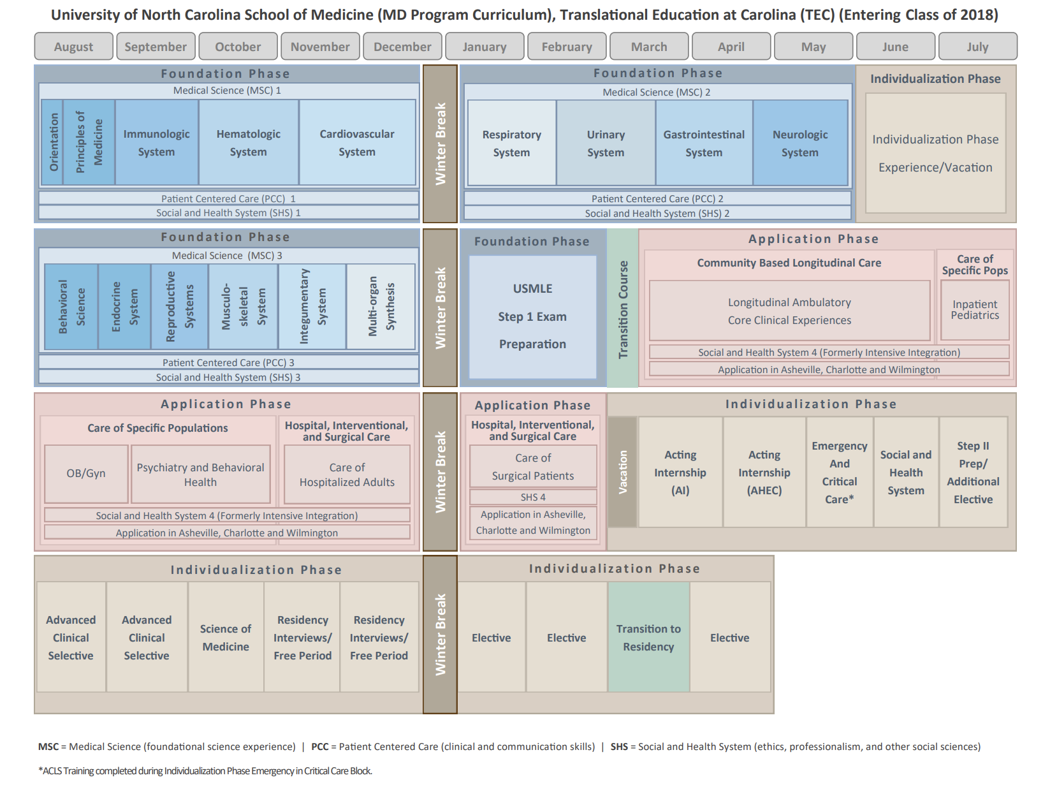
Barriers to Implementation
2/1/2019
25
Notes:
According to the AMA, Health Systems Science includes “the principles, methods, and practice of improving quality, outcomes, and costs of health care delivery for patients and populations within systems of medical care.”
Social and Health Systems 1-4: Considered “coils” or longitudinal threads that are weaved throughout the curriculum. Taught in weekly seminars throughout all 4 years. The focus is on social, cultural, economic, and historical forces that shape health and disease, the patient experience, health disparities.
Community Service and Care of the Underserved – actually starts in year 1 and continues through year 4. Purpose is developing leadership skills applicable to experiences leading community service or resource-poor organizations.

Slide 26
Implementation: Pilot #2: Community-Based Longitudinal Course
MS3 students (n=140)
16-week longitudinal block integrating clinical learning in FM, IM, and Peds with additional experiences in hospice, mental health, and senior care
Identify patient(s) in a clinical setting with barriers to care.
Identify ≥2 SDOH corresponding to barrier(s)
Complete the corresponding digital modules
Choose community organization(s) that addresses those determinants
Conduct site visit and write a reflection piece regarding how this organization can address their patient’s barriers to care
Optional but encouraged: provide resources to the patient

Slide 27
Questions for Discussion
How do we assess medical students’ (clinical vs pre-clinical) baseline understanding of SDOH within the larger effort of piquing student interest in addressing medical problems in a holistic, team-based approach?
Is there a need for standardized tools to evaluate teaching methods and measure students’ progress in mastering population health approaches to address complex health problems?
Do you have other ideas and examples of teaching population health and social determinants to medical students?
Notes:
Could lack of standardized/validated evaluation tools be limiting the wider adoption of a SDOH component in medical education?
Community Health Needs Assessment was published as a training tool for FM residents by Dr. Wilder and colleagues in Harlem, NY. Included primary (surveys, focus groups, key informant interviews) and secondary (review of public databases) data collection methods. Also included community resource survey.

Slide 28
Please evaluate this presentation using the conference mobile app! Simply click on the "clipboard" icon on the presentation page.

