Slide 1
Innovative, Online Resources to Promote Positive Parenting Behaviors and Early Childhood Development STFM 2022
Notes:
Karly – introduce

Slide 2
Introductions
​ | ​ | ​
Karly Pippitt, MD - University of Utah (Family Medicine)
Susan Cochella, MD, MPH - University of Utah (Family Medicine)
Blair Hammond, MD - Mount Sinai Hospital (General Pediatrics)
Quang-Tuyen Nguyen, MD – University of Utah (General Pediatrics)
Aimee Mankodi, MD– Institute for Family Health (Family Medicine)
Notes:
Karly leads - Round the room introductions (or raise hand to show where you are from)

Slide 3
Objectives
​ | ​ | ​
Recognize the impact of specific parenting behaviors on early childhood development and role of safe stable nurturing relationships (SSNRs) in lifelong health.
Identify two new resources to include in medical education to promote positive parenting behaviors and early childhood development within 3 months of the workshop.
Develop an action plan to support incorporation of these tools into medical education and medical education.
Notes:
Karly

Slide 4
Disclosures and Confessions:
​ | ​ | ​
We have no financial disclosures or conflicts of interest with the material presented.​
​
As new clinicians, we made up parenting advice.​
As parents, we often do not practice what we preach.
As providers, we find it difficult to fit in everything we have to cover in a well-child visit.
Notes:
Blair

Slide 5
Research has shown…
​ | ​ | ​
Positive parenting/caregiving behaviors lead to improved health outcomes.
Scientific literature now recognizes parenting/caregiving as a near-universal determinant of social, economic, and health outcomes.
Early negative experiences and relationships with parents change the expression of genes and can modify a child’s development and health in profound ways.
Pioneering research is identifying specific parenting/caregiving behaviors that are associated with improved outcomes and reduced risk of diseases such as asthma, obesity, diabetes and heart disease.
Notes:
Q/Blair

Slide 6
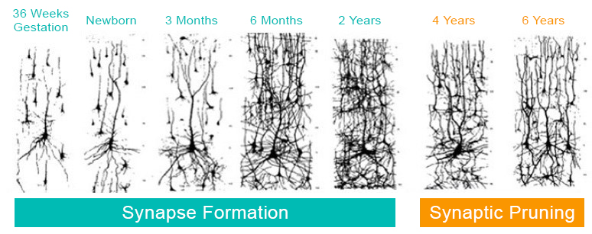
Science of Early Brain Development
​ | ​ | ​
In the first few years of life, more than 1 million new neural connections are formed every second.
Source: Image created based on work of Harvard University Center for the Developing Child
Notes:
Q/Blair

Slide 7
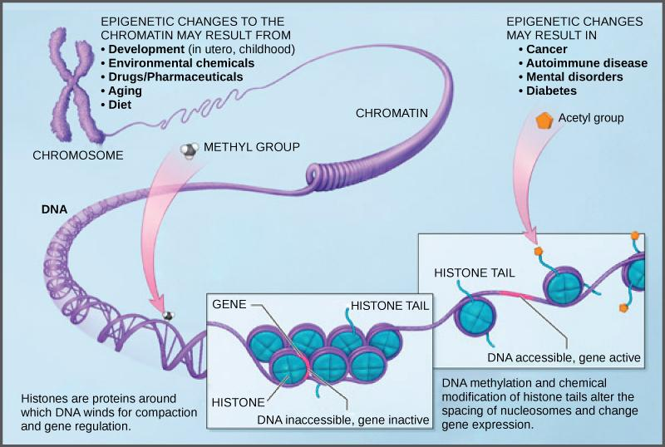
Early Parenting Environment
​ | ​ | ​
Stress and the Early Parenting Environment can…
Alter methylation
Modify brain architecture
Epigenetic changes affect:
Learning
Behavior/development
Physical health
Long term disparities
Source: Image created based on work of Harvard University Center for the Developing Child
Notes:
Q/Blair

Slide 8
There’s Good News…
​ | ​ | ​
Despite evidence that children exposed to early toxic stressors are at risk for poor outcomes, studies show that strong, stable, nurturing parent-child relationships buffer the harmful effects of early stress¹.
We need to focus on promoting:
Safe, stable, nurturing relationships that buffer toxic stress
The foundational social-emotional, language, and cognitive skills needed to develop healthy, adaptive coping skills
“Home Visiting and the Biology of Toxic Stress: Opportunities to Address Early Childhood Adversity,” Pediatrics, November 2013, VOLUME 132, ISSUE Supplement 2.
Notes:
Q/Blair

Slide 9
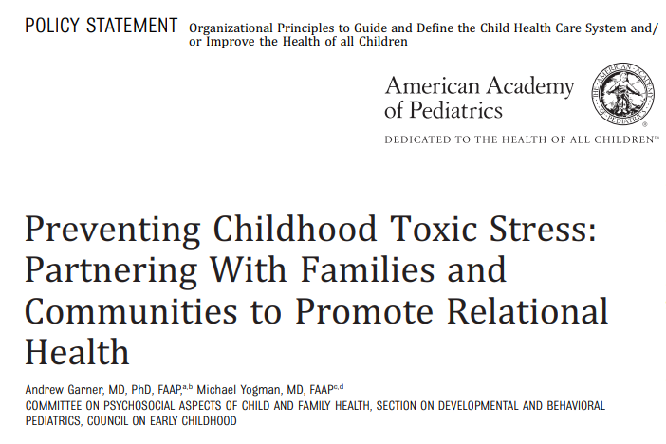
AAP Policy Statement
​ | ​ | ​
“The American Academy of Pediatrics asserts that SSNRs are biological necessities for all children because they mitigate childhood toxic stress responses and proactively build resilience by fostering the adaptive skills needed to cope with future adversity in a health manner.”
Notes:
Q and Susan

Slide 10
How would you define early relational health in a few words?
​ | ​ | ​
Notes:
Q asks the question, Karly and Susan engage with audience
- Kara helps with typing onto computer/Blair if flipcharts

Slide 11
​ | ​ | ​
Early relational health is:
Positive, stimulating, and nurturing early relationships
Critical for emotional security and connection that advance physical health and development, social well-being, and resilience.
Definition from the First3Years
Notes:
Lead: Q, “So there is an actual definition. We take from First3Years the following:”

Slide 12
Early Relational Health is also…
​ | ​ | ​
A paradigm shift for early childhood, society and our culture
Universal but recognizes cultural variability in parenting/caregiving
Foundational to equity, resiliency and recovery using science-based, family-centric care
Requires a dyadic and two-generational perspective for caregiver-child development
Promoting our families’ relational health
Improves our own relational health
Decreases burnout
Find meaning in our care practices again
Adapted from David Willis, Center for the Society for Social Policy
Notes:
Q: “More importantly, what we need to recognize is an epoch in medicine where we are learning and fostering the skills to have conversations again.”

Slide 13
How can we take what we know intuitively and incorporate intentionally in our future practice?
​ | ​ | ​
Notes:
Lead: Q “I suspect the themes we have been reviewing reverberate with what you know. So we are asking you, how do we do this?”

Slide 14
Small Group Breakout
​ | ​ | ​
How are you currently teaching early relational health and childhood development?
What resources are you using?
Where in resident training are you incorporating it?
Notes:
Lead: KA(5 minutes)
How are you currently training residents to promote early relational health and childhood development?
What resources are you using?
Where in resident trainings are you incorporating it?

Slide 15
​ | ​ | ​
Current Training on Relational Health: Resources
Where in Training? Who is teaching this information?
Notes:
Susan, Karly Type on screen, groups share different pieces (5 minutes)
How are you currently training residents to promote early relational health and childhood development?
What resources are you using?
Where in resident trainings are you incorporating it?

Slide 16
​ | ​ | ​
Action Plan/Breakout Session:
How can you enhance your current training on promoting relational health and child development?
What resources will you use?
When in training will this occur?
How can the learning be longitudinal?
How will you assess learners?
How do we hardwire this into our process?
For example:
Lectures
Grand Rounds
Behavioral Health
Well-Baby Nursery Rotation
Morning Report
Continuity Clinic and Observations
Faculty Training
QI Projects
Notes:
Susan
What resources will you use?
When in training will this occur?
How can the learning be longitudinal?
How will you assess residents?
If you are already doing this well, are there opportunities to collaborate with another program?
Small groups (15 minutes), how would you incorporate this and challenge you might have, can you start to think about an assessment (OSCI, written reflection, parent survey, etc.)
Different groups can discuss slightly different things (initial implementation, longitudinal assessment, learning)
Lead: Leora
Kara/Michelle/Chelsea send to participants to breakout rooms and copy questions into the chat, include 1 presenter in each small group to facilitate and select someone from each group to share points when we come back together for a large group

Slide 17
Before we break in to groups… a few free, online resources to promote early relational health and child development in clinical practice and medical education
​ | ​ | ​
Notes:
Lead: Susan

Slide 18
​ | ​ | ​
How do we support safe, stable, nurturing relationships, and foster adaptive (resiliency) skills in our everyday healthcare moments?
How do we move beyond identifying delays (in early childhood) to promoting healthy relationships through “keystones” of development?
Notes:
Lead: Blair
I added the words in paratheses because I think that is better. Adaptive skills is like ADLs and we’re really talking about emotional and mental health. -QTN

Slide 19
​ | ​ | ​
Keystones of Development Curriculum
Partners:
Notes:
Lead: Blair

Slide 20
​ | ​ | ​
Keystones of Development
A free, 3-4 hour, self-directed online residency curriculum that integrates the promotion of positive parenting behaviors into routine well-child visits.
Secure Attachment
Perspective Taking
Autonomy
Problem Solving
Self Regulation
Academic Knowledge
Predictive of later well-being and largely dependent on parent/caregiver behaviors
Notes:
Lead: Blair

Slide 21
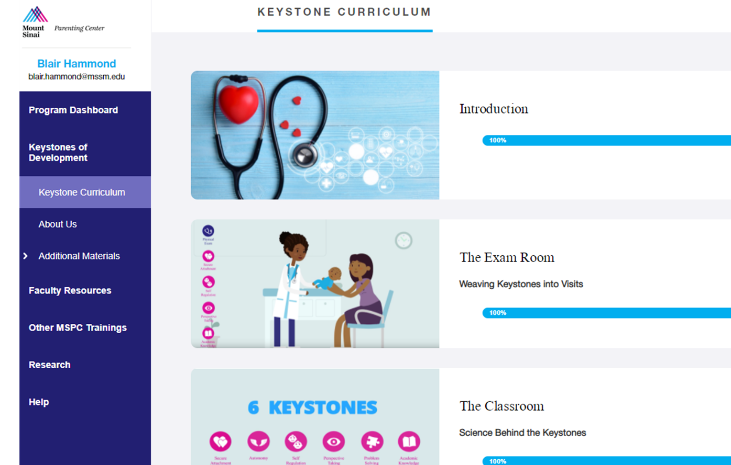
​ | ​ | ​
Brief Tour of the Curriculum and Platform
Notes:
Lead: Blair

Slide 22
​ | ​ | ​
Keystones of Development: Introduction
Notes:
Lead: Blair

Slide 23
​ | ​ | ​
Exam Room: 0, 1, 2 Month Visit
Notes:
Lead: Blair

Slide 24
​ | ​ | ​
Exam Room: 4-9 months
Notes:
Lead: Blair

Slide 25
Exam Room: 12-18 months

Slide 26
​ | ​ | ​
Classroom: Self Regulation
Notes:
Lead: Blair

Slide 27
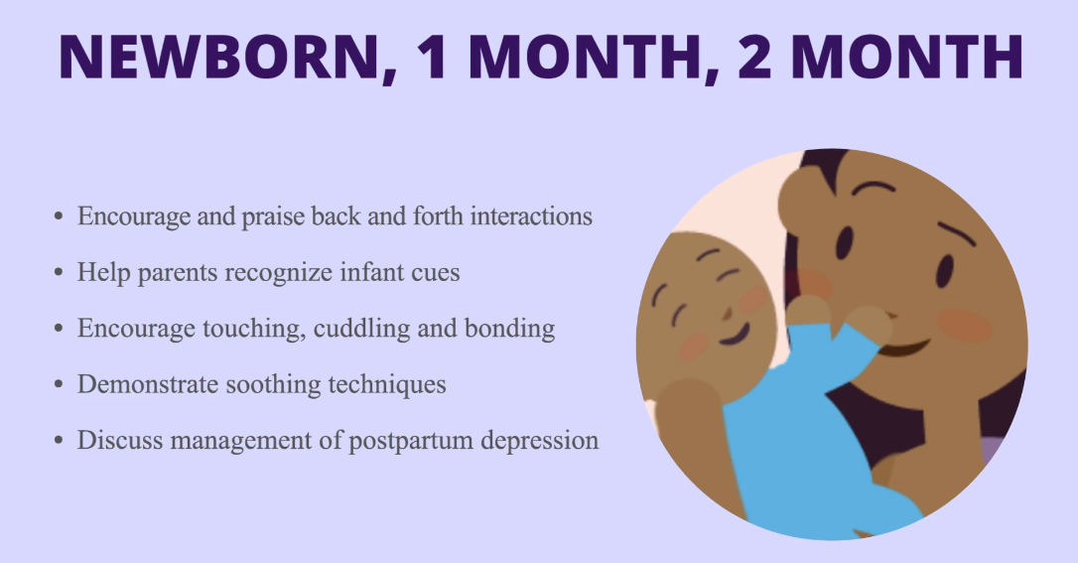
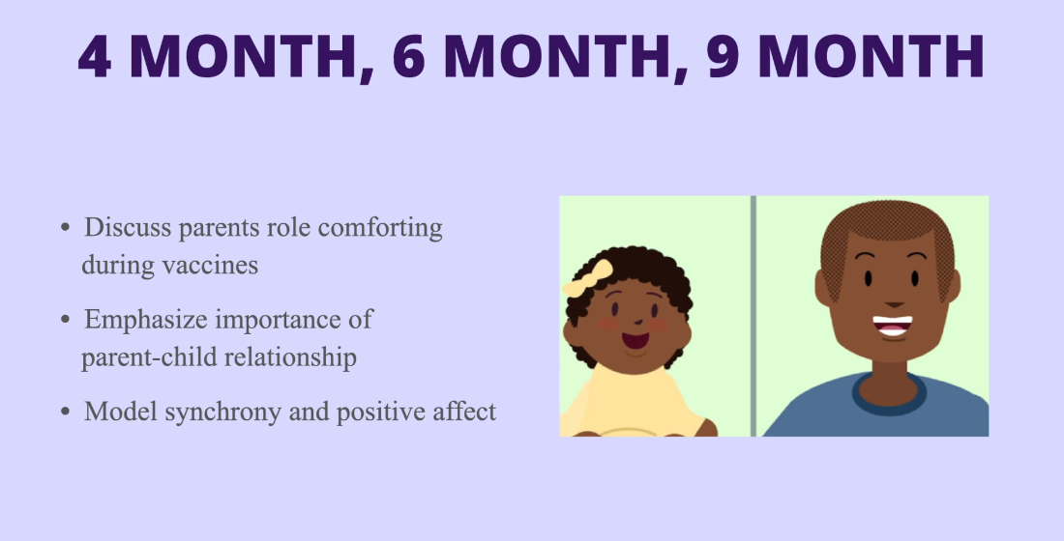
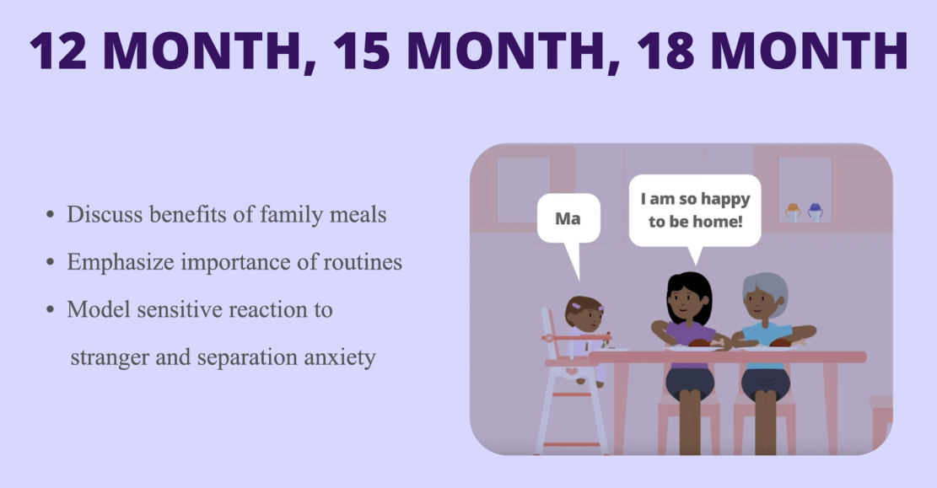
​ | ​ | ​
Promoting Attachment in the Clinical Setting
Notes:
Lead: Blair

Slide 28
​ | ​ | ​
Promoting Attachment in the Clinical Setting
Discuss:
Skin to skin – “Your touch teaches your baby”
“You can’t spoil a baby”
Noticing cues and responding to them
Avoid shaming older children
Model:
Warm, positive affect, using parentese
Back and forth interactions
Praise what you observe…
“He calms down so nicely when he snuggles with you”
“Those kisses are so great for his development and actually help build his brain.”
Notes:
Lead: Blair

Slide 29
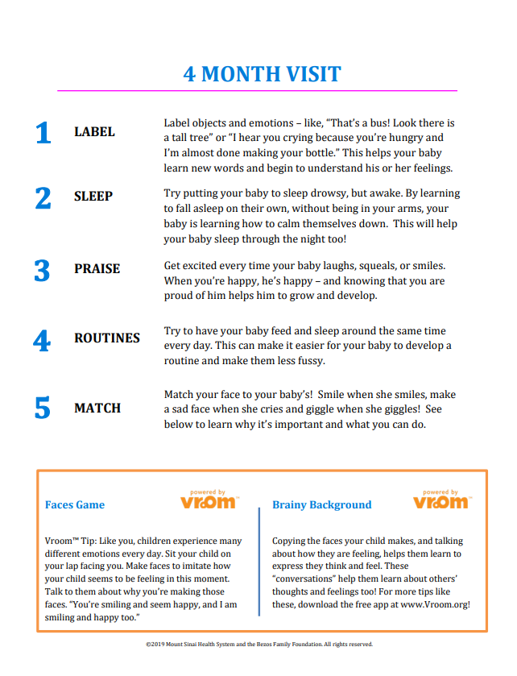
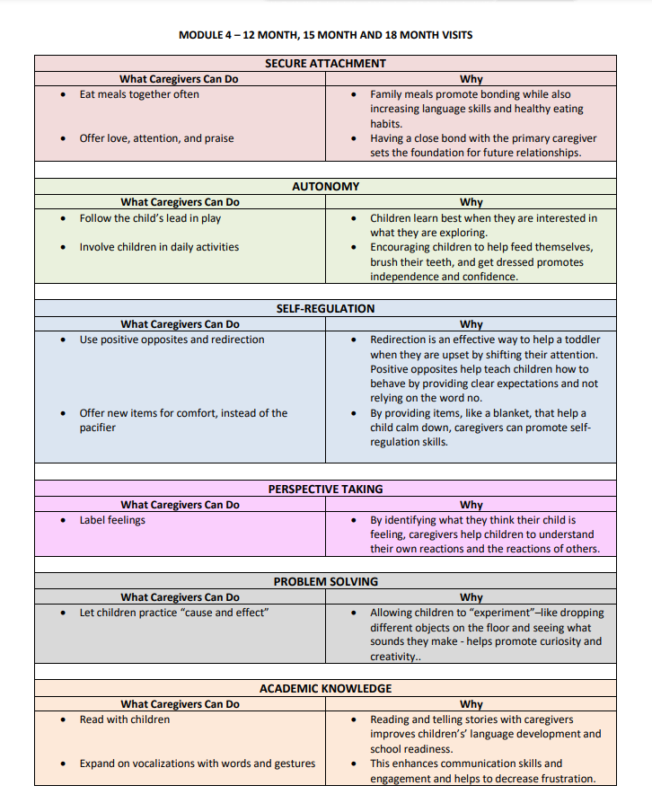
​ | ​ | ​
Brief Tour of the Curriculum and Platform
Notes:
Lead: Blair

Slide 30
​ | ​ | ​
2018-2019 Pilot Study
Mount Sinai Hospital
Elmhurst Hospital
Tulane Medical Center
Children’s Hospital LA
Mass General Hospital
University of Mississippi Medical Center
UT Southwestern Medical Center
University of Utah
108 residents completed the curriculum
67 residents completed pre/posttest
23% increase in Knowledge
37% increase in Confidence
38% increase in Behaviors
20% reduction in Perceived Barriers
Notes:
Lead: Blair

Slide 31
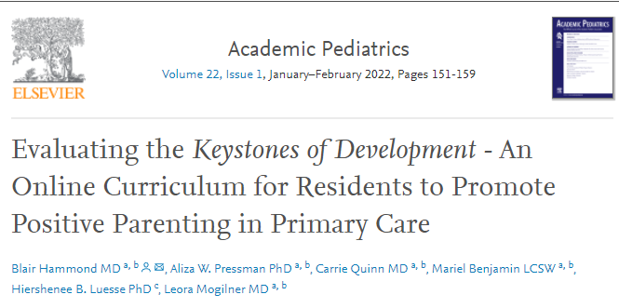
​ | ​ | ​
Pilot Study:
Changes in the predictors of behavior:
Barriers decreased from 2.65 to 2.12 (p<0.01)
Knowledge increased from 61% to 75% (p<0.01)
Self-efficacy increased 3.15 to 4.19 (p<0.01)
Attitudes changed from 4.35 to 4.43 (p=0.35)
Changes in Behaviors from 0.46 to 0.62 (p<0.01):
Discussion 0.37 to 0.56 (p<0.01)
Modeling 0.50 to 0.686 (p<0.01)
Praising 0.67 to 0.75 (p=0.05)
Notes:
Lead: Blair

Slide 32
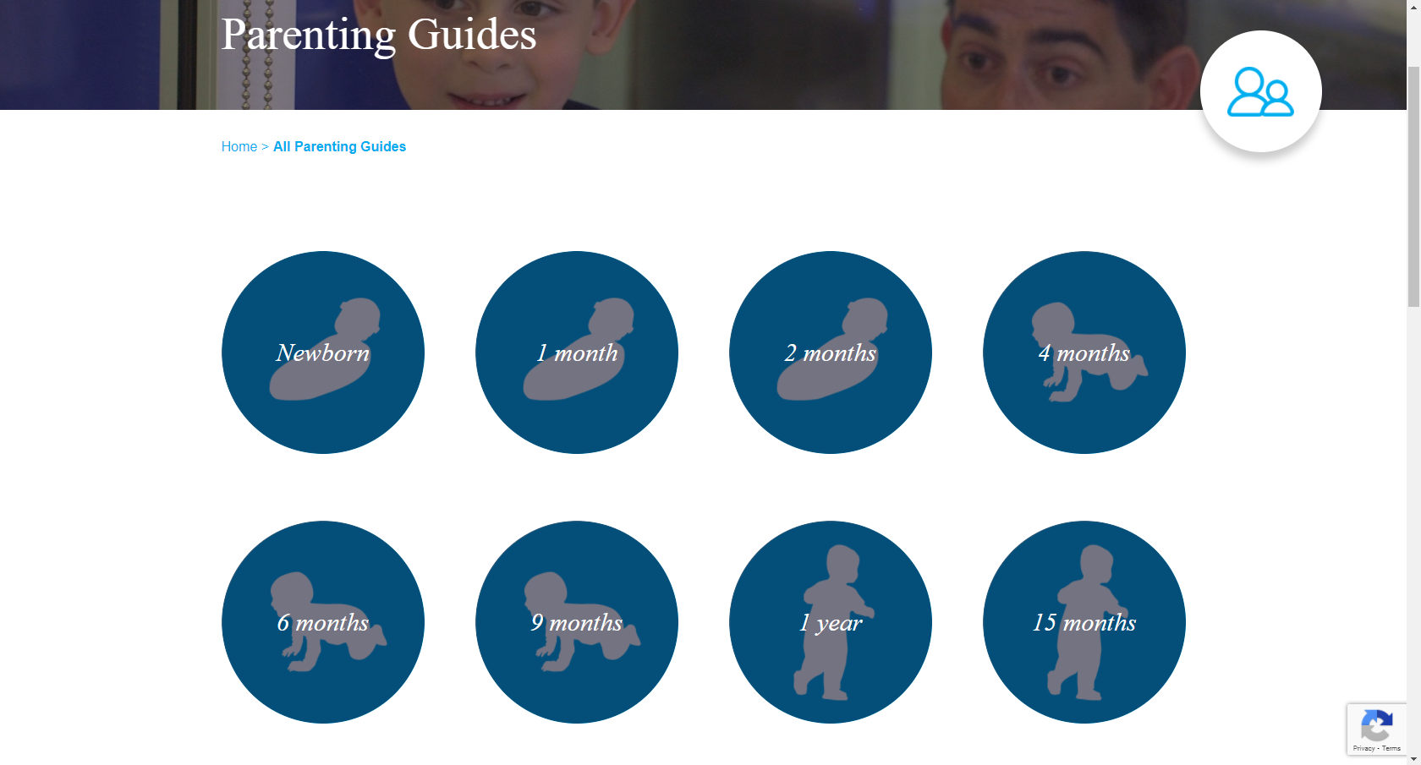
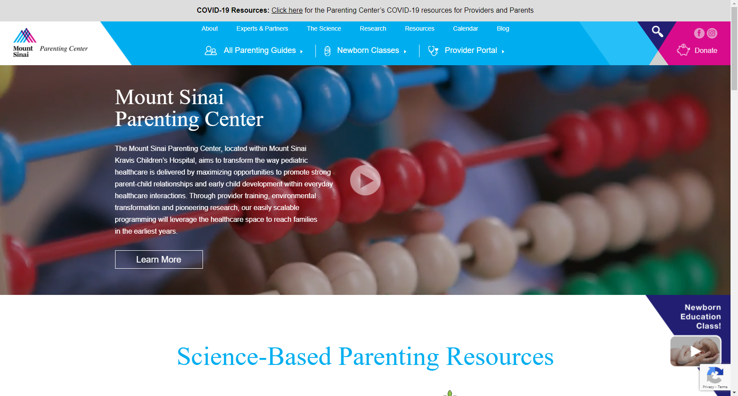
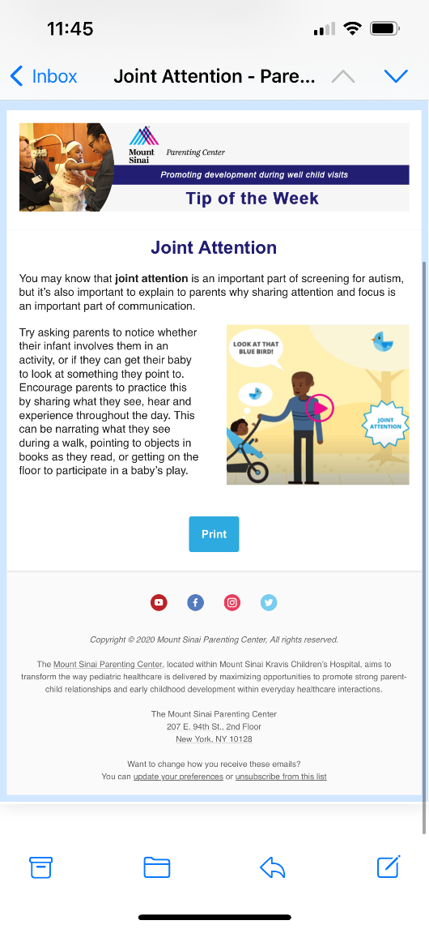
​ | ​ | ​
Website and Tip of the Week
Notes:
Lead: Blair

Slide 33
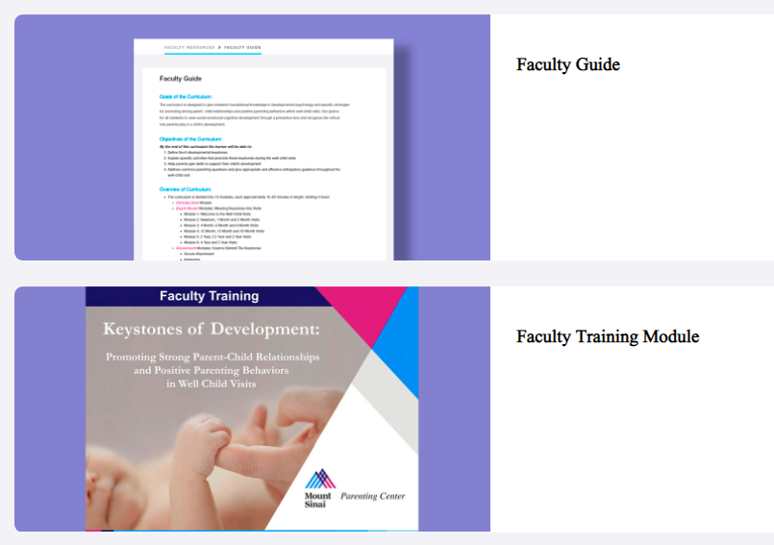
​ | ​ | ​
Faculty Guide and Training Module
Notes:
Lead: Blair

Slide 34
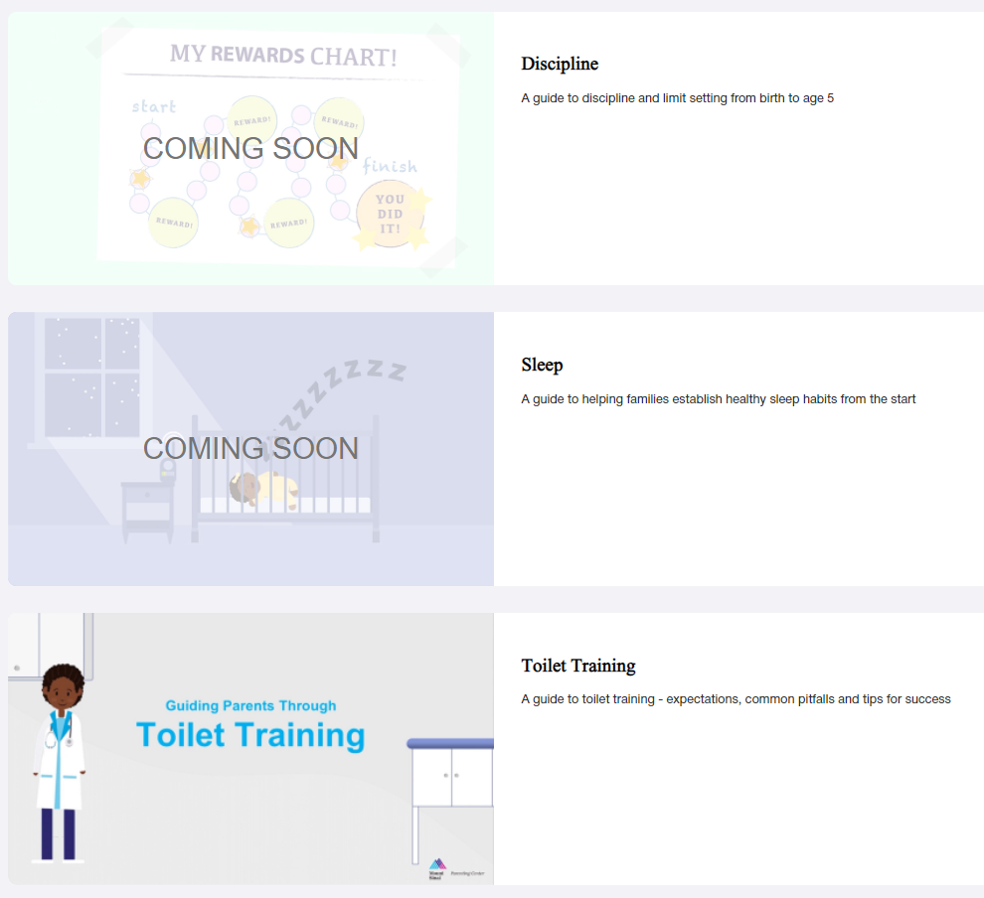
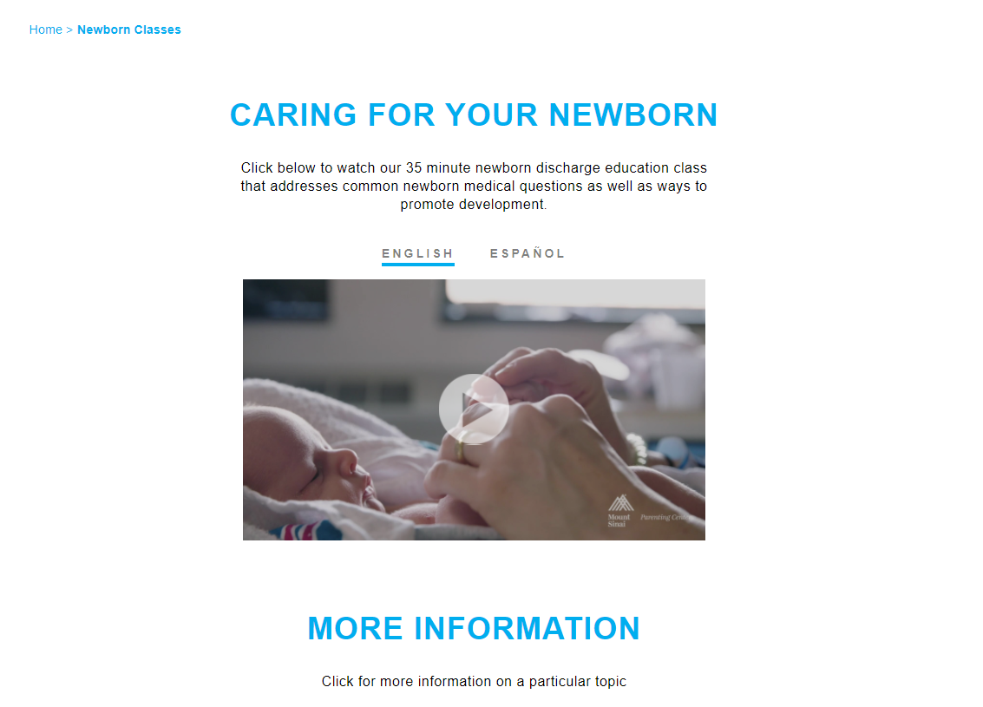
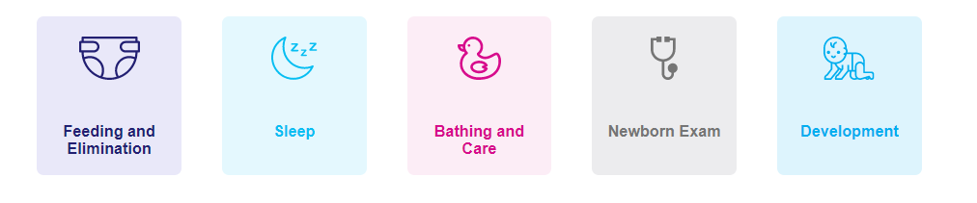
​ | ​ | ​
Additional Modules and Resources for Families
Notes:
Lead: Blair

Slide 35
Additional Resources

Slide 36
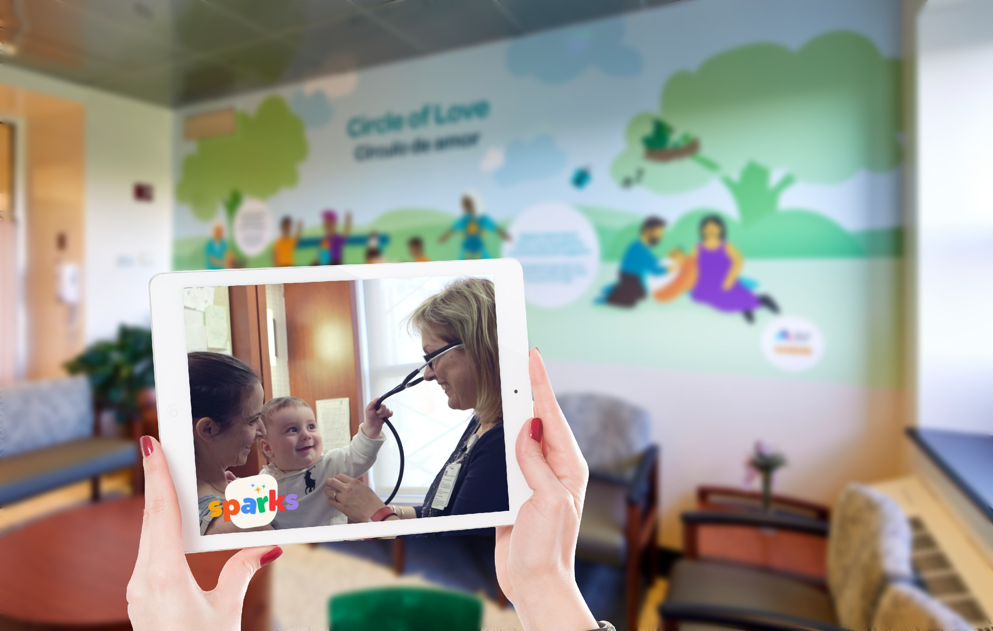
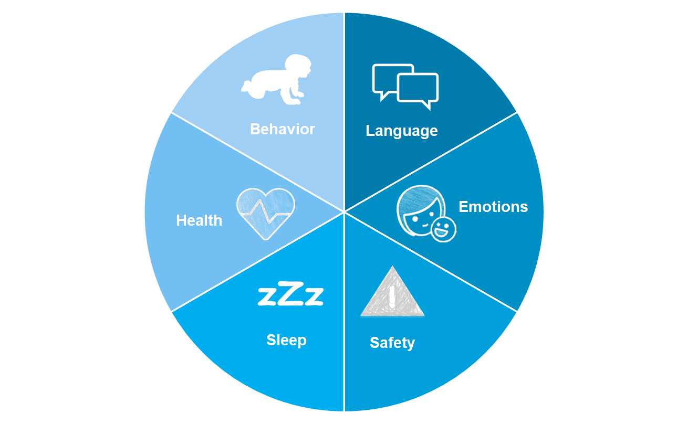
​ | ​ | ​
Coming Summer 2022
Parent Video Series
8 minute videos paired to each well child visit (0-5)
Discusses age-related health topics with practical skills to promote a child’s social-emotional-cognitive development.
In English and Spanish
Nutrition
Notes:
Lead: Blair

Slide 37
​ | ​ | ​

Slide 38
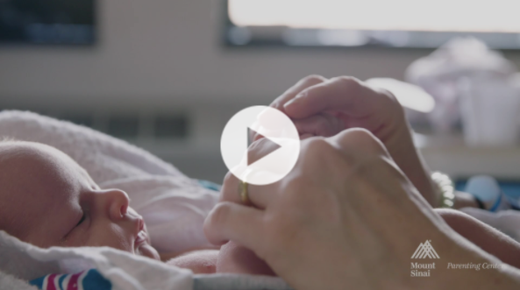
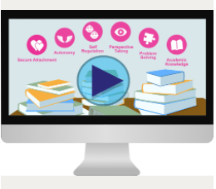
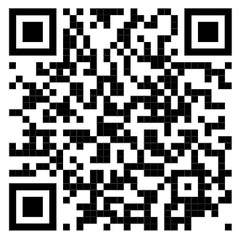
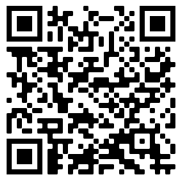
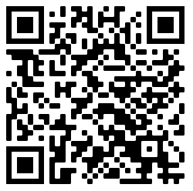
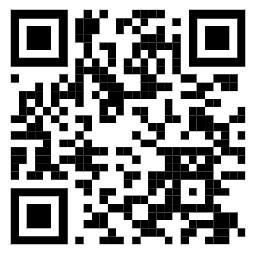
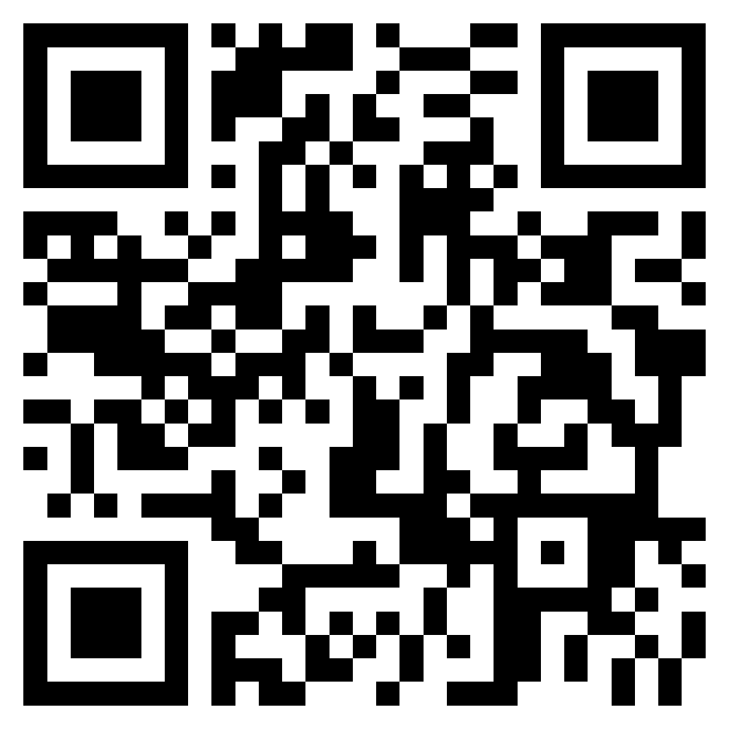
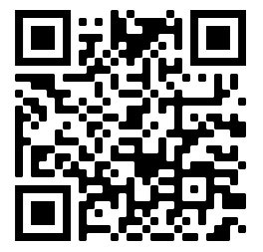
Resources
​ | ​ | ​
Newborn Video
Keystones of Development
healthychildren.org
Reach Out and Read
Triple P
Bright Futures
CDC Milestones
Coming Soon…
Video Series
Notes:
Lead: Blair
3, 2, 1 impact
Well child visit planner
CDC milestones
Q: Trip P, Reach out and Read

Slide 39
Think about your training of residents/learners and your clinical practice…
​ | ​ | ​
Notes:
Lead: Susan

Slide 40
​ | ​ | ​
Action Plan/Breakout Session:
How can you enhance your current training on promoting relational health and child development?
What resources will you use?
When in training will this occur?
How can the learning be longitudinal?
How will you assess learners?
How do we hardwire this into our process?
For example:
Lectures
Grand Rounds
Behavioral Health
Well-Baby Nursery Rotation
Morning Report
Continuity Clinic and Observations
Faculty Training
QI Projects
Notes:
Karly
What resources will you use?
When in training will this occur?
How can the learning be longitudinal?
How will you assess residents?
If you are already doing this well, are there opportunities to collaborate with another program?
Small groups (15 minutes), how would you incorporate this and challenge you might have, can you start to think about an assessment (OSCI, written reflection, parent survey, etc.)
Different groups can discuss slightly different things (initial implementation, longitudinal assessment, learning)
Lead: Leora
Kara/Michelle/Chelsea send to participants to breakout rooms and copy questions into the chat, include 1 presenter in each small group to facilitate and select someone from each group to share points when we come back together for a large group

Slide 41
​ | ​ | ​
Large Group Share
New Resources
Where in Training
Longitudinal
Assessment
Collaboration
Notes:
Karly

Slide 42
Call to Action:
​ | ​ | ​
What are one or two specific things you are going to do to improve training on promoting early relational health and child development?
Notes:
Karly

Slide 43
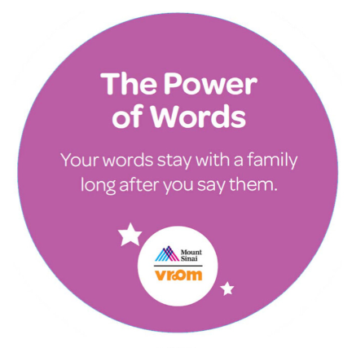
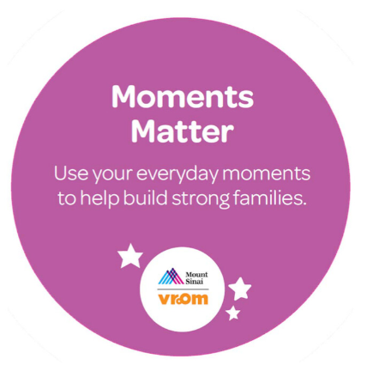
​ | ​ | ​
We Have Opportunities…
Questions?....
Notes:
Blair?

