Slide 1
Management of Cardiac Disease in the Developing World
Dr. Calvin Wilson
Clinical Professor of Family Medicine
University of Colorado Anschutz School of Medicine

Slide 2
Learning Objectives
By the end of this session, participants should be able to:
Describe the current and evolving epidemiology of heart disease in the developing world
Discuss the significant factors that contribute to the increasing prevalence of heart disease in poor countries
List the specific cost-effective interventions that may be effective for management of heart disease in resource-constrained countries

Slide 3
Case Study
History: Gabriel is a 58 year old male in rural Uganda who presents to the outpatient dept. of the district hospital complaining of several months of fatigue, difficulty working, shortness of breath when exerting himself, ankle edema, and difficulty sleeping at night because of shortness of breath and frequent urination. He has occasional episodes of anterior chest pain with exertion, but this is infrequent. These symptoms appear to be getting slowly worse, and he is concerned about being able to continue working.
Exam: Wt. - 142 lbs; BMI – 26.2; BP – 164/102; T – 36.4° C.; P – 96; RR – 32 and shallow
HEENT – normal except early bilat. cataract; Neck – thyroid slightly enlarged with no nodules, no nodes, trachea midline, visible neck veins sitting; Chest – bilat. fine rales lower half of chest with some dullness to percussion at bases; Heart – slight tachycardia with prominent S2, moderate enlargement with palpable chest heave; Abd. – liver 3 cm. below RCM and tender, + hepato-jugular reflux, otherwise neg.; Ext. – 2+ bilat. pitting edema; Neuro - normal

Slide 4
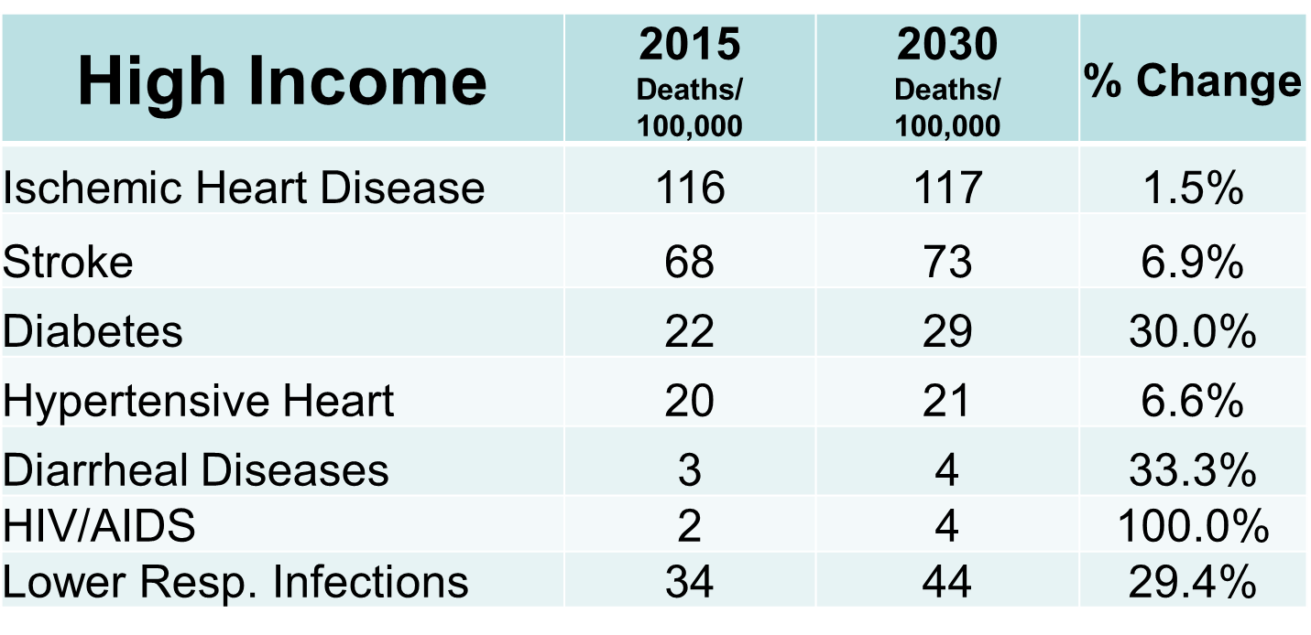
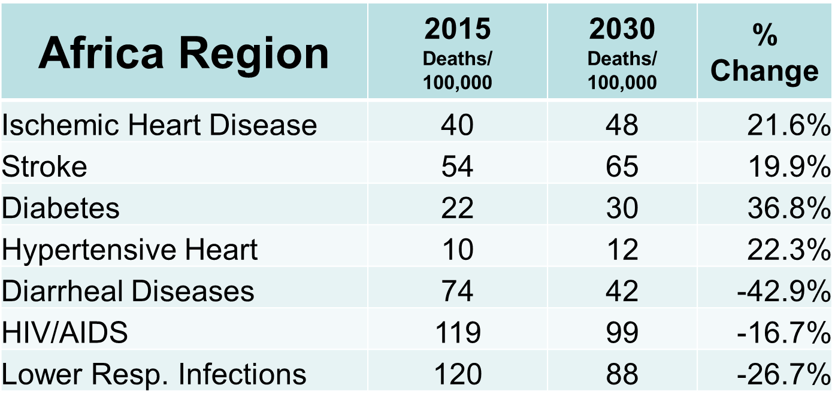
Epidemiology Projections - WHO

Slide 5
Epidemiology Projections

Slide 6
Epidemiologic Transition
Infectious Diseases
Non-
Communicable
Diseases
Mortality Rates
Time (Decades)
LaPorte, Ronald, Epidemiologic Transition, www.bibalex.org/supercourse/

Slide 7
Transition Dynamics of Cardiovascular Disease
Infectious Diseases
Ischemic (atherosclerotic) heart disease and stroke
Hypertensive heart disease (CHF) and stroke
Nutritional heart disease (alcohol, B vitamin deficiency)
Rheumatic heart disease
Non-
Communicable
Diseases
Mortality Rates
Time (Decades)

Slide 8
Factors Increasing Cardiovascular Disease in the Developing World
Increased tobacco use
Globalization
Improved household economies
Increasing indices of untreated hypertension
Urban transition
Dietary and activity level changes
Increasing levels of obesity
Increased incidence of diabetes
Increased lipid levels
Increased longevity and aged population
Improved public health and health care systems

Slide 9
Risk Factor Differences (WHO-2008)
Risk | High Income | Low Income
Tobacco Use | 30% | 15%
Inactivity | 42% | 22%
Dietary Fat | 37% | 18%
Overweight/Obesity | 58% / 25% | 17% / 4%
Hypertension | 41% | 41%
Diabetes | 10% | 8%
Increased Cholesterol | 56% | 25%

Slide 10
Barriers to CVD Management in Developing World
Medical care is hospital based, and focuses on curative, acute care
No strategies or structure for long-term management of cardiovascular disease
Very little implementation of CVD preventive care or community-based disease screening
Community health facilities staffed by non-physicians trained only in acute, curative care

Slide 11
Barriers to CVD Management in Developing World
Limited selection of cardio-active and diabetic medications
Lack of public awareness of cardiac disease symptoms and risks
Late presentation of patients – only when complications apparent
Limited access to palliative care and attention

Slide 12
Management Strategies for Cardiac Disease
Risk | Developed World | Developing World
Smoking | Stop-smoking programs for smokers | Target young people; ventilated cookstoves
Obesity | Weight loss programs | Mold cultural beliefs about overnutrition
Atherogenic diet | Public education regarding saturated and trans-fats | Public education, negotiate cultural beliefs about common foods
Inactivity | Personal and group exercise | Encourage normal walking

Slide 13
Management Strategies for Cardiac Disease
Risk | Developed World | Developing World
Diabetes | Intensive counseling and control | Identify diabetics in early stage; begin lifestyle and simple medication control strategies
Hypertension | Intensive counseling and control | Identify hypertensives in early stage; begin lifestyle and simple medication strategies
Hyperlipidemia | Intensive counseling and control | Identify increased lipids; begin diet and medication control strategies
Chronic disease management | Established chronic health programs and perspective | Develop chronic disease management perspective, and adapt primary health care system to chronic care needs

Slide 14
Evidence-Based, Cost-Effective Management Strategies
Tobacco/cookstove education and government control
Bhutan, Cuba, India, Ireland, Chile, Tonga, Thailand, Rwanda
Obesity and nutritional counseling of mothers and workers
activity, BP and diabetes screening; many countries
Community-based identification of hypertensive and diabetic individuals – enrollment in primary care followup clinics
South Africa, Peru, Rwanda
Identification of cardiac disease patients – management in primary care clinics
Ecuador, South Africa

Slide 15
Evidence-Based, Cost-Effective Medication Strategies
Medical treatment with baseline of no treatment, limited hospital access - $/QALY saved
WHO Region | ASA, BB | ASA, BB, ACEI | ASA, BB, ACEI, Statin | QALY level
East Asia, Pacific | $461 | $942 | $1914 | $3180
Europe & Central Asia | $530 | $1097 | $2026 | $6030
Latin America & Caribbean | $545 | $111 | $1942 | $11010
Middle East & North Africa | $527 | $996 | $1686 | $6270
South Asia | $386 | $828 | $1819 | $1320
Sub-Saharan Africa | $389 | $783 | $1720 | $1410
Gaziano, T, “Cardiovascular Disease in the Developing World and its Cost-Effective Management”, Circulation, 2005;112, pp. 3547-3553

Slide 16
Summary
Cardiovascular disease prevalence is rapidly increasing in the developing world
Will be the primary cause of death in most every country of the world by 2030
Risk factors for CVD in poor countries are very similar to those in wealthy countries, but approach to management must vary
Effective strategies exist for controlling risk factors and for maximizing medication benefit on a population basis
Individual case management of CVD (especially surgical interventions) may be delayed for most in poorer countries, but significant improvements in mortality and morbidity can be achieved.

