Slide 1
Learning by Teaching: Tools for Capacity Building, Meeting Local Health Needs and Global Health Targets in the Context of Family Medicine Graduate Medical Education
David Baltierra, MD
Tembele Yangandawele, MD
WVU Rural Family Medicine Residency
September 13-15, 2018
Jacksonville, FL

Slide 2
Conflicts of Interest Disclaimer None to Report

Slide 3
Abstract
Balance the need of learners for a valuable short-term experience while contributing to meeting the health needs and priorities of local under-resourced communities
Helping Babies Breathe, Helping Mothers Survive – Bleeding After Birth, Helping Mothers Survive – Preeclampsia and Eclampsia, and WHO and USAID Early Infant Male Circumcision Training Package, used by WVU Rural Family Medicine Residency Program as a strong educational experience while meeting the needs and health development priorities of local communities, working within the existing system to build capacity and strengthen the healthcare system, contributing to long term improvement
Family medicine residents used training and simulation models to teach specific and practical skills to local providers to maximize their own global health experience while moving the health of under-resourced and underserved populations forward toward specific global health goals.

Slide 4
Learning Objectives
Participants will be able to articulate the practical and ethical challenges of global health resident and medical student experiences vis a vis the needs and priorities of local under-resource communities and populations
Participants will be able to describe and use various collaborative models that can be used by global health graduate and undergraduate medical and education programs for teaching neonatal resuscitation skills, maternal survival skills, and early infant male circumcisions for building health care provider capacity, meeting local health needs, and meeting global health targets while providing a valuable global health experience for resident and medical student learners
Participants will be able to identify barriers and techniques to implementing these global health learning and teaching models and capacity building programs in resource poor environments and how to overcome these

Slide 5
Global Health Rotations in Residency/GME International Rotations
Who is doing GME global health rotations?

Slide 6
Global Health Rotations in Residency/GME International Rotations
What do these rotations look like?

Slide 7
Global Health Rotations in Residency/GME International Rotations
Why are they valuable?

Slide 8
Global Health Rotations in Residency/GME International Rotations
Valuable because:
Clinical experience
Globalization of disease
Fostering compassion and empathy
Learning to function in under-resourced setting
Career exploration and development
Learning principles of public health, health systems functioning, quality improvement, tropical diseases, evidence-based medicine
Train better future leaders in global health and family medicine
SERVING THE NEEDS OF THE LOCAL POPULATION

Slide 9
Challenges in Global Health and Graduate Medical Education
Practical Challenges and Difficulties?

Slide 10
Challenges in Global Health and Graduate Medical Education
Practical Challenges
Adjustment to different culture, burden of disease, and challenging environment
Safety
Logistics
Costs
International regulations and licensing
Accreditation credit (ACGME)

Slide 11
Challenges in Global Health and Graduate Medical Education
ACGME (not official statements, just my personal take on the topic)
Requirements vary by specialty
Education must not be compromised by service
Must meet same requirements as rotations within sponsoring institution such as work hours, supervision, evaluation, etc.
Not assumed to be in underserved area
Generates ethical concerns if used for case numbers

Slide 12
Challenges in Global Health and Graduate Medical Education
Example of Statement
ACGME – Otolaryngology Residency Review Committee FAQ
While the Review Committee acknowledges that international rotations may be important, they are fraught with circumstances that may not be in compliance with ACGME institutional and program requirements, such as clinical and educational work hour violations, inadequate supervision, inadequate opportunities for pre-, peri-, and post- operative care, and questionable continuity of care.

Slide 13
ACGME Review Committee for Family Medicine FAQ Response
…no specific language in the Program Requirements related to international rotations (broadly addressed under "Curriculum Organization and Resident Experience"), the Committee sees the following issue with regard to such rotations:
(1) A decision for an elective international rotation is a decision between the program and the Sponsoring Institution (assurance of resident safety, etc.) and would not require prior review/approval by the Review Committee.

Slide 14
ACGME Review Committee for Family Medicine FAQ Response
A decision to allow international rotational experience (e.g., patient care experiences) by a resident to satisfy minimum standards requires prior review and approval by the Review Committee. The program must submit a request for credit for an international rotation experience, goals and objectives for the experience, names of physician faculty members responsible for on-site supervision, and an example of the evaluation for the experience

Slide 15
Challenges in Global Health and Graduate Medical Education
What are the ethical challenges?

Slide 16
Challenges in Global Health and Graduate Medical Education
What should the model be?
Conflict between needs of the community being served and those of the learner – who sets the agenda?
Direct Care, Medical Volunteerism, “Proceduralism”
Short-term medical service/experience vs Long-term impact
Capacity building – short and long term
Skill transference
Health system enhancement
Policy creation
Quality improvement

Slide 17
WVU Rural Family Medicine Residency Model
Promote Family Medicine
Provide family medicine resident educational experience
Partner with local health care providers to meet local needs
Work for long term improvements
Build capacity
Sustainable
Collaborative
Academic – Educational, Scholarly, Evidence Based Practice
Export expertise in education
Build academic and system relationships

Slide 18
Rwanda site chosen
Faculty personal connection
Need
2015 Millennium Development Goals 4 & 5 (Reduce Child Mortality, Improve Maternal Health)
Personal experience and skill set
Maternity care
Helping Babies Breathe
Stability, safety, coordinated national health planning, and need to educate health professionals
Family Medicine postgraduate training in place
WVU Global Health Program future site for students
http://medicine.hsc.wvu.edu/tropmed/

Slide 19
WVU Rural FM program in Rwanda
February 2014 – Faculty and residents
Exploration, contacts, site visits
Pilot of training program with Helping Babies Breathe, HMS Bleeding after Birth, etc
May 2015
Medical school affiliation developed
September 2015
Partnering with Shyira Hospital
Training Program at hospital and health center
February 2016 – Resident and Medical Student rotation
February 2018 – Faculty and Resident training in Early Infant Male Circumcision and HMS Preeclampsia & Eclampsia
February 2019 (anticipated) – EIMC and HMS expansion and follow up

Slide 20
Where We Went
2014
Kigali - Nyabisindu Maternity Clinic – Christian Life Assembly Church – Midwives
District Hospitals -
Rwinkwavu Hospital - Partners In Health
Ruhengeri Hospital-Northern Province/Musanze - Rubanzabigwi Theoneste, MD
2015-16
Shyira District Hospital and Bigogwe Health Center
2018
Shyira District Hospital (new hospital) and Bigogwe Health Center
Future
Shyira, Bigogwe, and other health centers or other options

Slide 21
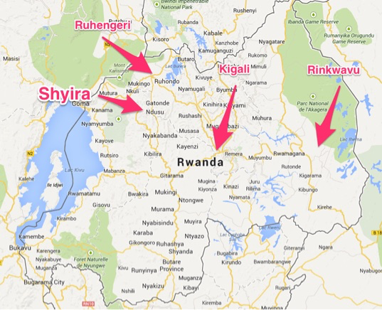

Slide 22
What We Taught
2014 Pilot
Helping Mothers Survive
Helping Babies Breathe
One Day Program
Teach the Teacher
Modified ALSO (Obstetric Emergencies)
Teaching Continuum of Skills from Antenatal to Postnatal

Slide 23
What We Taught
2015
Helping Mothers Survive
Helping Babies Breathe
One Day Program
Teach the Teacher

Slide 24
What We Taught
2018
Early Infant Male Circumcision
Helping Mothers Survive – Preeclampsia & Eclampsia
Teach the Teacher
Global Offsite Care Telemedicine Grand Rounds preparation

Slide 25
Who We Taught
Rwandans and N. Americans
Midwives and Midwifery students
Nurses and Nursing students
Medical Students
Residents (Family Medicine, Med/Peds)
Physicians (Family Medicine, Interns, GPs, Pediatricians, OBs, Neonatologists, )
Surgical technicians
Our residents and faculty

Slide 26
Maternal and Child Health Modules for Graduate Medical Global Health Experiences
Helping Babies Breathe
https://www.aap.org/en-us/advocacy-and-policy/aap-health-initiatives/helping-babies-survive/Pages/Helping-Babies-Breathe.aspx
https://laerdalglobalhealth.com/products/helping-babies-breathe/
Helping Mothers Survive – Bleeding After Birth Complete
https://hms.jhpiego.org/bleeding-after-birth-complete/
https://laerdalglobalhealth.com/products/hms-bleeding-after-birth/
Helping Mothers Survive – Preeclampsia & Eclampsia
https://hms.jhpiego.org/pre-eclampsia_eclampsia/
Modified ALSO and Global ALSO
https://www.aafp.org/cme/programs/also.html
https://www.aafp.org/cme/programs/also/international.html

Slide 27
Maternal and Child Health Modules for Graduate Medical Global Health Experiences
Early Infant Male Circumcision
https://www.malecircumcision.org/content/training-package-early-infant-male-circumcision-under-local-anaesthesia
JHPIEGO Trainer Resources
http://resources.jhpiego.org/resources/trainer-educator

Slide 28
Maternal and Child Health Simulators for Graduate Medical Global Health Experiences
Laerdal Global Health https://laerdalglobalhealth.com
NeoNatalie https://laerdalglobalhealth.com/products/neonatalie/
MamaNatalie https://laerdalglobalhealth.com/products/mamanatalie/
MamaU https://laerdalglobalhealth.com/products/mama-u/
Circumcision model – custom made, low cost

Slide 29
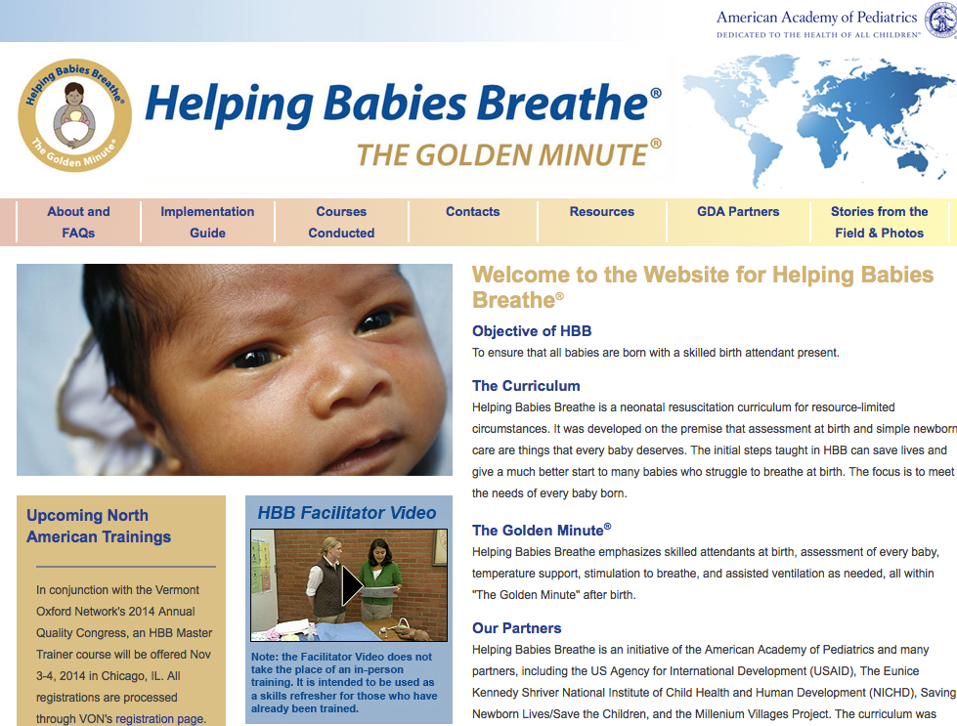
Helping Babies Breathe

Slide 30
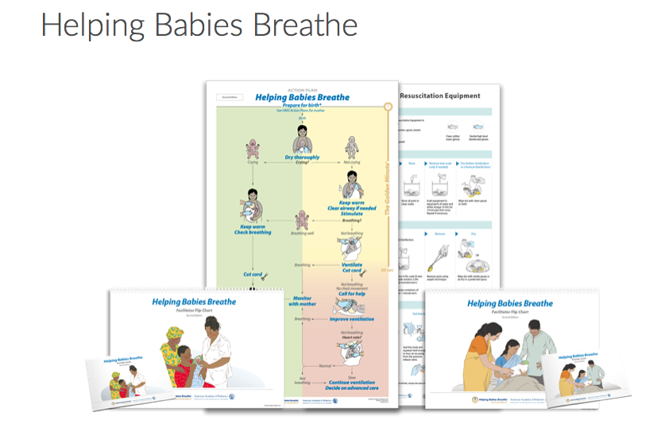

Slide 32
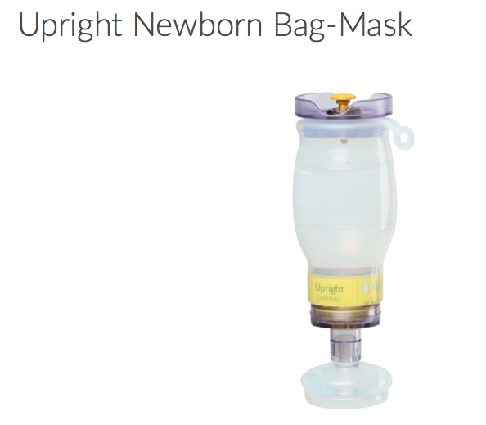
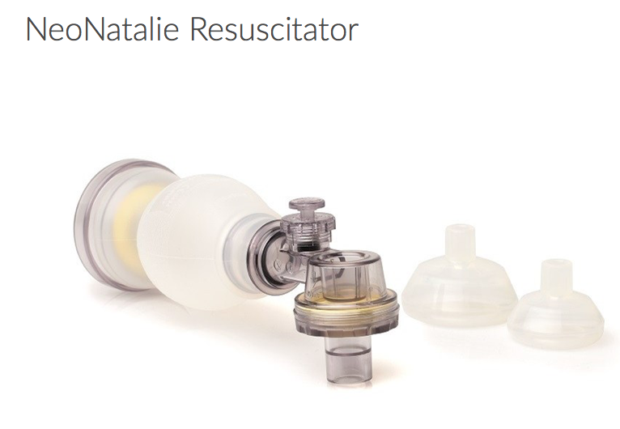

Slide 33
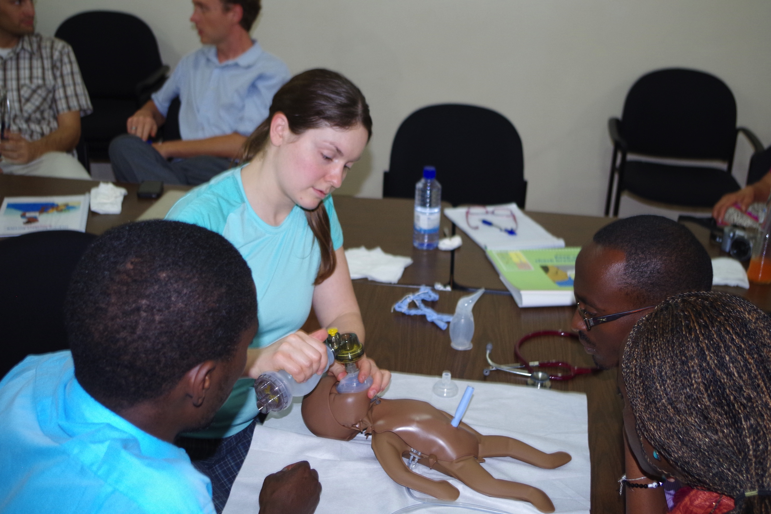

Slide 34
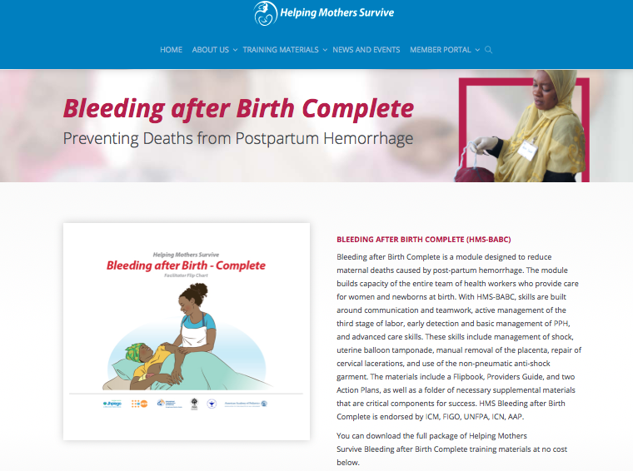

Slide 36
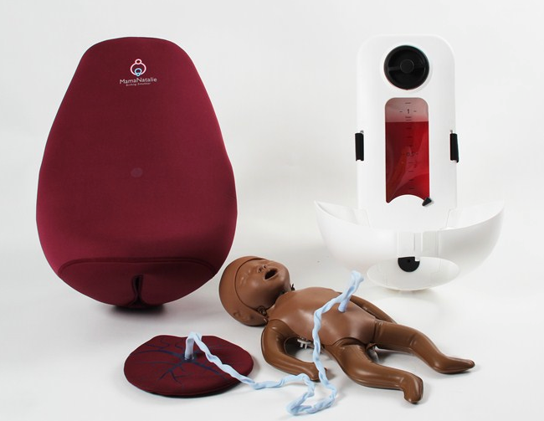
Mama Natalie & NEO NATALIE

Slide 37
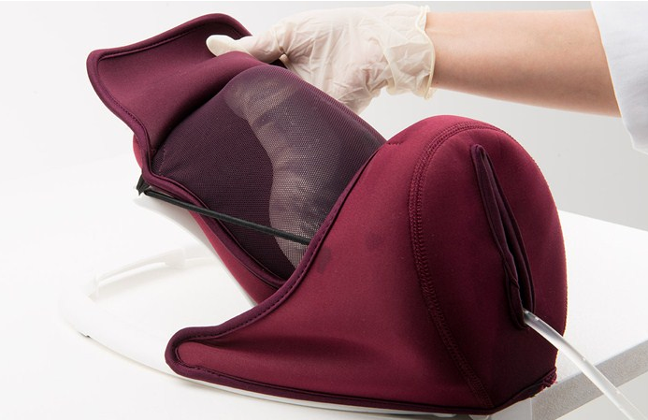
Mama U

Slide 38
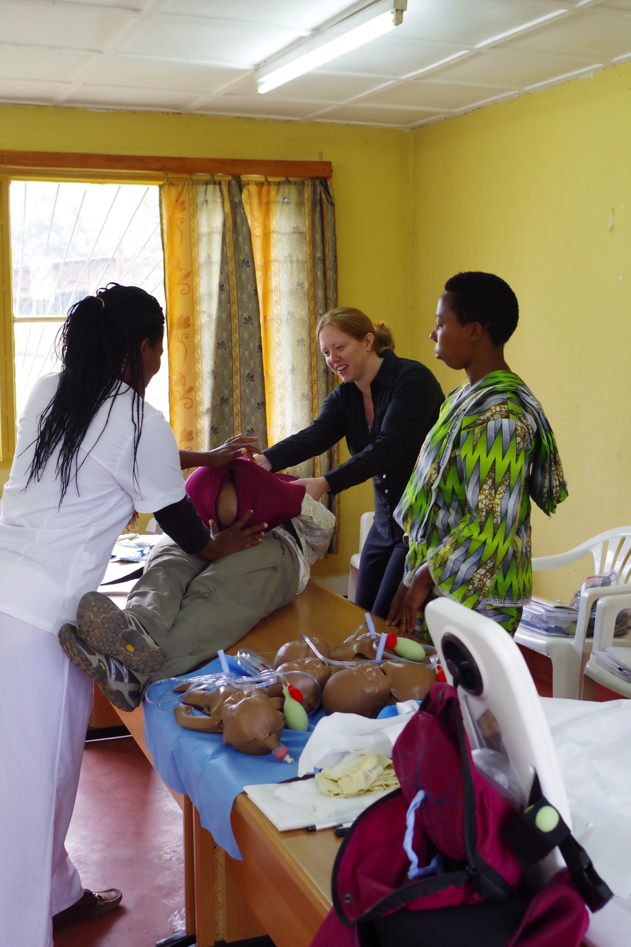
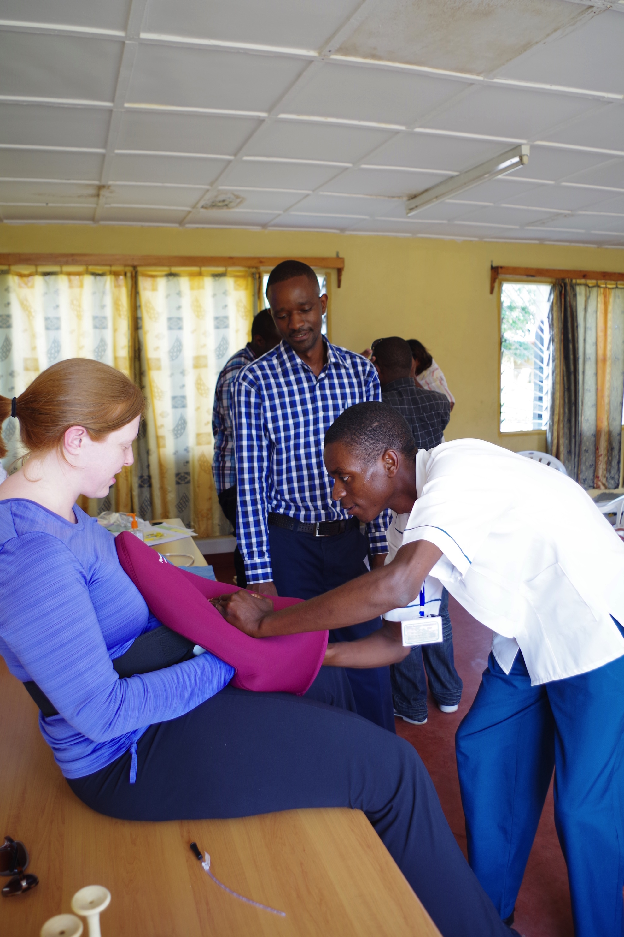

Slide 39
ALSO and Global ALSO (both modified)

Slide 40
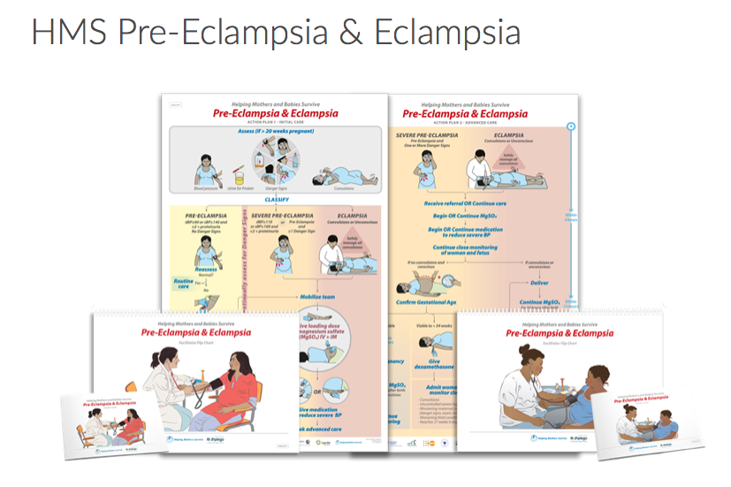

Slide 41
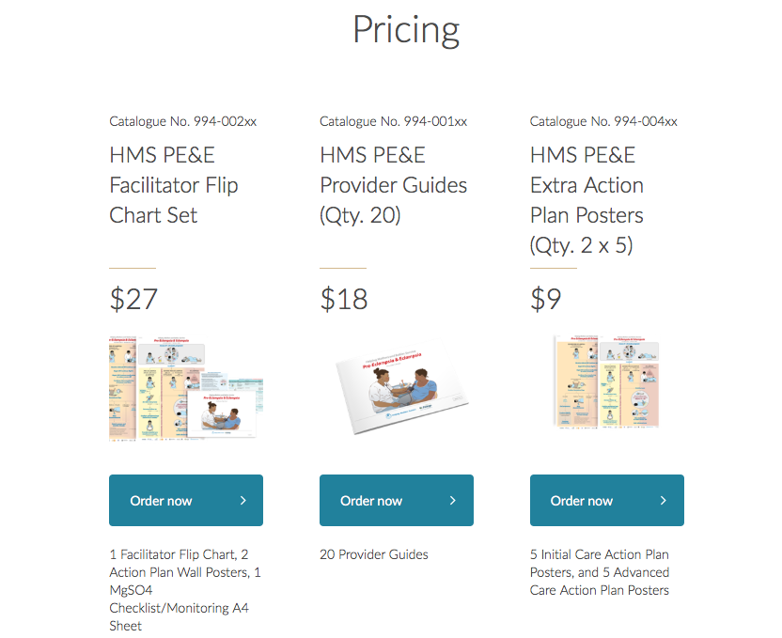

Slide 42
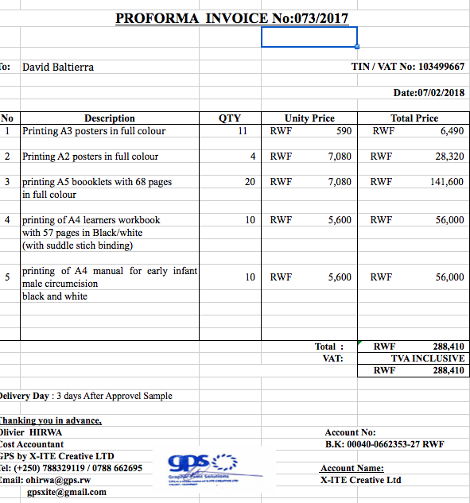

Slide 43
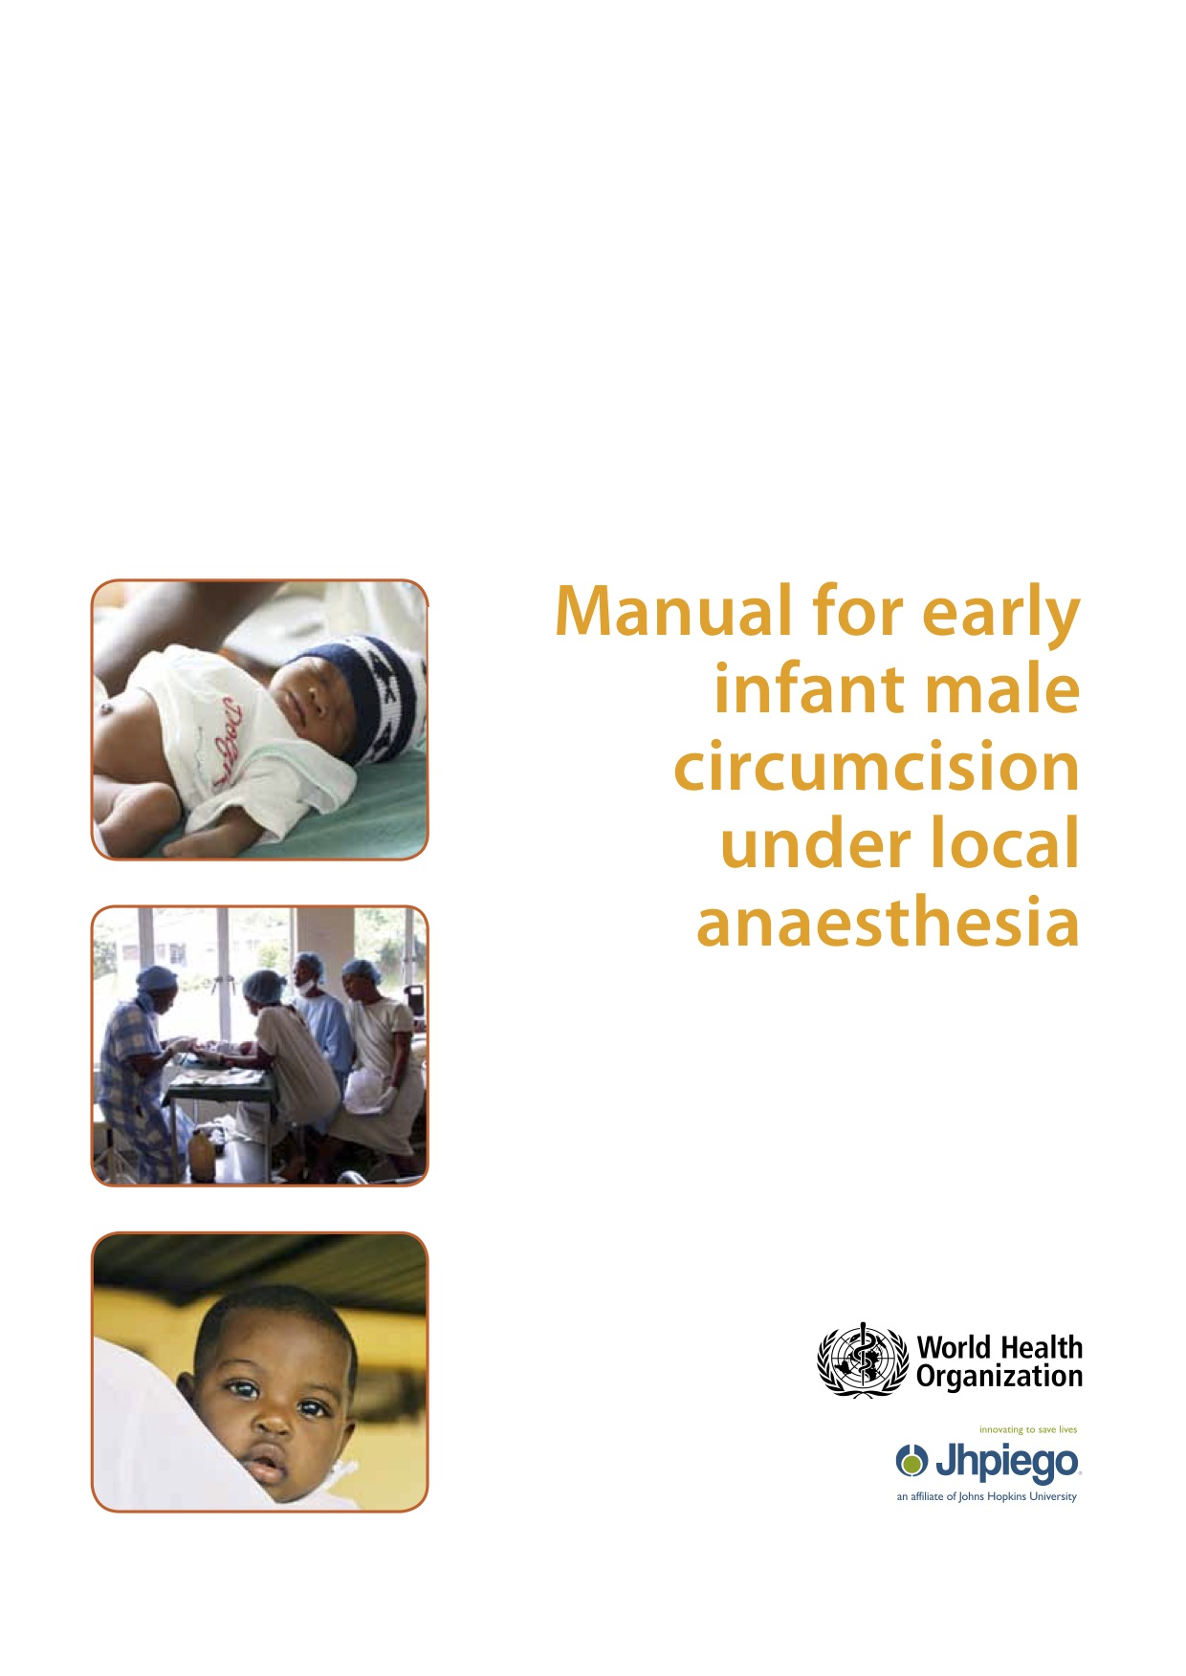

Slide 44
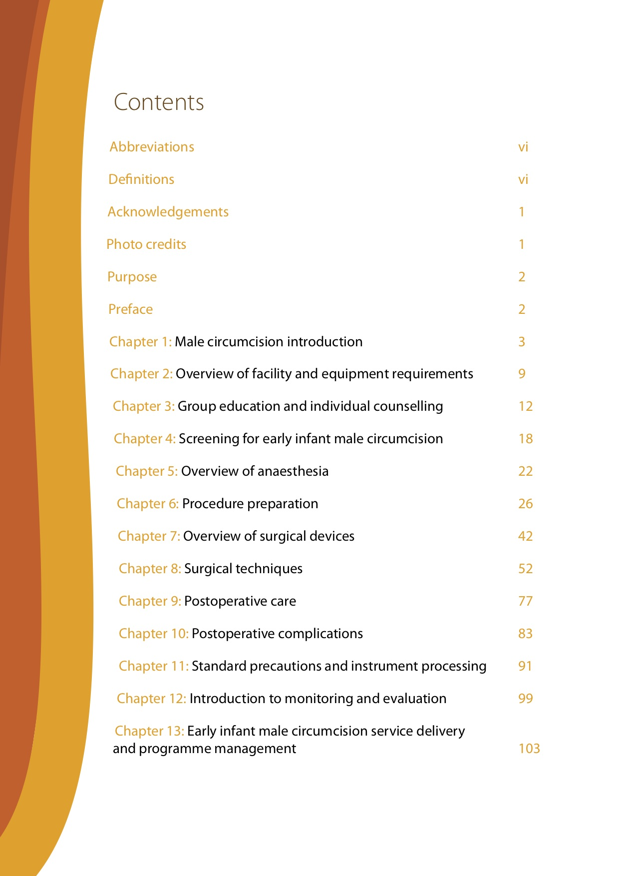
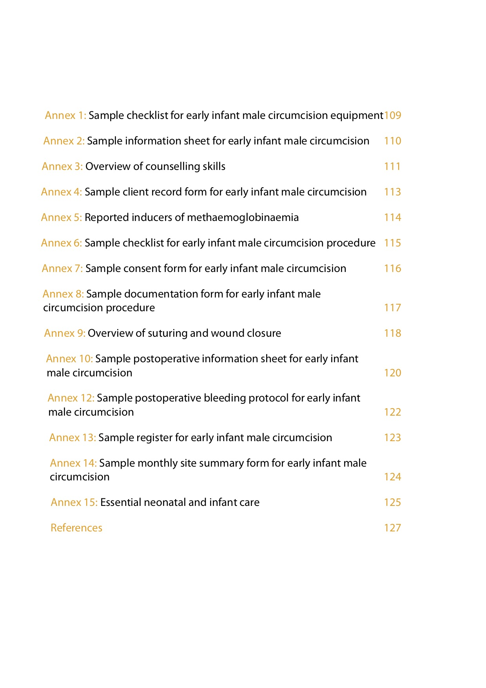

Slide 45
Chapter 1: Male circumcision introduction
Chapter 2: Overview of facility and equipment requirements
Chapter 3: Group education and individual counselling
Chapter 4: Screening for early infant male circumcision
Chapter 5: Overview of anaesthesia
Chapter 6: Procedure preparation
Chapter 7: Overview of surgical devices
Chapter 8: Surgical techniques
Chapter 9: Postoperative care
Chapter 10: Postoperative complications
Chapter 11: Standard precautions and instrument processing
Chapter 12: Introduction to monitoring and evaluation
Chapter 13: Early infant male circumcision service delivery and programme management

Slide 46
Annex 1: Sample checklist for early infant male circumcision equipment
Annex 2: Sample information sheet for early infant male circumcision
Annex 3: Overview of counselling skills
Annex 4: Sample client record form for early infant male circumcision
Annex 5: Reported inducers of methaemoglobinaemia
Annex 6: Sample checklist for early infant male circumcision procedure
Annex 7: Sample consent form for early infant male circumcision
Annex 8: Sample documentation form for early infant male circumcision procedure
Annex 9: Overview of suturing and wound closure
Annex 10: Sample postoperative information sheet for early infant
male circumcision
Annex 12: Sample postoperative bleeding protocol for early infant
male circumcision
Annex 13: Sample register for early infant male circumcision
Annex 14: Sample monthly site summary form for early infant male circumcision
Annex 15: Essential neonatal and infant care

Slide 47
Early Infant Male Circumcision
David A Baltierra, MD
Amanda J Baltierra, DNP, FNP, PMHNP
Tembele Yangandawele, MD
Shyira Distric Hospital
February 2018

Slide 48
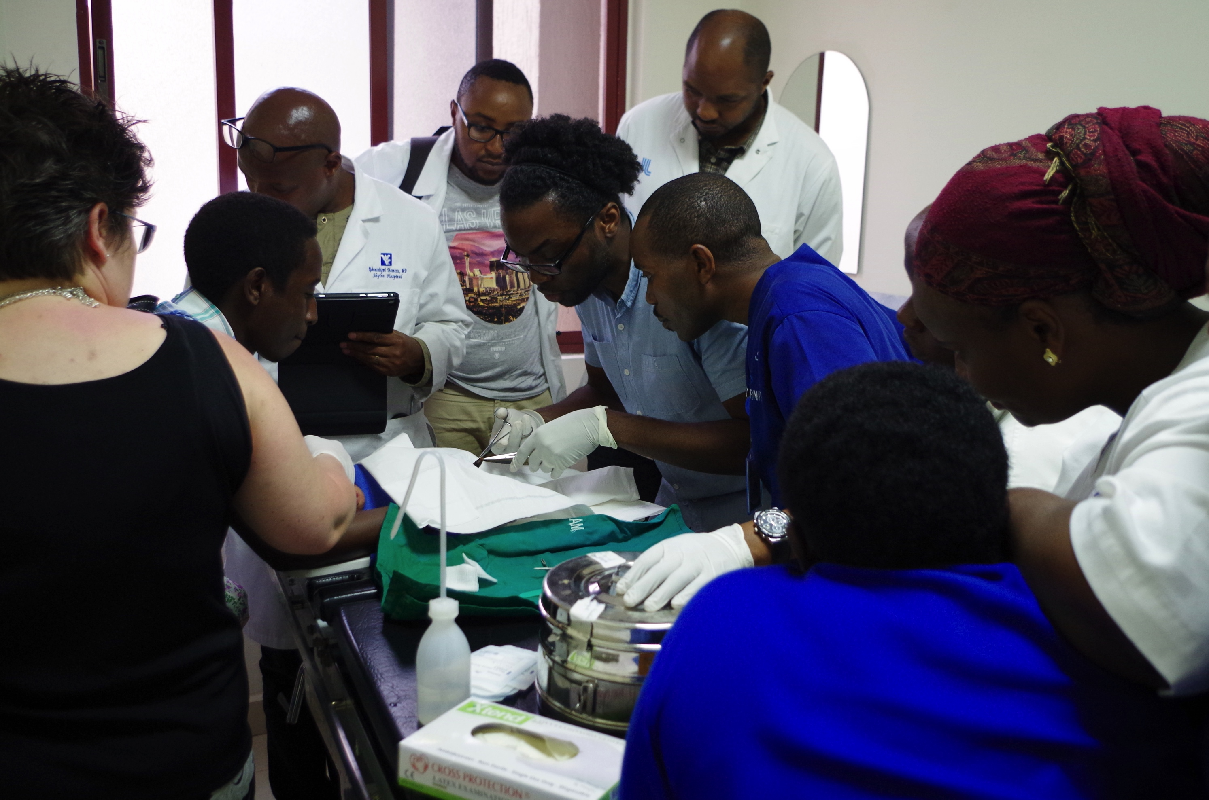

Slide 49
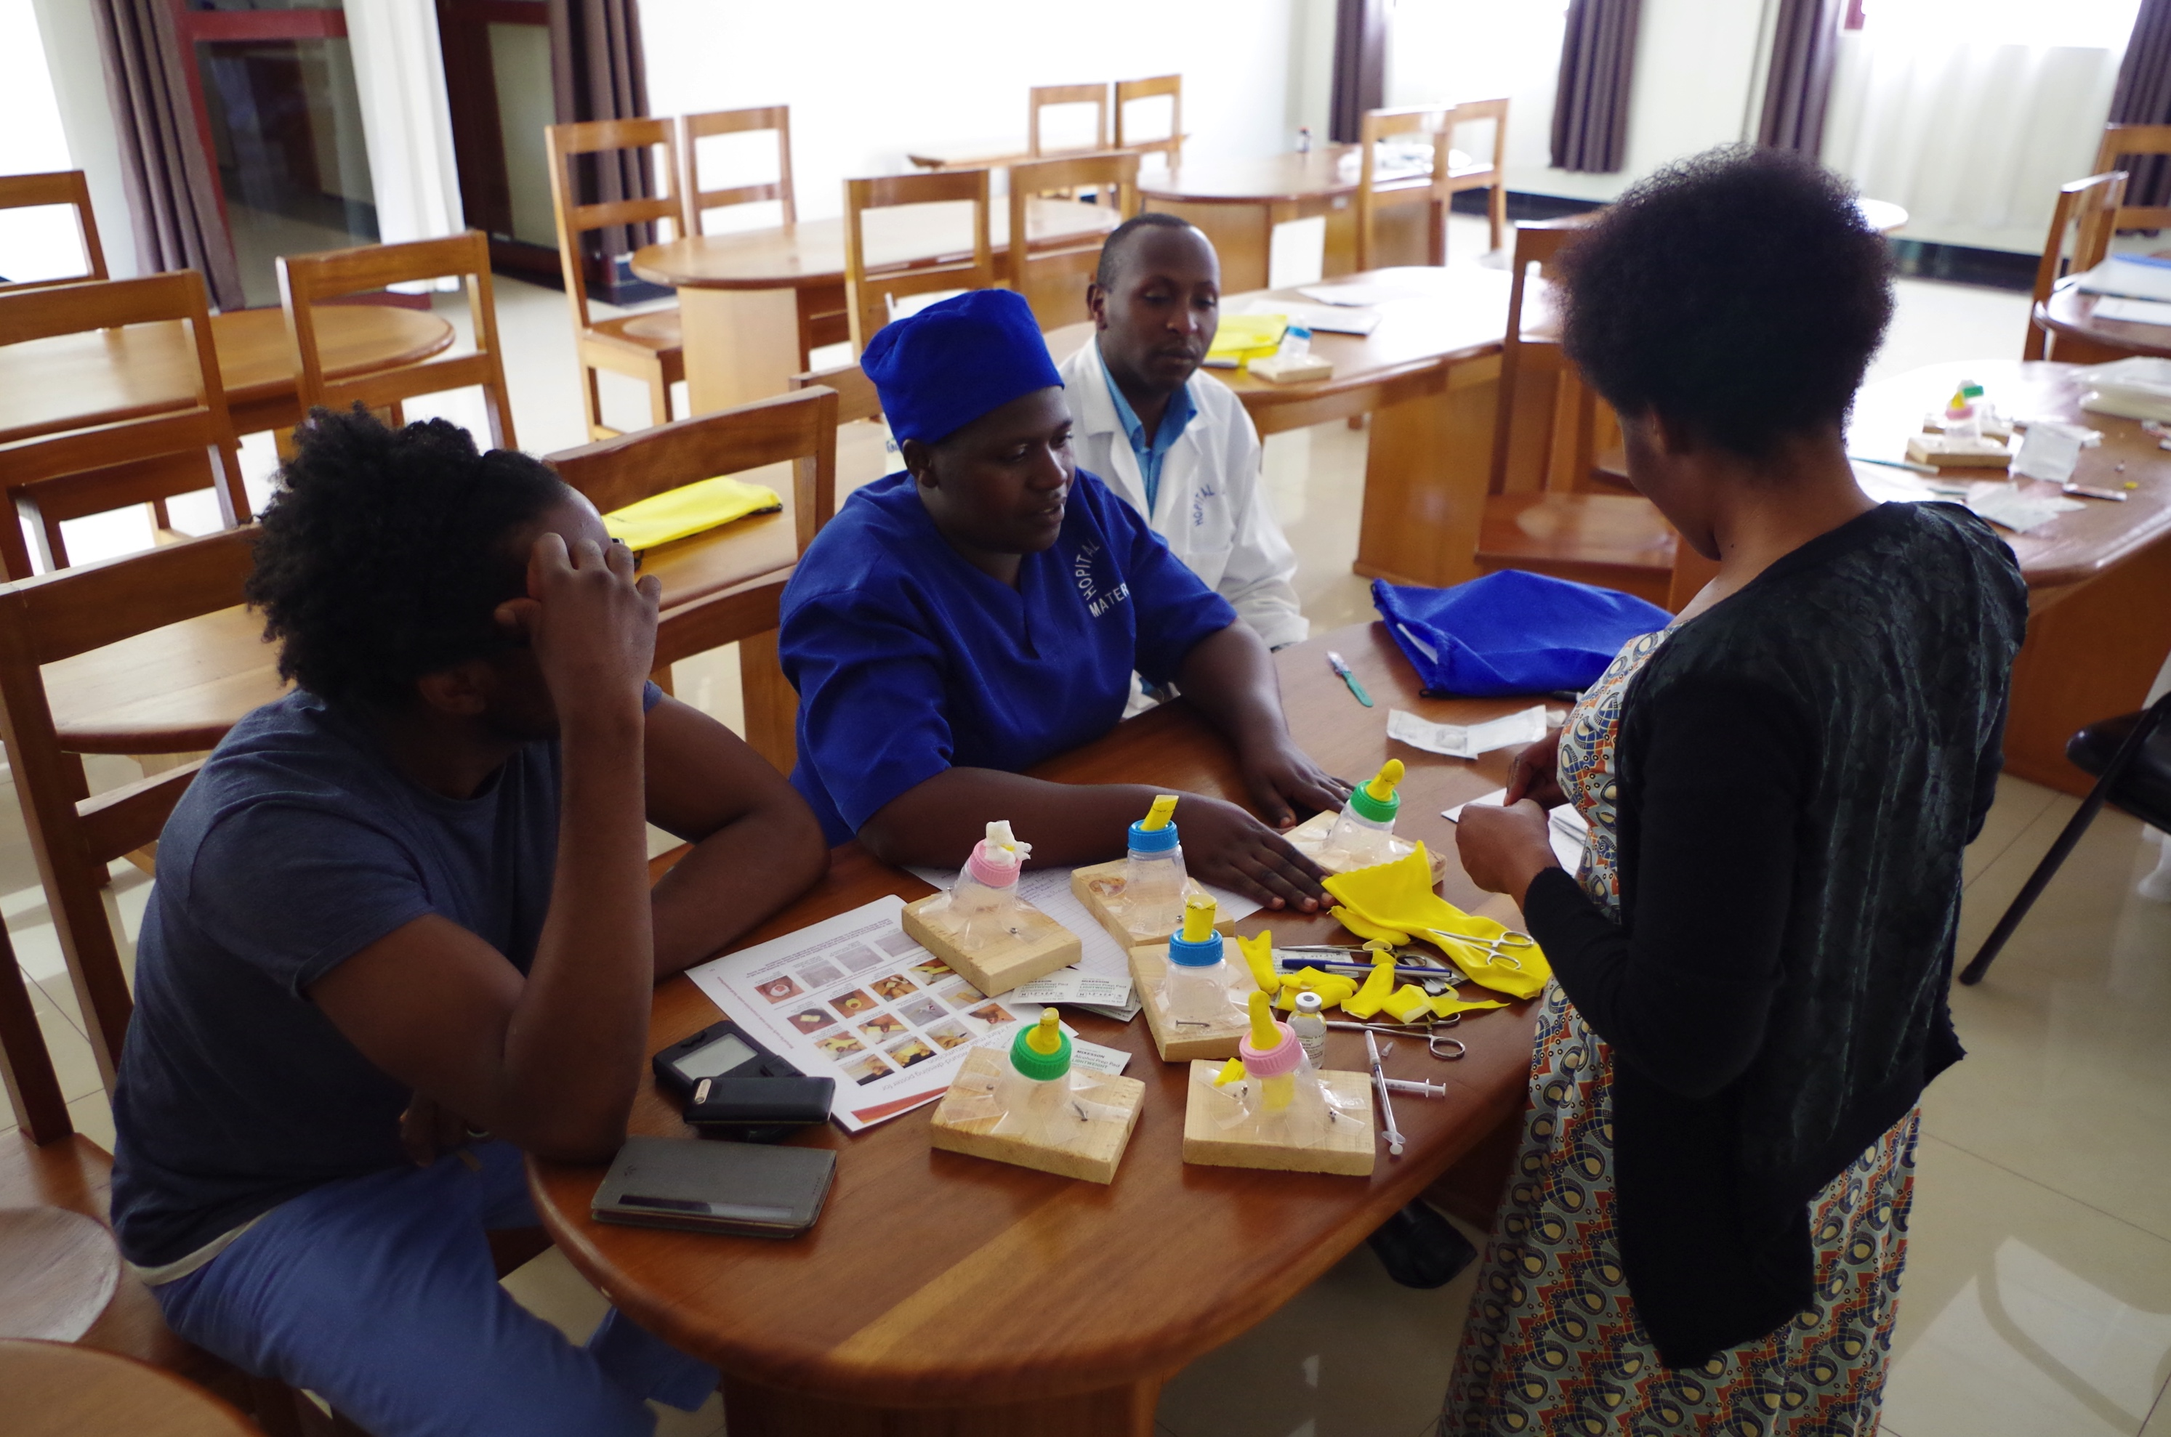
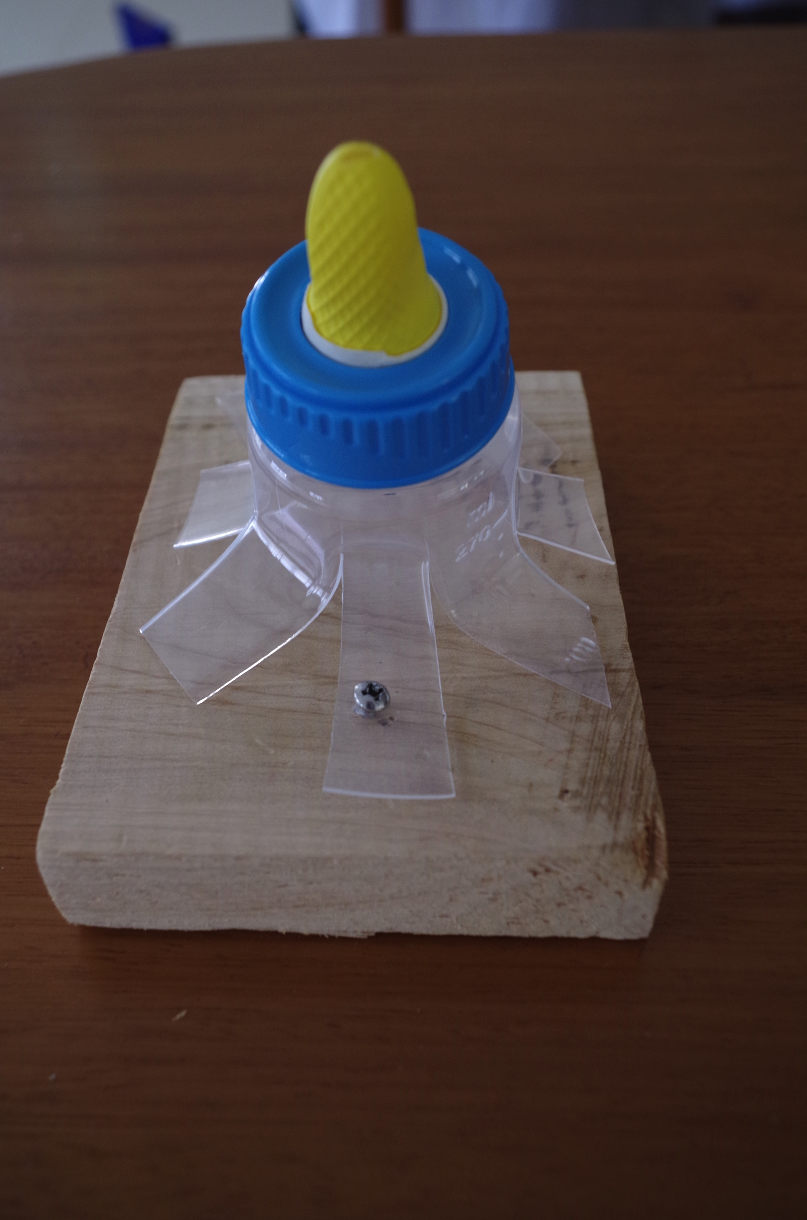

Slide 50
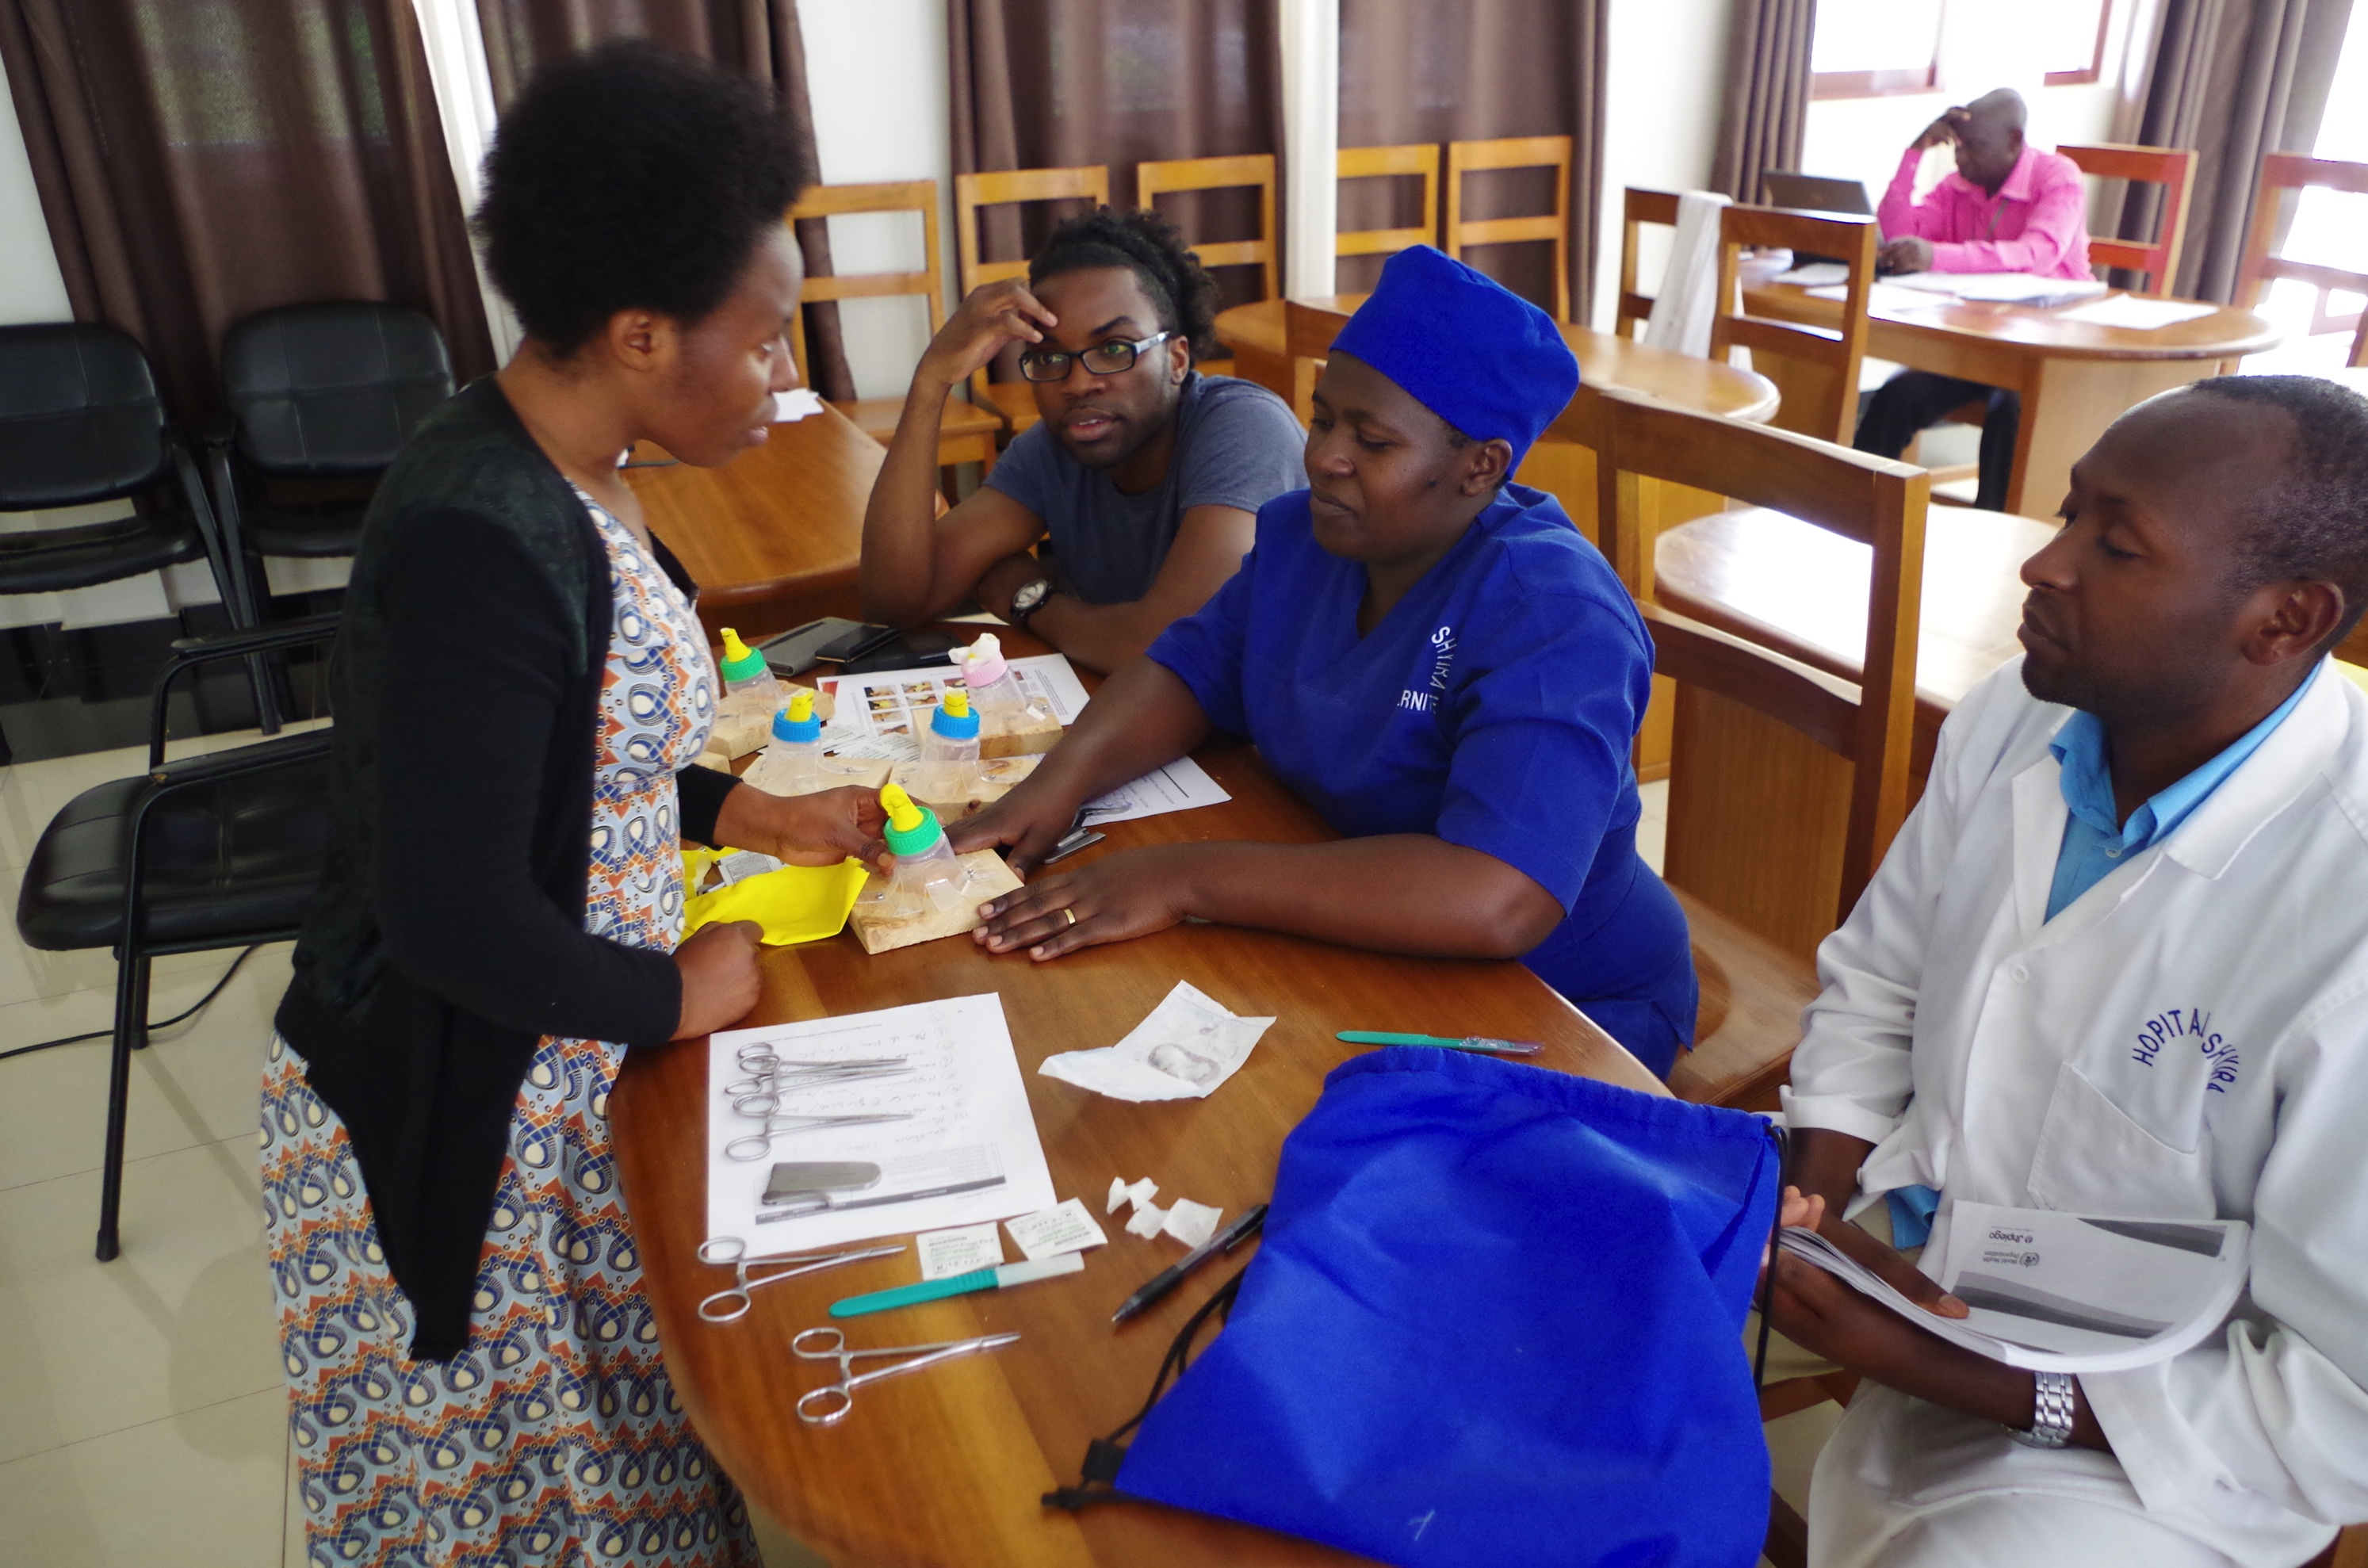
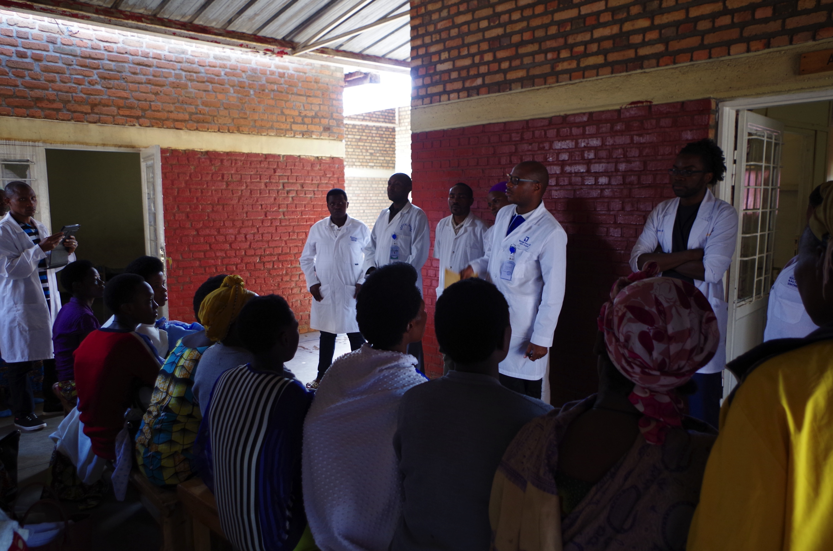
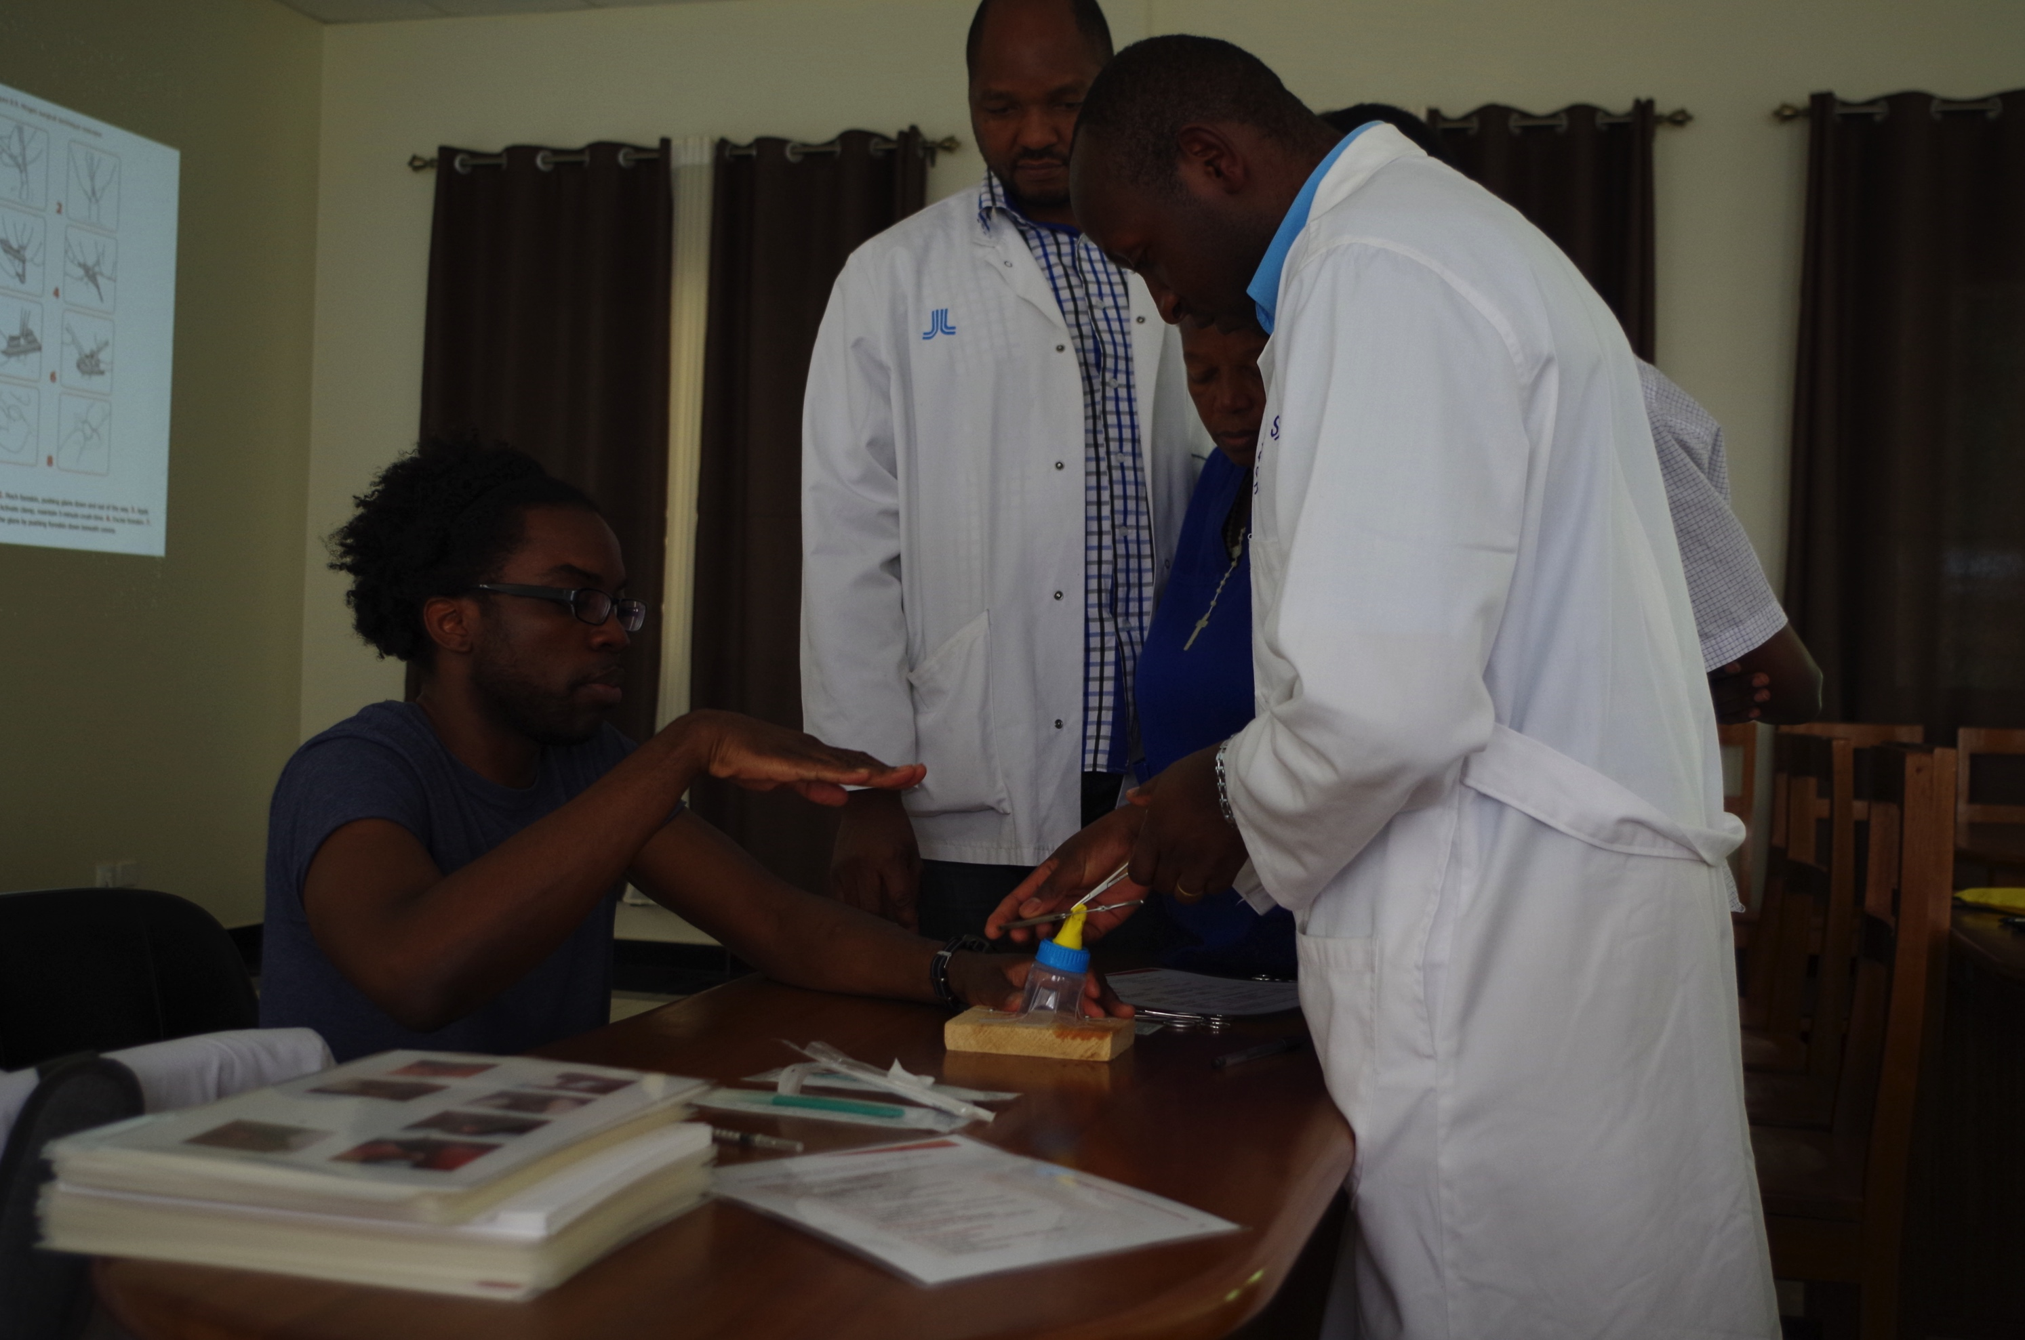

Slide 51
https://globaloffsitecare.org

Slide 53
Global Offsite Care Telemedicine Grand Rounds
Resident worked with local physician in how to prepare and present grand rounds
Skills developed
Case preparation
Literature search – evidence-based
Power point presentation
Telemedicine access and presence
Case review and critique
Increased confidence in telemedicine presentation, literature review and critique of own system of care
Analyzed call system and handoff system as contribution to gaps in care and need for improvement

Slide 54
Value to Resident Education
Teamwork
Multidisciplinary
Hands-On
Shared Collaborative Learning and Care
Flexibility
Culture impacts learners and teachers
Simulators and Hands-on is effective in low-resource and can assess competency
Meeting ACGME Family Medicine Milestones

Slide 55
Value to Resident Education (cont)
Learn principles for better teaching
Learners are interested in learning
Teaching the Teacher made it acceptable
It is possible to do something in 2 weeks (taught ~ 90 health care professionals HBB and HMS) (10 in EIMC)
Direct care is not always primary goal
Learned about advantages of the local health system (centralized, SMS, drones)
Developed skills in telemedicine
Scholarly Activity

Slide 56
ACGME FM Milestones Addressed
PC-3. Partners With the Patient, Family, and Community to Improve Health Through Disease Prevention and Health Promotion
SBP-1. Provides Cost-Conscious Medical Care\
SBP-2. Emphasizes Patient Safety
SBP-3. Is an Advocate for Individual and Community Health
SBP-4. Coordinates Team-Based Care
PBLI-1. Locates, Appraises, and Assimilates Evidence From Scientific Studies Related to the Patients' Health Problems
PBLI-2. Demonstrates Self-Directed Learning
PBLI-3. Improves Systems in Which the Physician Provides Care

Slide 57
ACGME FM Milestones Addressed (cont)
PBLI-1. Locates, Appraises, and Assimilates Evidence From Scientific Studies Related to the Patients' Health Problems
PBLI-2. Demonstrates Self-Directed Learning
PBLI-3. Improves Systems in Which the Physician Provides Care
PROF-3. Demonstrates Humanism and Cultural Proficiency
C-3. Develops Relationships and Effectively Communicates With Physicians, Other Health Professionals, and Health Care Teams
C-4. Uses Technology to Optimize Communication

Slide 58
Value to Local Healthcare Community
Mutual collaboration
Skills transfer and reinforcement
Assessment of skills of local system and providers
Empowering providers in view of local community
Development of teamwork, teaching skills, communication, quality improvement
Confidence in questioning status quo
Increased knowledge of quality improvement
Develop outreach programs to other communities

Slide 59
Value to Local Healthcare Community (cont)
Stronger connections within healthcare network in region
Strengthen creative thinking and problem solving
Explore telemedicine
Develop relationships with US academic center
Partnership increased credibility and legitimacy of local programs
Increased political cache
Improved teaching skills
Improved evaluation skills

Slide 60
Barriers to Implementation
Expectations and communication
Provider Mindset – scope of non-physicians, number of providers, way of doing thins
Cultural Limitations – power structure, acceptance, etc
Resource Limitation – equipment, sterilization, staffing, transport, diapers,
Scope of project within local environment
Unexpected delays should be expected
Cost issues
Time needed to understand culture and mindset
Acceptance vs challenge of local bureaucracy and system

Slide 61
Implementation Suggestions
Stronger two-way communication and verification
Clear articulation of plan and goals
Clear development of follow up after team leaves (data collection, expansion of training, etc.)
Definition of local support and resource needed
Shared decisions on scheduling and implementation plan and agreement to commit to schedule
Dissemination of plan to learners and hospital staff
Coverage of clinical duties
Cover costs of learners attending education

Slide 62
Implementation Suggestions (cont)
Approval via GME office, sponsoring institution, etc
Use institutional resources (Travel office, tropical medicine program, office of global engagement, travel insurance ex. International SOS)
Approval of education and training via official CME/CPD
In depth preparation prior to arrival in country
Available translators and in country partner for teaching
Increase emphasis on evaluation
Certificates and recognition of participants are important
Training Master Trainers important for sustainability
Assessment of trainees and trainers essential
Remain optimistic, sell it, it spreads

Slide 63
Additional modules
Helping Mothers Survive - Threatened Preterm Birth Care
https://hms.jhpiego.org/threatened-preterm-birth-care/
Helping Babies Survive – Essential Care for Every Baby, Essential Care for Small Babies, Improving Care of Mothers and Babies: A guide for improvement teams
https://www.aap.org/en-us/advocacy-and-policy/aap-health-initiatives/helping-babies-survive/Pages/Quality-Improvement.aspx
Emergency and Essential Surgical Care
http://www.who.int/surgery/en/
http://www.lancetglobalsurgery.org/implementation-tools

Slide 64
References and Resources
Am J Public Health. 2014 Jul;104(7):e38-48. doi:10.2105/AJPH.2014.301983. Epub 2014 May 15. Short-term medical service trips: a systematic review of the evidence.
Sykes KJ1. Medical Voluntourism Needs A Checkup. 03/25/2017 01:56 pm ET Updated Mar 27, 2017. https://www.huffingtonpost.com/entry/medical-voluntourism-needs-a-checkup_us_58d6a7b9e4b0f633072b3825
Practical Realities of Doing Volunteer Medical Work in the Developing World. Kenneth V. Iserson, MD, MBA, FACEP. Fam Pract Manag. 2013 Sep-Oct;20(5):22-26. https://www.aafp.org/fpm/2013/0900/p22.html
Global Health. 2018 Feb 7;14(1):18. doi: 10.1186/s12992-018-0330-4. Guidelines for responsible short-term global health activities: developing common principles. Lasker JN1, Aldrink M2, Balasubramaniam R3, Caldron P4, Compton B5, Evert J6, Loh LC7, Prasad S8, Siegel S9.

Slide 65
References and Resources
Bauer I. More harm than good? The questionable ethics of medical volunteering and international student placements. Tropical Diseases, Travel Medicine and Vaccines. 2017;3:5. doi:10.1186/s40794-017-0048-y.
Helping Babies Breathe Training Package http://resources.jhpiego.org/resources/helping-babies-breathe-training-package
Helping Mothers Survive Bleeding After Birth+ Training Package: English http://resources.jhpiego.org/resources/helping-mothers-survive-bleeding-after-birth-training-package-english-0
Helping Mothers Survive Pre-Eclampsia & Eclampsia Training Package http://resources.jhpiego.org/resources/HMS-PEE
Training Package on Early Infant Male Circumcision under Local Anaesthesia https://www.malecircumcision.org/resource-bundle/training-package-early-infant-male-circumcision-under-local-anaesthesia

Slide 66
© 2018 American Academy of Family Physicians. All rights reserved.
All materials/content herein are protected by copyright and are for the sole, personal use of the user.
No part of the materials/content may be copied, duplicated, distributed or retransmitted
in any form or medium without the prior permission of the applicable copyright owner.

