Slide 1
Beyond the Identified Patient: From Family Medicine Resident into Systems Thinker
Jay Brieler, MD
Max Zubatsky, PhD
Alicia Brooks, MD
Randy Gallamore, MA
Saint Louis University Family and Community Medicine

Slide 2
Disclosures
Funding: This project was supported by the Health Resources and Services Administration (HRSA) of the U.S. Department of Health and Human Services (HHS) under grant T0BHP30018 for Primary Care Training and Enhancement. This information or content and conclusions are those of the authors and should not be construed as the official position or policy of, nor should any endorsements be inferred by HRSA, HHS or the U.S. Government.

Slide 3
Why Cross Training?
Behavioral Health Integration as a standard
Training for practice in real environments
Residents want more interdisciplinary contact
Residents report team care experience as a strength of their behavioral health rotation
Zubatsky, M. Brieler J. Jacobs C. Clinical and Educational Experiences of Family Medicine Residents on Behavioral Health Rotations. Family Medicine. 2017; 49(8): 635-639.

Slide 4
Goals and Objectives
To understand basic professional culture differences in medical and therapist training.
To outline 3 training activities designed to optimize integrated training.
To highlight the personal experience of trainees in a multi-disciplinary educational setting.

Slide 5
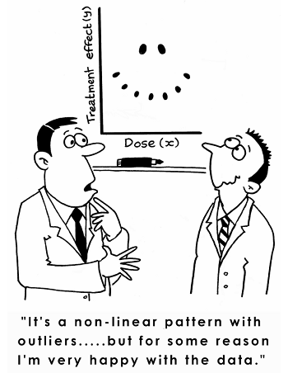
What is Systems Thinking?
Focuses on connections
Global perspective
Non-linear causation
Feedback loops
Reinforcement
Circular / spiral causation
Connectivity webs
J.B. Landers ©

Slide 6
Biopsychosocial Model
Biosphere
Society-Nation
Culture-subculture
Community
Family
Two person dyad
Individual
Organ system
Tissue
Cells
Organelles
Molecules
Atoms
Subatomic Particles
Engel, G. L. (1980). The clinical application of the biopsychosocial model. The American Journal of Psychiatry 137(5): 535 – 544.
Therapy Learners
Medical Learners

Slide 7
Medical Model
Biopsychosocial Model
A deductive way of assessing and determining criteria for a diagnosis. Taking a patient’s background information to make a final determination about their health based on biomedical information.
An inductive way to take a specific diagnosis or condition, and exploring the holistic perspective of the patient. Family/systemic/community connections around one’s condition are explored.

Slide 8
Cross Training Essentials
Create common language
Start from the basics
Overlapping skill sets
Interdisciplinary care experience
Therapy
Counselling
Education
Diagnosis
Medication

Slide 9
Timeline of Cross Training on the Behavioral Health Month at SLU
Resident Presents on a medical issue to MedFTs
1:1 lectures and consultations on attachment and family systems
Two lab simulations
Pre Test of Family Centered Skills
First Psychotherapy Reflecting Team
Second Psychotherapy Reflecting Team
Post Test of Family Centered Skills

Slide 10
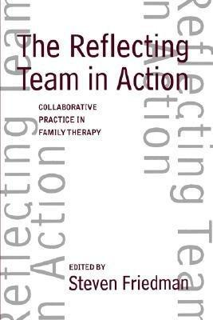
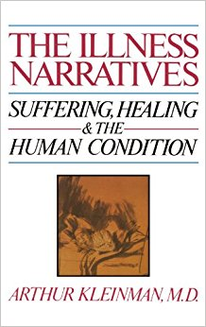
Psychotherapy Reflecting Teams Combining Narrative Medicine and Narrative Therapy Techniques

Slide 11
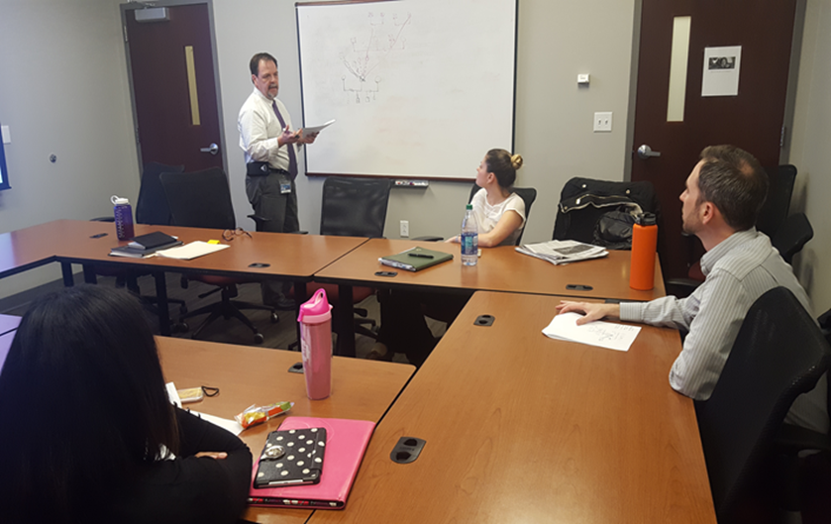
Reflecting Teams
45 minutes
Resident and therapy team view a family therapy session behind one way mirror
15 minutes
Family/Therapist and team switch, where the family hears the resident and therapy team reflect on the case.
15 minutes
Family/therapist and team switch again, where the family reflections on the professional summaries, strengths and suggestions.
15 minutes
After patient leaves, the therapist, therapy team and resident process the session. The resident and therapy team give the therapist a session evaluation

Slide 12
Residents attend at least two psychotherapy reflecting teams on their behavioral health month. The goal is to:
Increase their expansion of counseling skills with a couple or family
View problems from a biopsychosocial perspective
Offer feedback to families that is strength-focused

Slide 13
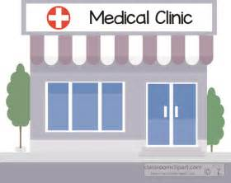
An interesting thing happen along the way to the clinic.

Slide 14
Seriously, lets be honest
Most of us have all heard the terms: “Integrated Care”, “Behavioral Health Consultants, “Behavioral Health Providers”, “Mental Healthcare Providers” and “Medical Family Therapy”.
Yet, we all have our own ideas what those terms mean.
Entering into my first medical care setting, I realized that my perceived definition of integrated care was about to be challenged and recreated.

Slide 15
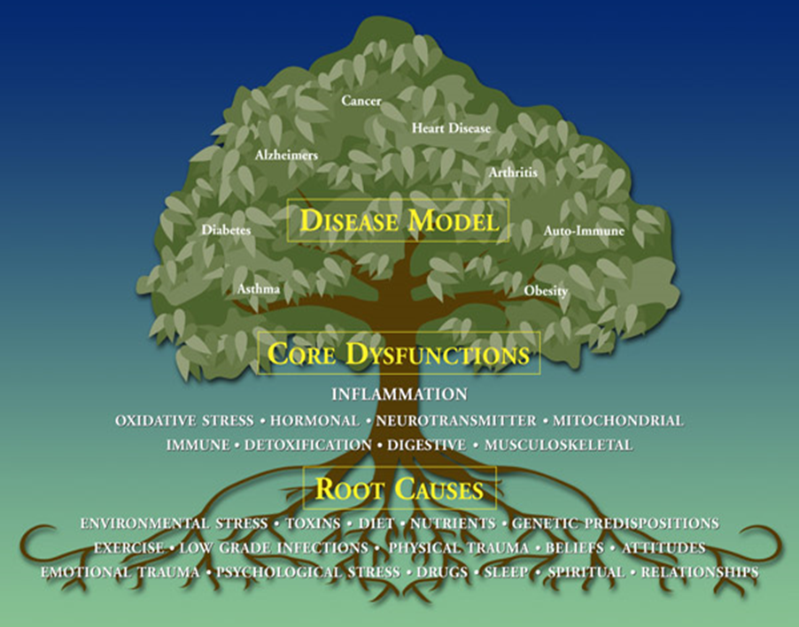
Integration of Care
Behavioral Health: Assessing the types of actions, thoughts and communication styles that a patient uses to manage day to day living, especially those behaviors that hinder the patient’s well-being
Mental Health: Assessing the emotive state of a patient.
Being mindful of the belief that emotions are learned behaviors when encountering a situation.

Slide 16
Genograms:
Presents a historical perspective on familial behaviors the either empowers or hinders healthy choice habits (Environment)
Helps determine learned behaviors of community in which the patient has developed patterns.
Accesses events that a patient has encounters which have influenced past and present day health decisions. (Constraints)
Challenges and empowers the patient’s decision making that is based on their values. (Agency)

Slide 17
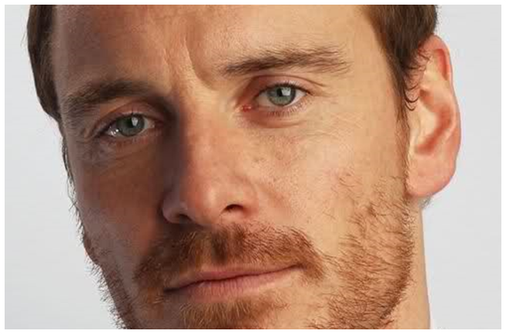
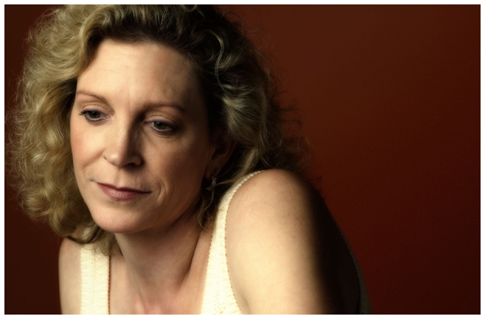
MJ – Single Father, Mid 30’s, Former athlete, Presenting concern: Broken Hand and “Lost Days” from blackouts
AC – Single female, Mid 40’s, Successful business woman, Presenting concern: Fatty Liver, Suffers from seizures, and recovering from substance abuse

Slide 18
As a integrated healthcare provider, my own biases and understanding has developed in the following ways:
-How to communicate more effectively within the system of healthcare and with families.
- How to craft my presence and the questions that I present to both the medical team and patient.
- My role as a family therapist is constantly evolving.
“The important thing is not to stop questioning. Curiosity has its own reason for existence. One cannot help but be in awe when he contemplates the mysteries of eternity, of life, of the marvelous structure of reality. It is enough if one tries merely to comprehend a little of this mystery each day.” – Albert Einstein

Slide 19
Resident Perspective
Medical school
Little Behavioral Health training in coursework
Psychiatry limited to inpatient experience
Rarely modeled by residents and attendings
Residency
Starting from groundwork laid by med school
Narrow focus due to workload and need for efficiency

Slide 20
Interaction with Medical Family Therapy
Inpatient service
Perspective expansion with genograms and input during rounds
Individual didactics
Attachment theory with Dixie Meyer
Teaching Med FT graduate students
Defining common medical terms
Giving medical framework for BH challenges
Putting myself in their shoes during preparation

Slide 21
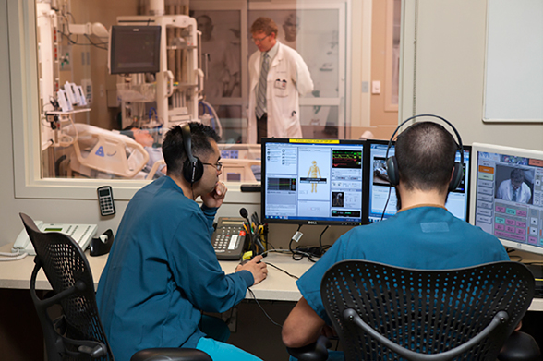
Bringing It All Together: Simulation
Med FT students and faculty evaluators
One way glass, simulated case and instant feedback
Similar to standard observed learning
Useful for reflection of skills and suggestions for improvement

Slide 22
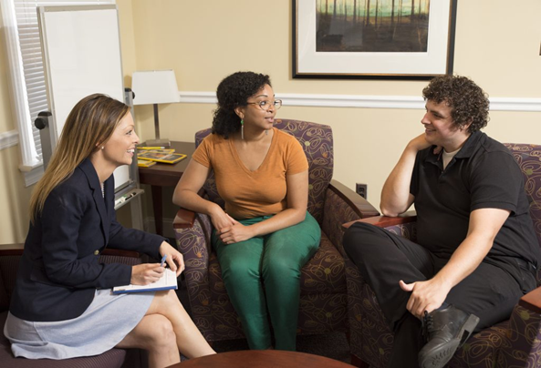
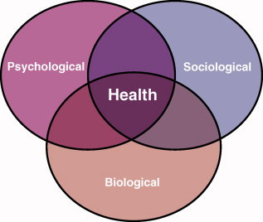
Let’s Create a Live Simulation!

