Slide 1
Family Medicine Collaboration with Behavioral Health: A Model of Integration
Cynthia Thomas, M.D.
Assistant Professor of Clinical Medicine,
SIU School Medicine, Dept of Family and Community Medicine
Michael Owolabi, M.D. M.D., MPH
Resident Physician
SIU School of Medicine, Dept of Family and Community Medicine

Slide 2
Disclosures
Nothing to Disclose

Slide 3
Goals and Objectives
Discuss higher prevalence physical conditions and life expectancy gap in the severely mentally ill
Discuss importance of primary care and behavioral health integration
Discuss levels of integration
Discuss potential resident learning objectives in this setting
Discuss potential integration barriers

Slide 4
Intended Audience
Family Medicine Faculty and Residents
Behavioral Health Specialists

Slide 5
A.H.
A.H. is a 32 year old AA male with hx of schizophrenia followed by MBH (previously MHCCI ) on 5 meds for mental illness
A.H. lives at “Jeremiah’s House” and has a case manager
Hx of asthma since age 2
Smokes cigarettes
Previous PCP retiring
Frequent emergency room visits for refill of inhalers

Slide 8
The Solution
Primary & Behavioral Healthcare Integration Grant
Substance Abuse and Mental Health Services Administration (SAMHSA), Center for Mental Health Services
$1,555,587 ($377,229/year for 3 years)
Co-locate primary care at MBH and provide care coordination to adults with serious mental illness related to their physical health care
Improve health of adults with serious mental illness and/or co-occurring substance use disorders who are at risk for co-morbid conditions & chronic diseases
Notes:
Grant Update
Integration Grant Awarded - Pending Review for Acceptance
The Substance Abuse and Mental Health Services Administration (SAMHSA), Center for Mental Health Services notified Mental Health Centers of Central Illinois on August 13 of an award of funding for a Primary and Behavioral Health Care Integration (PBHCI) Grant. Examination of the potential award and ramifications for accepting federal funding is underway. If accepted, the grant award would fund $377,229 for year one, with subsequent potential funding through year four totaling $1,555,587, subject to availability of funds and satisfactory progress on the project. If accepted, funding would establish coordinated and integrated services through the co-location of primary care services within MHCCI’s adult medical services in Springfield. The grant objective is to improve the physical health of adults with serious mental illness and/or adults with co-occurring substance use disorders who have or are at risk for co-morbid conditions and chronic diseases.

Slide 9
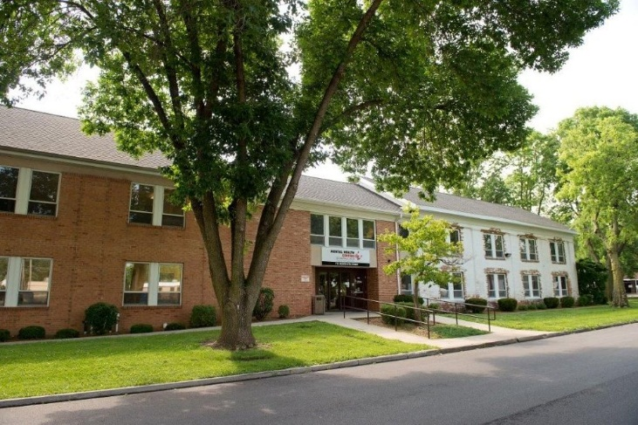
Memorial Behavioral Health Center
Previously Mental Health Centers of Central Illinois
Private, non –profit organization
One of the largest behavioral health systems in central Illinois
Hospital affiliation in 1996
Notes:
Serves Greater than 9000 annually
9 sites of care in Springfield, Sangamon County Illinois

Slide 10
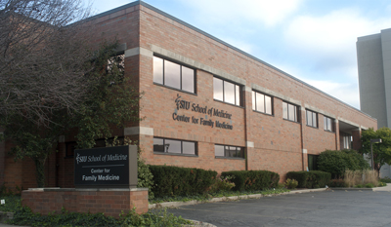
SIU Center for Family Medicine
One of two Federally Qualified Health Centers(FQHCs)in Springfield
Residency Training program(30 residents)
Behavior health consultants embedded in clinic
>13,000 pt. visits

Slide 11
CHFA Levels of Integration
Minimal Collaboration
Basic Collaboration
Basic on site collaboration with minimal integration
Close collaboration onsite in a partially integrated system
Full Collaboration in a fully integrated system
Notes:
Collaborative Family Healthcare Association

Slide 12
The Four Elements of PBHCI
Health Coaching
Primary Care
Care Coordination
Behavioral Health
Behavioral Health: Core population/core service—health home for consumers with serious mental illness
Primary Care: Director of primary and other specialty services
Care Coordination: the traffic controller and interpreter for the consumer
Health Promotion: activation of the consumer in own health outcomes

Slide 13
The TEAM
Psychiatrist
Psychiatric Nurse manager
Family Physician
Physician Assistant
Clinic Nurse
Project Manager
Peer Navigator
Care Coordinator
Wellness Coach
Substance Abuse Counselor

Slide 14
A.H. (cont’d)
A.H. establishes care with PBHCI Clinic accompanied by case manager
Examined, labs ordered , INHALERS REFILLED
Asthma education provided with discussion on controller inhalers and rescue inhalers

Slide 15
Seven Reasons for Integration
The burden of mental disorders is great
Mental and physical health problems are interwoven.
The treatment gap for mental disorders is enormous.
Enhance access.
Reduces stigma and discrimination.
Treating common mental disorders in primary care settings is cost-effective.
The majority of people with mental disorders treated in collaborative primary care have good outcomes
Evolving Models of Behavioral Health Integration in Primary Care
Milbank Memorial Fund
by Chris Collins, Denise Levis Hewson, Richard Munger, and Torlen Wade

Slide 16
At follow up visit…………….
A.H. and case manager report no ER visits in the past month
A.H. articulated having “rescue inhaler” with him and using controller inhaler daily

Slide 19
Incorporating FM Residents
Scheduled during Behavioral Science rotation or Community Medicine
Usually one half day

Slide 20
Resident Learning Objectives for PBHCI
The resident will be exposed to team care
Resident will be exposed to pre visit planning
Resident will enhance skills of caring for severely mentally ill
Resident will be more familiar with MBH
Resident will learn particular techniques to enhance clinical care for SMI and improve compliance

Slide 21
Resident Exposure to team care
Attend huddles before clinic
Increase appreciation for contribution of all team members
Enhance ability to interact with other professionals involved with process

Slide 22
Resident Exposure to pre visit planning
Records pulled from hospital by nurse
Behavioral staff present concerns/ background
Review patient records in electronic health record
Determine labs/ tests requiring follow up
Notes:
Behavioral health staff have access to behavioral health chart
Health indicators discussed; some may have been recently completed so avoid duplication.

Slide 23
Enhancing Skills Caring for Severely Mentally Ill
Position in room
Delusional behavior
Adjusting instruction complexity to patient level
Being aware of body language and voice

Slide 24
Enhance Familiarity with MBH
Location: have referred patient but often not gone themselves
Level of services: Case managers, therapy, psychiatrist
Services provided: Unit dose packaging for meds

Slide 25
Improving Medical Care and Increasing Compliance
Realistic goals
Prioritize
Engage patient in planning
Document specific instructions on visit summary
Share instructions with case manager.

Slide 26
My Experience as a Resident
Witnessed the PBHCI clinic firsthand
Pre-visit huddle by the team
every patient was discussed
medical and behavioral problems
were discussed
goals and plans were also addressed.

Slide 27
My Experience
After every patient's individual case was discussed, the pts were then assessed and evaluated. Goals and plans of care were then laid out/collaborated with each patient
In the afternoon (around 1pm), the pre-visit huddle was to also done to discuss afternoon clinic

Slide 28
My takeaway
It was a great experience because it provided the opportunity for behavioral health pts who may not have had consistent follow ups with their primary care physicians, to have one available where they had their care addressed for their psychiatric needs.

Slide 29
Success Story
I saw a young man who was obese and had several medical problems in addition to his depression and anxiety, through the PBHCI team, he had become motivated about losing weight, improving his BP, that he began to eat better and had lost 14 lbs. in 2 months, and spoke about how he had been walking miles that morning.

Slide 30
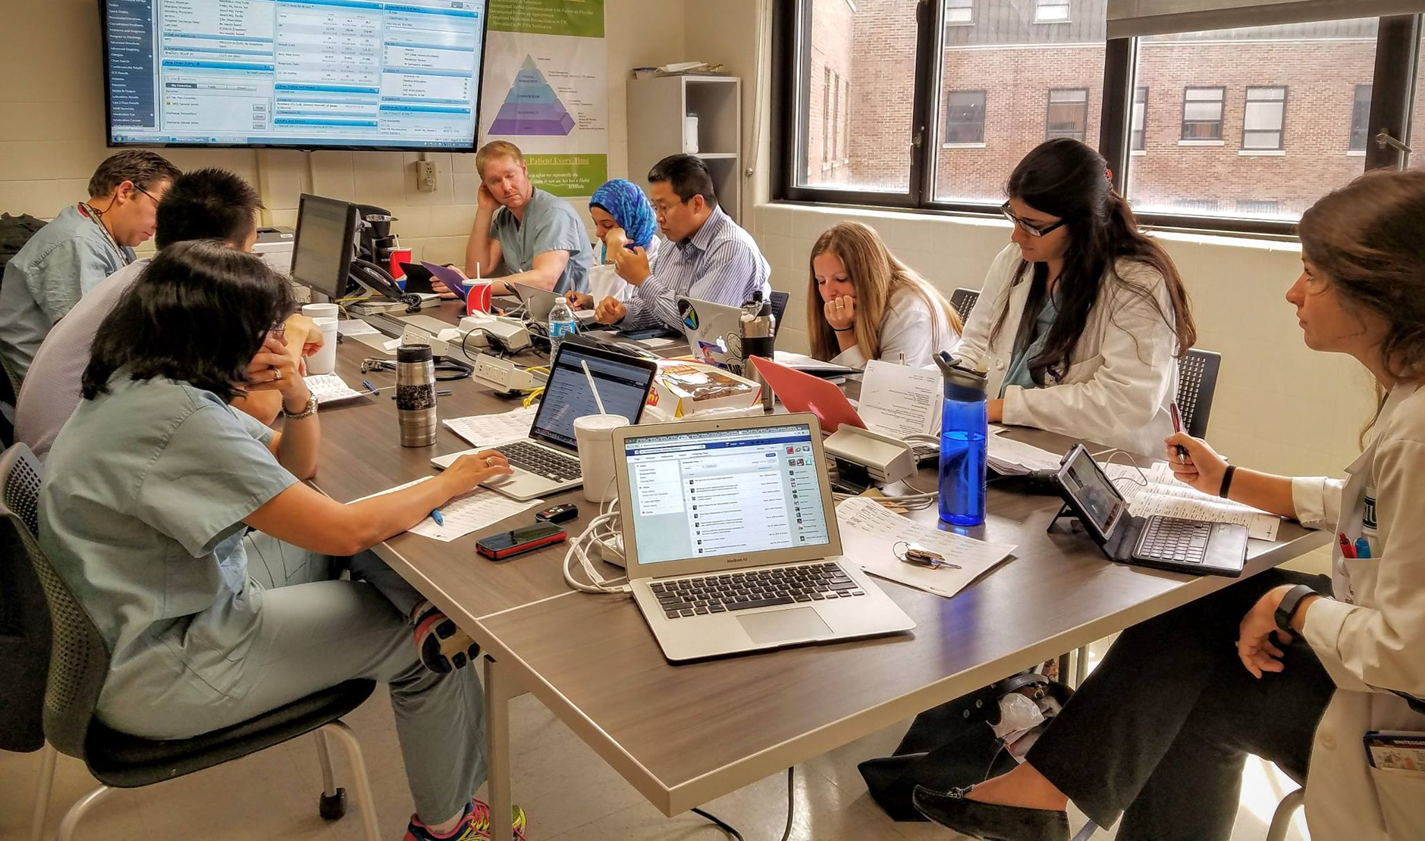
Integration of Residents
Since the emergence of the PBHCI,
4 residents from the SIU-SOM FM residency have had the opportunity to rotate through, work in the clinic and provided feedback based on their experience at the clinic

Slide 31
Questionnaire
A 7-question survey was provided to the residents to assess their feedback
The survey was based on a numeric, 9 point, Likert scale
The survey was based on their level of strong disagreement to strong agreement.

Slide 32
1. The clinic was helpful to my knowledge (Score 1-9, Average 8.5)

Slide 33
2. I learned more about integrating family medicine with mental health (Average 8.5)

Slide 34
3. I feel more comfortable applying my care and knowledge of family medicine to mentally ill pts (Average 7.5)

Slide 35
4. I learned about the team approach to patient care through the huddle meeting before pt was seen (Average 8.5)

Slide 36
5. I learned about the team approach to patient care through the huddle meeting after the pt was seen (Average 8)

Slide 37
6. Understanding and interacting with mentally ill pts will continue to help me provide better care for this pt population (Average 7.75)

Slide 38
7. The idea of integrating family medicine to the psychiatric setting, will help in the holistic care of mentally ill pts (Average 8.75)

Slide 39
Results
Although the results were obtained from a small sample size, the idea of integrating family medicine into behavioral health is one that the residents strongly agree would be beneficial towards their medical knowledge and training.

Slide 40
Potential Barriers to Integration
Basic Integration
Behavioral and physical health providers have long operated in their separate silos
Sharing of information rarely occurs
Confidentiality laws
Payment and parity issues
Evolving Models of Behavioral Health Integration in Primary Care
Milbank Memorial Fund
Resident Barriers
Scheduling Times
No show
Patient comfort
Space constraints
Notes:
Laws more restrictive for substance abuse and mental health

Slide 41
More Resident comments…….
“I really liked the concept of the clinic at behavioral center
I think it is a very patient centered approach to help patients with anxiety, depression or social phobias to feel comfortable and be in the same environment and get all the medical needs. Though we do see psych patients in our clinic, but at the center its sure you will see all of them and it was fun and challenging to provide them primary care.
I always believe integrating family medicine with mental health is important. The very def of health is mental and physical well being. Both go hand in hand in providing comfort and ease. If someone is stressed it messes their physical health and if they sick its stresses them out.
Yes I did feel comfortable providing care to mentally ill patient, and I would love to do it once or twice every month too!
The huddle was interesting, because you learn about the whole aspect of the patient. His previous needs, were they met? The mental treatment he is getting and also finding out which health aspect is bothering him more, which patient talks about to the therapist
Like I told deepa and Dr. thomas, I really like the concept and would be excited to see if we can make it a regular thing like we do for CCHC and nursing home..”

Slide 42
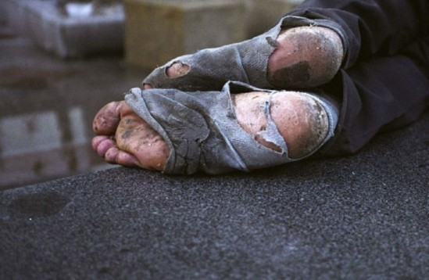
Making a Difference One Clinic at a Time… One resident at a time….
-FCM patient with atrial fibrillation, syncope, poor adherence and SMI, evaluated, expedited appointment with MBH
Coordinating with other departments on PBHCI patients
Routine care that has gone long untreated(pap, mammo)
Risk reduction (obesity, cholesterol)
Feet and Ears
Notes:
The impact of consistent and thorough care has been evidenced by the success stories from the clinic, both large and small.
Dr. Thomas Atrial Fibrillation in one client and ordered the appropriate tests / labs.
Dr. Thomas has had to provide intensive services to address “routine” needs – mostly involving feet and ears.
There have been a couple of patients that could not hear due to impacted cerumen and this was removed, resulting in improved hearing. One removal took 30 minutes… Others have toenails that were overgrown and affecting the ability to walk without pain. Trimming was provided along with referrals for further podiatry care…

Slide 43
References
Chris Collins, Denise Levis Hewson, Richard Munger, and Torlen Wade. “Evolving Models of Behavioral Health Integration in Primary Care”.
Milbank Memorial Fund by Health Services Research. Volume 48, Issue 1, pages 175–194, February 2013
MARC DE HERT, CHRISTOPH U. CORRELL, JULIO BOBES, et. al. “Physical illness in patients with severe mental disorders. I. Prevalence, impact of medications and disparities in health care”. World Psychiatry. Volume 10, Issue 1. February 2011 .Pages 52–77
MARC DE HERT, DAN COHEN, JULIO BOBES, et. al. “Physical illness in patients with severe mental disorders. II. Barriers to care, monitoring and treatment guidelines, plus recommendations at the system and individual level”. World Psychiatry. Volume 10, Issue 2. June 2011 . Pages 138–151
Minnesota Association of Community Mental Health Programs. Levels of Systematic Collaboration/Integration. Retrieved from http://www.macmhp.org/pdfs/levelsofsyst.pdf
SAMSHA Slides .http://www.integration.samhsa.gov/integrated-care-models/primary-care-in-behavioral-health#resources
Von Korff M, Katon WJ, Lin EH, Ciechanowski P, Peterson D, Ludman EJ, Young B, Rutter CM. “Functional outcomes of multi- condition collaborative care and successful ageing: results of randomized trial”. BMJ. 2011 Nov 10;343:d6612.
Watson LC, Amick HR, et al. “Practice-based interventions addressing concomitant depression and chronic medical conditions in the primary care setting: a systematic review and meta-analysis”. Journal Prim Care Community Health. 2013 Oct;4(4):294-306.
Wayne Katon, MD, Joan Russo, PhD, et al. “Cost-effectiveness of a Multicondition Collaborative Care Intervention”.
JAMA Psychiatry, 2012 :Arch Gen Psychiatry. 2012 May; 69(5)

Slide 44
Thank You!

