Slide 1
Group Medical Visits
Micahlyn Powers MD
Bridget Beachy PhD
September 2016

Slide 2
WHAT IF

Slide 3
What if…
You could simultaneously educate residents and increase your clinical revenue?
You could dramatically increase the preventative care you provide without working more hours?
You could get a better sense of how well your advisee leads and educates their patients?
You could deliver healthcare in a novel, effective way?
You could be more satisfied with your practice AND see more patients?

Slide 4
Group Medical Visits

Slide 5
Objectives
Define 3 techniques used by an effective GMV facilitator
Identify the cornerstones of GMV planning
Describe basic components of Medicare Annual Wellness Visit
Practice a GMV to provide perspective on team roles

Slide 6
Survey Results
92% believe GMV are a valuable way to deliver healthcare
84% have little to no experience leading a GMV
93% are willing to learn about GMV and facilitate a group
Notes:
Raise your hand if you were taught to facilitate GMV in grad school- either med school or your graduate program. Our BHC colleagues were taught but this is a hole in most of our medical education, mine included!

Slide 7
Everyone has a concern…or 2…or 3
46% concerned about loss of patient-physician connection
46% feel GMV are too much effort to organize
38% are concerned that our administration is not supportive of beginning GMV
61% are concerned that we have inadequate numbers of clinical staff to run GMV
Notes:
We will discuss what staff might be needed today and you will role play different team members roles later on.

Slide 8
Goals
That you would recognize GMV as a method that can improve outcomes & increase uptake of preventative care services
That you would feel confident to lead a group visit with help from your team
That each resident would lead 1 GMV before they graduate
That GMV would increase your job satisfaction and make you a happier & more effective clinician

Slide 9
BB

Slide 10
Bridget slides
Effective group facilitator training
Body language
Acknowledge Refer Return (use survey results)
Challenges to facilitation
Trouble shooting group dynamics
Monopolizer
Shy hermit
Negative Nick
Know-it-all Nancy

Slide 11
Poll Results

Slide 12
So, how are you all feeling?
For those who’ve done groups…
What’s worked?
What hasn’t?
For those who haven’t done groups…
Do you want to?
What do you like about them?
Don’t want to?
What’s concerning you?

Slide 13
Being an Effective Group Facilitator
Body language
If you act tentative, they will notice
Verbal language
Speaking in layman’s terms
If you talk “at” them, they will notice
Use open ended questions
Acknowledge-Refer-Return
Engaging others will help build confidence
Be enthusiastic
Know your material

Slide 14
Challenges to Facilitation
Stage fright
Get them started with an exercise
Make a clear plan before group (be ready for flexibility as well)
Personalities in groups

Slide 15
Troubleshooting Group Dynamics
“Monopolizing Monty”
Look to others, say thank you, and shift attention to the rest of the class
“Shy Sharon”
Break into smaller groups or partner work
“Negative Nick”
Validate experience, and re-frame, highlight resiliency
“Know-it-all Nancy”
Validate and redirect

Slide 16
Group Stages (Tuckman, 1965)
Forming
Normally nice, polite; feeling things out; establishing roles
Storming
Opening up and confronting others’ ideas
Norming
Focusing on shared values
Performing & Adjourning

Slide 17
References (Beachy)
Robinson, P., & Reiter, J. (2016). Behavioral consultation and primary care: A guide to integrating services (2nd ed.). New York, NY: Springer Science, Business Media, LLC.
Tuckman, B. W. (1965). Developmental sequences in small groups. Psychological Bulletin, 63(6), 384–399.

Slide 18
Medicare Annual Wellness Visit
Covered 100% by Medicare, no co-pay
Once a year
NO physical exam or problem focus
Risk screenings (falls, dementia, depression)
Vitals and visual acuity testing
Preventative care discussion & decision
*See Medicare preventative care recommendations handout
POLST
AllScripts Template!

Slide 19
Medicare Wellness Visit
Reimbursement: encounter rate PLUS 34%
Quality Improvement
Medicare Wellness Visits are 30min if done individually→ you can increase your productivity by 150-250% by running a GMV!
Documentation is done by end of GMV

Slide 20
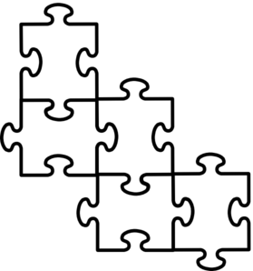
GMV Logistics
Space
-Room for 6-12 patients
-Break room? Conference room? Lobby?
-Comfortable chairs
-Tables for laptops, educational materials, snacks
-Whiteboards (optional)
-Area for vitals, eye exam, vaccines (can be separate from group area)

Slide 21
GMV Logistics
Time
-Usually 90min sessions
-Patients must arrive on time
-Patients must fill out questionnaires at home PRIOR to visit
-Plan agenda to ensure all preventative care topics are covered but can customize based on patients present (all female, all diabetic, etc.)

Slide 22
GMV Logistics
Team Roles
-Reception: schedule patients, recruit patients in person or by phone
-MA/RN: vitals, documentation, vaccinations, education
-BHC/Psych intern: facilitation, motivation
-Care Coordinator: education, invitations
-Resident/Attending: facilitation, education, documentation, planning & invitations
-Outreach team: invitations, follow up phone calls, scheduling
-Dietician: education (depending on topic)

Slide 23
GMV Logistics
Snacks
-Healthy?
-Themed with the health topic for the day?
-Water
-Nothing too noisy…
-Kept in an easy to access location

Slide 24
GMV Logistics
Scheduling
-Residents- ambulatory family medicine, R3?
-Preceptor- can be present for direct observation, can co-lead group, decide what level will be billed so preceptor can be present to examine pt if needed.
-BHC- can co-lead, be present for some or all of group.

Slide 25
GMV Logistics
Planning
-Set dates 2-3 months ahead
-Requires consistent communication with multi-disciplinary team
-Target census
-Patient selection
-Written, verbal, phone invitations
-Agenda
-Educational materials/media

Slide 26
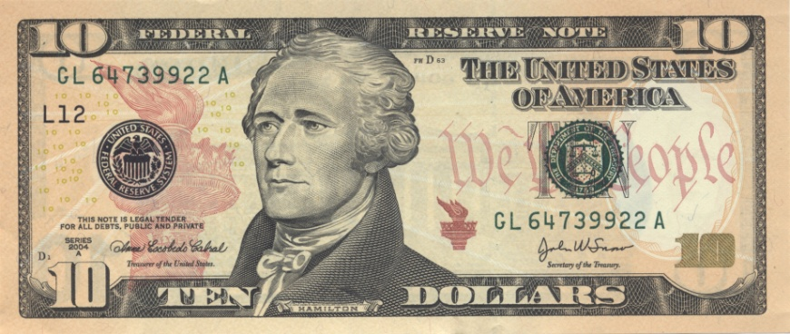
GMV Logistics
Documentation & Billing
-AllScripts template (Medicare Annual Wellness Visit, diabetic f/u visit)
-Send chart to billing
-Physician must have face to face contact with each patient in order to bill
-Group visit allows for more education to take place
-Bill for time?

Slide 27
Role Play Instructions
Divide into 2 groups- diabetes GMV vs. Medicare GMV
Scripts for each group member. Assign roles.
Role play for 20min
Debrief in large group

Slide 28
Debrief
What went well?
What needed improvement?
What facilitative techniques did you observe?
Open feedback
Post-training Catalyst survey

