Slide 1
Medication Assisted Treatment for Opioid Use Disorder
Alyssa Bruehlman, MD
University of Wisconsin Madison Family Medicine Residency
Marianne Koenig, PharmD, BCPS
UPMC St. Margaret Family Medicine Residency
Patricia McGuire, MD
UPMC St. Margaret Family Medicine Residency

Slide 2
Disclosures
No financial or commercial disclosures
Discussion of opioid epidemic can be distressing
Ongoing learners in MAT
Will primarily use generic drug names

Slide 4
Goals and Objectives
Describe opioids and opioid effects
Discuss scope of opioid epidemic in US
Review diagnostic criteria for Opioid Use Disorder (OUD)
Summarize principles of harm reduction
Review Medication Assisted Treatments (MAT) for OUD
Examine strategies to support recovery

Slide 5
Patient Case - Corey
27 yo female lives with her boyfriend and her mother
Wants to initiate MAT (Buprenorphine) for OUD
Opioid use started at age 16 after knee injury. Was started on opioids for pain for several weeks
After prescription ran out, “I got Oxy’s off the street.”
Later transitioned to heroin IV
Intermittently uses benzos and cocaine; no alcohol
Now voices strong motivation for recovery - "I need to do something. I’m here because I want to get clean for myself."

Slide 6
Language and Stigma
 | ENCOURAGED | AVOID
PERSON-CENTERED | “People who use drugs” “Person with substance use disorder” | “User” “Substance Abuser” “Addict”
CLINICAL | “Substance use disorder” “Use,” “Reduction,” “Abstinence” “Expected” vs “Unexpected” | “Abuse” “Clean” vs “dirty”
Notes:
** Study on impact of clinician

Slide 7
Goals and Objectives
Describe opioids and opioid effects
Discuss scope of opioid epidemic in US
Review diagnostic criteria for Opioid Use Disorder (OUD)
Summarize principles of harm reduction
Review Medication Assisted Treatments (MAT) for OUD
Examine strategies to support recovery

Slide 8
Notes:
Heroin
Carfentanyl
Acetylfentanyl

Slide 9
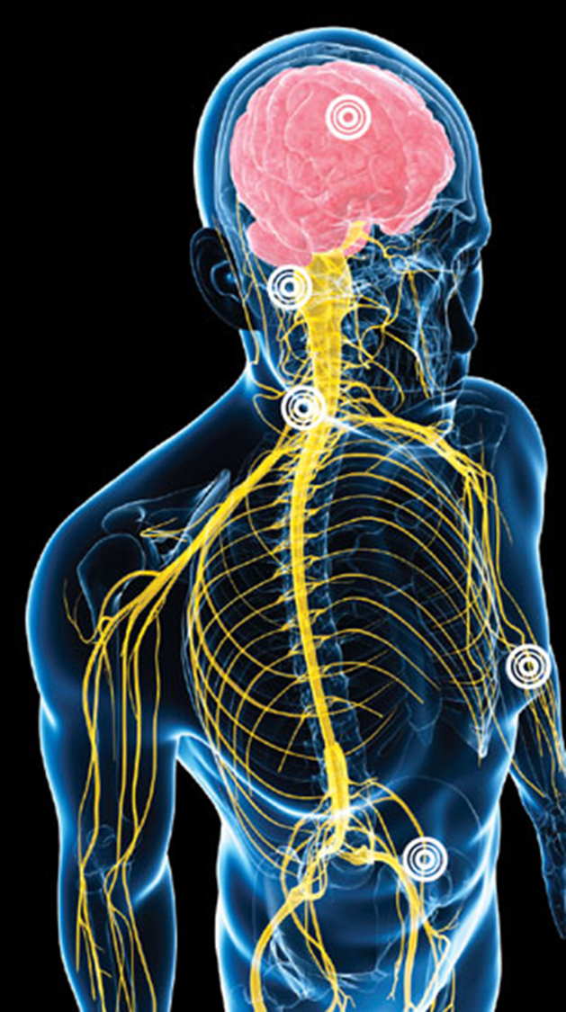
What do opioids do?
Receptors in brain, spinal cord, GI tract
Affect body systems which regulate breathing, blood pressure, mood
Minimize perception of pain
Stimulate brain reward centers
Overdose → Classic Triad
pinpoint pupils
respiratory depression
coma, death

Slide 10
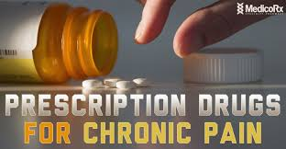
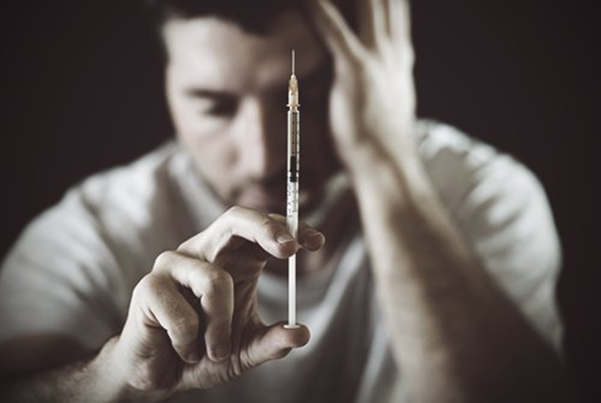
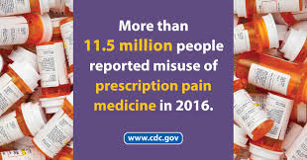
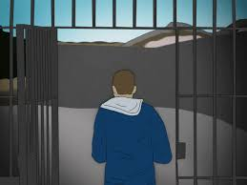
Who is at risk for overdose?
Notes:
Long-term opioid med management of chronic pain
Need for opioids pain meds for acute pain with history of opioid misuse
Illegal opioid use
Misuse of prescription pain relievers
Recent discharge from emergency medical care following opioid overdose
Recent detox from opioids
Abstinent from opioids for a period of time
Recent release from incarceration with prior history of opioid misuse

Slide 11
Goals and Objectives
Describe opioids and opioid effects
Discuss scope of opioid epidemic in US
Review diagnostic criteria for Opioid Use Disorder (OUD)
Summarize principles of harm reduction
Review Medication Assisted Treatments (MAT) for OUD
Examine strategies to support recovery

Slide 12
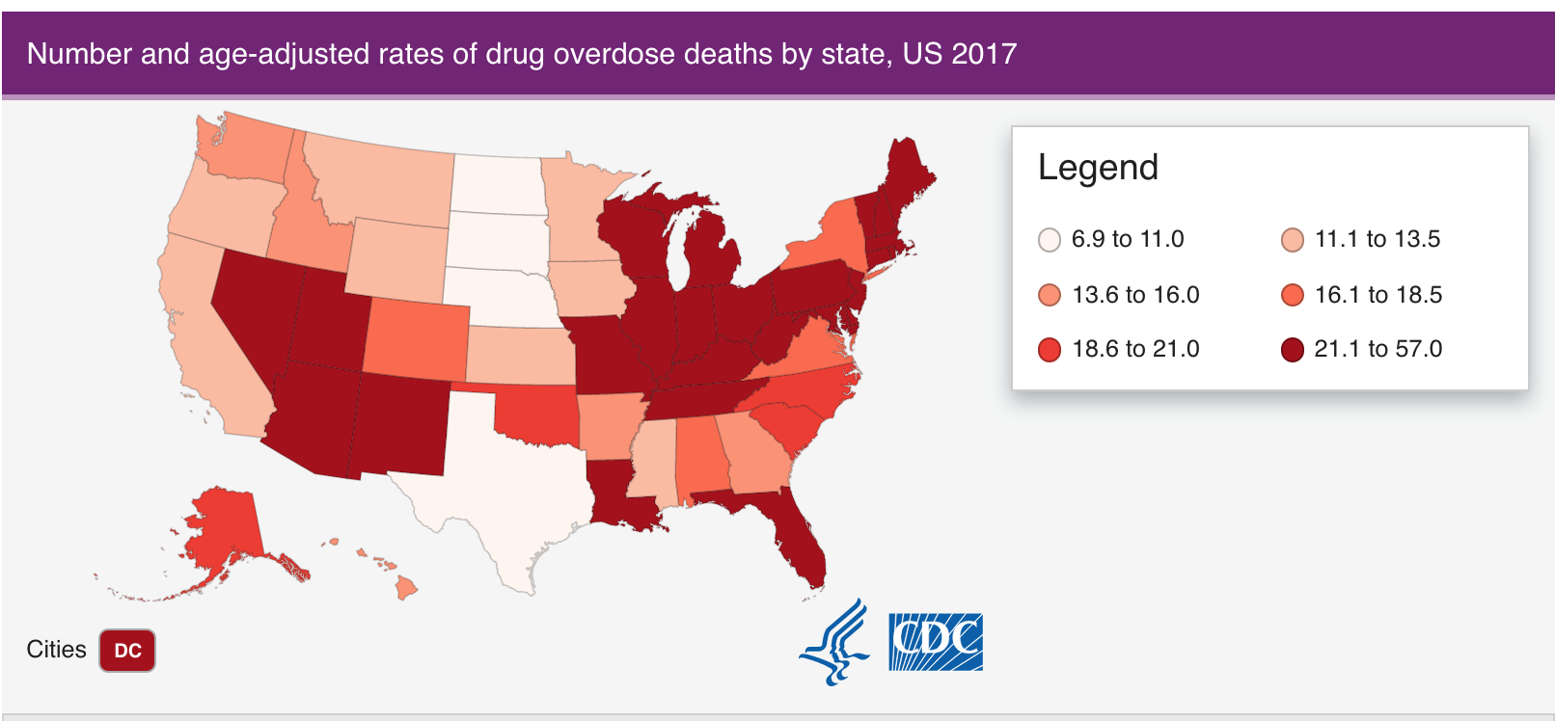
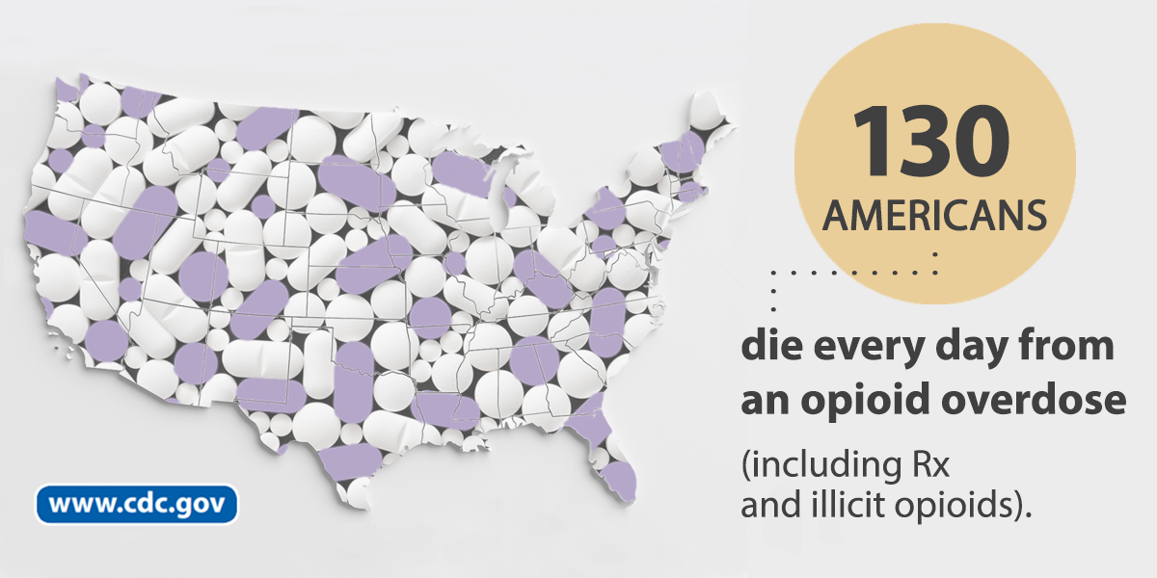
Opioid Crisis
From 1997 – 2017
400,000 deaths of opioid-related overdose
Sale of Rx opioids in the U.S. nearly quadrupled
Notes:
Image; cdc.gov/drugoverdose/epidemic/index.html
PA: 2017 3rd highest death rate 44/100,000
Wisconsin increase

Slide 13
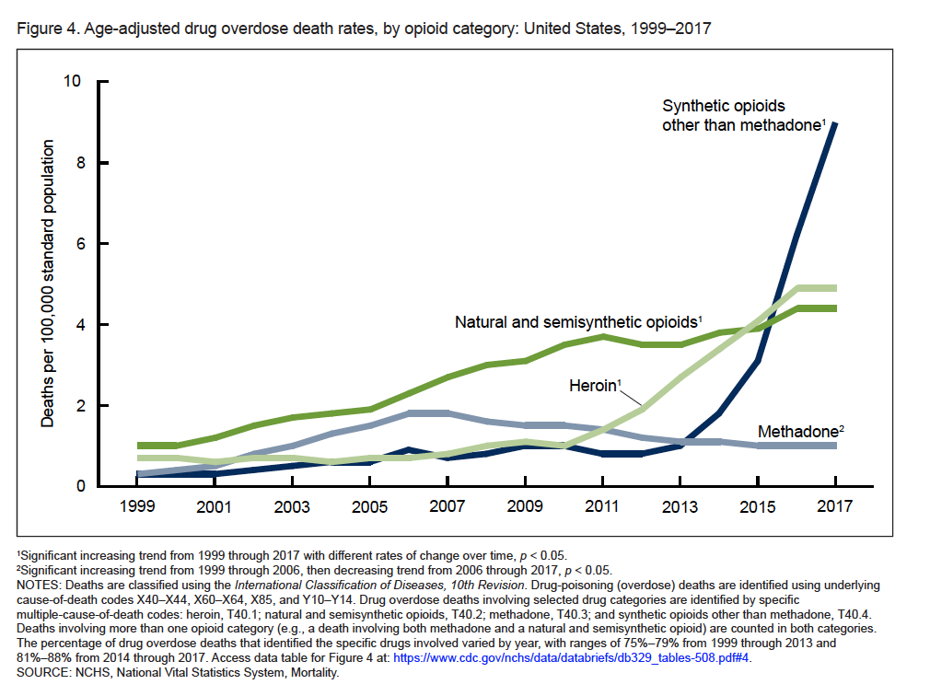
NCHS Data Brief “Drug Overdose Deaths in the United States, 1999-2017” November 2018
Notes:
NCHS Data Brief “Drug Overdose Deaths in the United States, 1999-2017” November 2018

Slide 14
Goals and Objectives
Describe opioids and opioid effects
Discuss scope of opioid epidemic in US
Review diagnostic criteria for Opioid Use Disorder (OUD)
Summarize principles of harm reduction
Review Medication Assisted Treatments (MAT) for OUD
Examine strategies to support recovery

Slide 15
What is Opioid Use Disorder (OUD)?
Problematic pattern of opioid use leading to clinically significant impairment or distress
≥ 2 criteria within 12 months
Mild (2-3 criteria); Moderate (4-5); Severe (≥ 6)
IMPAIRED CONTROL | SOCIAL IMPAIRMENT
RISKY USE | PHARMACOLOGIC DEPENDENCE tolerance withdrawal
Diagnostic and Statistical Manual of Menatal Disorders, 5th Edition
Notes:
DSM5
Impaired control
Opioids often taken in larger amounts or over a longer period than was intended
Persistent desire or unsuccessful effort to cut down or control opioid use
A great deal of time is spent in activities necessary to obtain the substance, use opioids, or recover from its effects
Craving, or a strong desire or urge to use opioids occurs
Social Impairment
Recurrent use of opioids results in a failure to fulfill major role obligations at work, school, or home
Use of opioids continues despite having persistent or recurrent social or interpersonal problems caused/exacerbated by effects of use
Important social, occupational, or recreational activities are given up or reduced because of opioid use
Risky Use
Use of opioids is recurrent in situations in which it is physically hazardous
Use of opioids is continued despite knowledge of having a persistent or recurrent physical or psychological problem that is likely to have been caused or exacerbated by opioid use
Pharmacological Dependence
Tolerance, as defined by either of the following:
Need for markedly increased amounts of opioids to achieve intoxication or desired effect
Markedly diminished effect with continued use of the same amount of opioids
Withdrawal, as manifested by either of the following:
Characteristic opioid withdrawal syndrome
Use of opioids to relieve or avoid withdrawal symptoms

Slide 16
Spectrum of Chronic Pain and OUD
Chronic Pain on Opioids
Physiologic Dependence
Complex persistent dependence
Addiction +
SUD
Manhapra A, Arias AJ, Ballantyne JC. The conundrum of opioid tapering in long-term opioid therapy for chronic pain: A commentary. Subst Abus. 2018;39(2):152–161. doi:10.1080/08897077.2017.1381663

Slide 17
Corey - Diagnosis
Heroin use has increased over time, particularly after grandmother’s death in February 2019
Dropped out of high school; ran with peers who were skipping school and using drugs
Unemployed. Trouble keeping a job due to attendance issues
Incarcerated x3 (retail theft, possession)
Overdosed 2x after getting out of jail in May 2019
Has shared needles in past; has Hepatitis C
Limited social supports - only her current boyfriend and her mother, but conflicts with them due to her drug use
Has relapsed several times after prior substance use treatment

Slide 18
Diagnosis of OUD?
Problematic pattern of opioid use leading to clinically significant impairment or distress
≥ 2 criteria within 12 months
Mild (2-3 criteria); Moderate (4-5); Severe (≥ 6)
IMPAIRED CONTROL | SOCIAL IMPAIRMENT
RISKY USE | PHARMACOLOGIC DEPENDENCE tolerance withdrawal
Diagnostic and Statistical Manual of Menatal Disorders, 5th Edition
Notes:
DSM5
Impaired control
Opioids often taken in larger amounts or over a longer period than was intended
Persistent desire or unsuccessful effort to cut down or control opioid use
A great deal of time is spent in activities necessary to obtain the substance, use opioids, or recover from its effects
Craving, or a strong desire or urge to use opioids occurs
Social Impairment
Recurrent use of opioids results in a failure to fulfill major role obligations at work, school, or home
Use of opioids continues despite having persistent or recurrent social or interpersonal problems caused/exacerbated by effects of use
Important social, occupational, or recreational activities are given up or reduced because of opioid use
Risky Use
Use of opioids is recurrent in situations in which it is physically hazardous
Use of opioids is continued despite knowledge of having a persistent or recurrent physical or psychological problem that is likely to have been caused or exacerbated by opioid use
Pharmacological Dependence
Tolerance, as defined by either of the following:
Need for markedly increased amounts of opioids to achieve intoxication or desired effect
Markedly diminished effect with continued use of the same amount of opioids
Withdrawal, as manifested by either of the following:
Characteristic opioid withdrawal syndrome
Use of opioids to relieve or avoid withdrawal symptoms

Slide 19
Goals and Objectives
Describe opioids and opioid effects
Discuss scope of opioid epidemic in US
Review diagnostic criteria for Opioid Use Disorder (OUD)
Summarize principles of harm reduction
Review Medication Assisted Treatments (MAT) for OUD
Examine strategies to support recovery

Slide 20
What is Harm Reduction?
Per World Health Organization:
“concept aiming to prevent or reduce negative health consequences associated with certain behaviors”
“WPRO: Harm Reduction Among Injecting Drug Users” WPRO 2013. http://www.wpro.who.int/topics/harm_reduction_injection/en/

Slide 21
What is Harm Reduction?
Per World Health Organization:
“concept aiming to prevent or reduce negative health consequences associated with certain behaviors”
“WPRO: Harm Reduction Among Injecting Drug Users” WPRO 2013. http://www.wpro.who.int/topics/harm_reduction_injection/en/
Notes:
NOT CURE OR ABSTAIN

Slide 22
Principles of Harm Reduction
Humanistic Values
Pragmatism
Focus on Harms
Balancing Costs and Benefits
Priority of Immediate Goals
Are we going to eliminate drug use?
Goal Setting
Not approval but not moral judgment
Not on the use itself
Evaluation
Hunt, Neil. “A review of the evidence-base for harm reduction approaches to drug use” IHRA, http://www.ihra.net/files/2010/05/31/HIVTop50Documents11.pdf

Slide 23
Harm Reduction versus Abstinence
HARM REDUCTION IS
STANDARD OF CARE

Slide 24
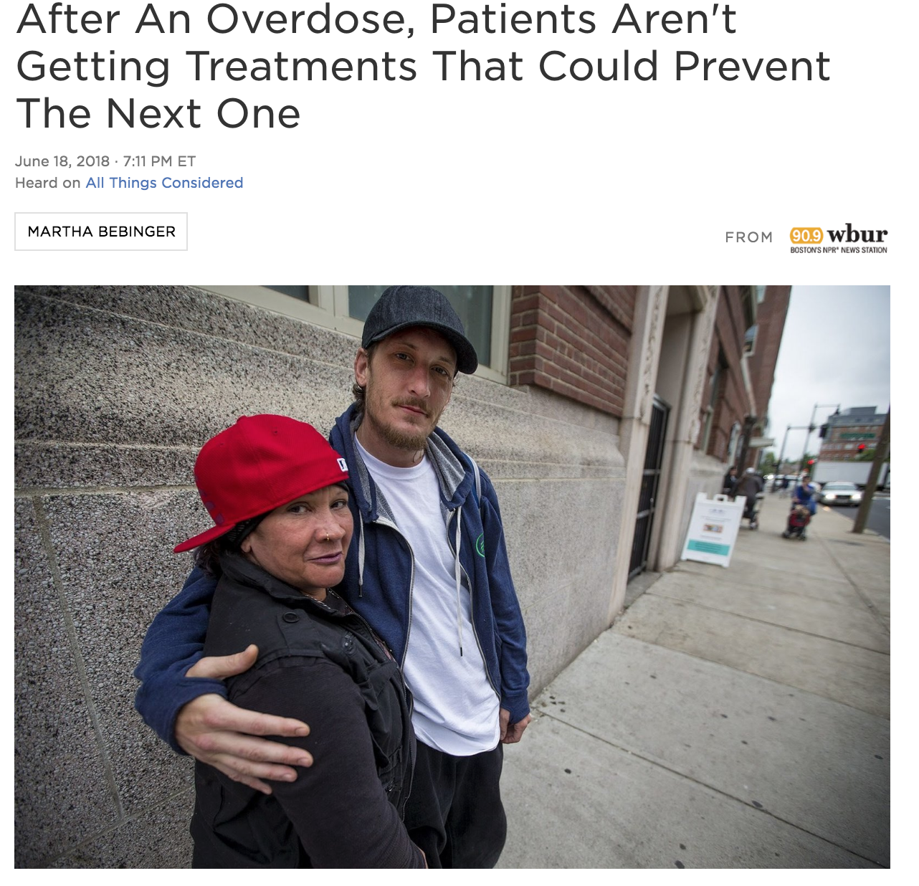
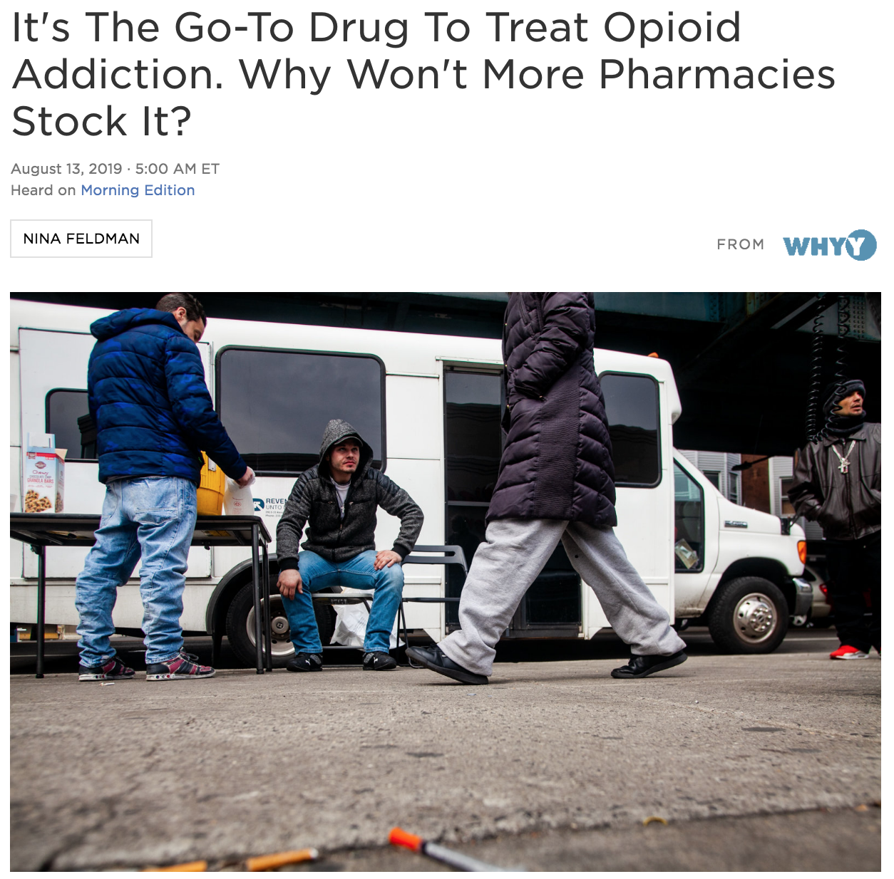

Slide 25
Goals and Objectives
Describe opioids and opioid effects
Discuss scope of opioid epidemic in US
Review diagnostic criteria for Opioid Use Disorder (OUD)
Summarize principles of harm reduction
Review Medication Assisted Treatments (MAT) for OUD
Examine strategies to support recovery

Slide 26
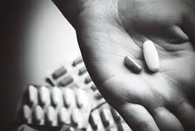
MAT for OUD
Acute overdose | Acute withdrawal | Opioid dependence
Reversal medication | Comfort medications | Maintenance meds

Slide 27
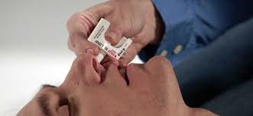
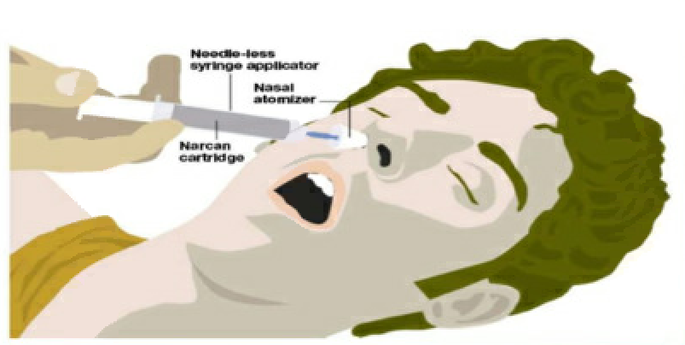
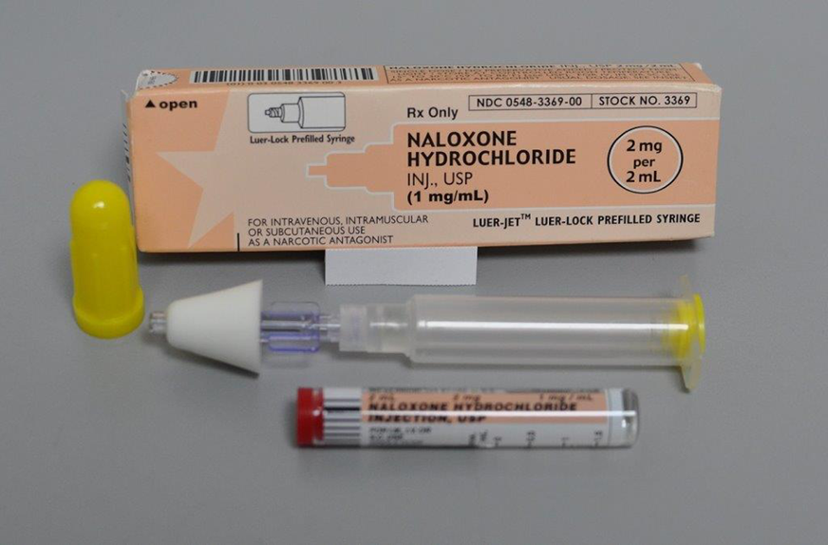
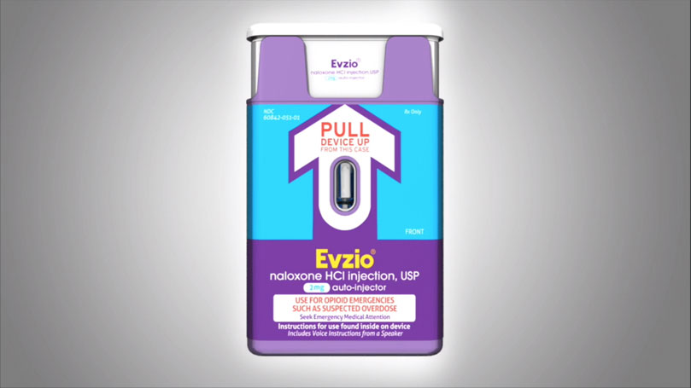
Acute Overdose- Naloxone

Slide 28
Acute Withdrawal Symptoms
Runny Nose | Increased tear production
Yawning | Dilated pupils
Sweating | Chills
Insomnia | Anxiety
Muscle aches | Stomach cramps
Diarrhea | Vomiting

Slide 29
MAT for Opioid Dependence
https://www.samhsa.gov/medication-assisted-treatment

Slide 30
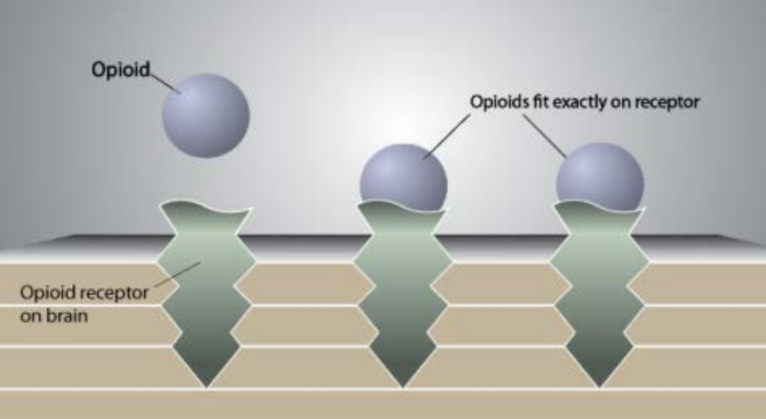
Opioid Receptors
Opiates exert their actions at multiple receptor sites that mediate both analgesic and rewarding effects on many systems in the body
Opioid analgesics act primarily on mu receptors
Notes:
As we mentioned previously, opioids bind to receptors in brain, spinal cord, GI tract and can affect body systems which regulate breathing, blood pressure, mood, can minimize perception of pain and stimulate brain reward centers
Three types of opioid receptors are found in our nervous system with opioid analgesia act primarily on the mu receptor
Methadone, buprenorphine, and naltrexone bind to the mu-opioid receptors in the central and peripheral nervous systems, gastrointestinal tract, and vascular system.
In the brain, these receptors mediate opioids’ analgesic and other effects (e.g., euphoria, respiratory depression, meiosis).
Through modulation of mu-opioid receptor activity in the brain, these medications exert therapeutic effcacy in treating OUD.

Slide 31
Methadone
Buprenorphine
Naltrexone
Agonist
Partial Agonist
Antagonist
Activity
Affinity

Slide 32
Methadone
Buprenorphine
Naltrexone
Agonist
Partial Agonist
Antagonist
Activity
Affinity

Slide 33
Corey – treatment history
Prior behavioral treatments/supports:
In-Patient Rehab x 4 (most recent June 2019)
IOP x 1
No 12 step groups
Prior medications
Tried several Buprenorphine preparations
Tried Methadone
Has Naloxone at home

Slide 34
Methadone
Waiver needed? | No
DEA schedule | II
Form | Liquid, dissolvable powder/dispersable tabs (tablets for pain)
Location of administration | Provided at specialized clinics
Pros | Dosing range Consistency Structure/ compliance
Cons | Opioid replacement therapy (ORT) Cardiac effects (QTc prolongation) Drug interactions
II
Liquid (Tabs for pain)
Provided at specialized clinics
Dosing,
Consistent,
Compliance

Slide 35
Naltrexone XR
Waiver needed? | No
DEA schedule | Not controlled substance
Form | IM Injection Tablet (for alcohol use disorder or for challenge dose)
Location of administration | Injection in office
Pros | Non-agonist Once monthly
Cons | Overdose death Precipitated withdrawal Coordination with pharmacy, prior authorizations, delivery & storage

Slide 36
Buprenorphine/Naloxone
Waiver needed? | Yes; Waiver training provided through pcssmat.org Navigate patient limits (30 patients in first year)
DEA schedule | III
Form | Sublingual film & tablets, implant, extended release injection (Patch is for pain)
Location of administration | Prescribed in office Taken at home or office
Pros | Effective Immediate Flexibility
Cons | Opioid Replace Therapy (ORT) Dose max Some risk of withdrawal Diversion Office visits

Slide 37
Discussion of options with Corey
Would like to stay at primary care clinic
Would like to avoid full withdrawal
Previously purchased buprenorphine off the street

Slide 38
Office-based MAT - Initial Visit
Assessment:
Substance use
Behavioral health
Physical health and exam
Current meds
Labs:
HIV, Hepatitis A/B/C, TB, STIs, LFTs
Obtain Urine Toxicology Screen
Notes:
Use other team members!

Slide 39
Office-based MAT - Initial Visit
Treatment planning:
Review structure and expectations
Controlled substance agreement
Serial Urine Tox
Single pharmacy
Random pill or film counts
Check PDMP (prescription drug monitoring program)

Slide 40
Buprenorphine Induction
Home > Clinic
Day 1:
Mild withdrawal

Slide 41
Clinical Opiate Withdrawal Score (COWS)
National Institute on Drug Abuse
National Institute on Drug Abuse

Slide 42
using 10 bags heroin per day Corey last use 14 hours ago current symptoms:
Objective | Subjective
Pulse = 78
Pupils mid size – normal for room light
No yawning | Reports nasal congestion
Mild hand tremor | Reports stomach ache, cramps
Irritable mood | Feels anxious
Goosebumps noticeable on arms | Reports bone/joint achiness
No sweating | Feels flushed
Sitting still in chair | Feels restless

Slide 43
Comfort Meds for Opioid Withdrawal
Medication | Blood Pressure | Diarrhea | Stomach Cramping | Nausea | Anxiety | Muscle aches | Restlessness | Insomnia
Clonidine | X |  |  |  | X |  | X
Acetaminophen or Ibuprofen |  |  |  |  |  | X
Hydroxyzine |  |  |  |  | X |  | X | X
Loperamide |  | X
Dicyclomine |  |  | X
Prochlorperazine or Ondansetron |  |  |  | X |  |  | X
Trazodone |  |  |  |  |  |  |  | X

Slide 44
Buprenorphine Induction
Home > Clinic
Day 1:
Mild withdrawal
4mg dose
Repeat 4mg in 1hr
8mg dose in 4hrs
Day 2:
8mg strip in AM
Repeat in 12 hrs if needed
Day 3:
16 mg daily dose

Slide 45
Goals and Objectives
Describe opioids and opioid effects
Discuss scope of opioid epidemic in US
Review diagnostic criteria for Opioid Use Disorder (OUD)
Summarize principles of harm reduction
Review Medication Assisted Treatments (MAT) for OUD
Examine strategies to support recovery

Slide 46
Strategies to Support Recovery
Frequent visits
Patient agreements
Check PDMP and Utox
Multidisciplinary team

Slide 47
Psychosocial Interventions
Social resources
Motivational Interviewing
Support groups – 12 step, SMART
CBT
Contingency Management

Slide 48
Relapse or Misuse
Remember: goal is HARM REDUCTION
Utox is informative, not punitive
Diversion as opportunity for further engagement

Slide 49
UDS/UTox

Slide 50
Corey – UDS (struggling)

Slide 51
Corey – UDS (stabilizing)

Slide 52
Change in Plans
Inevitable scenarios:
Surgeries
Acute pain
Pregnancy
Incarceration
Communication between providers and patient
Individualized and institutional protocols
Advocacy

Slide 53
Take-Home Points
Opioid epidemic is active and ongoing
OUD is multifaceted (illicit; pain)
Harm reduction is focus of treatment
MAT is evidence-based and effective
Best treatment is multimodal and what works best for patient recovery

Slide 54
Questions?

Slide 55
References
Hunt, Neil. A review of the evidence-base for harm reduction approaches to drug use. IHRA, http://www.ihra.net/files/2010/05/31/HIVTop50Documents11.pdf
Annual Surveillance Report of Drug-Related Risks and Outcomes. (2018). CDC National Center for Injury Prevention and Control. https://www.cdc.gov/drugoverdose/pdf/pubs/2018-cdc-drug-surveillance-report.pdf
Seth P, et al, Quantifying the Epidemic of Prescription Opioid Overdose Deaths. (2018). American Journal of Public Health, March 2018;108(4):e1-e3. https://ajph.aphapublications.org/doi/10.2105/AJPH.2017.304265
Skolnick P. On the front lines of the opioid epidemic: Rescue by naloxone. Eur J Pharm. 2018; 835:147–153
Ryan SA, Dunne RB, Pharmacokinetic properties of intranasal and injectable formulations of naloxone for community use: a systematic review. Pain Manag.2018;8(3):231–245.
American Society of Addiction Medicine. (2015). The ASAM national practice guideline for the use of medications in the treatment of addiction involving opioid use. Chevy Chase, MD.
Substance Abuse and Mental Health Services Administration. (2018). Medications for Opioid Use Disorder. HHS Publication No. (SMA) 18-5063PT3. Rockville, MD: Substance Abuse and Mental Health Services Administration.
Joshua D Lee, et. al. Comparative effectiveness of extended-release naltrexone versus buprenorphine-naloxone for opioid relapse prevention (X:BOT): a multicentre, open-label, randomized controlled trial. Lancet 2018; 391: 309–18; Published Online, November 14, 2017; http://dx.doi.org/10.1016/

