Slide 1
E-Cigarettes: What We Know, What We’re Teaching
Beverlee Ciccone PhD
Cindy Barter MD, MPH, IBCLC, CTTS, FAAFP
Debra Moorhead PhD

Slide 2
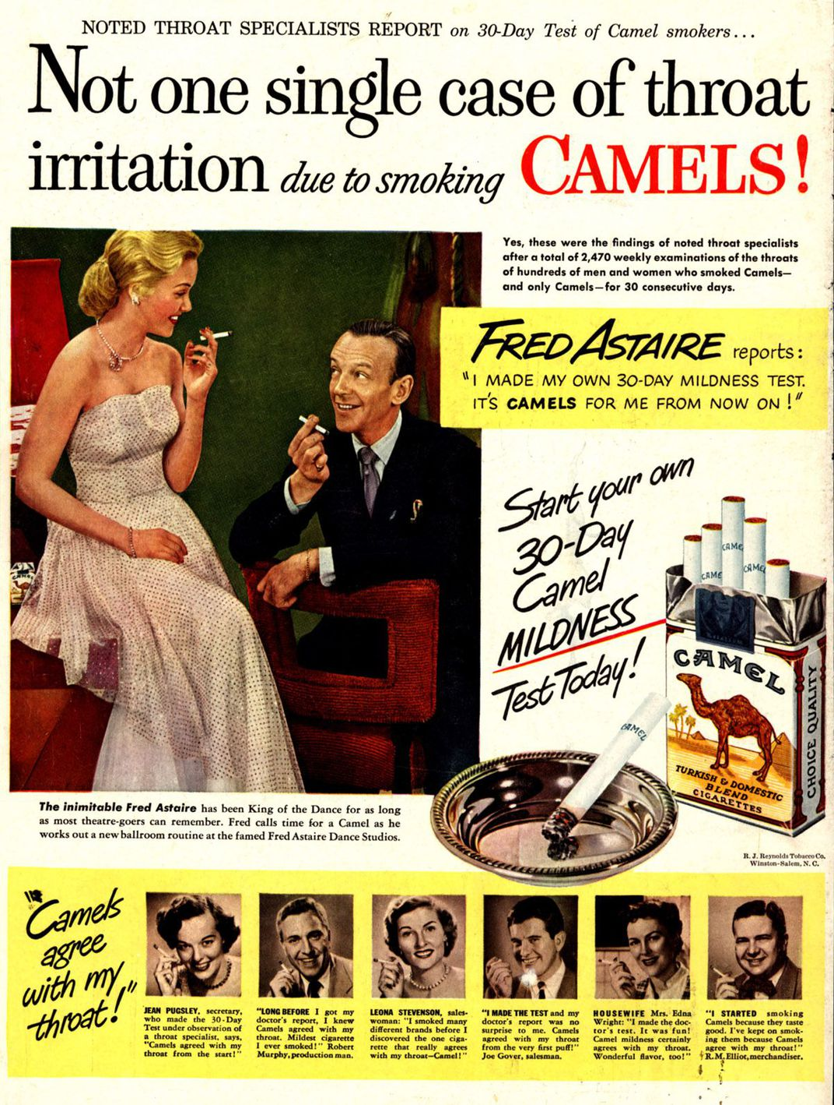
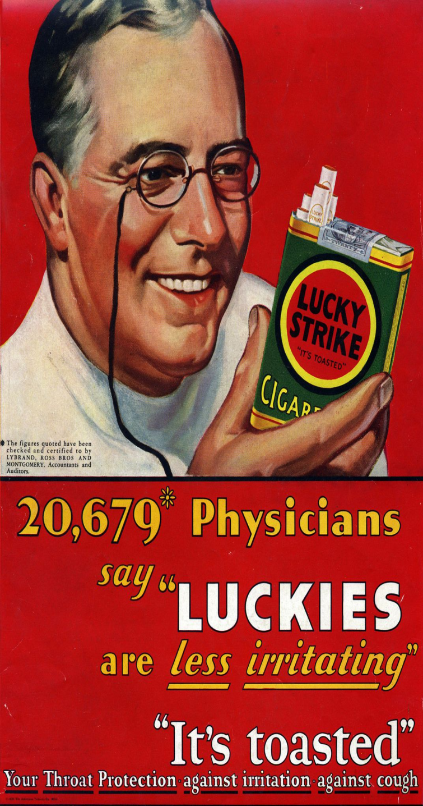
Keller, Kate. Ads for E-Cigarettes Today Hearken Back to the Banned Tricks of Big Tobacco. Smithsonian.com, Apr. 2018, www.smithsonianmag.com/history/electronic-cigarettes-millennial-appeal-ushers-next-generation-nicotine-addicts-180968747/

Slide 3
Disclosures
We have none.
Except
Since we began this project, much more has been studied and published...…

Slide 4
Juul went into a ninth-grade classroom and called its device 'totally safe,' teens testify
By Arman Azad, CNN Thu July 25, 2019
NBC Nightly News Aug 14, 2019
Officials investigating after young adults hospitalized with lung damage from vaping Calls Mount to Stop Vaping as Lung Injury Cases Skyrocket
Medscape Medical News August 30, 2019
The Mysterious Vaping Illness That’s
‘Becoming an Epidemic’
A surge of severe lung ailments has baffled doctors and public health experts.
By Sheila Kaplan and Matt Richtel Published Aug. 31, 2019 Updated Sept. 1, 2019, 4:05 p.m. ET New York Times m a rketer of poison and your target has been young people," one congressman told executives during a ring Thursday.
9/9/2019 CDC Investigation Notice Outbreak of Lung Illness Associated with Using E-cigarette Products
It’s time for a ‘federal reckoning’ in the wake of vaping-linked deaths, says former FDA chief
PUBLISHED MON, SEP 9 2019 8:47 AM EDT UPDATED MON, SEP 9 2019 10:30 AM EDT Jessica Bursztynsky
https://www.cnbc.com/jessica-bursztynsky/
Trump moves to ban flavored e-cigarettes
The Washington Post 9/11//19 Laurie McGinley

Slide 5
Goals and Objectives
Participants in this lecture/discussion will:
Increase their knowledge about the use and effects of electronic nicotine delivery systems.
Gain understanding of the current level of patient education about this topic given by primary health providers.
Strategize ways to increase both patients’ and health providers’ knowledge about ENDS use.
Discuss readiness to respond and teach regarding emerging health risk behaviors.

Slide 6
What do you all know:
Let’s get some baseline indicators …
www.kahoot.it

Slide 7
Our “project”:
R2 Community Medicine project:
Goal:
Increase awareness, provide resources and subsequently increase screening of vaping use in primary care practices;
Questionnaire “pretest” regarding knowledge and practices regarding e-cigarette use
Surveys collected March-June 2019
Followed by lecture presentation
Data reviewed in the EMR

Slide 8
E-Cigarettes Questionnaire
1. How prevalent is e-cigarette use among the patients in your practice:
Not very prevalent Somewhat prevalent Very prevalent
Please answer the following statements according to your practices up to this point:
2. In my well-visit sessions with middle-school-aged patients and teens, I ask them about e-cigarette use and vaping:
All of the time Most of the time Some of the time Never
3. I talk to parents of young teens about starting conversations with their kids about e-cigarette use:
All of the time Most of the time Some of the time Never
4. Information about e-cigarette use is easily recordable in the electronic medical records used in my practice.
Strongly agree Somewhat agree Neither agree nor disagree Somewhat disagree Strongly disagree
5. Which of the following is NOT considered an electronic nicotine delivery system device:
E-cigarettes
Vapes
Juuls
Tank device
None of the above
6. E-cigarettes are now the most commonly used tobacco product among youth. True False
7. E-cigarette use is considered a safe alternative to traditional combustible cigarette use. True False
8. All of the following statements are true EXCEPT:
Most e-cigarettes contain nicotine which has known health effects.
The battery-heated liquid produces an aerosol that is a harmless water vapor.
E-cigarettes may help non-pregnant adult smokers if used as a complete substitute for smoked tobacco products.
E-cigarettes can be used to deliver marijuana and other drugs.
9. Which of the following statements is NOT true about Juuls:
a. Juul “pods” contains as much nicotine as a pack of traditional cigarettes.
b. Juul is available in many flavors that are especially appealing to adolescents and adults.
c. The Juul product is manufactured to resemble a USB flash drive device.
d. Juul users have a significant risk of becoming combustible cigarette smokers.
e. All of the above are true.

Slide 9
Pre-Test results
At Hunterdon: Primary Care offices; n=61
At Brown: Family Medicine residents; n=11
Groups aren’t heterogenous:
Hunterdon much larger group comprised of primary practice staffs including physicians, clinical and office staff.
Brown comprised of all FM residents;

Slide 10
Findings of interest:
Most (61%) from both groups felt that e-cigarette use was somewhat prevalent amongst their patient population. (15% not very prevalent; 16% very prevalent).
How often providers asked teens about vaping:
Brown equally over all, most and some of the time;
Hunterdon more than half bring it up most and all the time; 16% some of the time or never;
How frequently providers address this with parents of teens:
Brown 10/11 said some of the time or never (1 respondent said always);
Hunterdon respondents were all along the frequencies, basically half all or most of the time, and half indicated some of the time or never;
Whether information about e-cigarette use is easily recordable in the EHRs:
Brown respondents didn’t strongly agree or disagree;
Hunterdon, 42% strongly or somewhat agreed; 21% strongly or somewhat disagreed.
Again, this information was gathered spring 2019!

Slide 11
Project Objectives
Understand the different types of ENDS (Electronic Nicotine Delivery Systems) available
Review the rising prevalence of vaping in adolescents and teenagers
Understand the health effects of ENDS/vaping
Understand how and where to accurately document in EMR (NextGen)
Understand how to counsel and what resources are available to patients

Slide 12
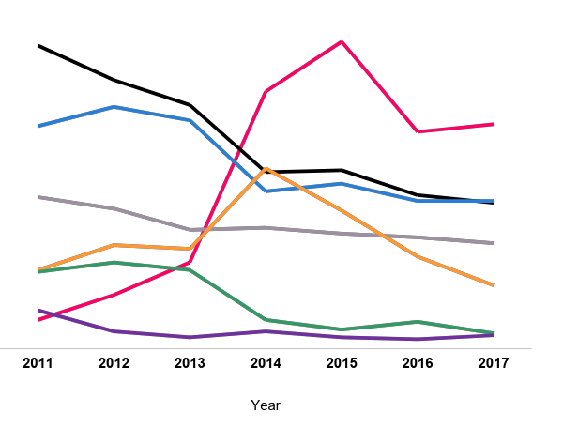
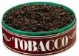
Current Tobacco Product Use Among U.S. High School Students by Tobacco Product – NYTS 2011-2017
Cigarette
15.8%
Cigar
11.6%
11.7%
Smokeless
7.9%
7.7%
7.6%
Hookah
4.1%
5.5%
Pipe
4.0%
3.3%
Bidi
2.0%
E-cigarette
1.5%
0.8%
0.7%
Source: Wang TW, Gentzke A, Sharapova S, Cullen KA, Ambrose BK, Jamal A. Tobacco Product Use Among Middle and High School Students — United States, 2011–2017. MMWR Morb Mortal Wkly Rep 2018;67:629–633.
Notes:
Vaping use is up among teens. Why?
In 2014, use of e-cigarettes among youth and young adults surpassed use of conventional cigarettes.

Slide 13
Teen Vaping Rates Continue to Rise
According to the CDC, 1 in 5 high school-age students were reported to use electronic cigarettes (March 2019)
https://www.cnn.com/2019/03/26/health/gottlieb-ecigarette-partner/index.html

Slide 14
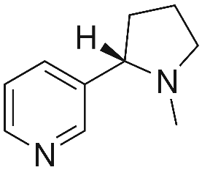
Youth Initiation and Use
Combination of Factors...
Advertising
Flavors
Nicotine
Source: CDC, 2018 The Rise of JUUL, Implications for Public Health Policy and Practice. Brian A. King PHD, MPH. October 26, 2018

Slide 15
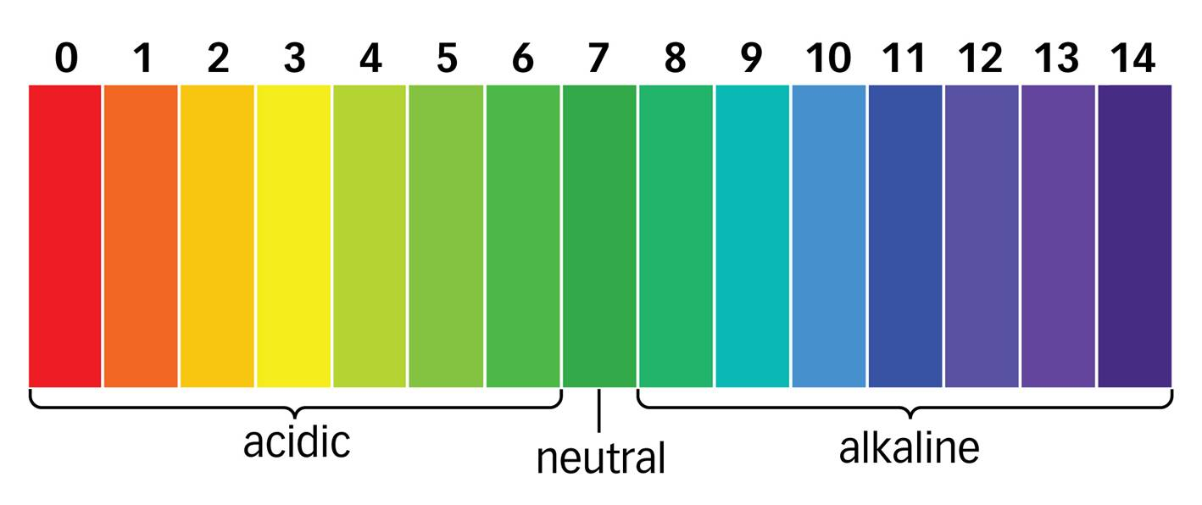
Nicotine salts allow particularly high levels of nicotine to be inhaled more easily and with less irritation than free base nicotine
Nicotine Salts
Free Base Nicotine
Source: CDC, 2018 The Rise of JUUL, Implications for Public Health Policy and Practice. Brian A. King PHD, MPH. October 26, 2018

Slide 16
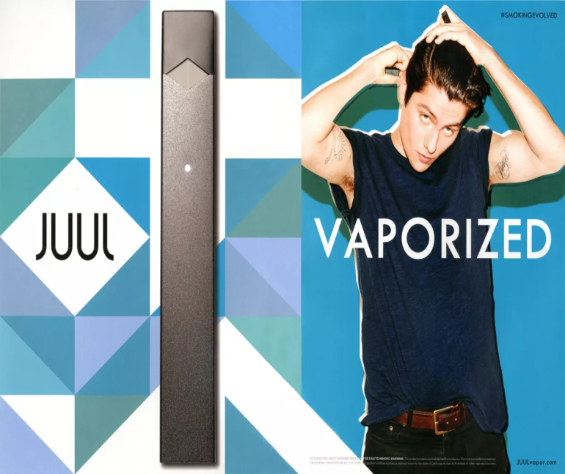
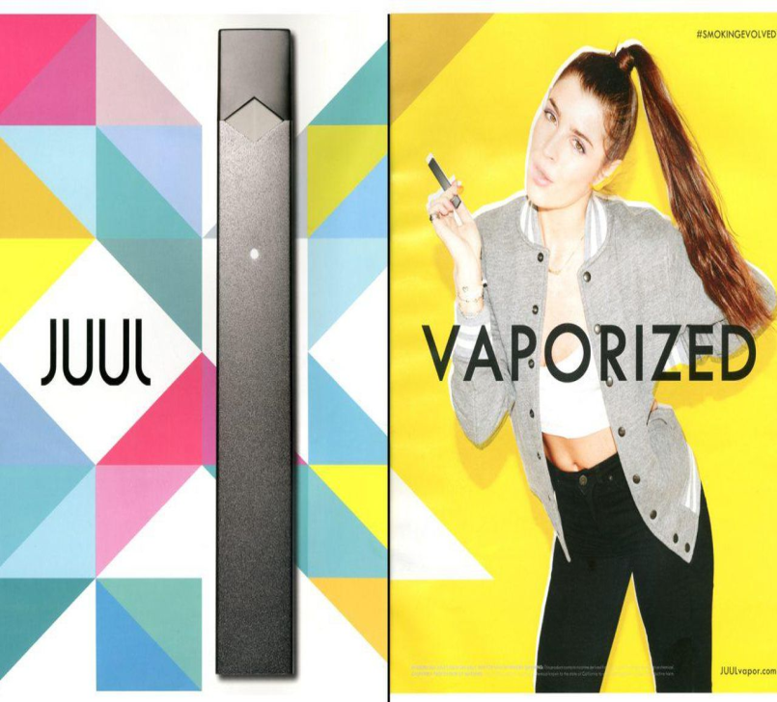
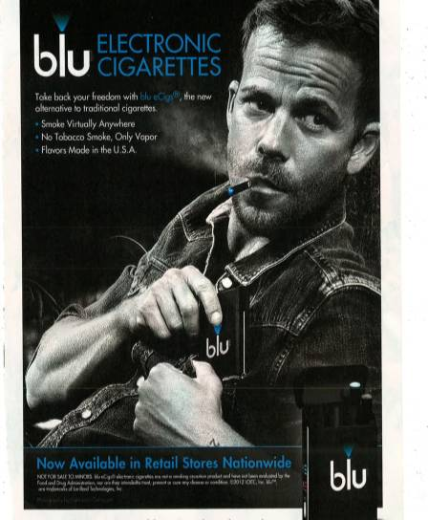
Youth Advertising

Slide 17
Social Media & Youth Marketing
JUUL’s Instagram is age-restricted (must be >18 yo)
BUT, their Twitter is NOT, and features almost identical content to their Instagram
Bach, Laura. JUUL and Youth: Rising E-Cigarette Popularity. Campaign for Tobacco Free Kids, Aug. 2018

Slide 18
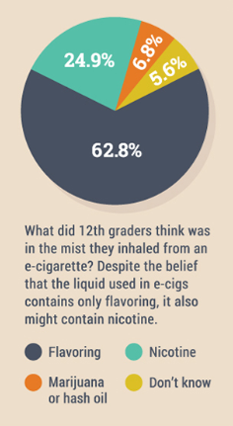
Are Youth Using E-cigarettes with Nicotine?
Self-reported nicotine consumption among youth may be subject to bias:
Youth may not know what nicotine is, let alone whether it is in their e-cigarette.
Youth who access e-cigarettes from peers may not see packaging.
Some e-cigarette labels obscure nicotine content.
Question asked respondents to choose only one response option.
Source: www.drugabuse.gov/related-topics/trends-statistics/infographics/monitoring-future-2016-survey-results
CDC, 2018 The Rise of JUUL, Implications for Public Health Policy and Practice. Brian A. King PHD, MPH. October 26, 2018

Slide 19
Nicotine Addiction & Youth
Nicotine is dangerous and highly addictive for youth at any age because the brain is still developing.
Nicotine effects brain circuits that control attention, learning, mood, impulse control, and increase susceptibility to addiction and other drugs use
In addition to nicotine exposure, e-cig use can be harmful due to the other chemicals/substances present in e-cig devices.
Nearly 1 in 11 middle and high school vaped cannabis in the US
Source: Tobacco Free for a Healthy NJ, NJ Dept of Health, 2018.
Notes:
Nicotine is highly addictive, by activating areas of the brain involving feelings of pleasure (dopamine)

Slide 20
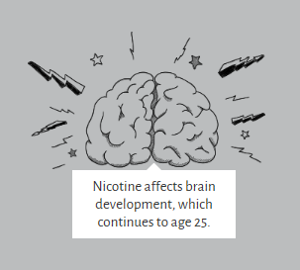
Nicotine in E-cigarettes and the Brain
Each time a new memory is created or a new skill is learned, stronger connections are built between brain cells.
Young people's brains build these connections faster than adults.
Because addiction is a form of learning, adolescents can get addicted more easily than adults.
Source: Centers for Disease Control and Prevention. E-Cigarette Fact Sheet; https://www.cdc.gov/tobacco/infographics/youth/pdfs/e-cigarettes-usb-flash-508.pdf; accessed: October 15, 2018. U.S. Department of Health and Human Services. E-Cigarette Use Among Youth and Young Adults. A Report of the Surgeon General. Atlanta, GA: U.S. Department of HHS, CDC, NCCDPHP, Office on Smoking and Health, 2016.

Slide 21
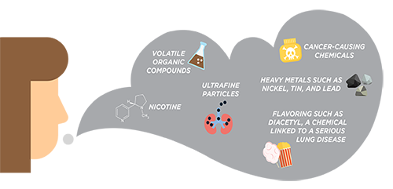
ENDs Vapor
The vapor does not contain the 7,000 chemicals traditional cigarette smoke does...
BUT is unregulated by the FDA and contains: heavy metals, organic compounds, cancer causing chemicals
99% of ALL e-cigs sold at convenience stores, supermarkets and similar outlets contain nicotine.
SOURCE: CDC,2018. Truth Initiative, 2018. Tobacco Free for a Healthy NJ, NJ Dept of Health

Slide 22
Popcorn Lung
When inhaled, diacetyl causes bronchiolitis obliterans
scarring of the tiny air sacs in the lungs resulting in the thickening and narrowing of the airways
Sxs: coughing, wheezing, SOB
Source: American Lung Association, July 2016 https://www.lung.org/about-us/blog/2016/07/popcorn-lung-risk-ecigs.html
Notes:
Over a decade ago, workers in a microwave popcorn factory were sickened by breathing in diacetyl—the buttery-flavored chemical in foods like popcorn, caramel and dairy products. While this flavoring may be tasty, it was linked to deaths and hundreds of cases of bronchiolitis obliterans, a serious and irreversible lung disease. As a result, the major popcorn manufacturers removed diacetyl from their products,

Slide 23
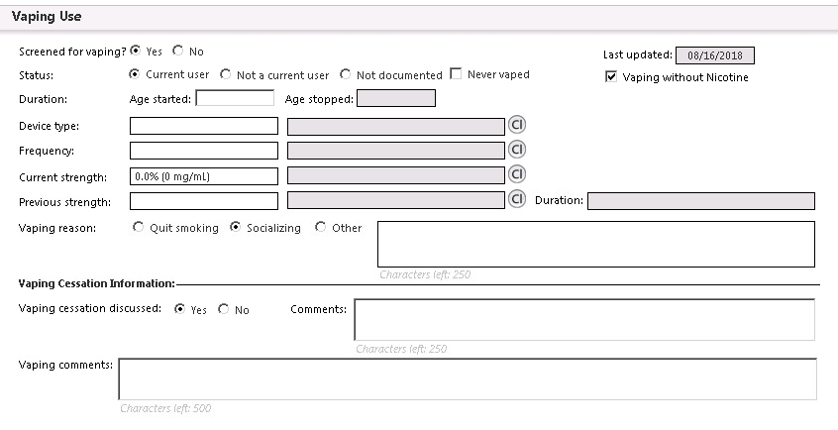
EMR
2018: No place to record screening for vaping.
2019: End of 2019 Q2 Hunterdon primary care practices had screened 12.91% of patients age 13 and above for vaping
Notes:
***also, open tellurian desktop and show them how to access the vaping toolkit

Slide 24
Small group discussion
For providers:
How has your discussion about vaping changed recently?
For Behavioral Science Faculty:
How has your instruction to residents regarding vaping changed recently?

Slide 25
So what do we know about use of these devices now:
Aid for quitting combustible products
Attractiveness
Ease of access
Addictiveness
Harmfulness

Slide 26
How does the discussion vary in these settings:
With children:
With adolescents:
With parents:
With adults:
How is this documented in our EHRs?

Slide 27
How are we teaching our residents to address vaping?
Tobacco use questions
Documentation
Motivational Interviewing techniques
Preparedness for subsequent unexpected situations.

Slide 28
Resources For Parents
From the Surgeon General’s Office and the CDC:
Talk with Your Teen About E-Cigarettes: A Tip Sheet For Parents. . CDC, DHHS, Office of the Surgeon General, e-cigarettes.surgeongeneral.gov/documents/SGR_ECig_ParentTipSheet_508.pdf.
Notes:
From Surgeon General, link at end of PP under resources

Slide 29
Know the Facts, Answer Their Questions
Talk with Your Teen About E-Cigarettes: A Tip Sheet For Parents. . CDC, DHHS, Office of the Surgeon General, e-cigarettes.surgeongeneral.gov/documents/SGR_ECig_ParentTipSheet_508.pdf.

Slide 30
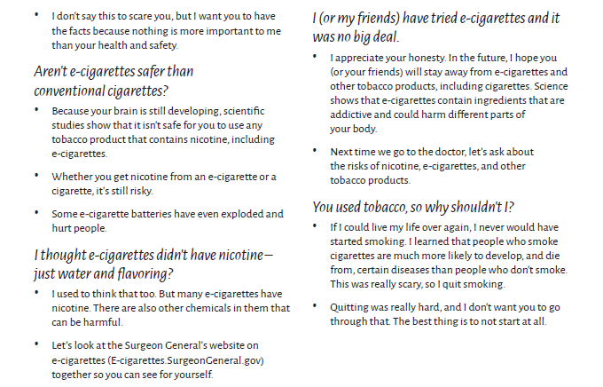
Resources For Parents
Talk with Your Teen About E-Cigarettes: A Tip Sheet For Parents. . CDC, DHHS, Office of the Surgeon General, e-cigarettes.surgeongeneral.gov/documents/SGR_ECig_ParentTipSheet_508.pdf.

Slide 31
More Resources
Talk With Your Teen - CDC/Surgeon General
https://truthinitiative.org/sites/default/files/Truth_E-Cigarette_FactSheet_FINAL.pdf
www.tobaccofreenj.com
www.teen.smokefree.gov
Impact on Cardiovascular Outcomes Among E-Cigarette Users: A Review From National Health Interview Surveys; Mohinder R. Vindhyal, et al; 3/18/2019
Klein MD, Sokol RA, Stroud. Electronic cigarettes: common questions and answers, Am Fam Physician. 2019 Aug 15;100(4):227-235.
https://www.dontgetvapedin.com A website for teens.
https://www.thetruth.com
Notes:
Click on first link -- gives good info about how parents can educate themselves and be ready for their kids questions about vaping

