Slide 1
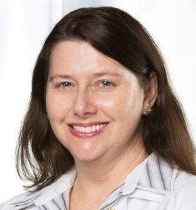
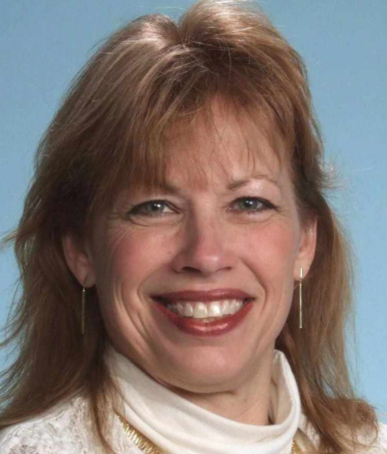
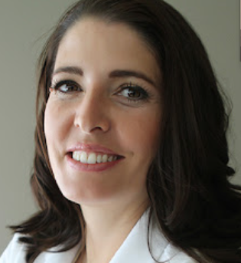
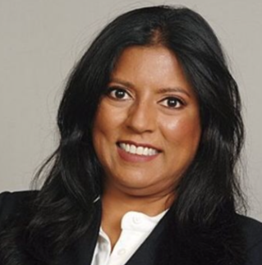
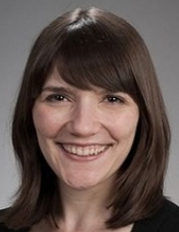
Writing an Effective External Letter of Review for Promotion
Suzanne Minor MD
Vicki Hayes MD
Jennifer R. Hartmark-Hill MD
Joanna Drowos DO
Sonya Shipley MD
Parvathi Perumareddi DO
Frank Domino MD
Jeanne Cawse-Lucas MD
Notes:
We are presenting on “Writing an Effective External Letter of Review for Promotion”.
This project actually started in 2018 when Vicki Hayes emailed STFM members on STFM Connect to ask about performing external review for promotions.
The authors of this session are myself, … list all
This presentation represents all members, though not all are speaking in the presentation.

Slide 2
Disclosures None
Notes:
Suzie

Slide 3
Objectives
Recognize that writing quality external letters of review for others’ promotion is an important service and skill for academicians.
Identify the role of the external reviewer in evaluation for the promotion process
Outline the process for writing an external letter of review
Critique sample external letters of review and edit letters to improve quality.
Notes:
Suzie

Slide 4
Why write external letters of review?
Important service and skill for academicians
Important for URM and women faculty retention and promotion
Photo/NIH
Notes:
Suzie
Why write external letters of review? The same reasons that we teach and mentor hold true with why perform external review for promotion.
This is an important service…
And it’s especially important to retaining and promoting our URM and women faculty in academic medicine.

Slide 5
The Promotion Process
1
Bio, Statements
Meet with Dept Chair
2
External Review
3
Dept Committee reviews application, including external letters of review
Then Dept Chair, Dean, Provost review application
Submit application
Notes:
Joanna

Slide 6
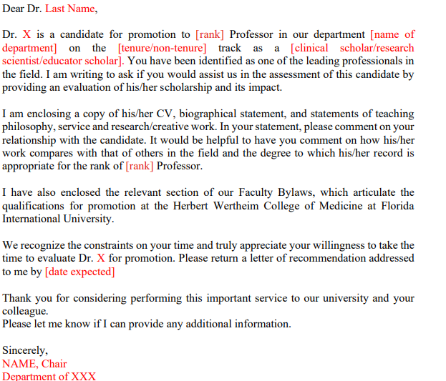
The Ask Letter:
Notes:
Joanna
This ask is coming from the individuals dept and weighs into the promotion decision.
If you cannot write the letter or have a conflict, it’s ok to bow out and it’s recommended to suggest another reviewer.

Slide 7
The Ask
Variable! Each school does this differently
Ask Letter should:
Detail promotion rank and track
Detail promotion criteria & supporting activities for each area of excellence (Clinical, Education, Investigation/Research, Service, etc.) their institution requires
Specific questions to answer in your review
Include due date
Attached materials: promotion criteria, CV, bio, statements of teaching, service, research/creative work
You can request further information as needed
Notes:
Joanna
Sometimes many need to ask for more information – details of assignment

Slide 8
Approach to Writing!
Saying yes or no
Check your bias
Reading & understanding institution’s criteria
Writing the letter
Components of external letter of review
Notes:
Joanna

Slide 9
The Process:
Agreeing to write?
All information needed?
Narrative for highlights?
Special questions for focus?
Examples from CV of criteria
Review criteria
Draft letter to template
Strengthen language, watch bias
Edit and read again before sending
Notes:
Joanna

Slide 10
Approach: Saying Yes or No
Time required
Arms length definition and if need to ask about this
Do you feel you can write a strong & supportive letter?
Notes:
Jeanne

Slide 11
LORs are fraught with bias . . .
Studies demonstrate that letters for women are shorter and have more doubt raisers
Letters for URiM candidates are often less agentic
Gender bias calculator: https://www.tomforth.co.uk/genderbias/
https://www.linkedin.com/pulse/5-tips-writing-great-letters-reference-avoiding-bias-sharonne-hayes
Notes:
Jeanne
LORs historically were meant to keep people out rather than inclusion
We need to be aware of this history and use our words wisely
Studies have demonstrated that even with identical resumes, women are viewed as less competent and less hirable than identical men, offered lower salary and less career mentorship, but more likable.
Letters for women: Shorter, More likely to portray as teachers and students vs. Men as researchers and professionals,
Letters for women have More doubt raisers
While not the best student I have had
She has a somewhat challenging personality
While his publications are not numerous as you know
He appears to be a highly motivated colleague
It appears that her health and personal life are stable
Not much research on race and LORs, but one did see URiM as less agentic
Things may be getting better – more recent studies show more equitable letters
Remember that these structures were created and propogated a long time ago and you might intentionally want to use words that could be considered “biased.” The point here is to think about how you are describing a student and be intentional.
2020 (Grimm) Radiology- women as MORE agentic but this was the only one that looked at race as well and URM (Black/Latinx) as less agentic
2020 (Kobayashi) Ortho– minimal difference in use of language and length of letters
2020 (Lin) Optho- LOR for male more authentic words, more leisure words, less feel words and less biologic process words
2019 (Filippou) Urology-460 letters, LOR for male have more authentic tone and mention of personal drive, work, and power. Power assoc w more matching.
2019 Surgery letters for women were shorter, had fewer “standout” words, and more grindstone and likability words
2019 (Miller) EM. 822 SLOEs in EM did not have significant different language by gender.
2018 (French) Surgery- 559 LORs reviewed for 400 terms/24 categories. Similar length and similar words used.
2017 (Li) EM SLOE: female applicants highlight communal characteristics of teamwork, helpfulness, and compassion. Contrary to prior research, ability words highlighting intelligence and skill appeared with greater frequency for female applicants. No pervasive differences were found in other word categories. In this sample, the standardized format of the SLOE resulted in letters that were relatively free of gender bias.
2016 (Messner) ENT-shows no gender difference. 2019 ENT Shows ongoing difference consistent with other studies. Interestingly, more “leisure” words for men.

Slide 12
What can I do?
Be comprehensive – include leadership, research, publications
Keep it professional – use Dr. and surname instead of first names
Focus on comparing the applicant with the requirements of the job
Check your writing- would you use the same phrases to describe someone of a different ethnicity or gender?
Notes:
Jeanne

Slide 13
Approach: Read & Understanding the Institution’s Criteria
Review the ask letter for priorities
Know your own institutional criteria so that you can add “this person would meet criteria at our institution for promotion to ___ Professor”
Notes:
Jeanne
Review the ask letter for priorities (should be the same areas of excellence, but applicants often talk about what they did, but not how they meet those areas)
Know your own institutional criteria so that you can add “this person would meet criteria at our institution for promotion to ___ Professor”

Slide 14
Approach: Writing the Letter
Draft
Use the asking letter as a template and pull from applicant’s statements to draft the external review letter
Mitigate
Be aware of gender bias or language particular to URMs in writing the letter
Consider
Consider tone & content, as if you were giving face-to-face (like pts seeing EMR notes)
Notes:
Jeanne

Slide 15
Let’s practice!
Critique this letter of review for promotion -- What is strong and what can be improved?
Notes:
Vikki

Slide 16
Notes:
Vikki
Too brief
Does not elucidate own rank and background/qualifications for writing the letter.
Does not demonstrate understanding of criteria for promotion.
Does not adequately describe the candidate’s background & accomplishments and the fulfillment of promotional criteria.

Slide 17
Approach: Components of the Letter
Your qualifications for writing this letter
Your understanding of criteria for promotion
Comparison of criteria to the promotion packet contents
organize by each criteria heading
consider quantity, quality, impact
Recommendation and closing - statement about if their activities would support that promotion at our institution.
Notes:
Vikki

Slide 18
Too Brief
No letter-writer’s background/
qualifications
No comparison of criteria
No conclusion related to meeting criteria
Notes:
Vikki

Slide 19
Let’s practice!
How about this one -- What is strong and what needs improvement?
Notes:
Vikki

Slide 20
Notes:
Vikki

Slide 21
Notes:
Vikki
Informality—not using titles in text (light blue)
Personal information (daughter’s school, caregiver) (dark purple)
Emphasizes effort, not accomplishments (hard-working, works to improve, supports) (green)
Stereotypical descriptors: caring, compassionate, warm, empathetic (yellow)
Letters for men more likely to mention research, publications
Faint praise (hot pink)

Slide 22
Let’s fix it!
Notes:
Vikki

Slide 23
You can do it! Just remember to…
Be comprehensive – include leadership, research, publications
Keep it professional – use Dr. and surname instead of first names
Watch for statements of faint praise
Check your writing- would you use the same phrases to describe someone of a different race or gender?
Try out the gender calculator!
Focus on comparing the applicant with the requirements of the job
Notes:
Vikki

Slide 24
Debrief & Closing
Comments
Questions
Take Home Points
Where are you in Promotion Process?
Notes:
Suzie
Writing quality external letters of review for others’ promotion is an important service and skill for academicians.
External review is a vital step in the promotion process
When you are asked to perform external review, consider saying yes or no and if you say yes, check your bias, have thorough understanding of their and your institution’s criteria, and use the guidelines Dr. Hayes just summarized in the previous slide.

Slide 25
References
Schlozman KL. External Reviews in Tenure and Promotions Decisions: How Does the Process Work? How Should It? Political Science and Politics. 1998;31(3):623-630.
Goldman E. Writing Tenure-Review Letters. Inside Higher Ed. 2017. https://www.insidehighered.com/advice/2017/01/19/advice-how-write-effective-tenure-review-letters
Misra J. Lundquist J. Letters of Assessment. 2016. https://www.insidehighered.com/advice/2016/07/14/advice-writing-letters-assessing-other-faculty-tenure-and-promotion-essay
Boonan D. Everything You Always Wanted to Know About Writing a Tenure Letter But Were Afraid to Ask An Academic Administrator. DailyNous. 2016. http://dailynous.com/2016/10/03/everything-wanted-know-writing-tenure-letter-afraid-ask/
Sample Letter to External Letter Writers for Promotion to Associate Professor. FAS Appointment and Promotion Handbook, Harvard University. https://academic-appointments.fas.harvard.edu/h-sample-letter-external-letter-writers-promotion-associate-professor
Heath JK, Weissman GE, Clancy CB, Shou H, Farrar JT, Dine CJ. Assessment of Gender-Based Linguistic Differences in Physician Trainee Evaluations of Medical Faculty Using Automated Text Mining. JAMA Netw Open. 2019;2(5):e193520. https://jamanetwork.com/journals/jamanetworkopen/fullarticle/2733173
Notes:
Suzie

Slide 26
Thank you!
Evaluation
Please be sure to complete an evaluation for this presentation because we want your feedback!

