Slide 1
Take a Deep Breath: A Randomized Controlled Trial
Shamita Misra, MD
Jane A McElroy, PhD
STFM May 9, 2018
Washington DC

Slide 2
Background
Hypertension (high blood pressure) is a public health problem and difficult to control
33% Americans (80 million) have hypertension
46% uncontrolled
1/3 Americans use Complementary and Alternative Medicine (CAM ) therapies for a condition

Slide 3
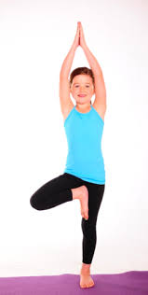
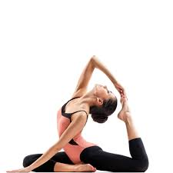
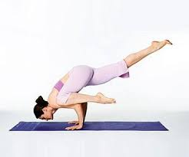
Background continued….
Previous studies have utilized all components of Yoga: breathing, meditation and postures and shown positive results BP
Some postures (asanas) are complex. Require flexibility.
Cannot be performed by all people
Use of device assisted breathing (to achieve 6 breaths/min) has shown promise in BP reduction
No device needed in Pranayama

Slide 4
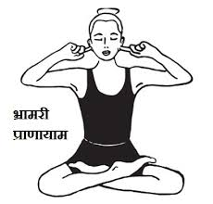
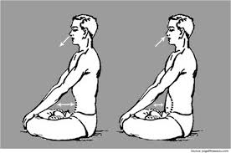
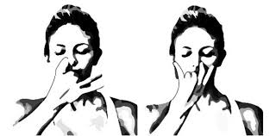
What is Pranayama
Type of deep Breathing
Sanskrit word meaning "extension of the prana or breath" more accurately, "extension of the life force.”

Slide 5
How does Pranayama Work
Likely stimulates Autonomic Nervous System
Parasympathetic component or the Vagus Nerve
This slows the Heart Rate and decreases BP

Slide 6
Our Pilot: What we did
In 2011 a pilot study was conducted in 8 people with prehypertension
One aspect of Yoga :- breathing( Pranayama) evaluated
6-week intervention with 1 month followup; recommend daily practice; in class instruction once a week
Both BPs decreased significantly, 11 mm SBP and 8 mm DBP at one month followup
But……no controls

Slide 7
Study Design
RCT (Participants with uncontrolled HTN)
3 arm: DVD/YouTube, Class, Control
Weekly BP measurements at clinic
One month and three month follow up
The goal was 25 participants each arm for power
3 waves: Oct, Nov and Feb

Slide 8
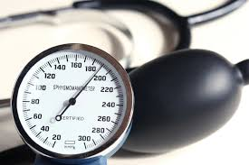
Eligibility Criteria
Inclusion
English-speaking adults
JNC 8 HTN classification
less than 60 years of age with BP measurements of ≥140/ ≥90 mm Hg
60 years of age or older with BP measurements of ≥150/ ≥90 mm Hg
diagnosed with diabetes with BP measurements of ≥140/ ≥90 mm Hg
patients with BP measurements of <180/ <110 mm Hg without hypertensive
urgency symptoms
Exclusion
patients who have COPD, renal disease or chronic alcoholism

Slide 9
Participant Recruitment
Patients (n=5509) identified through EMR uncontrolled hypertension (HTN) registry.
FCM Physicians (and residents) (n=54) received their uncontrolled HTN patient lists w/ 30 PCPs responding (56% response rate)
highly recommending *
recommending √
not recommending
don’t know patients
Confirmed HTN (n=1682 → 986) from chart review of * , √ patients

Slide 10
Recruitment continued
For 3 waves, introductory letters stating physician’s named sent to
All highly recommended * (n=310)
Random selection of ‘OK, √’ to contact (n=300 of 674)

Slide 11
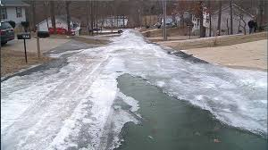
Enrollment Status (n=612)
Phone calls made to enroll for Oct, Nov, Feb waves
Status group | Number |  | Number
Agreed to participate | 135 (22%)
 |  | No shows on 1st week of intervention | 30
 |  | Completed study | 83
 |  | Partially completed ( Drop out) | 22
Declined | 240 (39%)
Unable to contact | 235 (38%)
62% completed study
Enrollment took <3 weeks (wave 1 and 2) and
1 day for wave 3 (ice day)

Slide 12
Methods
Wave 1 and 2 random assignment into one of the 3 study arms;
Wave 3 had DVD assignment only
Control (n=22, 88% completed)
Class (n=23, 79% completed)
DVD group (n=38, 79% completed)
All participants did a 6-week intervention with weekly BP measurements at clinic, 1 month and 3 month BP follow-up

Slide 13
Methods Continued…
Questionnaire at baseline, end of intervention (week 6), 3 month followup
IPAQ (Physical activity) *Pittsburgh Sleep scale
Overall diet *Apnea sleep scale
Special diet *DAR (anger) scale
PHQ9-Depression *CDC smoking status
NIAAA (Alcohol consumption) *Rand 36 scale (QoL)
Connor Davidson Resilience Scale *Perceived Stress Scale
Family hx of HTN, stoke, heart disease *Weight (height) measured
Self efficacy scale
Confirmed medication during intervention, and med changes, breathing exercise practice at 1 and 3 months; asked about white coat syndrome

Slide 14
Participant Characteristics (n=83)
Mean age 60 years (range 30-80 year olds)
93% white
63% college educated/working
82% married
54% Obese (mean BMI 32 kg/m²)
77% family history HTN, stroke, and/or heart disease
1/3 of PCP had 3 or more participants in the study
52% male

Slide 15
Systolic blood pressure over time by intervention group

Slide 16
Systolic Blood Pressure, Wave 1 only Oct 2016 – Dec 2016

Slide 17
Systolic Blood Pressure, Wave 2 only Nov 2016 – Jan 2017

Slide 18
Systolic Blood Pressure, Wave 3 (intervention only, election/inauguration already occurred by week 1)

Slide 19
Environmental Climate
What is happening in the real world when we are in the midst of our research?
Does it affect our results?

Slide 20
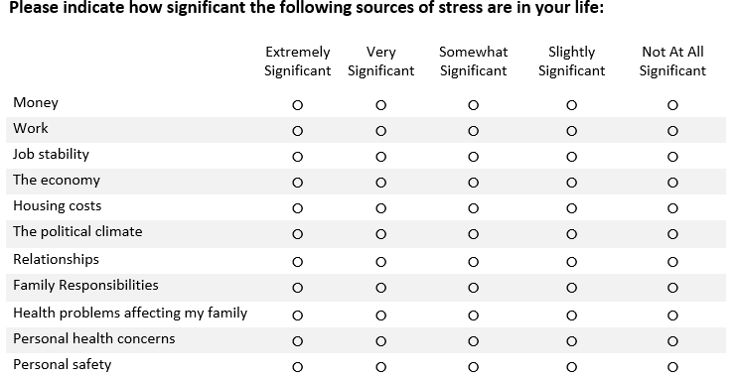
Evaluation of Impact of Election on BP
1. Survey Administered Feb (retrospective recall)
2. Thinking back to November (BEFORE the election), how significant was the political climate as a source of stress in your life? (Note: election date, November 8th, 2016)
3. In the two months AFTER the election and BEFORE inauguration, how significant was the political climate as a source of stress in your life? (Note: inauguration date, Jan 20th, 2017)

Slide 21
Identifying What Stresses People

Slide 22
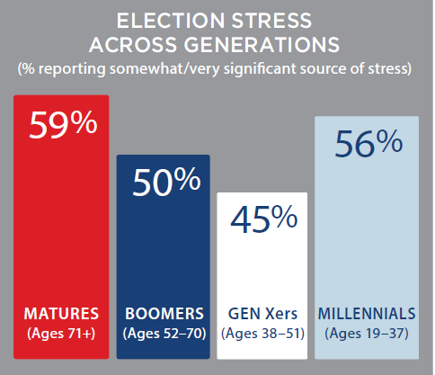
Our Survey: Gallup Poll Survey
Overall 51%

Slide 23
Identifying What Stresses People—extremely to somewhat
The political climate: 53%
The economy 42%
Personal health concerns: 40%
Money: 39%
Family responsibilities: 39%
Work: 37%
Health problems affecting my family: 35%
Relationships: 32%
Housing costs: 23%
Job stability: 21%
Personal safety: 15%

Slide 24
Thinking back to November (BEFORE the election), how significant was the political climate as a source of stress in your life? (Note: election date, November 8th, 2016)
CLASS | 45%
DVD | 47%
CONTROL | 64%
Overall
Somewhat - significantly
stressed
51%

Slide 25
In the two months AFTER the election and BEFORE inauguration, how significant was the political climate as a source of stress in your life? (Note: inauguration date, Jan 20th, 2017)
CLASS | 55%
DVD | 64%
CONTROL | 61%
Overall
Somewhat - significantly
stressed
60%

Slide 26
Wave 1
Wave 1
Wave 2
Wave 2

Slide 27
Wave 1
Wave 2
Wave 1
Wave 2
Wave 3

Slide 28
Interesting tidbits
PCPs who completed the list were happy to do so; PAPER COPY preferred
PCOR advisory board recommended NOT using the word ‘Pranayama breathing’ in patient material
Enrollment was super fast (< 3 weeks) Calling on Sunday worked well for getting hold of people)
Location may have mattered for enrollment
Evening in winter affected enrollment for older participants (declined due to need to drive at night)

Slide 29
Interesting tidbits
Need to over-enroll since 22% of those who agreed by phone were ‘no shows’
Overall, need to have more participants
(after enrollment) Email communication worked fine w/almost all (<5% needed phone calls)
Redcap (online) survey worked OK but needed to have paper copies for about 20% of participants
Dedicated email address simplified communication (BPStudy@missouri.edu)

Slide 30
Interesting tidbits
DVD instruction did just as well as the class so this is scalable
Wave 1, 2 were offered 3-4 days a week for classes/BP measurements. Wave 3 offered 1 day worked well; ONE DAY IS OK
Orientation with participants, especially telling controls how valuable they were to the success of the project may have influenced their low drop out rate
No difference in number who dropped out between class/DVD
Election seemed to have been super influential on study results---who would have guessed

Slide 31
We would like to acknowledge and thank---
Family and Community Medicine Department for supporting Dr. Misra’s effort through the LEAP project PCOR small grant funding Many interns and staff participants: Nuha Wareg, Muki Gandhi, Kelvin Hodges, Megan Cooper, Rachel Hermes and Dr. Amit Dasguta, Jamie Smith, our analyst
Questions ?

