Slide 1
Can We Broaden Our Focus?: Targeting Family Medicine Training to Non-physician Clinicians
Kathy Z. Chang, MD, MPH, FAAFP
Bridget Nandawula, Clinical Officer

Slide 2
Affiliations
Kathy Z. Chang, MD, MPH, FAAFP
VP Health, Chair - Medical & Health Committee / Engeye, Inc.
Bridget Nandawula, Clinical Officer
Clinic In-Charge, Engeye Health Clinic / Engeye Health Projects, LTD

Slide 3
Conflict of Interest Statement
Kathy Chang is involved as a volunteer with the non-profit organization whose example is described in this presentation. She has not received any financial compensation for this activity or presentation.
Bridget Nandawula is a salaried staff member of Engeye Health Clinic in Uganda. She has not received any financial compensation apart from the cost of travel and conference fees for her activities in the US or this presentation.
Notes:
Ask for participants to introduce themselves and where they are working/partnered.
What are they hoping to get out of today's presentation.

Slide 4
Learning Objectives
By the end of this workshop, participants should be able to:
Evaluate whether their current global health partnerships allow for expansion of medical education to include non-physician clinicians.
Apply strategies to encourage longitudinal continuing medical education programming in the low- and middle-income country (LMIC) peripheral and rural primary care setting.
Select local and international partners for targeting collaboration to increase attention to better delivery of primary care in LMIC.

Slide 5
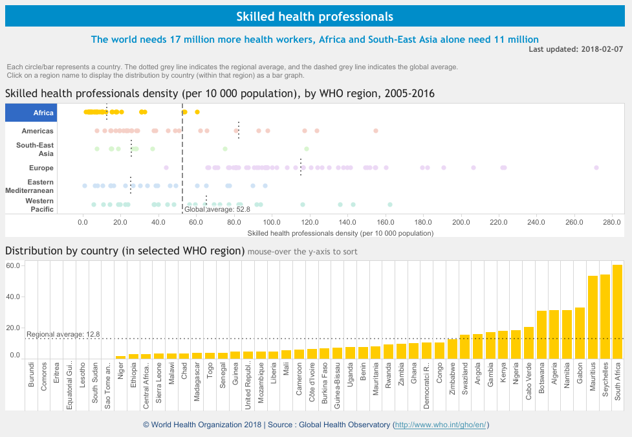
Density and Distribution of Health Workers
Shortage of skilled health professionals
Unevenly distributed despite need
African Region 24% of disease burden, 3% of health workers⁸
Brain drain to urban, for-profit, and international settings⁴
Rural/poor areas struggle to retain health workers
Source: http://apps.who.int/gho/data/node.sdg.3-c-viz?lang=en
Notes:
Reference:
WHO Density of physicians
Eyal

Slide 6
The Need
“to find answers for scaling up the health workforce to increase the quantity, and to improve the quality and relevance of health workers to meet the needs of the 21st century and contribute to better population health outcomes.”¹¹
~ World Health Organization, 2018
Source: WHO (2018). http://www.who.int/hrh/education/en/ (emphasis added)
Notes:
http://www.who.int/hrh/education/en/
http://www.who.int/hrh/workforce_mdgs/en/
“ensure skilled, motivated and supported health workers in the right place at the right time” “improve recruitment, performance and retention of workers - especially in rural and underserved areas”

Slide 7
Clarifying terms
Non-specific terms:
“Frontline health worker”
“Community health worker”
Concepts:
Patient-centered, team-based
Practitioner “tribalism”⁵
Notes:
Campbell et al. Maximizing the impact of community-based practitioners in the quest for universal health coverage. Bulletin of the World Health. Organization 2015;93:590-590A. doi: http://dx.doi.org/10.2471/BLT.15.162198
“...the terms “frontline health workers” and “community health workers” are often used in a non-specific way and can confuse the evidence base. The term “frontline” is not a classification recognized by the World Health Organization (WHO) or the International Labour Organization (ILO). Even the official classification of community health workers can refer to a diverse typology of lay and educated, formal and informal, regulated and unregulated, paid and unpaid health workers. Different policies relating to individual cadres, their scope of practice, education and relation to the health system undermine efforts to strengthen service delivery at community level.9 Large-scale studies that have analysed the policy and health systems features of community-based practitioner programmes have identified major gaps relating to the inclusion of these cadres in national health systems and in the adoption of appropriate education, deployment, performance management and retention strategies.10”
Patient-centered, team-based = ideal, talked about a lot. Very hard to enact in LMIC for multiple reasons.
Practitioner “tribalism” - interferes with integration of non-physician clinicians → multidisciplinary team and all sectors are needed to reach the SDGs
SCG3 = Good Health and Well-being: ensure healthy lives and promote well-being for all at all ages

Slide 8
Non-Physician Clinicians
Examples:
Clinical officer
Comprehensive Nursing officer
Health officer
Physician assistant
Nurse practitioner
Nurse clinician
Associate clinician
Formally educated
Regulated (licensed)
Paid
Defined scope of practice
Notes:
Apparently there’s some disagreement about exact definition for “NPC” - differ on description based on level of training, or roles/functions, level of autonomy etc.
A lot of variation by country

Slide 9
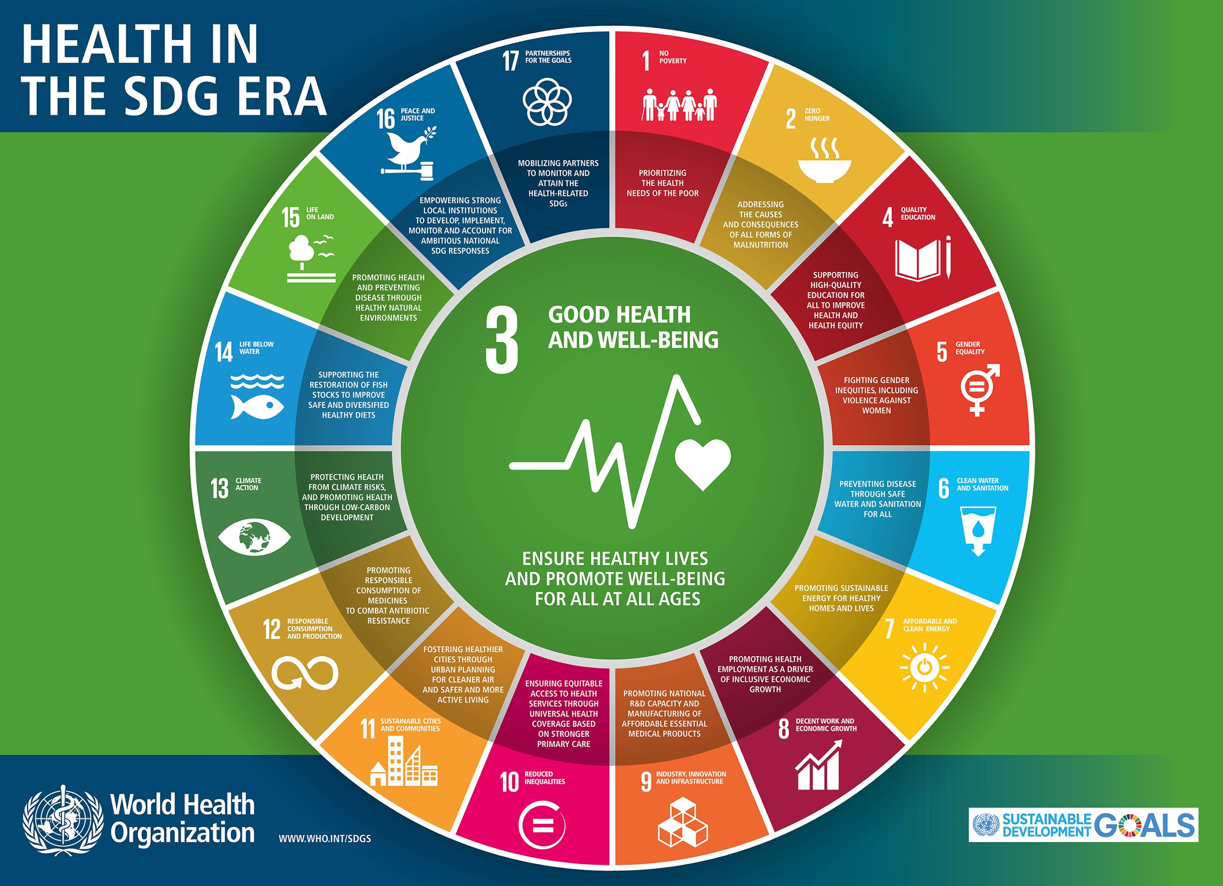
Goals of Primary Care
How do we delivery quality primary care through medical education when the bulk of the population may never see a doctor?
Health care is about taking care of individuals, communities, and populations
Widely accepted as essential
Alma-Ata Declaration, 1978
Sustainable Development Goals http://www.who.int/sdg/en/
Primary Health Care Performance Initiative http://phcperformanceinitiative.org/
Optimize impact of the “front-line” and community-based practitioners to provide quality primary care
Ex. “8 A’s and 3 C’s” or “10 C’s”
Source: http://www.who.int/topics/sustainable-development-goals/test/sdg-banner.jpg?ua=1
Notes:
Wikipedia = “Primary healthcare (PHC) refers to "essential health care" that is based on "scientifically sound and socially acceptable methods and technology, which make universal health care accessible to all individuals and families in a community.”
http://nursingexercise.com/primary-health-care-requirements/
BASIC REQUIREMENTS FOR SOUND PRIMARY HEALTH CARE (8 A’S AND 3 C’S):
The main aim of primary health care is to provide the best possible health services for everyone, everywhere in a country and the universal goal is to assure adequate access to quality care at a reasonable price. The following basic requirements for primary health care are needed to meet the goal towards improving and maintaining the health of the population, as well as first-line services to restore people’s health when they are unwell.
1. Appropriateness:
Primary health care must be suitable or fitting for a particular purpose, person whether the service is needed at all in relation to essential human needs, priorities and policies. Primary health care service has to be properly selected and carried out by trained personnel in the proper way. For example: A nurse should know how to give an injection correctly and safely, and use the ultrasound to provide antenatal care to the pregnant women. Appropriate healthcare technologies are an important strategy for improving the availability and accessibility of healthcare services.
2. Availability:
Availability of medical and health care means the sufficient supply of resources and competent and skilled health workers that ease of community people for emergency or urgent service’s needs. If services are available and there is an adequate supply of equipment’s, then the opportunity to obtain health care exists and can easily improve community people health. Such as TB drugs must be available in the primary health care center and available DOT worker who go to a patient’s home or worksite to facilitate the process.
3. Adequacy:
Adequacy means ability to provide reasonable health care services for a particular purpose to meet the need and demand of the community and country. Adequacy doesn’t indicate excellence or abundance, or even more than what is absolutely necessary. For example: having 200,000 children in need of polio vaccine, the amount of vaccines should be equal to the demand.
4. Accessibility:
Access to health care means having “the timely use, reachable and convenient health services to achieve the best health outcomes of community and country people.
5. Acceptability:
Acceptability is to be something that is considered to be socially pleasing to the receiver, agreeable or within the realm of what is appropriate, or something that is tolerable. For example if a maternal clinic is not good, pregnant women will visit it only when suffering severe pain or bleeding, and avoid recommended checkups.
Acceptability of primary health care depends on-
Cultural sensitivity of health technology and intervention.
User friendly and convenient.
Treat all people with dignity.
Right Target population.
Maintain confidentiality and privacy.
6. Affordability:
Affordability means a person or community able to pay health care costs. The cost should be cheap enough for people and resources of the individual and the country.
7. Assessability:
Assessebility means to set or determine the amount of medical care with a special payment that can be readily evaluated.
8. Accountability:
Accountability is an essential element in health care system. It entails the procedures and processes by which health care workers justify and take responsibility for their activities. Accountable and honest Health care providers are constantly striving to improve quality and efficiency by using performance management systems and quality improvement initiatives.
Making the boundaries of everybody role very clear.
Making duties clear and ensuring have the right training to carry them out safely and effectively.
Ensuring adequate support and supervision.
Providing agreed protocols to guide care delivery.
Offering opportunities to develop in role.
Making issues around delegation clear.
9. Completeness:
Completeness means the quality of being whole or perfect and having nothing missing. In primary health care, completeness is suitable and whole care to all aspects of a medical problem such as prevention, screening, early diagnosis, treatment, follow up measures, and rehabilitation without any restriction. Such as: providing physiotherapy for the hemiplegia after a cerebrovascular stroke and continuous follow ups for diabetic patients after describing drugs to them.
10. Comprehensiveness:
Comprehensiveness of care means providing care for all types of health problems not just the medical and physical ones. By comprehensive care in primary health care, they provide multiple physical and emotional health support of a patient over a period of time in relationship to family, life events and environment and reduce hospitalization, long-term care placement and mortality.
11. Continuity:
Continuity of care means provide quality of health care to community people within over time. It is a method by which community people and health care team are cooperatively comprised in continuous health care management toward the goal of high quality, cost-effective medical care. Continuity of care is important for chronic diseases: diabetes, hypertension, ischemic heart disease. Because these diseases if not controlled, they’ll cause severe problems, however if they’re controlled the mortality rate will be greatly reduced.
https://www.ncbi.nlm.nih.gov/pmc/articles/PMC1492385/
The many C’s of Primary Care doi: 10.1111/j.1525-1497.2004.40401.x
Continuity
Sees patient regularly over time for a large proportion of the patient's health encounters (providing longitudinal rather than cross-sectional care).
Comprehensiveness
Cares for most of the patient's health problems; capable of dealing with substantial comorbidity in those with multiple chronic problems.
Coordination
For the minority of problems that require services from other providers, arranges the referral, test, or procedure and collates the results.
Contact—first
Whenever possible, is willing to be the first provider the patient contacts for episodes of illness or health concerns.
Competence
Practices evidence-based medicine; participates in continuing education; enhances practice through continuous quality improvement.
Cost-effectiveness
Weighs benefits versus costs of care; sensitive to “economic C's” such as capitation, copayments, carve-outs, and conflicts of interest.
Communication
Communicates effectively with patients and other health care workers; uses computers skillfully for accessing literature and providing care.
Collaboration
Comfortably works in teams involving specialty physicians and other health care workers; partners with patients by educating them, eliciting their preferences for care, and engaging in shared decision making.
Compliance
Monitors and enhances patient compliance with medical advice; personally complies with practice guidelines, regulations, etc.
Competing demands
Prioritizes within the brief time allocated for clinic visits a patient's acute problems, chronic conditions, health maintenance, documentation, etc

Slide 10
Training and education fundamentals
WHO 2013 recommendations for transforming and scaling up health professionals’ training and education:¹²
Health equity and universal access
Improve quantity, quality, and relevance
Continuous professional development
Emergency/urgent actions overtake longer-term professional education on agendas⁵
Notes:
WHO
Frenk

Slide 11
The Role of Non-Physician Clinicians in LMIC⁷
Filling the gap of physician shortage in rural areas
NPCs trained with less cost and training duration than physicians
Recruited from rural and poor areas
Success in placement to work in rural/poor areas
Task shifting from physicians to NPCs in primary and secondary health facilities
Notes:
Mullan -
Physician shortage for the population - most sub-Saharan African countries have filled that gap with NPCs
Physicians are concentrated in urban/referral centers
Eyal - task shifting has happened, diversity of tasks (HIV, obstetrics care, NCDs and even surgery)

Slide 12
Redefining the role of physicians
Suggested “new” competency areas (Eyal, 2016):⁴
Health service delivery
Clinical consultation, lead multidisciplinary teams, manage clinical programs
Health workforce capacity building
training and evaluation, team-building
Health information systems
monitoring and evaluation, quality improvement plans, research and scholarship
Program management
Advocacy and fundraising
Specialist health care providers
Leaders
Managers
Mentors
Public health administrators
Notes:
Reference: Eyal
Address integration challenges for NPCs into health system
Reference: Greysen - avoid post-colonial syndrome - 1st what are the interests/goals of the African partner?

Slide 13
Medical education gaps
Greysen et al. (2011) identifies gaps in medical education based on available literature from sub-Saharan Africa.⁶
This offers an opportunity for physicians to:
Role model team-based care
Role model community-based education approaches
Build academic medicine
Notes:
Reference: Greysen - avoid post-colonial syndrome - 1st what are the interests/goals of the African partner?
Model effective teaching: Preparation time, available resource utilization, and adult learning strategies

Slide 14
Usual training of health professionals in LMIC
Post-secondary Diploma or Certificate program
Bachelors program
MBBS program or equivalent, with 1 year internship
Residency training program (self-financed)
Procedure-focused assistant training for NPCs

Slide 15
Usual opportunities for CME
Ministry of Health partners with NGOs for initiatives
NGOs with specific targeted trainings
Staff run meetings on recent topics

Slide 16
Cultural norms
Silo vs. team-based
Hierarchy vs. patient-centered
Clinicians can be afraid to ask questions
Usual care vs. evidence-based care due to lack of data to inform practice

Slide 17
Strategies to maximize effectiveness of NPCs⁴
Assist with standard algorithms and drug regimens
Tailor education to NPCs needs
Improve working conditions for safety and retention
Make complementary adaptations elsewhere in the integrated system
Notes:
Reference: Eyal
“Paucity of standardized decision-making algorithms and simplified drug regimens (which NPCs typically need more than physicians do) and of curricula and teaching materials tailored to NPCs,11,12,19
NPCs’ difficult work conditions, limited career development opportunities, and insufficient professional status and recognition,8,17,20-24
Opposition to NPCs from mainstream health professional societies,3,8,23,25 and occasional conflicts between NPCs and other health workers11,17,23,26 and,
Limited availability of dedicated faculty and teaching health facilities for NPC training.
These HRH experts propose important interventions to address these challenges,2,4,17,19,21,22,27,28 which focus primarily on improving NPCs’ own training and work conditions, for example by increasing NPC salaries and occupational safety.2,12,17 But NPCs are only one component of a broader health service delivery chain, which comprises other health workers such as physicians, nurses, midwives, and community health workers. All health workers must work together to deliver high quality health services. Major changes to one component of such an integrated system require complementary adaptations elsewhere.”

Slide 18
Key gaps that family medicine educators can fill
Expand quality improvement activities beyond tertiary institutions
NPCs are providing primary care services in primary and secondary institutions.
Medical education of physicians in LMIC should include improving understanding of rural and poor areas through training in those settings.
Model team-based care to assist implementation
LMIC suffers due to shortage of qualified teachers and training opportunities.
Modeling collaboration offers a training platform for developing local leadership.
Extend focused training to NPCs beyond Procedure-focused training
Evidenced-based practice and the integration of public health into delivery of healthcare in LMIC health systems are core competencies.

Slide 19
Engeye Health Clinic setting
Rural primary care clinic in Uganda (Health Center II) - just upgraded to HC III
Staffed year-round by Ugandan clinicians
Partners with Ministry of Health (MOH) for national initiatives
Partners with PSI (PACE Uganda) for family planning
Hosts ~ 2-3 medical teams per year
Has 2 non-medical post-grad Minerva Fellows for 9 months each year
Has 1 SUNY SPH masters of public health intern for 3 months each year
Has ongoing collaboration with local parish VHTs for continuing education
Has weekly staff CME
SUNY SPH = State University of New York School of Public Health
VHT = Village Health Team (lay community health workers)
Notes:
Bridget to tell story and reasonings
Current status update
Example of topic choice and practice change

Slide 20
CME at Engeye
In order of appearance:
Teams: CME topics offered by staff clinician requests and per visitor’s specialty
Monthly: Staff clinicians rotate leading health education for local VHTs
As offered: In-charge attends MOH or partner organization CME workshops
Yearly: Staff training on program planning and evaluation with MPH intern
Weekly: Staff clinicians rotate leading weekly CME session, topics determined by need/interest
Teams: Recently held life support CME courses - ALSO, HBB
Training workshop was extended to neighboring clinicians/midwives as well
Very well received, feedback comments highlight the hands-on simulation training
MPH = masters in public health ALSO = Advanced Life Support for Obstetrics HBB = Helping Babies Breathe

Slide 21
Future program plans
Continue existing activities
Follow-up with remaining Helping Babies Survive and Helping Mothers Survive modules
Continue collaboration with neighboring clinicians/midwives
Hope to include Ugandan physician specialists for ongoing CME sessions

Slide 22
Staff CME: How it came to be
Staff wanting continuing education
Staff enjoying CME when teams are visiting, but teams are not year-round
Modeled Team-culture made it okay to ask questions of colleagues
Practice improvement opportunities with new hires
Clinical questions arise during usual practice
Ministry of Health or current initiatives highlight topics of importance
Notes:
Bridget to tell story and reasonings
Current status update
Example of topic choice and practice change

Slide 23
Mini-Survey results and discussion
Basic Questions:
What are other health centers around us doing with CME?
What do other clinical staff think about their CME?
Where would we be able to collaborate more?

Slide 24
Group Discussion
See handout

Slide 25
Time for self-assessment
What are my personal/organizational goals?
Who are my current partners?
Who can I partner with?
What help do I need?

Slide 26
Small group time
Discuss your responses

Slide 27
Next steps
Specific
Measurable
Attainable
Relevant
Time-based
Source: https://www.flintrehab.com/2015/goal-setting-for-stroke-rehabilitation/

Slide 28
Achieving the Goals of Primary Care as Defined
“...achievement of the desired attributes of primary care will be easier in some form of integrated delivery system serving a defined population than in isolated practices...However, such arrangements do not exist in many primary care settings and may be a long time in coming. In the meantime, every practice can move forward toward meeting the goals of primary care.”²
(Donaldson, 1994, p. 34.)

Slide 29
References
Campbell et al. Maximizing the impact of community-based practitioners in the quest for universal health coverage. Bulletin of the World Health Organization. 2015;93:590-590A. http://dx.doi.org/10.2471/BLT.15.162198
Donaldson et al. Defining Primary Care: An Interim Report. Washington, D.C.: National Academy Press; 1994.
Dussault G, Cobb NM. Commentary: A new generation of physicians in sub-Saharan Africa?Int J Health Policy Manag. 2017; 6(1):57-59. https://doi.org/10.15171/ijhpm.2016.97
Eyal et al. Non-physician clinicians in sub-Saharan Africa and the evolving role of physicians. Int J Health Policy Manag. 2016; 5(3):149-153. https://doi.org/10.15171/ijhpm.2015.215
Frenk et al. Health professionals for a new century: transforming education to strengthen health systems in an interdependent world. Lancet. 2010; 376(9756):1923-1958. https://doi.org/10.1016/S0140-6736(10)61854-5
Greysen et al. Medical education in sub-Saharan Africa: a literature review. Medical Education. 2011; 45:973-986. https://doi.org/10.1111/j.1365-2923.2011.04039.x
Mullan F, Frehywot S. Non-physician clinicians in 47 sub-Saharan African countries. Lancet. 2007 Dec 22;370(9605):2158-63. https://doi.org/10.1016/S0140-6736(07)60785-5
World Health Organization (WHO). Global Health Observatory (GHO) data: Density of physicians. http://www.who.int/gho/health_workforce/physicians_density_text/en/. Accessed August 15, 2018.
World Health Organization (WHO). Health workers density and distribution. http://apps.who.int/gho/data/node.sdg.3-c-viz?lang=en. Accessed August 15, 2018.
WHO. Health workforce: Achieving the health-related MDGs. It takes a workforce! http://www.who.int/hrh/workforce_mdgs/en/. Accessed August 15, 2018.
WHO. Health workforce: Education and training. http://www.who.int/hrh/education/en/. Accessed August 15, 2018.
WHO. Transforming and scaling up health professionals’ education and training: World Health Organization guidelines 2013. Geneva: World Health Organization; 2013.

Slide 30
© 2018 American Academy of Family Physicians. All rights reserved.
All materials/content herein are protected by copyright and are for the sole, personal use of the user.
No part of the materials/content may be copied, duplicated, distributed or retransmitted
in any form or medium without the prior permission of the applicable copyright owner.

