Slide 1
Practical Considerations for Health Equity
Karen Isaacs MD, MPH

Slide 2
Disclosures
AAFP Health Equity Fellowship, 2019

Slide 3
Health Equity
https://www.mmshealthycommunities.org/collective-action/health-equity/
https://www.healthvermont.gov/about-us/our-vision-mission/health-equity
everyone has a fair and just opportunity to be as
healthy as possible
Braveman P, Arkin E, Orleans T, Proctor D, Plough A. What Is Health Equity? And What Difference Does a Definition Make? Princeton, NJ: Robert Wood Johnson Foundation, 2017
Notes:
I like to make sure we’re speaking the same language when talking about health equity. It’s not uncommon to hear doctors say “I treat all my patients the same”. Well…maybe that is a dis-service, and we need to individualize care for different patients.
Click → Equity vs equality. Equity = giving each person what they need to reach health.
Click → I like the 2nd pic b/c it recognizes that patients don’t all start with a level playing field. And we need different types/amounts of support to help achieve health.
But even the 2nd pic is mis-leading, b/c not all our patients are the same height, and not all blue…
Click →There are various similar definitions by:
American Public Health Association
Centers for Disease Control and Prevention
Health Resources and Services Administration
National Association of County and City Health Officials
World Health Organization
countless other public health organizations have their own
This RWJF def’n is most updated and specific; vs everyone reaching highest level of health, or absences of barriers to health.

Slide 4
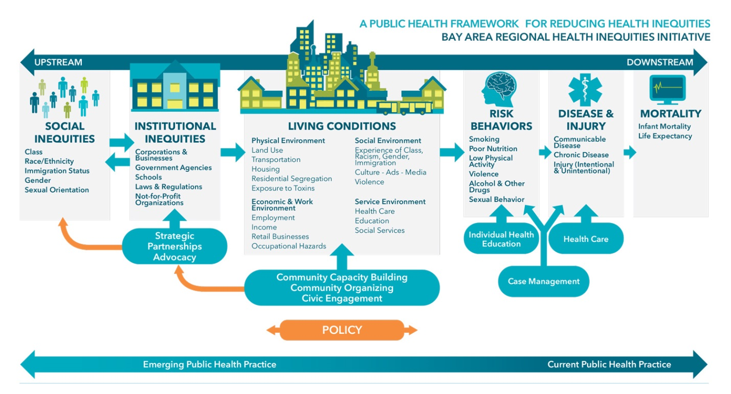
https://www.aafp.org/afp/2019/0415/p476.html
https://www.aafp.org/about/policies/all/socialdeterminantofhealth-positionpaper.html
Notes:
Health equity is complex!
So many different factors contribute to the uneven playing field in lie. Way beyond access to care and quality care, which are the “downstream” factors and area within which most of use work.
There are various determinants of health, including social determinants of health = SDOH, and these are often more “upstream” on this model, where many of us don’t have many touchpoints.
Because we mostly work downstream, many physicians may cite lack of time/resources to address these upstream factors. SDOH can be a major contributor to our own burnout, through frustrations with feeling unable to help patients change structural issues. And patients often have no control over some of these upstream drivers of health. In response, AAFP has toolkit online, called “The EveryONE Project” – where you can read and learn more. It’s important for us to gain awareness and knowledge about this, because it has been estimated that ~20% of overall health outcomes are determined by genetics or quality of clinical care; the remaining 80% is directly determined by the environment, social and economic factors, or personal health behavior’s that are mediated/influenced by SDOH.
SDOH definition laid out by AAFP: that SDOH/social determinants of health are the broad social/economic/environmental factors that impact people’s health (inclusive of access to healthcare and quality of healthcare). These can include the conditions under which people are born, grow, live, work and age– and can give rise to health inequity; they include financial/economic status (poverty), educational quality, food security (or insecurity), access to transportation (or lack of), affordable housing (or lack of), employment (or lack of), maintenance (or lack of) of basic utilities, safety (or violence). There are many more, including even social connectedness.
But let me not shy away from the reality that RACISM – structural and its off-shoots – are a basic underlying tenet for many SDOH. And then the concept of intersectionality, which suggests that multiple identities as a minority (and thus multiple sources of oppression – such as sexual or gender minority, ethnic minority, economic minority, ability minority, religious minority, etc) can amplify the dis-advantage.
Studies have shown that ongoing social inequities continue to feed health disparities, regardless of access to care/quality of care. No matter how good your health care services are, upstream factors can continue to fuel disease, and in a disparate way. Credit to REI/racial equity institute out of GSO who delivers trainings on racism: “Race neutral solutions do not solve race-based problems.” We have to acknowledge the undeniable and do something about it.
OK, so what do we do? You can screen for SDOH, but doing expansive SDOH screens may not leave you for much time for focus on healthcare. My fellowship project followed the NC DHHS recommendation –4 SDOH categories: IPV, transportation, housing, and food security issues. Which I will touch on shortly.

Slide 5
How to Start?
Learn about upstream factors
Get local and personal
Look at local data
Figure out “Stage of Change” for yourself and your institution
Look for local partnerships and collaborative opportunities
Advocate for change

Slide 6
QI Project
Problem: no routine way of screening for social problems in clinic
QI goal:
pilot a clinic-based SDOH screening process, including linkages to care as an intervention for +SDOH screens
Food security
Transportation
Housing
Interpersonal violence

Slide 7
Setting
Coastal Family Medicine
clinic for community-based Family Medicine residency program
clinic owned by New Hanover Regional Medical Center, Wilmington NC
Staffing
6 core faculty, 1 clinical pharmacist, 1 clinical psychologist, 18 residents (6-6-6)
clinical support staff:physician is ~1:1
Operations
Electronic health record = EPIC
Up to 11 patients per half day; mix of new, chronic follow-up, acute or walk-in, OB patients.
EOY 2018: 3972 unique patients; 56% Medicaid, 11% Medicare, 27% commercial insurance, 6% uninsured; 52% non-white.

Slide 8
QI Data
400 eligible encounters
365 patients screened = 91.25%
Prevalence of any SDOH = 96/365 = 26.3%
Notes:
I will share with you my data from my fellowship work.
I believe there is value in having your own data. Though health disparities are becoming more of a general truth, specific health disparities are not always generic. (think about environmental exposures, such as the water issue in Flint MI). Moreover, what works great elsewhere may not be the solution in your practice or locale – so dig into your own context.
My fellowship goal: pilot SDOH screen process, and clinic implementation, including linkages to care as an intervention for +SDOH screens. (NOT to debate which SDOH screen is best, or whether Aunt Bertha or NCCARE360/Unite Us or other is better).
Clinic = CFM, hospital owned FM residency clinic. 6-6-6 =18 residents, 6 core faculty. No care manager or SW. As of end of 2018:
56% Medicaid, 11% Medicare, 27.3% commercial insurance, 6.7% uninsured.
51.8% no—white, 48.2% white. 5.1% veterans.
63% Female, 37% Male. 29% age 0-12, 22% age 13-19, 25% age 20-49, 17% age 50-69, 6% age 70+.
Fellowship: followed encounters of mine/Dr Kirkland’s from 3/26/19 – 12/4/19, for SDOH screening. This was inclusive of any visit type except procedures – including chronic f/u, acute, walk-in, OB, preventive visits.
I looked at the process, whether there was a difference in screen rate, who had + screens, who got offered intervention, and who accepted interventions. We had a 6mo period in that time, where CCLCF agreed to provide us a ”health navigator” to work with patients who had + SDOH screens.
Click → We had 400 encounters between myself and Dr Kirkland during the time period, and 91.25% screen rate done (even if partial).
Cilck → raw data for patient refusals, missed screens, + and -. Of note, the “housing” category was added later during the pilot, so #s are lower.
Click --> prevalence among those screened patients during our pilot = 96/365 = 26.3%. (vs 24% of all encounters, screened or not). How does this compare to other clinics? This is compared to 27% (541 of 2018) prevalence at AF Williams FM Center (academic clinic in Colorado, 45 faculty + residents), where they screened for same categories + social isolation, at all new patient visits or preventive visits over 9mo period (40% (= 2018 of 5038 of eligible screens) completed). Their more prevalent issues were financial strain, then nearly equal food insecurity and social isolation. Notably, their payor spread was very different -- among those eligible for screening: 76% commercial insurance, 10% Medicare, 9% Medicaid, and 4% another plan. SO – even if you have very little Medicaid/medicare, don’t assume that SDOH prevalence/needs are less. We should be careful about over-generalizing, because these data only reflect info from those who come to our clinics – we know less about the patients who don’t come to clinic – or don’t have a medical home. We know less about the prevalence of those patients not accessing/utilizing health care systems (until/unless they end up in the hospital).
Click → of those patients screened, this is the SDOH burden. For those who screened + (27%) = over half have 1 +SDOH, 1/3rd with 2 +SDOH, and of course fewer with 3 and 4 +SDOH.

Slide 9
QI Data
Notes:
crucial learning point for me: of those positive SDOH screens, it was not just Medicaid patients.
This is important, when you start to consider interventions, and who will pay for it.
And remember, this is only data from patients who utilize our clinic -- I suspect the uninsured may have much higher SDOH than we see here.
This slide is the spread of payor sources, among those 96 positive screens. I’ll remind you that CFM clinic averages about 56% Medicaid, 11% Medicare, 27.3% commercial insurance, 6.7% uninsured].
No insurance/ch care: 2 (2%)
FPW: 1 (1%)
Medicaid: 50 (52%)
Medicare: 14 (15%)
Medicare dual: 13 (14%)
Tricare 1: (1%)
Private: 15 (16%)

Slide 10
QI Data
Community Linkages (for 96 +screens) | Completed | Not Done | Refused
Website info given (began 3/26/19), of 40 | 36 (90%) | 4 (10%) | 0
Health navigator referral (began 6/4/19), of 56 | 25 (45%) | 20 (36%) | 11 (19%)
Pediatric Food Box (began 5/1/19), of *14 | 8 (57%) | 5 (36%) | 1 (7%)
6 Patient Refusals
2 Not done
12 closed
5 not closed (unable to reach)
0 = a little
17 Social referrals
2 = not done
1 = a little
7 = a lot
2 = not done
2 = not at all
8 = a lot
2 = not at all
Patient satisfied to be asked about SDOH
Loop closed (17)
Health navigator outreach (25)
Patient feels SDOH will address health
Notes:
*only had pediatric food boxes during 6-month QI project; adult food boxes available spring 2020.
As of 8/29/19.
“not at all”: for husband/wife dyad (wife answered for them both).

Slide 11
QI Takeaways
Process flexibility favors accuracy over precision:
Not every patient agrees to/desires assistance
Some patients may refuse to answer, or not answer honestly
Wording bias of questions: food security = “nutritious” food security
Partnerships:
with CCLCF for 6-month demonstration of “health navigator” → set up process for college interns to take over this role
with Nourish NC for food boxes → and now also local food bank, and a community garden for fresh veggies
with several local CBOs to apply for ”NC Healthy Opportunities” Medicaid pilot
Non-physician staff involvement
Rooming staff now carry out food security screens and interventions at all encounters
Clinic now has chronic disease prevalence data, stratified by REAL and SDOH
Integrate NCCARE360 interface with EHR, for community referrals

Slide 12
Miscellaneous

Slide 13
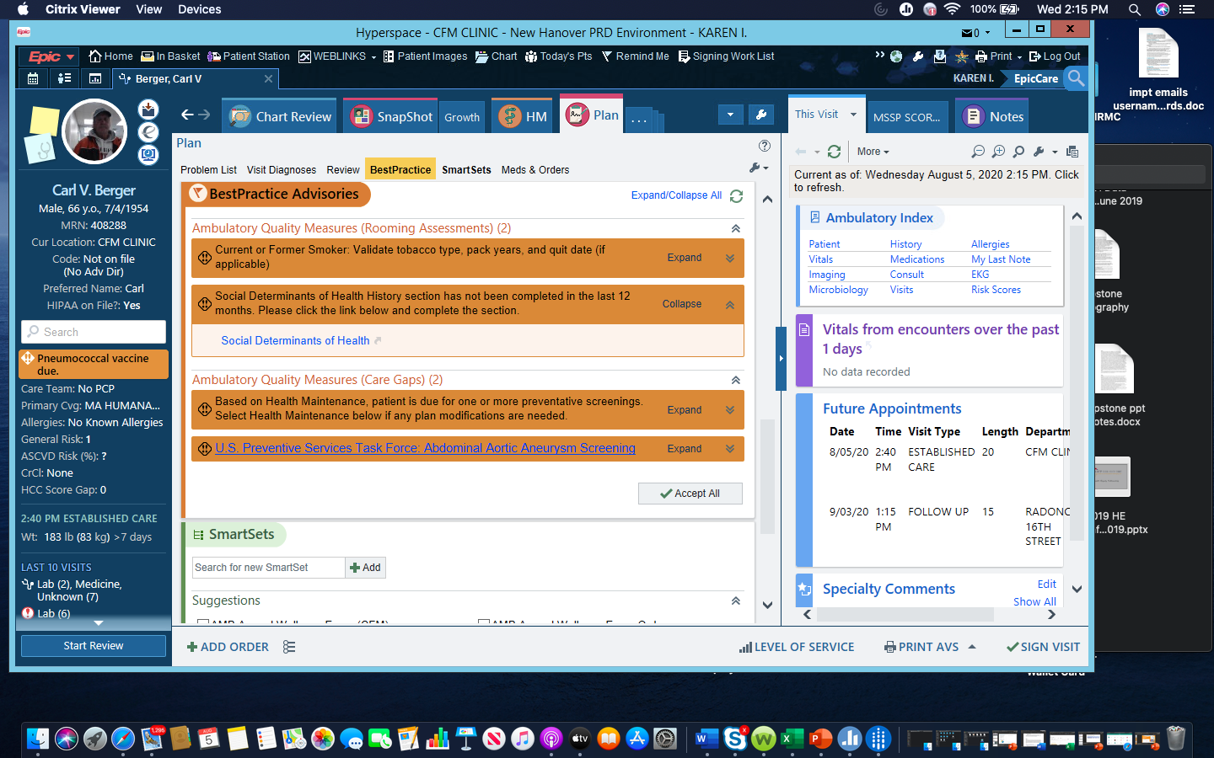
BPA for SDOH Screen

Slide 14
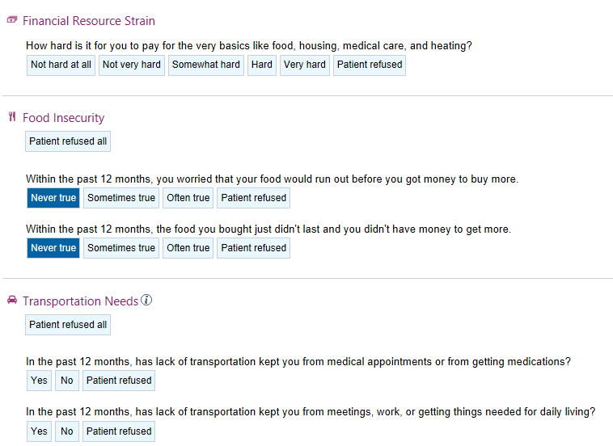
SDOH Questions in EPIC
As of 7/19/19
Notes:
EPIC, our electronic health record, released SDOH screening questions around the same time – which of course were not written exactly as those in the NC DHHS recommendation. Due to IT build and reporting issues, we kept the EPIC version of the questions, across the same 4 categories.
*IPV was already a standard part of rooming process.
The financial strain question was not terribly specific for housing difficulties, so a Housing question was added to our EPIC 7/19/19.
It also worth noting that a “positive” for food insecurity changed during my pilot 6/3/19 – to only “often true” rather than “sometimes true”. NC DHHS questions are Y/N only – easier to interpret positive or negative. Should be noted that 1 of my residents alerted me that AAP recommends + cutoff for either sometimes or often true.
For pilot, Dr Kirkland and I either asked questions directly, or had them printed for rooming staff to give to patients to complete.

Slide 15
SDOH Intervention
Referral to Health Navigator
Community referrals through Aunt-Bertha based online platform
Food Boxes
Notes:
Should be noted that the process also involved a consent form to be scanned immediately into EHR.
Then cc chart to health navigator.
Health navigator had 3 business days to contact patient by phone, and offer resource referrals through Our Community Link, but capturing work in EPIC “patient outreach encounter”.

Slide 16
Health Navigator Care Management Tracking (Encounter Type: Patient Outreach)

Slide 17
Cost-Benefit of Health Navigator Role
Credentials | Average Wage | Time spent (Jun-Jul 2019 pilot)
No one (link to online platform given) | $0 | n/a
Student/intern | $0 | Not studied
Lay worker | $15/hour | Not studied
Nurse/clinically trained staff* | $25/hour | 8.25 hours
Cost:
Benefit:
8.25 hours / 12 patients = 0.6875 hr/patient.
(496 patients) x (0.6875 hr/patient) = estimate of 341 hours per 12 month period
Volume | Jun-Jul 2019 (2 doctor pilot) | 12 month estimate (all CFM doctors)
Eligible encounters | 107 | 3972
Positive screens | 25 | 1033 = (3972 x 26%)
Referrals to health navigator | 12 | 496 = (12/25) x 1033
Notes:
There are reimbursement codes for CCC/medicare, but now also care coordination codes for primary care with mental patients.
Vs lay navigator or health navigator who is not reimbursed.
*additional skills, other coordination beyond social referrals.
3972: from 2018 clinic data.
1033 = 26% SDOH prevalence x 3972
496 = (12/25) * 1033.
Patient hours per month: 8.25hr/12 pts = 0.6875 hr/patient. 0.6875 * 496 = 341hr per year (well under 0.20 FTE, approx. 0.16 FTE).
Elephant in the room is the lack of direct reimbursement for care mgmt. services – but creativity can be employed (Medicare complex chronic care mgmt. (CCCM) codes, or all payer Collaborative care mgmt. (CoCM) codes for patients with comorbid mental illness). Moreover, we do not have PMPM cost estimates that may change as a result of SDOH interventions – so it remains unknown the price of savings from upstream work.

Slide 18
Local Clinic Data

