Slide 1
Family Medicine Clerkship Faculty Development: a Longitudinal, Team Endeavor!
Suzanne Minor, MD, FAAFP
Sarah Stumbar, MD, MPH
Marquita Samuels, MBA
Jacqueline Sroka, MD-candidate
Notes:
Sarah
Introductions and ask audience –
Raise your hand if you are a student, resident, clerkship director, preceptor, any other educators?

Slide 2
What are your Faculty Development Needs and Challenges?
Notes:
Sarah

Slide 3
Learning Objectives…
Identify the various roles and activities involved in a successful team-based faculty development model.
Describe the longitudinal and dynamic nature of relationships in faculty development.
Identify three strategies for enhancing your clerkship’s own delivery of faculty development.
Notes:
Jackie?

Slide 4
Disclosures
None
Notes:
Jackie

Slide 5
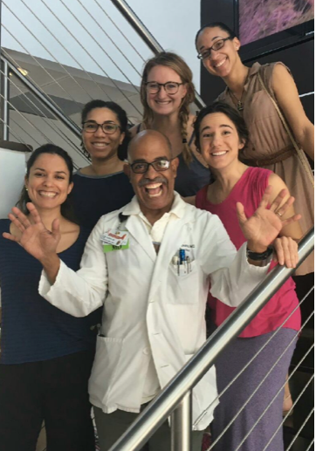
What are the components or your faculty development program?
Who’s on your team?
What is your content?
How do you deliver that content?
Notes:
Jackie?

Slide 6
Our Faculty Development Team!
Student
Coordinator
Clerkship Director
Clinical Faculty Development Director
Notes:
Jackie: Student: providing ad hoc faculty development for preceptors (regarding entrustable professional activities and required core clinical experiences), communicating with clerkship director to identify issues that need to be centrally addressed
Jackie: Coordinator: assembling and distributing feedback to preceptors on their teaching, performing site visits, building relationships, asking for a specific example to help with narrative comments on student assessments, building relationships
Sarah: Clerkship Director: providing one on one feedback to preceptors, site visits, academic detailing, creating regular newsletters, building relationships, identifying site-specific issues identified by students in clerkship evaluations
Suzie: Clinical Faculty Development Director: performing needs assessment, creating teaching cards, revising and creating online teaching modules, performing site visits for group and one on one development, building relationships

Slide 7
When to Deliver Faculty Development!
Onboarding of new preceptors
At site visits—at least annually, and whenever a concern arises
As frequently as possible via email – interesting articles about teaching, questions, updates about the COM, opportunities/events in the community/at the COM
Whenever there is a major change in clerkship structure or COM curriculum
Notes:
Sarah
Indicate which team member takes primary responsibility for each task:
Onboarding – Clerkship director
Site visits – Clerkship director, Clinical faculty development director
Email – CD, course coordinator, Clinical faculty development director
Changes in course policies- course coordinator, CD → students reinforce these changes

Slide 8
What You MUST Cover When
Orienting Faculty to Clinical Teaching
What to Teach
Clerkship learning objectives
Core cases and level of responsibility
FIU HWCOM EPO’s
How to Teach
Watch students do stuff as much as you can
Give feedback as much as you can
Ask students questions
Ask the patient to tell students how the students did
How to Assess
End of clerkship and just in time
CASP and narrative comments
HWCOM professionalism attributes
Notify clerkship team immediately of concerns
Policies and Practices:
Faculty will receive evaluations on their teaching at least twice/year
Duty Hours <80 hours/week
Zero Tolerance for Mistreatment
No faculty-student patient-provider relationships
Notes:
Suzie
Onboarding
This slide shows what must be discussed when orienting a faculty to teaching on the clerkship.
It’s also an example of a faculty development card that I created to give to all CD’s

Slide 9
Onboarding
What to Teach
Clerkship learning objectives (which are linked to the EPOs)
Core cases and level of responsibility
How to Teach
Observe students as much as possible
Give feedback as much as you can
Ask students questions
Ask patients to give feedback as well
Notes:
Sarah

Slide 10
Onboarding
How to Assess
End of clerkship and just in time
CASP and narrative comments
HWCOM professionalism attributes
Immediately notify clerkship team of concerns
COM Policies
Faculty will receive evaluations on their teaching at least twice/year
Duty Hours <80 hours/week
Zero Tolerance for Mistreatment
No faculty-student patient-provider relationships
Notes:
Sarah

Slide 11
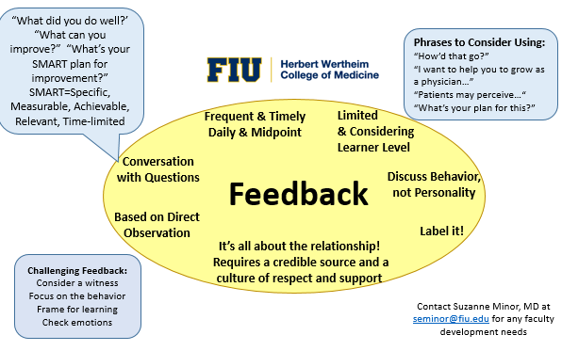
Teaching Cards!
Notes:
Suzie
This is an example of a teaching card. When meeting with faculty, we use these cards as cues for content and they also are then left with faculty.

Slide 12
Feedback to Faculty
Preceptor was available to answer questions when needed
Preceptor continued to provide learning opportunities even in the absence of patients
Preceptor stimulated my interest in the subject matter
Preceptor provided me with opportunities to practice various behaviors/techniques that enhanced my training and skills development
Preceptor feedback was constructive and timely
Preceptor modeled patient-centered care and practice throughout this clerkship
Preceptor communicated a teaching style that promoted decision-making and critical thinking
Preceptor served as a positive role model
Preceptor demonstrated expertise and knowledge in the discipline
Preceptor was prepared for his/her role in teaching
Preceptor guided me with completing goals (core cases and procedures) for this clerkship experience
Student concerns
Student midpoint meetings
Clerkship evaluations
Notes:
Jackie
Students play an important role in providing information that can contribute to faculty development.
Students/We are asked to let the clerkship director if there are concerns asap. We are asked about our experience with our attendings at our midpoint feedback meetings and again at the end of the rotation when we complete the clerkship evaluation.
Sarah
In orientation, I tell students to let me know asap if there are issues and I'll help troubleshoot issues with them...either help them figure out how to address it themselves or I'll talk to the preceptor, depending on the issue.
Twice a year we provide the student evaluations to the faculty. And if there are trends that are coming up that require addressing, then we can meet with that faculty and provide feedback between the routine feedback

Slide 13
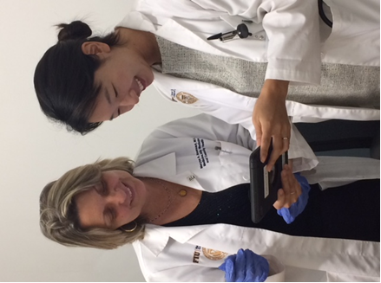
Our Faculty Development Program - Delivery
Site visits
Clerkship newsletter
Website
Online teaching modules (free CME)
ABFM/STFM MOC preceptor improvement project
Notes:
Suzie
We spoken about the content of our FD. Now let’s talk about how we deliver that content.
We have Site visits, such as when we give feedback to faculty for issues htat arise, for instance when students aren’t receiving feedback or writing notes.
Clerkship newsletter
ABFM/STFM MOC preceptor improvement project
Website
Online teaching modules (free CME)

Slide 14
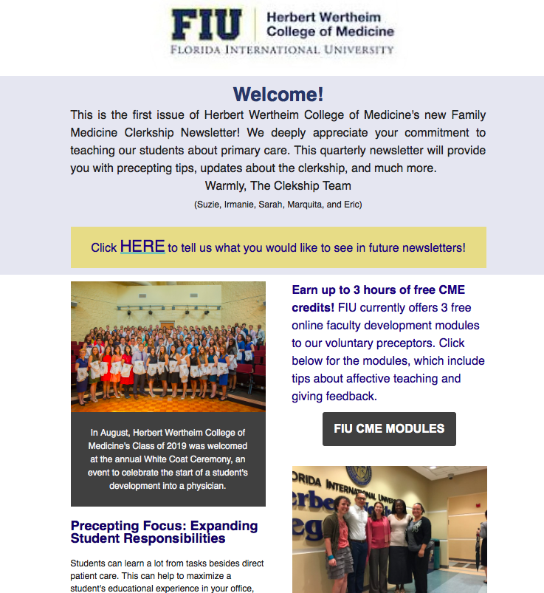
Notes:
Sarah
This is a picture of the family medicine clerkship newsletter.

Slide 15
Project Focus | Project Goal/Aim | Project Intervention/”To Do” | Outcome Measures
Improving quantity and quality of narrative feedback to students on CASP form (the end of rotation student assessment form) | Write at least three comments giving specific behavioral detail about the student’s performance (at least two strengths and one area for improvement) on each midpoint and final CASP. | [X] Meet with Dr. Stumbar or Dr. Minor to learn about writing narrative comments [ ] Complete Module 1: Narrative Evaluations of Student Performance https://ilearn.courses.med.fiu.edu/misc/CME_Narrative_Evaluations_of_Student_Performance/story_html5.html →this is also worth 1 hour of free CME credit COMPLETION DATE: AUGUST 1st, 2018 | [ ] Midpoint and final CASPs contain at least three comments giving specific behavioral detail about the student’s performance (at least 2 strengths and 1 area for improvement) COMPLETION DATE: NOV 1st, 2018
Notes:
Sarah
This is an example of one of our ABFM precepting pilot projects.

Slide 16
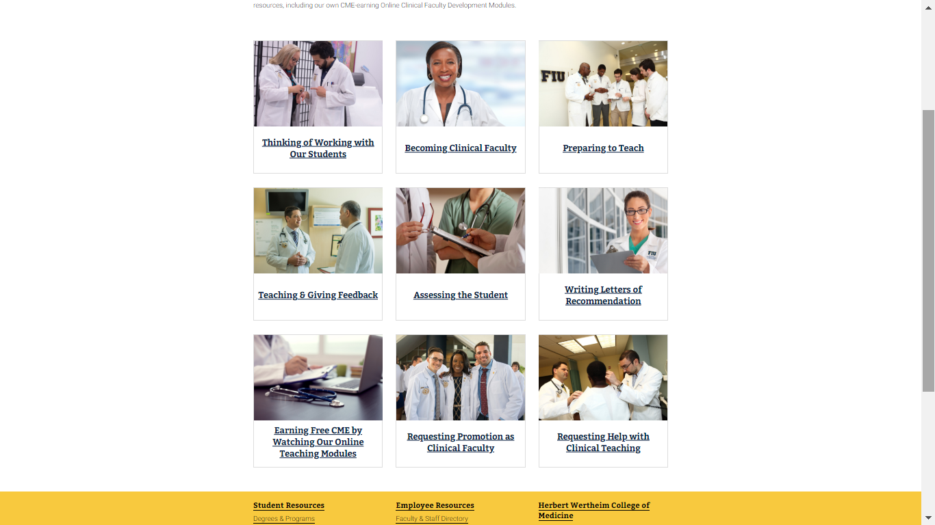
Notes:
This is our clinical faculty website and acts as a teaching manual and landing page for clinical faculty. It keeps improving with feedback from faculty. And here, you can see we have online modules for free CME as another method for delivering FD to preceptors.

Slide 17
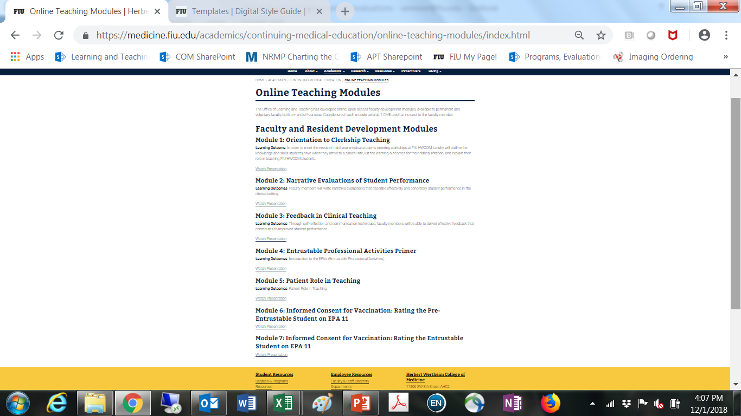
Notes:
Suzie
And this is our website showing our online teaching modules that give free cme to our faculty. Right now, we have 7 and these are the topics: Orientation to Clerkship Teaching, Writing Narrative Comments when Assessing students, Giving Feedback, a primer on the epa’s, the pt role in teaching, and these last 2 are about assessing students when they are obtaining informed consent. We have a few more modules coming online: assessing students in obtaining informed consent for IUDs, role modeling professionalism, and writing letters of recommendation.

Slide 18
Faculty Development Program Assessment
Clerkship reviews
Clinical FD database
Newsletter
Online teaching CME modules
When faculty call or ask for help!
Notes:
Suzie
Successful faculty development is measured by looking at data from students on our clerkship reviews, assessing for positive teaching examples and identifying concerns about teaching from faculty. We track all faculty development “touches” that occur between our team and our community and full-time faculty. We evaluate the success of our teachers based on student feedback and clerkship reviews. We monitor how frequently our newsletter is read by looking at the “number of clicks/opens.” We monitor how much our CME modules are used by running quarterly reports to look at the number of faculty who complete them.
We build relationships over time using email and phone communications, and visits.

Slide 19
Discussion
How can each of your clerkship team members play into successful faculty development?
How might you be able to enhance your own faculty development program?
How might you be able to involve students more successfully in your faculty development program?
How can you measure the outcomes of your FD program?
Notes:
Jackie

Slide 20
Please evaluate this session on the app

