Slide 1
Cure or Curse? The Latest Evidence Behind Cannabis Use and Mental Health
Kevin Brazill, DO, MS
Stephen Warnick, Jr., MD
Chris White, MD, JD, MHA

Slide 2
Disclosures
The presenters have no relevant conflict of interests to disclose regarding the content of this presentation.

Slide 3
Goals & Objectives
Communicate a general overview of how cannabis works in the body, and the medical and recreational cannabis landscape in the US and Canada
Understand up-to-date, evidence-based findings on prescribed uses for cannabis in the treatment of mental health disorders and contraindications for recreational use for mental health disorders.
Cooperatively develop several creative approaches to address medical and recreational cannabis use (and abuse) with patients in the primary care setting.

Slide 4
Today’s Presenters
Chris White, MD, JD, MHA
Stephen Warnick, Jr., MD
Kevin Brazill, DO, MS

Slide 5
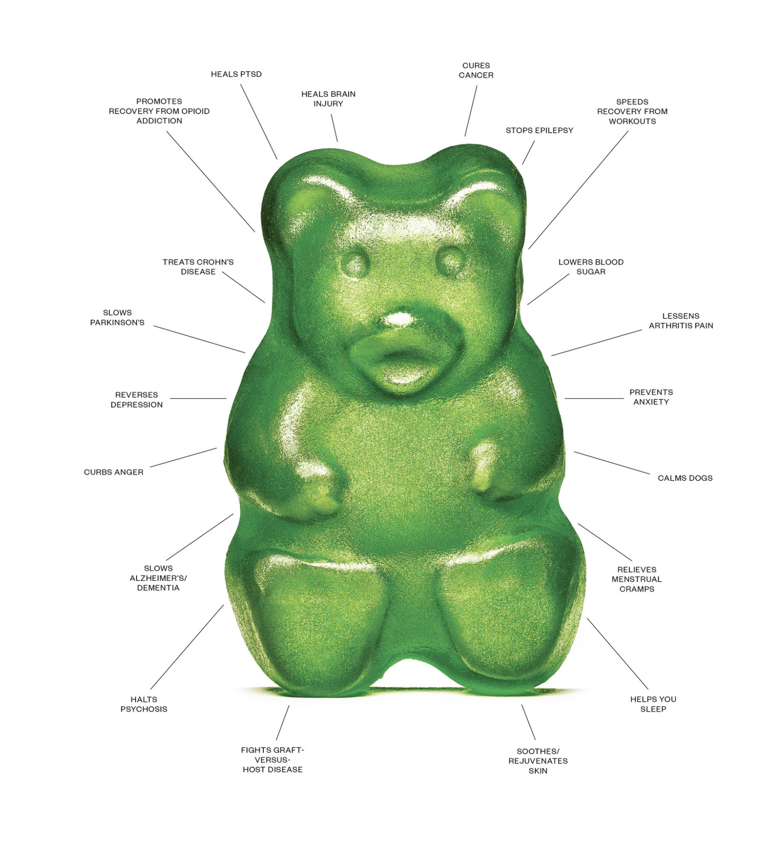
Cure?
…or Curse?

Slide 6
Audience Poll
How many of you practice in a state with legalized recreational or medical cannabis?
How many of your practices have formal policies or training on when/how to recommend cannabis to specific patients?
How many of you are currently making cannabis-based treatment plans for your patients with mental illness?

Slide 7
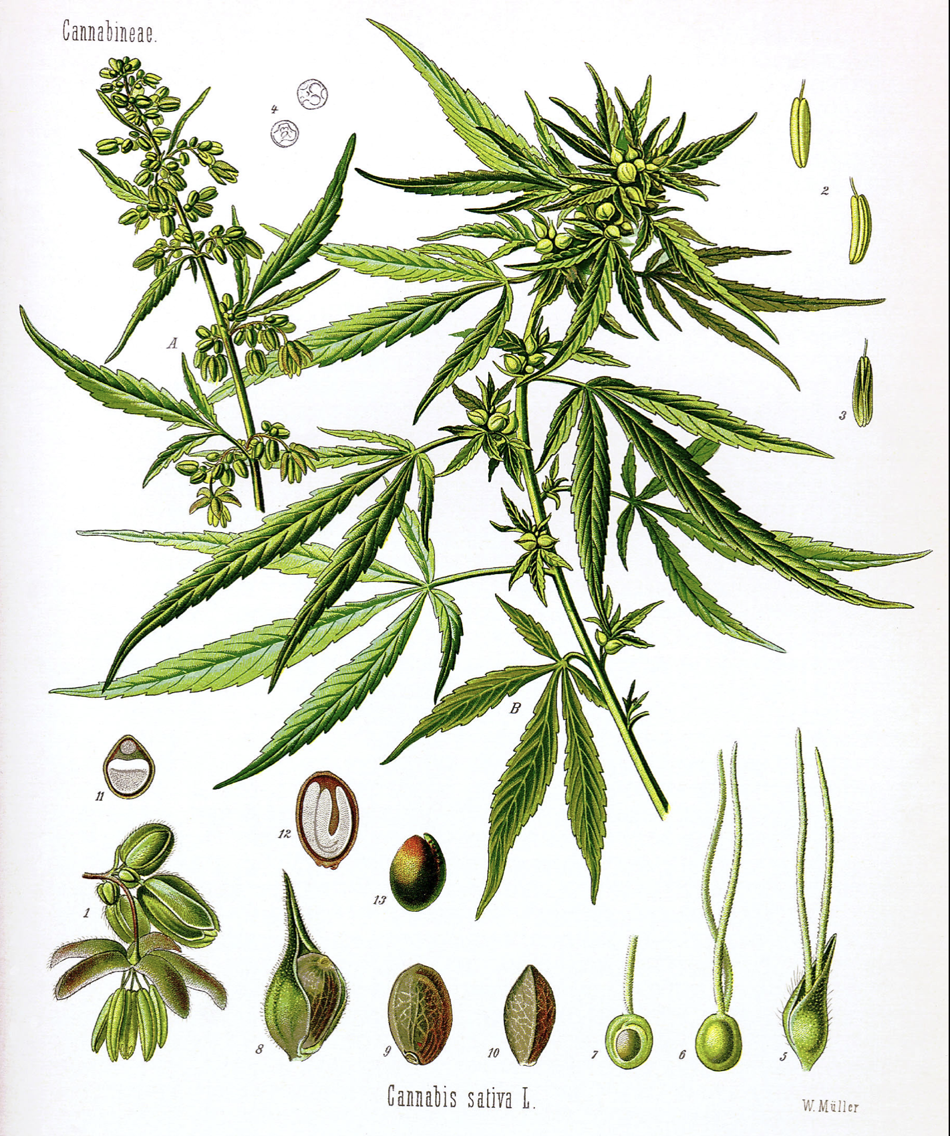
A few more polling questions…

Slide 8
Pre-Test Question #1
Emerging evidence between the use of cannabis and psychosis suggests which of the following relationships:
Psychosis is likely an acute substance-induced event which will completely resolve upon metabolization/elimination of the drug
Psychosis is associated only with inhaled forms and not oral cannabis compounds
Psychosis is only associated with synthetic cannabis products (K2, spice, “fake”)
Psychosis following cannabis ingestion may be indicative of an underlying disorder such as schizophrenia or schizoaffective disorder
Notes:
For me the answer is D talking about the evidence that MJ can trigger psychosis in SCZ predisposed indiviudals. A is also probably right so we may need to tweak it or simply allow that answer too… especially if they smoke wet or something laced which is what I was trying to hint at in C

Slide 9
Pre-Test Question #2
Which of the following is the most common approved mental health indication for medical cannabis?
PTSD
Major Depressive Disorder
Generalized Anxiety Disorder
Dementia related agitation
Autism
Schizophrenia, Paranoid-type

Slide 10
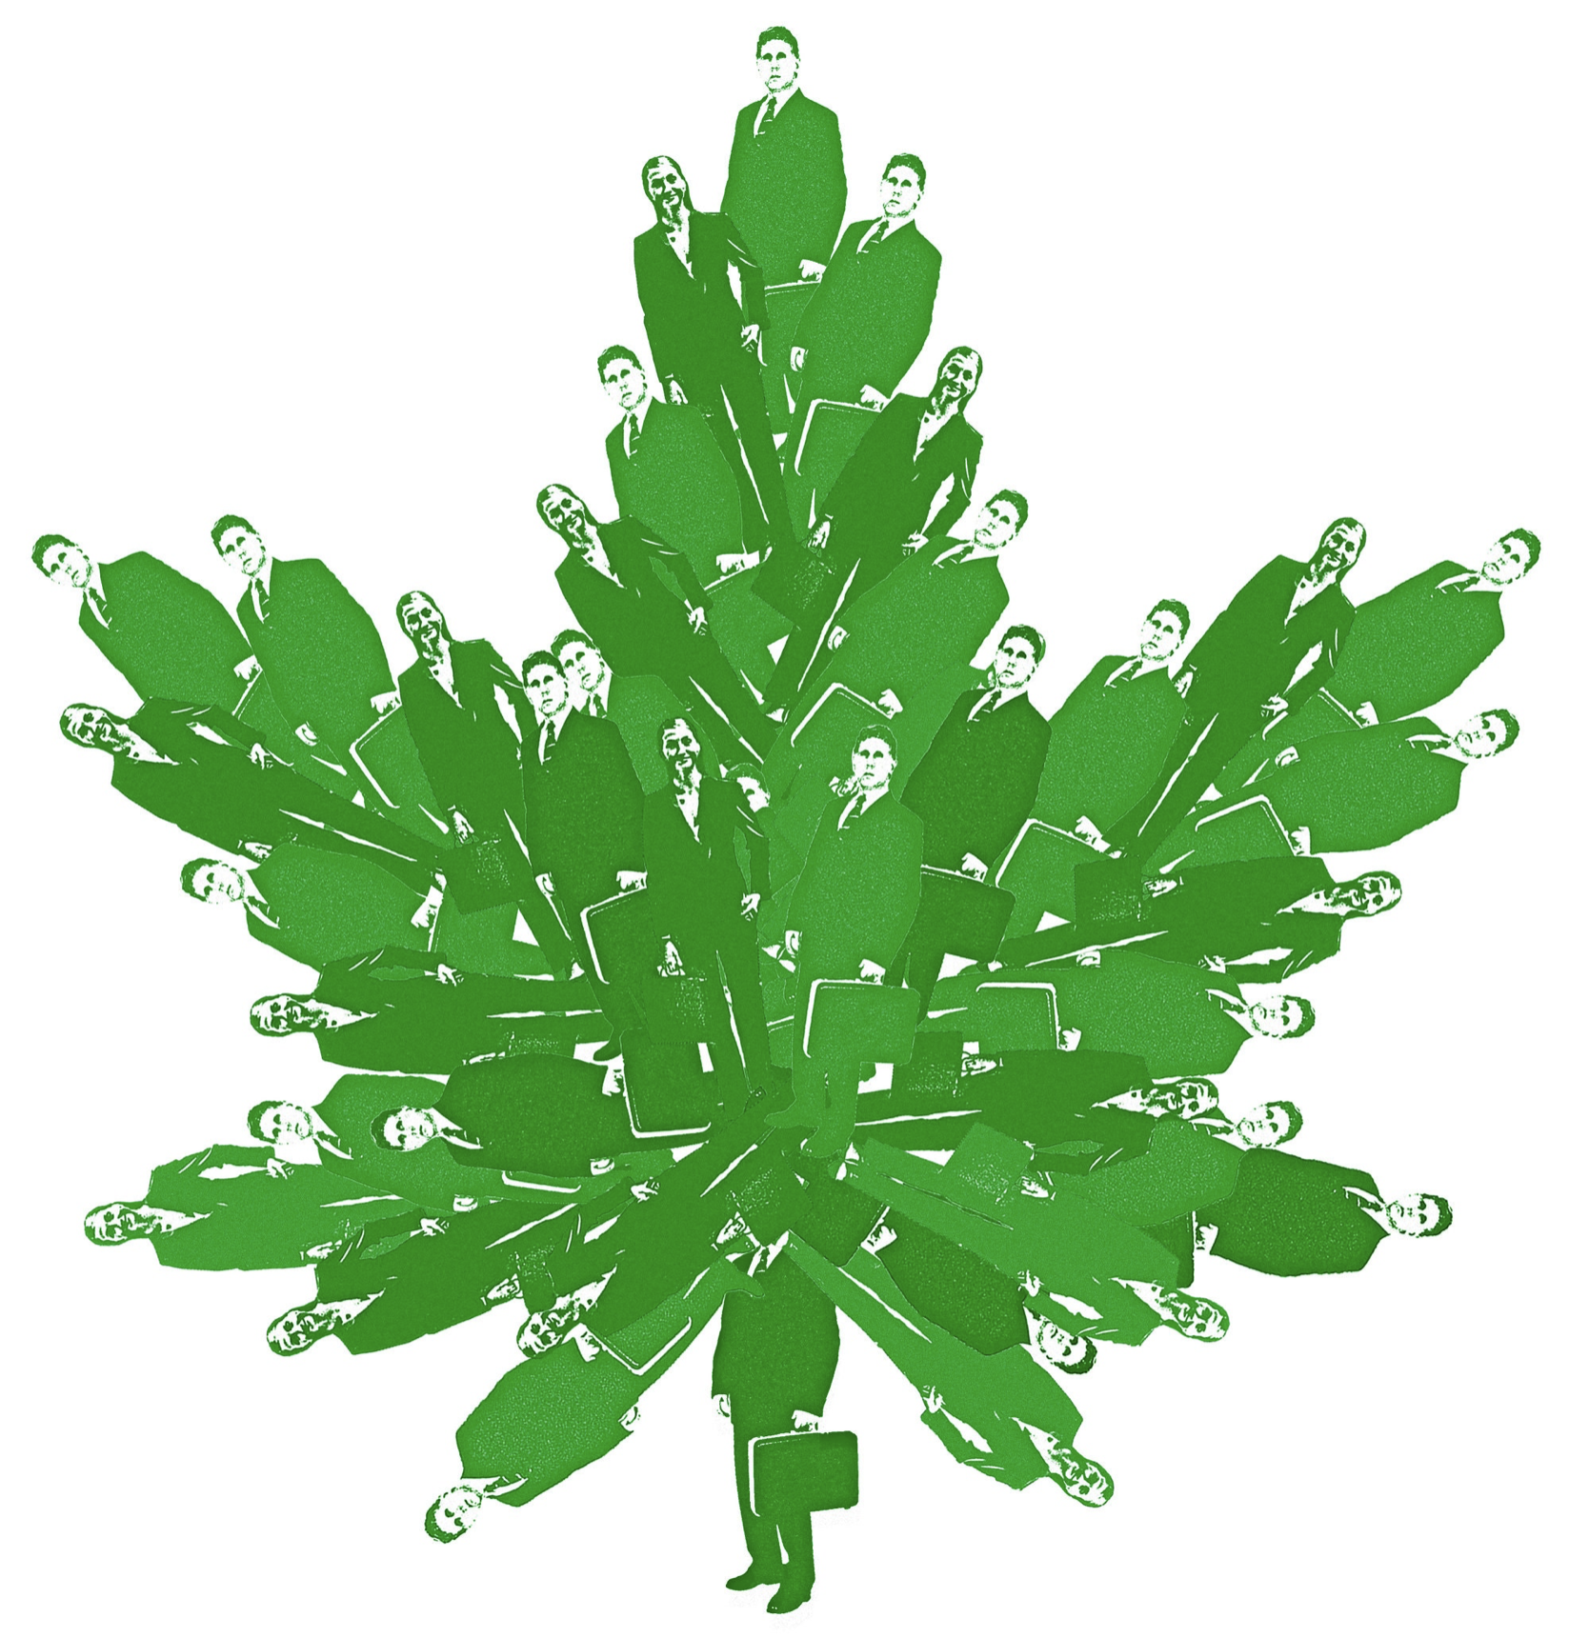
A Brief History of Cannabis in North America
Legal/OTC in the US until 1936, used commonly for many illnesses
After 1936, every US state restricted possession
1970, Comprehensive Drug Abuse Prevention & Control Act: Scheduling System implemented (prevents open/unlimited research)
1996: California legalized medical use, but writing/recommending jeopardizes prescribers
Since then, changes have occurred: 31 US jurisdictions (incl. DC. Guam, PR) & all provinces/territories of Canada have legalized medical cannabis

Slide 11
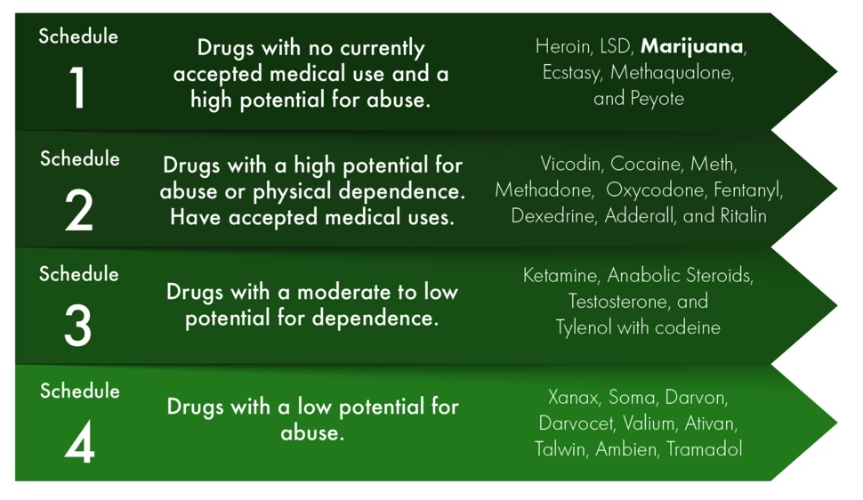
Cannabis: A Schedule I Drug

Slide 12
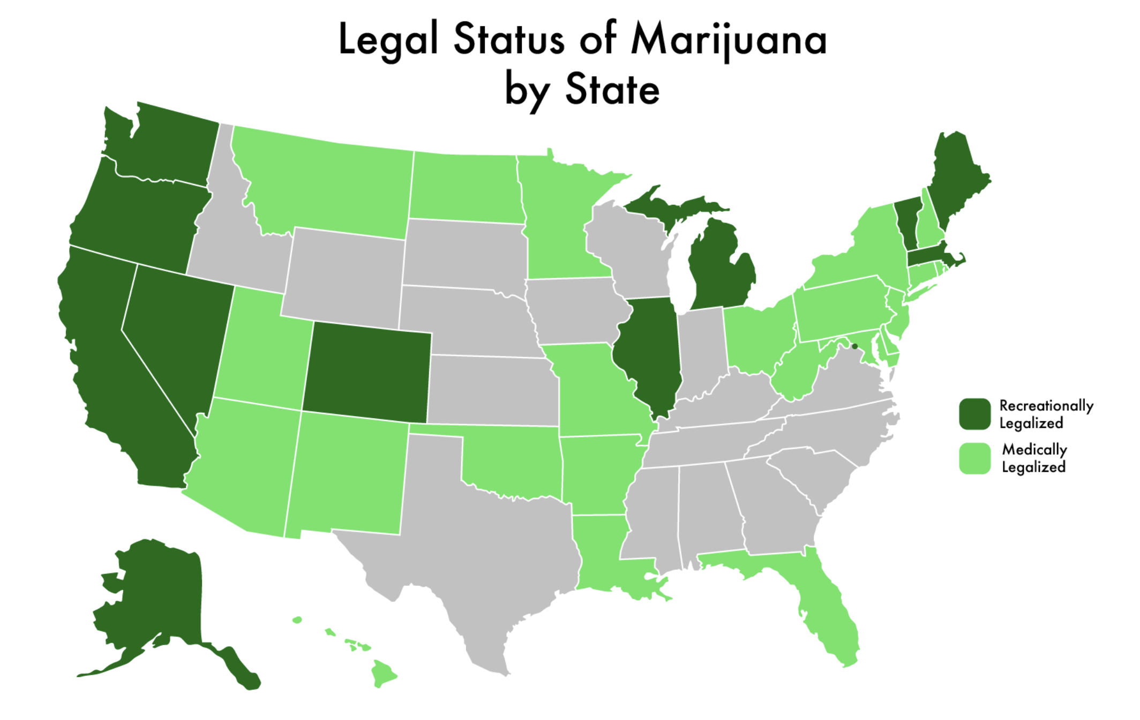

Slide 13
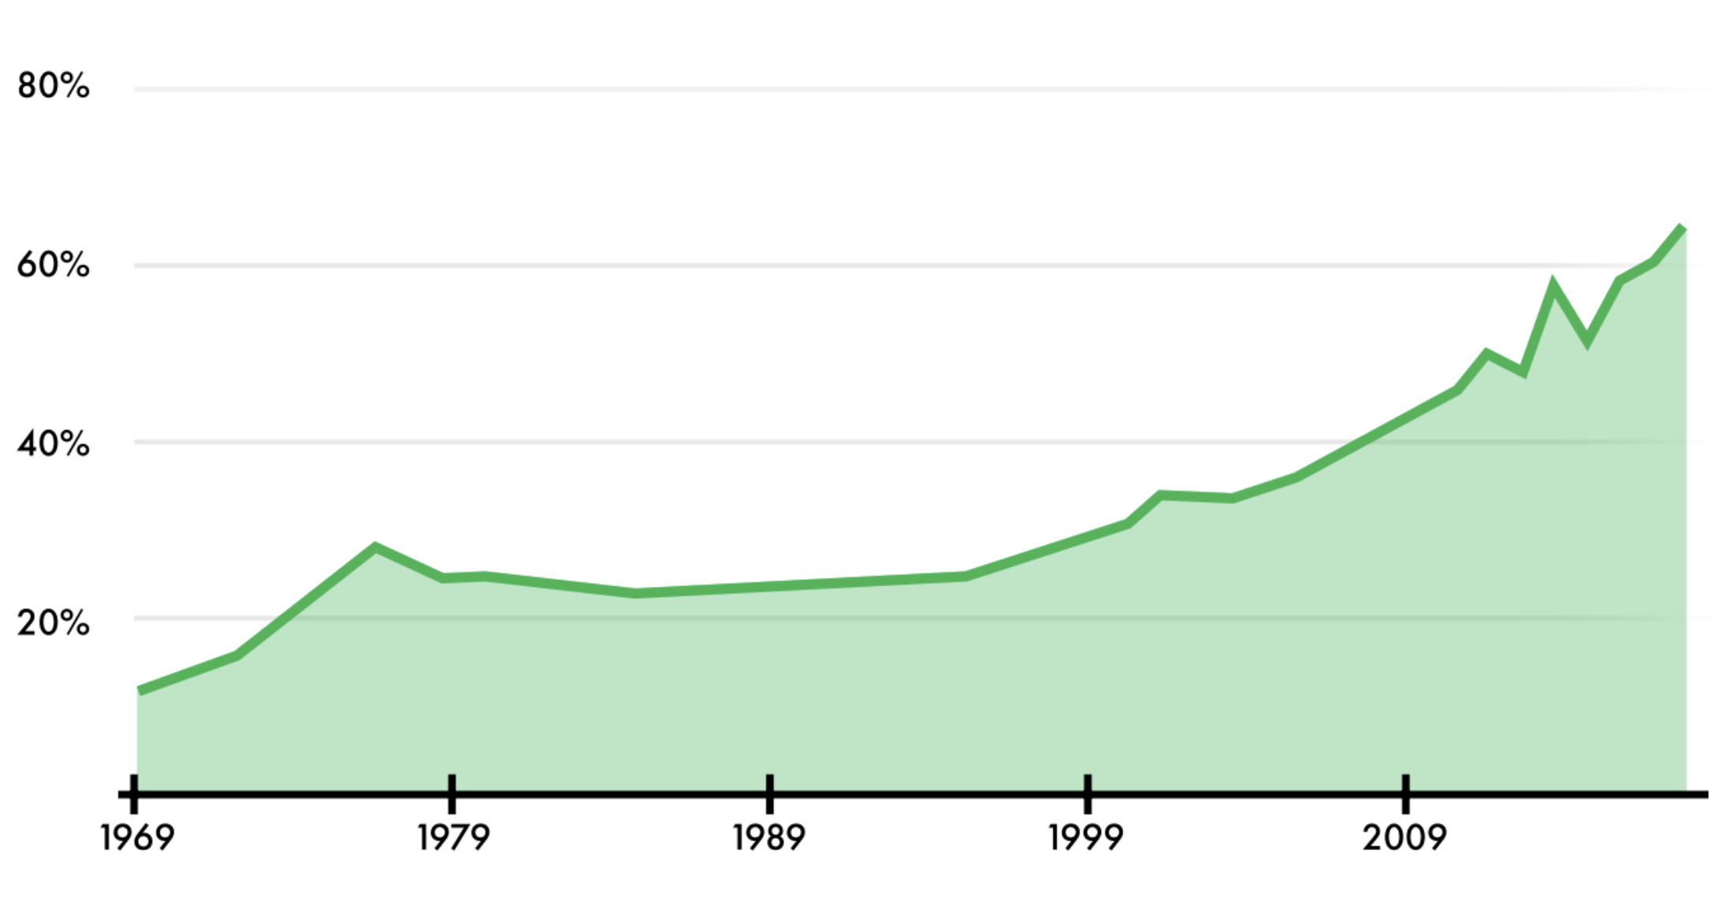
Changing Attitudes: Percentage of Americans in Favor of Cannabis Legalization

Slide 14
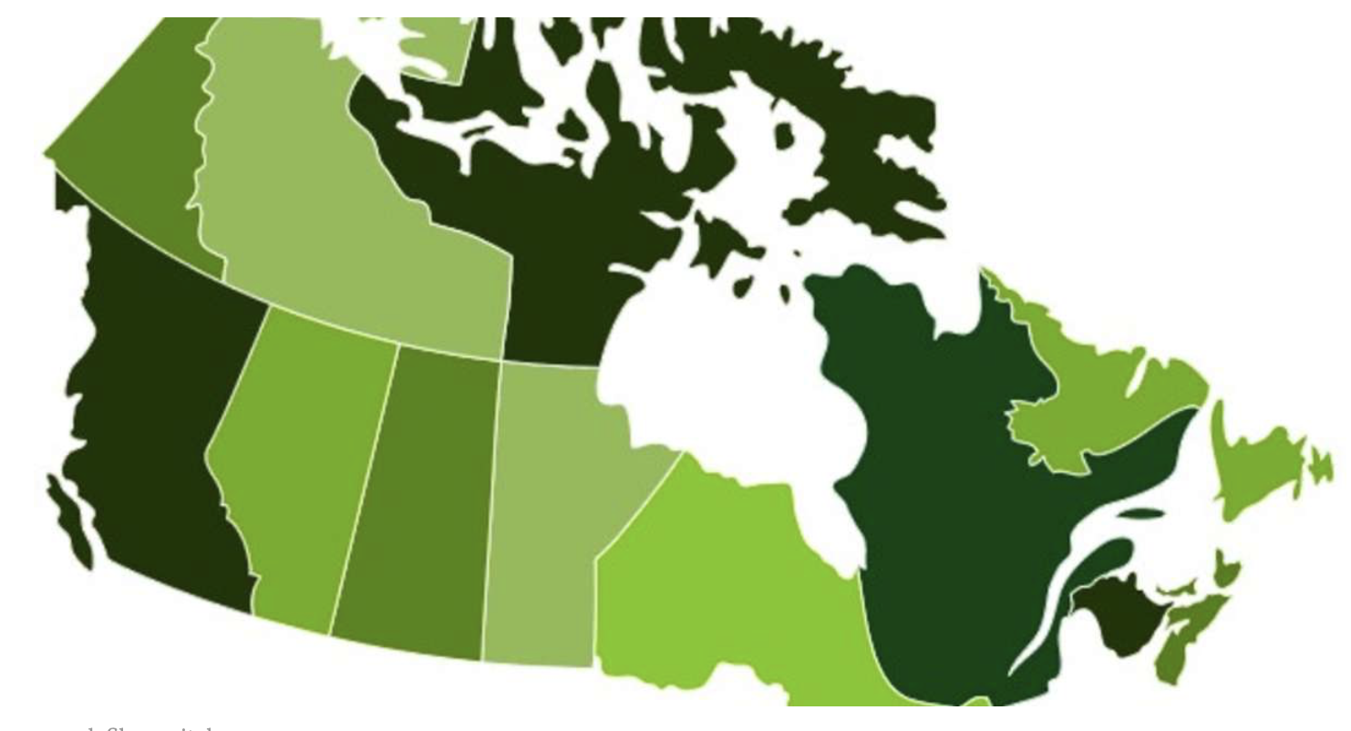
Canada
The Canadian government has taken a “public health approach” to legalizing, strictly regulating, and restricting access to cannabis. There is, however, no universally accepted definition of a “public health approach” to cannabis.

Slide 15
Medical Cannabis: Common Qualifying Conditions
ALS | HIV/AIDS
Alzheimer’s dementia | Multiple Sclerosis
Arthritis (Osteo & Rheumatoid) | Nausea
Cachexia | Neuropathies
Cancer | Pain
Crohn’s disease/UC/IBS | Parkinson’s disease
Epilepsy/seizure disorders | Post-traumatic Stress Disorder
Glaucoma | Sickle Cell disease
Hepatitis C | Terminal Illnesses

Slide 16
What is “Cannabis”?
“Whole plant” cannabis made up of >70 cannabinoids: most studied: △9-tetrahydrocannabinol (THC) and cannabidiol (CBD)
THC and CBD vary drastically in psychotropic effect, potency, concentration
THC: main psychoactive component in cannabis, may have anti-inflammatory, muscle relaxant, sedation, analgesic, appetite-stimulation, anti-emetic properties
CBD, primarily non-psychoactive with documented anxiolytic and antiepileptic benefits, may have others (analgesic, antidepressant)
Cannabis also categorized by 3 basic species/strains: indica, sativa and “hybrid”
Importantly, research suggest that interbreeding and hybridization does not predict actual cannabinoid profiles
To that end, a budtender’s recommendation that “Indica is really good for XXX,” is largely based on anecdotes
ElSohly 2005. Aizpurua-Olaizola 2016. Hillig 2004. Hanuš 2016.

Slide 17
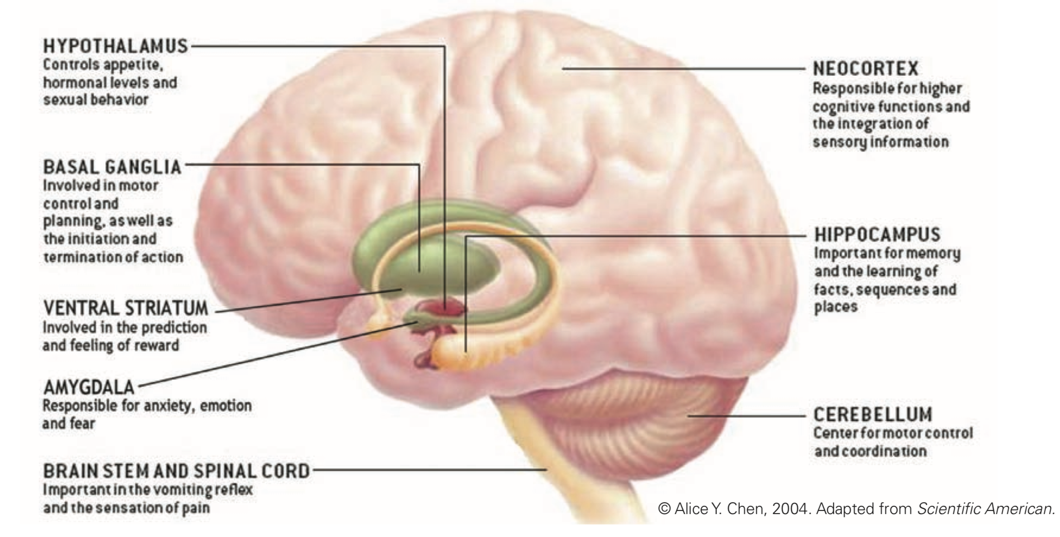
How does Cannabis work?

Slide 18
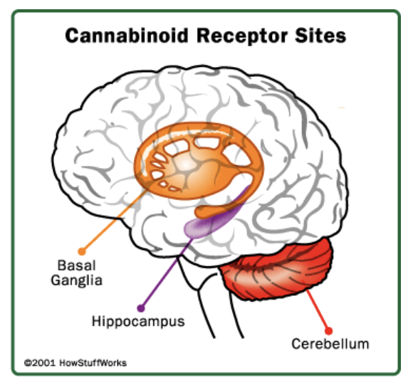
How does Cannabis work?
Anandamide is an endogenous cannabinoid neurotransmitter
THC mimics Anandamide and binds with cannabinoid receptors
Basal ganglia: THC impairs motor coordination, unconscious muscle movement
Hippocampus: THC interferes with short term memory/recollection
Cerebellum: THC impairs balance and coordination.

Slide 19
How does Cannabis work?
Cannabinoids can be smoked (flower, bud); vaped (dabs, waxes, oils); absorbed topically or sublingually; ingested (candy, baked goods, teas, infused drinks); or taken in pill/tablet form as a supplement.
Half-life of cannabis: 20 hours to 10 days, depending on potency and amount ingested
Cannabinoid receptors are effectively absent in the brainstem cardiorespiratory centers, essentially precluding possible fatal overdoes from cannabis intake
The mechanism underlying cannabis-associated psychosis is still largely unknown; not enough evidence to suggest a “safe dose” of cannabis
Marconi 2016

Slide 20
Side Effects to Cannabis
May exacerbate tachycardia, appetite, sleepiness, dizziness, hypotension, dry mouth/eyes, decreased urination, hallucinations, paranoia, anxiety, poor balance and posture in patients with dyskinetic disorders, impaired attention, memory, and psychomotor performance. It may worsen mental faculties in conditions that cause cognitive deficits.
Cognitive impairment by cannabis may be dose- and age-dependent.
High blood concentrations of cannabinoids, usually from overconsumption of edibles, can cause prolonged and often debilitating psychoses or hyperemesis syndrome.
Fatigue, suicidal ideation, nausea, asthenia, and vertigo.
People with asthma, bronchitis, or emphysema should be cautioned not to smoke cannabis.
Withdrawal from heavy and prolonged use of cannabis has varying symptomatology, including insomnia, loss of appetite, physical symptoms, and restlessness (initially), followed by irritability and anger, and then vivid and unpleasant dreams after a week.
Individuals with risk for suicide, schizophrenia, bipolar disorder, or other psychotic conditions should be cautioned that cannabis may exacerbate existing psychoses.

Slide 21
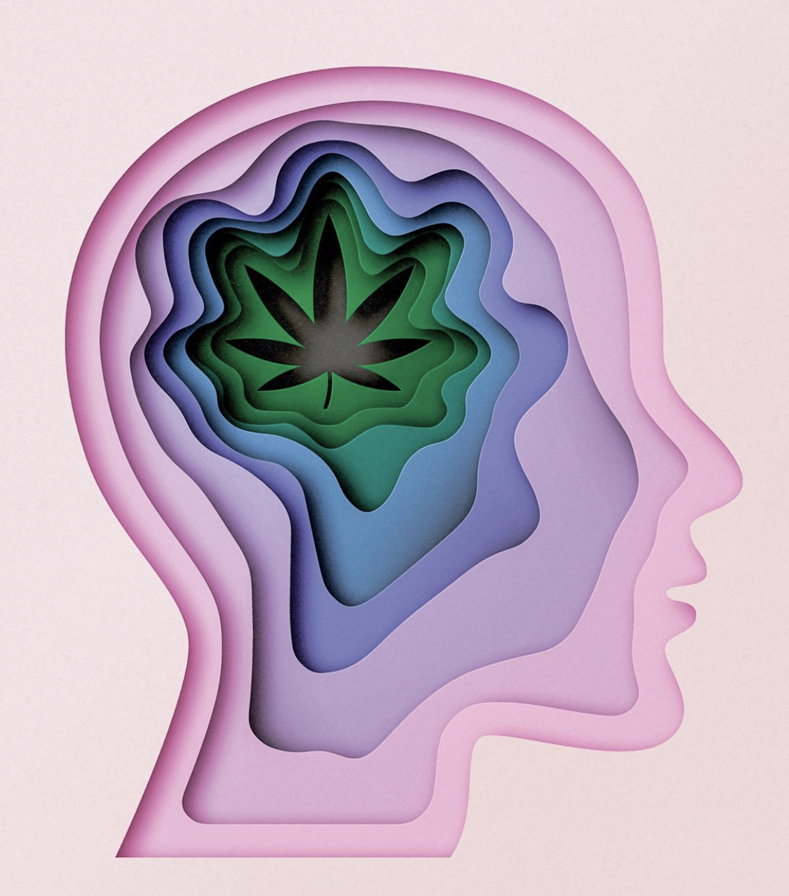
The Evidence: - Psychosis - Bipolar DO - Depression - Anxiety - PTSD

Slide 22
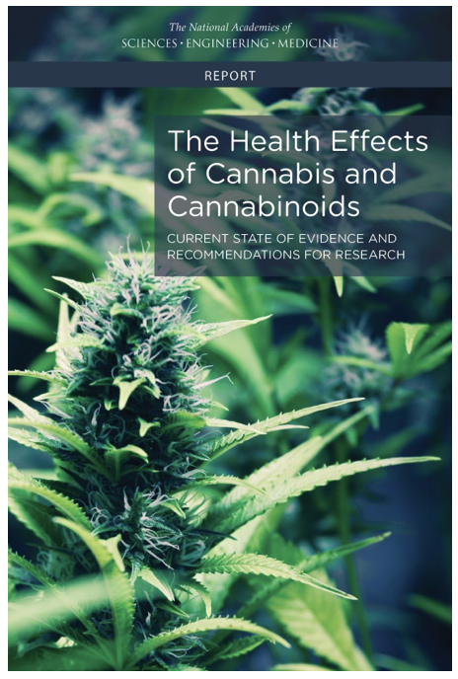
Published in 2017 by the National Academies of Science, Engineering & Medicine
Broadly concluded the need for much more research, particularly into investigation of “pharmacokinetic and pharmacodynamic properties of cannabis, modes of delivery, concentrations and dose-response relationships of cannabis, THC and other cannabinoids”

Slide 23
There is substantial evidence of a statistical association between cannabis use and the development of schizophrenia or other psychoses, with the highest risk among the most frequent users.
In individuals with schizophrenia and other psychoses, a history of cannabis use may be linked to better performance on learning and memory tasks.
Cannabis use does not appear to increase the likelihood of developing depression, anxiety, or posttraumatic stress disorder.

Slide 24
For individuals diagnosed with bipolar disorders, near daily cannabis use may be linked to greater symptoms of bipolar disorder than non-users.
Heavy cannabis users are more likely to report thoughts of suicide than non- users.
Regular cannabis use is likely to increase the risk for developing social anxiety disorder.

Slide 25
Recent (within 24 hrs of eval) cannabis use impairs the performance in cognitive domains of learning, memory, and attention.
Limited studies suggest that there are impairments in cognitive domains of learning, memory, and attention in individuals who have stopped smoking cannabis.
Adolescent cannabis use is related to impairments in subsequent academic achievement and education, employment and income, and social relationships and social roles.

Slide 26
The Evidence: Psychosis
2016 Meta-analysis:
10 studies, N of ~67,000 individuals
Studies included contained clear data on cannabis consumption prior to onset of psychosis using dose criterion (freq/amt used) and reported psychosis-related outcomes.
Higher levels of cannabis use associated with increased risk for psychosis in all included studies.
Dose response relationship between level of use and risk for psychosis clearly demonstrated.
Marconi 2016

Slide 27
The Evidence: Psychosis
2016 Prodromal Study:
N: 210, first onset psychosis pts evaluated from inpatient hospitalizations in GA and DC from 2008-13.
Cox regression (survival analysis) used to quantify hazard ratios for effects of diverse premorbid use variables on psychosis onset.
Conclusion: escalation of premorbid cannabis use in the 5 years prior to onset was highly predictive of an increased risk for onset of psychosis.
Daily use approximately doubled rate of psychosis onset, even after controlling for simultaneous alcohol/tobacco use.
Concluded that early adult use of cannabis likely just as important as adolescent use in psychosis onset.
Kelley 2016

Slide 28
The Evidence: Psychosis
2019 Lancet study
18-64 yr old pts (N: 901) with 1st episode psychosis at 11 sites across Europe and Brazil (controlled with local recruited people[N: 1237])
Applied adjusted logistic regression models to estimate patterns of cannabis use that carried the highest odds for psychotic disorder
Potency of cannabis also incorporated into modeling
Daily cannabis use associated w/ increased odds of psychotic disorders compared with never users
Daily high potency use increased to 5x increased odds of psychotic disorders
Differences in frequency of daily cannabis use and in use of high potency cannabis contributed to striking variation in incidence of psychotic disorder across the 11 studied sites
Di Forti 2019

Slide 29
The Evidence: Mania/Bipolar Disorder
Cannabis use may worsen the occurrence of manic symptoms in those diagnosed with bipolar disorder, and may also act as a causal risk factor in the incidence of manic symptoms
Meta-analysis suggests that cannabis use is associated with an approximately 3-fold increased risk for the new onset of manic symptoms
Gibbs 2015
2010 trial of CBD as monotherapy (600 mg to 1200 mg daily) demonstrated no improvement in symptoms
Zuardi 2010
2015 prospective observational study of nearly 2,000 adults with Bipolar Disorder:
earlier age of onset/more manic episodes/more hospitalizations/increased SA with regular cannabis use
2 years after cessation, BPD patients had similar clinical and functional outcomes as those who had never used cannabis
Zorrilla 2015

Slide 30
The Evidence: Depression
2017 Outpatient RCT California study
Cannabis use common and associated with worsening depression and anxiety, particularly in pts age 50+ over 6 month study period (N: 307)
Medical cannabis associated w/ poorer physical health in study participants
Bahorik 2017
2014 Meta-analysis of association between cannabis use and depression
Demonstrated a dose effect, concluding heavy, habitual cannabis use associated with increased risk of depression and worsening depressive symptoms
Lev-Ran 2014
2008 longitudinal Norwegian study
>2,000 adolescents followed for 13 years
Demonstrated cannabis use at least 11 times over 12 months associated with increased risk of SI and SA when subjects entered 20s
Pedersen 2008

Slide 31
The Evidence: Anxiety
2019 review of current evidence: CBD and anxiety
Review found evidence of acute anxiolytic effects and fear regulation by dampening expression, enhancing extinction and disrupting reconsolidation. The findings from the relevant clinical literature are still very preliminary but are nonetheless encouraging.
Papagianni 2019
2019 Large Case Series
Retrospective case study (N: 72) in outpt psychiatric clinic in CO using CBD (25 mg to 175 mg daily) as adjunct to existing med regimen for anxiety and insomnia for 3 months
Findings: decreased in Hamilton Anxiety scores, CBD better tolerated than SSRI, SNRI, benzodiazepines. Clinical trial recommended
Shannon 2019
2015 Meta-analysis
Cannabinoids may be superior to placebo for anxiety reduction
Using Cochrane Risk of Bias Tool, no conclusions could be made due to small trials
Whiting 2015

Slide 32
The Evidence: PTSD
Neurochemistry, Cannabinoids and PTSD
Fascinating study that describes the biological findings associated with PTSD, the role of cannabinoid signaling in these biological processes, and the impact cannabinoids have on them.
These data create an evidence-based rationale implicating the endocannabinoid system as a potential candidate system, whose impairment could be a substrate for the etiology of PTSD, as well as a target for the development of a novel class of drugs that could be used to treat symptoms of PTSD.
Hill 2018

Slide 33
The Evidence: PTSD
Vet-based study in NE US (N: 301), 2013-15.
Study examined the relationship of PTSD and MDD with cannabis use frequency, cannabis problems, and cannabis use disorder (CUD) as well as the role of three coping-oriented cannabis use motives (coping with negative affect, situational anxiety, and sleep) that might underlie this relationship.
Strong, unique associations between PTSD and MDD and the above.
Despite the coping-oriented premise for cannabis use steering a number of US states to legalize medical cannabis as treatment for individuals with PTSD, the science behind this legislative action is lacking.
Findings provide further evidence that people with PTSD and MDD, are at increased risk for cannabis use and related problems including CUD.
Metrik 2016

Slide 34
Three Cases
Mr. W Ms. X J

Slide 35
Case 1
Mr. W has struggled with generalized anxiety and depression for some time. He has trialed two SSRIs, buspirone, pregabalin, venlafaxine, and benzodiazepines, with only benzodiazepines offering some relief from his anxiety. He is currently on clonazepam 1 mg BID PRN (prescribed 30 pills a month), vilazodone 40 mg daily, and quetiapine 25 mg BID. He has a controlled substance agreement due to his clonazepam, and on his yearly urine drug screen THC is present. He states he has used this medically and has his card due to anxiety, and this is one of the only things that helps him out. He is functioning ‘okay’, working a part-time job and having partial success in his relationships, but still has multiple chronic stressors that impact his life.

Slide 36
Case 2
Ms. X has been dealing with Bipolar I Disorder since her mid-20s. She also has been diagnosed with fibromyalgia, type 2 diabetes, hypertension. She has treated her conditions with natural supplements in the past that have been partially effective, and her PHQ-9 is currently 18, GAD-7 16, Hemoglobin A1C 8.2, and her blood pressure is consistently in the 140s/90s. She has heard a lot from her friends and family about the benefits of either THC or CBD for her mental health and pain, and has many questions for you about using this to help her various conditions.

Slide 37
Case 3
J is a 16 year-old boy coming in for his well child exam. His mom has no concerns at this time. During the confidential interview he discloses that he has started using marijuana, both in joints and vaping with his friends 2-3 times a week. He feels like this helps him relax and deal with stress. He has not noted any functional impairment at this time, although you are concerned because his older sister was recently diagnosed with schizophrenia and his father, whom you also see, has had severe depression with psychotic features in the past.

Slide 38
Case Discussions
Break up into 3 groups
Evaluate potential risks of cannabis use in this case
Evaluate potential benefits of cannabis use in this case
How would you approach the patient’s questions about cannabis or current patterns of use?
Regroup in 5 minutes to discuss each case

Slide 39
Revisiting our Questions…

Slide 40
Post-Test Question #1
Emerging evidence between the use of cannabis and psychosis suggests which of the following relationships:
Psychosis is likely an acute substance-induced event which will completely resolve upon metabolization/elimination of the drug
Psychosis is associated only with inhaled forms and not oral cannabis compounds
Psychosis is only associated with synthetic cannabis products (K2, spice, “fake”)
Psychosis following cannabis ingestion may be indicative of an underlying disorder such as schizoaffective disorder or schizophrenia

Slide 41
Post-Test Question #2
Which of the following is the most common approved mental health indication for medical marijuana?
PTSD
Major Depressive Disorder
Generalized Anxiety Disorder
Dementia related agitation
Autism
Schizophrenia, Paranoid-type

Slide 42
Points to Consider
The risk of psychosis and development of psychotic disorders increases with regular cannabis use and frequent, high potency cannabis use.
Regulation, modes of delivery, purity and dosing remain serious issues regarding THC, CBD and cannabis use.
The use of cannabis and cannabinoids is best considered for patients who could benefit from complementary use or when currently accepted first- and second-line medications or therapies show no or insufficient effect, or demonstrate dangerous adverse events in selected patients
Anecdotes are not evidence-based; think… stories from friends and recommendations from “budtenders”
More, well-designed studies are necessary.

Slide 43
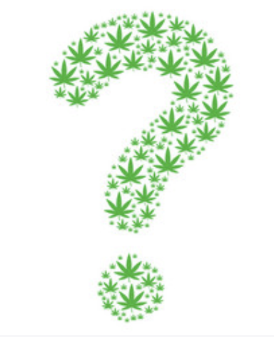
Questions

Slide 44
Works Consulted
Aizpurua-Olaizola O, Soydaner U, Öztürk E, et al. Evolution of the cannabinoid and terpene content during the growth of Cannabis sativa plants from different chemotypes. J Nat Prod. 2016. February 2;79(2):324–31.
Bahorik A, Leibowitz A, Sterling SA, Travis A, Weisner C, Satre DD. Patterns of marijuana use among psychiatry patients with depression and its impact on recovery. J Affect Discord. 2017 Apr 15; 213: 168-171.
Borgelt, LM, Franson KL, Nussbaum AM, et al: The pharmacologic and clinical effects of medical cannabis. Pharmacotherapy 33(2): 195-209, 2013.
Compton, MT (2016). Marijuana and mental health. (1st ed.). Arlington, VA: American Psychiatric Association.
Di Forti M, Quattrone D, Freeman TP et al. The contribution of cannabis use to variation in the incidence of psychotic disorder across Europe (EU-GEI): a multicenter case-control study. Lancet Psychiatry. 2019; 6: 427-36.
ElSohly MA, Slade D. Chemical constituents of marijuana: the complex mixture of natural cannabinoids. Life Sci. 2005. December 22;78(5):539–48.
Gibbs, M, Winsper C, Marwaha S, Gilbert E, Broome M, Singh SP. Cannabis use and mania symptoms: a systematic review and meta-analysis. J Affect Disord. 2015 Jan 15; 171: 39-47.
Hanuš L.O., Meyer S.M., Muñoz E., Taglialatela-Scafati O., Appendino G. Phytocannabinoids: A unified critical inventory. Natural Product Reports. 2016;33:1357–1392.

Slide 45
Works Consulted
Hill, MN, Campolongo P, Yehuda R, Patel S. Integrating endocannabinoid signaling and cannabinoids into the biology and treatment of posttraumatic stress disorder. Neuropsychopharmacology. 2018 Jan; 43(1): 80-102.
Hillig KW, Mahlberg PG. A chemotaxonomic analysis of cannabinoid variation in Cannabis (Cannabaceae). Am J Bot. 2004. June;91(6):966–75.
Kelley ME, Wan CR, Broussard B et al. Marijuana use in the immediate 5-yer premorbid period is associated with increased risk of onset of schizophrenia and related psychotic disorders. Schizophr Res. 2016 Mar; 171(1-3) 62-67.
Lev-Ran S, Roerecke M. Le Foll B, et al. The association between cannabis use and depression: a systematic review and meta-analysis of longitudinal studies. Psychol Med. 44(4): 797-810, 2014.
Marconi A, Di Forti M. Lewis CM, Murray RM, Vassos E. Meta-analysis of the Association Between the Level of Cannabis Use and Risk of Psychosis. Schizophrenia Bulletin. 2016 Feb; 42(5): 1262-1269.
Metrik J, Jackson K, Bassett SS, Zvolensky MJ, Seal K, Borsari B. The mediating roles of coping, sleep, and anxiety motives in cannabis use and problems among returning veterans with PTSD and MDD. Psychol Addict Behav. 2016 Nov; 30(7): 743-754.
Moore THM, Zammit S, Lingford-Hughes A, et al. Cannabis use and risk of psychotic or affective mental health outcomes: a systemic review. Lancet 370(9584): 319-328, 2007.

Slide 46
Works Consulted
National Academies of Science, Engineering, and Medicine. 2017. The health effects of cannabis and cannabinoids: Current state of evidence and recommendations for research. Washington, DC: The National Academies Press.
Papagianni EP, Stevenson CW. Cannabinoid regulation of fear and anxiety: an update. Curr Psychiatry Rep. 2019 apr; 21(6): 38
Pedersen W. Does cannabis use lead to depression and suicidal behaviours? A population-based longitudinal study. Acta Psychiatr Scand. 118(5): 395-403, 2008.
Shannon S, Lewis N, Lee H, Hughes S. Cannabidiol in anxiety and sleep: a large case series. Perm J 2019; 23: 18-041.
Volkow ND, Baler RD, Compton WM, et al. Adverse health effects of marijuana use. N Engl J Med. 370(23):2219-2227, 2014.
Whiting PF, Wolff RF, Deshpande S, et al. Cannabinoids for medical use: a systematic review and meta-analysis. JAMA 313(24): 2456-2473, 2015.
Zorrilla, I, Aguado J, Haro JM, et al. Cannabis and bipolar disorder: does quitting cannabis use during manic/mixed episode improve clinical/functional outcomes? Acta Psychiatr Scand 131(2): 100-110, 2015.
Zuardia, A, Crippa J, Dursun S et al. Cannabidiol was ineffective for manic episode of bipolar affective disorder. J Psychopharmacol. 24(1): 135-137, 2010.

