Slide 1
Tobacco Use Disorder: Helping Your Patients Extinguish the Fire
Scott A. Fields, Ph.D.
West Virginia University School of Medicine
Charleston Division
W. Michael Johnson, M.D.
Grant Family Medicine Residency

Slide 2
Disclosures
The individuals presenting today have no conflicts of interest to disclose.

Slide 3
Acknowledgment: Dr. Fields is a certified tobacco treatment counselor through the: Nicotine Dependence Education Program – Quarterly Trainings

Slide 4
Goals and Objectives
1) Participants will learn how to assess tobacco use and patient readiness to quit.
2) Participants will be able to list the tobacco counseling and behavioral strategies (including motivational interviewing) that improve a patient’s odds of quitting.
3) Participants will increase their understanding of the evidence-based pharmacologic management of tobacco use disorder and the optimal dosing needed for Nicotine Replacement Therapy.

Slide 5
Overview
Tobacco-Related Disorders
Assessment
Treatment
Conclusions

Slide 6
Tobacco Use Disorder
A problematic pattern of tobacco use, leading to clinically significant impairment as manifested by two or more of the following for 12 month period:
1) Tolerance – More tobacco to get the same effect.
2) Withdrawal – Four or more (24 hr): Irritability, frustration or anger; anxiety; concentration problems; increased appetite; restlessness; depressed mood; insomnia.
American Psychiatric Association, DSM-5 (2013).

Slide 7
Tobacco Use Disorder
3) Tobacco is used more and over a longer period of time than intended.
4) There is a persistent desire to cut down or control tobacco use.
5) A great deal of time is spent in activities necessary to attain, or recover from tobacco use.
e.g., drive 30 miles at 2:00 AM to get cigarettes.

Slide 8
Tobacco Use Disorder
6) Craving or strong desire to use tobacco.
7) Recurrent use resulting in failure to fulfill major obligations at home, school, work.
8) Continued use despite social or interpersonal ramifications of use.
9) Important activities given up or reduced.

Slide 9
Tobacco Use Disorder
10) Recurrent use in situations where it is hazardous.
11) Tobacco use continues despite clear knowledge of its harmful effects.
Specify If:
In Early Remission – No criteria met for 3 months but less than 12 months.
In Sustained Remission – No criteria met in 12 months excluding craving.

Slide 10
DSM Tobacco-Related Disorders
Tobacco Use Disorder
Tobacco Withdrawal
Other Tobacco-Induced Disorders
Unspecified Tobacco-Related Disorder

Slide 11
Tobacco Use Disorder
Linked to numerous diseases:
Cardiovascular disease
Lung diseases (COPD)
Cancer
Most preventable cause of death in the US (480,000 deaths per year)
Fiore, et al. Treating Tobacco Use and Dependence ^{(2008).}

Slide 12
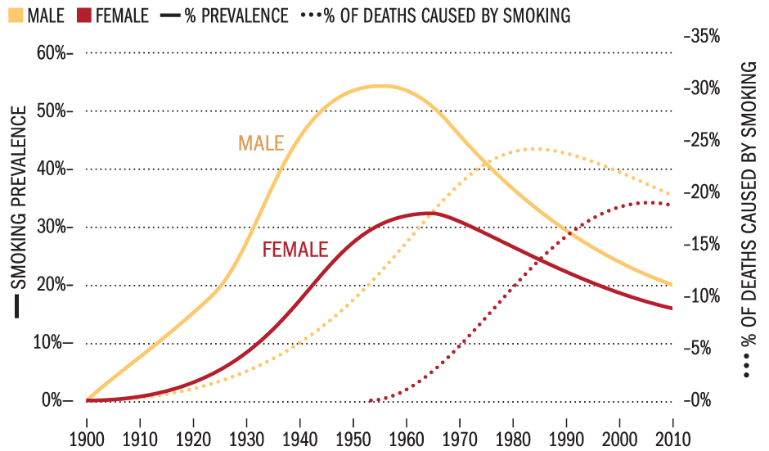
US Prevalence
US CDC stats (2016):
About 15% of adults in the US smoke tobacco (down from over 50% in 1963; 26% in 2001; 21% in 2010).
What major tobacco related event happened in 1963?
One in five of ALL US deaths tobacco related.
Two of three smokers die from a tobacco related illness.

Slide 13
Teen Smoking
Nationwide, 16% of high school students use tobacco habitually (Fairly steady since 2003)
WV – Mild Improvement of late (18.8%)
http://wvmetronews.com/2013/12/02/tobacco-prevention-efforts-working-on-west-virginia-teens/
RAZE – Teens talking with teens about never smoking has helped decrease number of youth who try tobacco:
2000 26% of teens never tried cigarettes
2013 53% of teens never tried cigarettes

Slide 14
How do we help our patients?
Confluence of circumstances:
The majority of tobacco users want to quit (70%)
Roughly 40% of smokers made a quit attempt in past year.
Treatments can increase likelihood of quitting threefold
Practice guidelines indicate that treatment is only offered to about 70% of those who currently use tobacco. (Up drastically from 22% in prior practice guidelines). Areas of improvement: Medicaid, youth
Fiore, et al. Treating Tobacco Use and Dependence ^{(2008).}

Slide 15
Assessment
Why is treatment sometimes not offered?
Misconceptions:
Tobacco users do not want to quit.
There are no effective interventions for nicotine dependence.
If someone wants to quit, they will ask.
Tobacco users get offended when you talk with them about quitting.

Slide 16
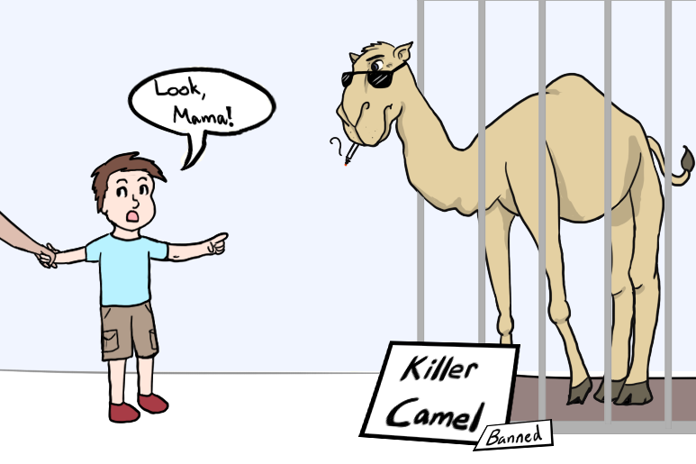
Assessment
A losing battle?
Just under 7% of people who quit tobacco usage stay quit one year later.
Many who say they want to quit mean it, but they are ambivalent about tobacco.
If we help someone quit smoking, there still is about a 75-85% chance they will relapse.
Dale, L. The Hospital Based Interventions ^{(2002).}

Slide 17
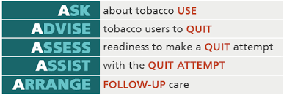
Assessment
Five A’s
Ask
Advise
Assess
Assist
Arrange
Fiore, et al. Treating Tobacco Use and Dependence ^{(2000).}

Slide 18
Assessment
ASK
Ask if the patient uses tobacco.
Mental health providers should ask every new patient and then periodically thereafter.
Primary care providers should ask every patient, every visit (part of vital signs).
A practice wide issue – Clinicians with a screening system for identifying tobacco users are 3 times more likely to help patients with their tobacco use.

Slide 19
Assessment
ADVISE
Advise the patient regarding cutting back/quitting
“Quitting is important to your physical and mental health, especially with your family history of cancer.”

Slide 20
Assessment
ASSESS
Assess the patient’s willingness to quit tobacco.
Traditional method: “Are you ready to set a quit date?”
Mayo method: Assess Motivation and Confidence
“On a scale of 1-10, how motivated are you to quit?”
Use it as conversation starter. “You say you are a 5, why are you not a 3?” - Inspires change talk
Same sequence used for Confidence
A yes to the first method, or 7 or higher on both questions of the Mayo method indicates readiness for a quit date.

Slide 21
Assessment
ASSIST
Assist the patient with a quit attempt.
Use the mnemonic STAR
Set quit date (within 1 month)
Tell family and friends about quitting
Anticipate challenges and withdrawal
Remove tobacco products from home, work, car

Slide 22
Assessment
ARRANGE
Arrange for the patient to follow-up
See them next week if possible.
See them within the month after a quit date to check for relapse or problems with the plan.

Slide 23
Assessment
ICD diagnosis
Tobacco Use Disorder (F17.210)
Tobacco use can be a primary or secondary diagnosis.
If Tobacco Use is the only problem being treated, it is difficult to get insurance to cover sessions for a non-physician providers.

Slide 24
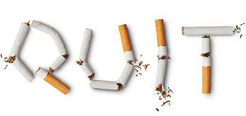
Treatment
Evidence-based treatments
Motivational Interviewing
Behavioral treatment
Pharmacotherapy & Nicotine Replacement Therapy

Slide 25
Treatment
Positive Predictors of Abstinence
High motivation
High readiness to change
Moderate to high self efficacy
Supportive social network
Negative Predictors of Abstinence
High nicotine dependence >1ppd
Psych comorbidity and substance use
High reported stress level
Exposure to other smokers

Slide 26
Treatment: Motivational Interviewing
Motivational Interviewing www.motivationalinterview.org
Motivational Interviewing: Preparing People to Change Addictive Behavior – W. Miller and S. Rollnick (1991)
A manner of intervention designed to help patients build commitment and reach decision to change.
Four principles: Express empathy, develop discrepancy, roll with resistance, support self-efficacy

Slide 27
Treatment: MI
OARS
Open-ended questions
“What are your concerns about quitting?”
“What could stand in your way?”
Affirmations – genuine compliment
Reflective listening – surface and deep reflections
Double sided reflection – “On one hand…on the other hand…”
Summaries – shows that you have been paying attention and provides a framework.

Slide 28
Treatment: Behavioral
Three types of interventions have been helpful:
Problem solving and skills training
Social support as part of treatment
Social support outside of treatment
Fiore, et al. Treating Tobacco Use and Dependence ^{(2008).}

Slide 29
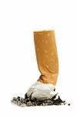
Treatment: Behavioral
Problem Solving
What do you enjoy about smoking?
It calms me down
I like the taste
It relieves boredom
It’s a break from my routine

Slide 30
Treatment: Behavioral
List some possible solutions to the problem of tobacco and then help form a plan:
When I feel anxious, I will:
Take a walk
Get a can of diet soda
Chew some gum (possibly nicotine gum)
Etc.

Slide 31
Treatment: Behavioral
Do not forget the problem.
The problem is the patient is addicted to nicotine and is using it as a tool to relieve stress, boredom, depression, etc.
There is NO evidence that tobacco helps, and in fact people who smoke tend to be more anxious.
Thus, the problem is using an addictive harmful, life threatening substance that is ineffective.
^{West & Hajek, Am Jrnl Psych} ^{154, (1998)}

Slide 32
Treatment: Behavioral
Preparing to Quit
Set a quit date within the month
DO NOT put yourself in a smoking environment
Change up your routine
Avoid drinking alcohol or using rec. drugs
Start to characterize yourself as a non-smoker
Keep an emergency kit with you (gum, etc)
Get all tobacco products out of home

Slide 33
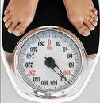
Treatment: Behavioral
Skills training (other issues)
Weight gain – remind those who use tobacco that the average weight gain from quitting is 8 lbs. in the first year (<10). They would have to gain over 100 lbs. to have similar health risks from tobacco use. Also gum, lozenges and Bupropion may help negate weight gain.
On average, it takes five times trying to quit to stay quit. Even one quit attempt is something to build on!
Clark, M. Weight Concerns in Tobacco Treatment (2002).

Slide 34
Treatment: Behavioral
Social support as part of treatment
Support groups have proven to be helpful, but do not do as well as individual treatment (Odds Ratio 1.3 vs. 1.7 individual)
Opportunities to help others and feel like one is not alone in their abstinence
Family involvement in treatment is also important
Fiore, et al. Treating Tobacco Use and Dependence ^{(2000).}

Slide 35
Treatment: Behavioral
Social support outside treatment
Remember STAR – The T stands for tell family and friends
Family and friends can remind the tobacco user of their commitment to stay quit
Common precursors to relapse: social settings where alcohol and tobacco are present, stressful situations with family members
Family members can help enforce the NO SMOKING rule in the home and car

Slide 36
Treatment: Pharmacotherapy & NRT
Pharmacotherapy
Varenicline (Chantix) – First line treatment
Best data for cessation; black box warning gone
Bupropion (Wellbutrin; Zyban) – First line treatment
Contraindicated with history of seizures
Good for weight concerns and depressive features
Nortriptyline (Pamelor) – Second line treatment. TCA side effects are concern and lacks FDA approval.
Cheapest of the bunch
Clonidine (Catapres) – Second line treatment
Good data, but increased likelihood of side effects and rebound blood pressure problems when discontinued

Slide 37
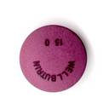
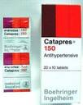
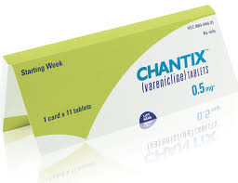
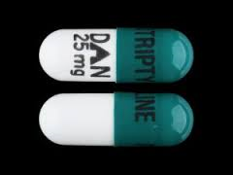
Treatment: Pharmacotherapy & NRT Note: Month of Cigarettes @ 1 ppd: $163 ($5.43 per pack)
Odds Ratios
Product OR Range Cost#
Varenicline 2.6* 1.5 – 3.8 $382
Clonodine 2.1 1.2 – 3.7 $7
Bupropion 2.0 1.8 – 2.2 $20
Nortryptiline 1.8 1.3 – 2.6 $4
^{Fiore, et} al. Treating Tobacco Use and Dependence ^{(2008).}
*Odds for 4 mg = 3.1, 2 mg = 2.1
# Price based on GoodRx

Slide 38
Pharmacotherapy Issues
Varenicline
Start one week prior to quitting
Days 1-3 .5 mg
Days 4-7 .5 mg bid
Total tobacco quit day on day 8
Day 8 - end of treatment 1 mg bid
Take with food and 8-12 oz water
Nausea – most common, can be mitigated with drinking water and a eating banana
Treat for 3-6 months

Slide 39
Pharmacotherapy Issues
Bupropion
Start one week prior to quitting
Days 1-3 150 mg
Days 4-7 150 mg bid
Total tobacco quit day on day 8
Day 8- end of treatment stay on 150 mg bid
Treat for up to 12 months
No need to taper when quitting
Avoid with patients who have hepatic issues; seizures

Slide 40
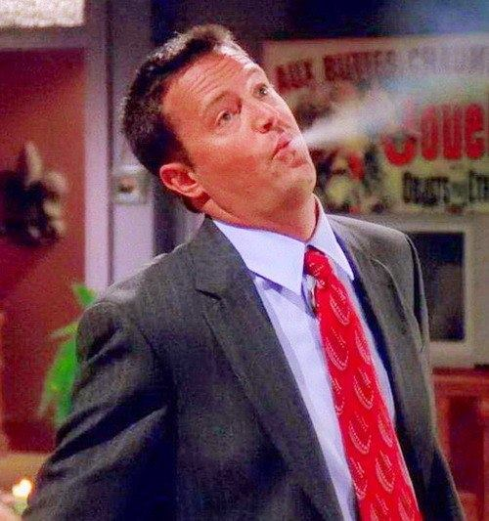
What is Chan-Ban?
Would you ever combine Chantix and Zyban?
In heavy smokers (> than 1ppd), there is evidence to support the use of both together.
In Mayo study, “Chan-Ban” quit rates were higher at 12, 26 and 52 week follow ups as compared to Chantix plus placebo.

Slide 41
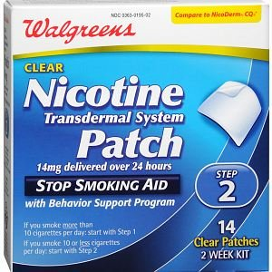
Treatment: Pharmacotherapy & NRT
Nicotine Replacement Therapy
Works for many people trying to quit tobacco.
Those who smoke less than 10 cigarettes per day or who do not smoke within first 30 minutes after awakening may derive less benefit.
Patch, Gum, Lozenge, Inhaler, Spray

Slide 42
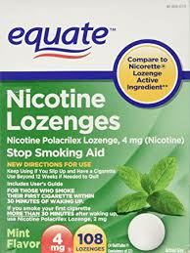
Treatment: Pharmacotherapy & NRT
Odds Ratios
Product OR Range Cost
Nasal Spray 2.3 1.7 – 3.0 $400
Hi Dose Patch 2.3 1.7 – 3.0 $60
LT (14 wk) Gum 2.2 1.5 – 3.2 $25
Inhaler 2.1 1.5 – 2.9 $398
Lo Dose Patch 1.9 1.7 – 2.3 $40
Lozenges 1.5 ??? $30
Fiore, et al. Treating Tobacco Use and Dependence ^{(2008).}
Prices from riteaid.com; Goodrx

Slide 43
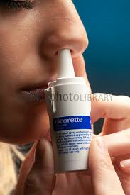
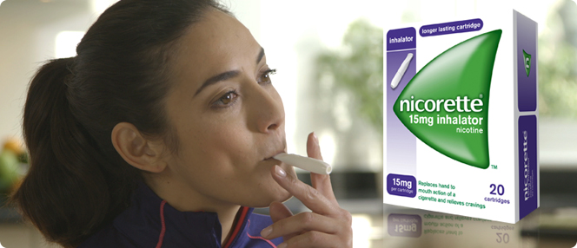
Treatment: NRT
Long term maintenance – 6 months recommended
Spray and Inhaler better mimic smoke tobacco’s mechanism of action, but require script and much more expensive
Combination of therapies is also advantageous. LT patch and gum or spray best (3.6 OR). Of course, patch and gum more economical.
Experts recommend individual counseling plus NRT as best practice.

Slide 44
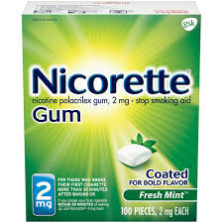
Treatment Tips
Spray – absorbs in the lower nasal mucosa; do not sniff like some other nasal sprays.
Inhaler – absorbs in lining of the mouth, not necessary to inhale deeply. Requires a lot of repetition.
Gum – 4 mg for heavy smokers or smokers within 30 minutes of waking up. 2 mg for others. Chew and park – absorbs like snuff.
Lozenge – Same dosing as gum, same type of absorption. Do not eat or drink 15 minutes before or during

Slide 45
Treatment Tips – Nicotine Patch
Generally the patch is under-dosed in practice
This contributes to patient notion that it “doesn’t work.” Does anything work well when it’s not the proper dosage?
Have patient rotate where they apply patch to decrease skin irritation
Dosing is generally just over 1 mg per 1 cigarette per day (cpd)
Taper dosage after 4-6 weeks tobacco free
Dosing: >39 cpd 42 mg patch
21-39 cpd 28-35 mg patch
10-20 cpd 14-21 mg patch
< 10 cpd 14 mg patch

Slide 46
Specific Patient Considerations
Pregnant
WV leads the nation in pregnant smoking
5 As; Bupropion
Breastfeeding
NRT; Varenicline; Bupropion
http://www.cdc.gov/mmwr/preview/mmwrhtml
Older patients (65 and up)
Be mindful of other illnesses (e.g. renal)
Elhassan & Chow (2007). Clin Geriatr, 15:38

Slide 47
Off the Beaten Path
Tabex
Reduced cost ($40/month) made with Cytisine (similarities to Varenicline)
Cytisine used in Eastern Europe for tobacco cessation since the 1960s
Similar efficacy to current recommended drugs (Varenicline, Bupropion)
Hajek, McRobbie & Myers (2013). Thorax. 68 (11): 1037–42

Slide 48
Popular Is Not the Same as Effective: E-cigarettes/Vaping
Battery operated cigarette look alike.
Supposed to have controlled dosage of nicotine to help wean smokers. FDA says NO
Buyer beware! Lack of scientific data
Harvard 2015 study – “same cardiovascular risks of a cigarette”
Most made in China with very little oversight.
Impurities and carcinogens in > 50% samples.
“No nicotine” samples had nicotine in them.
Amounts of nicotine never accurate.
^{www.aafp.org}

Slide 49
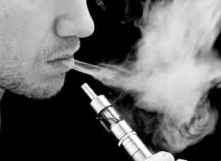
Ecigs
Not FDA Approved
No scientific studies on safety
No scientific studies show that ecigs are effective to help people quit smoking
Wait and see approach – cannot recommend unless there is good evidence

Slide 50
References
American Psychiatric Association (2013). Diagnostic & Statistical Manual of Mental Disorders, Fifth Edition. Washington, DC: APA.
Clark, M. (2002). Weight concerns in tobacco treatment. In Mayo Clinic Nicotine Dependence Seminar: Counselor Training and Program Development Manual. Rochester, MN: Mayo Foundation.
Dale, L. (2002). Bedside interventions: Hospital Services. In Mayo Clinic Nicotine Dependence Seminar: Counselor Training and Program Development Manual. Rochester, MN: Mayo Foundation.
Elhassan, A. & Chow, R. (2007). Smoking cessation in the elderly. Clin Geriatr, 15:38.
Fiore, M., Bailey, W, Cohen, S., et al. (2000). Treating Tobacco Use and Dependence. Rockville, MD: U.S. Department of Health and Human Services. Public Health Service.
Fiore, M., Bailey, W, Cohen, S., et al. (2008). Treating Tobacco Use and Dependence. Practice guideline update. Rockville, MD: U.S. Department of Health and Human Services. Public Health Service.
Hajek, McRobbie and Myers (2013). Efficacy of cytisine in helping smokers quit: systematic review and meta-analysis. Thorax, 68 (11): 1037–42
Miller, W, & Rollnick, S. (1991). Motivational Interviewing: Preparing People to Change Addictive Behavior. New York: Guilford Press.
Prochaska, J. & DiClemente, C. (1992). Stages of change in the modification of problem behavior. In M. Hersen, R. Eisler, & P. Miller, Progress in Behavior Modification, 28, Sycamore, IL: Sycamore Publishing Company.
West, R., & Hajek, P. (1997). What happens to anxiety levels on giving up smoking? American Journal of Psychiatry, 154, 1589-1592.
www.aafp.org; www.cdc.gov; www.chantix.com; www.fda.gov; www.motivationalinterview.org; www.tobaccofreekids.org; www.wvdtp.org; http://www.cdc.gov/mmwr/preview/mmwrhtml

