Slide 1
Collaboration with Google Docs
Emily Walters
May 8, 2017

Slide 2
Disclosures
I have no disclosures to report.

Slide 3
By the end of this session, you should be able to:
Create and share Google Docs and Microsoft Office files
Navigate Google Drive
Collaborate and share files in real time
View and edit files while offline
Assign different roles for different users

Slide 4
What do you want to learn today?

Slide 5
What’s the difference between
Google Docs and Google Drive?
Notes:
Google Docs is an online word processor that lets you create and format text documents and collaborate with other people in real time. Google Docs functions a lot like good old Microsoft Word, but is designed specifically for collaboration.
Google Drive is a free file storage service that allows you to store and access files using the cloud. Cloud-based storage allows you to access files from anywhere, at any time. Instead of storing individual files on your computer’s hard drive or on a thumb drive, you are storing the files online so that you can access them over the internet from anywhere.

Slide 6
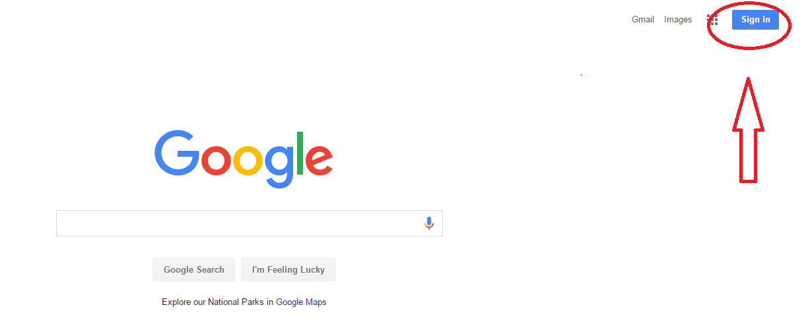
Getting Started
1.) Create or sign in to a Google account.
Notes:
You’ll need a Google account to use Google Drive. If you already have a Gmail account, you’re all set. Otherwise, you can create a Google account with your existing email address. Simply follow the instructions under “Create an Account” to get started.

Slide 7
Open Google Drive
Notes:
Navigate to Google Drive from any Google page by clicking on the grid icon in the upper right corner, then selecting the triangular Drive icon. You will need to be signed in first.

Slide 8
Navigation in Google Drive
Notes:
The column on the left will help you navigate around your file storage. The bright red “New” button allows you to create a new document, upload an existing document from your computer, or create a new folder. The “Shared with me” option allows you to see only files that have been shared with you by other users, instead of just your own folders.
Google Drive has many ways to find files. You can use the “Search” bar to search for a particular term, or sort using the filters under the “AZ” button on the right top corner. You can also star important folders to be able to quickly find them in your Drive.

Slide 9
Create a Google Doc File
Notes:
Select “New,” then click on “Google Doc” to create a new file. Other useful file formats include Google Sheets (a spreadsheet program similar to Excel) and Google Slides (a presentation program similar to PowerPoint). For this presentation, we’ll just focus on Google Docs, the word processor.

Slide 10
Google Doc Files
Notes:
Your new Google Doc will appear in a new tab on your web browser. Don’t forget to rename your document in the upper left corner. You’ll find many of the same features as in a normal word processor, including text size, fonts, bullets, and formatting options. One great feature is Autosave, which means that you never have to click save while working on the document. As long as you have internet connection, Google will automatically save your changes.

Slide 11
Upload a Word Doc
Notes:
You can store different types of files on Google Drive, particularly Microsoft Office files like Microsoft Word documents. Once you’ve uploaded a Word file, you can share it with others. However, if you want to edit the content and collaborate with others, you’ll need to convert the Word Document into a Google Doc file. We’ll get to the sharing and collaboration stuff soon, but just remember that you can upload, store, preview, and download your Word Doc directly in Google Drive. To edit, you’ll need to download it or convert it.
Click on the red “New” button, then select “File upload.” Choose your file from your documents or computer desktop.

Slide 12
Convert Files to Google Docs
Notes:
To convert a Word Doc into a Google Doc file for editing or collaboration, double-click on the file (Here I’ve clicked on my Google Docs abstract file). A preview of the file will appear, with a black background around the file. Click on the “Open with Google Docs” option with a blue square beside it. This will automatically create a new Google Doc file that will appear in a new tab. If you click back to your original screen in Google Drive, you’ll now see two versions of your document. One (the original) has a blue W for Word beside it. The new file in the Google Docs format has a blue square with white lines beside it.

Slide 13
Sharing Files With a Team
Notes:
Google Docs offer many great features for collaboration through editing and commenting features. Before you can get started with collaboration, you need to share your files with your team. You can do this two ways: Method #1. Share the file you want to share with specific people and their email addresses by clicking the “Share” button in the upper right corner, entering your chosen email addresses into the pop-up box, and sending an email invitation. With the drop-down menu, you can decide whether those people have editing privileges, can comment, or just viewing privileges for your document.

Slide 14
Sharing Files with a Group
Notes:
Method #2: If you want a larger or even unlimited number of people to be able to view or edit your document, you can choose to create a shareable link. In the same way as before, click on the “Share” button, and choose the “Get shareable link” option in the upper right corner. This will create a hyperlink that you can paste into an email or even post on a website so that anyone who has the link can access that specific file.

Slide 15
Start Collaborating
Notes:
If everyone has editing or commenting privileges, you can leave comments and questions for each other. You can set up a whole thread of comments and responses in the right column. You’ll also have the option of directly editing in the text. When one of your team members is editing the text, you’ll see a bright blinking cursor and changes made in real time.

Slide 16
Add or Change Share Permissions
Notes:
If at any point you want to check who has access to your file, hover over the blue Share button to view the permissions. In this example, the file is still private. I can now click on the Share button to edit those settings or email a link to another collaborator.

Slide 17
Different Roles
Notes:
Sometimes you might not want someone to make changes directly in your document. If you’re looking for feedback or review, share your file with your collaborator, but set the dropdown option to “Can Comment.” Some other collaborators might only need to view your document, so you can set the “Share” settings so that they can only view the document.

Slide 18
Download or Convert a File
Notes:
If you’re ready convert a Google Doc back into Microsoft Word or save it to your computer for offline access, you’ll want to download the file. In Google Drive, simply right-click on the document you’ve chosen. Then select the “Download” option near the bottom of the menu that pops up. This will download a copy of the file in Microsoft Word to your computer. From there you could upload the document to a flash drive for access offline, or sent it as an email attachment.

Slide 19
What Did We Cover? How To:
Create and share Google Docs and Microsoft Office files
Navigate Google Drive
Collaborate and share files in real time
View and edit files while offline
Assign different roles for different users

Slide 20
Let’s try it out!

Slide 21
Additional Resources
Check out the free tutorials on Google Docs and Google Drive on the website GCFLearnFree.org
https://www.gcflearnfree.org/googledriveanddocs/

Slide 22
Please evaluate this presentation using the conference mobile app! Simply click on the "clipboard" icon on the presentation page.

