Slide 2
Touring the Town: Using a Walking Survey to Teach Your Community's Social Determinants of Health
Betsy Mathew MD
Nath Samaratunga M1
Rutgers Robert Wood Johnson Medical School
New Brunswick, New Jersey
Other Contributors: Shilpa Paii MD, Joyce Afran MD, Brad Kamitaki MD

Slide 3
Disclosures: none

Slide 4
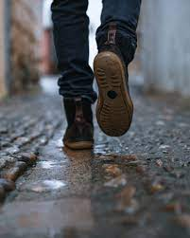
Objectives
Describe an innovative active learning strategy for teaching SDOH, increasing awareness of a specific community’s assets and challenges, and promoting upstream solutions.
Discuss the use of written reflections to assess learning about SDOH and community factors.
Evaluate the potential benefits and challenges of incorporating such experiential learning curricula in medical student or resident education.
Notes:
Dr. Mathew

Slide 5
What were we already doing to teach Social Determinants of Health (SDOH)
Didactics and Cased Based Learning
- Seminar introducing SDOH and why they matter
- Panel Presentation including Physicians from the community, Community Health Workers and Representatives from some Community Organizations
We wanted to add a required, EXPERIENTIAL learning activity
Notes:
Brief
Dr. Mathew speaking

Slide 6
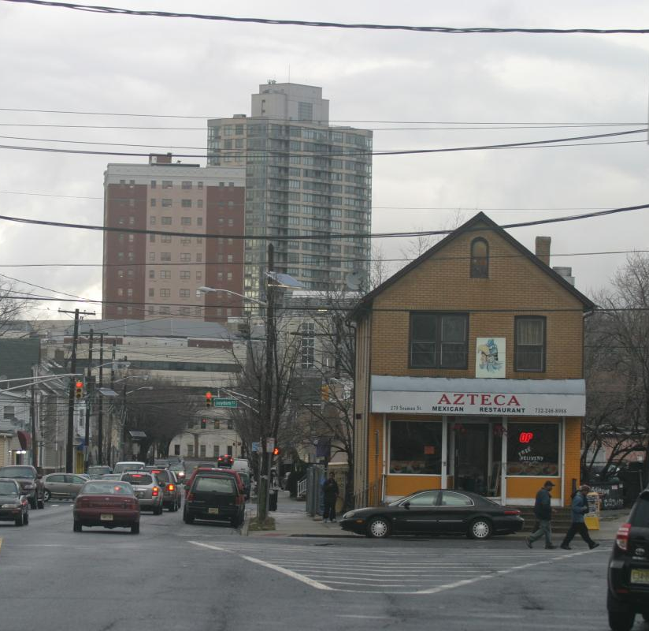
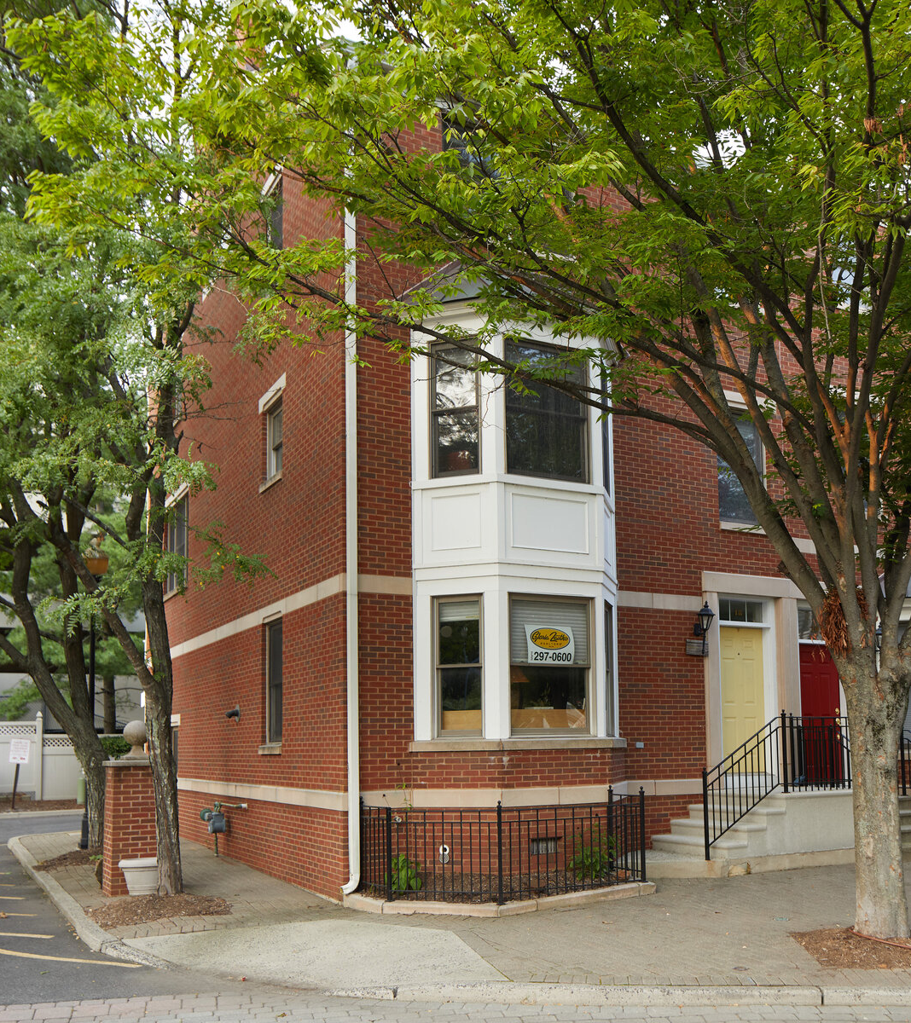
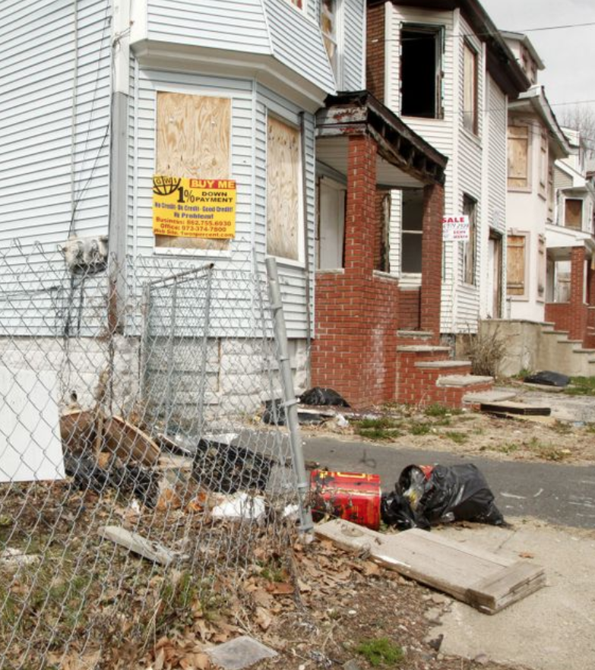
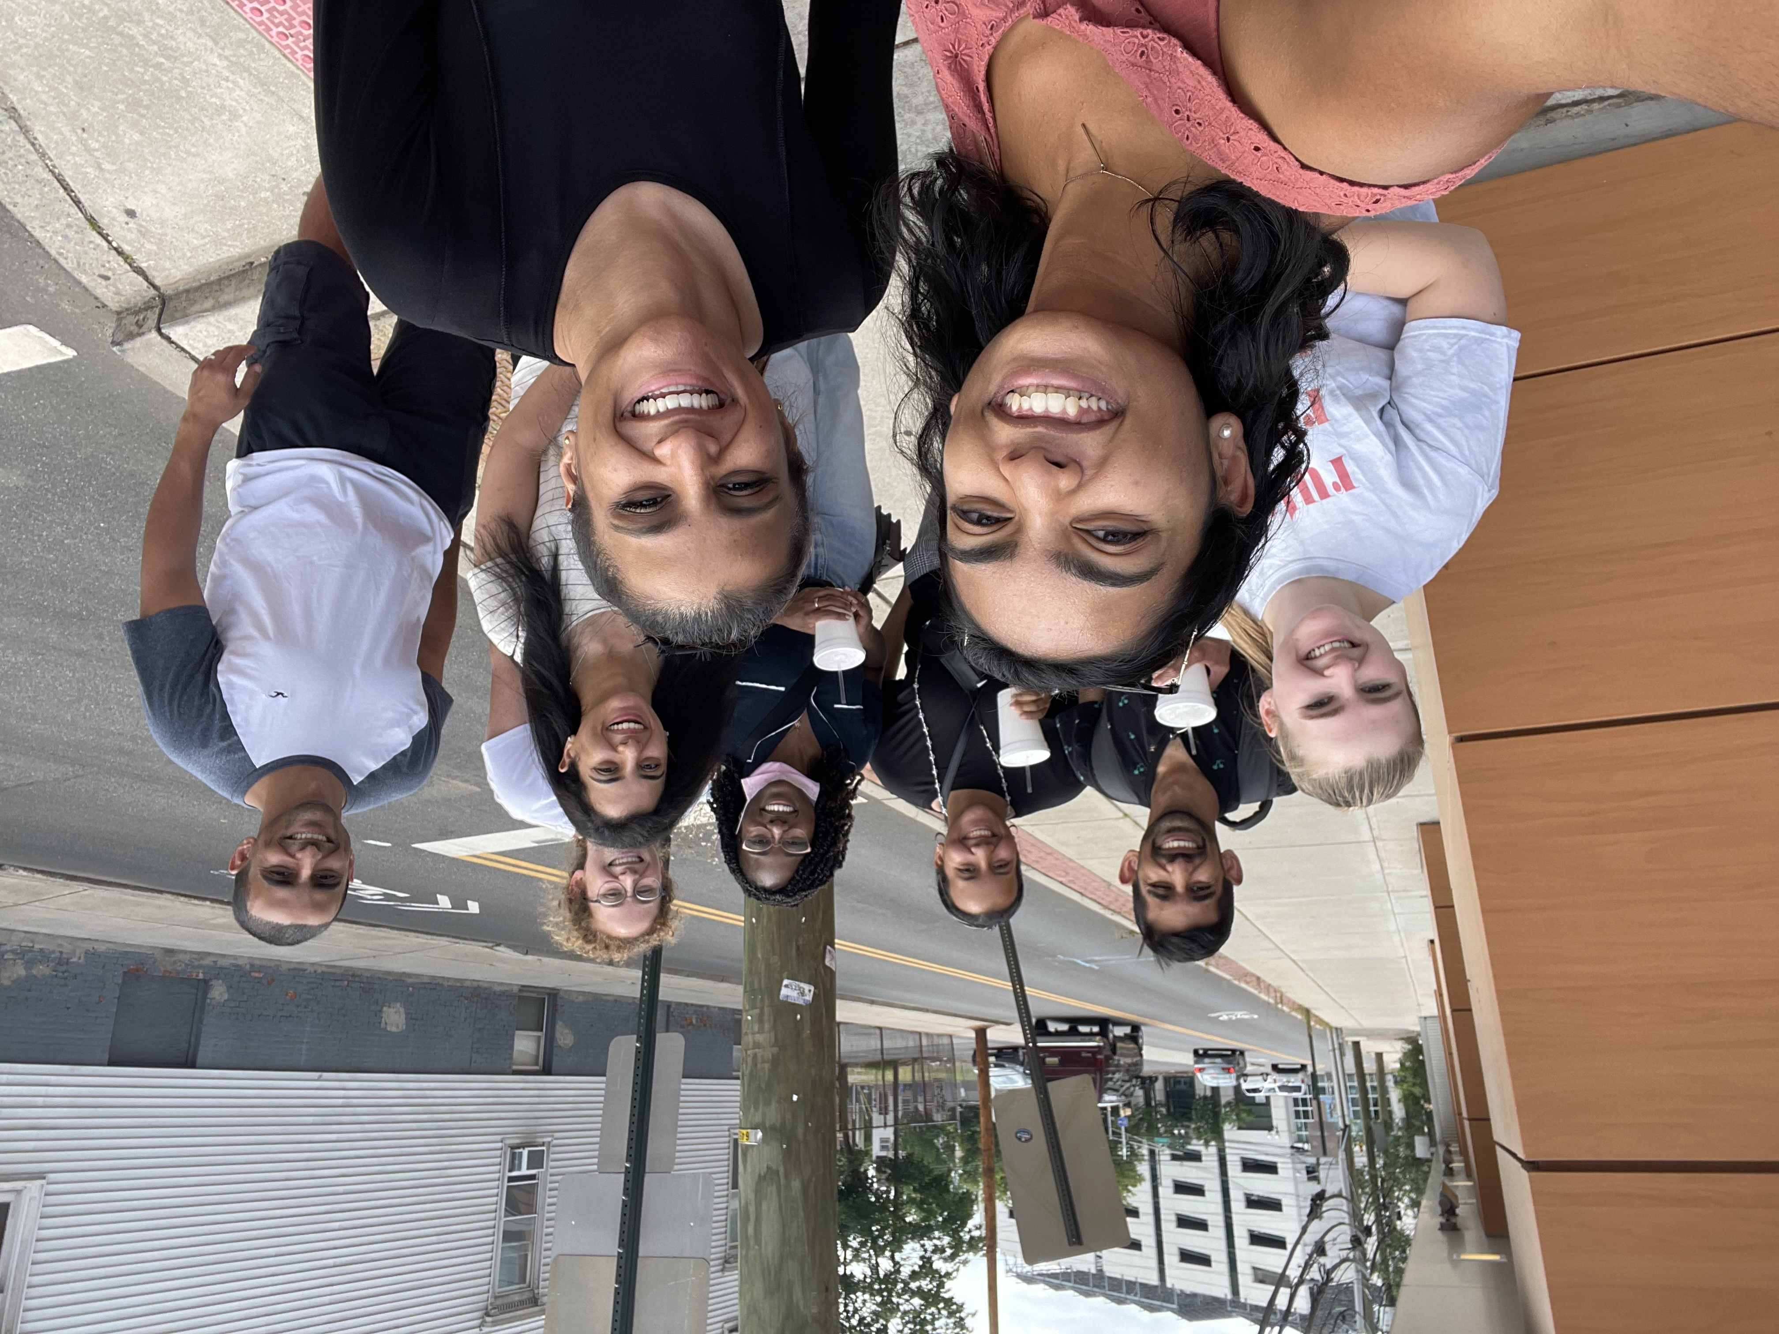
A Walking Survey! Students went out in groups of 2-3 to actively SEE the neighborhood
Notes:
Dr mathew

Slide 7
Has this been used before?
Walking Surveys (or Windshield Survey) have been used with medical students and residents before.
Main takeaways for the learners included increased awareness of financial barriers to care, barriers in access to high-quality food, and structural racism
Majority of studies that showed this was well-received noted integration of a reflection segment following the tour
No other identified study utilized the walking survey tool as a REQUIRED activity (all participants were self selected)
No other studies were done on such a large sample size
Notes:
Nath

Slide 8
Walking Survey Experiential Learning Activity
After the Didactic on SDOH and intro to New Brunswick Community (3-6 hours), students were given a guide to do the following activity on their own:
- Pre Tour Research (1 hour)
- Actual Walking Survey using a Written Guide (2 hours)
- Post Tour Written Reflection (1 hour)
- Facilitated Small Group Discussion (30 min)
Notes:
**Share specific pre-tour research Qs**
Dr. Mathew speaking

Slide 9
Pre-Tour Research
Access various online data resources to compare statistics from New Brunswick (Zipcode 08901) to another zip code (preferably one you grew up in or have lived in before):
Census Bureau Website: data.census.gov
Minority Health Social Vulnerability Index:
https://onemap.cdc.gov/Portal/apps/MapSeries/index.html?appid=3384875c46d649ee9b452913fd64e3c4&utm_medium=email&utm_source=govdelivery
New Brunswick Community Health Needs Assessment (CHNA) Report
Research questions include:
What is the median household income?
What percentage of the population age 25 years and older have less than a high school diploma?
What percentage of residents live below the poverty level?
What is the average obesity rate?
What percentage is without health care coverage?
What are top 3 health related concerns of the residents?

Slide 10
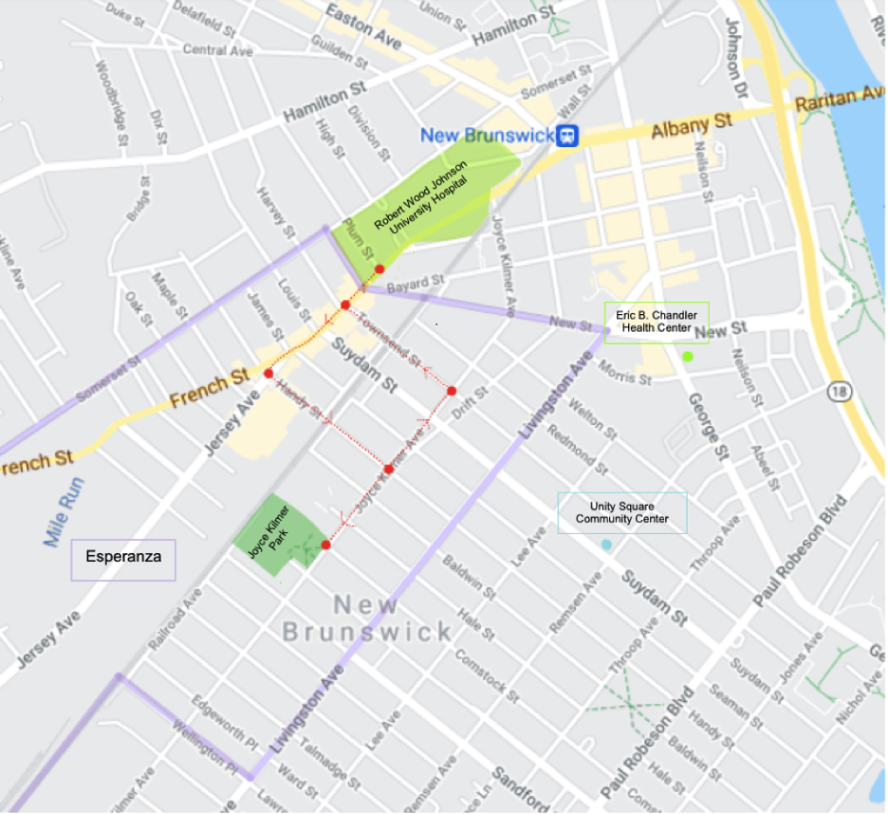
Walking Survey Route
Find a walking area that is
Fairly safe
Includes the neighborhood’s different ethnic areas, gentrified areas, historic areas, and the health center

Slide 11
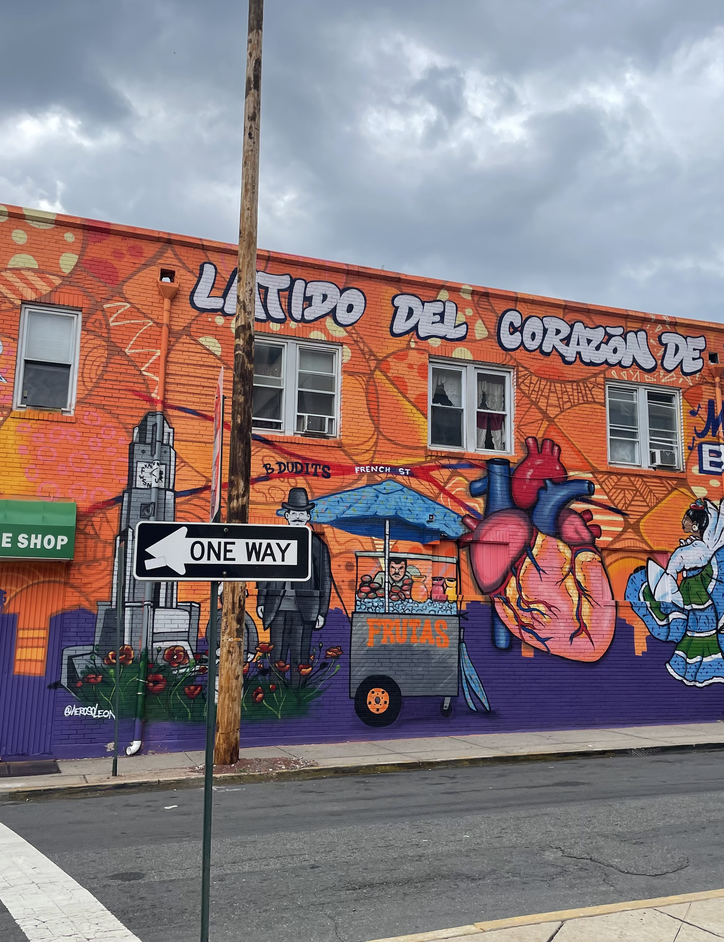
Tool: What to look for
Housing
Open Spaces (parks, playgrounds)
Shopping Areas (groceries, bodegas)
Schools
Houses of Worship
Health Care (hospitals, clinics, pharmacy, dentist)
Means of Transportation (buses, train, cars)
Protective Services (police, fire, neighborhood watch)
Neighborhood Life (activities, who is outside, ethnicities represented, homelessness)
Encouraged to participate in the neighborhood if possible

Slide 12
Post Tour Written Reflection
Why add a Written Reflection?
Reflections enhance student learning and provide a more comprehensive means of assessment
- Multiple choice questions are difficult to apply to SDOH and will not be specific to your community/service area
- Reflections can be used to evaluate knowledge integration and application
Investment:
More time for grading
Require a Rubric for more standardized grading

Slide 13
Reflection Prompts and Instructions:
Maximum 750 word essay using all of the following four prompts:
1. DATA: Summarize key data points that you gathered during the background research (online data resources). Discuss the importance/relevance of key data points you obtained.
2. COMPARISON TO ANOTHER COMMUNITY: How is the community that you will now be serving compare to another community/zipcode. (Consider comparing to another community you might know about, or have lived in before)
3.STRENGTHS & CHALLENGES: Describe several assets or strengths of the community as well as several needs or challenges that may impact the health and well-being of the residents of New Brunswick? (Think through the variety of social determinants of health that can positively and negatively impact health)
4. UPSTREAM INTERVENTION: Describe a specific social determinant of health which you, as a physician, could act on – using an “upstream” or advocacy approach.
Each prompt was scored on a 5 point scale

Slide 14
Reflection Prompt #1: Data
Summarize key data points that you gathered during the background research (online data resources). Discuss the importance/relevance of key data points you obtained.
Rubric (max 5 points)
5: Addressed at least 3-4 different data points and discussed how they connect to SDOH and how they are interrelated. The data was not just told, but well digested.
3: Addressed 3-4 data points but did not explicitly show the connection to SDOH or interrelation between the points was not made.
1: Only addressed 1 data point and/or did not discuss its meaning/relevance.

Slide 15
Reflection Prompts 2-4
Prompt #2: Comparing Data/SDOH to another Community
5: Critically compared and contrasted at least 3-4 SDoH characteristics between 2 communities
3: Compared/contrasted 1-2 SDoH characteristics between 2 communities
1: Superficially compared 2 communities, but did address SDoH
Prompt #3: Recognizing Community Assets and Challenges that affect Health
5: Addressed at least 3 strengths AND 3 challenges of New Brunswick and related them to SDoH and health outcomes
3: Addressed 1-2 strengths AND 1-2 challenges of New Brunswick and/or related them to SDoH and health outcomes
1: Only 1 strength AND/OR only 1 challenge; may or not have related it to SDOH or health outcomes.
Prompt #4: Proposing Upstream Solutions
5: Synthesized information from data gathering and walking tour to creatively and realistically address an SDoH that is felt to be a need in New Brunswick
3: Reflected on information from data gathering and walking tour, but was unable to create a workable upstream approach (e.g., may have created a solution but not very feasible)
1: Did not include info from BOTH data gathering and walking tour, but created an upstream approach

Slide 16
Results
Average Overall Score: 17.6 out of 20
We considered 14 or above to be passing (70%)
Graph of total score and individual scores by Prompt

Slide 17
Small Group Discussion
Peer to Peer Learning
Sharing Individual perspectives
Faculty connecting observations to health

Slide 18
Did students learn about the SDOH of their new community?
“We took notice of the strong religious faith and cohesive cultural ties in the neighborhood showcased by the numerous churches, free pre-schooling available, restaurants, Damon House rehabilitation center, and even amongst the homeless who were playing dominoes under the bridge.”
"During my walk, I noted a general lack of fresh fruits and vegetables in the grocery stores servicing Esperanza. Without access to fresh produce, residents of Esperanza will have difficulty cultivating a healthy diet, even when recommended by their physician. "
“Initially, I marveled at these houses: much bigger than I expected. Then I noticed the mailboxes. Two on one door. Three on another. Because these weren’t truly houses, but rather apartments carved from homes half the size of mine. How could you possibly socially distance yourselves in such a small space? For the first time, I understood why COVID-19 hit poor, urban areas so hard.”
"While there were green spaces, playgrounds, and some sports fields in the area, the only gym we saw was the RWJ Fitness and Wellness Center which is likely too expensive for most residents at $67/month."
Notes:
Nath

Slide 19
What else did they learn about themselves or their new patients?
“Seeing these statistics really had an impact on me because it allowed me to better understand the struggles of the people living here and therefore gave me more understanding and empathy towards them. Going on this walk also reminded me of my family since most of them live in areas like Union City and West New York, which are like New Brunswick.”
“I was impressed by the ease of access to healthy food options, but even more so by the diverse selection of cultural foods. When I was a child, I remember that we lived near a Chinese grocer and was fortunate to eat a lot of the food I was accustomed to or enjoyed from China. Thus, I was happy that immigrants can have the same experience.”
“Ultimately, this walking tour gave me the chance to start brainstorming how I can serve as an advocate in my early clinical years while proactively planning how I should approach each patient encounter with their specific needs in mind.”

Slide 20
Benefits and Challenges of this Experiential Learning Activity
Benefits:
- Increase student understanding of social determinants of health through experiential learning
- Understanding the population they would now be serving
- Increase student interest in community-engaged work
- Allow for individual reflection and comparison to own lived experience
- Foster critical conversations amongst learners
- Fairly short, self directed activity (<6 hr activity)
Investment:
- Faculty grading time
- Faculty training
- Vetting of walking route
- Verifying tour is representative of population
Notes:
Share convo about # of parks // ppl identifying same things as strengths versus weakness
Both speaking

Slide 21
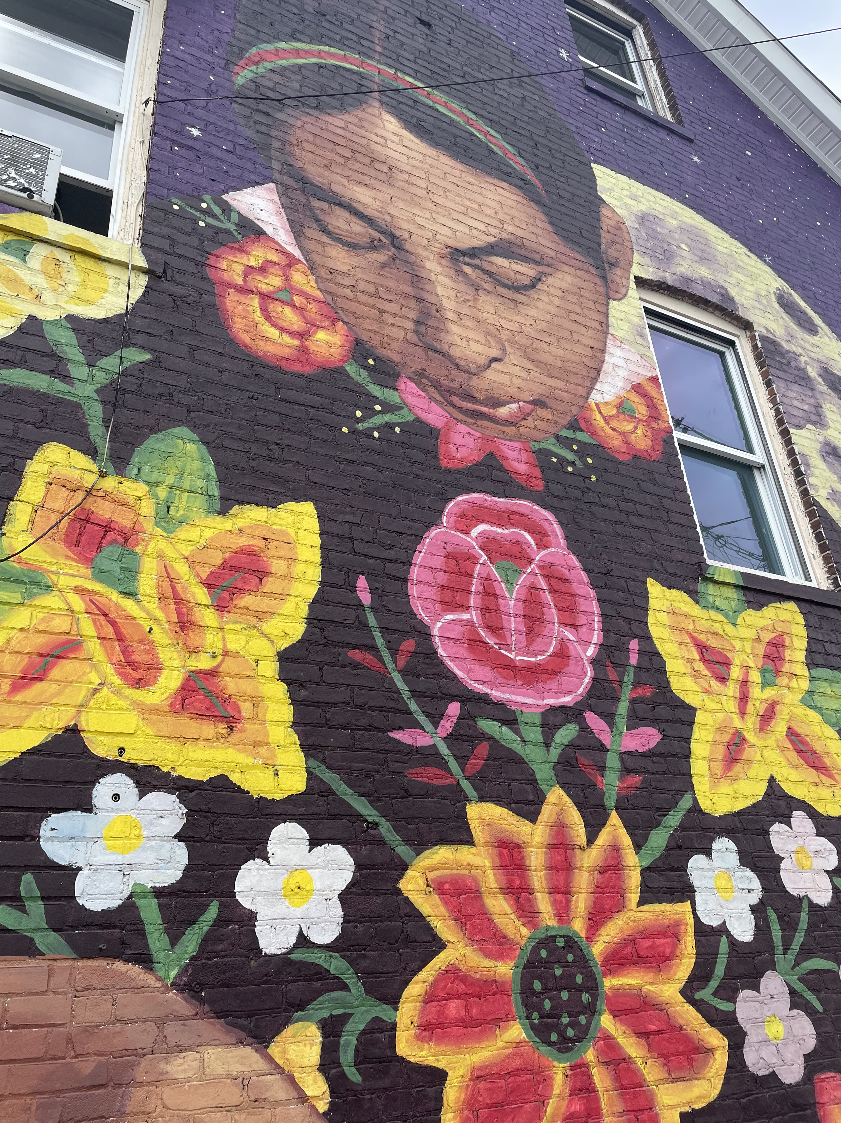
What would it look like to incorporate this activity at your program? What practical benefits or challenges do you anticipate?

