Slide 1
Family Medicine Cares International: Partnership development in third world countries
Anna Doubeni, MD MPH
Mary Jo Welker, MD
Kathy Walmer, NP

Slide 2
Disclosures
Presenters have no Conflicts of Interest or Financial Disclosures to report

Slide 3
Learning Objectives
Understand the change in partners for the FMCI Delegation trip to Haiti
Understand the principles of partnership development and how they influence partner choices
Understand the challenges and barriers to successful partnerships.
Understand how to develop successful partnership in third world countries

Slide 4
What is Family Medicine Cares International?
Humanitarian program created to provide sustainable and accessible health care to underserved populations around the world.
Provides patient care, delivers education and training in Family Medicine, and works to improve the health and quality of life of people in Haiti.

Slide 5
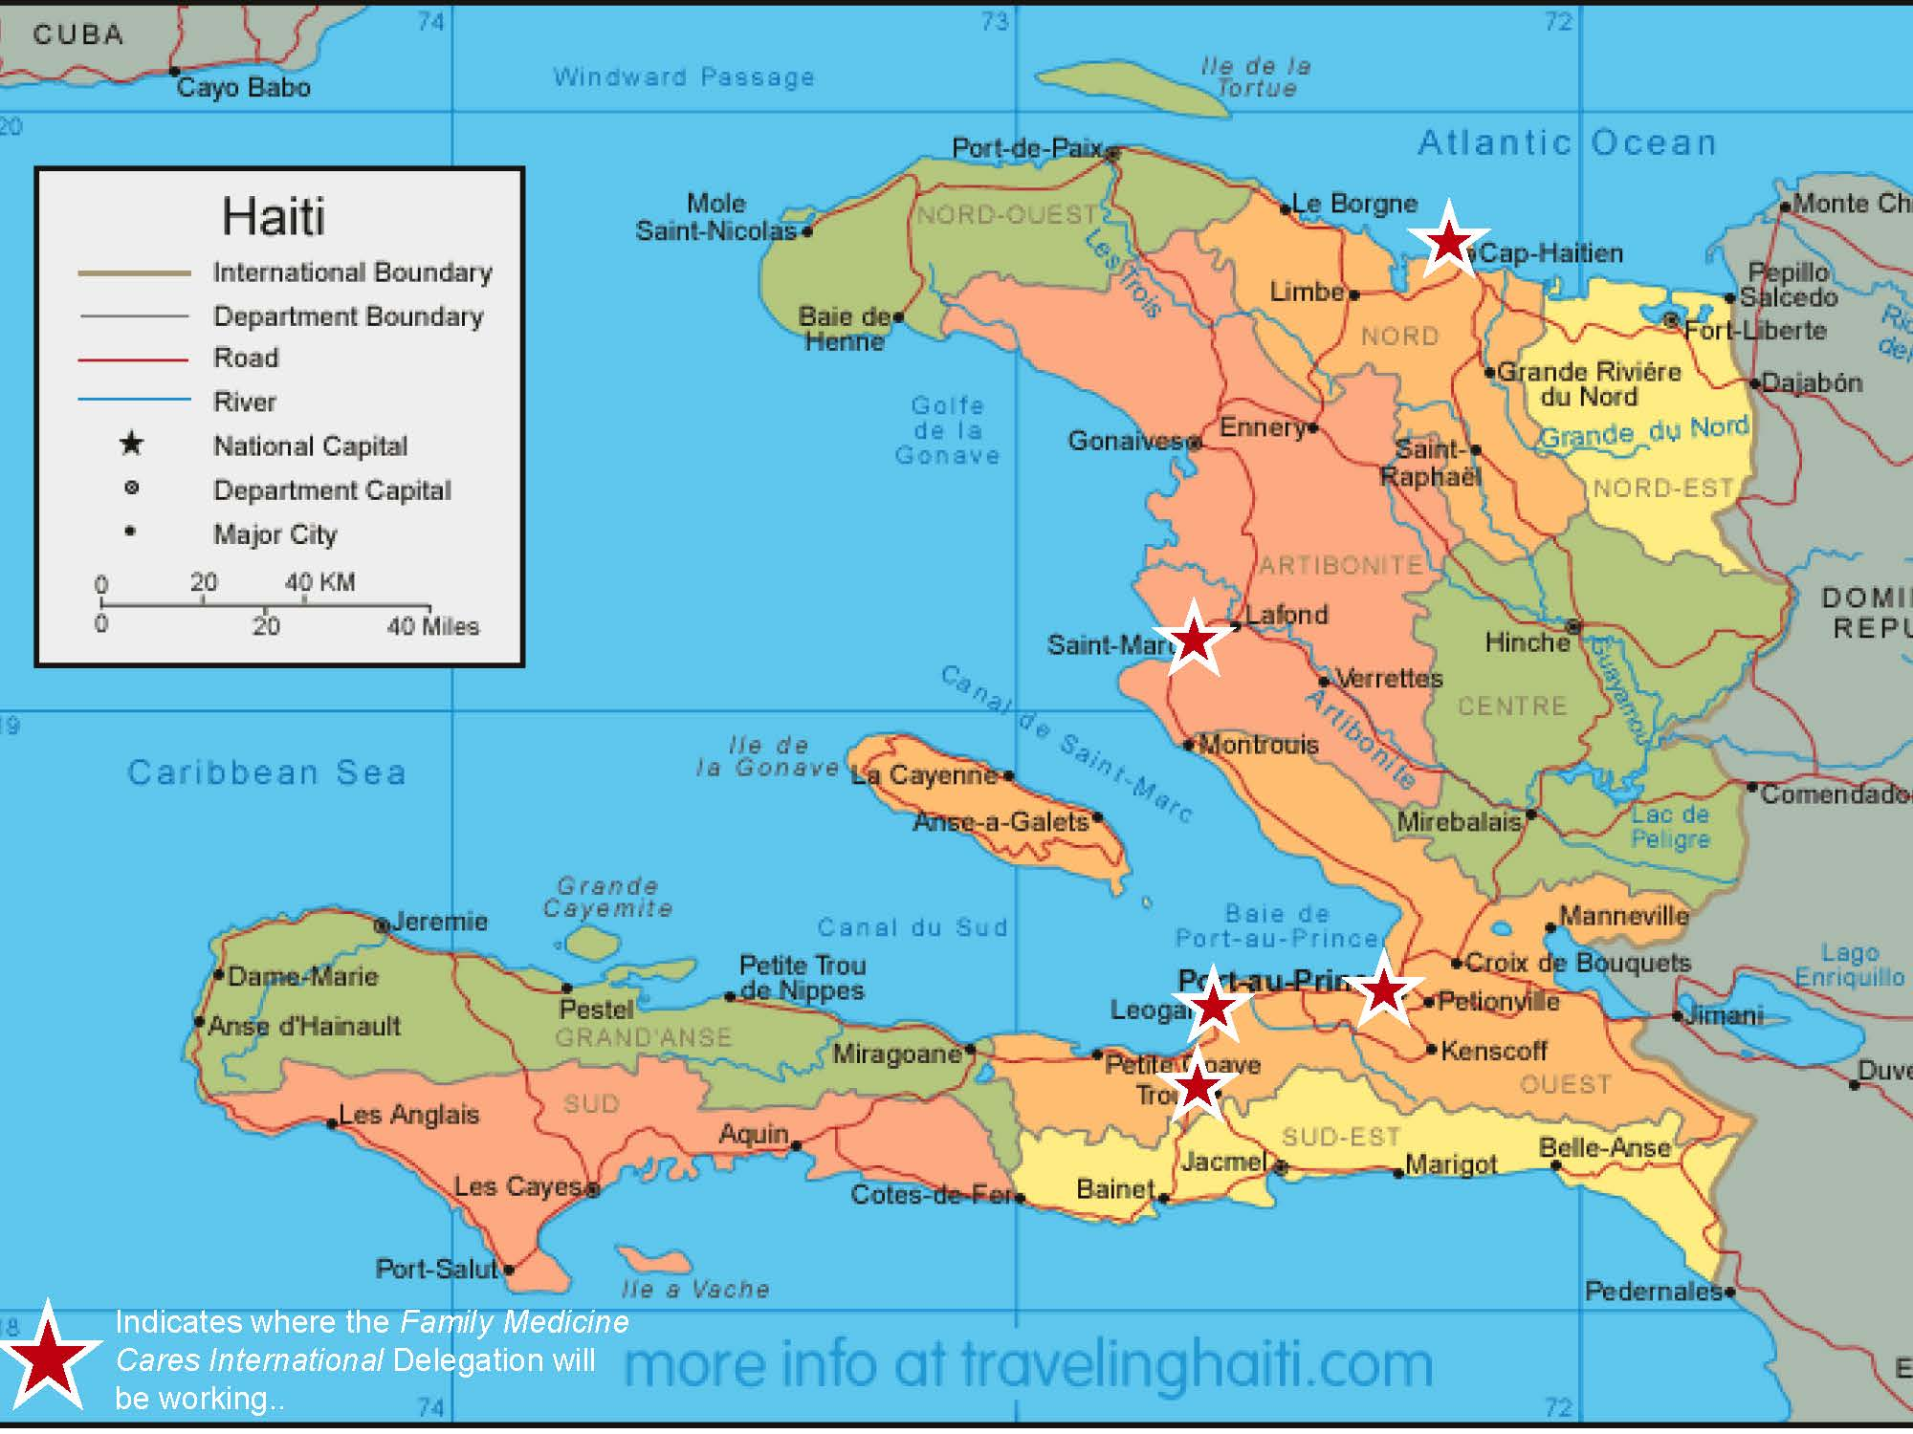

Slide 6
Family Medicine Cares International
Program Components
Patient Care
Medical Education and Training
Children and Youth Projects
Medical Equipment and Supplies
Work is Accomplished Through
Annual Delegation
Faculty Development Trips
Ongoing Communication and Mentoring

Slide 7
Annual Delegation Trip
The Annual Delegation trip is a one-week volunteer opportunity that includes both medical and non-medical individuals.
Delegation has three teams:
Patient Care
Medical Education
Service
2019 Delegation: February 23 – March 2

Slide 8
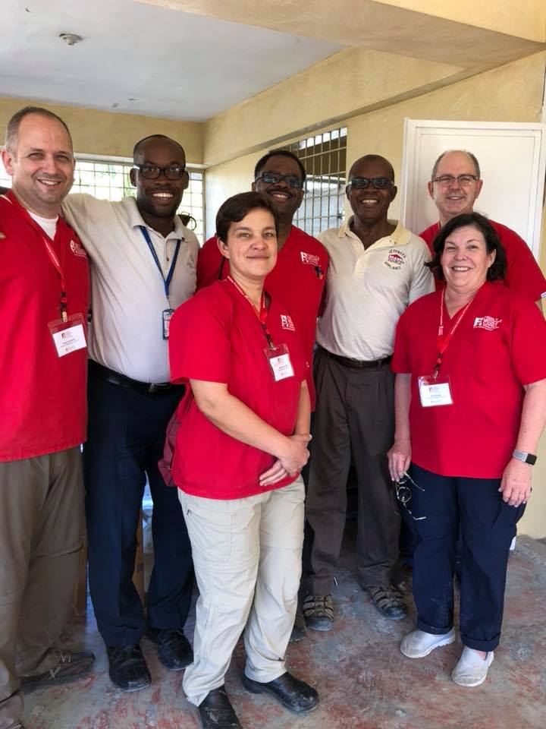
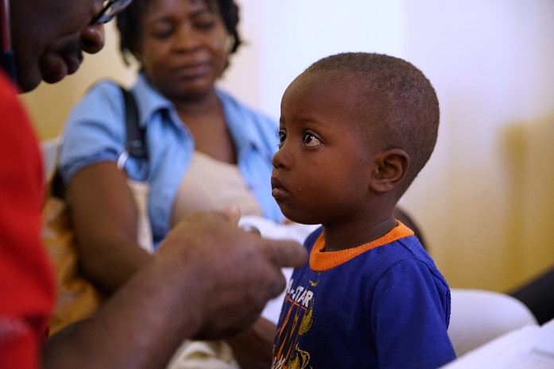
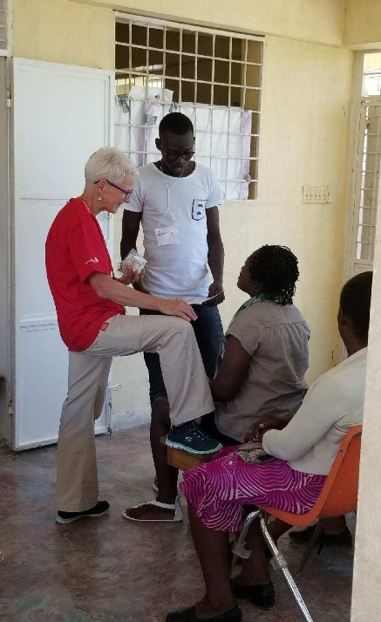
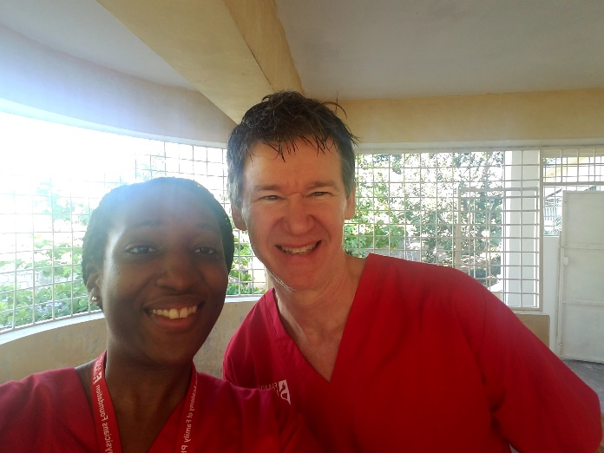
Patient Care Team
799 Patients seen!

Slide 9
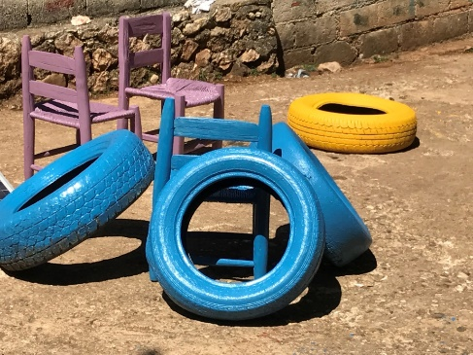
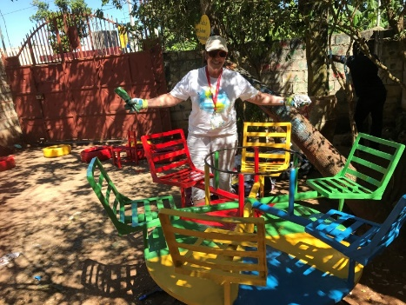
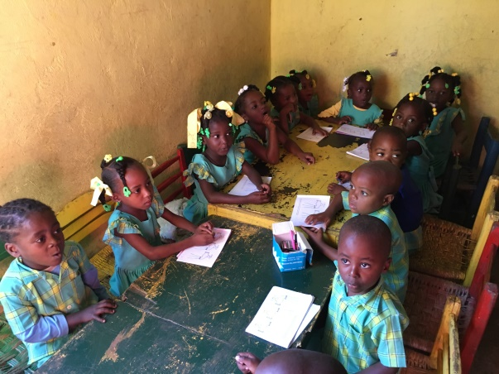
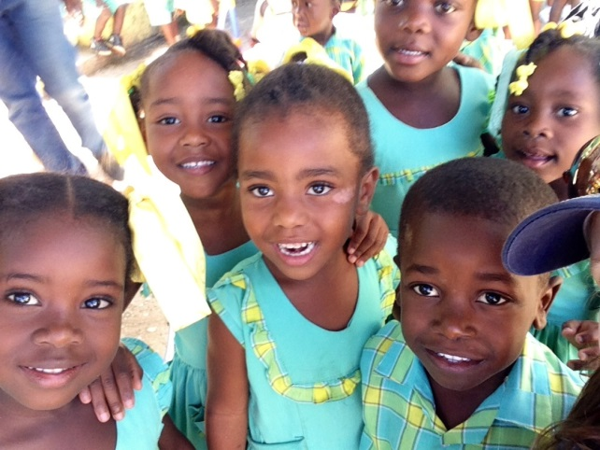
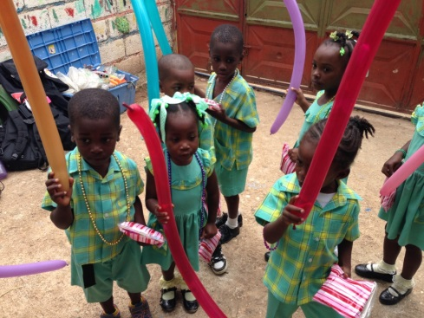
Service Team
Seeks to improve the quality of life and the health of children in Haiti, as well as provide health and hope to Haiti’s youth. It also allows non-medical Delegation members to participate in meaningful volunteer efforts.
Notes:
400 Children were impacted by the Service Team
2 schools and 1 orphanage
Painted playground equipment
Painted 1 school interior
Painted 1 school exterior and a fence
Painted chairs and tables
Assisted with well child exams
Provided hundreds of school supplies, soccer balls, jump ropes
CompHealth donated:
500 Treat Bags and provided $2,000 to purchase French children's books in Haiti.

Slide 10
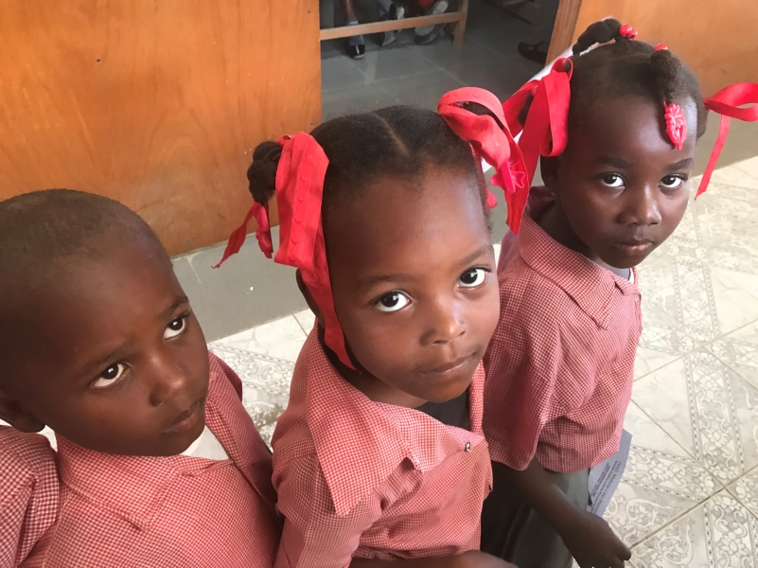
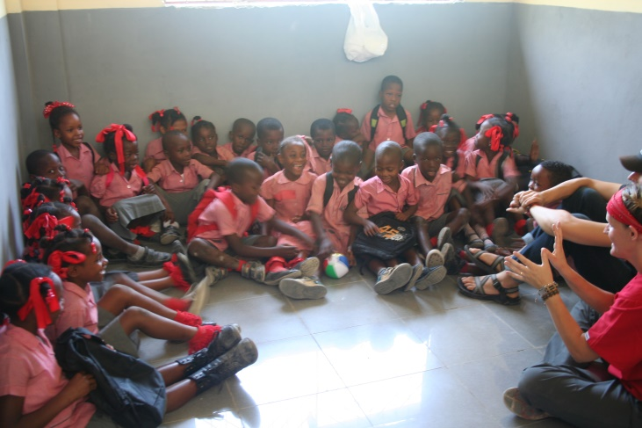
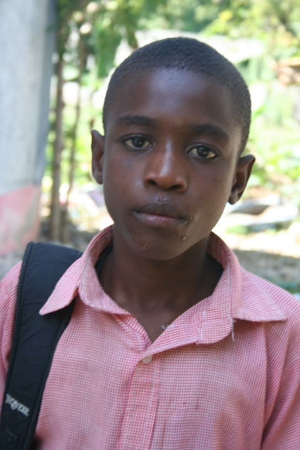
Patient Care and Service Team Collaboration
Patient Care Team performed physical examinations for school age children and made necessary follow up for those in need.
Service Team delivered toys, sports equipment, and school supplies to the children upon completion of their visits.
10
Notes:
172 Well child visits were accomplished with the help of the Service Team.

Slide 11
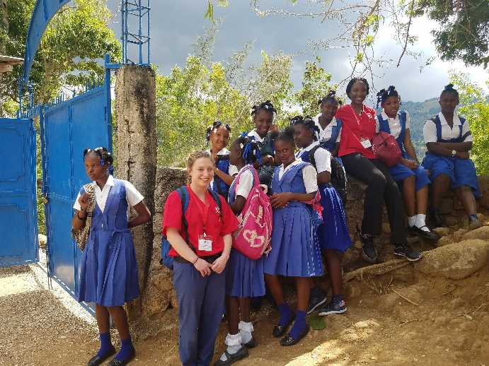
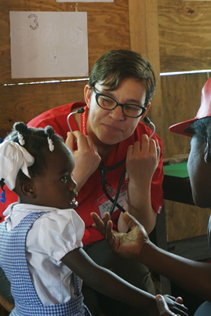
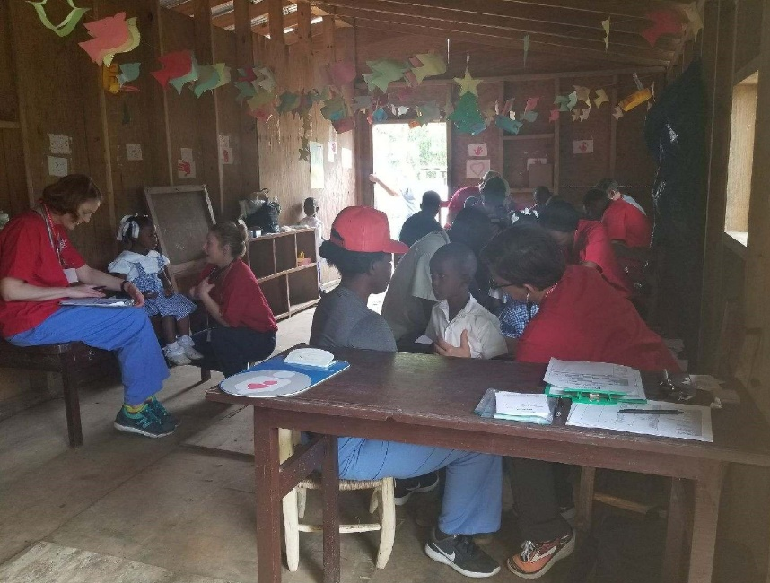
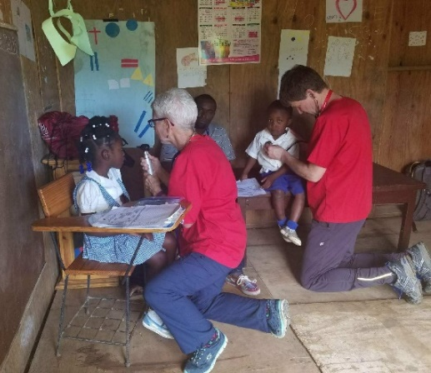
Patient Care and Service Teams at Fondwa School and Orphanage
320+ Well child visits conducted
Notes:
Mention that AAFP staff donations provided vitamins which are now being administered daily by school staff as well as deworming medication for all 600+ students

Slide 12
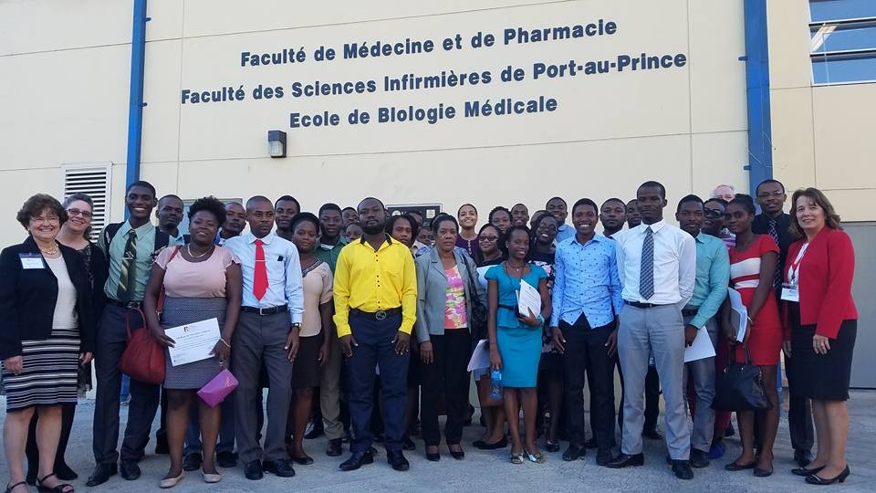
Symposia
Full day, CME-type conference
Topics/themes recommended by Haitian faculty
Recent: Women’s Health, Mental Health, Adolescent Care
Presented in Cap Haitien and Port au Prince
Speakers are both FMCI and Haitian faculty
In French
30-50 participants at each location

Slide 13
Faculty Development: Program Philosophy and History
Philosophy
Mission work is important but not enough
Need committed, well-trained, local medical community
History
Started with a request for a book…
Led to a meeting at the PAP airport…
Spurred discussion with the Foundation

Slide 14
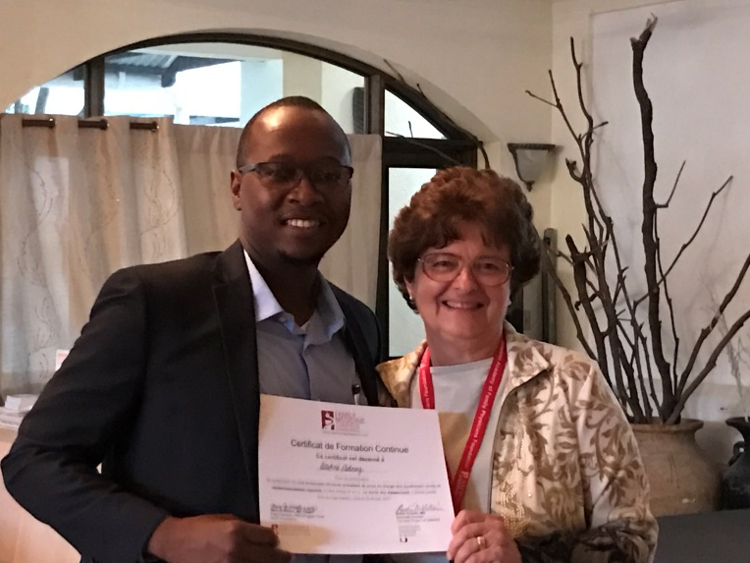
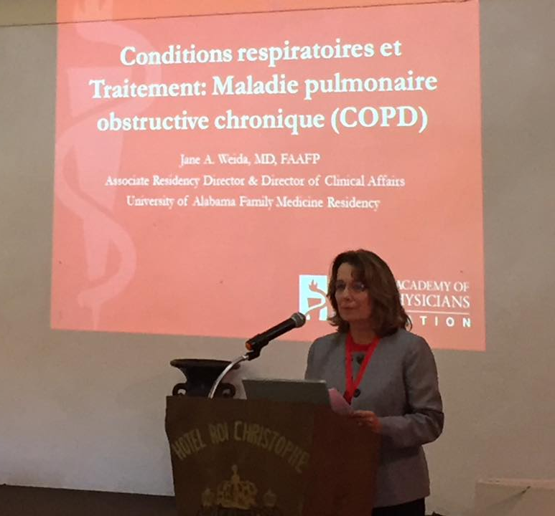
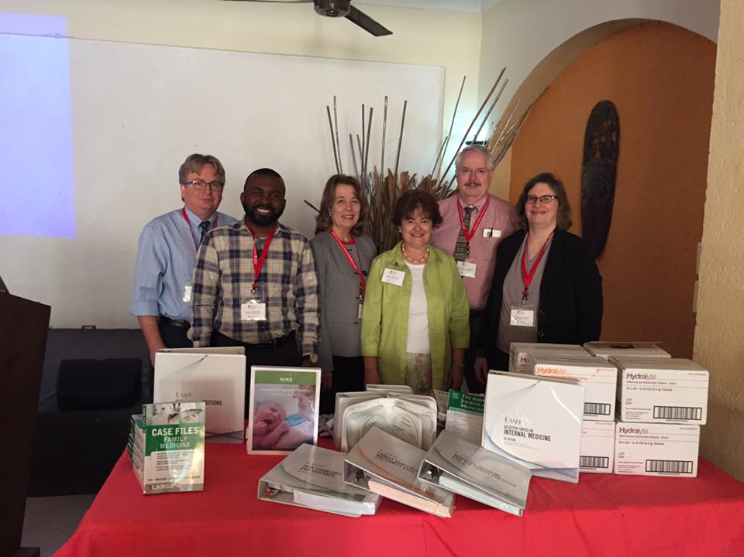
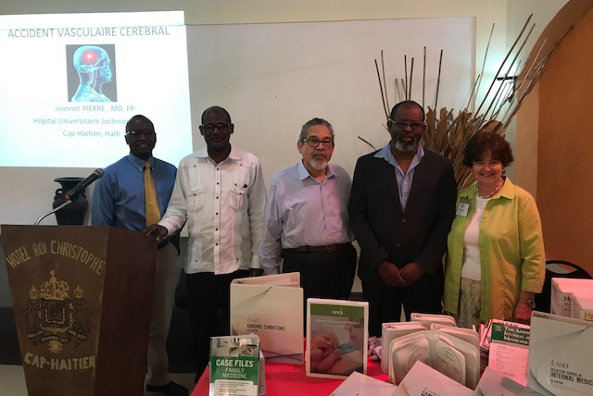
Medical Education Team

Slide 15
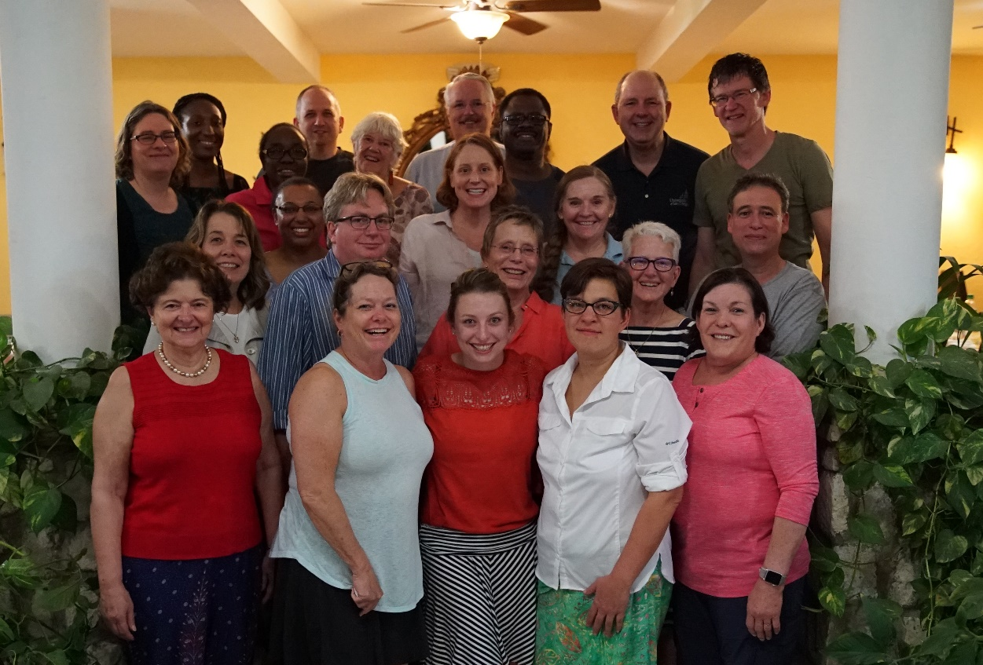
Thanks
Faculty of Hospital St. Nicolas, St. Marc
Faculty of Hospital Universitaire Justinien, Cap Haitien
UNTHSC Faculty Development Center
AAFP Foundation

Slide 16
New Partner/Old Partner
Heart To Heart
Partner for over 25 years in Physicians with Heart and Haiti
Leadership changes
Mission changes
Disaster Relief
Sustainability issues
Focus on Family Medicine Development, Education and Children’s Projects
Family Health Ministries
Commitment to Haiti and have been there for 25 years
Commitment to patient care in underserved areas
Working with Haitian physicians and staff
Working with schools and children in Haiti

Slide 17
Family Health Ministries (FHM)
Mission:
We support Haitian communities in their efforts to build and sustain healthy families by developing best health care practices to share across Haiti and other low-resource communities.

Slide 18
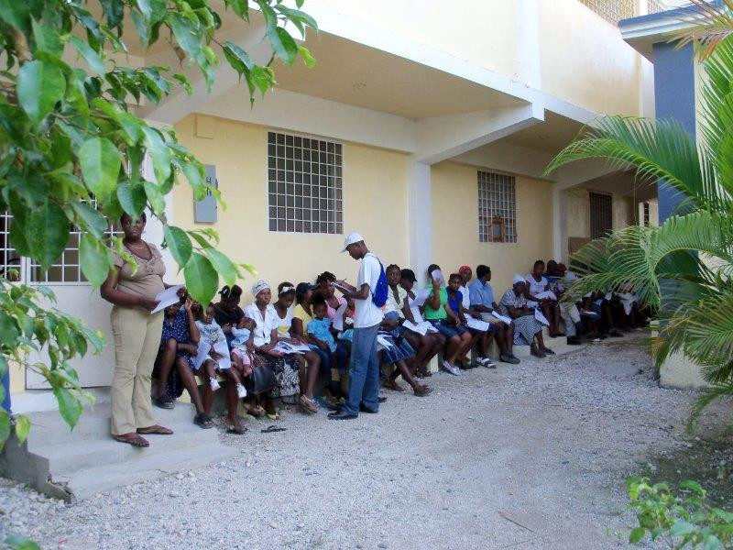
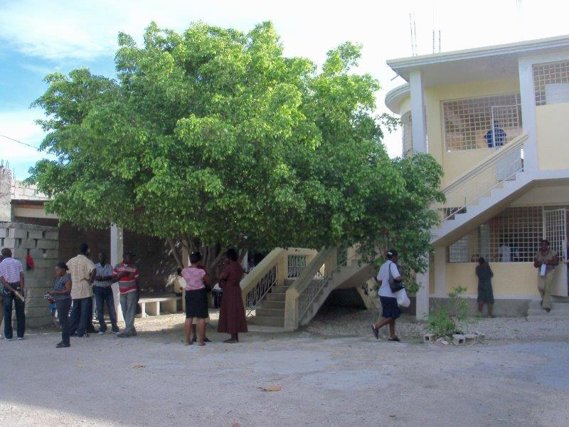
Blanchard Clinic
The Blanchard Clinic in Port-au-Prince was opened in 2006 and provides women’s health services to a community considered a part of Cite Soleil.
Nearly 20,000 women have been screened for cervical cancer.
Expanding to full primary care.
Notes:
Services include general GYN, prenatal and preventive health services. In 2008, the second floor of the clinic was opened and cervical cancer screening was added to the list of services.

Slide 19
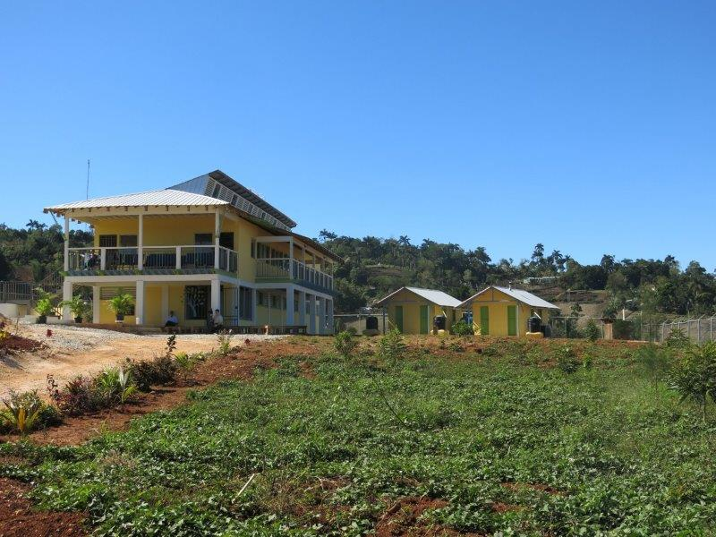
Birthing Center in Tom Gato
The Carmelle Voltaire Women’s Health Center opened in early 2016 in the rural mountain community of Tom Gato. This is the only facility in the area providing comprehensive women’s health services.
Notes:
Construction of the project was accomplished in partnership with the Building Goodness Foundation. This facility is staffed by a part-time OB/GYN, highly skilled nurses and skilled birth attendants.

Slide 20
Principles of Partnership
Equality
Transparency
Result-oriented Approach
Responsibility
Complementary

Slide 21
Assessing the impact of partnerships
Pre-assessment
Priority-Need alignment
Sustainability
Resource allocation/diversion
Evaluation plan: include impact assessment
Process metrics
Outcomes

