Slide 1
Experiences Of Canadian Medical Students Who Are First In Their Family To Attend University
2018 STFM Spring Conference
Ike Okafor, Sr. Officer Service Learning & Diversity Outreach, University of Toronto Faculty of Medicine
Research Team: Sarah Wright, Victoria Boyd, Ike Okafor, Ryan Giroux, Maria Mylopoulos, Malika Sharma, Lisa Richardson and Nikki Woods

Slide 2
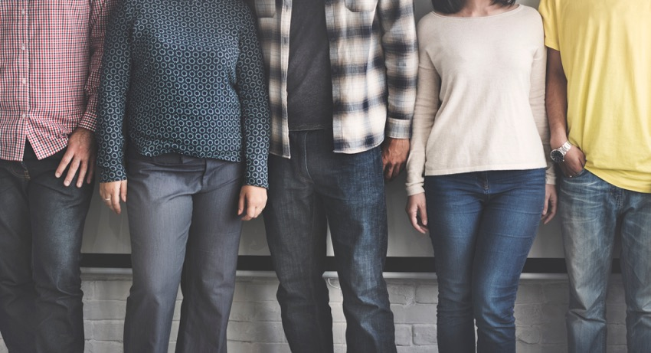
diversity
Notes:
Improving Diversity is Strategic Goal & Priority at U of T (and in canada and pretty much worldwide).
Medical students in Canada disproportionately hail from families earning well above the median Canadian income. Groups identified as being underrepresented are: black canadians, indigenous people of canada and economically disadvantaged students.
There are many perceived benefits of diversity such as:
a sense of social justice. Underrepresentation suggests inequality.
improves access to care for underserved groups,
develops culturally informed care
broadens the health research agenda
And yet, improving the diversity of our student body remains a persistent challenge; not only for U of T but nationally and worldwide.

Slide 3
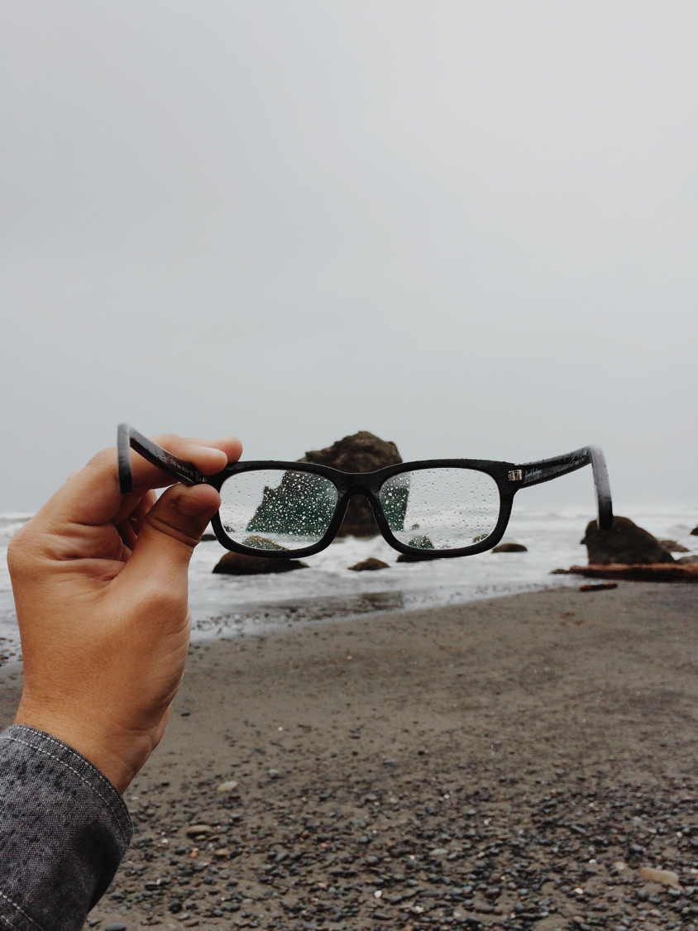
focus of research is often on barriers to entry

Slide 4
https://unsplash.com/photos/O0T1SIgHAfM?from_login=true&like_photo=true
Notes:
Less is known about the experiences of students who get into medical school from diverse backgrounds. Becoming a medical professional can be a huge shift for students from underrepresented groups and understanding these experiences can help us tailor our strategies to achieve diversity goals in perhaps more meaningful ways. And by this I mean, its not enough to change the proportions of intake, we need to make the most of the diversity we seek.

Slide 5
how do medical students who are first in their family to attend university experience medical school?

Slide 6
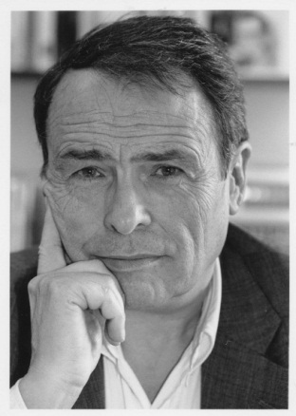
Pierre Bourdieu
french sociologist
revealed that power differences are reproduced through cultural practice
instead of promoting social change, education settings tend to reproduce social inequalities.
Image: © 2012 Listal.com

Slide 7
Habitus
“system of dispositions which acts as a mediation between structures and practice” (bourdieu, 1973; p. 72)
structured by the past
influences the present
habitus operates within a ‘field’

Slide 8
Field
“a social space within which there is a struggle for resources” (Brosnan et al, 2016)
agents within a field compete for capital

Slide 9
Capital
economic capital- wealth
cultural capital - culturally authorized tastes, attributes, skills, awards and abilities
social capital- network of social contacts
Notes:
You can easily see how these forms of capital are related- for example if a family has economic capital they may send their child to the best private school so that the child can obtain further cultural capital and form connections thereby gaining social capital.

Slide 10
Habitus, Field and Capital
fields are characterized by a struggle for capital
Bourdieu sees this as a ‘game’
players are differentially placed (dominant or subordinate) due to how much capital they possess
the amount of capital they can possess is determined by their habitus
the dominant class decides what capital is to be valued
Notes:
This makes it difficult for those in more subordinate positions to not only access capital, but to recognize the forms of capital that are valued in an unfamiliar field.

Slide 11
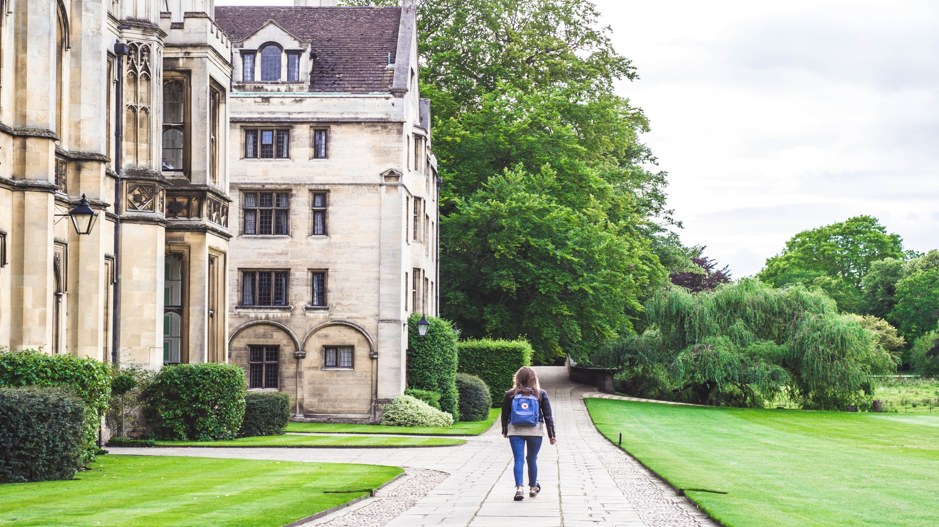
Photo by Victoria Heath on Unsplash
Notes:
By identifying the kinds of capital that are valued within the field of medical education and first in family students ability to access that capital, our study sheds some of the mechanisms by which inequality may be reproduced.
We conducted 16 interviews with undergraduate U of T med students in 2nd , 3rd and 4th year who identified as first generation in their family to go to university. We also included students whose parents were educated abroad who had qualifications not recognized in canada.

Slide 12
Results
Influence of Capital
Feelings of legitimacy
Identity Shifts
Notes:
Bourdieu’s concepts of habitus, field and capital were used as sensitising concepts to explore the data. Participants brought up how capital influenced the admissions process and experiences at medical school, issues of (not) feeling like legitimate medical students and tensions inherent in navigating their pre-medical life with their new identity as medical students.

Slide 13
Influence of Capital
Notes:
One of the key things that students compete for during medical school is experiences that will make them attractive when it comes time for the CARMS match. Capital influenced their ability to access such activities.

Slide 14
that was something that I was constantly worried about, how do I make enough money in the summer to make sure that things are okay'ish during the year? But other people are doing research and doing these things but they don’t pay you basically anything.
P3, 4th year
economic

Slide 15
one of my friends was telling me oh, yes, I’m with the head of the department at this hospital and this hospital. And I was thinking oh, my god, how do you even find out who that is and then selectively book an elective with them? I was left thinking that would have been smart but I don’t even know how I would have gone about doing that. It always just seems like I’m a little bit of a step behind.
P3 4th year
social & cultural

Slide 16
you do feel like they are from a higher socioeconomic status, generally, and that some people seem like they didn’t have a lot of experience seeing people from different life backgrounds [. . .] when you think about what most peoples’ path to medicine looks like, it’s like, I have a parent who is a doctor, or two parents who are doctors, and I've been wanting to be doctor my whole life [. . . ] I think that is the typical narrative, so if you have that kind of life, it’s hard to get exposure to different kinds of people because they're busy getting skills that I don’t have. I haven't worked in a lab. I don’t have very strong clinical or basic science research skills.
P8, 3rd year
Notes:
There were also cases where participants recognized the capital that they had when dealing with patients and understanding social issues, compared to their peers.

Slide 17
Feeling legitimate
Notes:
Related to capital, first in family students brought up instances in which they did not feel like legitimate medical students, that they didn’t belong, or that they were missing key pieces of information that seemed obvious to others.

Slide 18
a lot of people in my class, they were very accomplished. A lot of them are very well-travelled, they’ve been all over the world backpacking. They are very intelligent, very athletic people [. . . ] In a way, I felt like I had to work harder to be equally as impressive as them. I remember with anatomy, I came an hour earlier than [ … ] when everyone else came, and I stayed two hours later, and I came in on the weekends, and then the week leading up to the anatomy exam, I studied until, like, 3:00 a.m. every day just to make sure that I knew the material well.
P6, 3rd year

Slide 19
I feel like your common theme here is going to be impostor syndrome. [. . . ] you’re like, oh, my god, everyone is such a genius. They are so brilliant. Everyone has 15 degrees and a thousand papers published. [. . .] I guess it was just those initial feelings of do I belong here? Will I be good enough? It’s such an exciting experience but at the same time you do notice there is a particular “type” of medical student. And you question yourself a little bit.
P7, 3rd year

Slide 20
you hear people talking out loud about, oh, I did an overnight call with this person, who is really influential in this field that I want to apply to, and this is because I want to apply to this program, and I want them to know who I am. When you hear people just share anecdotes like that, you're thinking, oh my gosh, I'm so behind.
P8, 3rd year

Slide 21
Shifting identities
Notes:
Becoming a medical professional can represent a significant deviation from the ‘normal biography’ of individuals from underrepresented groups, which may affect their experience on the medical course. This is one of the more challenging and overlooked aspects of diversity and outreach initiatives.

Slide 22
I try to think about how am I going to go through my career and continue moving up as much as my ambition will push me, while still keeping true to who I am based on how I’ve had to work for things. And I still go home and see friends and family from home and stuff and I want to make sure that I don’t ever walk in there like somebody who thinks less of it, if that makes sense. I sort of fight with that a little bit, how am I going to become one of those people in a sense and get along with them as colleagues [ . . . ] while still holding onto a little bit of what I think is an asset and has been a major piece in how far I have made it.
P3, 4th year

Slide 23
[its] almost as if I was able, through medicine, to bring myself and my family up a social class [… ] I remember when I was in high school [. . . ] I would often deliver newspapers as a job, and in one of the areas where I delivered newspapers, it was very wealthy [. . . ] they were very multi-million dollar type houses, and I would often look through the gate and it will almost be me separated by that social class of people. [. . .] when I got into medicine, it was almost like having that [… ] It’s definitely opened up a lot of doors for my family to improve financially, but also in terms of just the people I hang out with in my social circle.
P6, 3rd year

Slide 24
Discussion
Diversity is a priority but is complex and difficult to achieve
Understanding the experiences of first in family medical students can help us better understand our own values system as a medical school and how these values work to reinforce advantages for particular groups and potentially devalue the forms of capital brought in by students who we seek through outreach strategies.

Slide 25
Acknowledgements
Education Development Fund
Department of Family and Community Medicine
Research Team:
Victoria Boyd, Ryan Giroux, Maria Mylopoulos, Ike Okafor, Malika Sharma, Lisa Richardson and Nikki Woods
International Collaborators:
Caragh Brosnan and Erica Southgate
(University of Newcastle, Australia)

