Slide 1
Two Years in Tansen Global Health Through the Lens of Life and Work in Nepal
Rebecca A. McAteer, M.D.
Core Faculty / Hospitalist
Phelps-Northwell Family Med Residency Program

Slide 2
Objectives
Understand the current Nepali medical system & attitudes toward healthcare, including common disease trends in Nepal
Review the Nepali-Bhutanese refugee crisis and resettlement, which is the contextual backdrop for a majority of Nepali’s accessing healthcare in America
Discuss several various “core skills” essential to providing sustainable, high-quality cross-cultural medical care

Slide 3
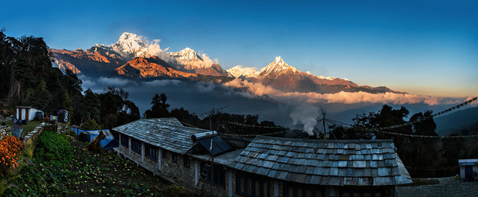
FOCUS ON NEPAL
PART I

Slide 4
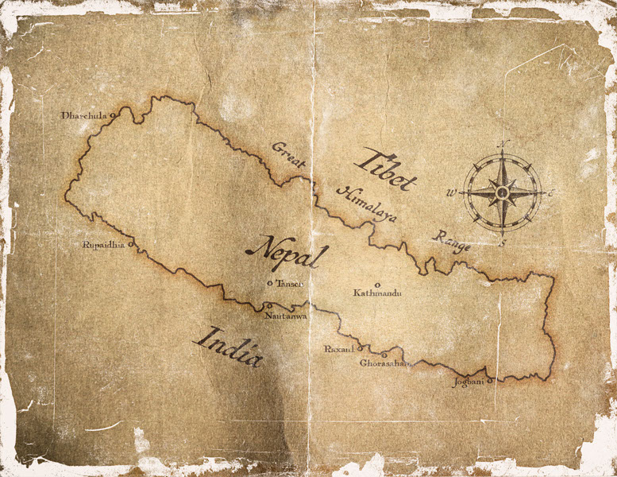

Slide 5
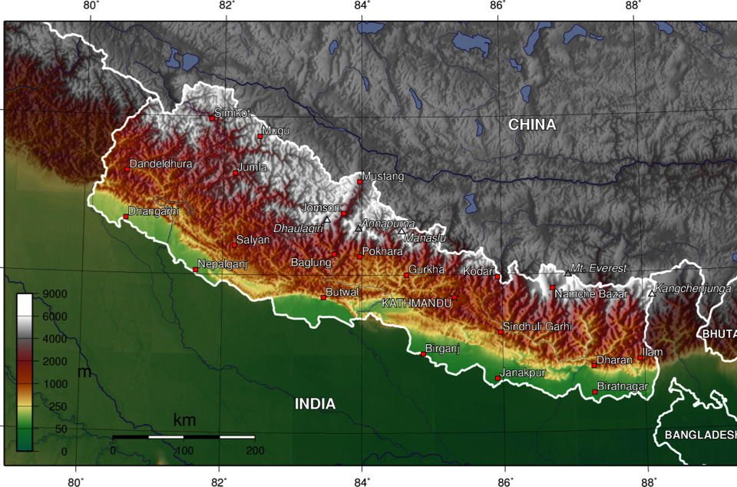
United Mission to Nepal

Slide 6
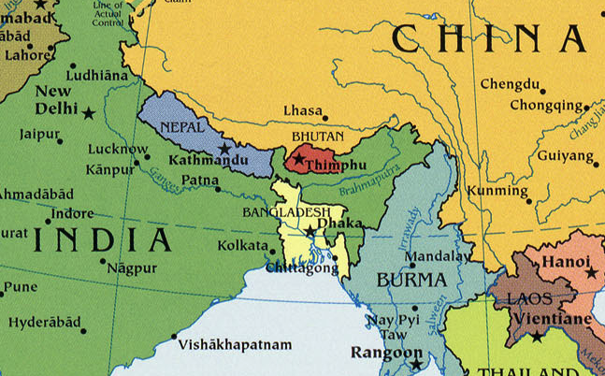
BHUTANESE
or NEPALI?

Slide 7
The Unfolding of a Refugee Crisis
Late 1800s: Migration of “Lhotsampa” from southern Nepal to Bhutan
1958: Lhotsampa > Bhutanese citizenship
1985: Bhutanese government revokes Lhotsampa's citizenship
1988: Bhutan mandates uniform culture & customs (that of Buddhist Ngalong ruling class)
Notes:
Late 1800s: Migration of “Lhotsampa” from southern Nepal to Bhutan (possibly as early as 1600’s)
1958: The Lhotsampa receive Bhutanese citizenship
1985: Bhutanese government revokes the Lhotsampa's citizenship unless various obscure proofs can be provided
1988: Bhutan mandates one language & style of dress/ social etiquette (that of Buddhist Ngalong ruling class); social stigmatization of Nepali language/ dress/ religion

Slide 8
The Unfolding of a Refugee Crisis
Late 1980s - Early 1990s: Protests, persecution, forced emigration; refugee camps set up
1991 - 2007: Long-term refugee status & identity established in camps
2007 - Present: Third-country resettlement option made available
Notes:
Late 1980s - Early 1990s: Unsuccessful negotiations with village elders leads to protests, imprisonment, rape, torture and forced emigration to India & Nepal (peak, 1990-91). UN & INGO’s set up 7 refugee camps in SE Nepal to address the mounting humanitarian crisis
1991 - 2007: Increasing rootedness in camps creates an increasingly complex panoply of cultural & national identities among these diverse refugees.
2007 - Present: Option for third-country resettlement is made available, a decision which is seen as controversial, potentially undermining political momentum to return to Bhutan.

Slide 9
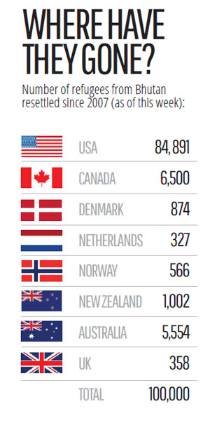
*
Notes:
data as of 2015; passed a major milestone that year: the resettlement of over 100,000 Bhutanese refugees from Nepal to third countries since start of program in 2007, when there were approx 108,000 refugees from Bhutan living in seven camps in Jhapa and Morang districts in eastern Nepal; as of 2015, just two camps remaining with refugee population of less than 18,000 people.
A core group of eight countries came together in 2007

Slide 10
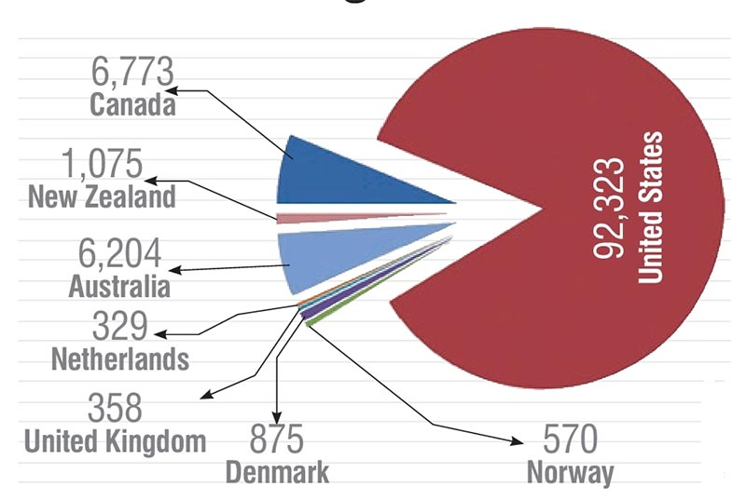
Bhutan Refugee Third-Country Resettlement (Feb 2017)
Sources: UNHCR; US Refugee Processing Center
Notes:
Program to end this year, after 10 years

Slide 11
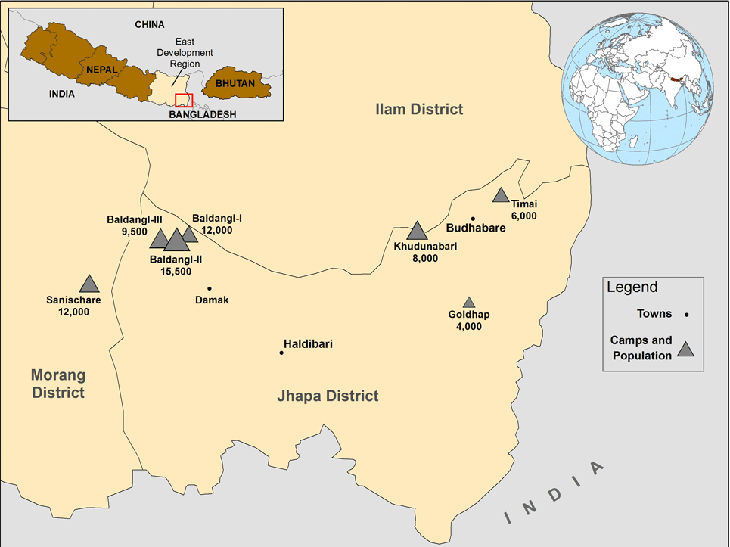

Slide 12
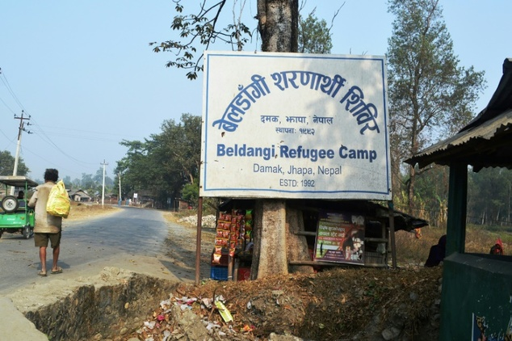

Slide 13
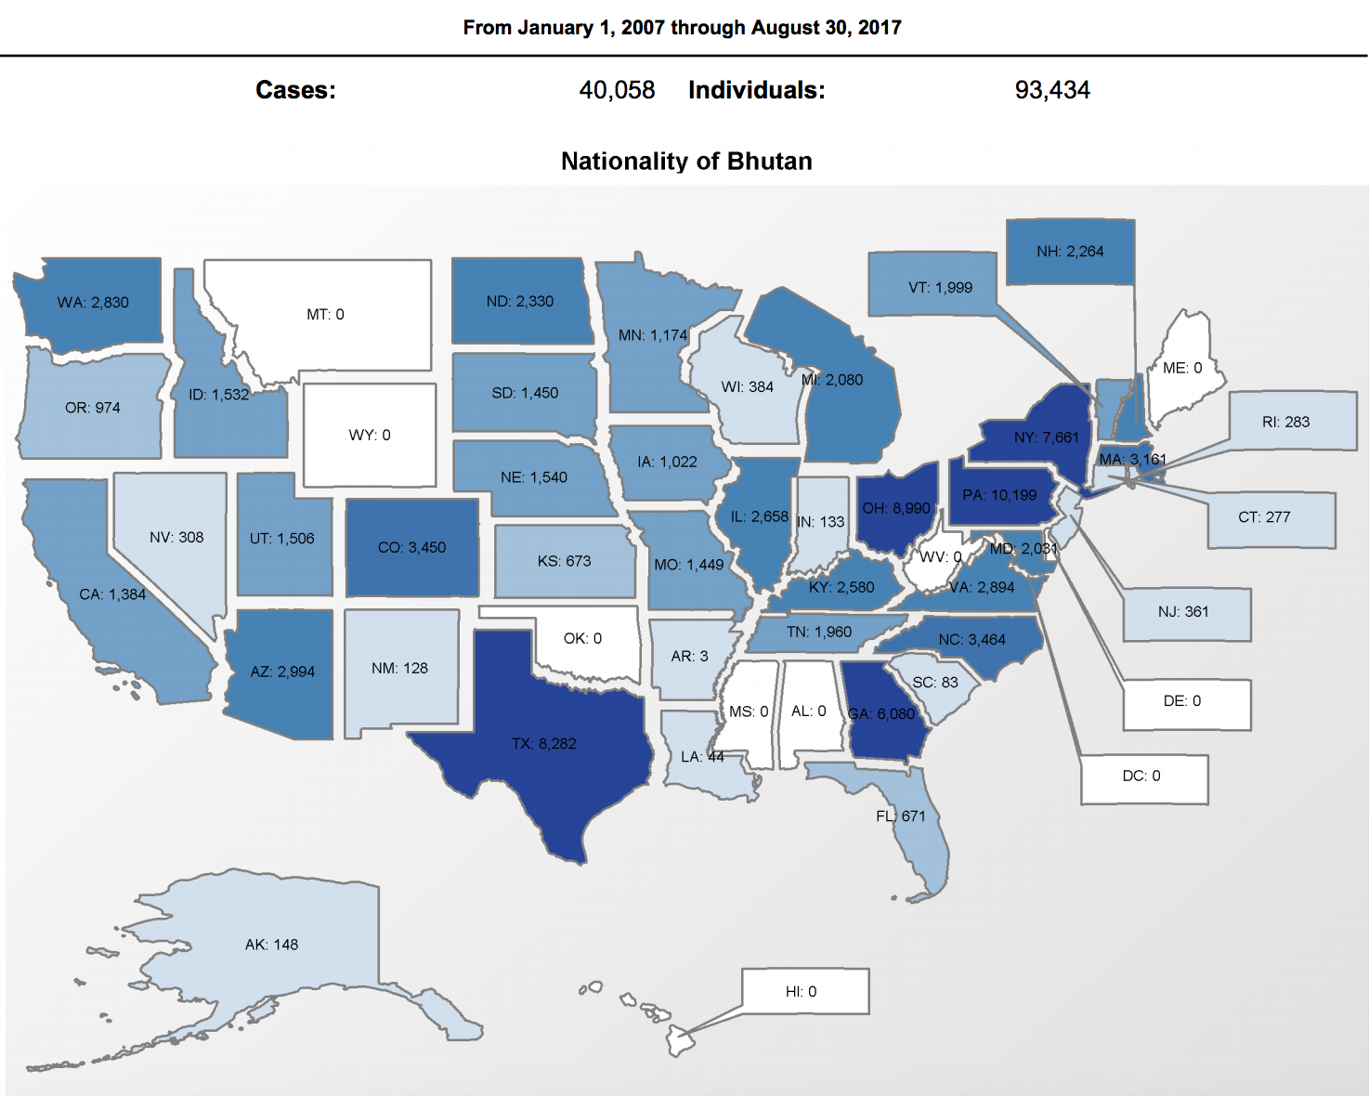
Jan 2007 - Aug 2017
Source: Refugee Processing Center (wrapsnet.org)

Slide 14
MEDICINE IN NEPAL

Slide 15
Health Quality Indicators
Data source: The World Bank (2011-15)
 | NEPAL | UNITED STATES
Life expectancy at birth (years, M/F) | 68/71 | 77/81
Health expenditure per capita (USD) | $40 | $9403
Maternal mortality rate (per 100k live births) | 258 | 14
Infant mortality rate (per 1000 live births) | 29 | 6
Under-5 mortality rate (per 1000 children) | 36 | 7
Under-5 growth stunting (height for age) | 40% | 2.1%
Tuberculosis rate (per 100k) | 158 | 3
Notes:
total population (approx): 28 million; rural: 23 million (82%)
In 2003: Nepal had 10 health centers, 83 hospitals, 700 health posts, and 3,158 "sub-health posts" (for villages)
in 2003, 1,259 physicians (one for every 18,400 persons)
68% of women receive prenatal care
In 2000: approximately 70% of health expenditures were out-of-pocket
Government allocations for health were around 5.1% of FY2004 budget; foreign donors provided around 30% of the total budget for health expenditures

Slide 16
Top 10 Causes of Death (Nepal)
Lung disease
Coronary Heart Disease
Stroke
Influenza/ Pneumonia
Diabetes Mellitus
Diarrheal Diseases
Tuberculosis
Suicide
Road Traffic Accidents
Kidney Disease

Slide 17
Top 10 Causes of Death (Nepal)
Lung disease
Coronary Heart Disease
Stroke
Influenza/ Pneumonia
Diabetes Mellitus
Diarrheal Diseases
Tuberculosis
Suicide
Road Traffic Accidents
Kidney Disease

Slide 18
Cause of Death
Notes:
(CD: includes maternal, prenatal & nutritional causes of death)
prenatal care & reproductive health – growing governmental infrastructure (health posts, encouraging delivery by a professional / reducing home births; encouraging regular PNC – at least 3 visits during pregnancy, including an early visit for accurate dating; SBA training programs like the one at UMHT, perinatal care / umbilical cord disinfectant gel – Nepal was first country to adopt this measure, resulting in 23 percent decrease in neonatal deaths due to infection and winning the nation the USAID Pioneers Prize in 2014

Slide 19
Cause of Death

Slide 20
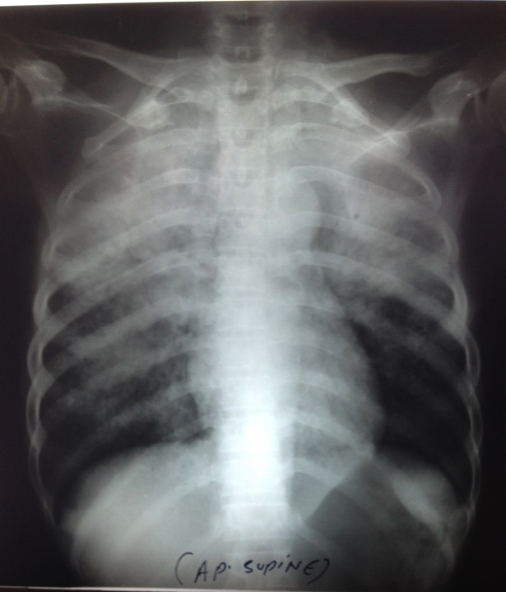
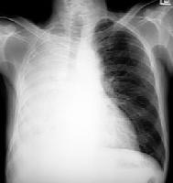
TB
Notes:
…of a different context for my medical practice, while seeing (or supervising the care of) some 15,000 patients over the two years
56 yo F with cough, hemoptysis, weight loss/ cachexia… CXR inset – in Pittsburgh? In Nepal?

Slide 21
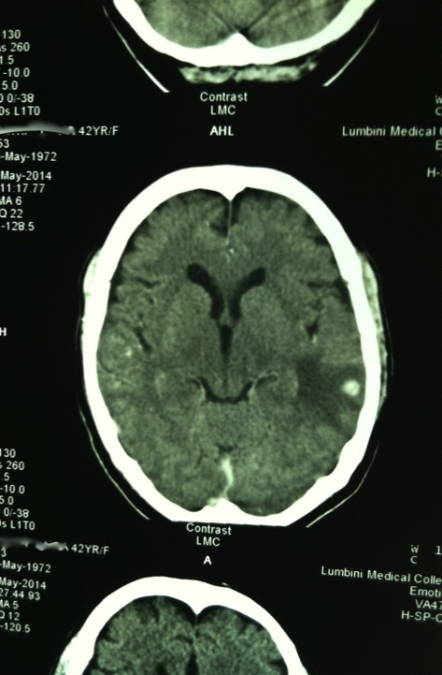
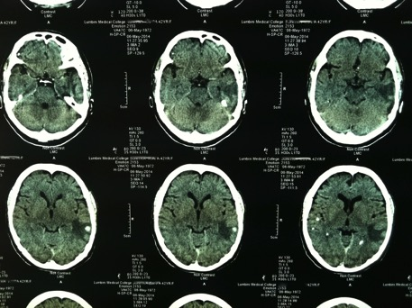
NCC
Notes:
Infectious/ Tropical diseases (AGE, meningitis, visceral leishmaniasis [kala azar], leptospirosis, amoebiasis/ intestinal parasites, PNA/ empyema, typhoid, dengue, malaria, NCC, leprosy)

Slide 22
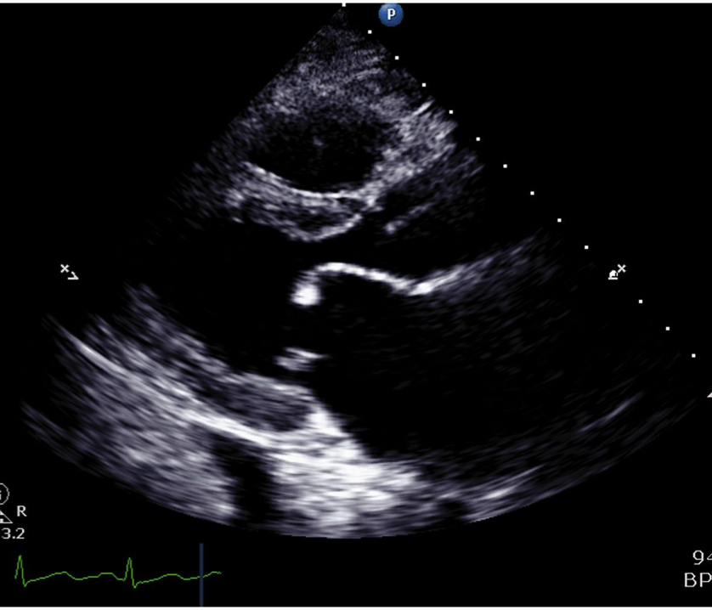
R
H
D

Slide 23
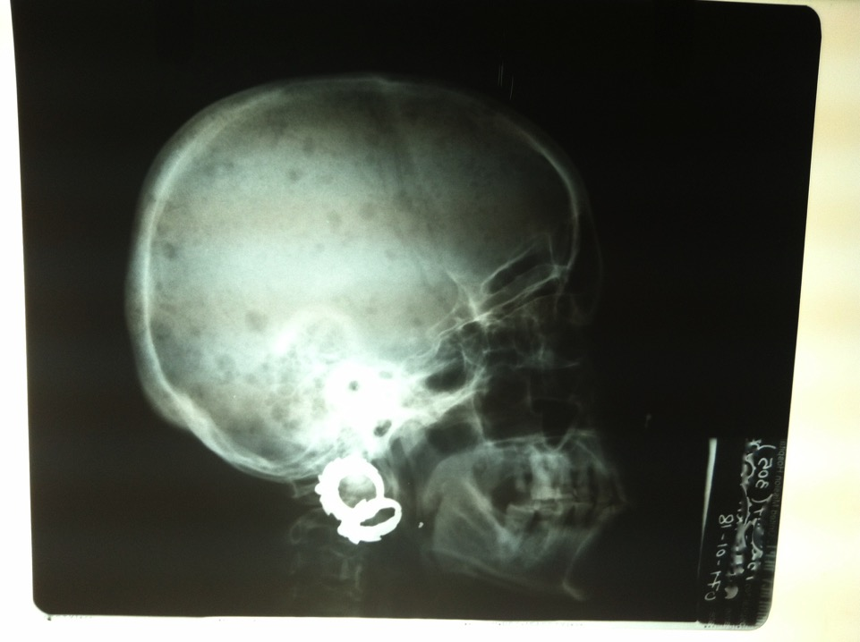
MM
Notes:
MULTIPLE MYELOMA
with “punched out” bony lesions on skull radiograph

Slide 24
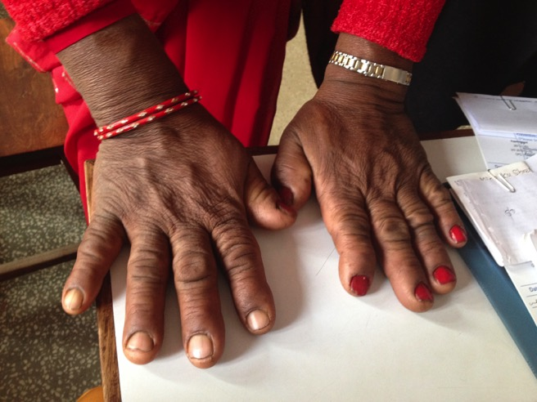
ACROMEGALY
Notes:
ACROMEGALY
Longstanding enlarged, coarse facial features (nose, lips, ears, and forehead), macroglossia, hirsuitism; Hoarse/ deeper voice, snoring; Enlarged hands & feet (can lead to carpal tunnel syndrome); Thicker skin with multiple skin tags; polyhidrosis; she was here because of her Arthritis (esp in knees); Heart disease (cardiomyopathy, HTN, CHF); Diabetes / insulin resistance, hypertriglyceridemia

Slide 25
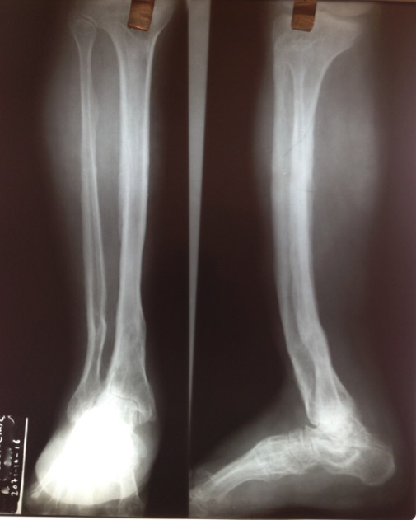
Late Presentations
Notes:
Diseases late in presenting, or not appropriately treated initially

Slide 26
OTHER TRENDS…
Increasing burden of NCD’s:
Heart disease & Stroke
HTN, HL, CHF
DM2, Obesity
Mental health, alcoholism
Notes:
Mental health (anxiety, depression) & Suicide (OP poisoning; fire)
Alcoholism (self-medicating, Raxshi local industry) and effects (ALD, DT/withdrawal seizures; ESLD/ SBP/ Hepatorenal syndrome)

Slide 27
OTHER TRENDS…
Specific to environment:
- COPD, GERD
Snake bites, mushrooms
Malnutrition, DM type 1-1/2
Goiter/ hypothyroidism
Trauma, burns
Notes:
Specific to local environment:
COPD (wood fire smoke)
GERD (dietary – chili peppers, chai)
snake bites (monsoon: green & krait)
accidental mushroom poisoning
malnutrition (kids) and DM type 1-1/2 (long-term sequela in adults?)
goiter/ hypothyroidism

Slide 28
OTHER TRENDS…
High-risk OB:
Pre/ecclampsia
Precipitous vag breech deliveries
Cord prolapse
Molar pregnancy / invasive GTD
IUGR; IUFD; TORCH syndromes

Slide 29
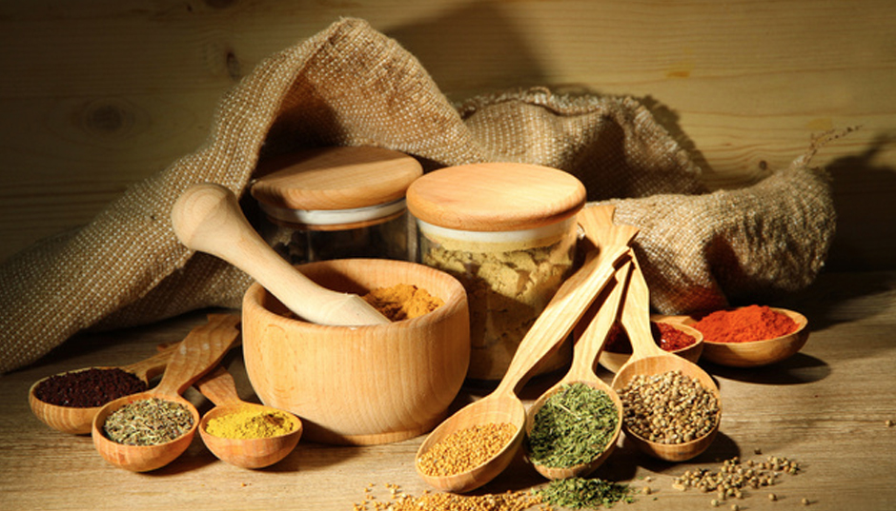
Notes:
attitudes about health and disease prevention – “Asian” at its core; “hot-cold dynamic; first seek help from traditional aryuvedic/ spiritual healers / yogic medicine, shamans (spiritual healers, or “jumping doctors”) which can often delay healing, particularly in post-partum women; food-based medicine as central/ significant importance
family & community dynamics (mother-in-law abuse; patriarchal society / separation of the sexes socially; communal nature / different understanding of privacy; shame-honor and “saving face” as all-important)

Slide 30
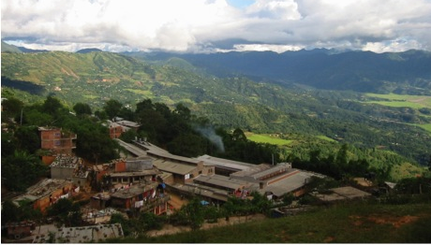
TWO YEARS AT “MISSION”

Slide 31
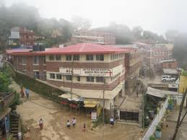
Palpa District, Nepal
Sept 2013 – Dec 2015

Slide 32
MEDICAL CARE TEACHING PRECEPTING

Slide 33
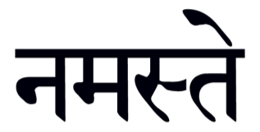

Slide 34
Inpatient wards Outpatient clinics Laboratory Pharmacy Dental Physical & Occupational Therapy X-Ray / Ultrasound Community Health Pastoral Care / Social Services
Notes:
Here are a few of the main services available at Tansen Hospital

Slide 35
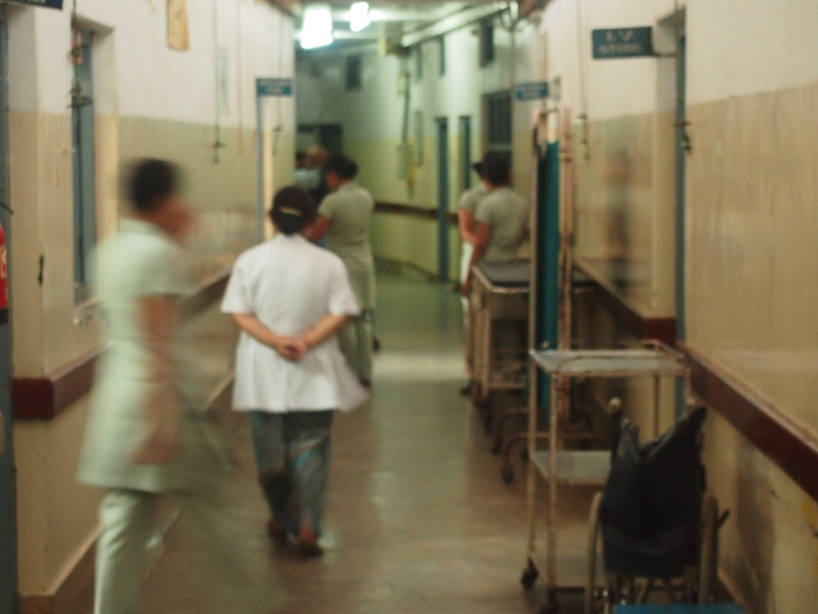
Bed capacity: 170 (80-120%)

Slide 36
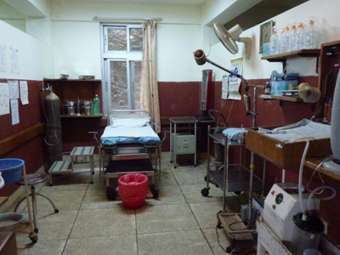
Obstetrics

Slide 37
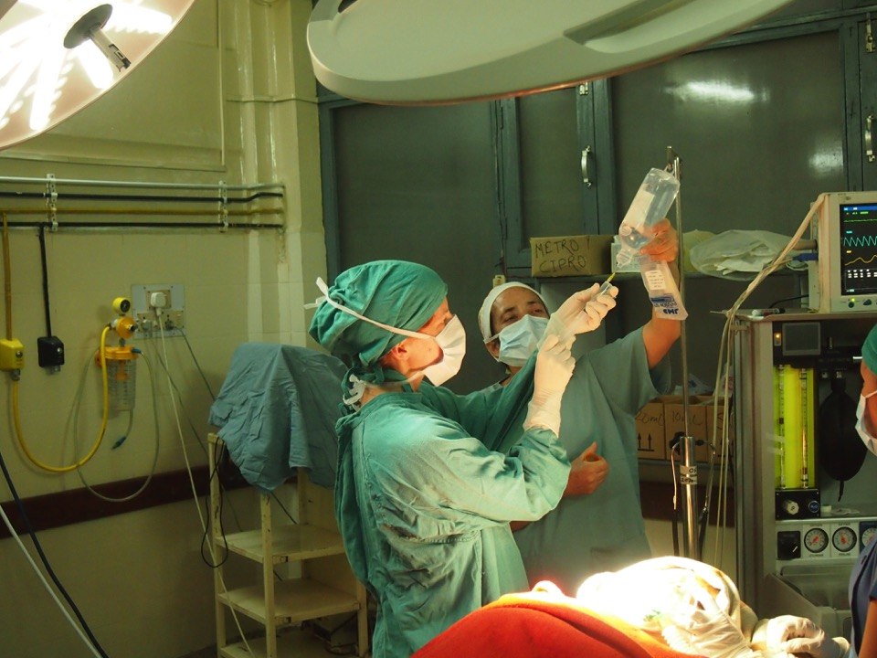
i
Surgical Services

Slide 38
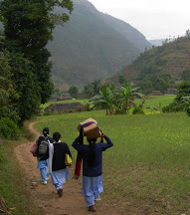
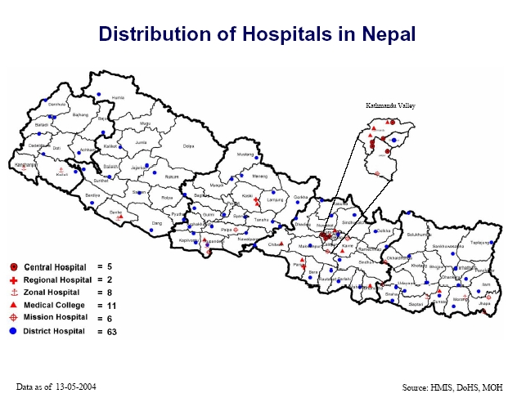
Community Health
Notes:
active community health program, often traveling to villages without vehicle access – vaccination programs, health education, nutritional assessments/ training
Healthcare govt-sponsored system in Nepal (healthposts, DHO, zonal hospitlas, etc) and challenges with staffing, esp in rural areas
access to health care – difficult; even in our own district, Palpa, some patients live a day’s journey away, including a four-hour hike to the nearest motor road; makes follow-up very challenging, and results in patients often waiting far too long before seeking care (coming in critically ill, beyond point of help, or in advanced stages of pathology)

Slide 39
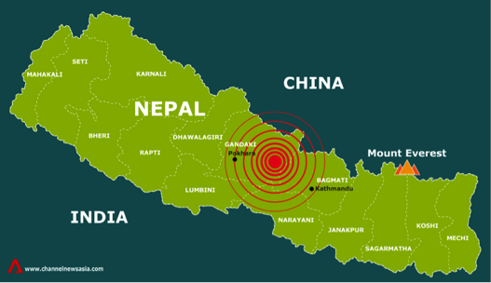
April 25, 2015
Notes:
and of course, living through a natural disaster for the first time with the EQ’s and hundreds of aftershocks last spring

Slide 40
SEEING THROUGH THE WIDE LENS
PART II
Notes:
Taking a long-lens view of our work; a few words of encouragement and perspective; lessons learned
Key qualities necessary for global health practice

Slide 41
CORE SKILLS
Global Health

Slide 42
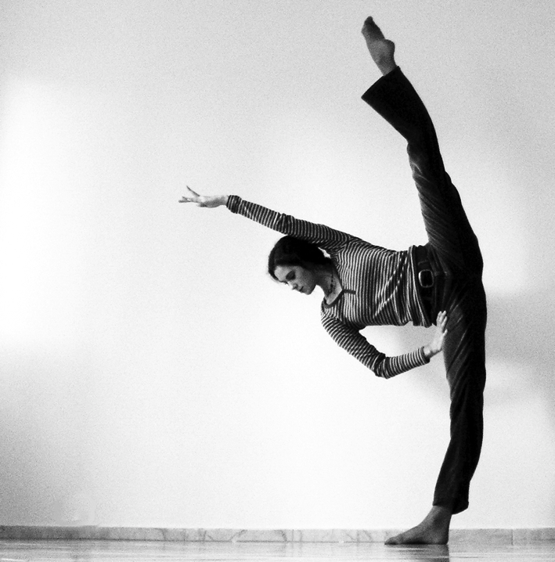
FLEXIBILITY
Notes:
FLEXIBILITY
Things are different, and don’t always go as planned
Need to be light on your feet & able to multi-task
Busy ER scenario
No “TB” precautions/ negative pressure isolation rooms
Often not enough beds in which to put patients; needing to make difficult triage decisions
Learn which battles to fight, and how (peds nurses and IV morphine) – often, there’s a reason (and usually a good one) behind barriers that seem strange, or counter to the patients’ best interest, if you take time to look into it

Slide 43
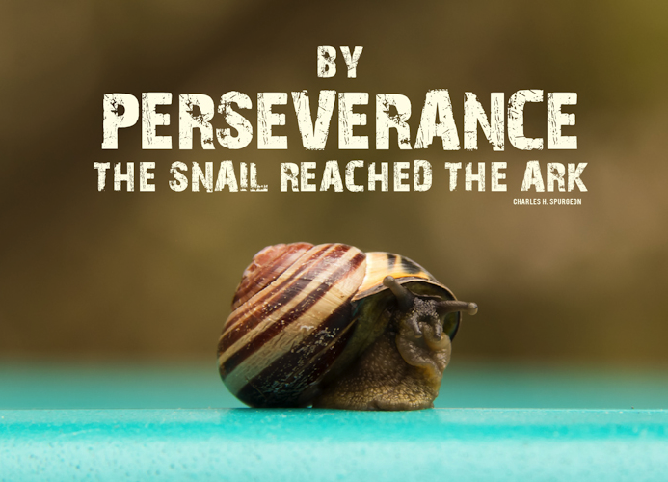
Notes:
PERSEVERANCE / STEADFASTNESS
You won’t always (if ever!) feel like you’re effective/ making a difference; it’s vital that you get to a place where that’s still OK
Stresses of Gorkha EQ relief experience (outdoor clinics, not sure “why we were there” but seeing later that this was in fact a huge encouragement to the local communities / villages we reached, which rebuilt much faster & more resiliently than other nearby villages with similar degrees of infrastructure damage)

Slide 45
Awareness
Notes:
It’s easy to make mistakes, as we bring our “western” attitudes and values, which are sometimes in direct opposition to those of the country in which you are a guest
Privacy vs. communal support (blog post); efficiency vs. collective (and time-consuming) deliberation over an idea; the best way for the patient/ family, vs. the best-appearance (PCM vs “putting on a show” of a code blue); cultural value of relationship as currency
Touching the feet (and my first experience with a woman grabbing my hand and placing it on her own head); asking about sensitive issues like weight loss (similar to asking about weight gain – with body image being a topic for a whole other day)
Sometimes the needs are not always clear, and the decision being made may seem wrong, but is actually the best decision for the family/ community (taking home a daughter to die, because even the treatment may mean that families starve – cost of treatment, lost income/ lost time planting & farming) – trust that the people can actually think well and make a wise decision, even if it’s one you wouldn’t (or at least think you wouldn’t, though you have no way of knowing what you’d do in that situation); also, disclosure of terminal diagnosis vs deferring to family to hide this from family (recent TAL episode!)
In this way, the local people may not be the best teachers (they sometimes haven’t traveled even to their own nation’s capitol city, let alone to another culture), but it is an experience of identifying with immigrants to America, those who have emigrated from their own countries – sometimes to live abroad for the rest of their lives – and I better understand a little bit of the painful and exhausting experience that it is to be constantly stared at and marked out as “different,” to not have your accent understood, to be assumed to be less intelligent or less reliable because your language isn’t great, to be taunted and teased by kids and teens on the road as a matter of course
Be prepared for the discomfort of being different, a cultural outsider; this is a VITAL experience for all Americans to go through, in my opinion, and will make you a far better physician, leader and citizen for it, discomfort and all; explore implications for how this impacts our understanding of those on the margins of our own culture
Participate only in a longitudinal program that has some continuity; chances are that anywhere in the world you’re looking to go, someone is already there doing similar work; partner with them! Don’t re-invent the wheel, creating redundancy in the system and huge potentials for harm; first see what’s happening on the ground already

Slide 46
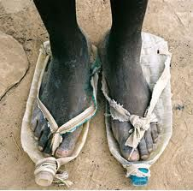
RESOURCE-fulness
Notes:
RESOURCEFULNESS
Must be able to look stuff up and figure out a lot of things on your own (plus adapting the “EBM standards” in a resource-limited setting)
Decision-making without sophisticated labs & imaging at your disposal (enumerate the labs & imaging options available at UMHT here)
Rheumatologic cases; SLE case (with pics)
Doing procedures and treating conditions that are waaaay outside your scope of practice or training (“scope of practice” is itself something of a crazy concept in this setting); be prepared for the discomfort of this, and for needing to decide when NOT to do something
Pericardiocentesis (plus pleural/ peritoneal/ meningeal taps); scroll through a list of the “common” and “strange” cases that I saw during my two years
In this way, too, you can look to those around you in the culture as your teachers; they are incredibly resourceful, and are generally able to accomplish quite a lot with just a little; be a willing learner from the national docs; create and foster a spirit of bi-directional learning and experience-sharing
Costs of coming into hospital/ travel implications

Slide 47
A PANOPLY OF DISEASE
Bullous pemphigoid
Pneumothorax ex vacuo
Bilateral hip dysplasia
Drug-induced lupus Ecclamptic seizures
Elephantiasis
CIDP (Chronic Inflammatory Demyelinating Polyneuropathy)
Bronchiectasis
Iatrogenic Cushing’s Disease
Tropical eosinophilia (pulmonary filariasis)
Cholera (sporadic)
Amoebic dysentery w/pyogenic liver abscess
Hydatid cyst disease
Necrotizing fasciitis
Neurosyphillis (suspected)
Primip Precipitous Vaginal Breech Del.
Notes:
Pneumothorax ex vacuo (trapped lung with recurrent effusion, due to longstanding pulmonary TB)
Bilateral hip dysplasia (in a term infant breech female)
Severe, purulent bronchiectasis
Necrotizing fasciitis (we treated five cases in a single month, age 45-94 yrs, with 100% mortality)
Hydatid cyst disease (including multiple huge lung and liver cysts in a 35 year old male)
Tropical eosinophilia (pulmonary filariasis) - 74% eosinophils with a white blood cell count of 29,600

Slide 48
Notes:
C.S. Lewis: “Humility is not thinking less of yourself; it is thinking of yourself less.”
Willingness to ask questions & be wrong / teachable attitude
The residents often knew a lot more than I did about what I was seeing (especially early on)
NamoB: kala azar patient (no ABG, no vent, think twice about Vanc)
“this could be leptospirosis”
R.I.C.E. – “But better check with the patient to see if there’s even ice available at their home”
Pretty much everyone knows more than you do when you first come, and for a while afterward (language, protocols, standard practice, what’s available/ realistic, cultural taboos and norms)
This also hurts, and involves a great deal of uncomfortable growth and, frankly, humiliation
This is also a place to explore the incredible resilience and cultural resources of the nationals where you’re going; don’t just see NEED, see CAPABILITY too! Try to gather their stories and gain insight into the culture through them

Slide 49
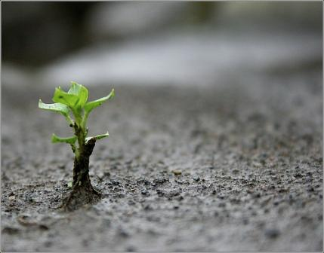
Resilience
Notes:
RESILIENCE
Patients die. A lot.
A “typical week” picture
A span of three weeks where a baby died after delivery on every single call I took, many of them surprises (unexpected flat baby, etc)
before this, I had never actually seen a baby (or child) die, and had only rarely been at the bedside for the moment of death (in a medically-sterilized world in which the physician is called to pronounce long after death, and after the family has already cried their tears and left the room)
In this, you can look to the local people as your teachers; they are dealing with a lot of suffering, and (at least in my experience) are remarkably able to face it, live through it, and keep going with hope and a sort of persistent joy (pre- and post-EQ Gorkha experience)

Slide 50
The expectation
that we can be immersed
in suffering and loss daily
and not be touched by it
is as unrealistic as expecting
to be able to walk through water
without getting wet.
Rachel Naomi Remen,
Kitchen Table Wisdom
Notes:
“Nepal brings everyone to the end of themselves; at least, everyone that stays for more than a few months…” (Ansie) – you WILL be crushed in spirit at parts, and it takes resilience of spirit and being to get back up and face the hostility and discomfort of this alter-universe, in which you are an alien
Going to the poor / marginalized / suffering / those in need MEANS taking on some of that into your own life and heart, in the form of grief as you see hard things, physical risks of illness or accidental injury; be ready for it to hurt; yet this enables us to empathically identify in even tiny ways with the people we serve, and that’s crucial for the success of our service, as well as for preserving our own humanity
The expectation that we can be immersed in suffering and loss daily and not be touched by it is as unrealistic as expecting to be able to walk through water without getting wet.
This sort of denial is no small matter. The way we deal with loss shapes our capacity to be present to life more than anything else. The way we protect ourselves from loss may be the way in which we distance ourselves from life... We burn out not because we don't care but because we don't grieve. We burn out because we've allowed our hearts to become so filled with loss that we have no room left to care."
- Rachel Naomi Remen, Kitchen Table Wisdom

