Slide 1
How to Design Effective Evidence Based Local Health Campaigns in an International Setting Using an HPV Immunization Program in Rural Kenya as a Model
David Klee MD FAAFP and Kelly Clark MD
Munson Family Medicine Residency
Traverse City, Michigan
Notes:
Good morning. I am David Klee and I am Kelly Clark. We both are faculty at Munson Family Medicine Residency a Michigan State Affiliated program in the northern part of lower Michigan. For the past 10 years we have been partnering with the PCEA hospital in Chogoria, Kenya.
As family physicians we are called upon to wear many hats. The role of family physicians at some of our international partner sites may be even broader. In Kenya, the family physician not only has both out patient and inpatient clinical responsibilities that cross all specialties but also significant public health responsibilities.
This project arose out of our collective goal to develop a local health campaign in Chogoria.

Slide 2
© 2018 American Academy of Family Physicians. All rights reserved.
All materials/content herein are protected by copyright and are for the sole, personal use of the user.
No part of the materials/content may be copied, duplicated, distributed or retransmitted
in any form or medium without the prior permission of the applicable copyright owner.

Slide 3
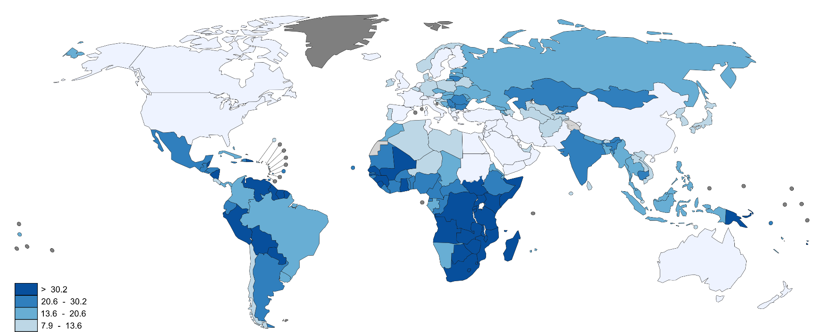
Problem: High Rates of Cervical Cancer in Kenya
2012 GLOBOCAN. http://gco.iarc.fr/
Notes:
Here is the why:
There are over a quarter of a million deaths from cervical cancer world wide every year. accounting for 7.5% of all female cancer deaths. Almost nine out of ten (87%) cervical cancer deaths occur in the less developed regions.
[ estimated 266,000 deaths from cervical cancer worldwide in 2012,]

Slide 4
Notes:
As you can clearly see this is a big problem in East Africa.
Malawai and Mozambique have the most amount of cervical cancer cases, though Kenya ranks 16th world wide with an age standardized rate of 40.1 cases per 100,000 compared to the rate in the US of 7.5 cases per 100,000, over a 5 fold increase.
90% of the new cervical cancer cases occur in Africa as well as 90% of the deaths. Cervical cancer ranks as the top cancer causing deaths in Africa. Similar to HIV/Aids, his cancer strikes young women ages 35-45 thereby significantly effecting the workforce and family life.

Slide 5
Cervical cancer screening in Kenya
3.2% Kenyan women 18-69 have been screened in any 3yr period
Presentation with advanced disease
HPV = 99.7%
70% Cervical cancer are types 16 and 18
HPV vaccine 90% efficacy
Notes:
As we know cervical cancer is easily detectable and curable in its early stages. However, cervical cancer screening is uncommon in Kenya. Only a little over 3% of Kenyan women are screened. Therefore, many women present with advanced disease that is only pallitive.
Virtually all cervical cancers are associated with human papilloma viruses (HPV).
We have a vaccine now that targets the oncogenic strains and has
Been shown to be more than 90% efficacy to prevent precancerous lesions in females naïve to vaccine‐specific HPV
.

Slide 6
Kenya MOH Plan
Promote abstinence or delayed sexual debut for adolescents
Promote faithfulness to one partner for those in relationships
Promote condom use
Promote HPV vaccination
Promote male circumcision
Kenyan National Guidelines for the Prevention and Management of Cervical, Breast and Prostate Cancer,. January 2012. Accessed September 4th, 2018. http://guidelines.health.go.ke:8000/media/National_Guidelines_for_Prevention_and_Management_of_Cervical_Breast_and_Prostate_Cancers.pdf
Notes:
So how can we work to decrease mortality from cervical cancer in Kenya?
The following strategies are recommended for primary prevention in Kenya by the plan from the Minister of Health.
Any of these modalities could be used as a basis for a health campaign but we zeroed in on HPV vaccination.
This seemed like a good fit for Kenya since we know that HPV vaccination programs may be cost-effective in countries where high-quality screening is not widespread, vaccination coverage is high (> 70%), and the cost of a three-dose course is low (< US$10-25).
The minister of health plan recommends that if HPV vaccination is introduced it should be a part of a coordinated strategy, including community education
and mobilization with appropriately targeted messages to different audiences.
So know we had a plan.

Slide 7
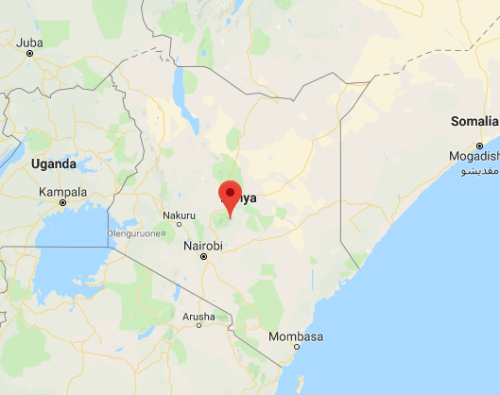
HPV Vaccination: Will Chogoria Embrace it?

Slide 8
HPV Study Proposed Timeline
Survey
Knowledge and beliefs about cervical cancer and HPV
Groups (patients, students, nurses)
International partner buy-in (admin, physicians, principal)
Survey in English/Swahili/Meru
Hire nursing students
Complete surveys
Analyze data
Develop local education programs
Implement plan
Notes:
So we suspected there might be some barriers to the vaccine program but we weren’t sure what they would be. So we decided to survey patients, staff and students about their knowledge and beliefs regarding the vaccine. We figured we could then analyze this data and make the educational plans the MOH wanted.

Slide 9
Public Health 101: Family Physician Edition
Notes:
Ok, so we wanted to help create a heath campaign.
But we realized that neither of us had those MPH letters after our names and we didn’t see that happening any time soon
We recognized our proposed method wasn’t working really well since we were identifying more stake holders as we went along that we had not incorporated earlier and we had not done a good job vetting the role the social determinants of health may be playing.
Our conventional process design, developed in our silo in the US, wasn’t working once on the ground in Kenya

Slide 10
Is there a better way of developing health campaigns with partner institutions?
Notes:
WHO
CDC
Discovered several models - how to consolidate all these different models for practicing family docs, who don’t have training w/ MPH
Created an algorithm that amalgamates a few different models in a novel approach

Slide 11
Accessed on 9/13/2018. http://www.who.int/communicating-for-health/evaluation/campaigns-evaluation/en/
Notes:
Inputs- required resources ($$, personnel, equipment)
Activities-actions taken to achieve project goal
Outputs-achievements such as people trained, posters presented
Outcomes-changes in audience knowledge, behavior or attitudes
Impact-long term health goals achieved

Slide 12
Accessed: 8/24/2018. http://www.who.int/communicating-for-health/principles/en/
Notes:
Accessible: interpersonal, organizational, community
Actionable: Level of awareness. Personal relevance. Confidence can do it. Endorsed by community. Worth the cost.
Credible: Competence. Trust. Transparence. Honesty. Dependability. Commitment. Caring. **Re-inforce
Relevant: Know audience. Listen. Tailor the message. Motivate.
Timely: Communicate early. At the right time. Build the conversation.
Understandable: Plain language. Familiar language. Real stories. Visual.

Slide 13
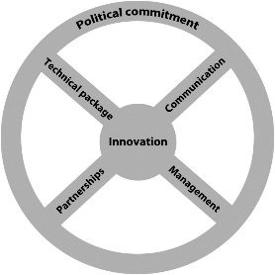
Innovative Implementation
Technical Package – KISS
Inner. Outer. Individual.
Performance Management
Partnerships / Coalition
Ongoing Communication
Adapted from:
Frieden, Thomas. Six Components Necessary for Effective Public Health Program Implementation. 2014. Am J Pub Health; 104 (1): 17-22.
Keith, Rosalind et al. Using the Consolidated Framework for Implementation Research (CFIR) to produce actionable findings: a rapid-cycle evaluation approach to improving implementation. Implementation Science; 12 (15).
Notes:
Innovative: Idea. Communication. Data. Operations. *Not always invention – scaled up based on evidence
Technical Package – simple. Intervention characteristics, selected group of related proven interventions (surveillance and vaccination in polio eradication. Most effective, feasible and sustainable interventions. May lead to future “scale up”
Concept of Inner setting (implementing organization), Outer environment, Individuals
Performance Mgmt: A system to track performance (accurate, timely, critical information = impact, and/or progress / continuous refinement (task sharing)
Partnerships / Coalition: Shared mission / vision to achieve common goal. Gov’t and NGO. Mindful of ethical.
Ongoing Communication: Political commitment. Social media / internet. Interactive conversation. Data on outcomes – increase credibility, motivation.

Slide 14
Health Impact
Timely
Relevant
Credible
Reasonable
Select Intervention
Stakeholders
Funding
Barriers
Time line
Modified Logic Model
Outcomes
Activities
Outputs
Inputs
Innovative Implementation
Meeting goal?
Technical Package
Performance Management
Partnerships / Coalitions
Communication
Review/Next Steps

Slide 15
Health Impact = Meaningful Goal

Slide 16
Decrease local cervical cancer mortality
Health Impact
HPV vaccine release date: 2019
Highest cancer related deaths
Backed by MoH goals
High Public Health need
Timely
Relevant
Credible
Reasonable
HPV Education Campaign
Select Intervention
Patients, providers, staff, NGO
In kind donation. Low tech.
Unknown: beliefs, education?*
2-3 Years
Stakeholders
Funding
Barriers
Time line
Game Strategy
Modified Logic Model
2 programs: Providers & Patients
CME & Community presentation
Media: Digital and paper, live
Champions, workers, supplies
Outcomes
Activities
Outputs
Inputs
Successful Kickoff
Innovative Implementation
Meeting goal?
CME & Community program
Real time feedback: surveys*, rate
Coalition building: Political, local
Data disperse home/local leaders
Technical Package
Performance Management
Partnerships / Coalitions
Communication
Review/Next Steps

Slide 17
Health Impact
Timely
Relevant
Credible
Reasonable
Select Intervention
Stakeholders
Funding
Barriers
Time line
Modified Logic Model
Outcomes
Activities
Outputs
Inputs
Innovative Implementation
Meeting goal?
Technical Package
Performance Management
Partnerships / Coalitions
Communication
Review/Next Steps

Slide 18
Sharing is Caring

Slide 19
Take Away
Choosing Wisely Campaign: Health Impact
Invest in the planning process
Stakeholders?
Timetable?
Be flexible and innovative
It’s ok to build upon strong foundation

Slide 20
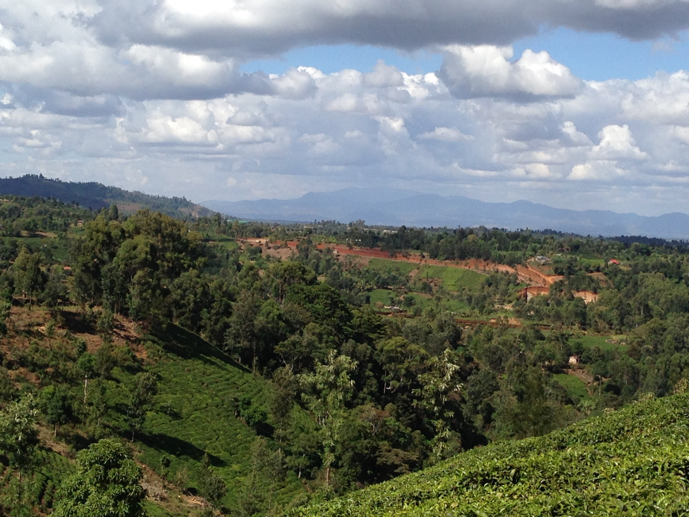
Asante Sana!

