Slide 1
Reinvigorating the Feedback Loop: Teaching the ARCH Model for Giving Feedback within a Residents-as-Teachers Curriculum
Dennis Baker, PhD
Amanda Cuda, MD
Courtney Halista, MD
Chase Hughes, MD
Dina Kurzweil, PhD
Karen Marcellas, PhD
Carolina Merrigan, MD
Dana Nguyen, MD
Kristen Wyrick, MD
Notes:
Introduction of Team Members (Each Team Member to provide a short overview of role and location)

Slide 2
Disclosures
This presentation does not represent the official opinions or methods of the U.S. Government, the Department of Defense, or the Uniformed Services University.

Slide 3
Objectives
By the end of this session, participants will be able to:
Recognize the importance of providing feedback
Identify actions that facilitate effective feedback
Recall the components of the ARCH model
Demonstrate the use of the ARCH model to provide feedback
Begin planning curriculum interventions
Notes:
5 Minutes (Nguyen) - Introduction and Objectives: Introduce all presenters, briefly explain roles in development of current curriculum. Give overview for session/agenda review.
Residents are largely involved in the education and oversight of medical students. However, structured faculty development sessions are lacking for resident teachers. One of the most important skills for any teacher is that of providing effective feedback to learners.
This interactive symposium will share our experiences of implementing our new “Giving Effective Feedback” Resident-as-Teachers sessions from the background theory and curriculum development to the implementation of the actual sessions. We will use video demonstrations to contrast the spectrum of feedback quality using no model, using the “sandwich” model, and finally using the ARCH model. The participants will then have an opportunity to practice the model and debrief their experience. Finally, we will provide opportunity for collaboration so the participants can plan how they could implement a similar session in their programs.
Multiple models of feedback exist. Rather than offer a theoretical overview of multiple models, we focus on one practical model, the ARCH model, conceptualized at Florida State University College of Medicine by Dennis Baker, PhD. Teachers at all levels will benefit from the symposia, as they can use this model to enhance the quality of their feedback to junior learners. Additionally, in this symposium, clerkship directors and residency curriculum leaders will enhance their own abilities to successfully plan, create, and execute effective curriculum interventions.
By the end of this session, participants will be able to:
Describe the background of feedback models
Identify actions that facilitate effective feedback
Recall the components of the ARCH model
Demonstrate the use of the ARCH model to provide feedback
Recognize the importance of providing feedback
Begin planning curriculum interventions

Slide 4
Carolina Merrigan, MD CPT, MC, USA PGY2 Ft. Belvoir Community Hospital, VA

Slide 5
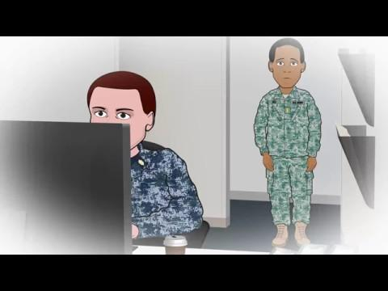
Perspectives
Notes:
10 Minutes (Merrigan)-Introduction of the problem—residents in general do not have the skills in providing effective feedback; review typical resident feedback video (USU); solicit input from the audience regarding scope of the problem
8 minutes - Mistakes when giving feedback, Share Experiences
Reflections on feedback animated video (ReflectionsOnFeedback_final) - This animated video is designed to show common mistakes when providing feedback.
Click the image in the PowerPoint to start the video; it will open in a new browser window. Minimize or close that window to return to the presentation.
Play the video in full, and then facilitate a discussion from the participants about the “problems” identified with feedback in the video. Can they relate? As a learner? As a teacher? Is it hard to conceptualize or provide constructive criticism?
To assist you, a key of feedback concerns is listed below.
Scene 1 - resident provides vague feedback; when asked for something specific resident tells student to “read more” (students hate this!)
Student 1 was told things were great but inside feels it was average and didn’t seem great. Also when student digs deeper for additional help/feedback everything remains vague.
Resident needs to identify a specific issue and work with the student to make a plan to improve
Scene 2 - resident provides “feedback sandwich”
Two different issues can arise: 1) student focuses only on the good and does not hear the bad; or 2) student focuses only on the bad and does not hear the good.
Also, sometimes when doing this, the resident skims quickly over the negative
Resident needs to focus on being more clear that feedback is being provided, and provide positive feedback separate from negative feedback
Resident also needs to be clear that student needs to work on something specific, and work with student on making a plan for how to improve.
Scene 3 - Resident is too busy to provide feedback
Student is left not knowing whether they did well or poorly, and what to sustain or improve
Resident needs to make time for feedback!

Slide 6
Dina Kurzweil, PhD
&
Karen Marcellas, PhD Education Technology & Innovation Support Office Uniformed Services University Bethesda, MD

Slide 7
Planning for Success Education Technology & Innovation Support Office, USU
Developing and Integrating the Team
Distribution of Material to Facilitators
Implementation/Presentation of Materials
Back up Plans
Notes:
Dr. Kurzweil and Dr. Marcellas
10 minutes (Kurzweil/Marcellas)- integrating with a development team, review of resources required, technology needs, considerations for distribution of material across learning sites
Developing and Integrating the Team - This requires forward thinking and planning. Below are some of the elements you need to consider in order to put a team together:
Identify what skillsets you need to develop your product.
Possibilities include instructional design, graphic design, animation, video production
Determine how will you get access to those skill sets and how you will pay for them.
Develop as a team the central mission/goal for your project and a shared vocabulary
Establish the lines of communication
Determine how the team will review products
Identify roles on the team
Considerations include who will maintain the schedule, who will make final decisions, who needs to provide approval on which products
Coordinate a project timeline that works for everyone
Distribution of material to facilitators
Review capabilities for receiving materials across sites.
Look for the lowest common denominator to ensure equal capabilities.
Implementation/Presentation of Materials
Questions to consider:
Can I hook my outside computer to the training site’s projection and internet systems? Most people like to do presentations from their own computer so that they do not have to rely on the Internet and so that they have the appropriate software available. If you have to use the training site room’s computer, it raises a number of additional considerations:
Do the technical versions of the training materials work in the training environment? Make sure you know what software is needed for your presentation (e.g., PowerPoint, media player)
How will you access your presentation materials? Can you access a shared network directory? If not, does what external media can be used (e.g., CD or DVD or flash drive). Consider emailing the materials to yourself as a backup as well.
What is the room layout? If you want participants to be able to work in small groups, you’d like to have a room where people (including facilitators) have space to move around easily
What is the audio/visual setup of the room in which you will be presenting?
How will your presentation be displayed? If they do not have a large screen for display, consider bringing a projector
Will you be able to project sound to the room? If not, consider bringing your own speakers.
Do they have consistent/reliable Internet access? If not be prepared and have everything downloaded to your laptop as well as a CD or DVD or Flash drive (if allowed).
Back up plans - What will you do if:
Materials are missing
Always have duplicate copies of everything and try to figure out a way to print onsite or consider a printing center like Fedex.
Technology breaks down
Have paper copies of everything and bring your computer with elements downloaded so in the worse case scenario you can bring everyone around your computer.

Slide 8
Amanda Cuda, MD, MPH
LTC, MC, USAR Uniformed Services University Bethesda, MD

Slide 9
How it all Started
FM Clerkship Site Directors Conference, USU
Gathered 16 FM teaching faculty
Engaged 2 PhD Education Specialists
Dick & Carey and Kern for systematic instructional design
Video Filming and Editing Done
University video studio
Gig Harbor home “studio”
Piloted Session at 2 Sites
JAN 2018
April 2018
SEPT 2017
March 2018
Spring 2018
Facilitator’s Guide Completed
Narrowed scope to feedback
Iterated objectives
Established tasks and team
Wrote Facilitator’s Guide
Script for video content
Completion of session “package”
Forwarded to clerkship sites
Google Drive
Vimeo
Notes:
10 Minutes (Cuda): Walk participants through our history of the process of curriculum/instruction development, review time required for developing instruction material. Best message is - doesn’t matter what model we use, just that you use a systematic process. This takes time and may want to prioritize and decide what is most important. Site director meeting as well as multimedia choices and interactive options. Complete a needs assessment.

Slide 10
Dennis Baker, Ph.D. Assistant Dean for Faculty Enrichment and Professor of Family Medicine Alabama College of Osteopathic Medicine & Emeritus Professor of Family Medicine and Rural Health Florida State University College of Medicine

Slide 11
“Some” Characteristics of Effective Feedback
Considers emotions of teacher and learner
Start with the learner via self-assessment
Expected
Right time
Right amount
Based on direct observation
Specific and descriptive language
Collaborative, goal oriented
Packaged well
Notes:
Dr. Baker

Slide 12
“Some” Characteristics of Effective Feedback
Considers emotions of teacher and learner
Start with the learner via self-assessment
Expected
Right time
Right amount
Based on direct observation
Specific and descriptive language
Collaborative, goal oriented
Packaged well
Notes:
Dr. Baker

Slide 13
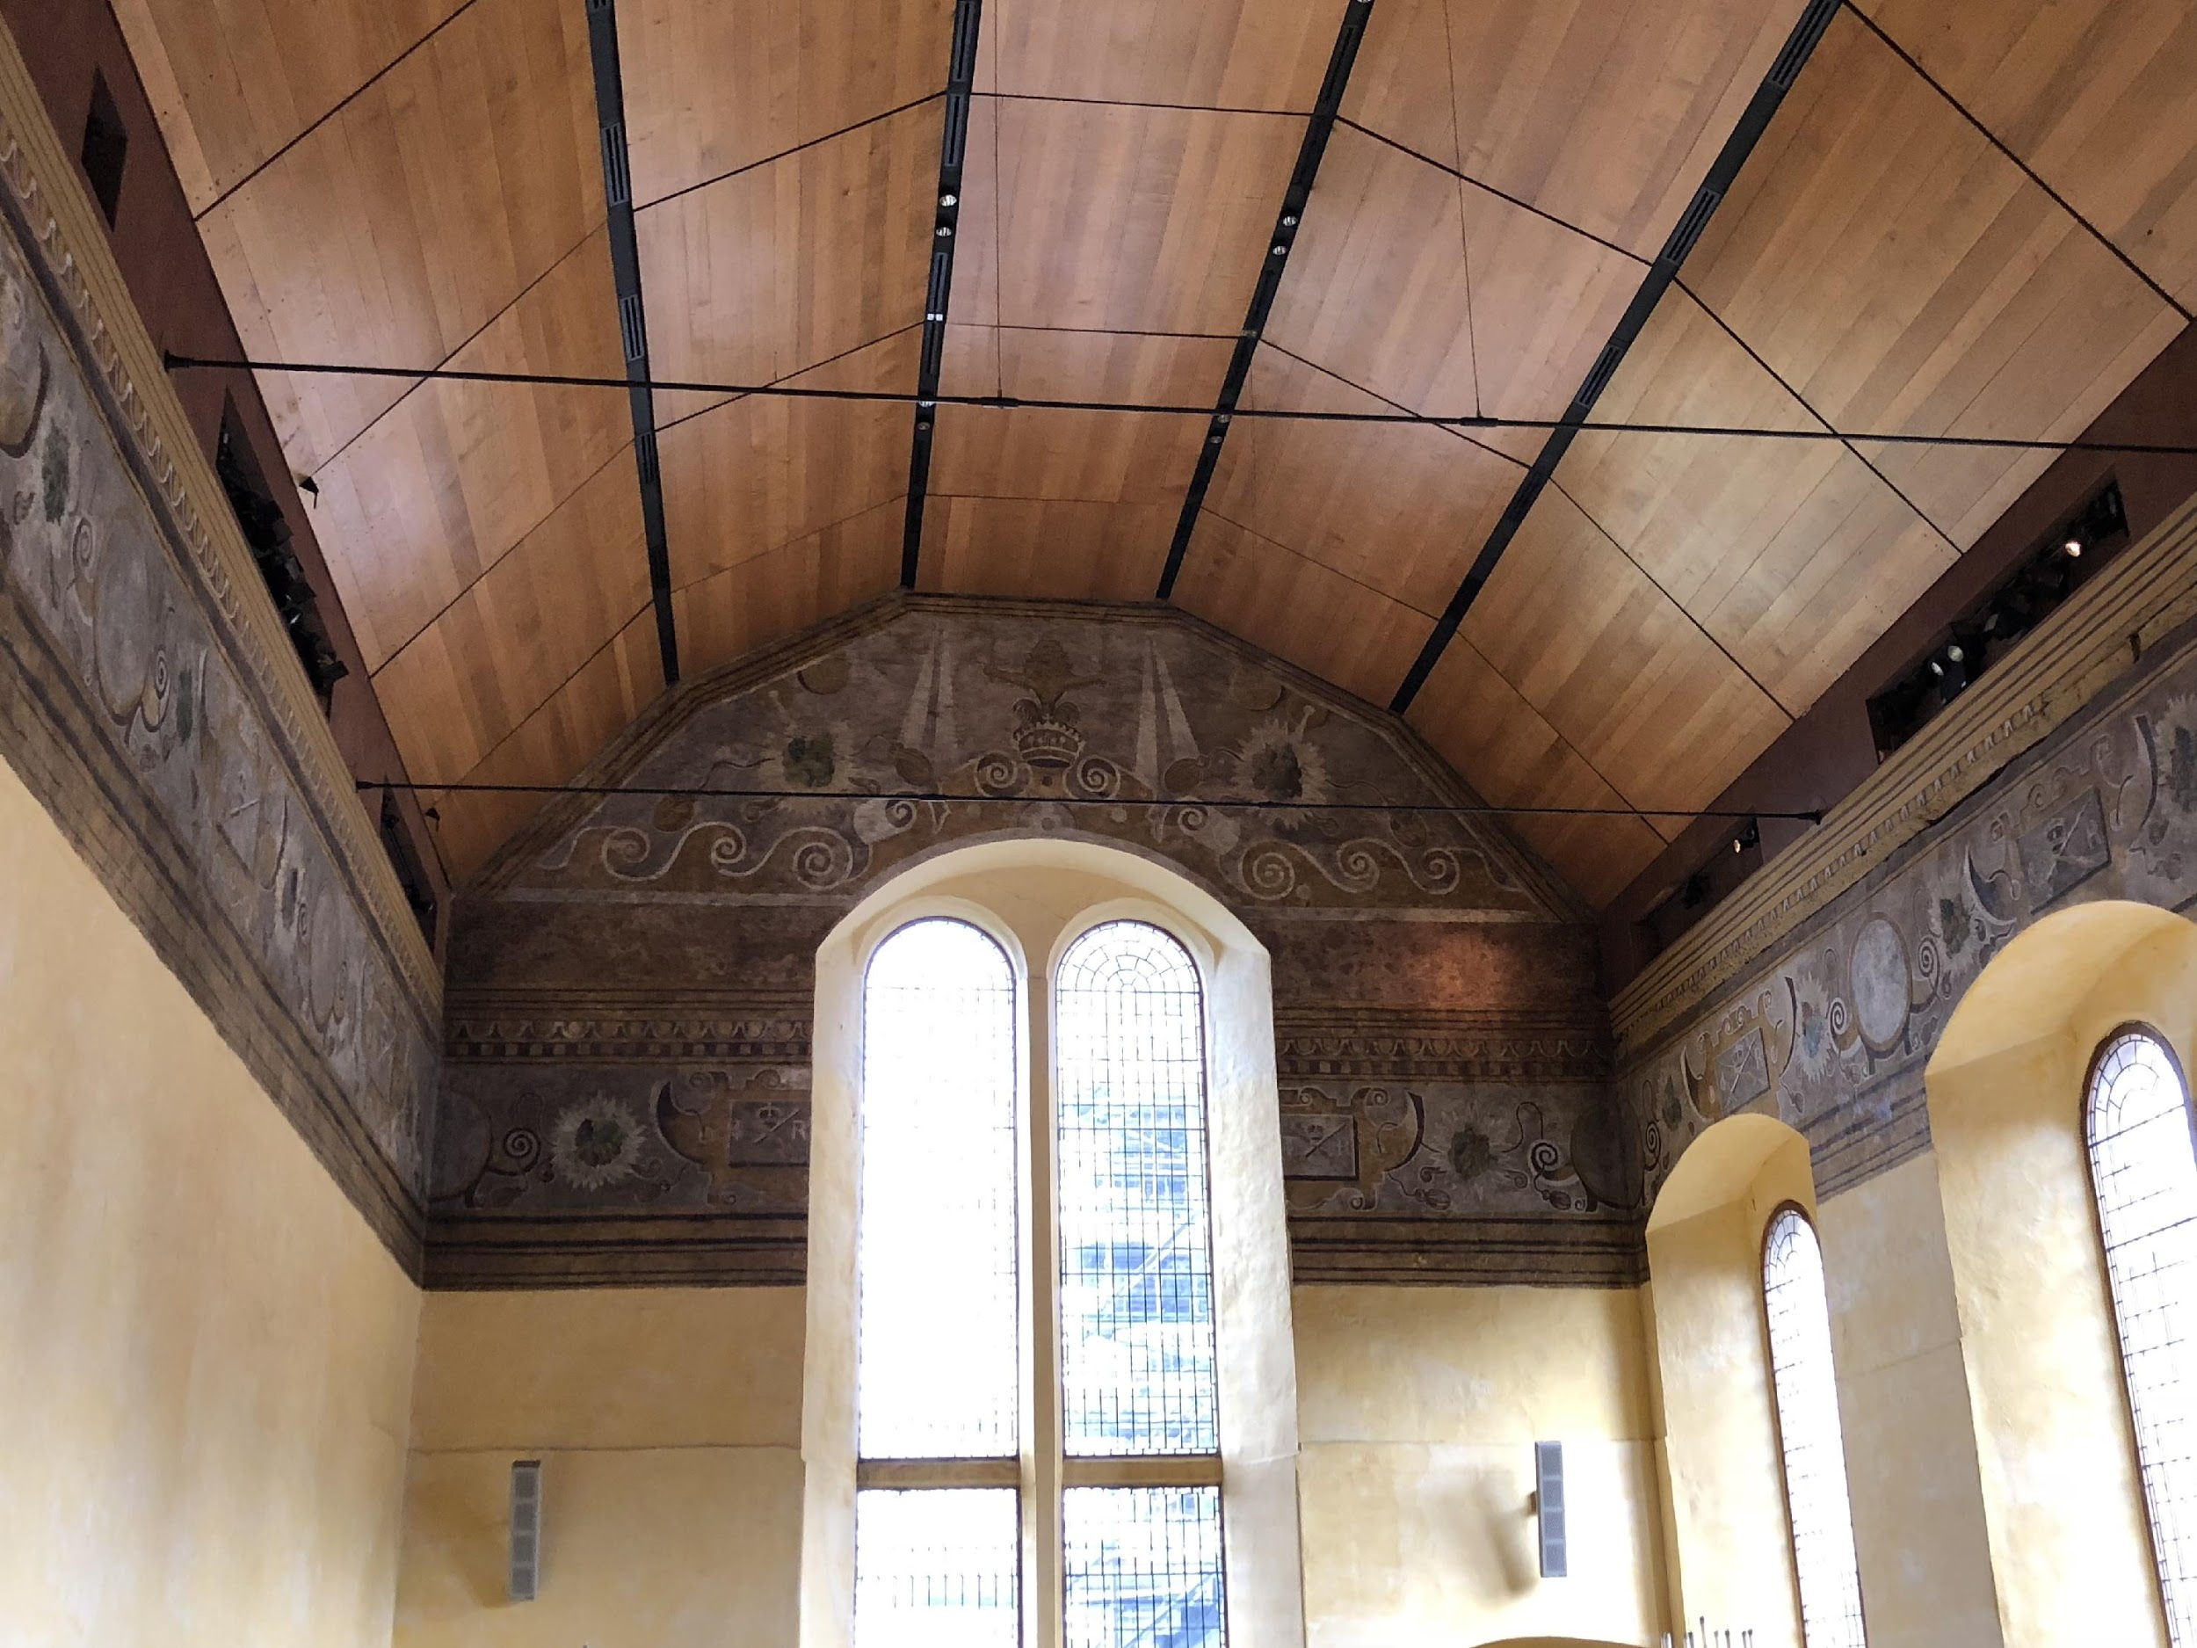
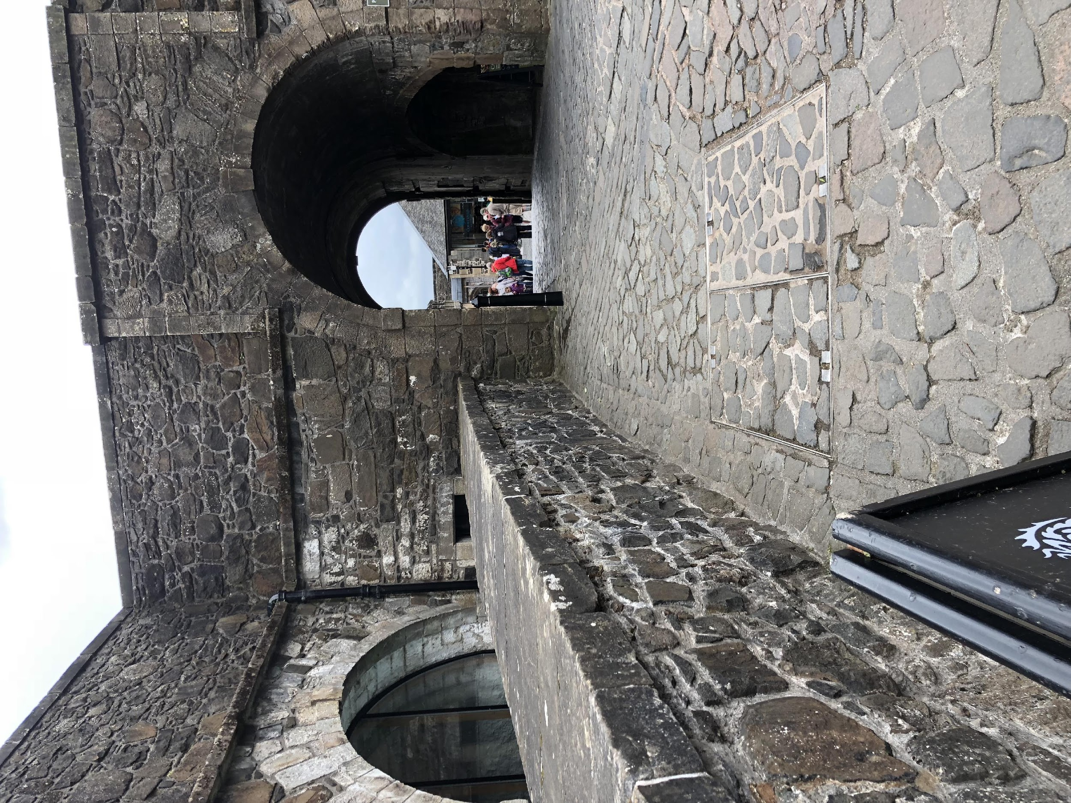
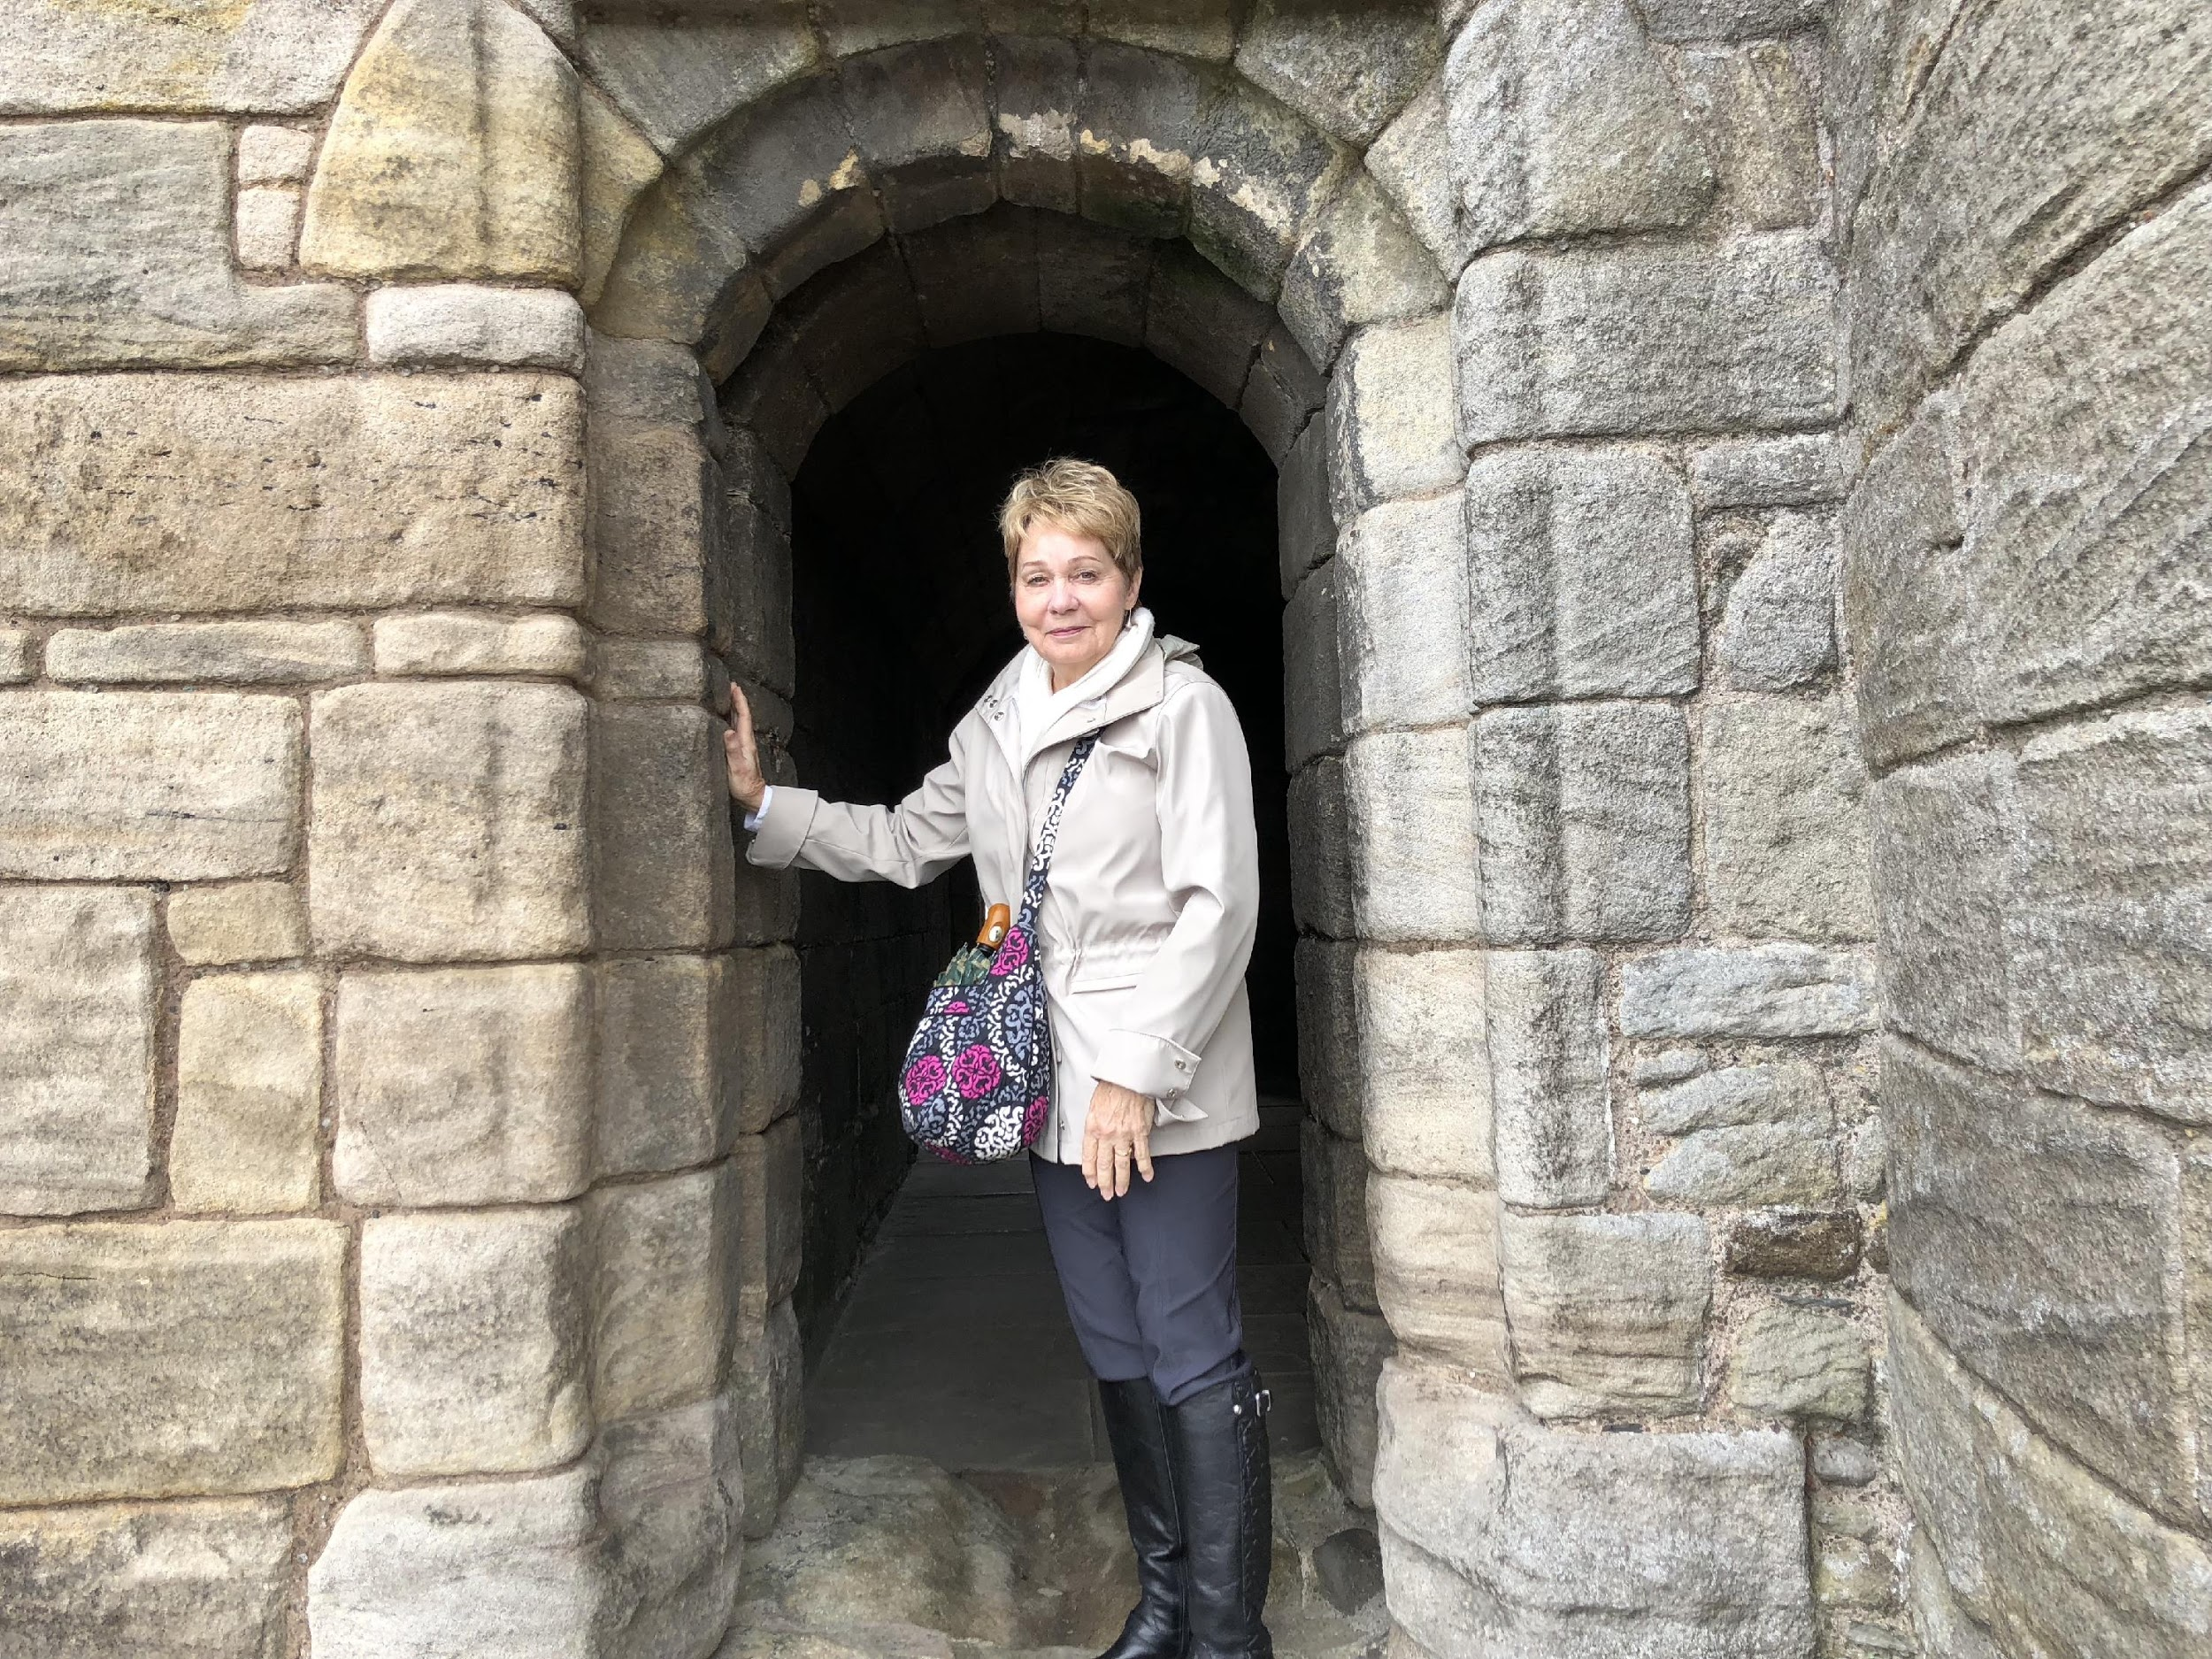
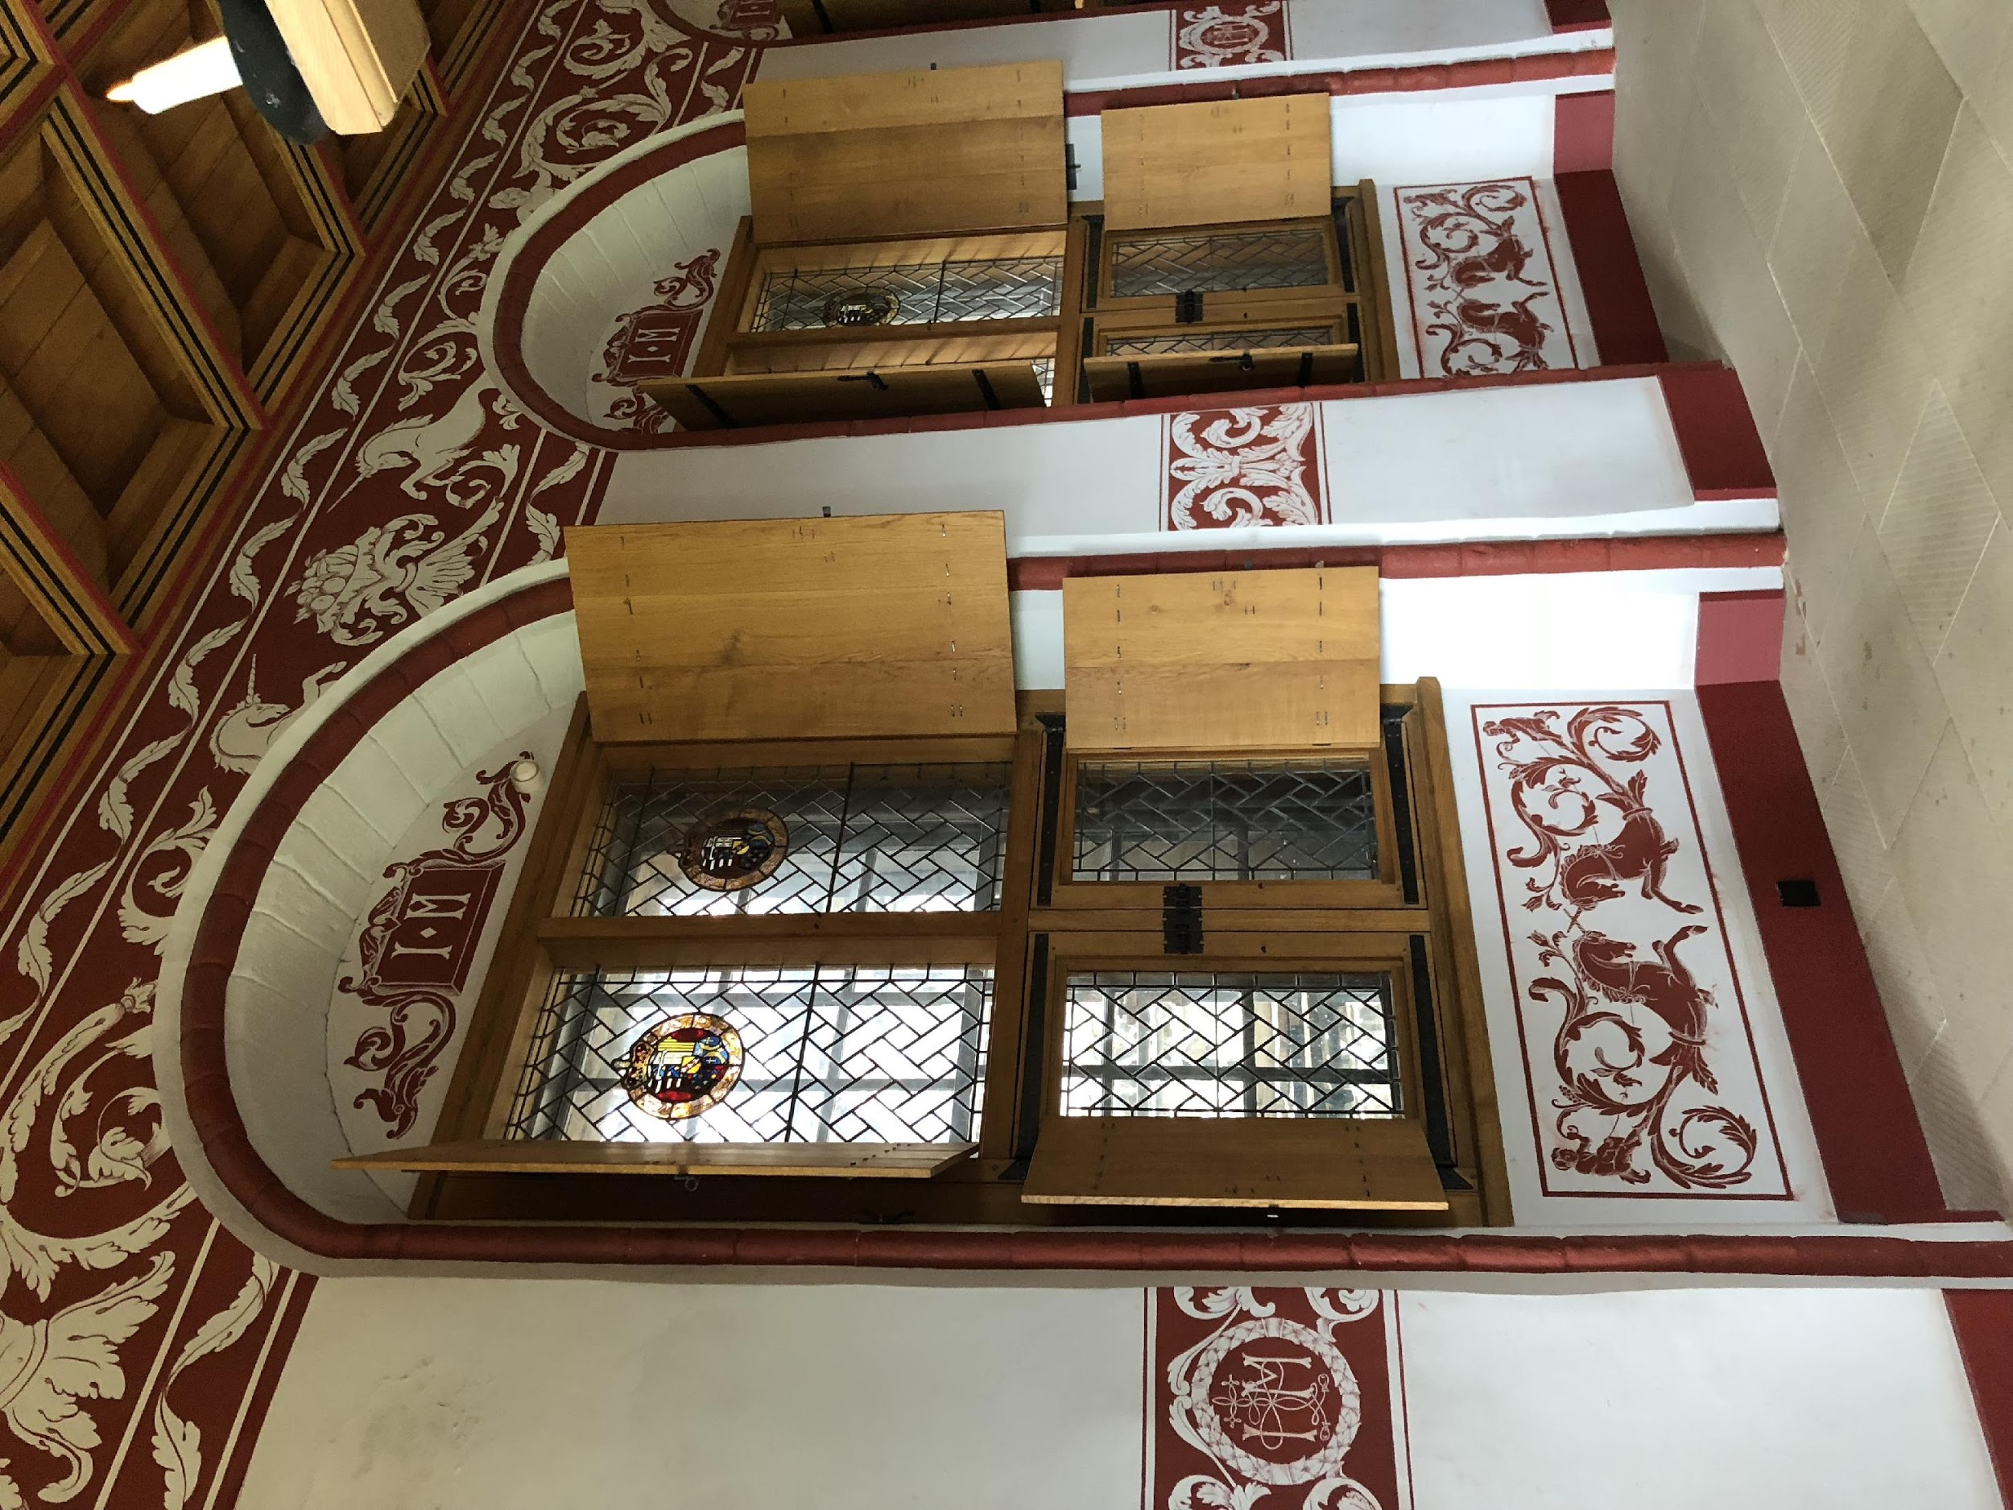

Slide 14
ARCH Feedback Model
A
Ask/Allow for self-assessment
Reinforce things done well (KSA)
R
C
Confirm areas needing correction
H
Help learner with improvement plan
Notes:
Dr. Baker

Slide 15
ARCH Allow/Ask for Self-Assessment
Create safe environment
Ask/Allow for self-assessment
Use self-assessment as base for RCH
ARCH Reinforce Things Done Well (attitudes, skills, knowledge)
Discuss learner’s self-addressed strengths first
Explore how strengths developed
Add strengths you have observed and why important
Notes:
Dr. Baker

Slide 16
ARCH Confirm Areas Needing Correction
Ask for learner’s identified areas for correction/improvement
Confirm & clarify via restating
Add areas for correction you identified and check for understanding
ARCH Help With Improvement Plans
Obtain learner’s input for improvement strategies
Add suggestions to strategies
Clarify goals & plans followed by documentation process
Notes:
Dr. Baker

Slide 17
ARCH in Action
Notes:
Dr. Baker

Slide 18
Courtney Halista, MD Capt, MC, USAF Faculty Travis AFB, CA
Chase Hughes, MD LT, MC, USN
PGY4 Naval Hospital Camp Pendleton, CA

Slide 19
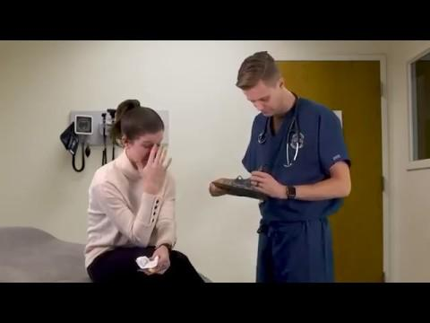
Let’s Practice!
Notes:
Courtney and Chase
10 minutes (Halista/Hughes) – Practice providing feedback using the ARCH model—individual skill development. All participants will watch a standard scenario (USU video) and then work together in pairs to outline feedback to the student based on the ARCH model. (Do not have time to do the second scenario)
(1 Minute) - Introduce activity and timeline
(5 Minutes) - View patient encounter videos (click the links to view the videos).
(4 Minutes) - Have students pair up and then write out main points of feedback individually and start thinking about what they would say to the medical student if they were the resident.

Slide 20
ARCH Feedback Model
A
Ask/Allow for self-assessment
Reinforce things done well (KSA)
R
C
Confirm areas needing correction
H
Help learner with improvement plan
Notes:
Courtney and Chase
You can use this slide to solicit audience discussion and recommendations for feedback based on the scenario they saw

Slide 21
Dana Nguyen, MD, FAAFP
LTC(P), MC, USA
Associate Professor & Clerkship Director Uniformed Services University Bethesda, MD

Slide 22
Preparing for Implementation Facilitator’s Guide
Purpose- To allow “anyone” to use content without consulting the design team
Not a ‘word for word’ script
Provides objectives and key information that needs to be covered
Outline
Notes:
10 minutes (Nguyen) Walk through facilitator guide as a background for building a facilitator guide, specific to structure and implementation rather than specifics of this material
Review of Facilitators Guide components
The facilitator guide should be designed so that somebody can download it and teach the session without consulting the design team. While it does not need to provide a “word for word” script, it should provide the objectives along with the key information that needs to be covered in order to meet the objectives. Below is the outline of the facilitator guide for our session
General information about session
Pre and Post Survey
Objectives
Introduction
Audience
Timing - schedule for training event.
Format
Facilitator Resources
Media Requirements
Pre-Session Work
Session Structure and Content
References

Slide 23
Facilitators Guide Components
General information
Pre and Post Survey
Objectives
Introduction
Audience
Timing
Format
Facilitator Resources
Media Requirements
Pre-Session Work
Session Structure
Session Content
References
Notes:
10 minutes (Nguyen) Walk through facilitator guide as a background for building a facilitator guide, specific to structure and implementation rather than specifics of this material
Review of Facilitators Guide components
The facilitator guide should be designed so that somebody can download it and teach the session without consulting the design team. While it does not need to provide a “word for word” script, it should provide the objectives along with the key information that needs to be covered in order to meet the objectives. Below is the outline of the facilitator guide for our session
General information about session
Pre and Post Survey
Objectives
Introduction
Audience
Timing - schedule for training event.
Format
Facilitator Resources
Media Requirements
Pre-Session Work
Session Structure and Content
References

Slide 24
Kristen Wyrick, MD
LtCol, MC, USAF Uniformed Services University Bethesda, MD

Slide 25
Putting It all Together
8 Minute video
Role Play Script
2 Minute Video
ARCH Card
Video on TeachingPhysician.org
STFM Education Column
Full article submitted to Medical Teacher
45 minute session
Facilitator guide
Power Point
4 videos
Handout
Notes:
Kristen
Briefly review the final products we developed at each of our institutions. Dr. Baker while at FSU (left) and ours at USU (right). Not too much to talk about here but makes an easier transition as to facilitating a large group discussion instead of going abruptly from my last slide.

Slide 26
Time For You!
Consider an educational need or concern for your program.
Consider your local resources. Do you have education specialists and/or technology developers?
What might this project cost?
Who else should be on the team?
Is this type of curriculum something that could be implemented at your institution?
Notes:
15 minutes (Wyrick)- Lead audience in discussion/facilitation regarding application to own situation; if large group discussion ensues, Wyrick to facilitate; if participants want to work on planning their own product, all presenters will wander around and assist as resident/faculty subject matter experts

Slide 27
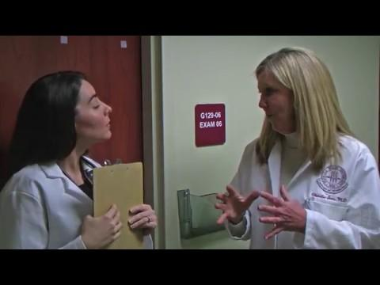

Slide 28
Please evaluate this presentation using the conference mobile app! Simply click on the "clipboard" icon on the presentation page.

