Slide 1
The Peer Review Process: Insight From the Editors of Family Medicine Journals
Sumi Sexton, MD and Kenny Lin, MD, MPH
American Family Physician
Nicholas Pimlott, MD, PhD
Canadian Family Physician
John Saultz, MD
Family Medicine

Slide 2
Upon completing of this session, participants should be able to:
Define peer review and the purpose behind it.
Have a general understanding of the review processes for each journal, including the similarities and differences between journals and article formats.
Understand what journals are looking for in a review, including tips on performing a thorough review and the benefits of becoming a reviewer.

Slide 3
Peer Review Under Fire?
“Peer Review: The Worst Way to Judge Research, Except for All the Others”
Aaron E. Carroll, The New York Times, Nov. 5, 2018
“To Maintain Trust in Science, Lose the Peer Review”
Benjamin Mazer and John Mandrola, Medscape, February 19, 2019

Slide 4
Questions for the panelists
What is peer review?
Internal vs. external
What purpose does it serve at your journal?
What value does it add?
What are you looking for in a good review?
What are the benefits to reviewers?
How do I sign up to be a reviewer?

Slide 5
American Family Physician
Reasons to become a reviewer:
Gain insight to the types of articles AFP receives
Attain CME credit
For more information:
https://www.aafp.org/journals/afp/reviewers/guide.html
Email afpjournal@aafp.org

Slide 6
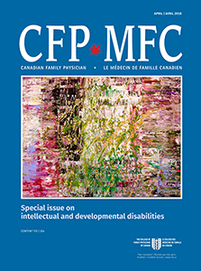
Canadian Family Physician
Becoming a peer reviewer for CFP and other Family Medicine journals:
http://www.cfp.ca/content/60/12/1158

Slide 7
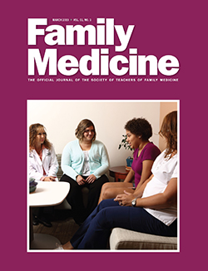
Family Medicine
Family Medicine is focused on publishing original research on medical education in family medicine. We also publish narrative essays and poems that relate to the work of family physicians.
To become a reviewer, visit the journal’s web site: https://journals.stfm.org/familymedicine/

Slide 8
Examples of good review comments
Line 84: Discuss proper use of ibuprofen and acetaminophen on this section. Data on alternating both medications is conflicting. Recent data in the surgical literature doesn't show improvement on pain with the combination (Merry AF, Edwards KE, Ahmad Z, et al. Randomized comparison between the combination of acetaminophen and ibuprofen and each constituent alone for analgesia following tonsillectomy in children. Can J Anesth 2013;60:1180-9).
Table 2: Add a section discussing the treatment of AOM on patients less than 6 months. Add a section discussing the treatment of AOM on adult patients.

Slide 9
Questions for the audience
Who has reviewed for one of our journals before?
What are your experiences with the process?
Any tips to share with others?

Slide 10
Tips for doing a good review – “Do’s”
Ensure no Conflicts of Interest before accepting
Review for a journal which you regularly read
Familiarize yourself with the journal’s content and style
Work with a mentor for your first review and plan to mentor others (but acknowledge if you received help)
Review literature and bibliography (put the article into context)
Comment on misinterpretation or confusion
Recommend adding important missing elements
Question assertions and statistics
Be constructive in your critique

Slide 11
Tips for doing a good review – “Don’ts”
DO NOT
Agree to review for a journal you don’t read
Lose sight of the journal’s purpose and audience
Accept review if can’t complete it in the expected time frame
Forget to be constructive in your review
Try to be the author or rewrite the article
Make suggestions based on personal bias
Worry about grammar and wording

Slide 12
Contact information
Sumi Sexton
makkars@Georgetown.edu, @ssextonmd
Kenny Lin
KWL4@Georgetown.edu, @kennylinafp
Nicholas Pimlott
np@cfpc.ca, @NicholasPimlott
John Saultz
fmeditor@ohsu.edu

