Slide 1
ESCAPE THE ROOM: HYPERTENSION
Developed by Rachel Gottlieb, M22
Tufts University School of Medicine, Boston MA

Slide 2
Vitals
Physical Exam
HPI

Slide 3
Hmm, good thought. Maybe you should get to know the patient first?

Slide 4
HPI
Preston Jackson is a 56 year old non-smoker, an investment banker originally from Liverpool, England, with no significant past medical history, who presents for his annual physical. He has not seen his family physician for six years.

Slide 5
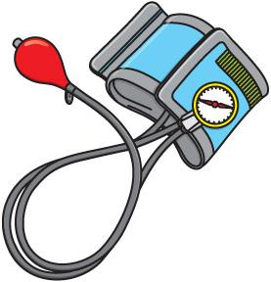
VITALS |
You bring Mr. Jackson right back to the exam room. He hops up on the exam table, and you take his BP right away. Mr. Jackson is very friendly, and he is chatting with you as you take his BP.
What may be the reasons your BP reading is inaccurate?
Not allowed to relax for 5 minutes
Patient can’t stop talking about bitcoin
Not examined at his natural habitat (the bank)
Not examined at his natural altitude (secret catacombs of London)
Patient is slouching on the exam table
You were practicing for when vitals-taking becomes an Olympic sport
Already made a Dunkin’ run today
The only cuff you could find was from the 5yo well child check

Slide 6
NAILED IT!
Need to wait 5 minutes for physiologic relaxation. Stress, pain, and physical activity increase blood pressure transiently.

Slide 7
NAILED IT!
Need to have the patient with their feet flat on the floor and back supported.

Slide 8
NAILED IT!
Talking will artificially raise BP. Stress from not understanding bitcoin may be contributary.

Slide 9
NAILED IT!
Take your time getting an accurate measurement: make sure to go well above the BP you might expect and slowly release pressure to appreciate changes in sound. You can’t diagnose hypertensive urgency if you don’t measure high enough to detect it.

Slide 10
NAILED IT!
Too big of a cuff= underestimates HTN
Too small of a cuff= exaggerates HTN

Slide 11
Not examined at his natural habitat (the bank)
Hypertension isolated to the medical setting, or “white-coat hypertension” is well-documented. Previously considered a confounding factor, it is now recognized as a meaningful subset of hypertension warranting further monitoring due to elevated cardiac risk.
Fun Fact: 15% to 30% of the population believed to have hypertension may have lower blood pressure outside of the office setting
This Photo by Unknown Author is licensed under CC BY-SA-NC
Notes:
https://www.aafp.org/afp/2016/0215/p300.html#afp20160215p300-b1

Slide 12
Fun fact (not for test-taking purposes): High altitudes (>8,200ft or >2500m) are associated with a modest increase in blood pressure for those not acclimatized. This is due to adrenergic activation, arterial stiffness, and reduced vasodilatory responses. However, this is not considered an inaccuracy but rather a real physiologic change.
This Photo by Unknown Author is licensed under CC BY-SA-NC
Notes:
https://www.aafp.org/afp/2016/0215/p300.html#afp20160215p300-b1

Slide 13
Already made a Dunkin’ run today
This is a real physiologic effect from caffeine (and other stimulants) that should be monitored.
This Photo by Unknown Author is licensed under CC BY-SA-NC
Notes:
https://www.aafp.org/afp/2016/0215/p300.html#afp20160215p300-b1

Slide 14
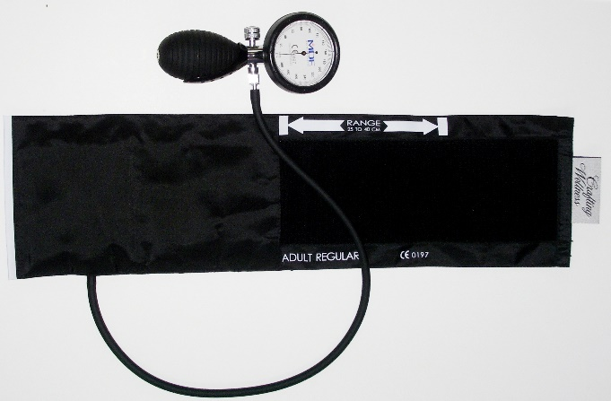
Looks like the BP machine won’t start until you can select the correct cuff
Back

Slide 15
Whoops, didn’t seem to work. Maybe you should check some more scenarios?

Slide 16
You get a reading of 148/88 after getting Mr. Jackson (56yoM) in optimal measurement conditions …
What is the threshold for hypertension per JNC-8 for this pt?
>139/99
>149/89
>139/89

Slide 18
You get a reading of 148/88 after getting Mr. Jackson (56yoM) in optimal measurement conditions …
What if this was a 60yo?
What is the threshold for hypertension per JNC-8 for this pt?
>139/99
>139/99
>149/89
>149/89
>139/89
>139/89

Slide 19
You get a reading of 148/88 after getting Mr. Jackson (56yoM) in optimal measurement conditions …
What if this was a 60yo?
What if this was a 60yo with Type 2 Diabetes?
What is the threshold for hypertension per JNC-8 for this pt?
>139/99
>139/99
>149/89
>149/89
>149/89
>139/89
>139/89
>139/89
>139/99

Slide 20
You get a reading of 148/88 after getting Mr. Jackson (56yoM) in optimal measurement conditions …
What if this was a 60yo?
What if this was a 60yo with Type 2 Diabetes?
What is the threshold for hypertension per JNC-8 for this pt?
>139/99
>139/99
>149/89
>149/89
>149/89
>139/89
>139/89
>139/89
>139/99
Next

Slide 21
Good Job! Now onto the next patient…
Next

Slide 22
Vitals
HPI
Physical Exam

Slide 23
Hmm, good thought. Maybe you should get to know the patient first?

Slide 24
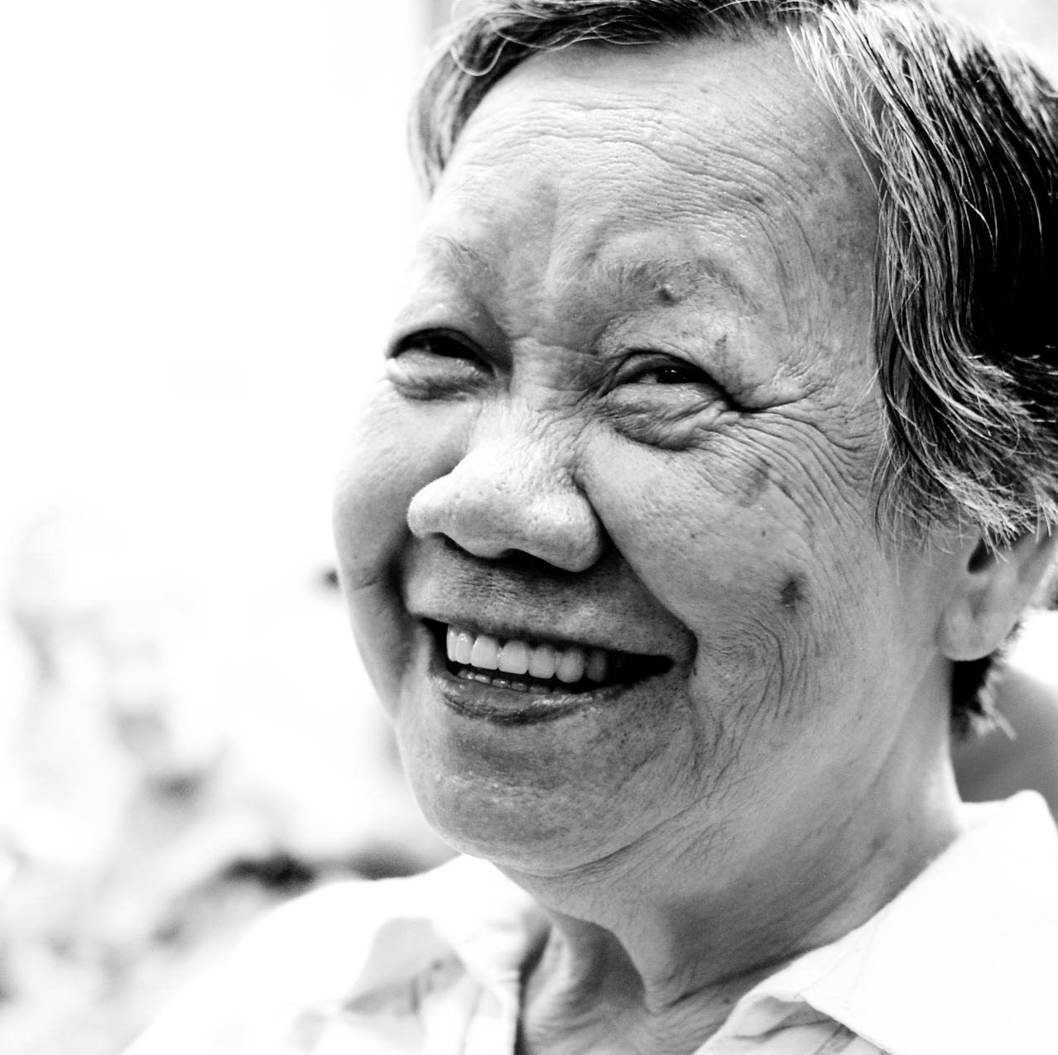
HPI
Your next patient is Trang Nguyen, here with her husband. She is a 72 year old non-smoker with a blood pressure of 155/95. She has a past medical history only significant for kidney stones, occasional constipation, and being overweight. She drinks one coffee each morning and one herbal alcoholic beverage every evening. She recently has moved to Dorchester from Hanoi, Vietnam to be with her children and grandchildren. She finds living in a new place very stressful and she does not yet have health insurance. She saw a doctor last year in Vietnam who told her she had high blood pressure but Trang never took the medications that the doctor had prescribed as she does not like the idea of taking medications.
Next

Slide 25
What are some lifestyle changes that lower BP, in order of efficacy?
Weight Loss
Smoking cessation
Exercise with stable weight
Alcohol reduction
Caffeine reduction
DASH Diet
Stress Management
Salt Restriction
Notes:
Per Dynamed, reduction in SBP by mmHg:
Weight Loss/Nutrition (5-20mmHg/ 22lbs of weight loss)
DASH Diet (8-14)
Smoking (7-9)
Decrease sodium consumption (5-10)
Exercise independent of weight loss (4-7SBP)
Stress management (4-5)/ Caffeine (5)
Decrease or eliminate alcohol (2-4)

Slide 26
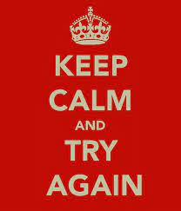

Slide 27
What are some lifestyle changes that lower BP, in order of efficacy?
1
Weight Loss
Smoking cessation
Exercise with stable weight
Alcohol reduction
Caffeine reduction
DASH Diet
Stress Management
Salt Restriction
Notes:
Per Dynamed, reduction in SBP by mmHg:
Weight Loss/Nutrition (5-20mmHg/ 22lbs of weight loss)
DASH Diet (8-14)
Smoking (7-9)
Decrease sodium consumption (5-10)
Exercise independent of weight loss (4-7SBP)
Stress management (4-5)/ Caffeine (5)
Decrease or eliminate alcohol (2-4)

Slide 28
What are some lifestyle changes that lower BP, in order of efficacy?
1
Weight Loss
Smoking cessation
Exercise with stable weight
Alcohol reduction
Caffeine reduction
2
DASH Diet
Stress Management
Salt Restriction
Notes:
Per Dynamed, reduction in SBP by mmHg:
Weight Loss/Nutrition (5-20mmHg/ 22lbs of weight loss)
DASH Diet (8-14)
Smoking (7-9)
Decrease sodium consumption (5-10)
Exercise independent of weight loss (4-7SBP)
Stress management (4-5)/ Caffeine (5)
Decrease or eliminate alcohol (2-4)

Slide 29
What are some lifestyle changes that lower BP, in order of efficacy?
1
Weight Loss
3
Smoking cessation
Exercise with stable weight
Alcohol reduction
Caffeine reduction
2
DASH Diet
Stress Management
Salt Restriction
Notes:
Per Dynamed, reduction in SBP by mmHg:
Weight Loss/Nutrition (5-20mmHg/ 22lbs of weight loss)
DASH Diet (8-14)
Smoking (7-9)
Decrease sodium consumption (5-10)
Exercise independent of weight loss (4-7SBP)
Stress management (4-5)/ Caffeine (5)
Decrease or eliminate alcohol (2-4)

Slide 30
What are some lifestyle changes that lower BP, in order of efficacy?
1
Weight Loss
3
Smoking cessation
Exercise with stable weight
Alcohol reduction
Caffeine reduction
2
DASH Diet
Stress Management
4
Salt Restriction
Notes:
1. Weight Loss/Nutrition (5-20mmHg/ 22lbs of weight loss)
2. Exercise independent of weight loss (4-7SBP)
3. Decrease or eliminate alcohol (2-4)
4. Decrease sodium consumption (5-10)
/DASH Diet (8-14)
5. Stress management (4-5)
6. Caffeine (5)\
Smoking (7-9)

Slide 31
What are some lifestyle changes that lower BP, in order of efficacy?
1
Weight Loss
3
Smoking cessation
5
Exercise with stable weight
Alcohol reduction
Caffeine reduction
2
DASH Diet
Stress Management
4
Salt Restriction
Notes:
1. Weight Loss/Nutrition (5-20mmHg/ 22lbs of weight loss)
2. Exercise independent of weight loss (4-7SBP)
3. Decrease or eliminate alcohol (2-4)
4. Decrease sodium consumption (5-10)
/DASH Diet (8-14)
5. Stress management (4-5)
6. Caffeine (5)\
Smoking (7-9)

Slide 32
What are some lifestyle changes that lower BP, in order of efficacy?
1
Weight Loss
3
Smoking cessation
5
Exercise with stable weight
Alcohol reduction
6
Caffeine reduction
2
DASH Diet
6
Stress Management
4
Salt Restriction
Notes:
Per Dynamed, reduction in SBP by mmHg:
Weight Loss/Nutrition (5-20mmHg/ 22lbs of weight loss)
DASH Diet (8-14)
Smoking (7-9)
Decrease sodium consumption (5-10)
Exercise independent of weight loss (4-7SBP)
Stress management (4-5)/ Caffeine (5)
Decrease or eliminate alcohol (2-4)

Slide 33
What are some lifestyle changes that lower BP, in order of efficacy?
1
Weight Loss
3
Smoking cessation
5
Exercise with stable weight
7
Alcohol reduction
6
Caffeine reduction
2
DASH Diet
6
Stress Management
4
Salt Restriction
Next
Notes:
Per Dynamed, reduction in SBP by mmHg:
Weight Loss/Nutrition (5-20mmHg/ 22lbs of weight loss)
DASH Diet (8-14)
Smoking (7-9)
Decrease sodium consumption (5-10)
Exercise independent of weight loss (4-7SBP)
Stress management (4-5)/ Caffeine (5)
Decrease or eliminate alcohol (2-4)

Slide 34
At 3 month follow up…
Trang worked at lifestyle modifications but was not able to bring her BP down. She has agreed to start taking medication.
Next

Slide 35
Vitals
HPI
Physical Exam

Slide 36
HPI
Your patient is Trang Nguyen, here with her husband for 3 month follow up for hypertension. She is a 72 year old non-smoker with a blood pressure of 158/93 today.
She has a past medical history only significant for kidney stones, occasional constipation, and being overweight. She drinks one coffee each morning and one herbal alcoholic beverage every evening.
She moved to Dorchester from Hanoi, Vietnam to be with her children and grandchildren. She is still getting used to living in Dorchester and her MassHealth insurance application is currently being processed. Trang never took the medications for blood pressure before and is concerned about possible side effects.

Slide 37
Vitals
You measure a blood pressure of 158/93 in the right arm and 155/90 in the left arm.
She does not check her blood pressure at home.
Heart Rate 80. Respiratory rate 12. Oxygen Saturation 99%. Temperature 98.7F

Slide 38
Physical Exam
General: Well-appearing, talking comfortably in no acute distress
HEENT: PERRLA. Normal oral mucosa. No cervical LAD.
CV: RRR, no murmurs. +2 radial pulses, symmetric.
Pulmonary: Clear to auscultation bilaterally. No crackles, wheezes, or rubs.
Abdomen: Soft, nondistended, mildly TTP in LLQ with modest palpable stool burden in rectosigmoid area.
Extremities: trace edema in legs bilaterally, varicose veins

Slide 39
Which medication is the best first choice for Ms. Nguyen?
Lisinopril
Hydrochlorothiazide
Amlodipine
Atenolol
Back

Slide 40
Hydrochlorothiazide is an excellent choice for many reasons. Which of the following is NOT true of HCTZ?
Reduces peripheral edema
Low cost
Protects against nephrolithiasis and osteoporosis
Minimal electrolyte abnormalities
Back

Slide 41
Hydrochlorothiazide is an excellent choice for many reasons. Which of the following reasons is NOT true:
Reduces peripheral edema
Low cost
Protects against nephrolithiasis and osteoporosis
Minimal electrolyte abnormalities
Correct!
Next

Slide 42
There may be a better choice.
Try again.

Slide 43
Now, what if Ms. Nguyen’s sister needs a BP med and has asthma, migraine headaches, and Raynaud’s?
Captopril
Hydrochlorothiazide
Nifedipine
Metoprolol

Slide 44
Now what if Ms. Nguyen’s sister needs BP meds and has asthma, migraine headaches, and Raynaud’s?
Captopril
Hydrochlorothiazide
Nifedipine
Metoprolol
Correct!
Next

Slide 45
There may be a better choice.
Try again.

Slide 46
Now, what if Ms. Nguyen’s other sister needs a BP med and has first degree heart block, diastolic CHF, and gout?
Lisinopril
Hydrochlorothiazide
Amlodipine
Atenolol

Slide 47
Now what if Ms. Nguyen’s other sister needs BP meds and has first degree heart block, diastolic CHF, and gout?
Lisinopril
Hydrochlorothiazide
Correct!
Amlodipine
Atenolol
Next

Slide 48
There may be a better choice.
Try again.

Slide 49
Good Job! Now onto some med check visits…
Next

Slide 50
As you enter the room, what symptoms or physical exam findings should you look for based on the antihypertensive medication?
Next

Slide 51
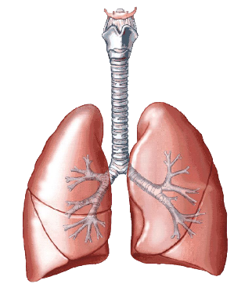
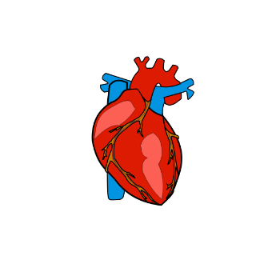
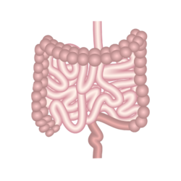
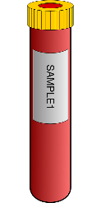
What symptoms or physical exam findings might occur with lisinopril? (There may be more than one!)
Click the system then the correct symptom.
General
HEENT
Try again!
Lip swelling
Sinus congestion
Headache
Cardiovascular
Pulmonary
Try again!
Wheezing (worsening asthma)
Shortness of breath
Dry cough
Abdomen
Try again!
Try again!
Try again!
Try again!
Let’s get some routine labs:
Try again!
Extremities
Try again!

Slide 52
What labs should we draw today for someone with HTN and no comorbid conditions who takes lisinopril? (add up the lab numbers)
15
17
40
41
PTH
Calcium
CBC
Creatinine
Potassium
BUN
Lipid panel
Glucose
Uric Acid
Phosphate
Sodium
U/A
Magnesium
Try again!
Try again!
Try again!
Correct!
Focused lab monitoring would include BUN, Cr, K. Hyponatremia is extremely rare with ACEi/ARBs.
Next

Slide 53
What symptoms or physical exam findings might occur with beta blockers?
General
HEENT
Fatigue, depression
Try again!
Cardiovascular
Pulmonary
Try again!
Heart block
Wheezing (worsening asthma)
Dry cough
Increased sputum production
Try again!
Chest pain
Try again!
Tachycardia
Try again!
Abdomen
Try again!
Bradycardia
Sexual dysfunction
Gallstones
Constipation
Try again!
Let’s get some routine labs:
Extremities
Try again!

Slide 54
What labs should we draw today for someone with HTN and no comorbid conditions who takes atenolol? (add up the lab numbers)
0
10
12
15
PTH
Calcium
CBC
Creatinine
Potassium
BUN
Lipid panel
Glucose
Uric Acid
Phosphate
Sodium
U/A
Magnesium
Try again!
Try again!
Try again!
Correct!
No routine labs needed for beta-blockers.
Next

Slide 55
What symptoms or physical exam findings might occur with calcium channel blockers?
General
HEENT
Try again!
Try again!
Cardiovascular
Pulmonary
Try again!
Heart block
Worsening systolic CHF
Wheezing (worsening asthma)
Try again!
Bradycardia
Dry Cough
Try again!
Abdomen
Tachyarrhythmia
Try again!
Ulcers
Constipation
GERD
Try again!
Try again!
Extremities
Next
Leg edema
Neuropathy

Slide 56
Keeping you on your toes…What labs should we draw for someone with HTN and no comorbid conditions who takes HCTZ? (add up the lab numbers)
PTH
Calcium
CBC
Creatinine
Potassium
BUN
Lipid panel
Glucose
Uric Acid
Phosphate
Sodium
U/A
Magnesium
41
56
65
68
Try again!
Try again!
Try again!
Correct!
Routine labs would include a BMP (Na, K, BUN, Cr, glucose) as well as electrolytes calcium (can be ↑) and magnesium (can be ↓). HCTZ can also slightly increase lipids and glucose intolerance, which should be monitored periodically. There is no utility to uric acid surveillance for HCTZ-induced gout.
Next

Slide 57
General
HEENT
Try again!
Retinopathy, stroke
What diseases might occur with chronically untreated hypertension?
Cardiovascular
Pulmonary
CAD, CHF, Cardiomyopathy
CHF
Abdomen
AAA, CKD
Great work! Now that you’ve brushed up on sequellae, let’s do a final telehealth visit to contextualize risk for your patient.
Extremities
Peripheral vascular disease
Next

Slide 58
Your final appointment will be conducted over a HIPAA-compliant telemedicine platform. Your goal for this visit is to help assess the risk of acute coronary syndrome given recent lab results.
Next

Slide 59
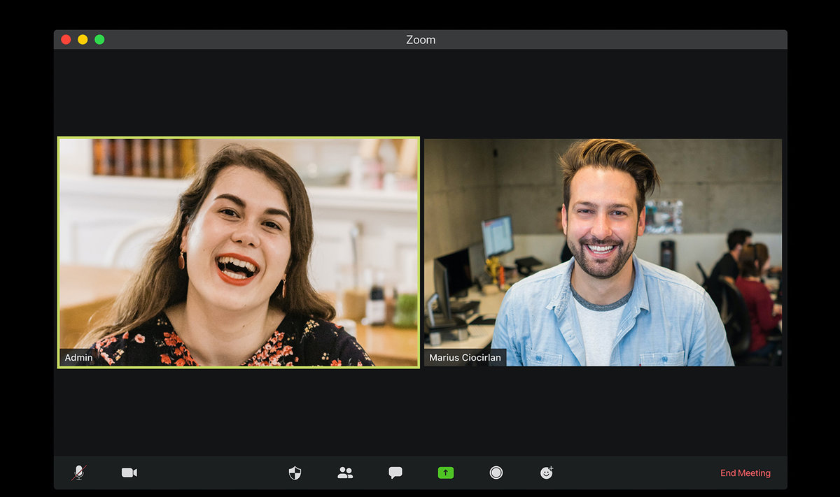
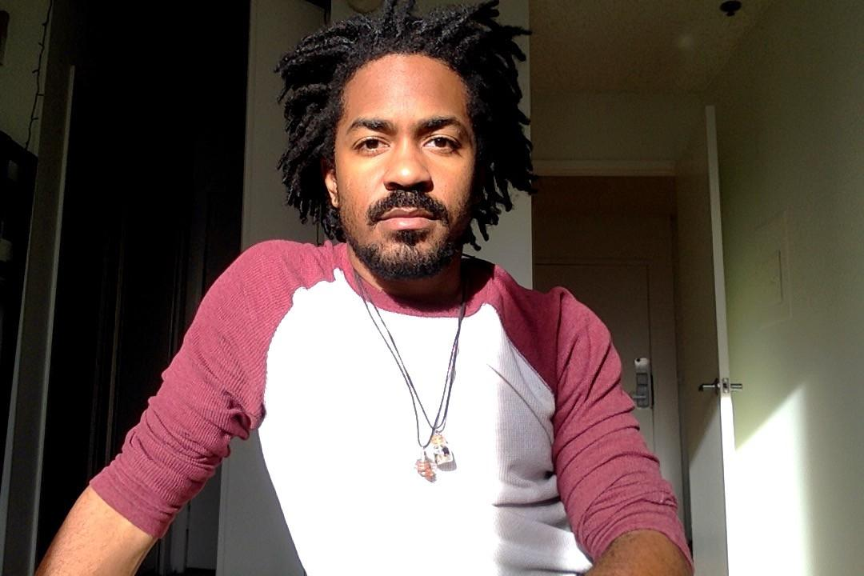
Student Doctor Alicia (she/her/ella)
Chidi (they/them/theirs)
Take a History

Slide 60
WHOA, DON’T BE RUDE.

Slide 61
Your final patient, Chidi Ikande is a 40 year old who identifies as gender non binary (assigned male at birth) and uses pronouns they/them/their. They are visiting family in Nigeria and are accessing your care via TeleHealth.
HPI
Back
PMH
They have no significant Past Medical History. They take no medications daily
Next
Family History
Next, you look at the relevant labs…
Chidi has no known family history of heart disease or stroke.
Chidi has never smoked. Their sister in Nigeria is studying to be a physician. She loves Chidi and likes to worry about them. She measured their BP at 138/86. She was reading about the new BP guidelines of the ACC/AHA and believes Chidi should be started on BP medication right away.
Social History

Slide 62
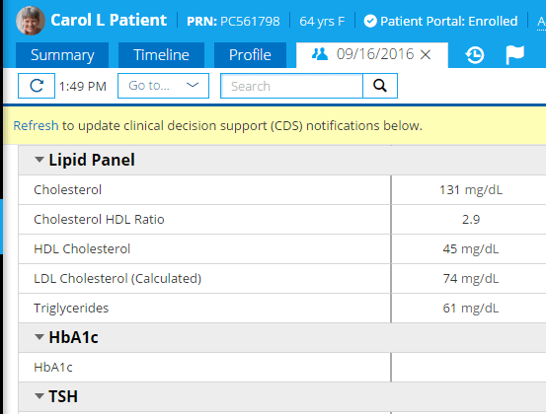
Chidi Ikande
40 yrs
09/16/2021
Back
Next
190
Next, back to the visit…
50
50
120
80
5.6

Slide 63
Back
Student Doctor Alicia (she/her/ella)
Chidi (they/them/theirs)
“Your risk of heart disease or stroke in the next ten years is…”
1.0%
1.1%
3.5%
5.8%

Slide 64
Great job!
Notably, you used the “Other” race category for their ASCVD calculation. The AAFP recognizes that race is not a biological construct. Rather, race is a social construct, and racism directly mediates worse health outcomes for Black, Indigenous, and People of Color. AAFP advises using caution with the race dimension of the ASCVD calculator. Proceed to the next page by clicking “Other”.

Slide 65
Great job!
Notably, you used the “African American” race category for their ASCVD calculation. The AAFP recognizes that race is not a biological construct. Rather, race is a social construct, and racism directly mediates worse health outcomes for Black, Indigenous, and People of Color. AAFP advises using caution with the race dimension of the ASCVD calculator. Proceed to the next page by clicking “African American”.

Slide 66
Try again, you’re almost there!

Slide 67
You did it! You finished your clinic day, now a total pro at hypertension care. Keep shining, rockstars!

